Slide 1
Member Care Manual
“Supporting the membership journey”
Appendix F
Skeletonized New Member Orientation Slide Presentation

Slide 2

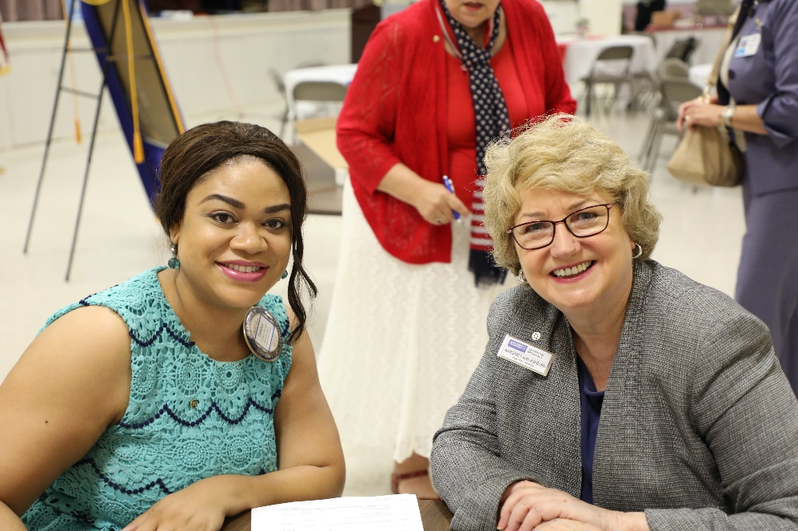
New Member Orientation
Welcome to our Rotary Club
Notes:
Hello, we are delighted to welcome you to the Rotary Club of ____________________.
In this orientation, we’re going to introduce you to some of our club members, discuss our organization and get you involved in one of your areas of interest as a new club member. We’ll also outline some actions you can take to expand your level of knowledge beyond what we’ll discuss in this orientation session.
So let’s get started…

Slide 3

Introductions
New Members
Name
Occupation
Sponsor
  Why You Decided to Join our Rotary Club
Current Members
Name
Number of Years in Rotary
  Why You Stay in our Rotary Club
Questions from Discover Rotary Experience?
Notes:
Let’s begin by introducing ourselves and getting to know who’s here today.

Slide 4
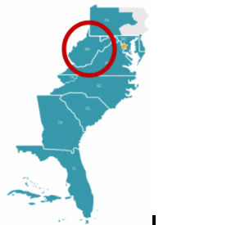
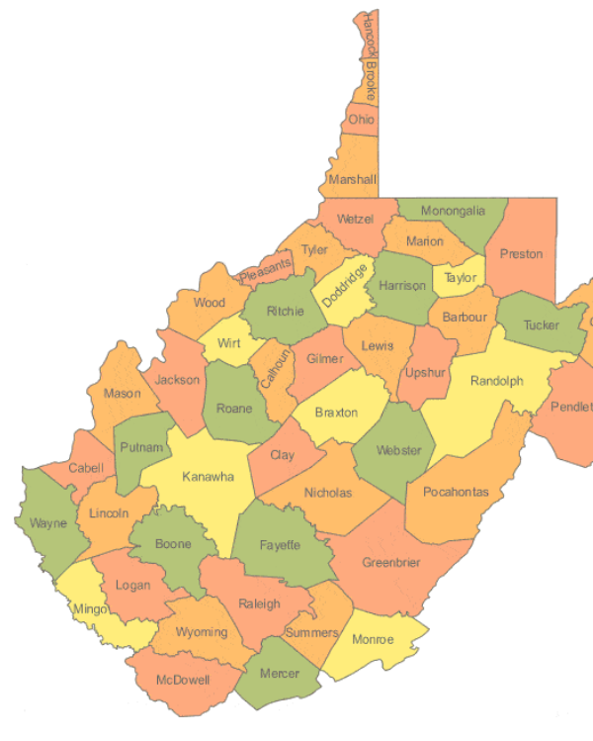
Where we sit in the Rotary Structure
Zone 33/34
District 7545
Worldwide
1.2 million Rotarians
In 200 countries
36,000 clubs
535 districts
34 zones
54 Clubs and 1,800+ Members
Notes:
As you probably remember from your Discover Rotary presentation, our club is one of over 36,000 Rotary clubs worldwide in over 200 countries.
Our district, District 7545, covers all of West Virginia with the exception of the eastern panhandle. It is part of Zone 33, the northern section of the Zone 33/34 Zone pair.
We are one of the 54 Rotary Clubs in our district.

Slide 5
About Our Club
Insert appropriate picture of your club or meeting location
Founded:
Members:
Service area:
Notes:
Our club was founded in _________, and as such is one of the __________ clubs in West Virginia.
Currently we have ___________ members.
Our Club’s community service is centered in _____________ County.

Slide 6
Our Club’s Leadership
Club President:
Club President-elect:
Club President-nominee:
Club Secretary:
Club Treasurer:
Membership Committee Chair:
Community Service Chair:
Foundation Chair:
Public Image Chair:
Board member’s-at-large:
Insert photos of club officers
Notes:
Our Club is led by a Board of Directors comprised of the Club Officers and chairs of the various committees of the Club pictured on this slide.
A directory of our club members is available to you on DACdb.

Slide 7
Club Meetings
Meeting day:
Meeting time:
Meeting location:
Meeting format:
Insert photo of club meeting and/or meeting place
Notes:
Our Club meets ________ (frequency) at ________________ (location) at _______________ (time).
Typically are meetings have an opening during which the Club President __________________________, a _________________ meal (if applicable), and a presentation on a topic of interest to the club.
Recent speakers topics have included such topics as _______________________________________________________________________________________________________________________________________________.
On occasion our meeting might involve a micro service project in lieu of a speaker. Recent examples have included ______________________________________________________________________________.
There is no requirement regarding the number of meetings you attend, however, we hope you will join us as often as possible.

Slide 8

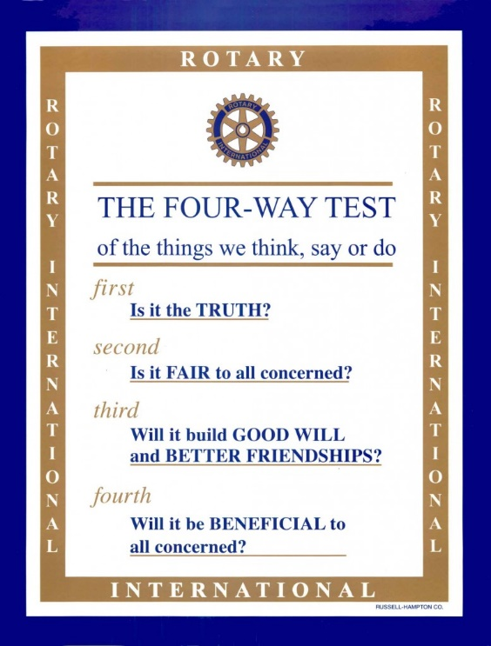
Club Governance
Rotary Guiding Principles
Core Values
Object of Rotary
Four-way Test
Governing documents
Club constitution
Club bylaws
Rotary’s core values:
Service
Fellowship
Diversity
Integrity
Leadership
Notes:
As Rotarians we are governed by Rotary’s Core Values, The Object of Rotary outlined during your Discover Rotary presentation as well as our Four-way test.
Our board governs our club through the use of two governing documents; a standard Rotary Club Constitution provided by Rotary International and our club’s bylaws.

Slide 9
Communications
Club website:
Club Facebook page:
Club Newsletter
District website:
District Facebook page:
Zone website:
Insert copy of recent newsletter or website/Facebook post
Notes:
You can stay informed on club, district and zone activities through several means:
Our club maintains a Facebook page (and a Club website, if applicable) which you are encouraged to follow
_______________ our club publishes a newsletter (if applicable)
You can also stay informed on District and Zone activities on their sites listed here.

Slide 10
Community Service
Insert pictures and discussion of recent club service projects

Slide 11

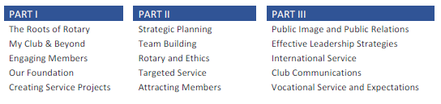
Rotary Leadership Institute
Rotary knowledge and leadership advanced training program
Develops leaders for your club and the district
Worldwide program
  We are in Mid-Atlantic Zone (14 Rotary districts)
  Delivered in three modules
  http://www.rli33.org/ for additional information and to register
Notes:
The Rotary Leadership Institute (RLI) is a grassroots coalition of Rotary districts and regions offering a leadership development program for potential leaders of Rotary clubs. Any Rotary member can enroll in RLI courses. It’s a great way to expand your Rotary knowledge beyond the club, learn more about leadership in the club and meet fellow Rotarians from around our district.
The basic course of RLI is covered in three days, each day being called Parts I, II, and III. Usually at an RLI Event, all three Parts are available, but a member only enrolls in one part at a time. Generally, members would allow some time between taking each Part to allow for their club activities to give them perspective. Graduate seminars are also offered for those who have completed Parts I, II, and III.

Slide 12


Sporting Our Rotary Foundation
Outline of ways to give used by your club

Slide 13
Our Club’s Mentor Program
Outline of activities accomplished under the guidance of the mentor
Photo and background of assigned mentor

Slide 14
New Member Orientation
Outline of activities accomplished during the club’s new member orientation process

Slide 15
Welcome
to the Rotary Club of ________________

