Slide 1
Member Care Manual
“Supporting the membership journey”
Appendix D
Discover Rotary Sample Slide Presentation

Slide 2
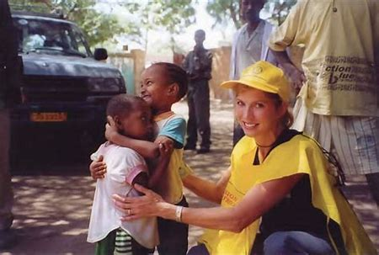
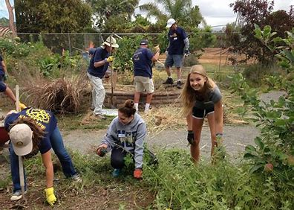
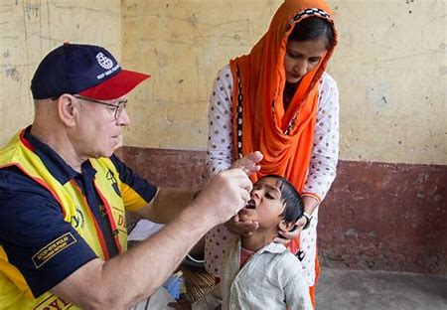
Welcome to Discover Rotary
We are people of action
Notes:
Hello, we are delighted to welcome you to Discover Rotary. I am ___________________ of the Rotary Club of __________________________ and it is an honor for me to be with you to talk about how Rotary makes a difference in people’s lives around the world and right here at home. We’ll begin with introductions.

Slide 3
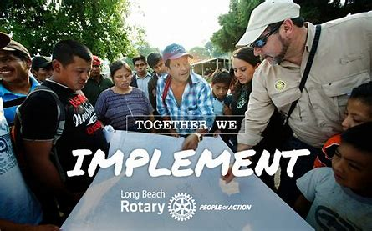
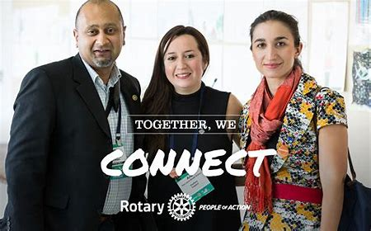
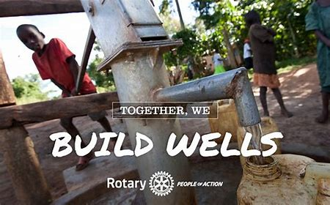
What Is Rotary?
People Of Action
Notes:
Rotary is an international membership organization that does service.
We are a global network of business and professional leaders
We do humanitarian service
We encourage high ethical standards
We strive for goodwill and peace in the world
1.2 million of us in 35,000 clubs in over 200 countries around the world
Motto: Service Above Self. Put simply, Rotary is where neighbors, friends and problem solvers share ideas and take action to create lasting change.

Slide 4
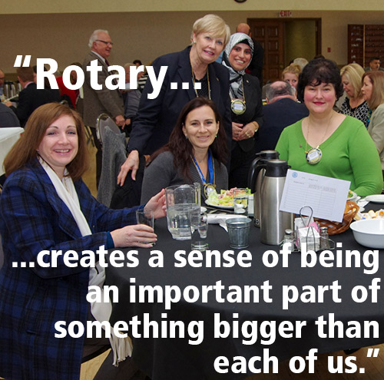
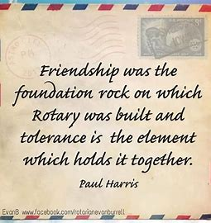
The best way to find yourself is to lose yourself in the service of others.
Notes:
In Rotary we are an important part of something much bigger than ourselves. We accomplish so much more by being a Rotarian.

Slide 5
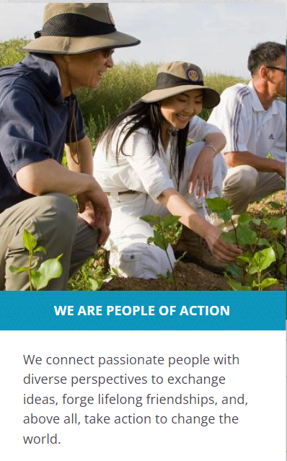
Rotary’s Mission
To provide service to others, promote integrity, and advance world understanding, goodwill, and peace through our fellowship of business, professional, and community leaders.
Notes:
Rotary is all about service to others. We are People of Action making a difference in our communities and the world as a whole.

Slide 6
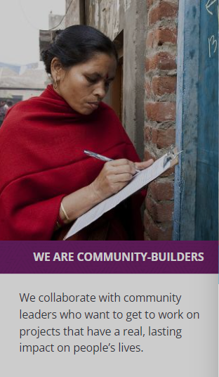
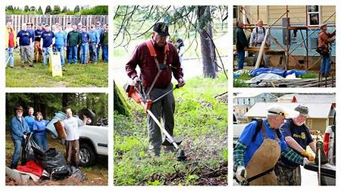
Rotary’s Vision
"Together, we see a world where people unite and take action to create lasting change — across the globe, in our communities, and in ourselves."
Rotarians Annually Contribute
~$200 Million to our Foundation
16 Million Volunteer Service Hours
Notes:
Rotarians are guided by a strong vision. Together, we see a world where people unite and take action to create lasting change – across the globe, in our communities, and in ourselves. We work to meet the needs of and support the development of the communities in which we live. Collectively we contribute close to $200 million annually to our Foundation while providing 16 million volunteer hours to promote peace, fight disease, provide clean water, save mothers and children, support education and grow local economies.

Slide 7
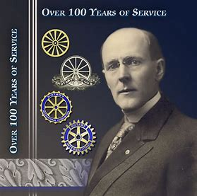
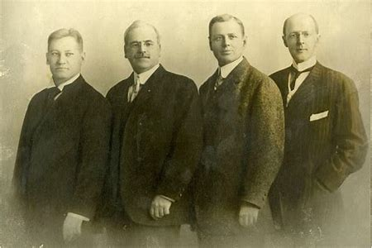
How Rotary Got Started
The first Rotary Club was organized in 1905, by Chicago Attorney Paul P. Harris
The original four member club met for fellowship in rotation at member’s offices…thus the name ROTARY
Their first community service project – install a public toilet outside the Chicago City Hall
People Of Action
Paul Harris
From left: Gustavus Loehr, Silvester Schiele, Hiram Shorey and Paul Harris.
Notes:
Great history in how Rotary got started. Paul Harris an attorney in Chicago gathered some friends in 1905 for fellowship and it grew from there. Their first reason for being was FELLOWSHIP.

Slide 8
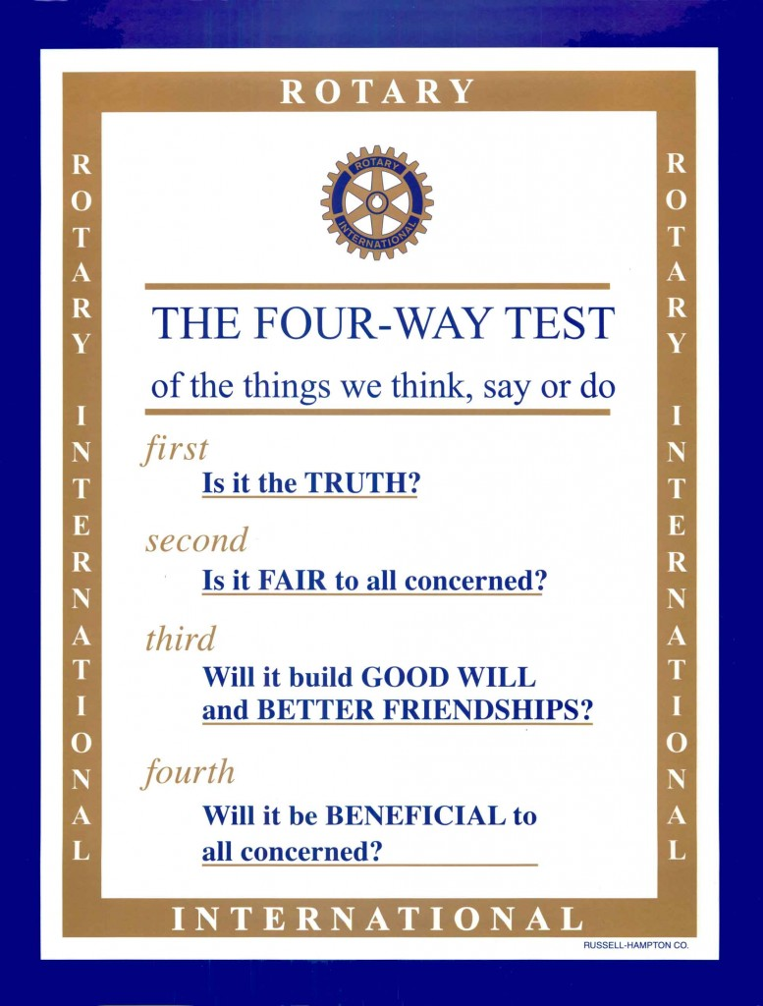
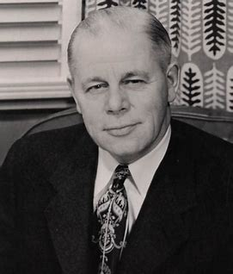
Rotarians Live by the Four-Way Test
Of the things we think, say or do!
While having fun in the process!
Herbert Taylor
Notes:
The Four Way Test is used by Rotarians world-wide as a moral code for personal and business relationships. It can be applied to almost any aspect of life. It was developed by Herbert J. Taylor in 1932 to save the Aluminum Products Distribution Company from bankruptcy. It was later adopted by RI. Rotarians always known for their sense of humor some Rotarians have added a fifth question: Is it Fun? I certainly never realized there was a song written about the Four Way Test.

Slide 9
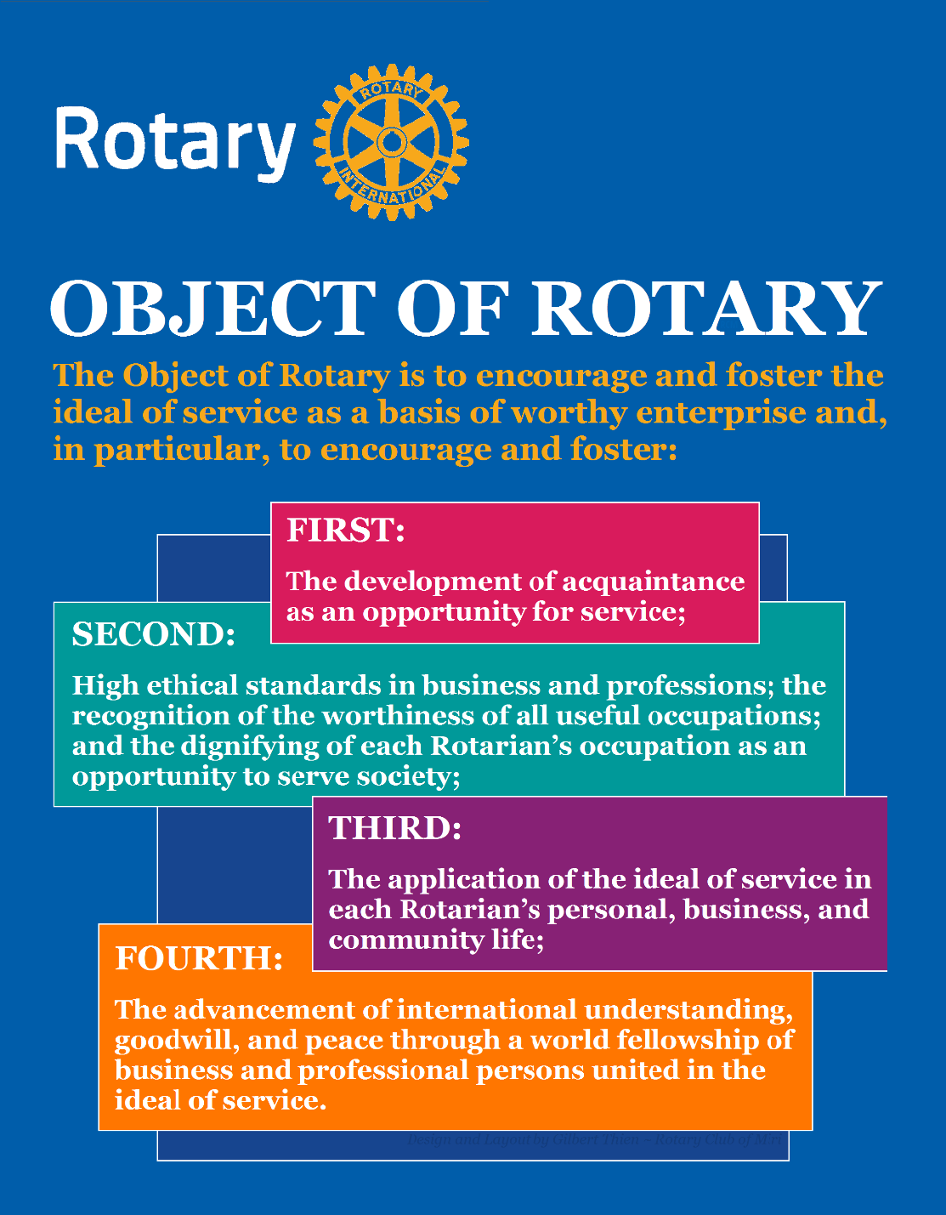
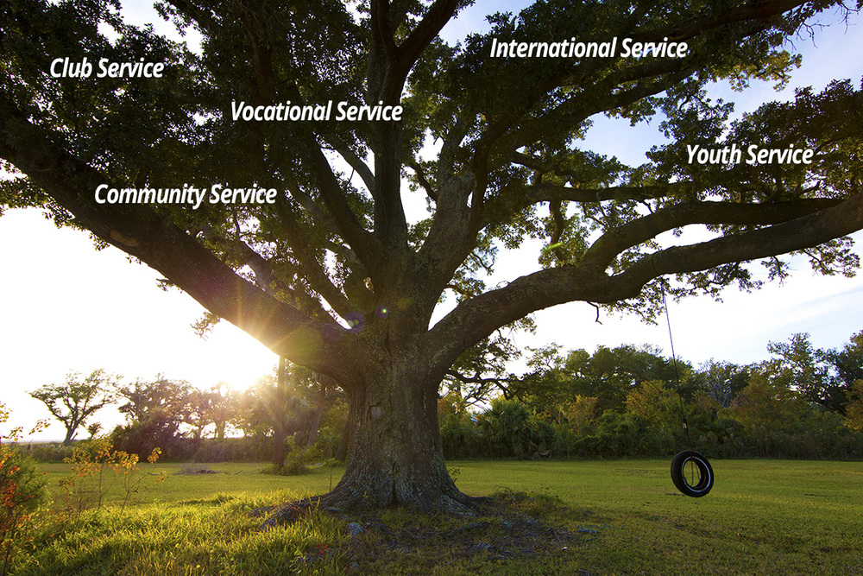
Five Avenues of Service
The Object of Rotary comes to life through its Five Avenues of Service
Notes:
The Object of Rotary places great value on service, friendships and high ethical standards. Our occupations and professional skills help us to increase cultural understanding, goodwill and peace through community service. The Object of Rotary comes to life through Five Avenues of Service which are the branches of a deeply rooted membership organization and they are: Club Service, Vocational Service, Community Service, International Service and Youth Service. This is how we reach out and make a difference in people’s lives around the world and right here at home.

Slide 10
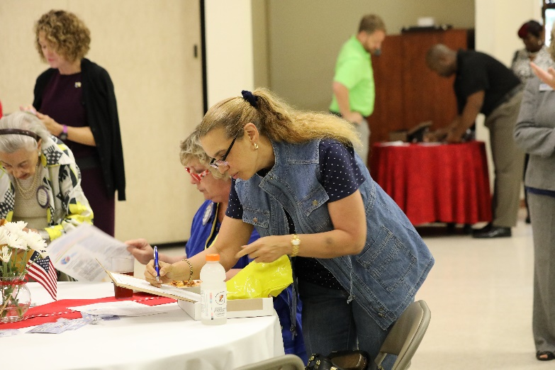
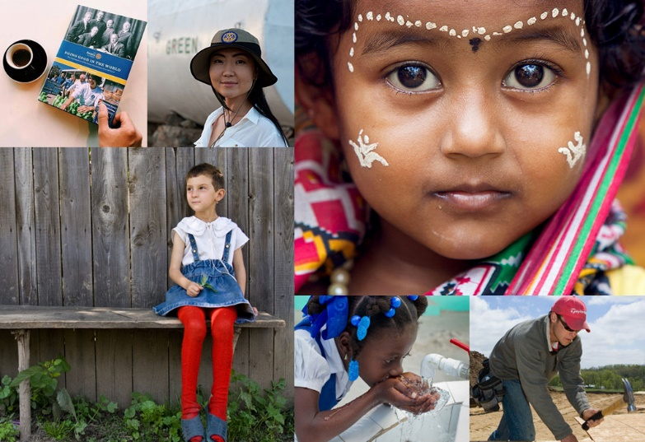
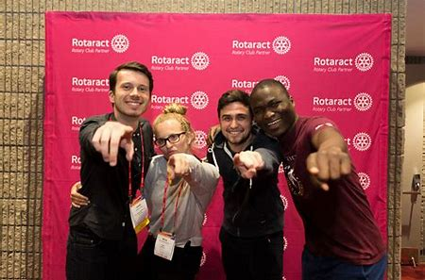
Five Avenues of Service In Action
Club Service
Vocational Service
Community Service
International Service
Youth Service
Notes:
Here’s a way of looking at our five avenues of service in action:
- Club Service: A vibrant Rotary Club is characterized by engaged membership, strong leadership, fellowship and membership growth
- Vocational Service: We put our skills and expertise to work for our communities and to mentor others in our professions
- Community Service: We respond to the needs of our local communities in the form of service projects and financial support
- International Service: We improve the lives of people around the world through global service on a scale that is unmatched, polio eradication being a primary example
- Youth Service: We assist in developing youth through leadership development programs, involving them in supporting their communities and supporting global student exchange opportunities

Slide 11
Rotary’s Seven Areas of Focus
Basic education & literacy
Peace & conflict resolution
Economic & community development
Mother & child health
Water & sanitation
Disease prevention & treatment
Supporting the environment
Notes:
Rotary clubs serve communities around the world, each with unique concerns and needs. Rotarians have continually adapted and improved the way they respond to those needs, taking on a broad range of service projects. We focus our efforts in seven primary areas we refer to as Rotary’s seven areas of focus. Rotary International and The Rotary Foundation recognize these seven areas of focus as organizational priorities. They are also the lens through which our Foundation views grant funding requests.

Slide 12
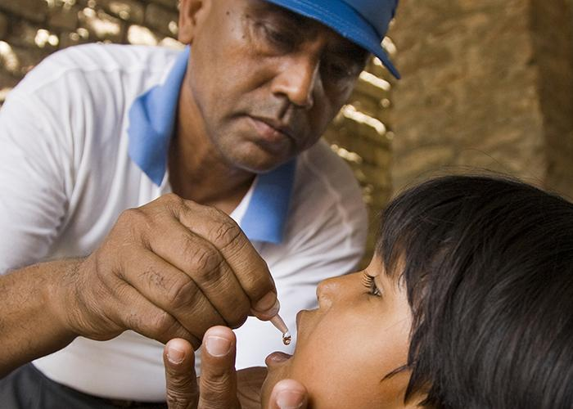
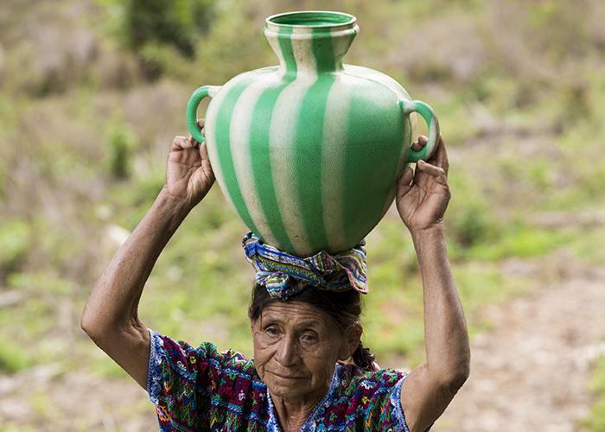
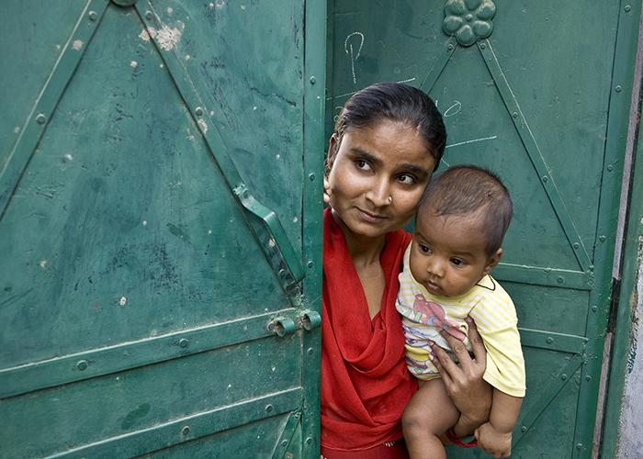
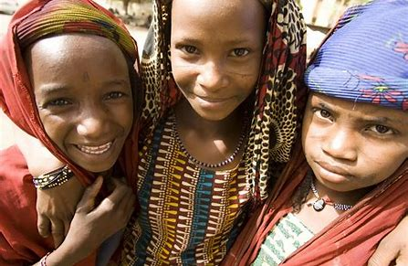
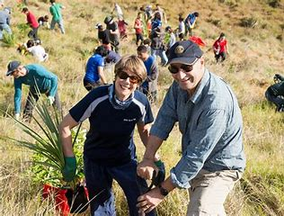
Seven Areas of Focus
Water, Sanitation &
Hygiene
Maternal & Child Health
Peacebuilding & Conflict
Prevention
Disease Prevention &
Treatment
Basic Education & Literacy
Community & Economic Dev.
Support The Environment
Notes:
It’s in these areas of focus that Rotarians are engaged continuously throughout the world, both locally and on a global scale. Through these 7 Areas of Focus we build international relationships, improve lives, create a better world, support peace and are very close to ending polio forever.

Slide 13
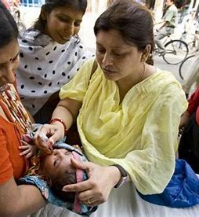
Rotary is easy to understand…
Just Remember Four – Five - Seven
The Four Way Test (What we live by)
The Five Avenues of Service (How we serve)
The Seven Areas of Focus (Issues we address)
Notes:
Rotary is easy to understand. Just remember four, five, seven. The Four-Way Test (what we live by), The Five Avenues of Service (how we serve) and The Seven Areas of Focus (issues we address) all intended the improve the lives of people right here at home as well as around the world. Keep an eye out for that “Rotarians at Work” logo. You’re likely to see it anywhere people are doing good for others.

Slide 14
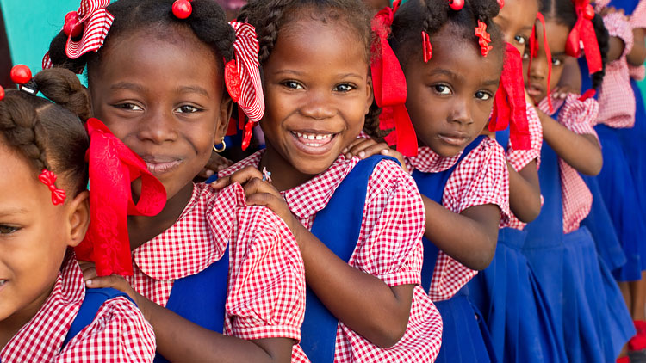
Since it was founded more than 100 years ago the Rotary Foundation has spent more than $4 billion on life-changing, sustainable projects.
Notes:
At the 1917 Rotary International convention, outgoing RI President Arch Klumph proposed setting up an endowment “for the purpose of doing good in the world.” That one idea, and an initial contribution of $26.50 set in motion a powerful force that has transformed millions of lives around the globe. Arch Klumph planted a seed and thanks to his vision, staunch advocacy and the extraordinary generosity of Rotarians worldwide, the Rotary Foundation has become one of the world’s leading humanitarian foundations.

Slide 15
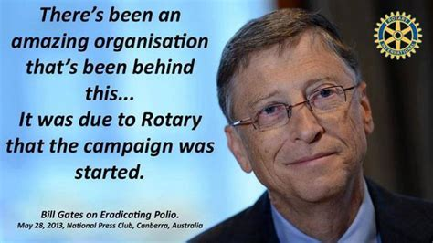
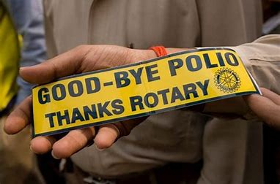
Over 2.5 billion children have been immunized against polio.
Rotarians have contributed $1.9 billion and countless volunteer hours.
There has been a 99.9% reduction of polio cases worldwide.
Notes:
Rotary’s number one external priority is to eradicate polio in the world. The Polio Plus campaign to do just that was launched in 1985 and has reached a 99.9% reduction in the number of Polio cases worldwide. We are now working on the final countries: Pakistan and Afghanistan. In 2017 Rotary committed to raise $50 million per year with every dollar to be matched with two additional dollars from the Bill and Melinda Gates Foundation bringing the total to $450 million. That match opportunity has subsequently been extended as Rotary continues its efforts to keep its promise to the children of the world to eradicate polio.

Slide 16
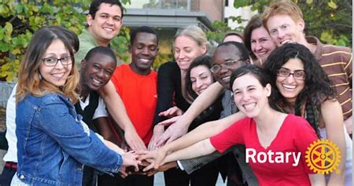
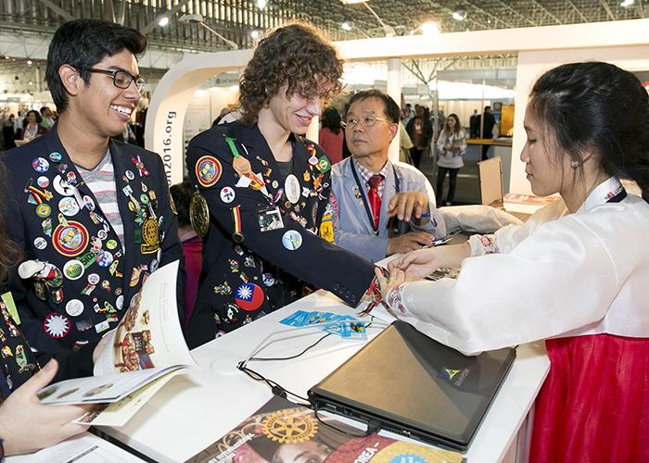
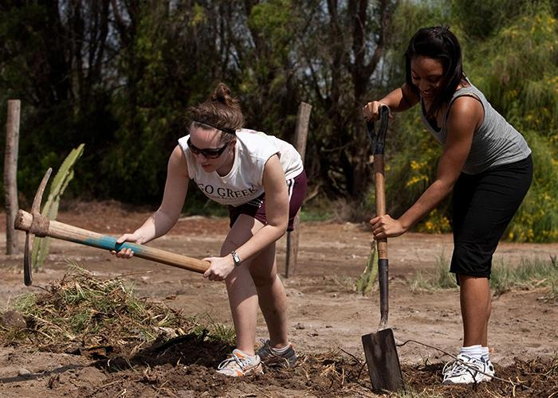
Youth Programs
Rotary Youth Exchange
Rotary Youth Leadership Awards (RYLA)
Rotary Peace Fellowships
Grants & Scholarships
Rotaract Clubs
Interact Clubs
Notes:
Rotary believes in developing the next generation of leaders. Our programs help young people build leadership skills, expand education and learn the value of service. There are several programs available from Youth Exchange to Rotary Peace Fellowships, grants and scholarships. Rotaract Clubs promote leadership, professional development and service for college age adults and young professionals seeking to develop themselves and support their communities. Interact Clubs bring people ages 12-18 together to develop leadership skills and learn about the world through service projects and activities.

Slide 17
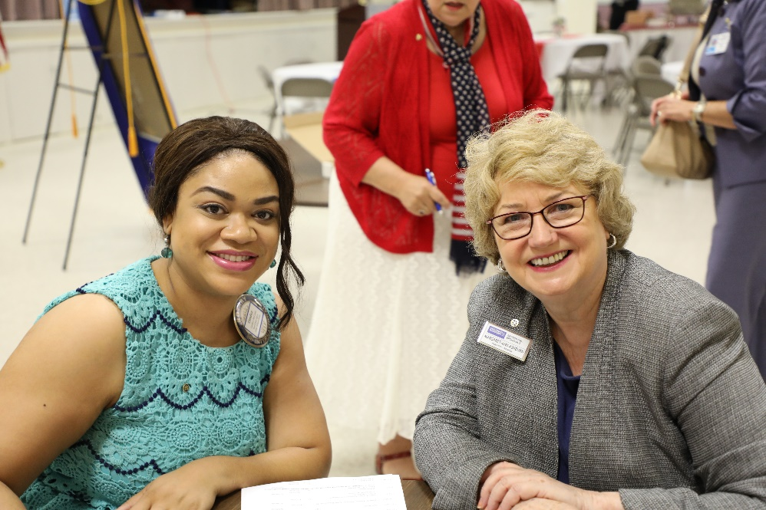
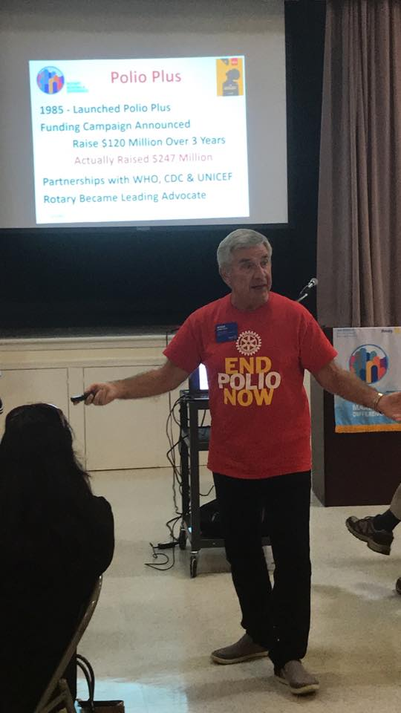
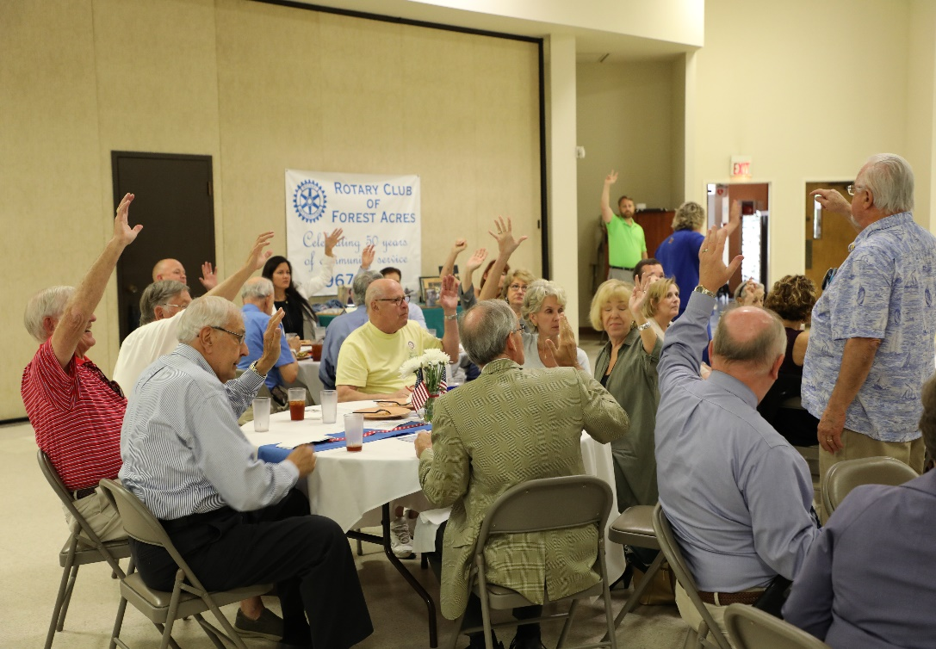
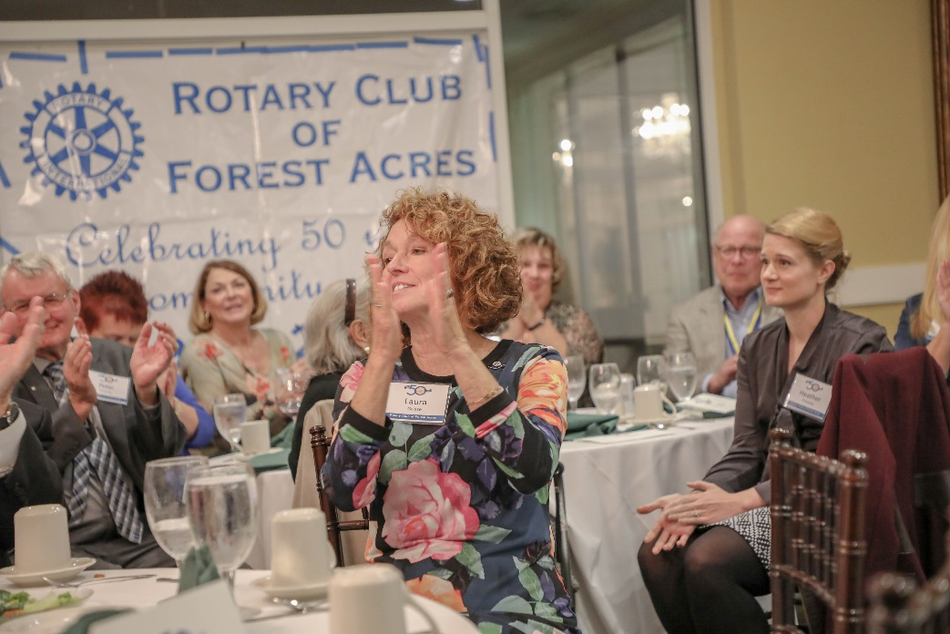
Notes:
Our clubs are the heart and soul of Rotary. They are where our People of Action reside and through which the work of Rotary is accomplished.
Rotary clubs vary is size, composition and format. The old vision of Rotary clubs being a group of older gentlemen sitting around a table for a formal presentation and lunch have largely disappeared. Today’s Rotary clubs are filled with a diverse set of Rotarians with a common interest in doing good in their communities and the world. They are a vibrant group, engaged in activities and making a difference. They are men and women from all walks of life who share a common set of interests based on the 4-5-7 set of Rotary foundations we talked about earlier. They meet at all times of the day and their meeting format is linked to the interests of their club members.

Slide 18
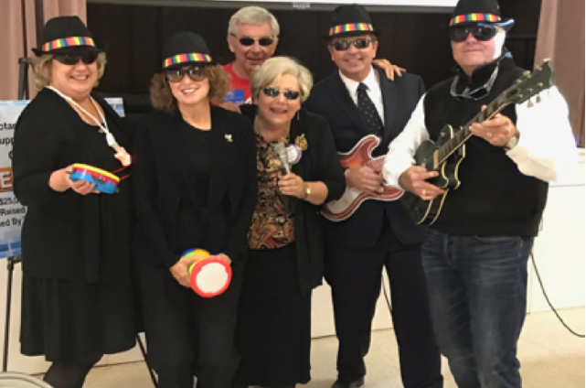
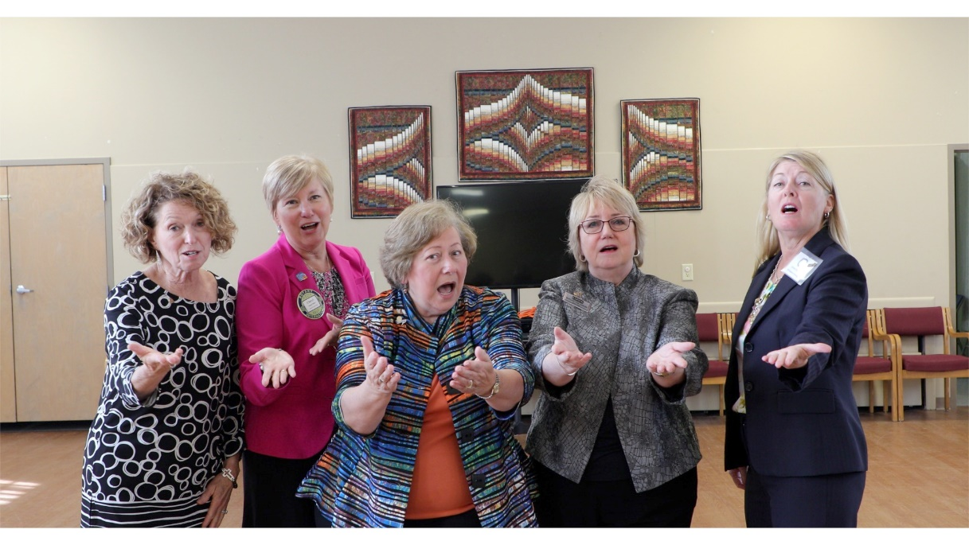
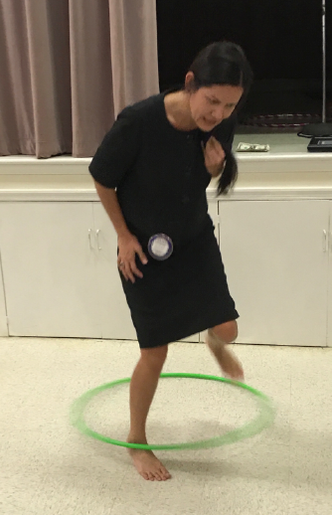
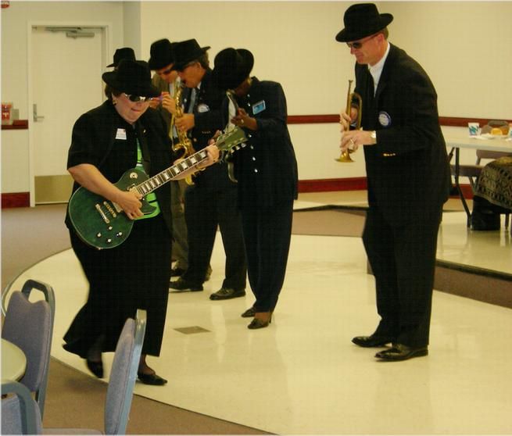
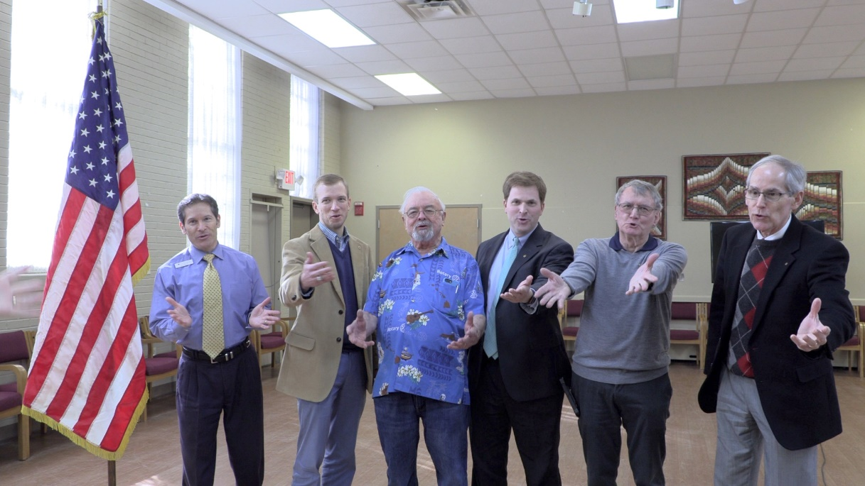
Hula Hoops to the Blues Brothers & Sisters!
Our Clubs Have Great Fun Together
Notes:
We are also known to be a little crazy at times, but that’s the way we keep our gatherings exciting and fun!

Slide 19
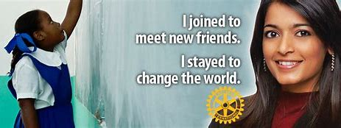
Why Join Rotary?
Fellowship, camaraderie and fun
Lifelong friendships
Network and business development
Give back to community
Be part of something larger than yourself
Professional development & mentoring
Leadership training & opportunities
Personal growth and recognition
Travel
…..to name just a few of the reasons millions of people around the globe have joined Rotary for 117 years.
(February 23, 1905 – today)
Notes:
There are many good reasons to join Rotary. Life-long friends, making the community a better place, being part of something larger than yourself, networking, leadership and personal growth. These are just a few of the reasons why millions of people have joined Rotary over the past 117 years since Paul Harris started that first Rotary Club in Chicago in 1905.

Slide 20
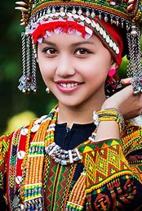
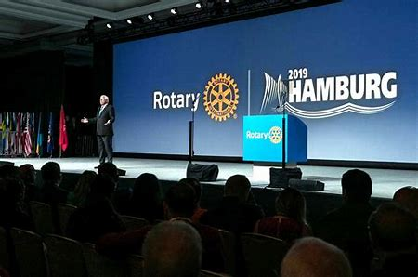
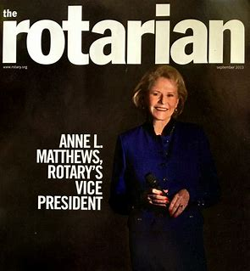
How to Join
Membership is by invitation from a Rotarian
The cost of quarterly membership ranges from $50-$175 depending on club policies
You submit a membership application
You are inducted into the club and introduced to the membership
You are assigned a mentor to assist & guide you as a new member
You complete new member orientation & training
You get involved in club activities & events

Slide 21
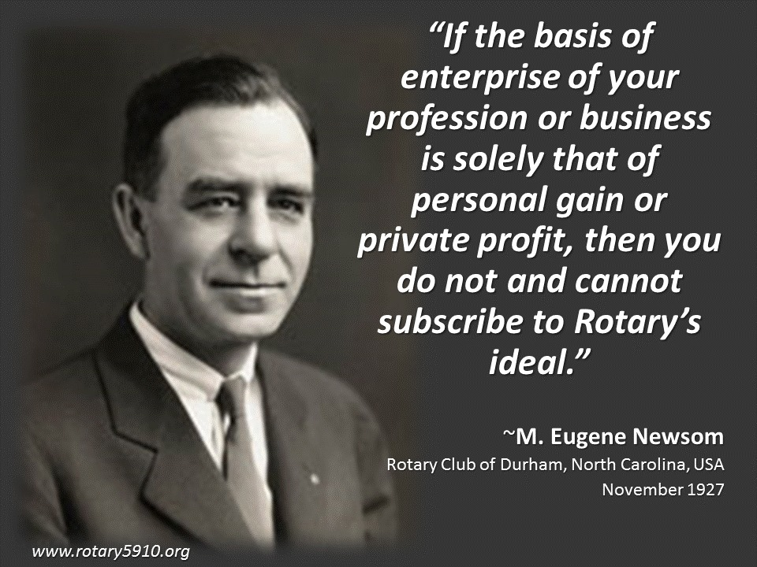
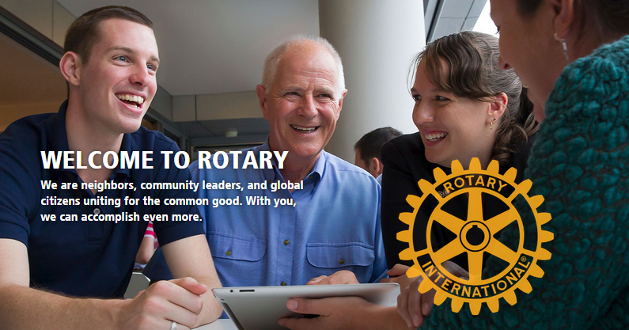
Notes:
Eugene Newsom gives a great answer to the question of Why join Rotary? Building your business is a good reason for joining but it cannot be the only reason. While he said this 93 years ago in 1927…it is still true today. We are looking for members who want to make a difference in people’s lives…people who will offer their time, talent and resources to further Rotary’s causes.

Slide 22
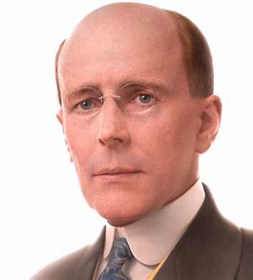
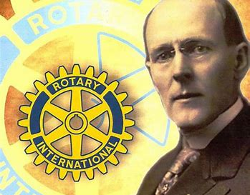
“If you have the love of your fellow men in your heart, my friend, you are a potential Rotarian.”
Paul Harris who organized the first Rotary Club in 1905
Notes:
Paul Harris said it best in describing what it takes to be a Rotarian when he said, “if you have the love of your fellow men in your heart, my friend, you are a potential Rotarian.” We’ve come a long way as Rotarians since that 1905 beginning, but our fundamentals haven’t changed: we’re still People of Action doing good in the world.

Slide 23
Thanks for your interest in Rotary
You Too Can Be A Rotary Hero!
Notes:
A great quote to end our session today comes from Harriet Tubman…”Every great dream begins with a dreamer, always remember you have within you the strength, the patience and the passion to reach for the stars to change the world.”
Rotary has been doing this for 117 years, is it time for you to put your passion to work as a Rotarian?

Slide 24
Backup slides (use at your discretion)

Slide 25
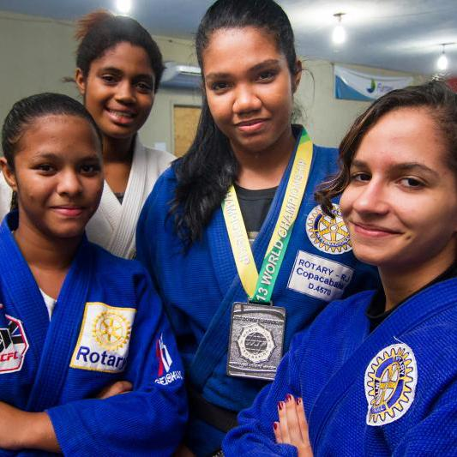
Peace & Conflict Prevention/Resolution
70 Million People Displaced…
Half are children
Rotarians refuse to accept conflict
as a ways of life
Notes:
Today over 70 million people are displaced as a result of conflict, violence, persecution, and human rights violations. Half of them are children. Rotarians refuse to accept conflict as a way of life. Rotary encourages conversations to foster understanding within and across cultures. We train adults and young leaders to prevent and mediate conflict and help refugees who have fled dangerous areas.

Slide 26
Fighting Disease
99.9% reduction in polio cases since our program started in 1985,
$60 million in grants was given last year to fight disease.
Notes:
Rotarians educate and equip communities to stop the spread of life-threatening diseases like polio, malaria, HIV/AIDS, Alzheimer’s, multiple sclerosis, diabetes and Ebola. We improve and expand access to low-cost and free health care in developing areas.

Slide 27
Water & Sanitation
$24 is all it takes to provide one person with safe water.
110 schools in Ghana have better sanitation and hygiene thanks to the Rotary-US Agency for International Development (USAID) partnership.
Notes:
Clean water, sanitation, and hygiene education are basic necessities for a healthy environment and a productive life. Rotary has been involved in water and sanitation projects from the Philippines to Tanzania, India and Guatamala. We don’t just build wells and walk away. We share our expertise with community leaders and educators to make sure our projects succeed long-term.

Slide 28
Saving Mothers and Children
6 Million Children Under The Age Of Five Die Each Year Because Of Malnutrition
Notes:
We expand access to quality care so mothers and children everywhere can have the same opportunities for a healthy future. An estimated 6 million children under the age of five die each year because of malnutrition, inadequate health care and poor sanitation – all of which can be prevented.

Slide 29
Supporting Education
More than 775 million over the age of 15 are illiterate.
Notes:
More that 775 million people over the age of 15 are illiterate. Our goal is to strengthen the capacity of communities to support basic education and literacy, reduce gender disparity in education, and increase adult literacy.

Slide 30
Growing Local Economies
Nearly 800 million live on less than $1.90 a day.
Last year Rotary spent $9.2 million to grow local economies.
Notes:
Rotarians carry out service projects that enhance economic and community development and create opportunities for decent and productive work for young and old. Entrepreneurs use microloans to become street venders, rickshaw drivers, weavers and tailors.

Slide 31
Supporting The Environment
Notes:
Rotary has long supported activities that sustain the environment. In the past five years, we have allocated $18 million to such projects through global grants tied to other areas of focus.

Slide 32
Rotary International District 7545
Zone 33/34
District 7545
Worldwide
1.2 million Rotarians
In 200 countries
36,000 clubs
535 districts
34 zones
54 Clubs and 1,800+ Members
Notes:
The working end of the Rotary organization is our clubs. There are over 36,000 Rotary clubs worldwide in over 200 countries. Rotary Clubs are organized into districts and the districts, in turn, are organized into zones. Each pair of Rotary zones is represented on the Rotary International Board of Directors.
Our district is District 7545 which is part of Zone 33 and represented by the Rotary International Director that oversees the Zone 33 and 34 zone pair which stretches from Pennsylvania into the Caribbean.
Our district covers all of West Virginia with the exception of the eastern panhandle and includes 54 clubs and over 1800 Rotarians.

