Slide 1
The Membership Experience

Slide 2

Goals of Today’s Assembly
Understand the challenges in attracting new members into Rotary and how Rotary International has provided Rotary Clubs the ultimate flexibility
Learn about what other clubs are doing successfully
Explore ideas that could work for you/your club
Notes:
Let’s quickly go over what we hope you will take away from today’s presentation.
This webinar will help us:
Understand the challenges in attracting new members into Rotary
Learn about what other clubs are doing successfully
And Explore ideas that could work for you/your club

Slide 3
WHY MEMBERSHIP MATTERS
Low(er) public image = Reduced interest in joining and declining membership
Most donors are members
Declining membership = fewer donors
Membership
Public Image
Foundation Giving and Programs
Unfunded or poorly
funded programs and projects =
Reduced public image
Fewer donors =
Bigger contributions required to avoid funding shortfalls
Notes:
If you start anywhere on this chart, you can see how weakness in one area affects membership. Nearly all of our donors are members. So as membership declines, one of two things has to happen: Remaining donors have to contribute more to maintain current program funding levels, or if remaining donors are not able or willing to increase contributions, program funding wanes.
As program funding wanes, projects may not succeed. Members and beneficiaries lose enthusiasm and this leads to lower public image. Lower public image further hampers interest in joining, lowering membership further, and so on, and so on… It’s a self-reinforcing cycle.
This is why membership is so important at the club level. Clubs need more members in order to participate in all the activities and programs they wish to take part. With more members, there are more membership dues coming in. With more membership dues coming in, there are more funds available for allocation. That means more programs and services can be created at the club, district, and international level for members to get involved with. The more involved the club and club members are – the better our organization and respective communities.

Slide 4
WHAT THE #’s TELL US

Slide 6
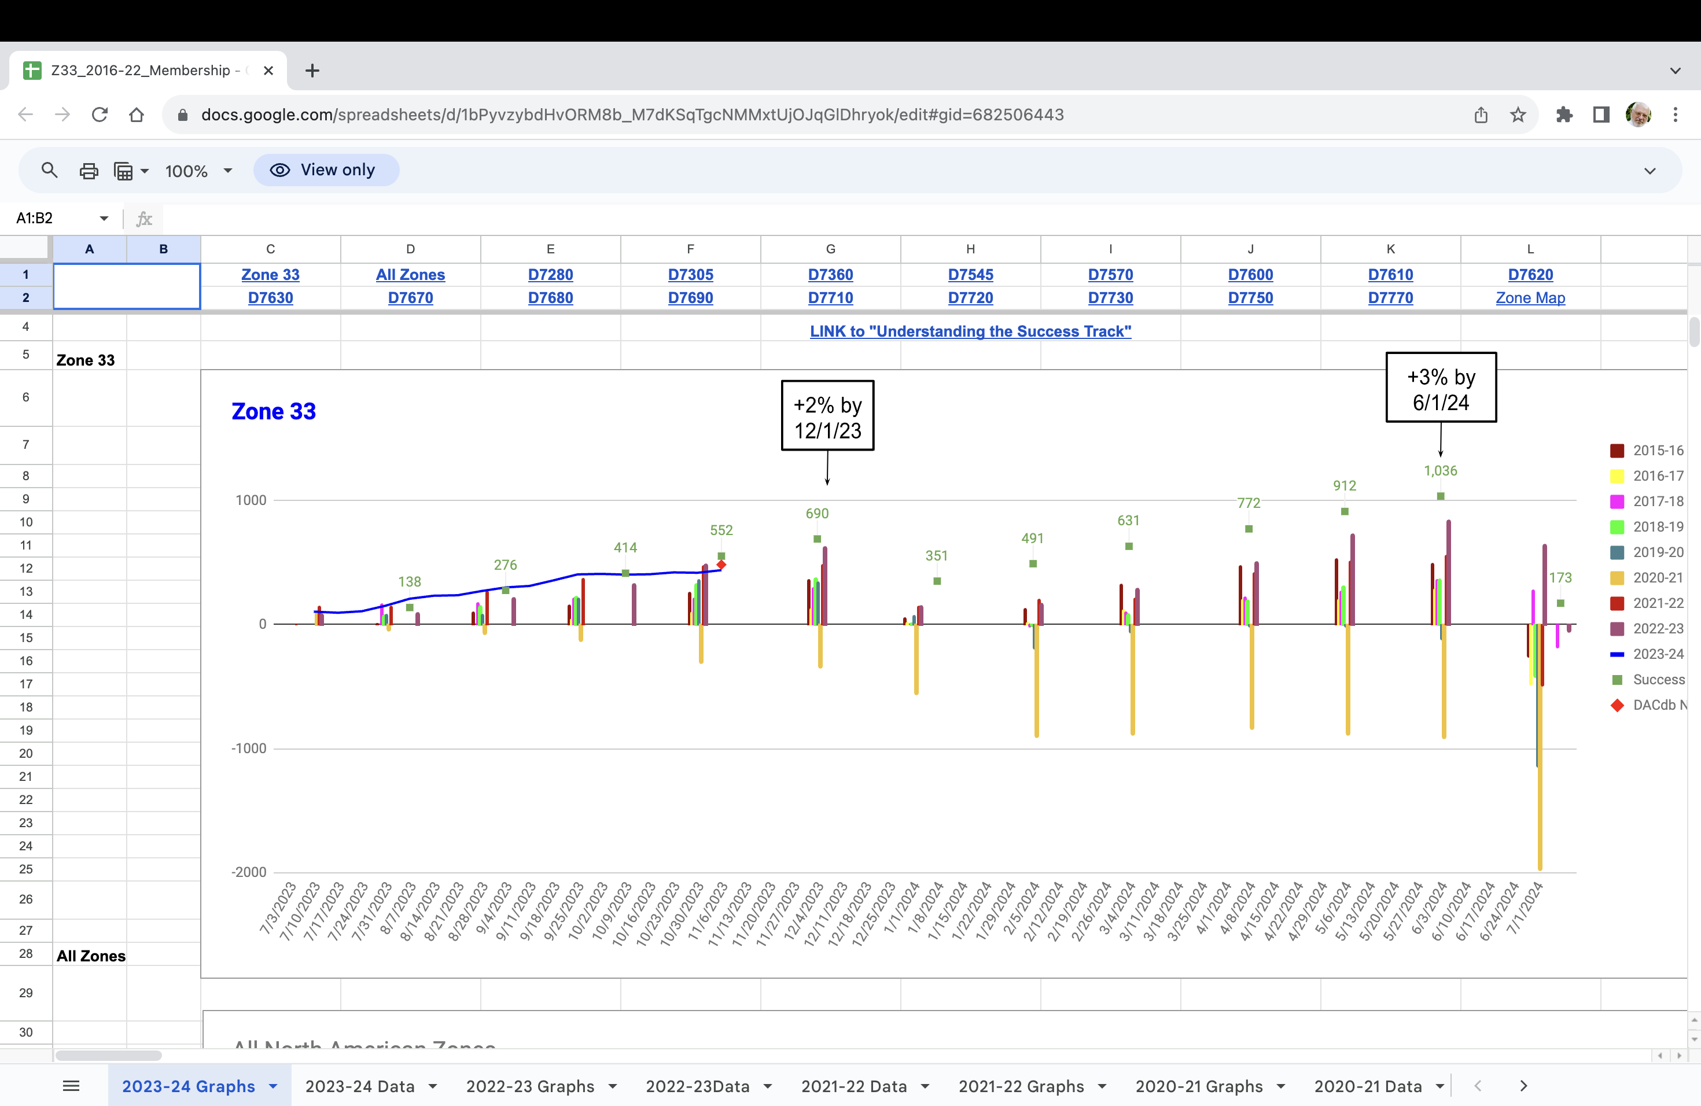
MEMBERSHIP Trends Zone 33

Slide 7
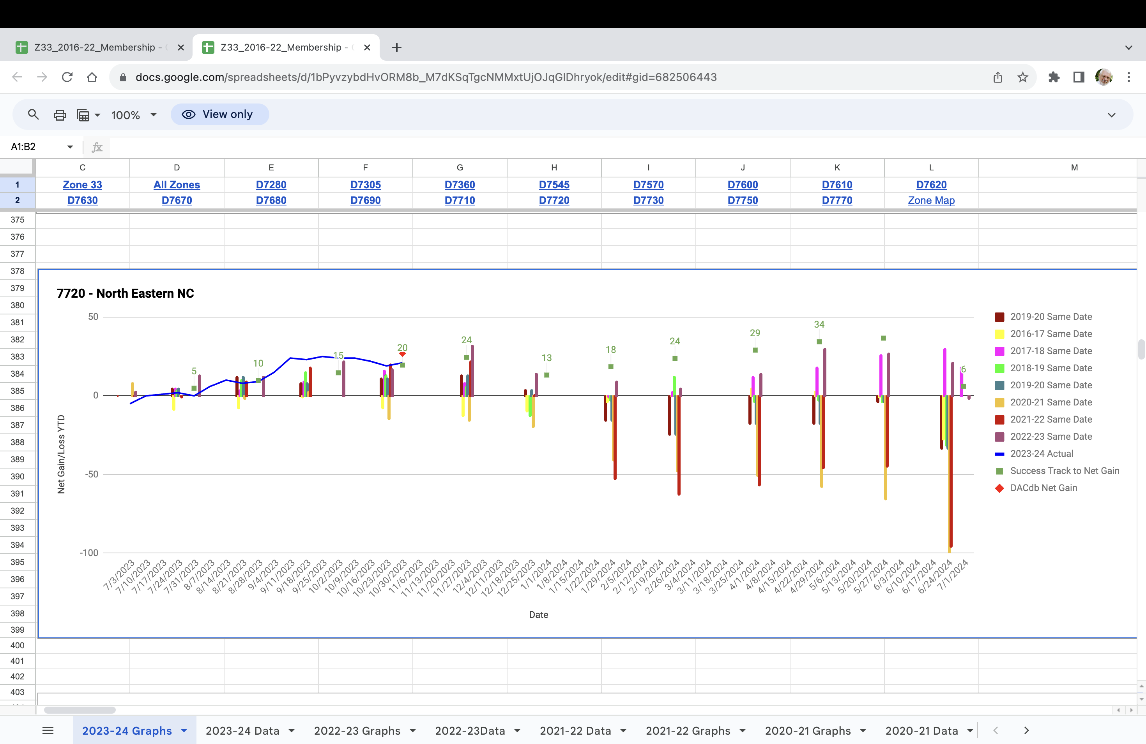
Membership Trends Our District

Slide 8
MEMBERSHIP DIVERSITY AND WORLDWIDE TRENDS
Our District
Female Members 28.05
Male Member 69.61
Members Under 40
8% of Rotarians are under the age of 40;
26% of Rotary club members
are in North America,
down 19% since 2014;
36% of Rotary club members
are in Asia,
up 26% since 2014. and World Wide
Notes:
One of the membership areas where our zones and District are dong well is in diversity, specifically with gender and age. As you can see, you’re doing much better than the global average in female members. You’re also higher than the global average of members under the age of 40 (although only about 50% of members currently report age – you can help improve our records and possibly increase your average just by encouraging members to add their birthdate to My Rotary).

Slide 9
BUT…... WHAT DO MEMBERS EXPERIENCE?

Slide 10

THE PRIMARY REASONS PEOPLE JOIN ROTARY…
Why did you initially join Rotary?
To positively impact my community
Friendship and fellowship
30%
Professional networking/
business development opportunities
To have a positive impact globally
20%
Potential for personal/
professional recognition
Development and training opportunities
10%
0%
Notes:
So lets take a look at the primary reasons of why people join Rotary. You can see on the far right of this slide the two key reasons. First, to positively impact my community and secondly for friendship and fellowship that are born out of the enduring connections we make with each other.
What is interesting is when we ask the question Why do people stay? Watch what happens to these two columns.

Slide 11

…ARE THE SAME REASONS THEY STAY ROTARIANS
Why do you stay with Rotary?
To positively impact my community
Friendship and fellowship
30%
Professional networking/
business development opportunities
To have a positive impact globally
20%
Potential for personal/
professional recognition
Development and training opportunities
10%
0%
Notes:
While they invert ever so slightly these are also the same two reasons people stay with Rotary year after year.
For “community” and “connection.” For the enduring relationships that are created through our membership.

Slide 12
THE PRIMARY REASONS PEOPLE LEAVE ROTARY
Notes:
In a different survey a few years ago, Rotary asked former members why they left their clubs. The results were eye opening. I’ve listed the top 10 reasons reported here. You see personality issues at the top of the list, which may or may not be fixable (sometimes human beings have irreconcilable conflicts with one another). But any of these issues, such as club leadership issues (by better training of officers), unwillingness to adapt and make real changes (by being flexible and getting members feedback), volunteering or community involvement expectations were not met (by having an active club with engaged members), unable to meet participation expectations (by being flexible with attendance requirements), etc., can be changed.

Slide 13

THERE IS NO EASY ANSWER
Notes:
Make it Fun!
Rotary Club of Naperville Sunrise?

Slide 14

WHAT IS OUR VALUE PROPOSITION?
Notes:
So what is our value proposition? What do we offer that other organizations don’t? And what make us a category of one?
There are five areas that I would like to touch on.
The first is Leadership. We provide a forum for new and emerging leaders to both hone and develop their skills. My own mother was a club president two years ago and it was a joy to watch her leadership style grow and blossom.
Second - networking. Somewhere along the way, networking seemed to become a negative word in our organization but we need to remember our roots and why Paul Harris and his friends united – a big part of it was networking.
Another area of value that we offer is mentorship. Where else can you as an emerging leader sit next to and become friends with someone that outside of Rotary you might pay thousands of dollars for their counsel. And for established leaders it’s a chance to keep their thinking fresh and contemporary by working along side members of every age.
The final two are concepts that I have already touched on Fellowship and Service. Through Service to our community and our world we apply our leadership and expertise to solve social issues. And through Fellowship we build lifelong relationships.

Slide 15
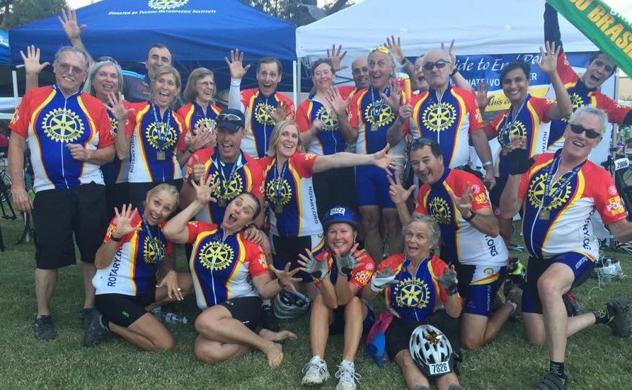
MAKE IT FUN!

Slide 16

WHO SHOULD JOIN? IDENTIFIYING OUR PROSPECTS
Notes:
Let’s now focus on who we should be targeting. How do we identify our prospects?
I like to think that we attract quality members and not play a numbers game. I’ve often heard it framed that we want to find people who are already Rotarians they just don’t know it yet.
Another thing to think about is look at those closest to you – family members, good friends, co-workers, neighbors.
There is someone likely right under your nose and you just haven’t realized it.

Slide 17

WHOSE RESPONSIBILITY IS IT?
Notes:
You know we often hear that everyone in the club is on the membership committee. And to a certain extent this is true. But someone has to own it and some people are better than others when it comes to asking. Not everyone in your club is a great recruiter.
Ask everyone in the club to name one person
Look at classifications which are not represented – who else do we like to work with? Electricians, Plumbers, etc
Any new businesses in town whose owners are looking to be embraced by the community?
After making the list, came the next step – picking up the phone and calling or meeting personally. This is not a task for email.

Slide 18
OUR MISSION STATEMENT
We provide service to others, promote integrity, and advance world understanding, goodwill, and peace through our fellowship of business, professional, and community leaders.

Slide 19
THE SALES PITCH: OUR ESSENCE STATEMENT
Rotary joins leaders from
all continents, cultures and occupations
to exchange ideas and take action
for communities around the world.
Notes:
As I mentioned at the beginning we have spent a lot of time examining our brand and we needed to come up with a clear way of explaining who we are, what we do and why it matters. We needed a way to frame Rotary so that we can all start singing of the same song sheet with a consistent message. What we arrived at is our essence statement seen here.
Rotary joins leaders from
all continents, cultures and occupations
to exchange ideas and take action
for communities around the world.
Our essence statement distills our strengths and differentiates us from other nonprofits. Our essence:
Clarifies Rotary’s role as connector; reinforces “category of one” status by removing traditional nonprofit descriptors.
It defines leadership the way we think not by our titles versus title; emphasizes Rotary’s greatest point of difference in relevant terms.
It balances friendship and fun with service and impact and is active and inspiring.
And finally it balances community and global impact.

Slide 20
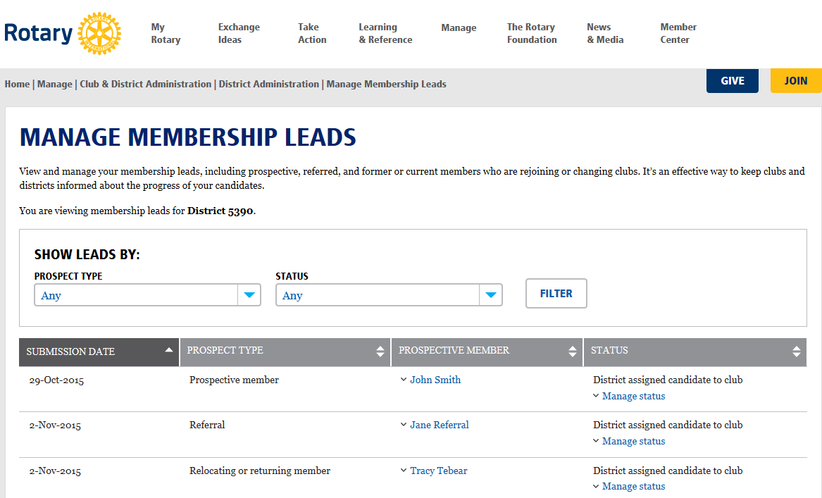
MEMBERSHIP RESOURCES
Notes:
District governors and district membership chairs get an automatic alert through e-mail when RI staff assigns a lead to the district; and the club president, club secretary, club membership chair, and club executive secretary gets automatically alerted about new leads when the district assigns a lead to their club.
But all Rotarians can also use the tool, if you are relocating to a new community, you can use it to get connected with a club that fits your needs.
And if you meet someone who you think could be a great Rotarian, even if not in your club, you can use it to refer them to Rotary, and we’ll connect them with a club that may be right for them.

Slide 21
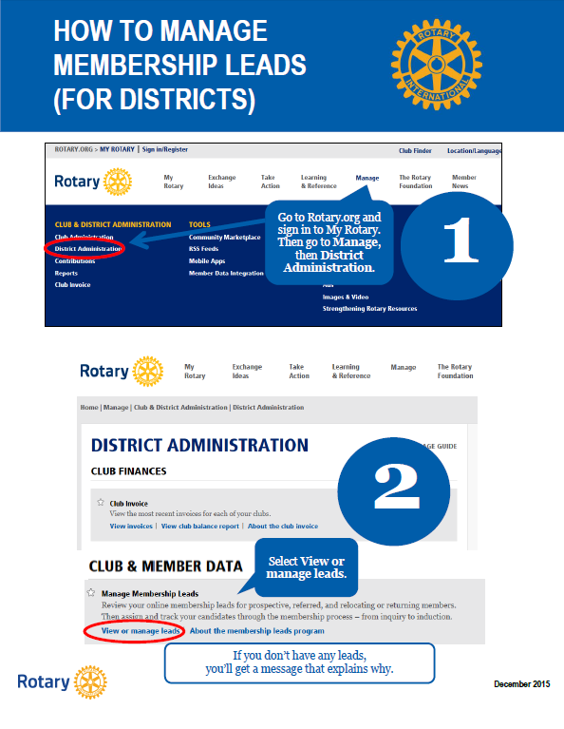
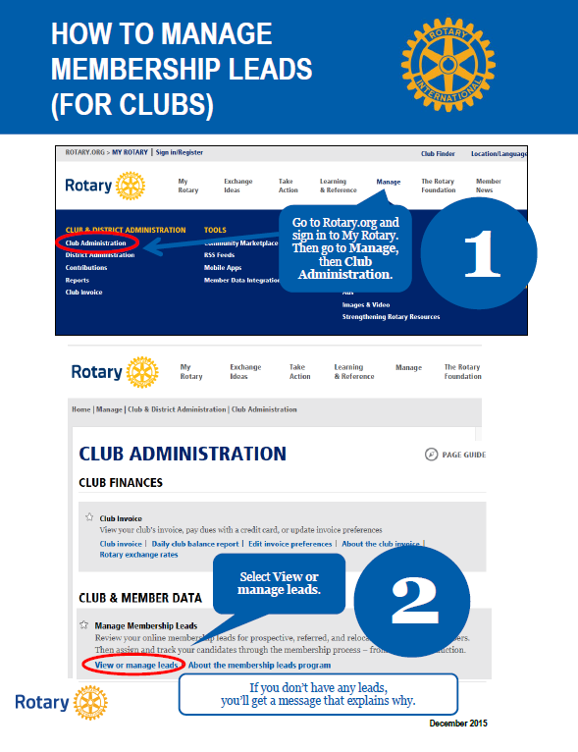
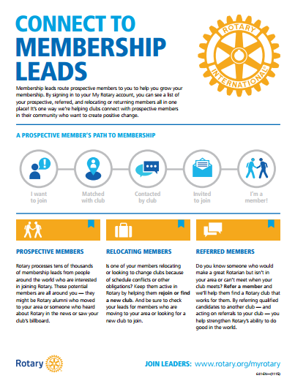
MEMBERSHIP RESOURCES
Connect to Membership Leads
For club and district leaders
Explains how membership leads flow from rotary.org to clubs
Details responsibilities for managing leads
Links to how-to guides online
Club and district Membership Leads video is also available at https://vimeo.com/rotarytraining
Notes:
The Connect to Membership Leads guide provide greater details on this flow from the Rotary website to the club, details the responsibilities for managing leads at the district and club levels, and provides links to downloadable “how to” guides for district and club leaders. There’s also a 3 minute video available for viewing and download on Rotary’s Vimeo page.

Slide 22
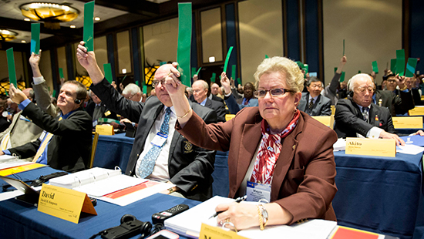
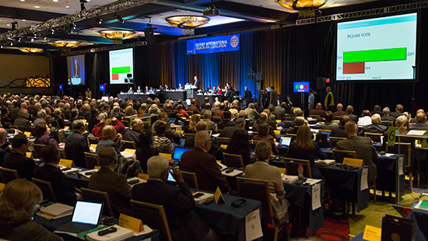
Rotary International MEMBERSHIP DECISIONS
Flexibility in meeting frequency, format, and attendance
Flexibility in membership types
No distinction between e-clubs and traditional clubs
Dual membership for Rotaractors
Notes:
As you know, in April the Council on Legislation met and approved changes that give clubs greater flexibility in when, where, and how they meet and the types of membership they offer. Through research and experience, Rotary, Rotary has consistently found that when a club has more freedom to determine how they hold their meetings, who they invite to membership, and what defines engagements, the club is more vibrant and more able to grow. The approved changes include:
Flexibility in meeting frequency, format, and attendance
Flexibility in membership types (such as corporate or family membership)
No distinction between e-clubs and traditional clubs
Dual membership for Rotaractors
It’s important to note two things. First, clubs that wish to follow their traditional requirements for meetings, attendance, structure, and categories of membership may continue to do so. Second, to be counted as an active member by RI, (eligible for holding office, receive Rotary awards, and counted in membership statistics) individuals must pay dues to RI.

Slide 23
CLUB FLEXIBILITY PAGE ON NEW WEBSITE - RESOURCES
Frequently asked questions
Rotary’s governance documents
Start guide for alternative membership types
Start guide for flexible meeting formats
Club meeting flexibility & format (video)
Membership types and attendance flexibility (video)
Membership flexibility overview
Membership Best Practices Discussion Group
Notes:
Resources & reference
Frequently asked questions
Rotary's governance documents
Start Guide for Alternate Membership Types (includes sample bylaws)
Start Guide for Flexible Meeting Formats (includes sample bylaws)
Club meeting flexibility and format (video)
Membership types and attendance flexibility (video)
Membership Flexibility Overview

Slide 24

MEMBERSHIP RESOURCES
Rotary Club Health Check
Tool for club leaders to take their club’s pulse
Includes checklists to quickly diagnose what needs extra attention
Suggests resources and ideas that can help remedy problem areas
Notes:
Just as routine doctor’s visits help us identify health risks before they become serious, Club Health Check will allow club leaders to quickly diagnose problem areas in the club and suggest resources and ideas to help remedy them. Areas covered by the tool include the club experience, service and social activities, membership, public image, and club operations. Club Health Check is an online only publication available at www.rotary.org.

Slide 25

Rotary’s New Approach
Notes:
DG Kathy Fahy D5970:
They have completely thought out of the box in terms of a satellite-type club. Their satellite is named SAIL (Serve. Act. Inspire. Lead.) and is an offshoot of the weekly noon club that meets on Mondays. Members of the satellite group actually only meet once a month in the evening and is always centered around a service project.
They have 43 members in the satellite club (all but 7 are new Rotarians) and how they have it structured is that they are full dues paying members of the noon club except they do not pay for the meal fees (and of course they can attend if they are able but many work in professions where it is hard to break away for lunch).

Slide 26
Q & A Session
Notes:
Q & A

