Slide 1
MembershipSeminar
Membership Retention

Slide 2
Membership Retention
Membership Retention

Slide 3
Membership Retention
What is the scope of “Membership” ?
➢ The factors involved in a developing and
keeping a Rotary club strong and healthy
➢ Locating and inducting new members.
➢ Keeping all members happy and active.
➢ Forming new Rotary clubs
➢ Telling the world what Rotary does.

Slide 4
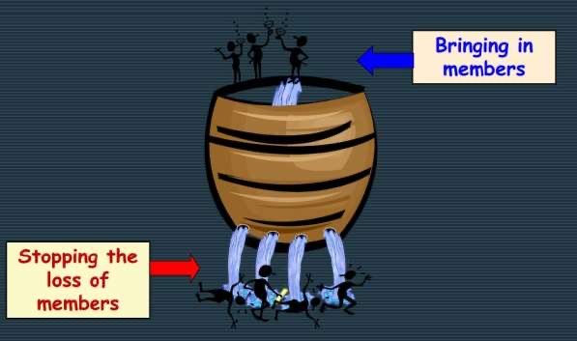
Membership Retention
The rusty bucket of membership
development& retention

Slide 5
Membership Retention
We could keep doing what we have always
been doing….
• A few people inviting guests each year
• People not getting engaged or not having fun
• People moving on
• Some come, some go!
And we could expect to get
what we’ve always got:
DECLINING MEMBERSHIP !

Slide 6
Membership Retention
Why do people leave Rotary?
Club reasons
• No pre-induction education about the responsibilities of membership.
• No new member orientation program
• Networking expectations not being met.

Slide 7
Membership Retention
Why do people leave Rotary?
Club reasons
• Fellowship expectations not being met.
• Unconnected to the club’s activities.
• No mentoring
• Attendance requirements

Slide 8
Membership Retention
Strategies to create
Dedicated Rotarians
Retention begins before the
member is inducted into the club

Slide 9
Membership Retention
Membership Retention Strategies
“Plugging the Membership Leak”
1. EducateMembers
2. Care about Members
3. Communicate with Members

Slide 10
Membership Retention
EDUCATION of Members
NEW MEMBER ORIENTATION
➢ Membership benefits
➢ Membership responsibilities
➢ Organizationof Rotary
➢ History
➢ Rotary programs
➢ Rotary Foundation

Slide 11
Membership Retention
EDUCATION of Members
ATTEND:
1. Club Board Meeting
2. Club Committee Meeting
3. District Conference
4. District Seminar
5. District Assembly
6. Rotary Leadership Institute
7. Other Rotary Clubs

Slide 12
Membership Retention
CARE ABOUT of Members
CARE ABOUT THEIR IDEAS & OPINIONS
➢ New members bring new ideas about projects.
➢ New members have opinions on how the club
meetings are run.

Slide 13
Membership Retention
CARE ABOUT of Members
CARE ABOUT THEIR IDEAS & OPINIONS
➢ New members have expectations about what Rotary
can offer them.
➢ New members have questions
LISTEN / ACKNOWLEDGE / CONSIDER

Slide 14
Membership Retention
CARE ABOUT of Members
MENTOR NEW MEMBERS
➢ Introduce them to members, partners, the AG etc.
➢ Assist them with committee / board roles
➢ Take them to District Assembly, District Conference,
District Seminars, other Clubs
➢ Ask them for feedback on the Club
➢ Encourage “Member Behind the Badge” talk

Slide 15
Membership Retention
CARE ABOUT of Members
WELFARE of MEMBERS
➢ Cares about welfare of members & their families in a
discrete way
➢ Enquires when members are absent
➢ Keeps President and/or fellow members informed if a
member has problems with health, family, business etc.

Slide 16
Membership Retention
CARE ABOUT of Members
WELFARE of MEMBERS
➢ Announces birthdays, anniversaries etc.
➢ If a member has issues with the club or its members the
where appropriate, offer to help resolve them

Slide 17
Membership Retention
COMMUNICATION with Members
COMMUNICATE WITH:
➢ Members
➢ Their families
➢ Local community
➢ Potential audience

Slide 18
Membership Retention
COMMUNICATION withMembers
COMMUNICATE BY:
➢ Talking / Meeting announcements
➢ Club Bulletins
➢ Club Websites
➢ Social Media (Facebook, Twitter, Whatsapp..)``

Slide 19
Membership Retention
COMMUNICATION withMembers
COMMUNICATE ABOUT:
➢ Club events/ projects
➢ District events / projects
➢ Support for community events
➢ Rotaryinformation/ achievements
➢ Member achievements

Slide 20
Membership Retention

Slide 21
Membership Retention

Slide 22
Membership Retention
ThankYou!!

