Slide 1
Innovative ideas for club growth
This Photo by Unknown Author is licensed under CC BY-SA-NC

Slide 2
5 attributes of successful clubs

Slide 3
5 attributes of successful clubs
Strong Leadership
Leadership

Slide 4
5 attributes of successful clubs
Strong Leadership
Clear Membership Goals and a Growth Plan
Leadership
Goals & Plans

Slide 5
5 attributes of successful clubs
Strong Leadership
Clear Membership Goals and a Growth Plan
Active in the Local Community / Many Events and Service Projects
Leadership
Goals & Plans
Service

Slide 6
5 attributes of successful clubs
Strong Leadership
Clear Membership Goals and a Growth Plan
Active in the Local Community / Many Events and Service Projects
Visibility in the Community / Strong Public Image
Leadership
Public Image
Goals & Plans
Service

Slide 7
5 attributes of successful clubs
Strong Leadership
Clear Membership Goals and a Growth Plan
Active in the Local Community / Many Events and Service Projects
Visibility in the Community / Strong Public Image
Active, Intentional Member Engagement
Leadership
Engagement
Public Image
Goals & Plans
Service

Slide 8
The
Key
Attribute
Notes:
This survey, along with the attrition/attraction data we’ve collected makes it clear that club leaders have the greatest impact on club growth and success.
That impact can be positive – or negative.
Success – or failure – usually occurs over time.
Strong clubs have leadership:
Consistency
Continuity
Collaboration
Communication
This is your opportunity to make a difference.
Intro to video: As you’ll see from these clips, Rotary leadership is about WE, not ME.

Slide 9
Attracting New Members Start with a Goal and a Growth Plan

Slide 10
Clear Membership Goals and Plan

Slide 11
Clear Membership Goals and Plan
every Club States That Membership Growth was a Top Priority
16 out of 32 clubs Uploaded Their Membership Goals in MAP PROGRAM

Slide 12
Clear Membership Goals and Plan
Everyone States That Membership Growth was a Top Priority
16out of 32 Uploaded Their Membership MAP
32 have a Club Membership chair

Slide 13
Clear Membership Goals and Plan
Everyone States That Membership Growth was a Top Priority
16 out of 32 Clubs Uploaded Their Membership Goals in MAP
32 Club have Membership Chair
Active attraction by Members was a Key Strategy
Notes:
Strategies followed included:
Members asking Friends (Each One, Bring One)
Active follow up with prospects
Consistent messaging to club members
Starting satellites with alternate experiences (Young Professionals, Cantonese speaking)
Membership is not a committee of one. In most of these clubs, it was a priority for all members.
Intro to video: As you’ll see, goals and plans were top of mind for everyone in the club.

Slide 14
Membership Sources for Rotary Clubs
Inquires from website (10%)
Friends/relatives/ co-workers of Rotarians (70%)
Inquiries at fundraisers (15%)
Transfers (5%)

Slide 15
suggestions for your club’s growth plan
EVERY club member is on the membership team
Be a Rotarian every day, talk about Rotary!
Remind members every meeting to invite others
Take time in your club to develop and update your current Membership Plan
Suggestion: Have a Town Hall meeting format with your Club a few times per year
What is working, what changes needed
Invite the District Membership Team
Start a satellite club?

Slide 16
Member Attraction Plan - Ideas
Hold a Membership Contest, Make it fun!
Attend outside Networking Events as a Rotarian
Call a friend, Invite them to your next Service project
Invite from your local chamber, community leaders, and organizations your club supports
Maintain a “Friends List”

Slide 17
MORE innovative ideas to include your membership plan
Adopt Different Meeting Structures?
Multiple Membership Dues Structures?
Appoint a Club Diversity, Equity & Inclusion Chaire
What else?

Slide 18
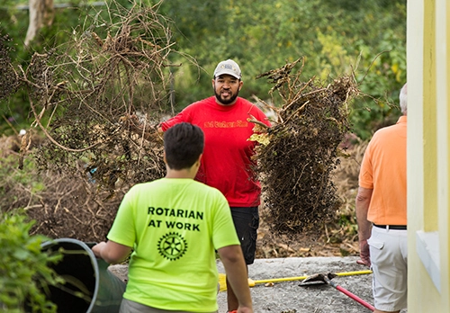
Active IN their local CommuNity Many events and service projects
Many Highly Visible Service Projects
often monthly and/or ongoing
HOLD Events Targeted at New Member Attraction
Notes:
These clubs seized the moment to be of service. Covid was an opportunity, not an excuse. They:
Searched out areas of immediate need
Partnered with other Civic groups
Took Diversity, Equity and Inclusion to heart
Identified projects that would appeal to prospective members
A variety of projects for members to choose from
They focused on ‘not yet Rotarians’:
Inviting them to a wide variety of service projects, special events and club meetings
Holding “Rotary Day” social events to introduce Rotary to the community
In sum, they were active, engaged and engaging.
Intro to video: As you’ll see from these clips, they didn’t stop moving.

Slide 19
SERVICE PROJECTS recommendations
be well planned
be meaningful and worthwhile
partner with other civic organizations
involve as many members and guests as possible
be on a regular basis (bi-weekly, monthly or quarterly), Can be different projects
be an enjoyable experience

Slide 20
Visibility in the community- Strong Public Image
It’s not just doing, it’s being seen doing!
Notes:
Clubs made active use of social media and more often than not, this was taken up by the club as a whole, rather than an individual or committee.
Intro to video: Here are some examples.

Slide 21
Increase your Club’s Visibility
Post your events and service projects on social media (Instagram, Facebook, …)
Articles in local news
Billboards
Announcements at Local Chamber and partner events
Club newsletter sent to friends (not just members)
Use Meetup for events
What Else?

Slide 22
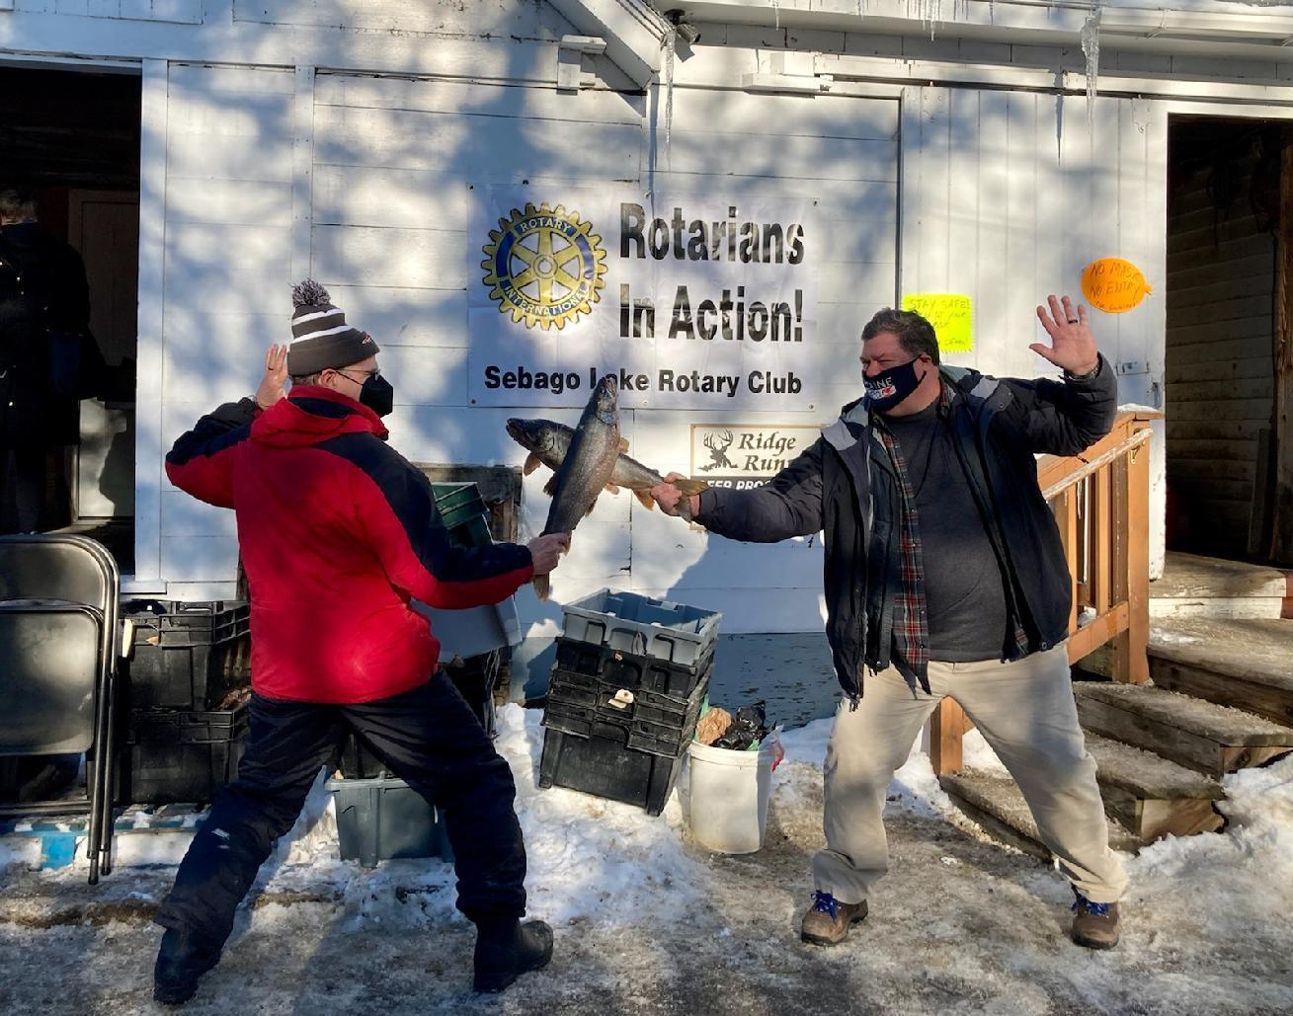
Active, Intentional Member Engagement
Consistent meetings with mixed formats
Strong Meeting Programs
Friendly, Fun, Inclusive
New Member Onboarding
Engage members in committees/projects
Recognize all contributions by participants
Notes:
The key message to repeat here is that clubs were active and intentional about engaging their members – and ‘not yet Rotarians’.
Intro to video: These leaders make this point best.

Slide 23
New Member Engagement Tips
Provide a “Fun” New Member Orientation (preferably live)
Invite them to “Welcome to Rotary” session
Hold an entrance interview, learn their interests
Assign a mentor
Give them an assignment: Committee, Greeter, Board Member, service project

Slide 24
Existing Member Engagement Tips
Strong and Friendly Fellowship
Desirable Meeting Place
Make sure they participate in the club’s activities
Contact members that are not attending
Get feedback from your members (Survey)
Encourage Members to attend RLI

Slide 25
Other Engagement Suggestions
Hold “one-on-ones” with members
Make sure members feel they are heard
Ask members “What is Missing” in the club to improve it
Encourage members to suggest projects and fundraiser ideas
Make sure every one is happy with the job they have in the club
call missing members before they leave
Keep it fun and celebrate accomplishments
get family members involved in projects as Friends of Rotary

Slide 26
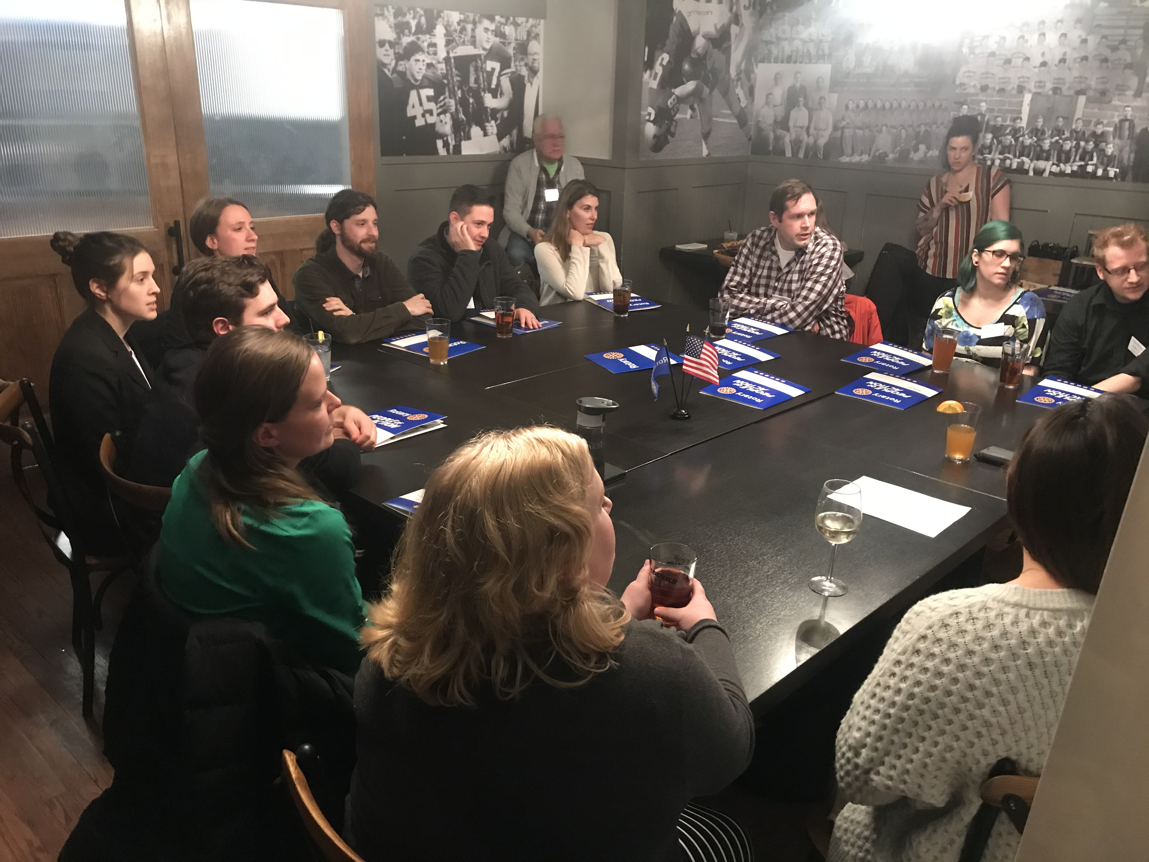
Alternate ExperiEnce
(Satellite Clubs)
Alternate Meeting Time
Adjacent Community
Young Professionals
Service Group
Common Cause
Common Culture
Rotary Alumni
What Else???

Slide 27
5 attributes of successful clubs
Leadership
Engagement
Public Image
Goals & Plans
Service
Notes:
Bring people back to diagnose, plan, act

