Slide 1
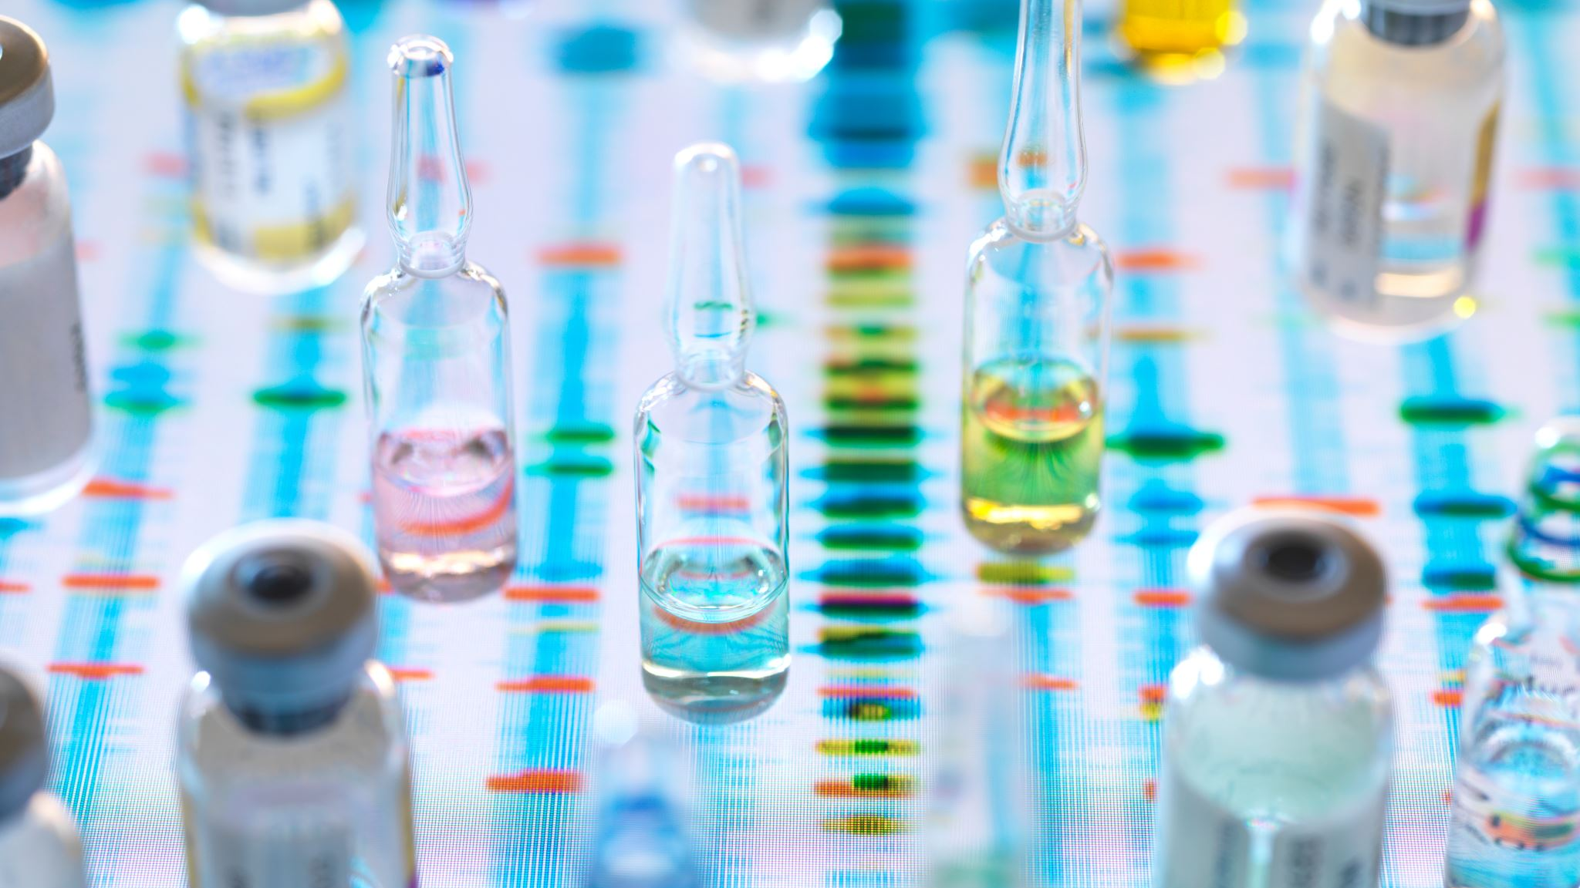

Polio Plus update
2022-2023

Slide 2
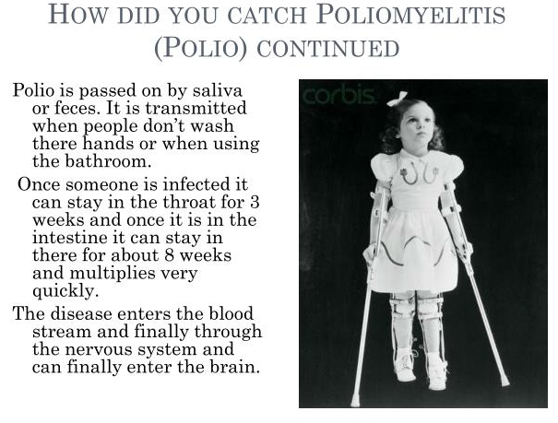

Slide 3
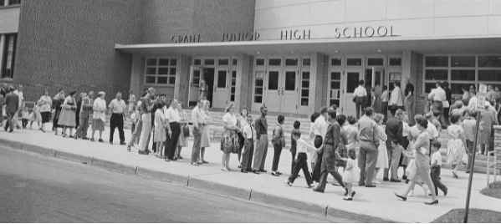
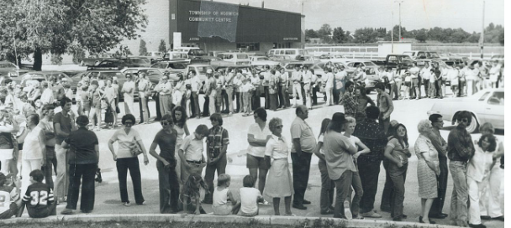
Waiting for Vaccines
Thanks to Jonas Salk (BTW, Birthday is October 24!!)
Albert Sabin developed the oral version
Sugar cube Sunday
This scene duplicated across America starting in mid fifties
This is how we beat polio in the U.S.

Slide 4
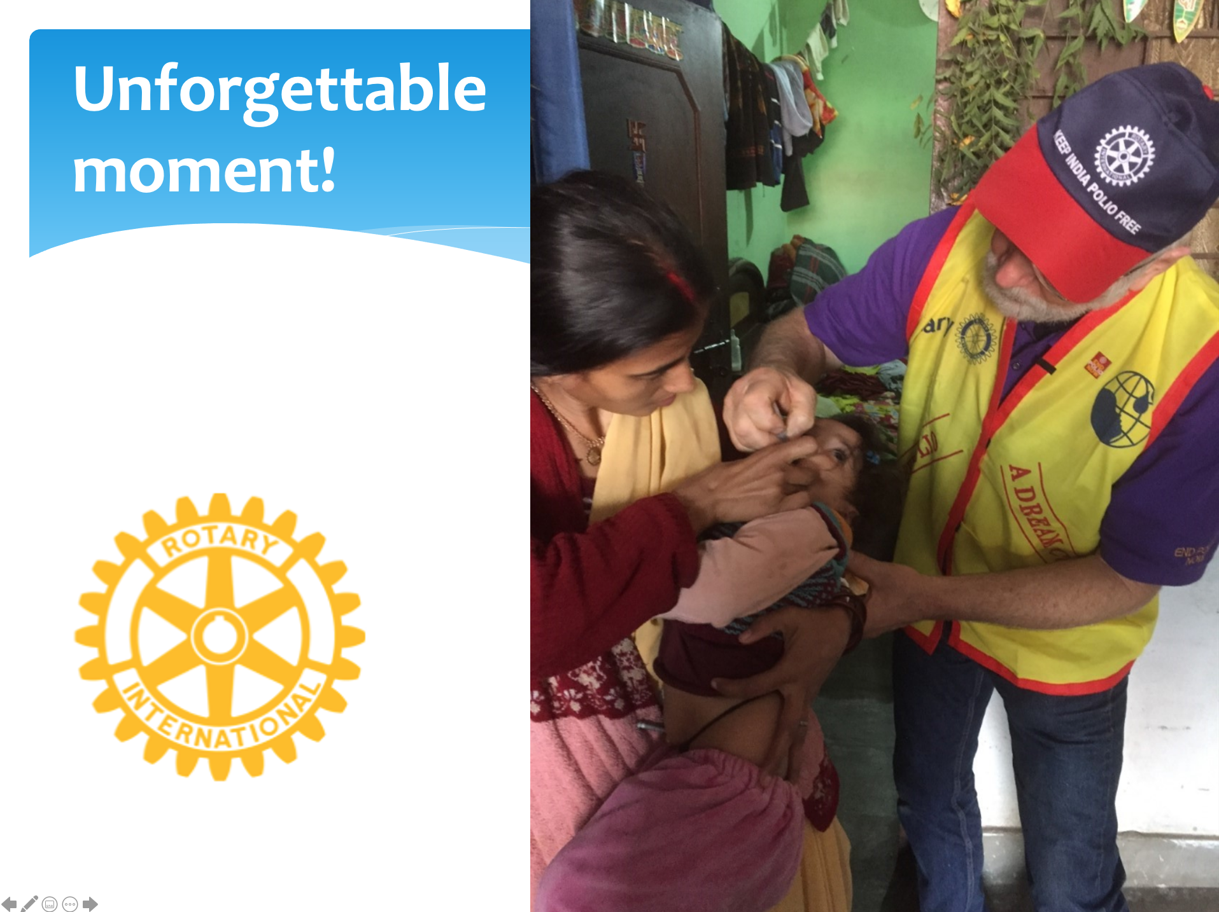
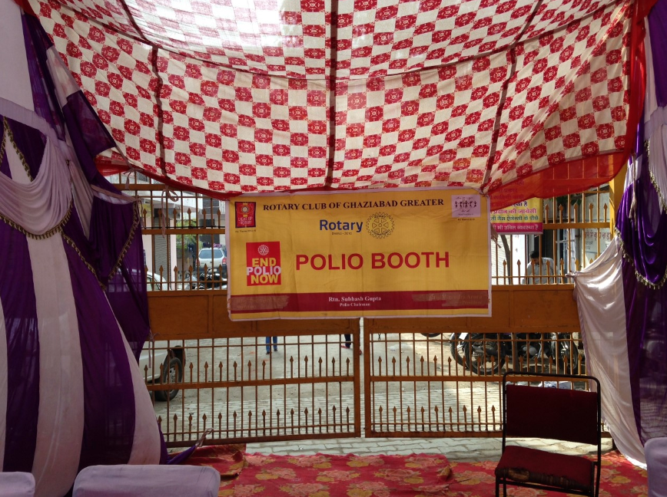
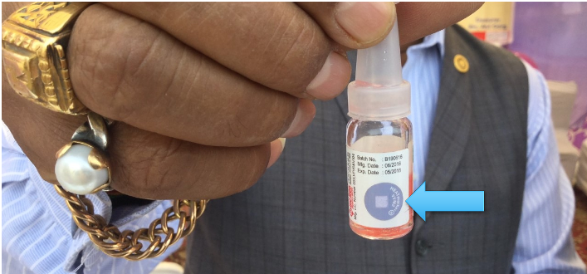
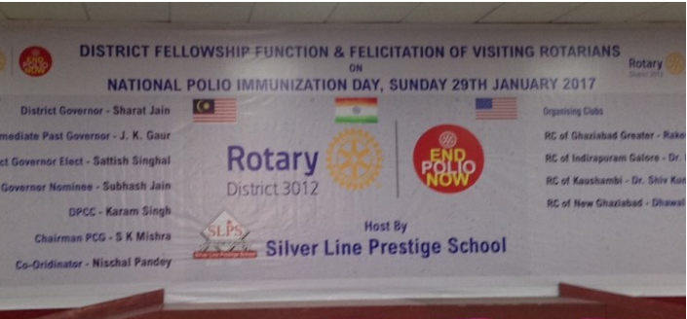
This is how polio was beat in India

Slide 5
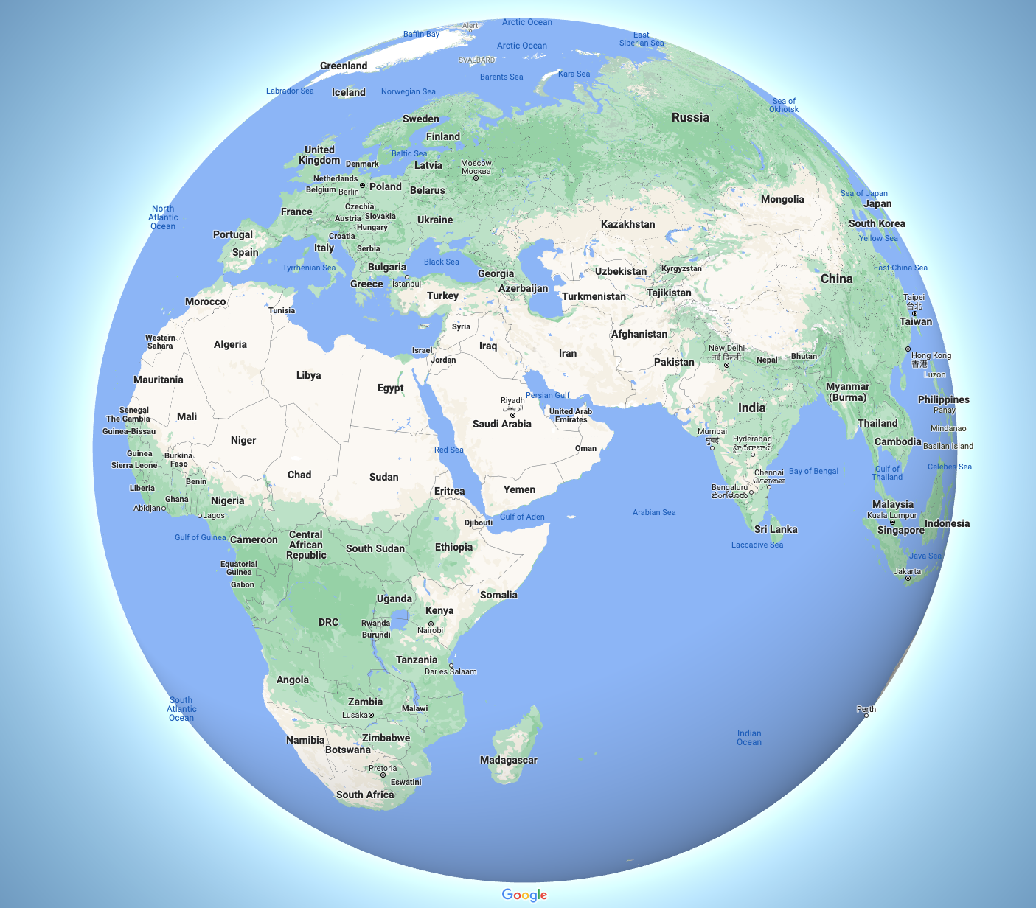

Look how far we’ve come!
Afghanistan & Pakistan remained with cases, one in Afghanistan and seventeen in Pakistan, for all of 2022!
The REST of the world is Polio Free!
BUT:
  We still immunize hundreds of millions of children in dozens of countries
  We still monitor wastewater around the world
  We still work to improve our vaccine
  We Still need your help!

Slide 6
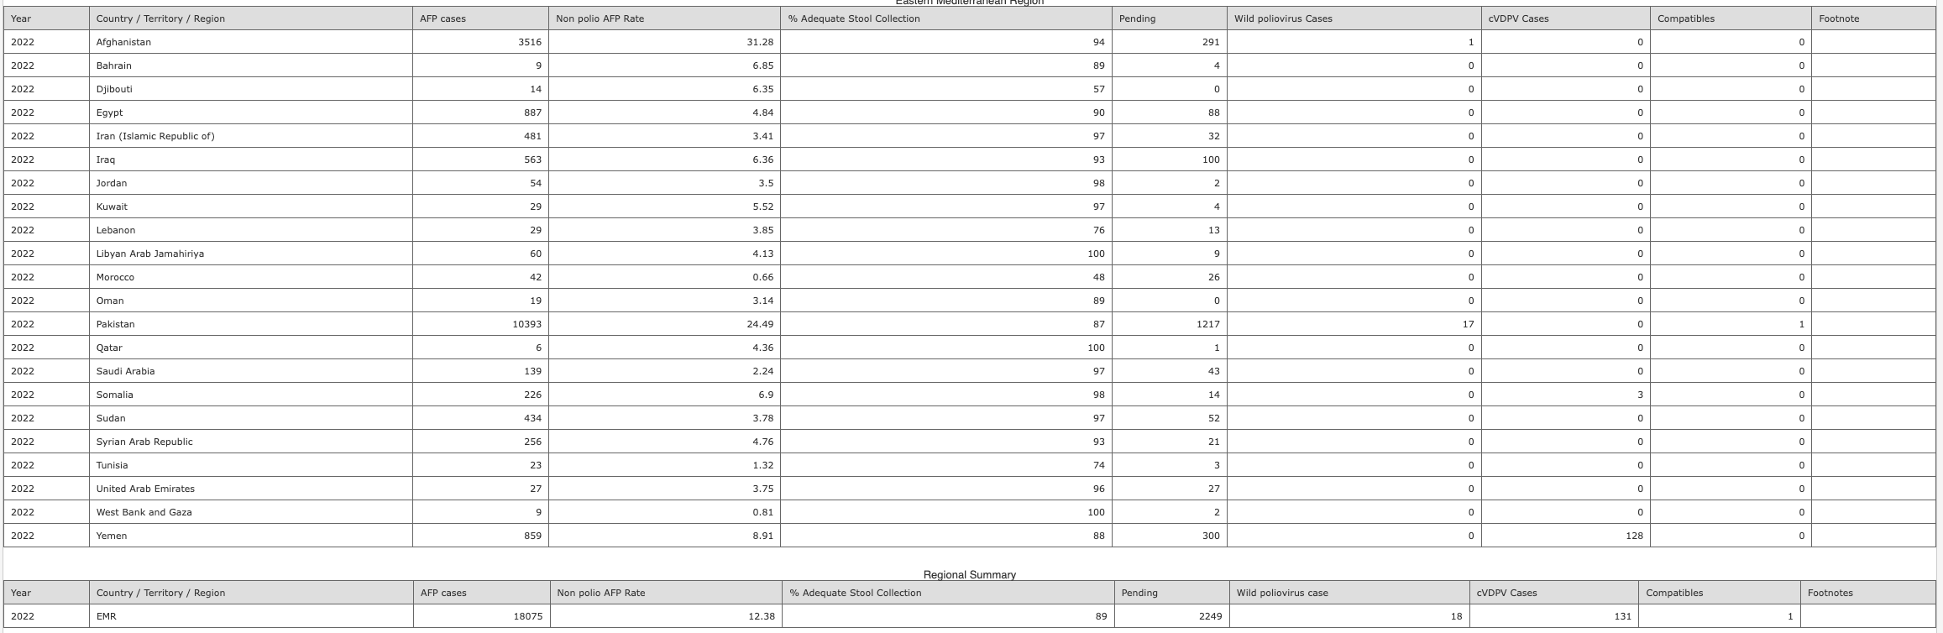
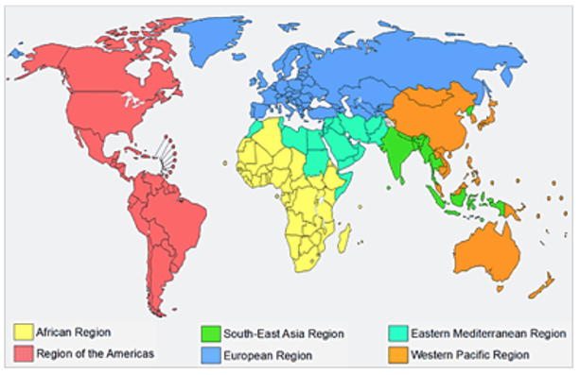
“FYI.... Just remember these figures are very good...BUT, there is always a "but". The numbers are good because we are vaccinating 400 million plus kids, at approximately $2.60 a dose in over 40 countries including Afghanistan and Pakistan because testing in the countries by the WHO in their Labs in the African and Asian regions tell us the wild polio virus is present. And, we have had very few outbreaks because of "preventative inoculations.” Rocky Jacobs

Slide 7
Afghanistan and Pakistan reexamined issues and making adjustments:
Afghanistan Update
From Dr. Hamid Jafari is director for polio eradication in the eastern Mediterranean region at the World Health Organization.
Jafari said the Taliban has historically been supportive of polio vaccinations.
As the Taliban seized control of Kabul, effectively becoming Afghanistan’s de facto rulers, a key question is what that means for the polio program in the country.
“None of the key actors in Afghanistan, including the Taliban, are opposed to polio eradication and are expected to support the program,” he wrote in response to questions.
“The ban on access to those areas controlled by the Taliban was a ban on house-to-house vaccinations, not a ban on polio eradication per se. The ban on vaccination was mainly for security reasons not in opposition to vaccination or polio eradication,” he added.
“Historically, this is the lowest number of cases that either country has ever reported. But experience tells us that even one case is one too many, and polio has repeatedly shown that it’s one of the most difficult viruses to eliminate. This is a time therefore to sustain the gains by focusing on achieving high quality campaigns and intensifying surveillance,” Jafari said.

Slide 8
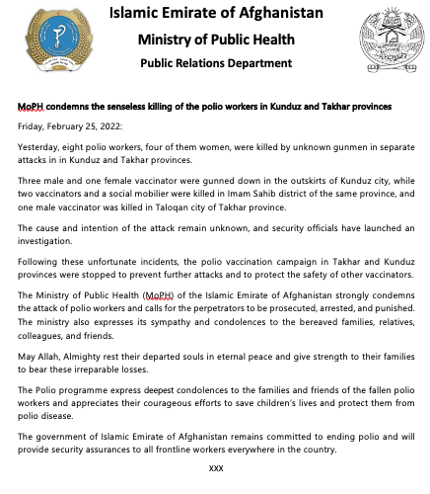
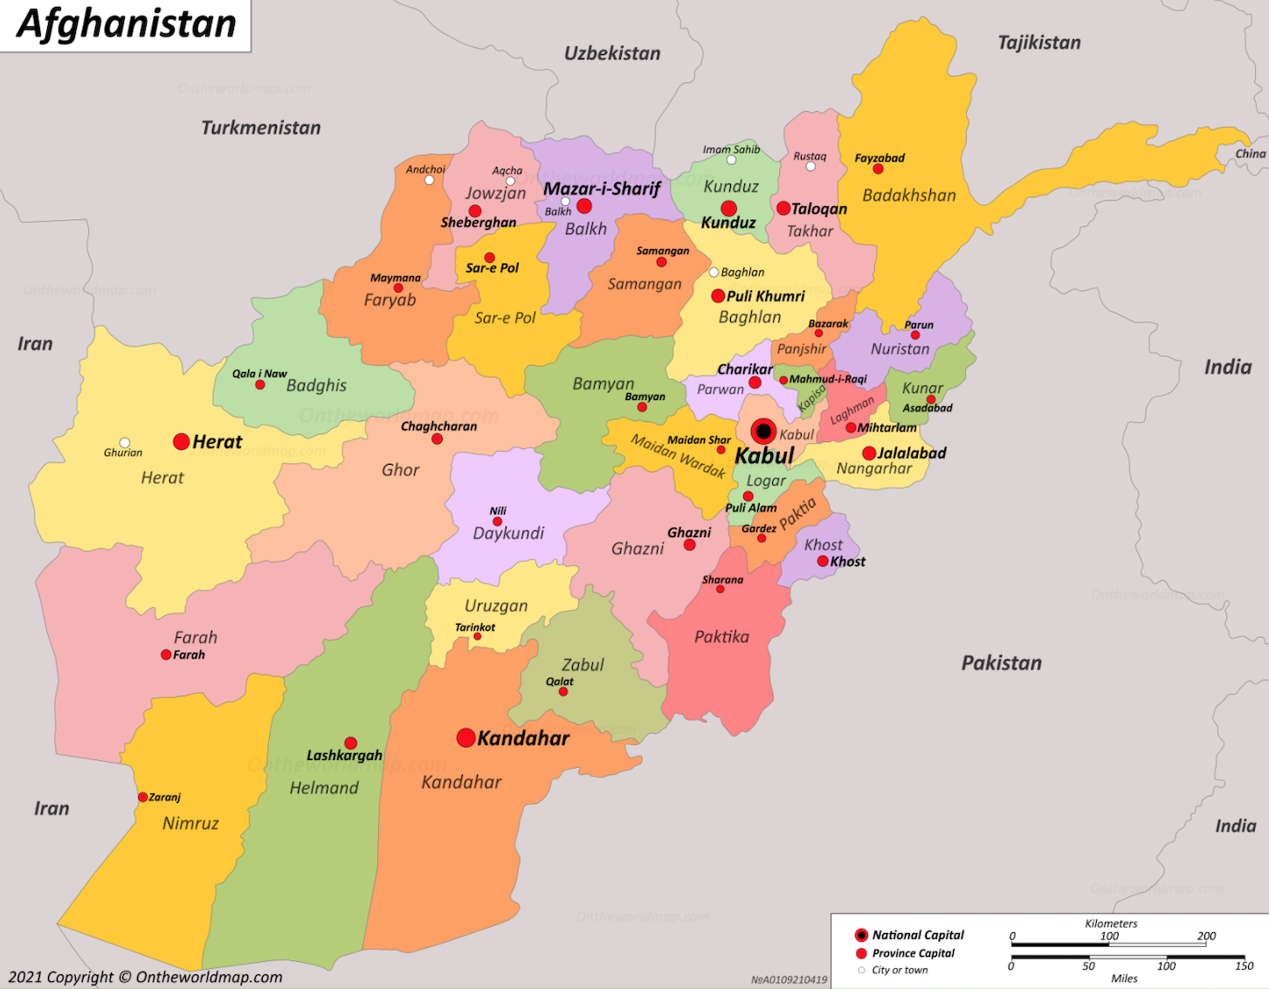

Slide 9
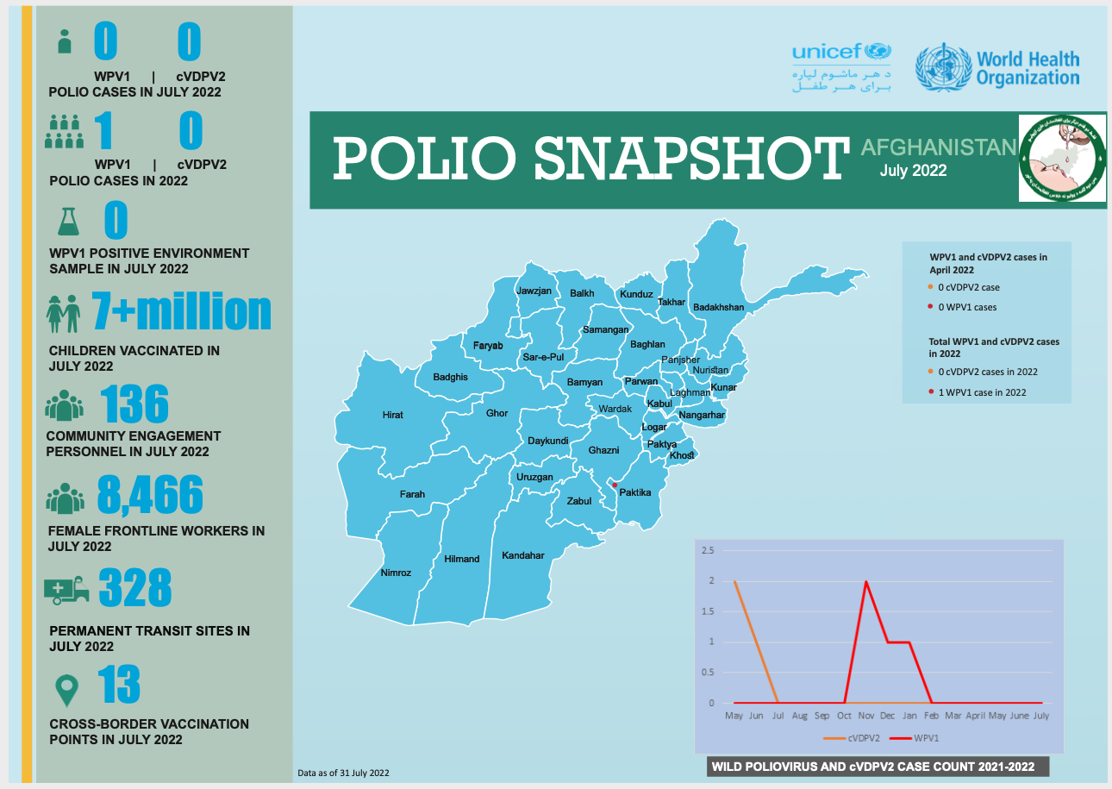
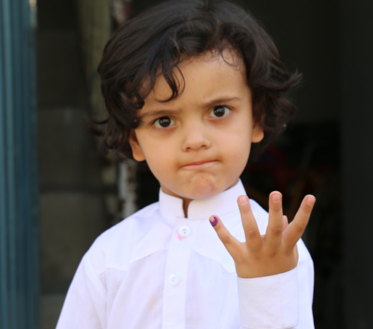

Slide 10
Pakistan update
Many of these communities, have grown weary of regular visits from polio vaccinators and few other health professionals. Integration of other vaccines, medicines, and maternal health advice this will improve health more broadly.
Second, increased partnerships with governments and empowering local leaders to support polio vaccination campaigns and engagement with families is a positive step. Pakistan Prime Minister Imran Khan made recent commitments to keep treating polio as a public health priority.
And finally, the GPEI is working to broaden the use of innovative new tools that can help us defeat polio. These include a next-generation oral polio vaccine that could help more sustainably end outbreaks of cVDPV, and digital payments for polio workers, which are helping improve the efficiency of polio vaccination campaigns and boost motivation.
All these tactics are part of the new GPEI Polio Eradication Strategy 2022-26, and they give us a lot to be hopeful for. But no matter how strong our plan is, it will only succeed if governments and donors recommit the political and financial resources that the GPEI needs to end polio for good. If they don’t, polio could resurge in countries where it has previously been eliminated and once again start paralizing tens of thousands of children every year – an unimaginable prospect, given how far we have come.

Slide 11
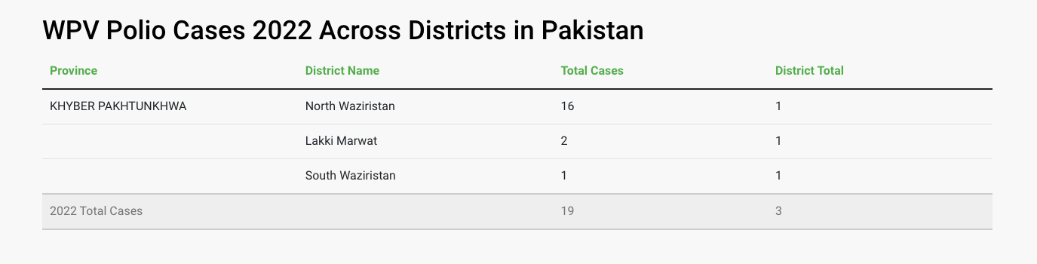
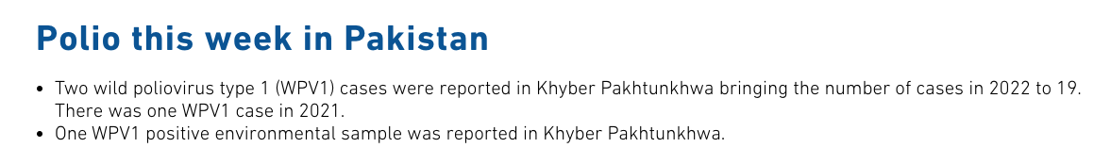

Slide 12
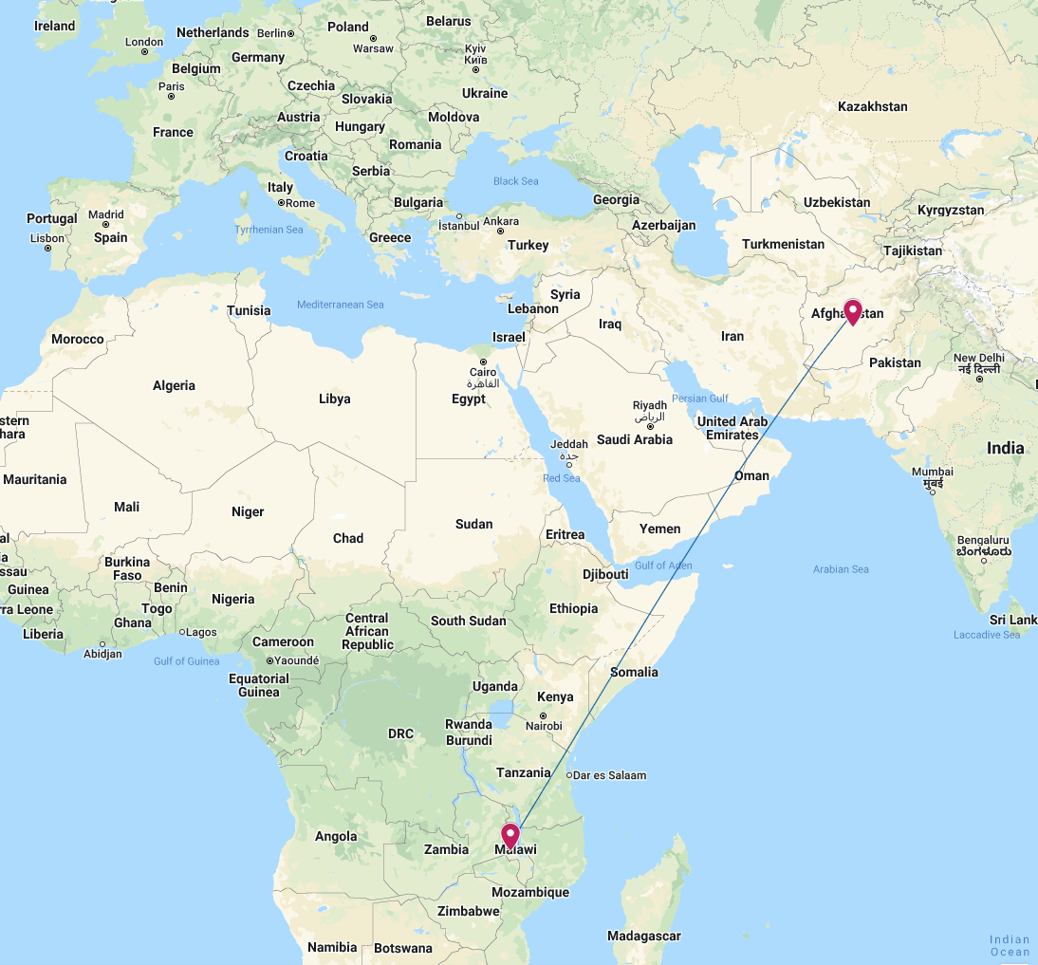
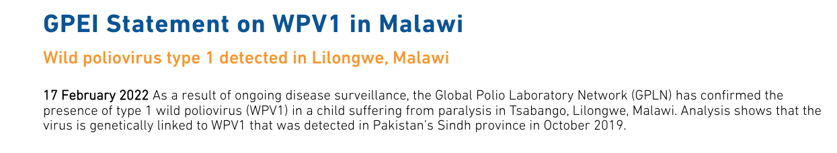
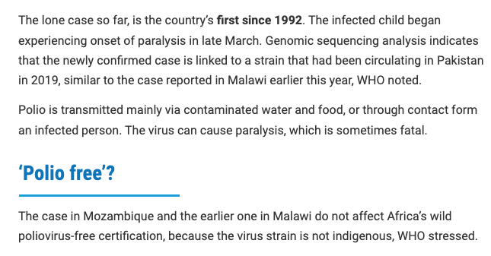
Approximately 4,000 miles!
Mozambique, Africa

Slide 13

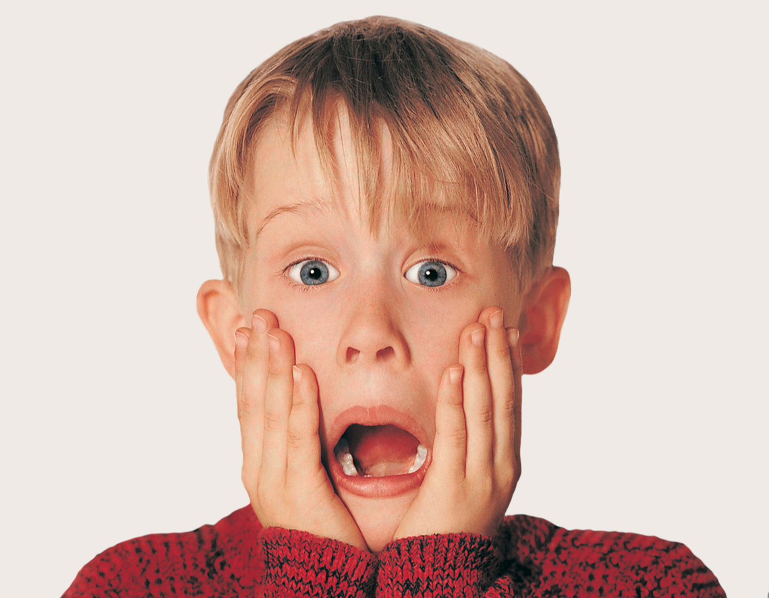
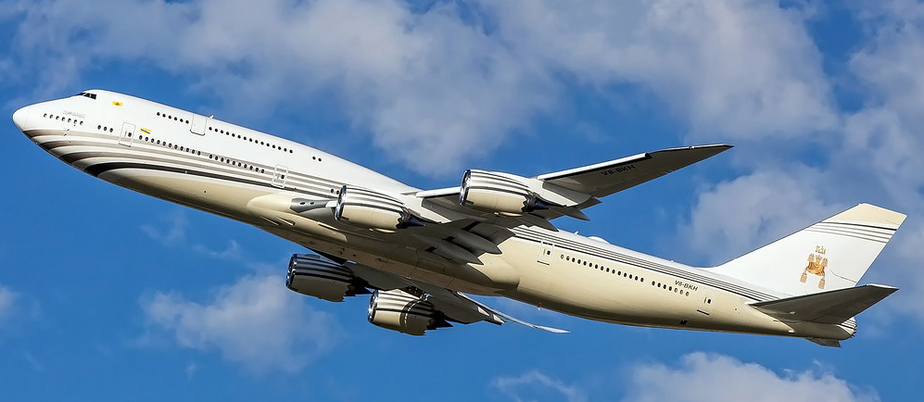
It’s always been one flight away!

Slide 14
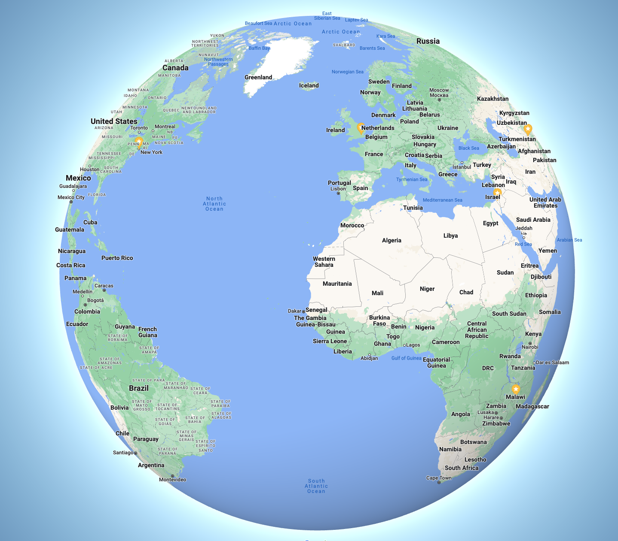
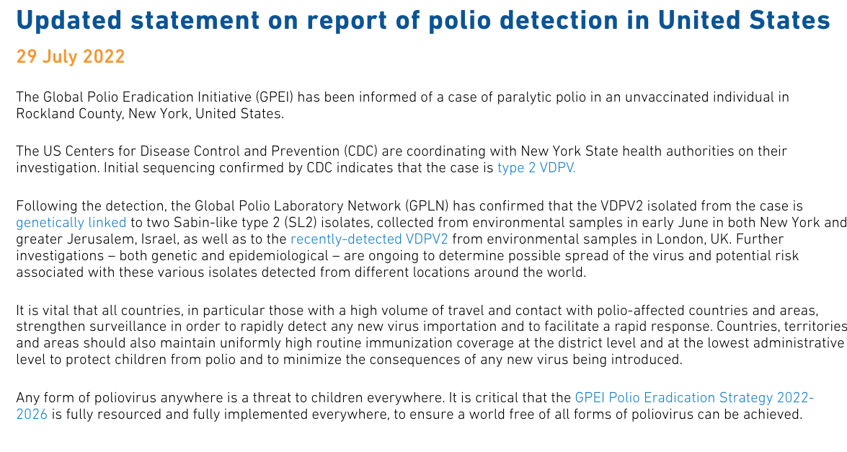


3,400 miles
2,200 miles

Slide 15
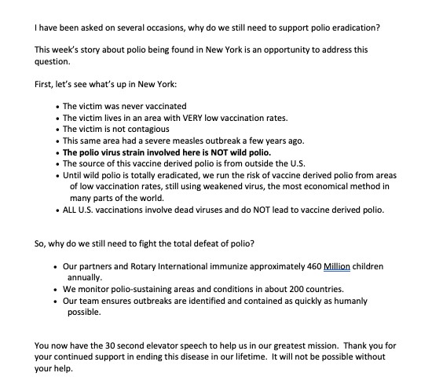

Slide 16
What can each of us do?
At your Club:
  Know the Rotary Polio story (see below)
  Keep up-to-date on advances in medication and case numbers
  Invite guest speaker to talk
  Have your club’s Foundation Chair give contribution updates
  Continue to financially support Polio Plus
https://www.rotary.org/en/plus-polioplus
https://www.cdc.gov/polio/GPEI/index.htm

Slide 17
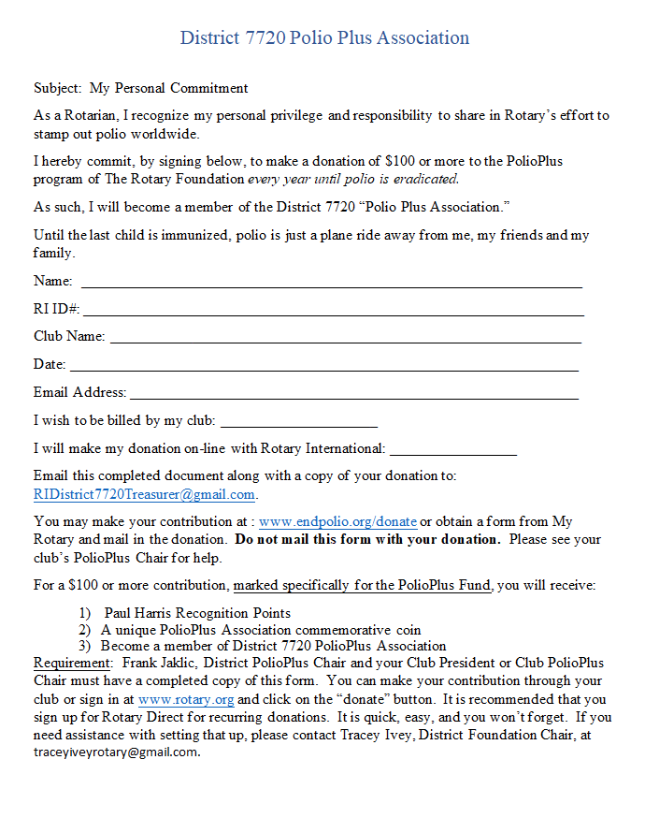
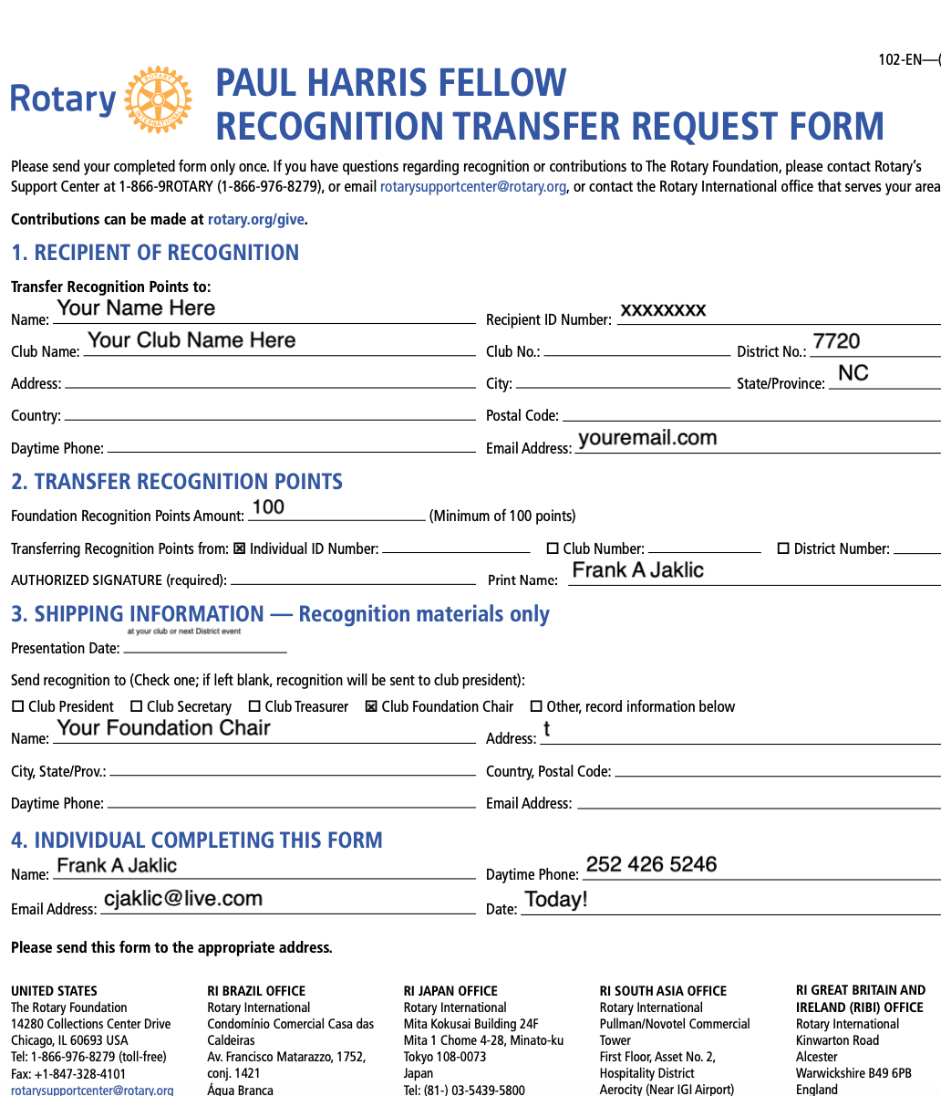
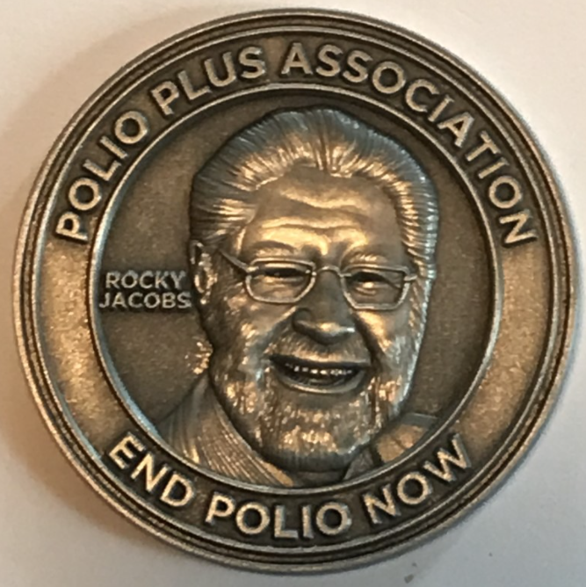
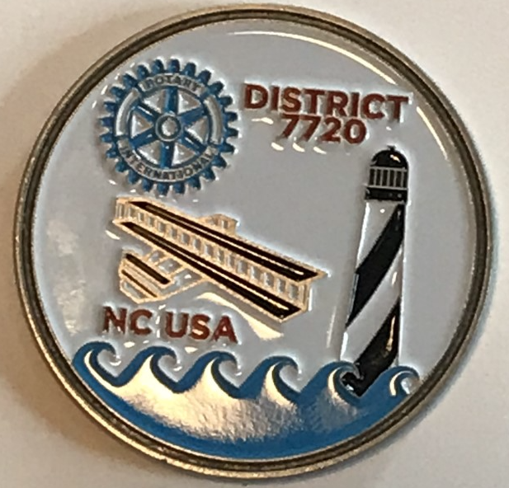
Polio Plus Association:
A District 7720 Exclusive
Continue to financially support Polio Plus

Slide 18
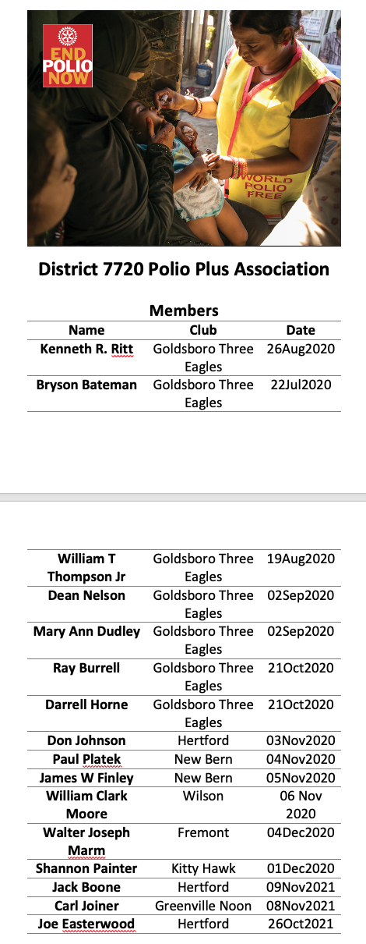
DISTRICT 7720 POLIO PLUS ASSOCIATION
PLEASE CONSIDER JOINING THIS ELITE GROUP TRYING NOT TO BE SO ELITE!
INFORMATION POSTED ON DACdb
FORMS AVAILABLE

Slide 19
What can each of us do?
In your Community:
  Continue to create awareness:
  World Polio Day on October 24, every year
  Do press releases & social media updates
  Plan an event
  Ask others to support Polio Plus

Slide 20
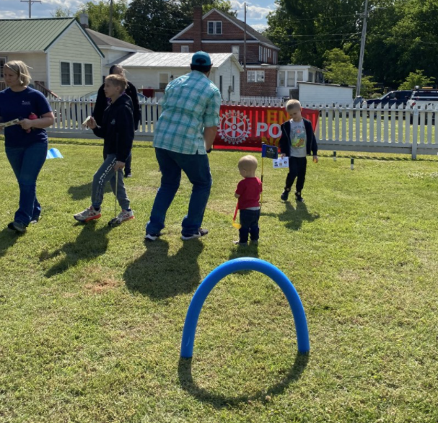
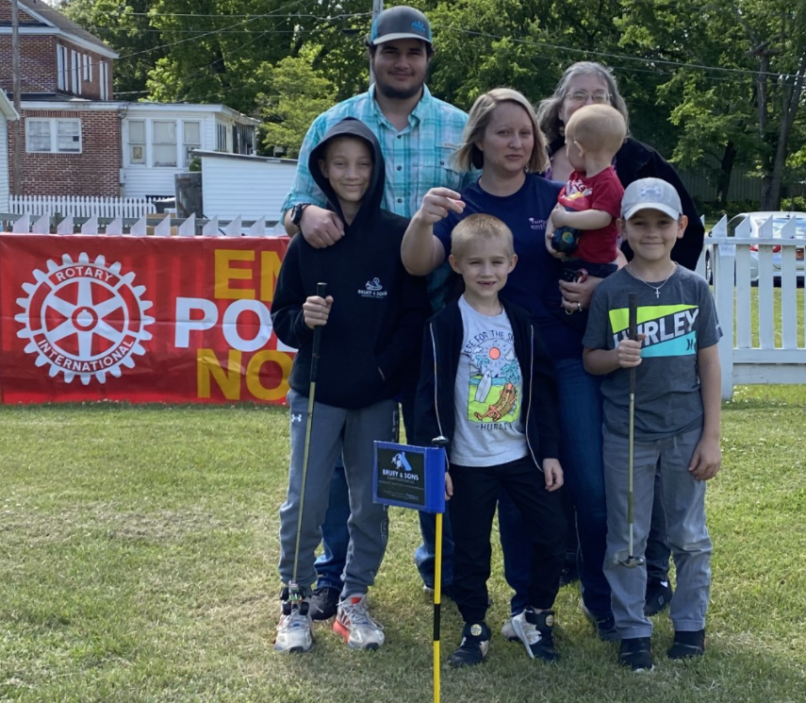
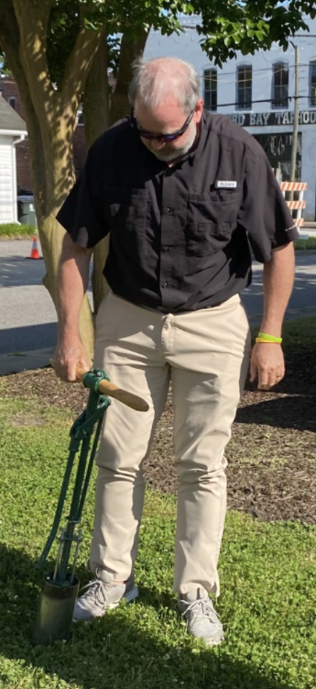
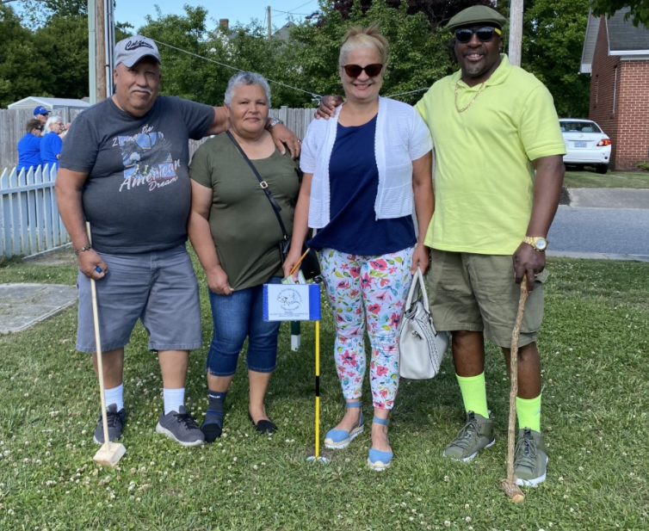
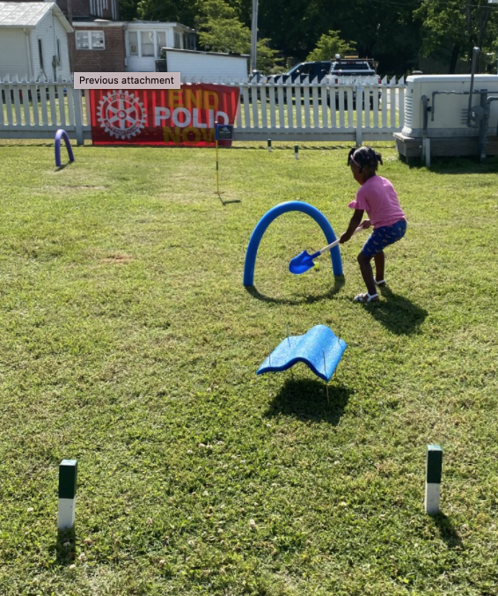
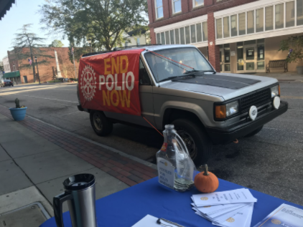
World Polio Day on October 24
Do a local event
Putt-putt for polio
What to do:
Put up a booth
Ask locals to share their stories
Do an event that involves children
Create awareness
Don’t be afraid to ask for help to do our number one benefit to the world
polio Awareness table in front of local pharmacy

Slide 21
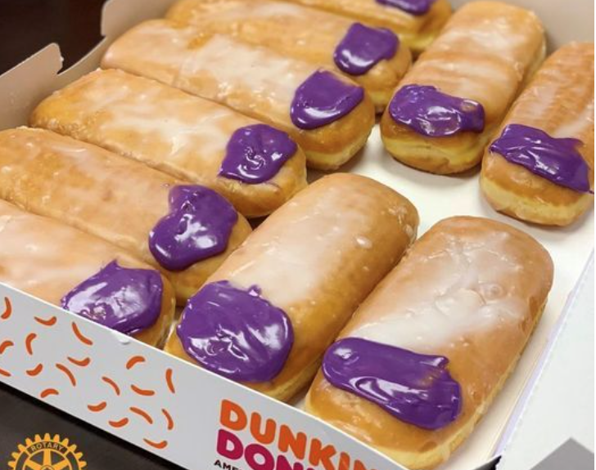
Other ideas:
Purple Pinky's - If you can have an in-person meeting or event, do a Purple Pinky fundraiser- e.g. $5 per fingernail painted purple. Work with a local Dunkin Donuts to make "Purple Pinky Donuts" which can be sold at a community event. More information can be found at www.purplepinkiedonuts.org
Pints for Polio - Beer, blood, or ice cream! Partner with a couple of local restaurants and a tap house and they donate $1 per pint sold, Partner with a local Community Blood Bank to host a blood drive and request donations for every pint donated,
More-Host a Walk-a-Thon, Cycling Event, or Swim Marathon and ask participants to secure donations for how many miles they walk, cycle or laps swam. Host a Bingo where a portion of the proceeds benefits "End Polio Now"
Don't forget to register your event at endpolio.org.

Slide 22
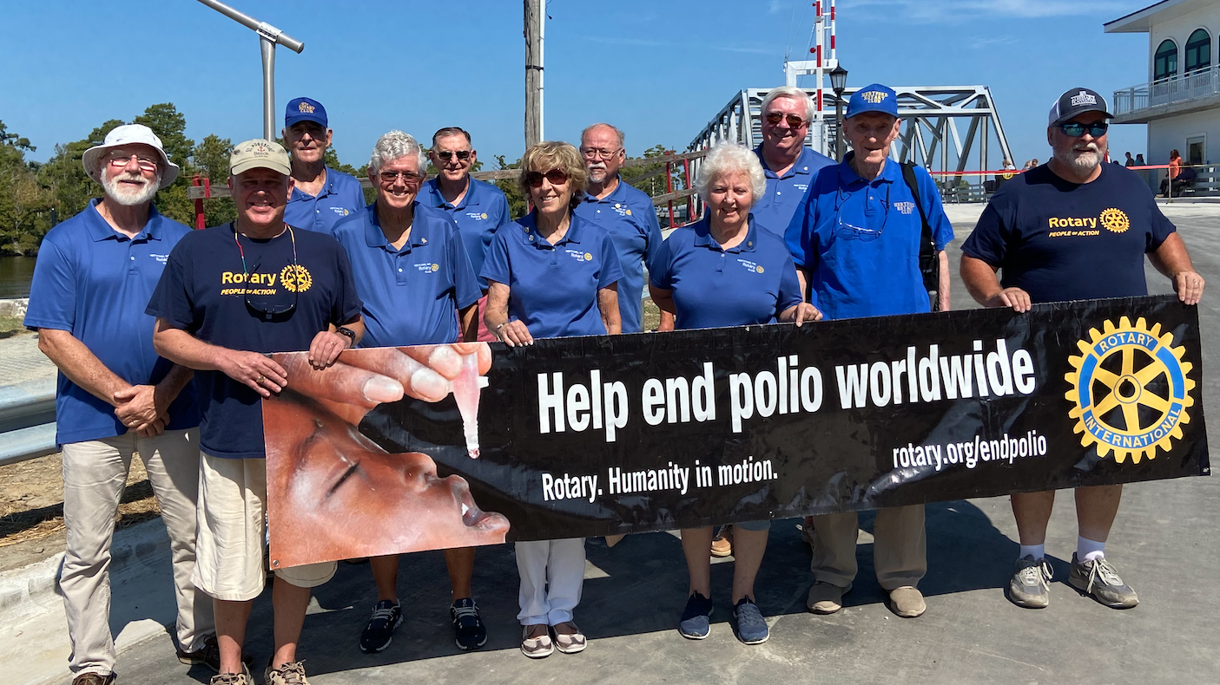
Continue to create awareness!

Slide 23


Slide 24
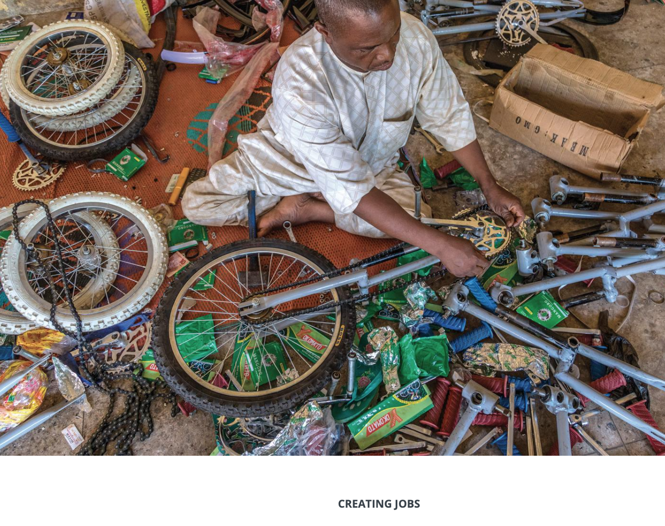
What does Polio Plus mean?
Polio Vaccine plus:
Maybe mosquito netting
Maybe malaria medicine
Maybe a grant to assist in financial recovery
It varies by local needs!

Slide 25
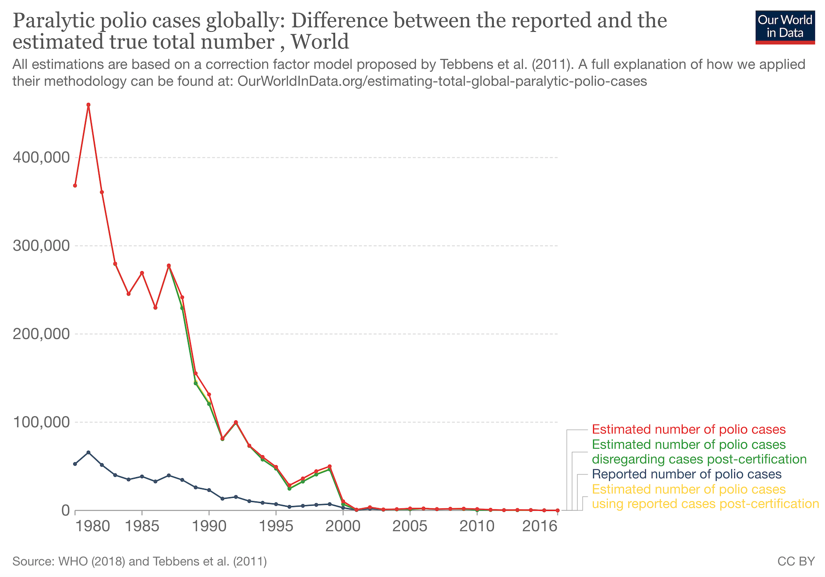
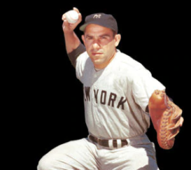
The results of OUR efforts
Yogi Berra: It ain’t over till it’s over
Rotary starts!

Slide 26
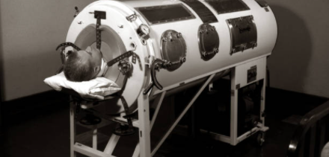
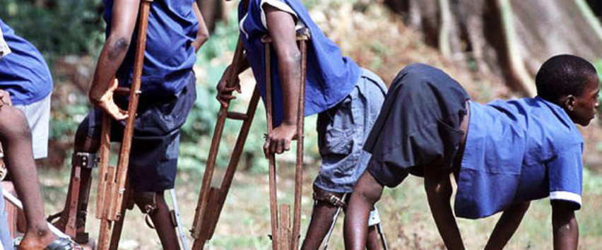
Without our polio eradication efforts, more than 19 million people who are currently healthy would have been paralyzed by the virus!
We have vaccinated over 3 BILLION children!
Contribution to the world economy:
19,000,000 x $1,000/year* x 30 years =
$570,000,000,000 (570 Billion USD)
*based in minimum wage in last four countries

Slide 27
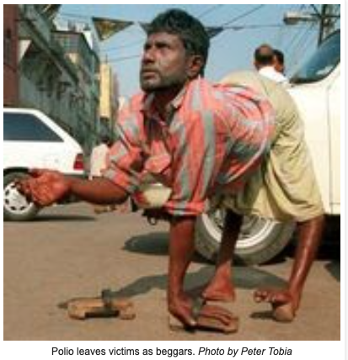
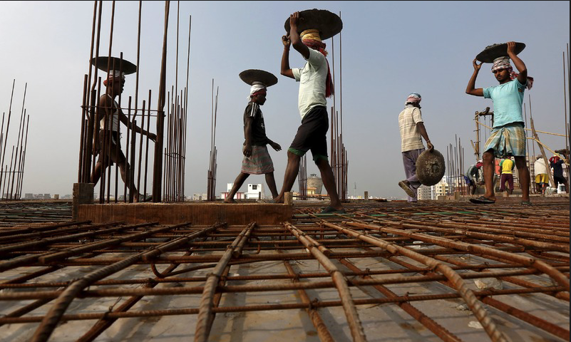
We are not rich because of what we have, we are rich because of what we do
Contribution to the world economy:
19,000,000 x $1,000/year x 30 years =
$570,000,000 (570 billion USD)
540/18 = 31 to 1 return on our worldwide investment (kinda like buying Apple stock)
The United States, Canada and Japan are among the largest donors for the vaccination drive.

Slide 28
Circulating Vaccine-Derived Polioviruses
Wild poliovirus (WPV) is the most commonly known form of the poliovirus.
there is another form of polio that can spread within communities: circulating vaccine-derived poliovirus, or cVDPV.
cVDPVs are rare
They have been increasing in recent years due to low immunization rates within communities.
cVDPV type 2 (cVDPV2) are the most prevalent, with 959 cases occurring globally in 2020.
cVDPV are now the only form of the poliovirus that affects the African Region.

Slide 29
How cVDPVs Occur
The oral polio vaccine (OPV) has many benefits: the live attenuated (weakened) vaccine virus provides better immunity in the gut, which is where polio replicates.
The vaccine virus is also excreted in the stool, and in communities with low-quality sanitation, this means that it can be spread from person to person and actually help protect the community.
However, in communities with low immunization rates, as the virus is spread from one unvaccinated child to another over a long period of time (often over the course of about 12-18 months), it can mutate and take on a form that can cause paralysis just like the wild poliovirus.
This mutated poliovirus can then spread in communities, leading to cVDPVs.

Slide 30
We Still need your help!
How to Stop cVDPVs
The cause of cVDPV is low immunization rates.
The best way to prevent them and stop them when there is an outbreak is to vaccinate children. The polio vaccine protects children whether the kind of polio is wild poliovirus or vaccine-derived poliovirus. Outbreaks (whether WPV or cVDPV) are usually rapidly stopped with 2–3 rounds of high-quality supplementary immunization activities (immunization campaigns).
An improved outbreak response tool: the novel oral polio vaccine type 2, or nOPV2.
it contains improvements that help make the vaccine virus less likely to mutate and cause disease in communities with low immunization

Slide 31
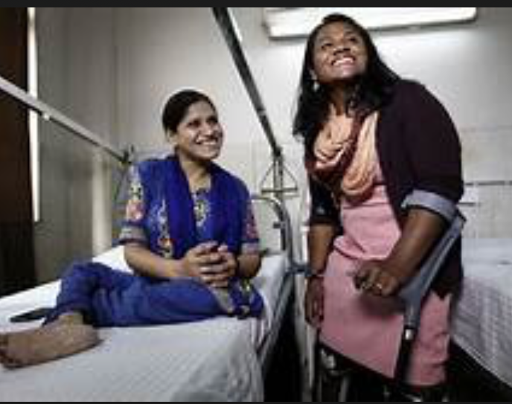
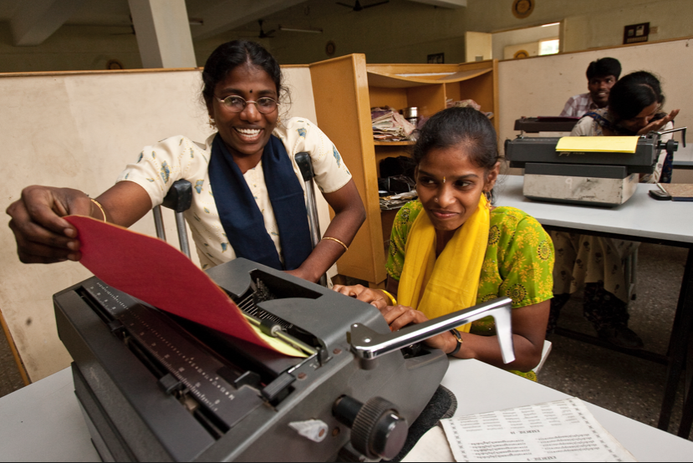
Rotary has not forgotten the past victims of polio
Rehab facilities work to mend, educate, and train lifelong polio victims to become productive members of society.
Many walk out of these facilities for the first time in their lives. Imagine that!
You and Rotarians around the world make this happen.
Global Grants at work!
And the continuing Rotary story!

Slide 32
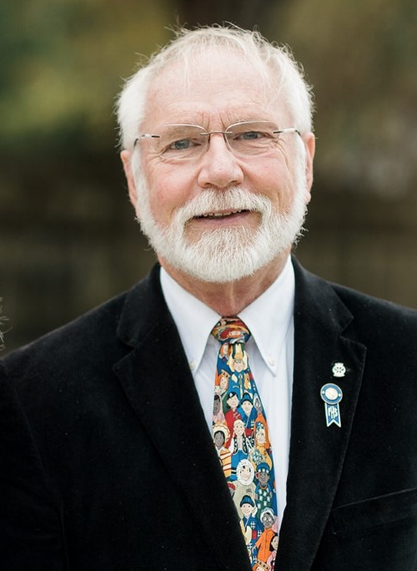
Need a GUEST SPEAKER?
Frank Jaklic
PDG
District 7720 Polio Plus Chairman
252 426 5246
cjaklic@live.com
We can ZOOM!

Slide 33
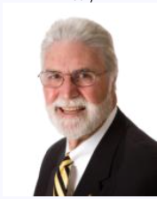
Join the Polio Plus Association of District 7720

Slide 34

We Still need your help!

Slide 35


