Slide 1
Navigation DACdb
Know your ID

Slide 2
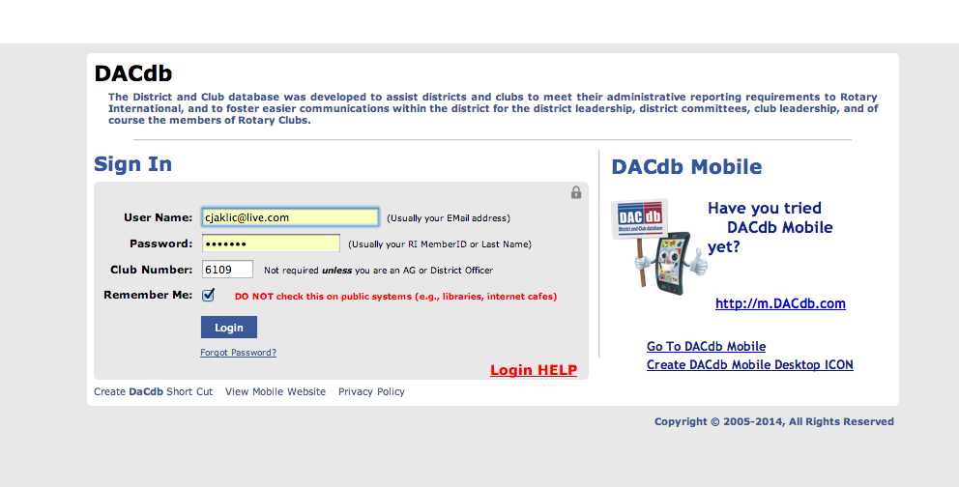

Slide 3
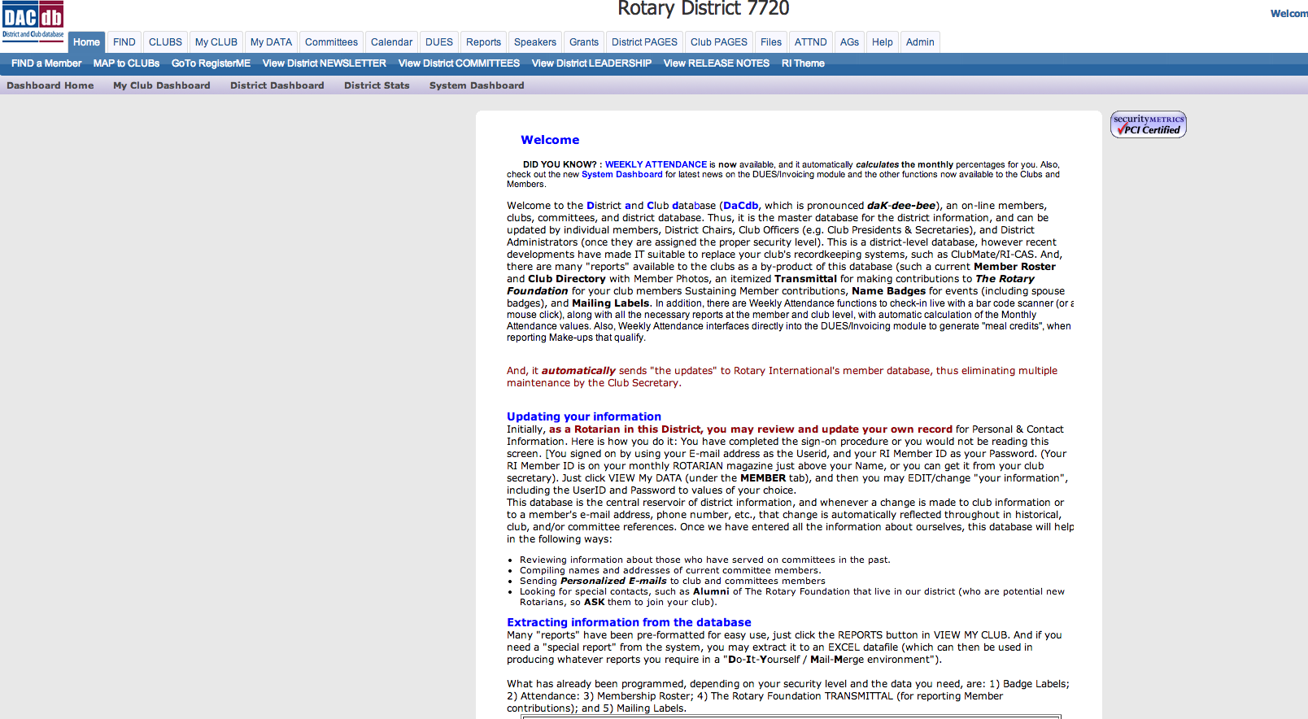
Finding “YOUR” information

Slide 4
Why you need to enter Club Number

Slide 5
Where to find Club Number

Slide 7
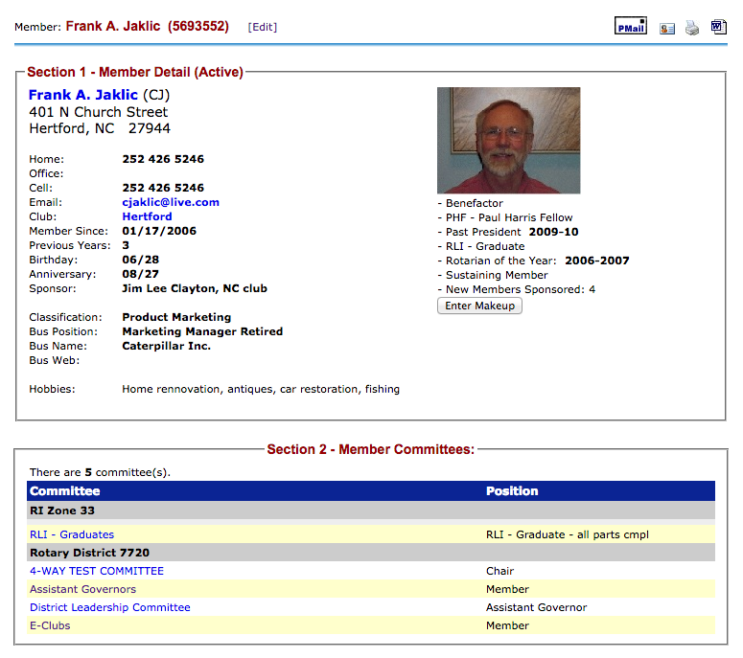
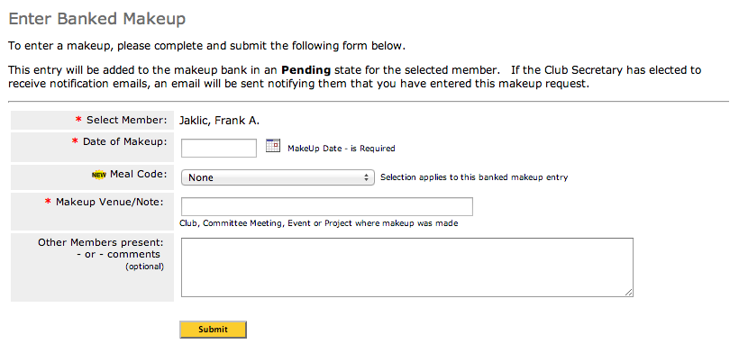

Slide 8
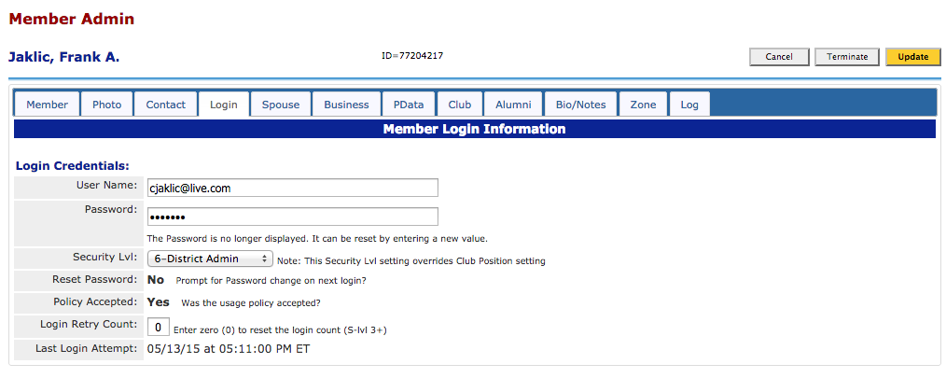

Slide 9
PMAIL

Slide 10
PMAIL

Slide 11
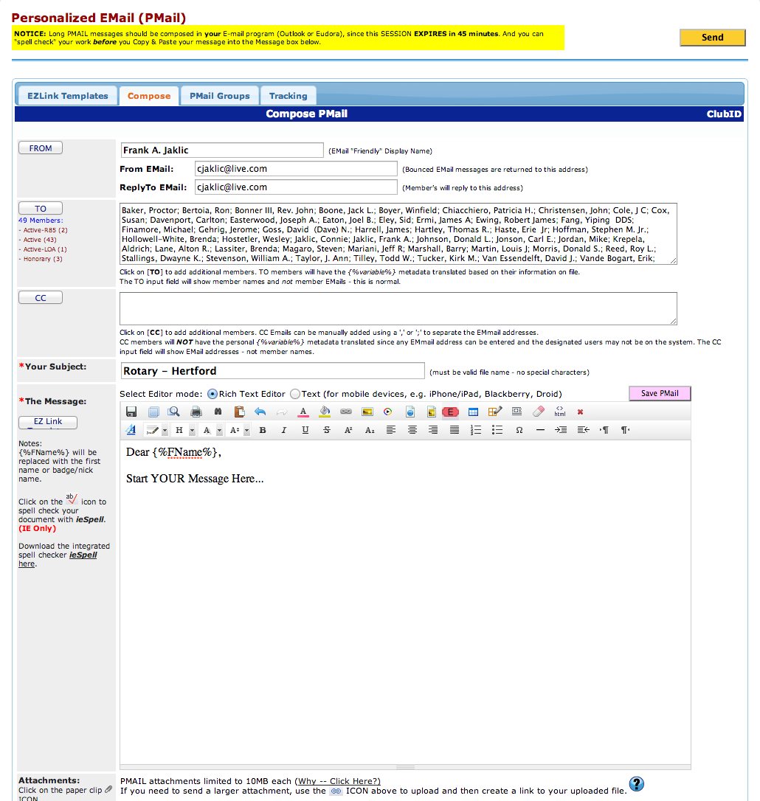
PMAIL

Slide 12
CLUB DASBOARD

Slide 13
Dashboard

Slide 14
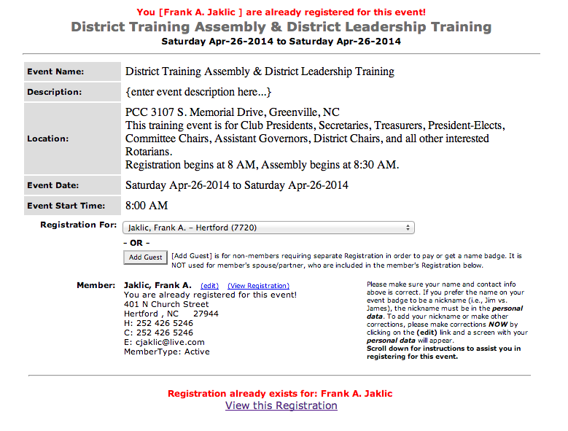
Using the District Calendar

Slide 15
FILES

Slide 16
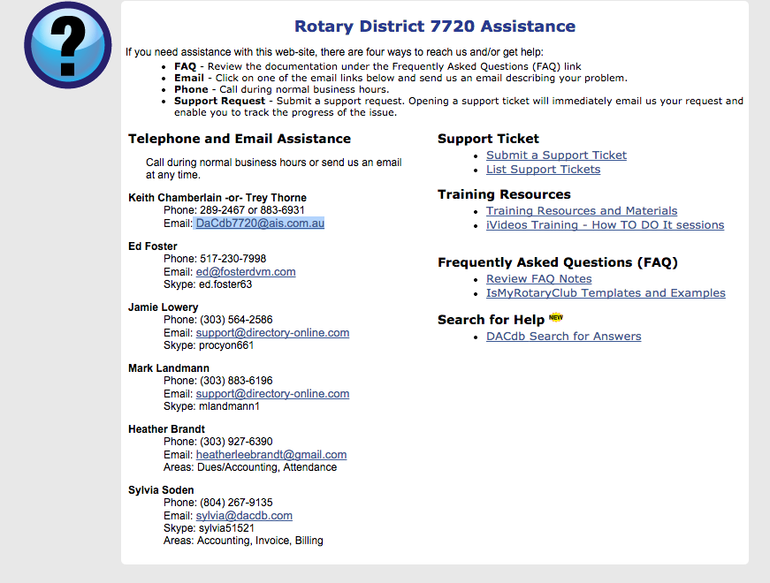
HELP

