Slide 1
What I need to Know to be a co-sponsor (Community Resettlement Partner)

Slide 2
What is Co-sponsorship?
Community sponsor groups come from faith communities, businesses, other social groups, and can include individuals who come together to form a sponsorship group. Community sponsors are ambassadors of welcome in their cities and towns. They help equip, guide, and educate newcomers as they navigate their new home in the United States.
The U.S. Department of State’s Bureau of Population, Refugees, and Migration (PRM) is the agency with the mandate to provide resettlement services to newly arriving refugees. They contract with nine national resettlement agencies (USCRI being one) on an annual basis and outline a specific list of services, called core services, that must be provided during a 30–90-day period as part of its Reception and Placement (R&P) program. The national resettlement agencies have a network of affiliates in designated locations across the U.S. where they resettle refugees.

Slide 3
What is Co-sponsorship?
Requirements | Support Teams (USCRI’s current Welcome Home Program) | Co-Sponsorship
Majority of core services provided by the sponsor | No | Yes
Signed MOU with resettlement agency | No | Yes
In-kind or financial contributions | Yes | Yes
Paired with a specific family or individual | No (this happened previously with Family Mentoring which we are discontinuing) | Yes

Slide 4
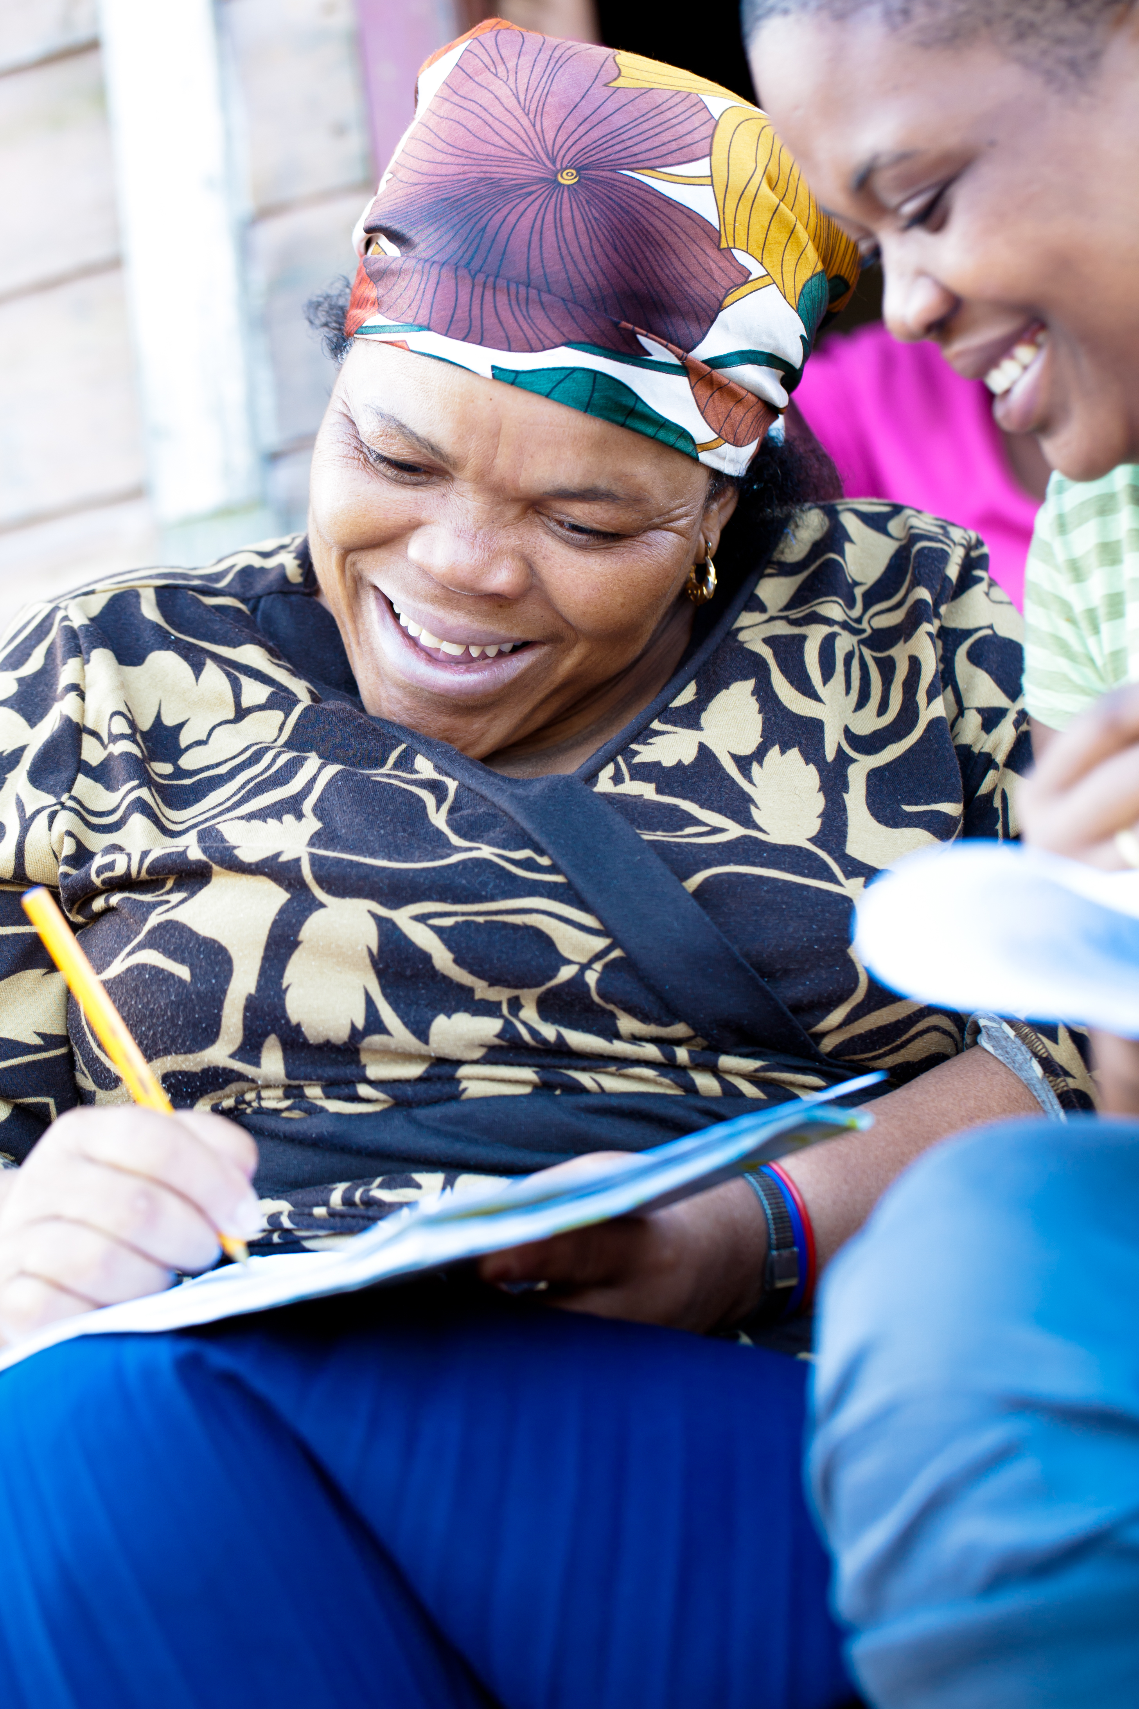
How is Co-Sponsorship similar to what we are doing now?
Groups and our vetted volunteers would still be:
Setting up the home, including food and hot meal for the first night
Assisting with transportation, airport pickup, tutoring, ESL, school enrollment, cultural orientation, teaching them to pay bills, what to do with mail, bus training, food assistance, reporting issues with the apartment, seasonal clothing and job support.

Slide 5
How is Co-Sponsorship different to what we are doing now?
Working in partnership with the case manager throughout the process.
In conjunction with the case manager, the group would be responsible to pick up the family from the airport and take them to their home. USCRI would provide the interpreter.
In conjunction with USCRI case manager signing up the family for services; Social Security card, WIC, SNAP, Millbrook Food Pantry, Selective Services, bank account, some financial literacy
Weekly communication with case manager.

Slide 6
Timeline Of Expectations for Program
Our mission at USCRI is to move our families towards a place where they can learn to problem solve, have choices and thrive in our community!
Therefore, when we look at the expectations of tasks to be performed between the co-sponsor and the client; the co-sponsor will be heavy in the first month and then will move to very little by the 4th month and then the clients will move in the opposite direction.

Slide 7
How To Manage Your Co-sponsor (Community Resettlement Group)
Your group is free to divide the tasks using the gifts of each person. Here is one example of how you can do that!
1. Main Contact and Coordinator to the Case Manager
2. Airport pickup
3. Home Set up
4. Transportation
5. Applications of Subsides
6. Health Assessments
7. Cultural Orientation
8. Financial Literacy

Slide 8
The Advantages Of Co-Sponsorship
Better integration for the clients!
Better understanding for the volunteers of the services USCRI can offer!
Better communication for case managers and volunteers!
More flexibility for everyone!
A true beginning and ending of services, but not the relationship!
Assist PRM to better understand how the community is supporting refugees in their area, which in turn will impact future funding for refugees in that community – more support more funding!

Slide 9
Additional Information
All participates will need to become vetted volunteers – this is a process of attending orientation, filling out a couple of forms and then a background check at no cost to you.
All participates will be part of the USCRI training which is divided into pre-arrival and post arrival.
There is no money obligation at this time.
There will be an official transition for the co-sponsors providing services to becoming friends with the clients. The ending time will happen at 4 months of arrival and job placement of the client.
The Family Mentor Program no longer exists.
The Welcome Home Program will still be in place and groups can continue to set up the home – there will not be an option to work directly with the family.
Individual Volunteers are still needed for the various tasks within USCRI.

Slide 10
What’s next?
Your group will need to decide if they would like to participate in the program with USCRI.
Go through the regular volunteer process if they are not already vetted volunteers – this will include us ensuring that their paperwork is current and up to date with out HR policies.
We will set up the dates for the pre- arrival and post arrival trainings.
We will send an MOU, but your group will not need to sign it since this is a trial period.
Be matched with a family!

Slide 11
Thank You! We Feel That This Will Be A Great Way To Partner Together!
Any Questions?

