Slide 1
Your place to Connect, Discover and Grow!

Slide 2
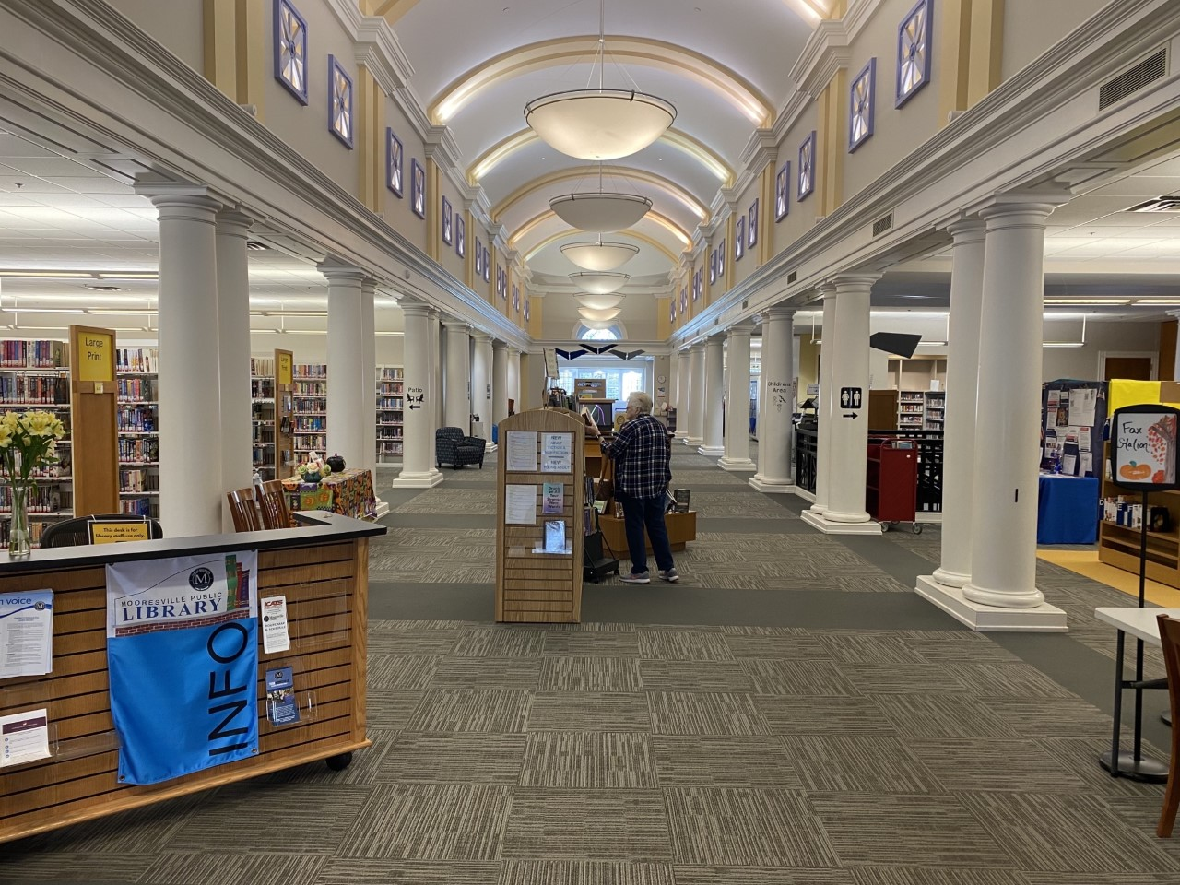
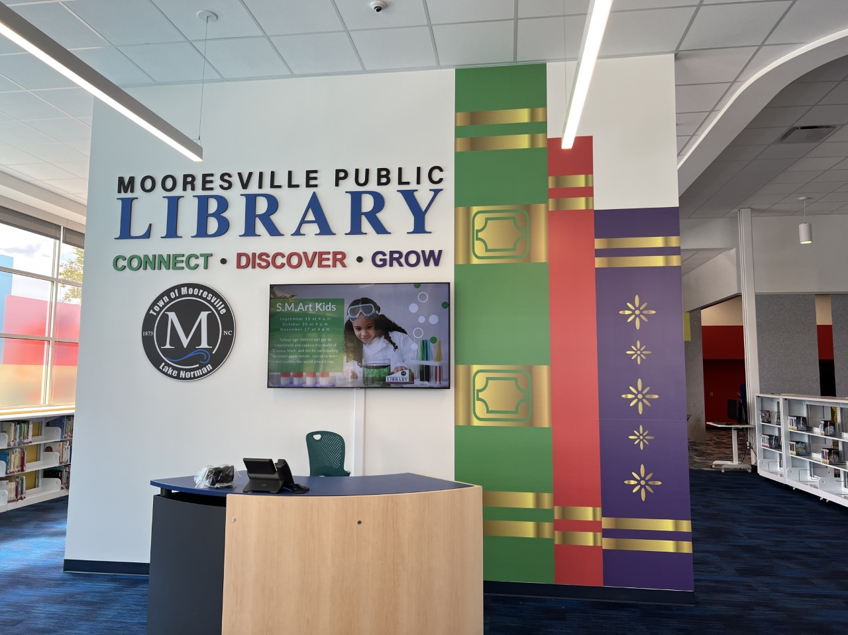
Library Access and Locations
Main Library 304 South Main Street | West Branch Library 614 Brawley School Road
Monday-Thursday 9 AM – 8:30 PM | Monday & Wednesday 9 AM – 8 PM Tuesday, Thursday, & Friday 9 AM – 5 PM
Friday – Saturday 9 AM – 5 PM | Saturday 9 AM – 3 PM
 | Self-Service Hours Tuesday & Thursday 5 PM – 8 PM Saturday 3 PM – 5 PM
Sunday Closed | Sunday Closed

Slide 3
Your Library Card
Free for:
People who live or own property in Iredell County
Partner Institutions
What to Bring:
Valid government issued photo ID (NC License, Military, Student, passport)
Proof of residence (NC License, tax records, mail)
Other Cards
Mooresville All Access Cards for students and staff in ISS, MGSD and participating private schools. Students and Staff use their school identification number to access online resources. Their PIN is the last four of their ID. They can also check out up to up to five items from a branch location.
Individuals who live outside Iredell County can pay $25/year for full access to library holdings.
Notes:
Similar to Iredell Public Library, all participants in the partner institutions as well as schools have a memorandum of understanding with Mooresville Public Library to send us basic information so that we can create access using their unique student or staff ID. An email is sent but we have found that it is often sent to spam.. Information is shared after the 10th day of school and we try to upload new students/staff quarterly. Our neighbors at the IB school make excellent use of their cards but we would like to see more use. If there is anyway you could help us get the word out that students and staff already have access to resources, we would greatly appreciate it.

Slide 4
Connect, Discover and Grow
What might you expect?
Computers
Open Wi-fi
Auto Renew Material
Fine Free Checkout
Printers/Copiers/Faxes
Business and Research Databases
Free Online Classes
Study Rooms
Test Proctoring
What might you not expect?
Access to genealogical records
Access to foreign language instruction
Classes on grant writing
Programs on aging and parenting
Borrow books from libraries across the country
One on one virtual or in person help with new personal devices
Volunteer opportunities
Things that happen in the Library that might surprise you.
Virtual job interviews
Employee Recruitment
Tutoring, Tutoring, Tutoring
Speech therapist meet clients
Special needs assessment
Family counseling
Print from a phone
Receive faxes
Books on Wheels
Notes:
A couple of stories:
Our interlibrary loan staff was able to locate and receive a scanned copy of a patron;s thesis from their university on the west coast
One of our Library volunteers received recognition from the Governors office at a recent Uited Way function for Iredell County
Like Meals on Wheels we use volunteers to deliver books to shut ins and library users living in nursing homes
Caribou Coffee recently conducted all their job interviews at the main library

Slide 5
24/7 Access to your favorite things on computer or app mooresvillelibrary.org
Notes:
These are some of our online services. Most popular are Libby & Hoopla: Our two primary resources for free e-books, audiobooks, music, and movies.
We have a Library App. Go to your google or apple store and type in Mooresville Public Library and look for our logo. There is a Mooresville Indiana so be sure and get us! You can link your library card or the student/staff ID to the app.

Slide 6
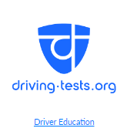
Online Resources for Students of All Ages
Notes:
Transparent Language can help you learn basic phrases, or you can achieve complete language immersion . More than just a language course, Transparent Language Online contains full courses and dozens of resources, while also providing extensive reference information, vocabulary building, relevant culture learning, and guidance for learning over 110 languages (including English).
Driving-Tests.org prepares you for your driver's license test in a fun easy and interactive platform. With their comprehensive resources, including permit tests, DMV driving tests, and permit practice tests, it helps you succeed whether you're preparing for your first drivers test or looking to brush up on your skills. It also has practice CDL, and motorcycle practice tests.

Slide 7
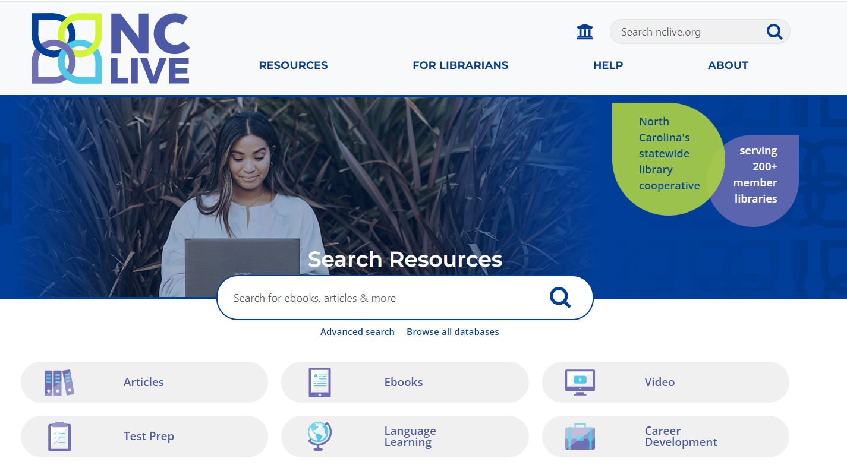
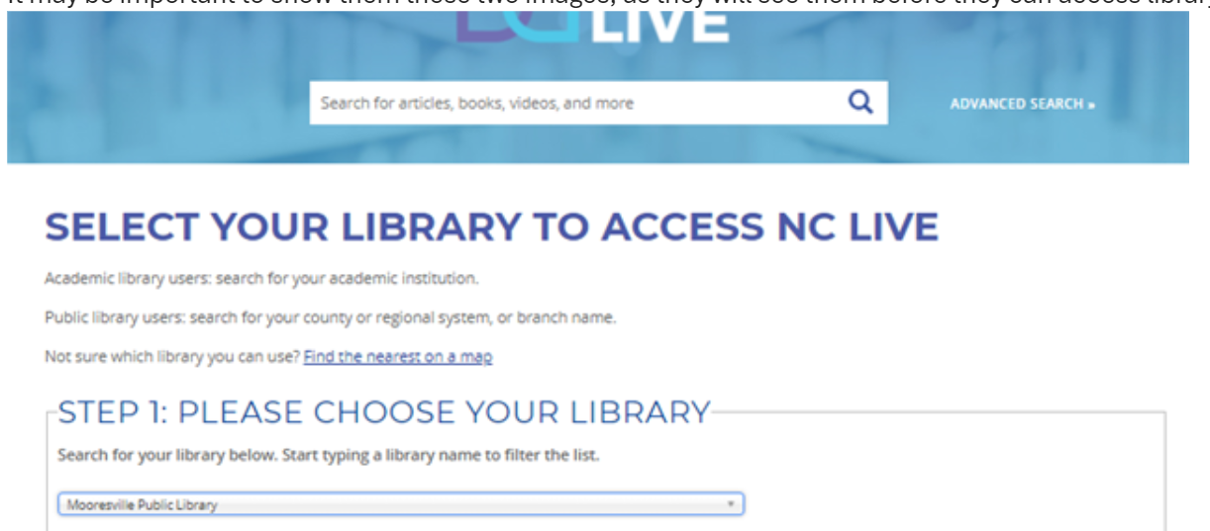
The Ultimate Resource
Notes:
NC LIVE It provides high quality, electronic resources to 200+ public and academic libraries across North Carolina. Resources
include: E-books, audiobooks, videos, magazines, newspapers, journals, language-learning tools, peer-reviewed articles, and other online materials.
Many of the individual resources I am going to share come from NC Live.

Slide 8
Resources for Grade 4+ Teachers and Test Preparation
Notes:
Gale Courses offers a wide range of highly interactive, instructor-led courses online. Everything from Introduction to personal finance to QuickBooks is offered and for free.. Gale courses use online facilitators to monitor progress along with assessments which must be passed to move onto the next lesson. Students usually have 6 weeks to finish a course. We have used it for new supervisors, customer service training and Microsoft office suite training.
Learning Express: Test, college, and career prep for 4th grade and up as well as for educators. Tests include SAT, ACT, PSAT, GED, Postal Service, ASVAB, and many more.

Slide 9
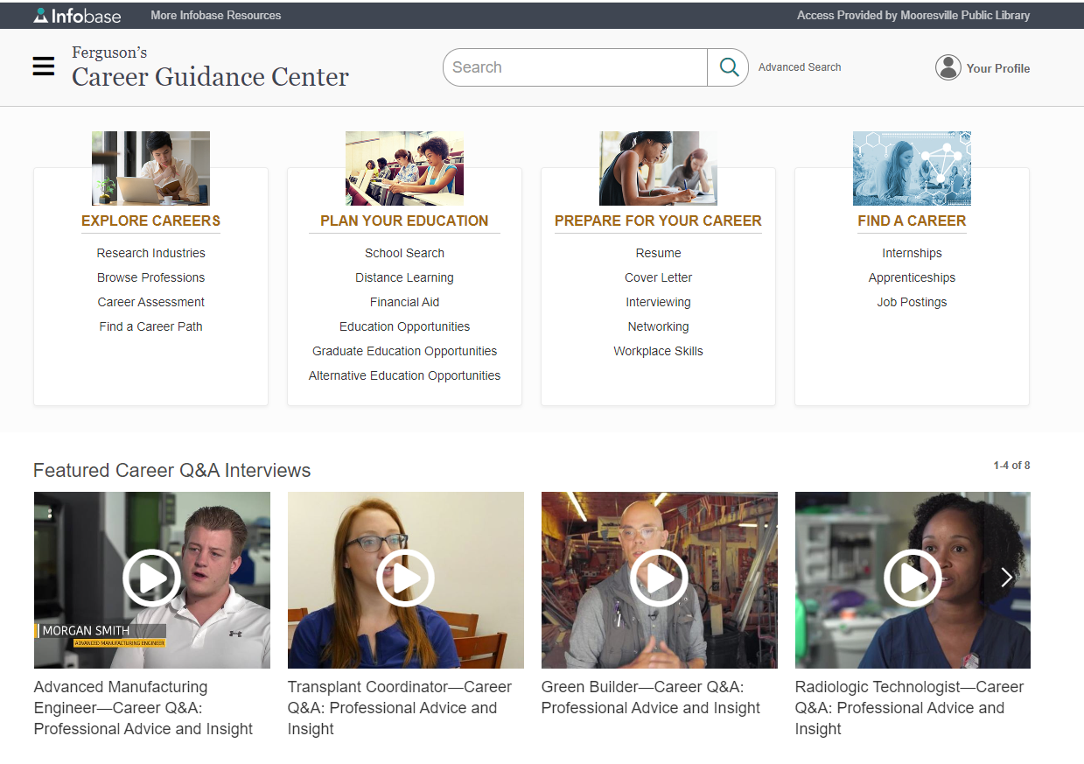
Career Information links on our Online Resources Tab
Notes:
Two resources students and adults can use to ask the what if questions are linked under our website’s online resources.
Ferguson’s offer tips for writing resumes, cover letters, interviewing and workplace skills. It also includes overviews of what a careers are available in specific fields.

Slide 10
Resources for K-6 Teachers, Parents and Students
Notes:
Tumble Books provides titles for grades K-6, including animated, talking picture books, read-along chapter books, nonfiction books and videos, curated playlists, and books in Spanish and French. These titles are available to multiple users simultaneously.
Tumble Math has the most comprehensive collection of math stories available to multiple users and if in the same format as Tumblebooks.
NCKids Digital Library is a resource for free children’s e-books, audiobooks, music, and movies. Multiple users can access the same item a whole class or school using their student/staff ID. At home students can access it through their school ID or their regular llibrary card. In Libby and Sora you can access these titles separately from the North Carolina Digital Library collection. Funded provided through the State Legislature and the NC Public Library Directors Association.
Just for Kids: Access Video through NC Live provides a thoroughly kid-safe, advertisement-free media platform that staff can use and students can explore and enjoy. The collection is ideal for classroom downtime or after-school or ESL/ELL programs to use as homework help for students that they can access anywhere, anytime. Like NCKids and Tumblebooks the platform allows multiple users to simultaneously access the same title.

Slide 11
Lexile and Accelerated Reading Levels with Novel List Plus
Notes:
NoveList +:A readers’ advisory resource that uses appeal factors and expert reviews to offer read-alike and listen-alike recommendations for fiction, nonfiction, and audiobooks. Similar to Good Reads it make recommendations based on titles or authors you have liked or read. But its more than that. You can find the Lexile or Accelerated Reading levels with this tool on our Library Catalog. Novel List Plus includes the option to search by Lexile or AR reader. Click on the recommended titles to see if MPL already owns it.

Slide 12
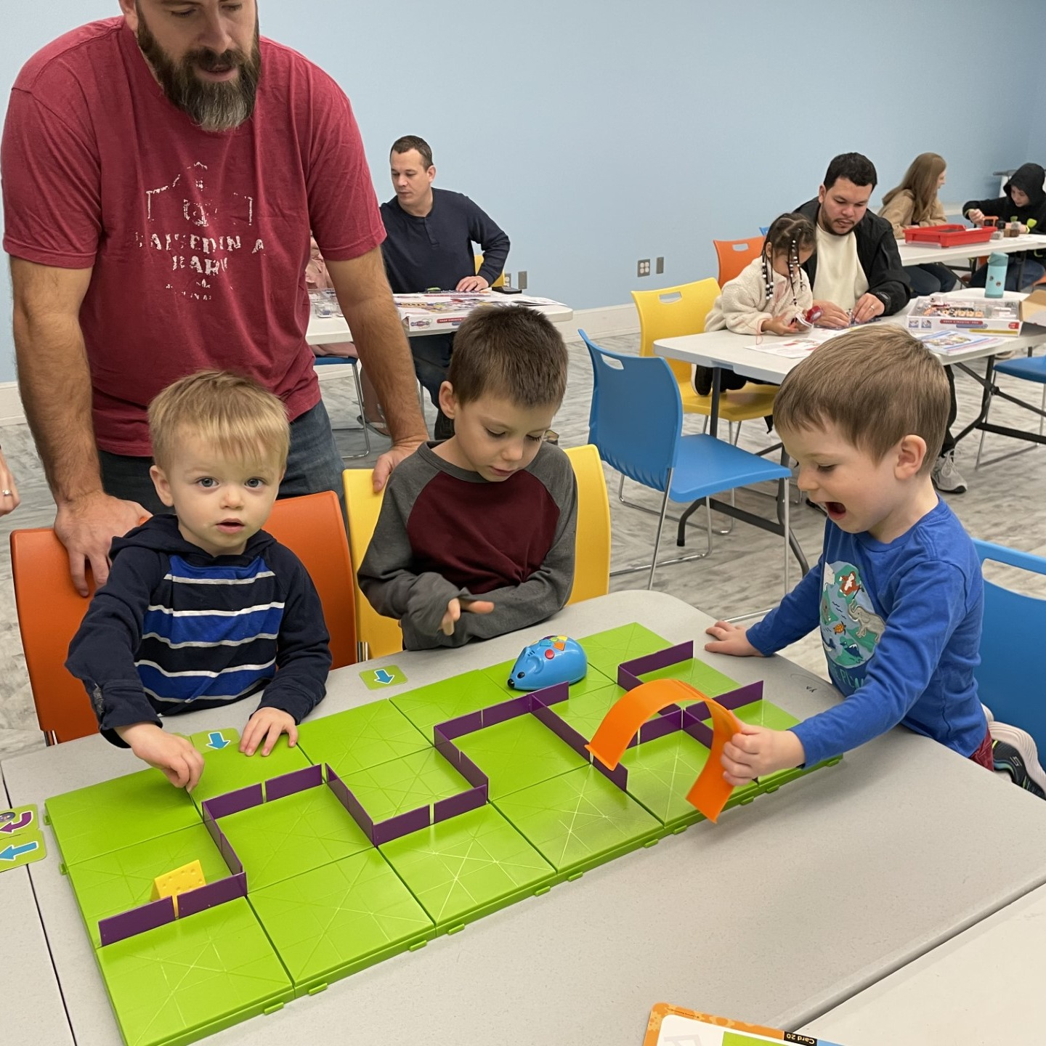
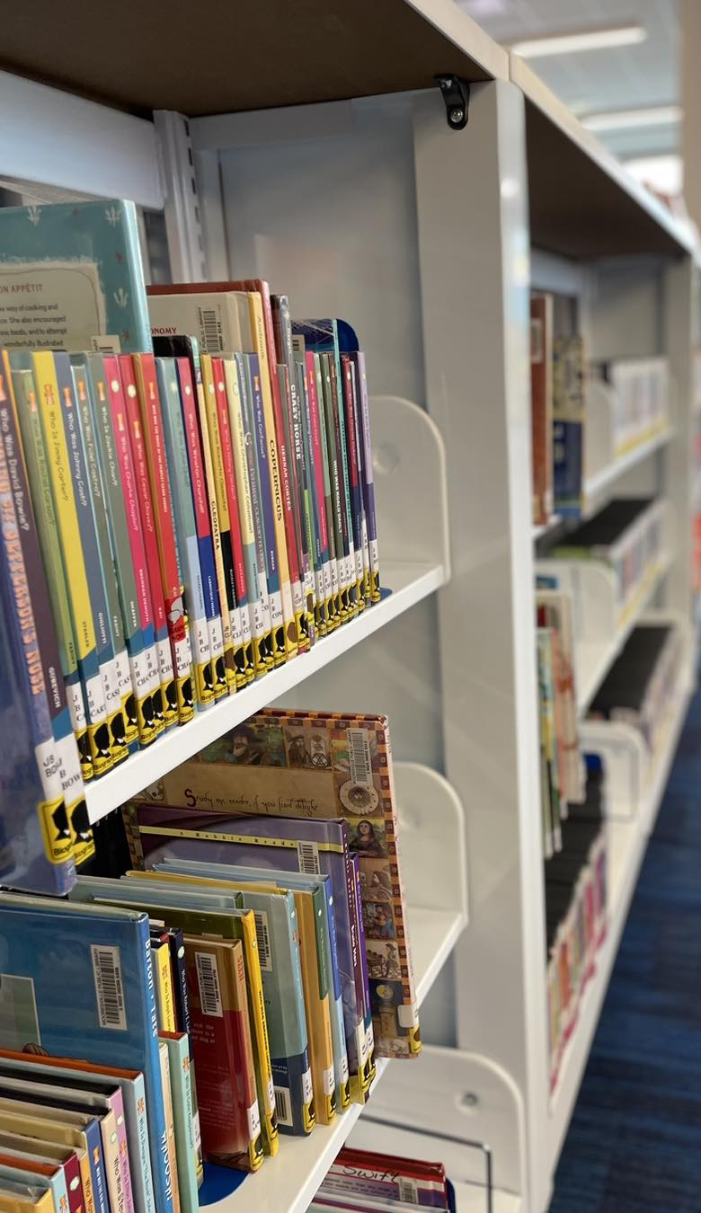
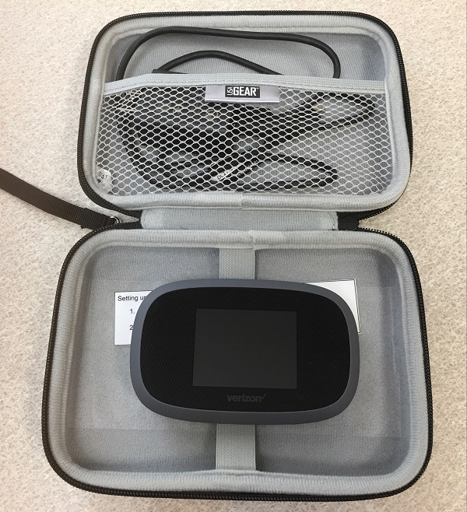
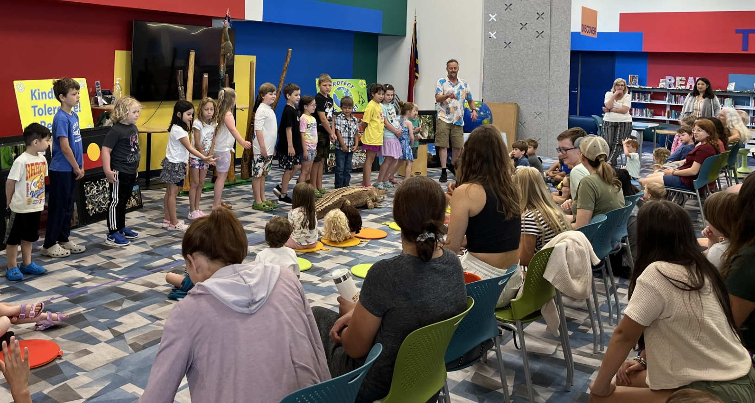
Programs, hotspots, books and other things
Notes:
We have121,770 circulating items as of July 29 with a multitude more resources online through consortiums and subscriptions.
For the FY ending June 30th MPL offered 1,143 programs with a total attendance of 42,331.
Door count/library visits approximately 186,700
Per capita physical visits using Mooresville City limits are 3.5
Per capita physical visits using an estimate of 90,000 people for Southern Iredell is 2

Slide 13
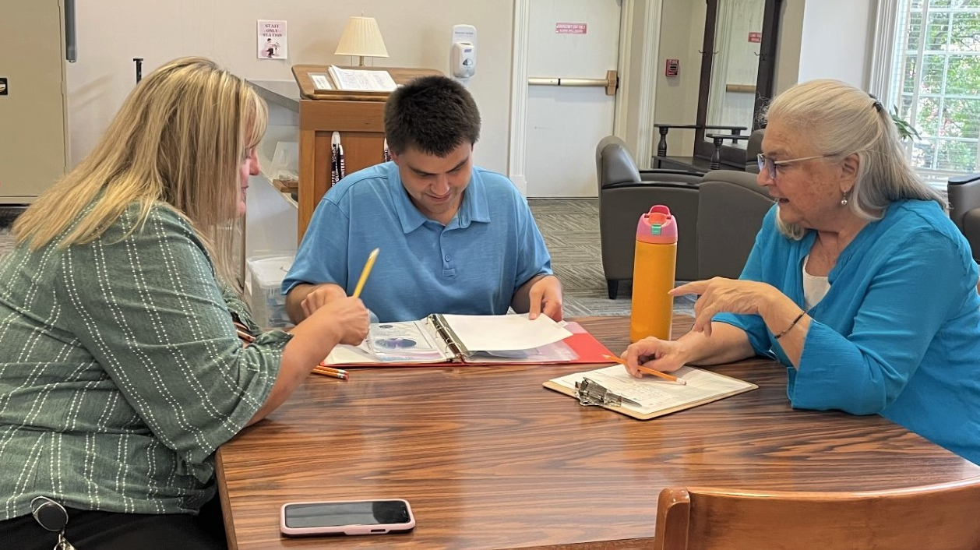
Collaborative and Quiet Space
Notes:
We want to be a gathering place and encourage collaborative and single use space. People are welcome to bring their coffee or covered drink to work together, alone or just hang out. We love our regulars, and we always love meeting new faces. Any questions?

