Slide 2
ABOUT CART
Founded in 1995 by Roger Ackerman (Rotary Club of Sumter, SC in District 7770)
501(c)3 non-profit organization registered in state of SC
Has its own Board of Directors
NOT A ROTARY INTERNATIONAL PARTNER
Can be a District or Club partner
Supported by more than 500 Rotary Clubs & 31 Rotary Districts in 2022-23

Slide 3
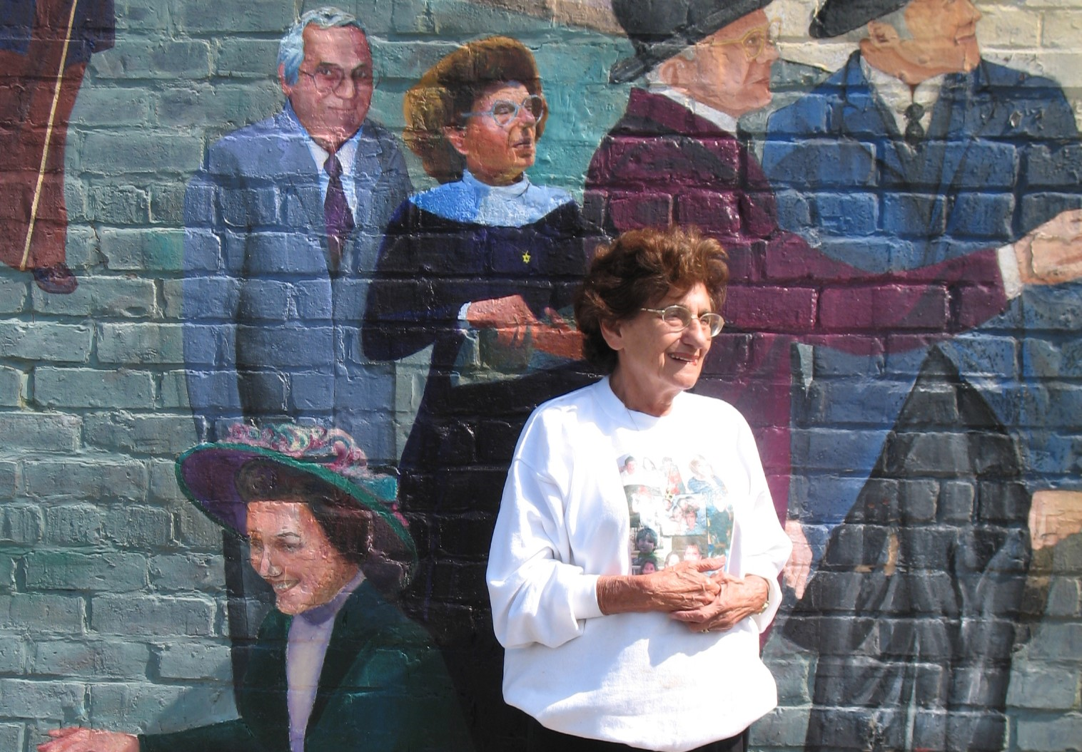
Alzheimers is personal
My mom, Rose Post
Age 81

Slide 4
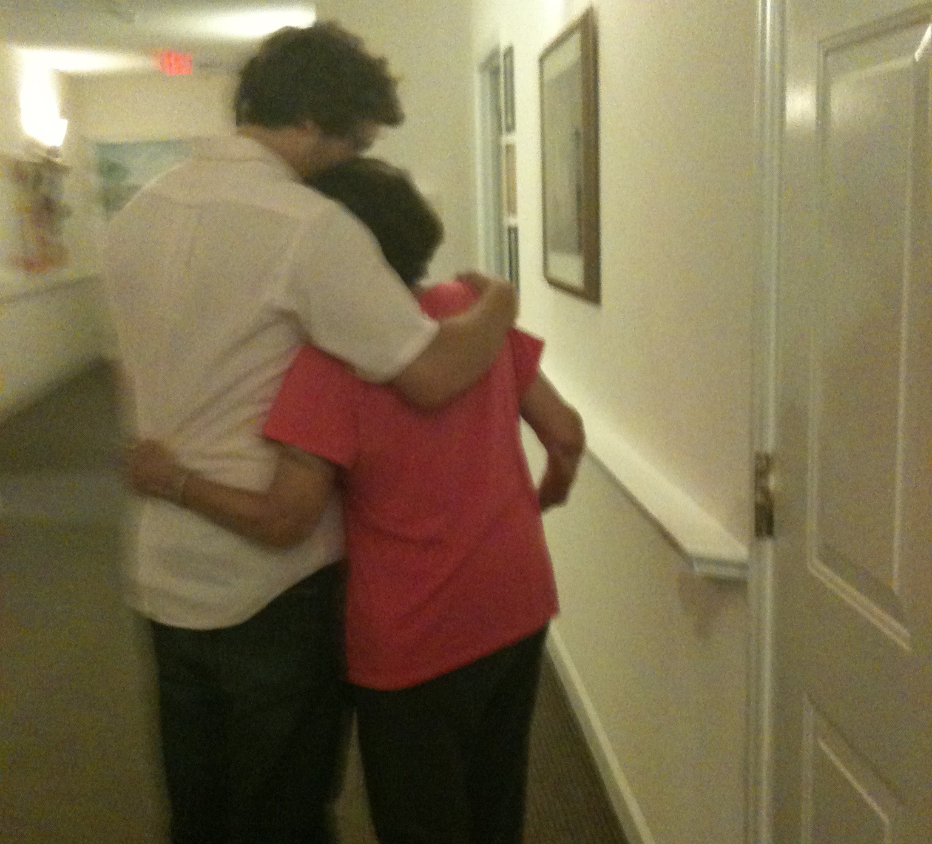
Alzheimers is personal
My mom, Rose Post
Age 84

Slide 5
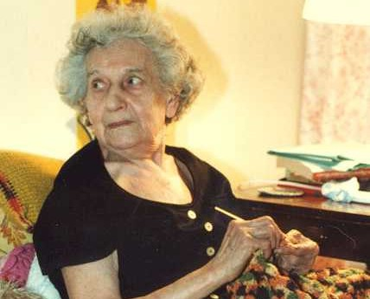
Alzheimers is personal
My grandmother
Anna Zimmerman
Age 89

Slide 6
Why Alzheimer’s
6th leading cause of death and is climbing as other diseases are finding better treatments and population ages
The number of people suffering with Alzheimer’s is expected to triple in next 30 years
Current treatment is limited.
Lots of drugs are beginning to offer some help, but none are curing the disease.
Research is seeking new therapeutic targets

Slide 7
WHAT CART DOES
100% of donations designated to research
Since 1999
Awarded $11.6 million
66 different cutting-edge seed grants
Institutions in the US
Selected by a Scientific Review Panel

Slide 8
WHERE CART IS
Mostly East Coast (Rotary Zones 33 and 34)
500 clubs
31 Districts
Mission is to expand within Rotary and increase awareness beyond Rotary

Slide 9
GRANT HIGHLIGHTS
April 1999: First grant $100,000 to Dr. Allan Levey (Emory University)
July 2003: Contributions to CART exceeded
$1 million
May 2008: Multiple grants awarded for first time (2 totaling $450,000)
May 2019: Six grants awarded totaling $1 million for first time
May 2023: Total grants exceeded $11 million

Slide 10
WHAT RESEARCHERS SAY:
Dr. Todd Golde (Mayo Clinic): "CART funding was vital in getting an NIH grant for $2.5 million over five years.“
Dr. Gary Landreth (Case Western Reserve University) provided research findings on a then-novel class of drugs originally developed for the treatment of diabetes.
“The CART funds were absolutely critical to our success, as they allowed us to pursue experiments investigating the mechanism of drug action, for which we had no other means of financial support.”

Slide 11
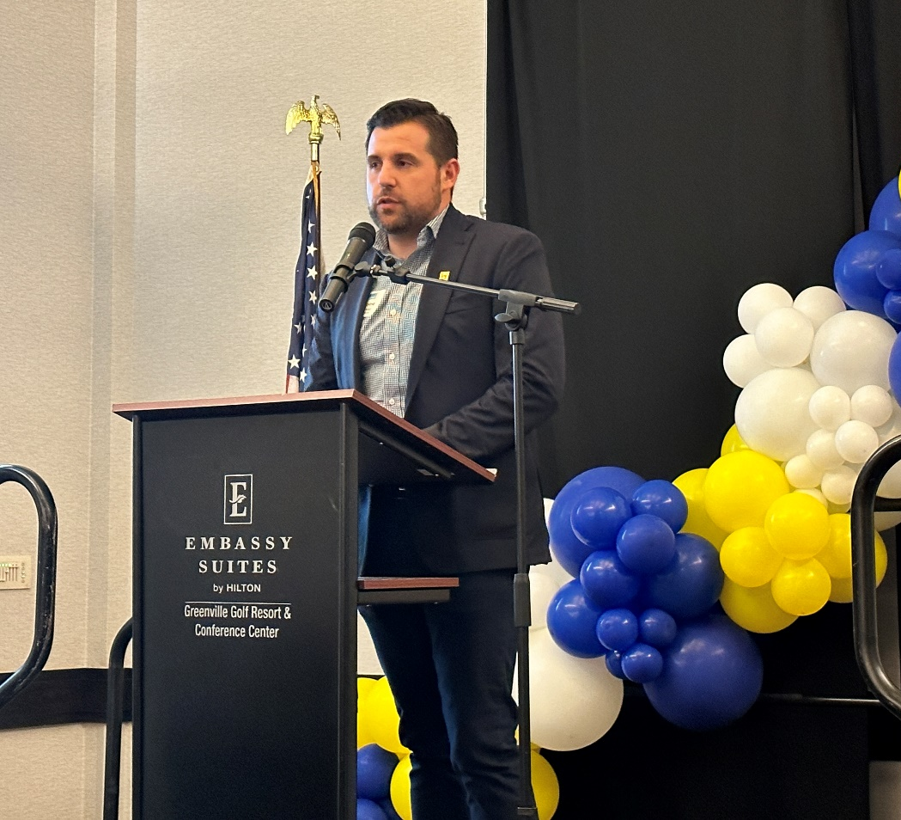
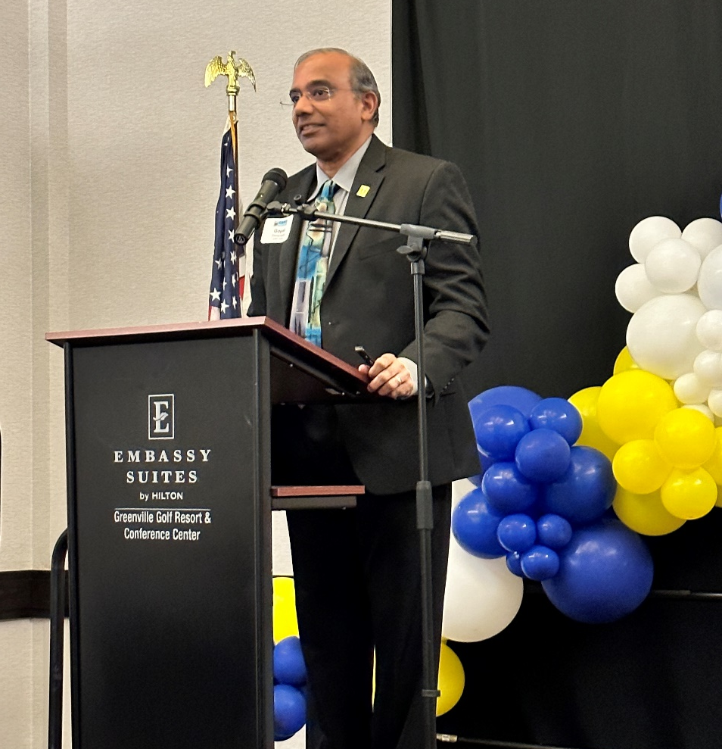
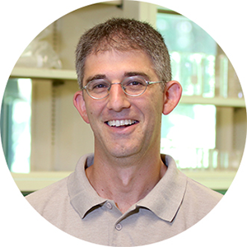
2023 Grant Recipients
$300,000
Antoine Louveau, PhD (Cleveland Clinic)
Studying the Role of Vascular Function in Alzheimer’s Disease
$250,000
Gopal Thinakaran, PhD University of South Florida)
Studying Epitranscriptomic Modulation of Tau Pathology Through M6a RNA Methylation
$250,000
Paul Greer, PhD (University of Massachusetts)
Development of Small Inhibitory RNA Approaches for the Treatment of Alzheimer’s Disease

Slide 12
Mice? Why?
Human (and mice) genome has about 20-30,000 genes
Relatively small number of genes (20 or so) that mutate that affect the likelihood of causing Alzheimer’s
These scientists can remove or alter one gene at a time to explore what happens
(All I can really understand is the pictures.)

Slide 13
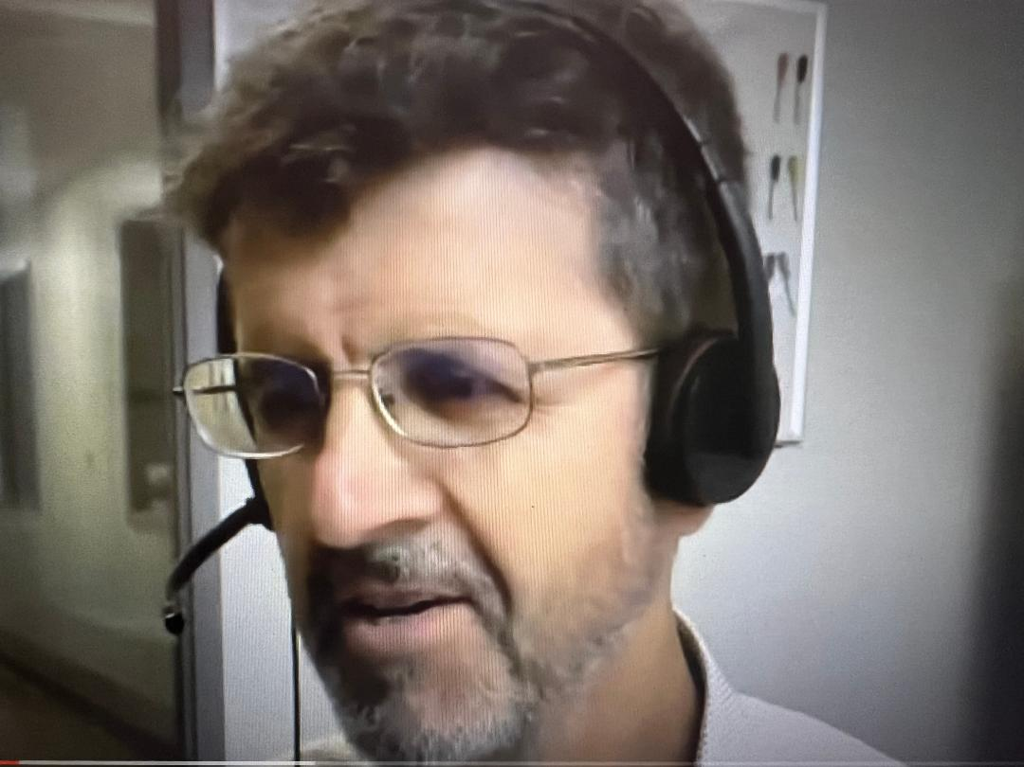
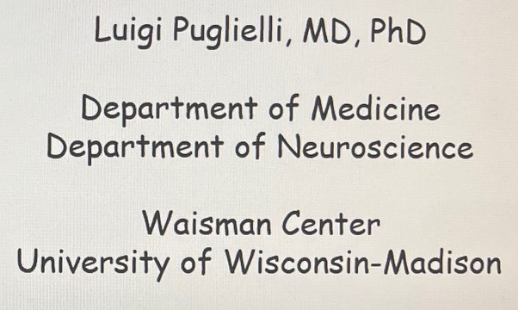
One of CART’s Heroes

Slide 14
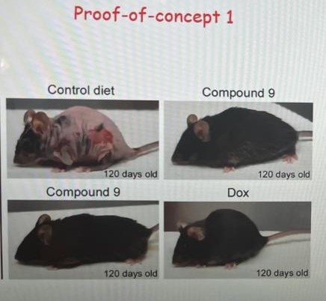
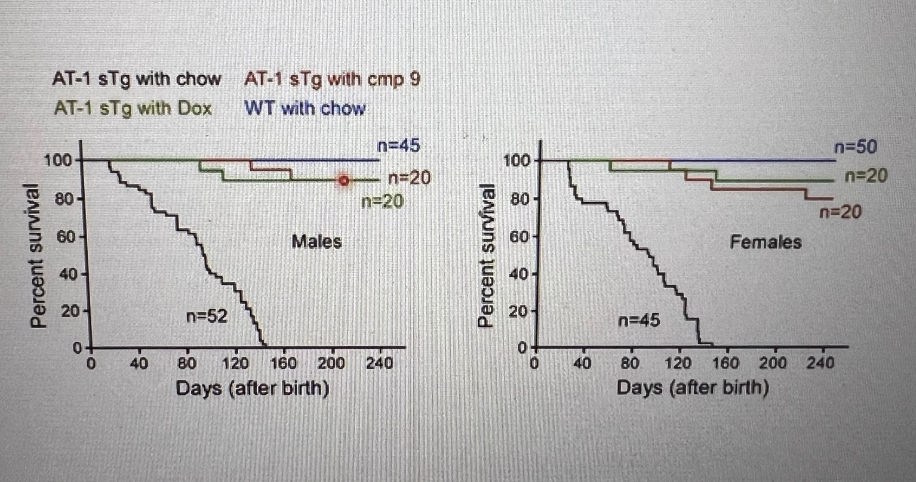
Example of Research Results
On “mother’s milk” for 2 months.
The diet is controlled in the lab
If compound not used, mice die in about 4 months.
If compound is added to diet, mice live a normal life span

Slide 15
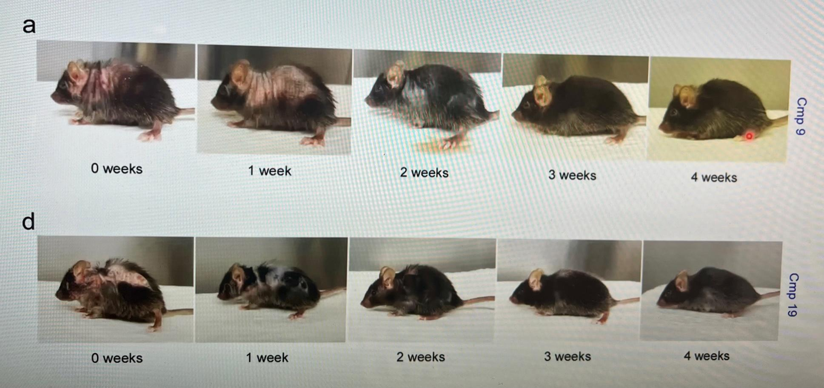
Example of Research Results
Two mice, 2 months old, and obviously very sick.
Within 4 weeks, dramatic change when given a test compound.
Scientifically, this is a very “quick read.”

Slide 16
To see more:
If you want to watch these presentations ….
CART has a channel on YouTube
https://www.youtube.com/@cartfund

Slide 17
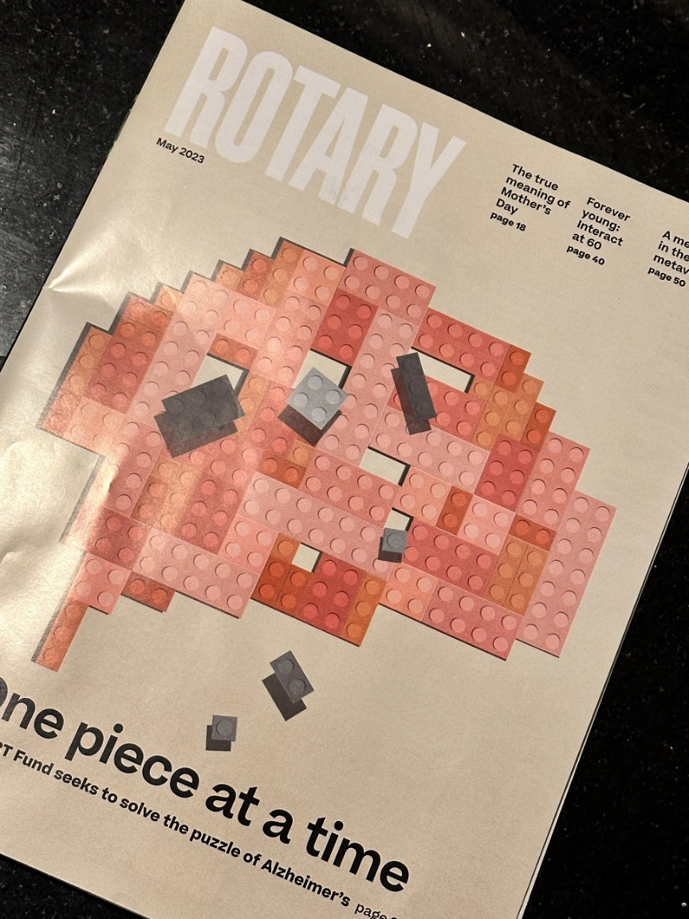
Cover of Rotary Magazine
(May 2023)
Largest gift to CART - $1 Million Dollars from Rotarian in NC
Record fundraising exceeded $2 million dollars in 2022-23

Slide 18
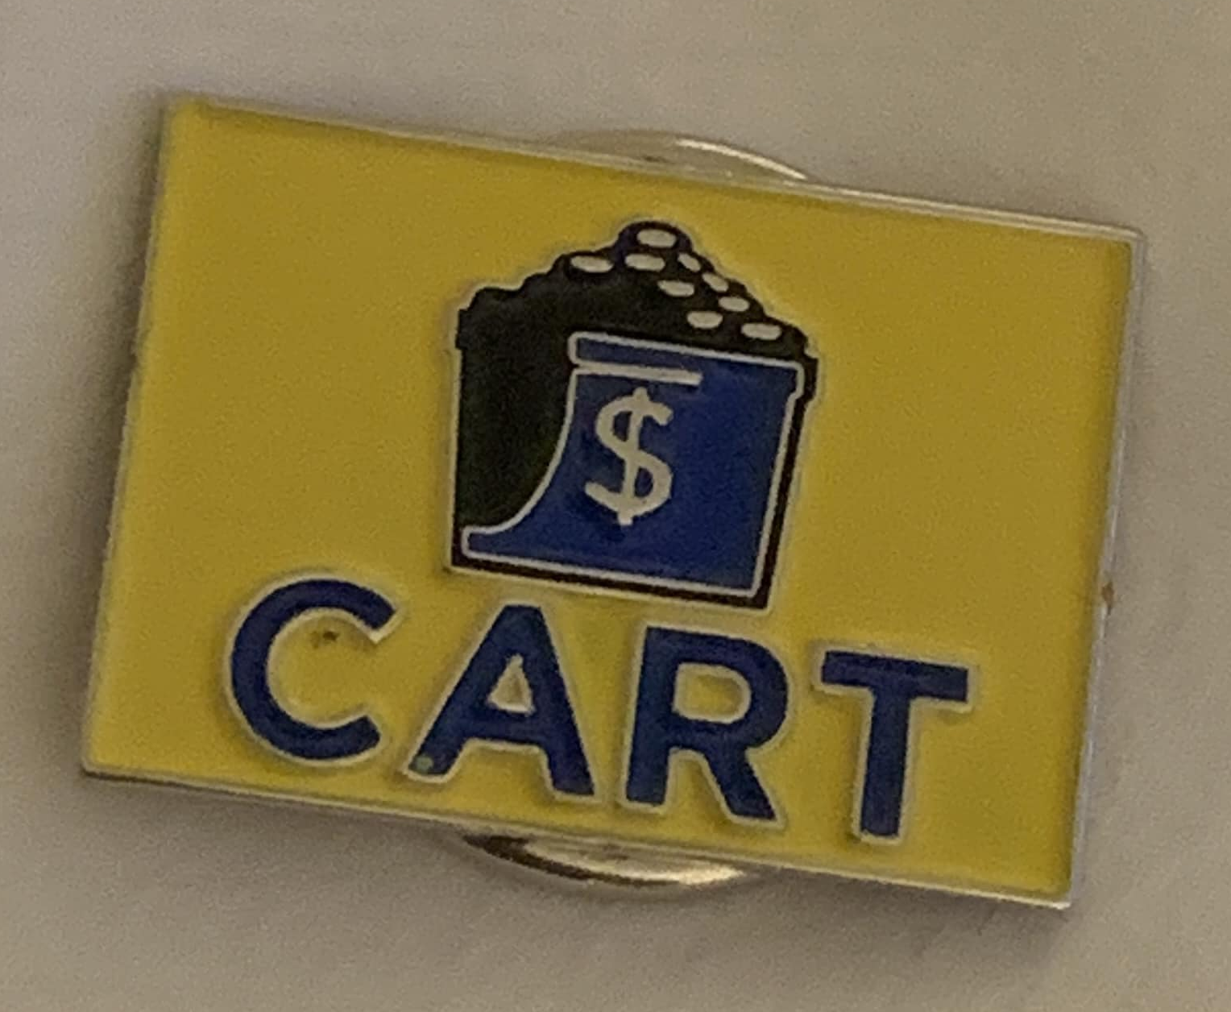
Expand the recurring giving program
“Roger Ackerman Circle”
(limited edition lapel pin)
Planned giving opportunities
Sponsorship opportunities for TRAC

Slide 19
Salisbury Rotary Approach
CART Chair and co-chair
We ask at every meeting
Regular reports
Weekly “match” by a volunteer

Slide 20
ABOUT CART
Online donor portal (www.mycartfund.org)
For individuals, Rotary Clubs & Districts (DacDB login)
TRAC – A supporting non-profit that operates CART
Raises funds separately
So 100% of CART goes to research
New website & branding/collateral materials (www.cartfund.org)

Slide 21
FIND US ONLINE!
@CARTFUND
@CARTFUND
@CARTFUND
.CARTFUND.ORG

