Slide 1
ENERGY UPDATE
ROTARY PRESENTATION-FOCUS ON NATURAL GAS

Slide 2
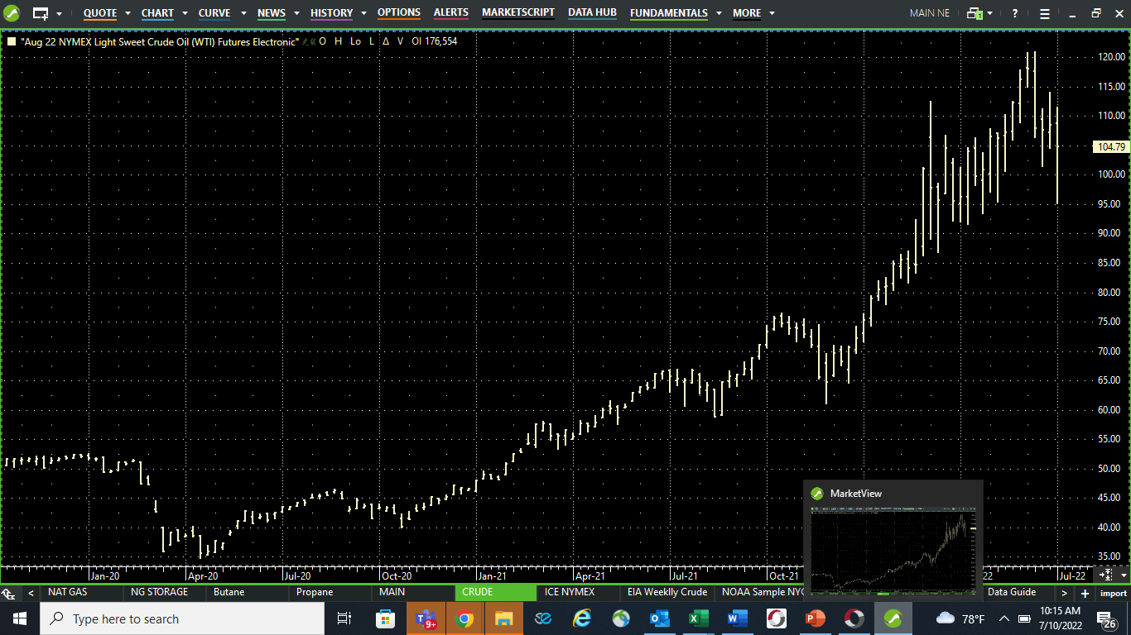

Slide 3
CRUDE TO GASOLINE-THE BASICS (ESTIMATED AMOUNTS)
COST OF BARRELL OF CRUDE $104
COST PER GALLON OF CRUDE (42 GAL) $2.47
COST TO TRANSPORT CRUDE TO REFIN. $.10
COST TO “CRACK (CRUDE TO GAS) $.60
COST TO TRANSPORT GAS TO STORE $.20 (includes pipeline)
FEDERAL EXCISE TAX $.184
NORTH CAROLINA EXCISE TAX $.385
TOTAL COST TO RETAILER $3.94
COST TO CONSUMER $4.30 (TODAY)

Slide 4
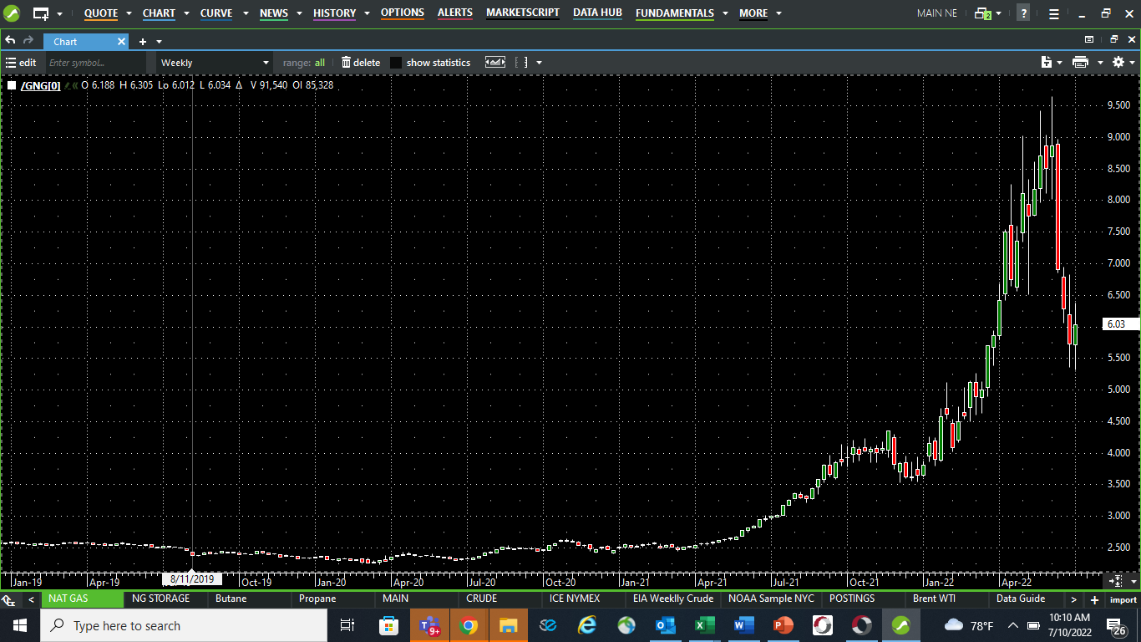

Slide 5
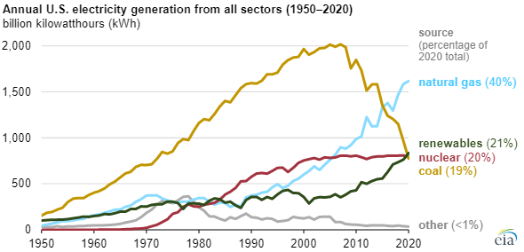

Slide 6
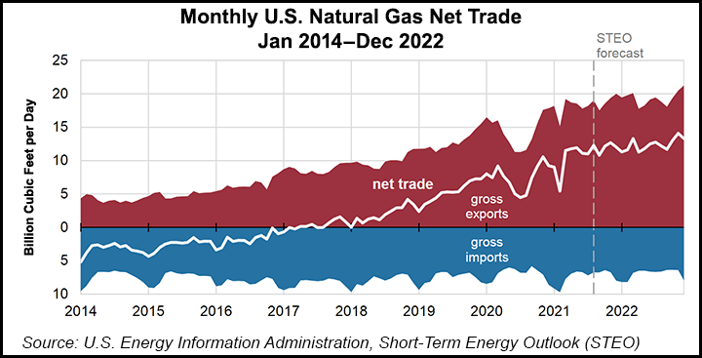

Slide 7
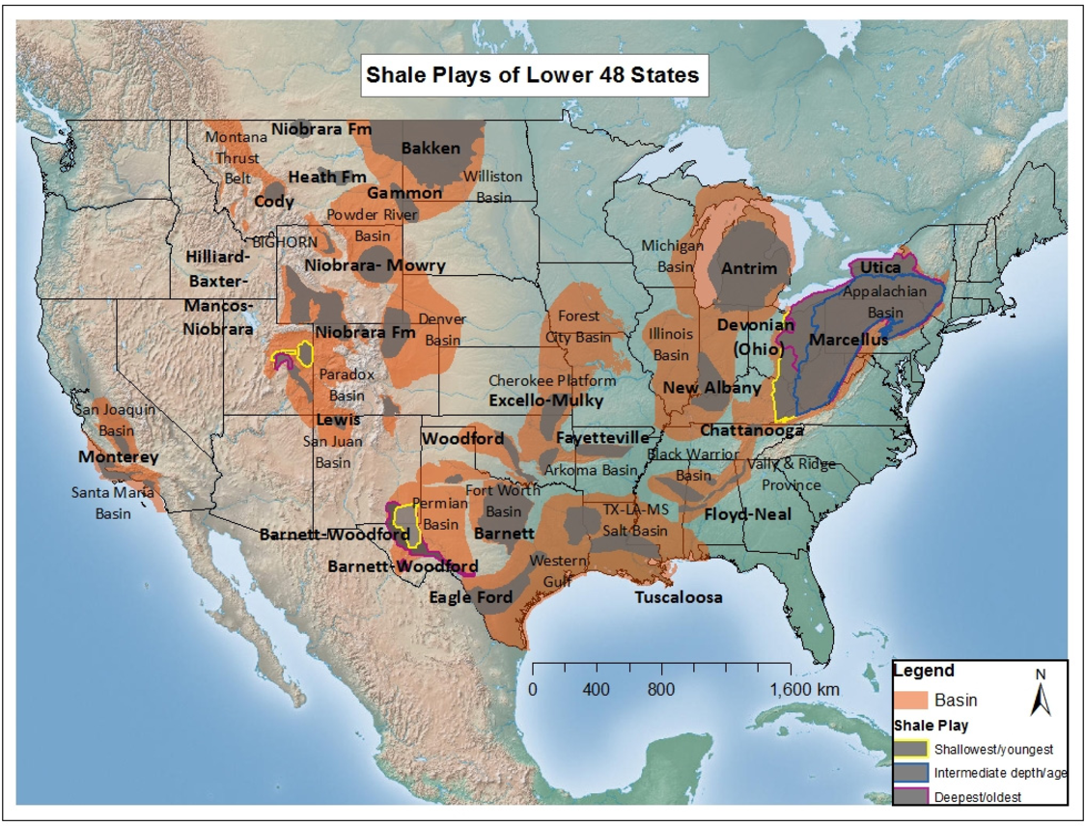

Slide 8
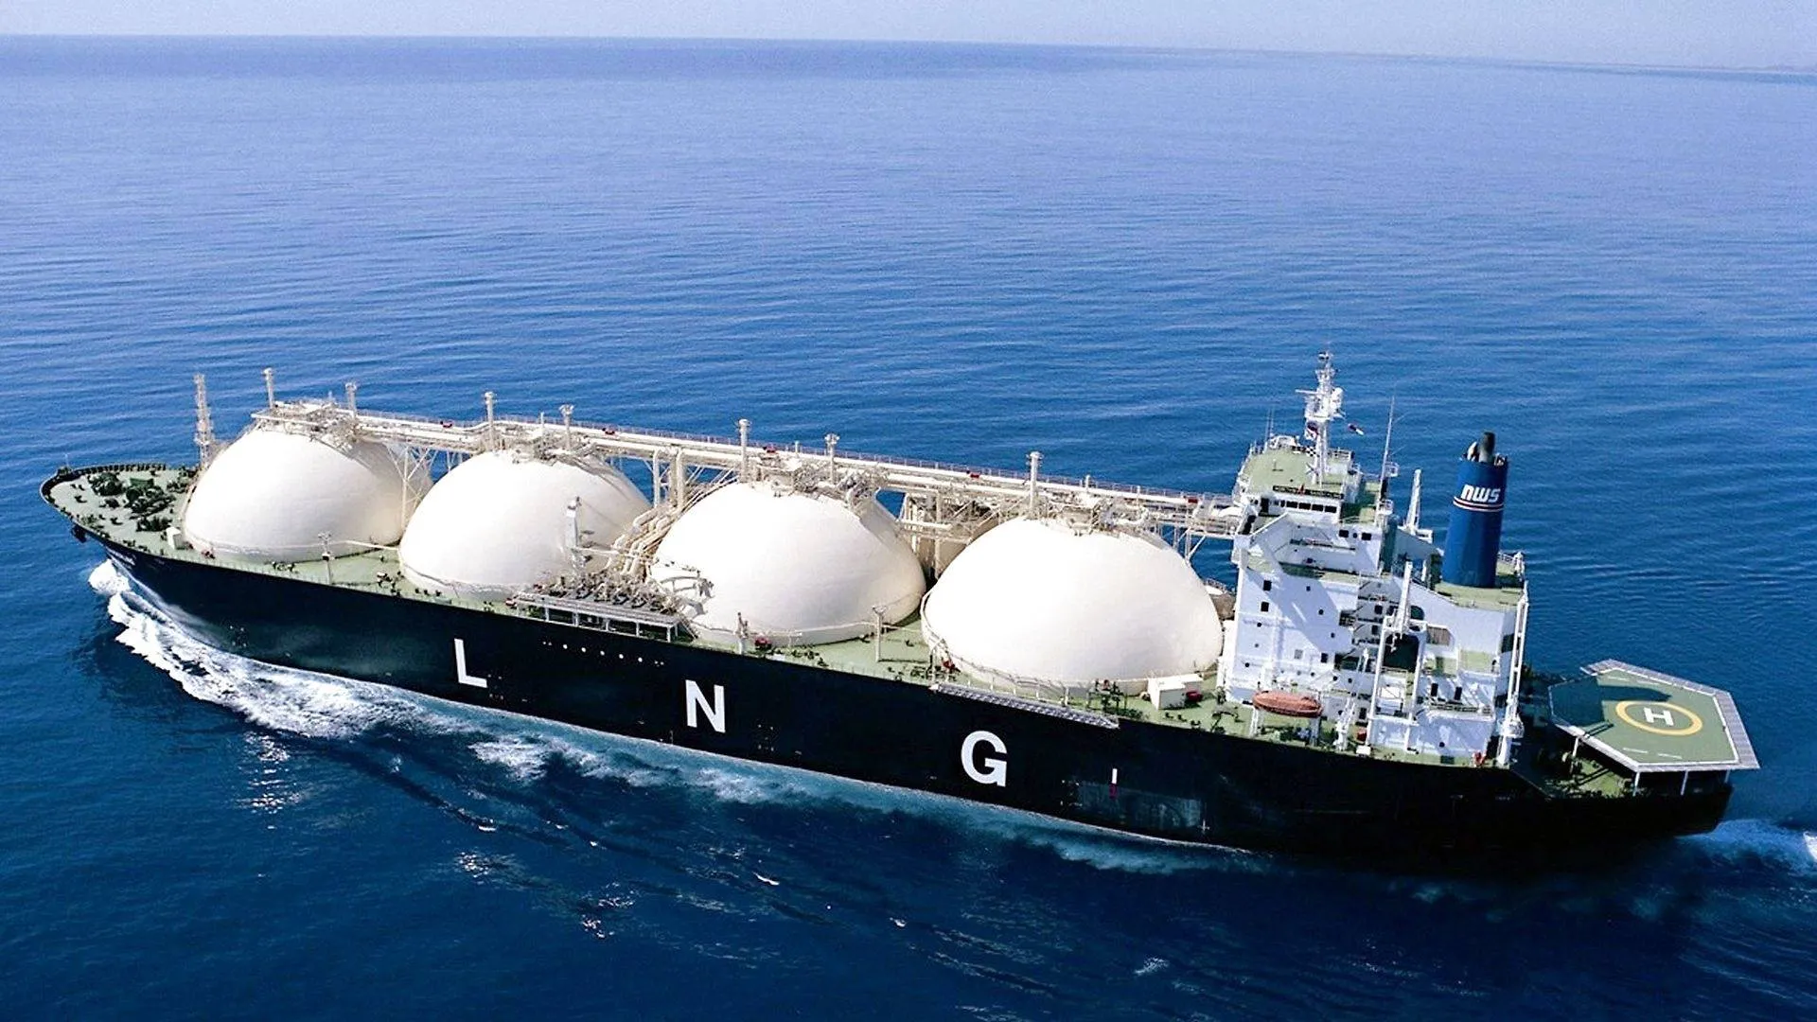

Slide 9
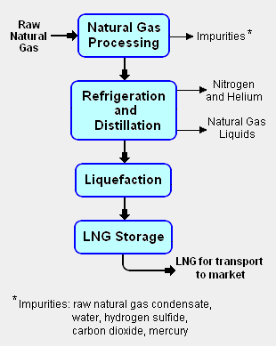

Slide 10
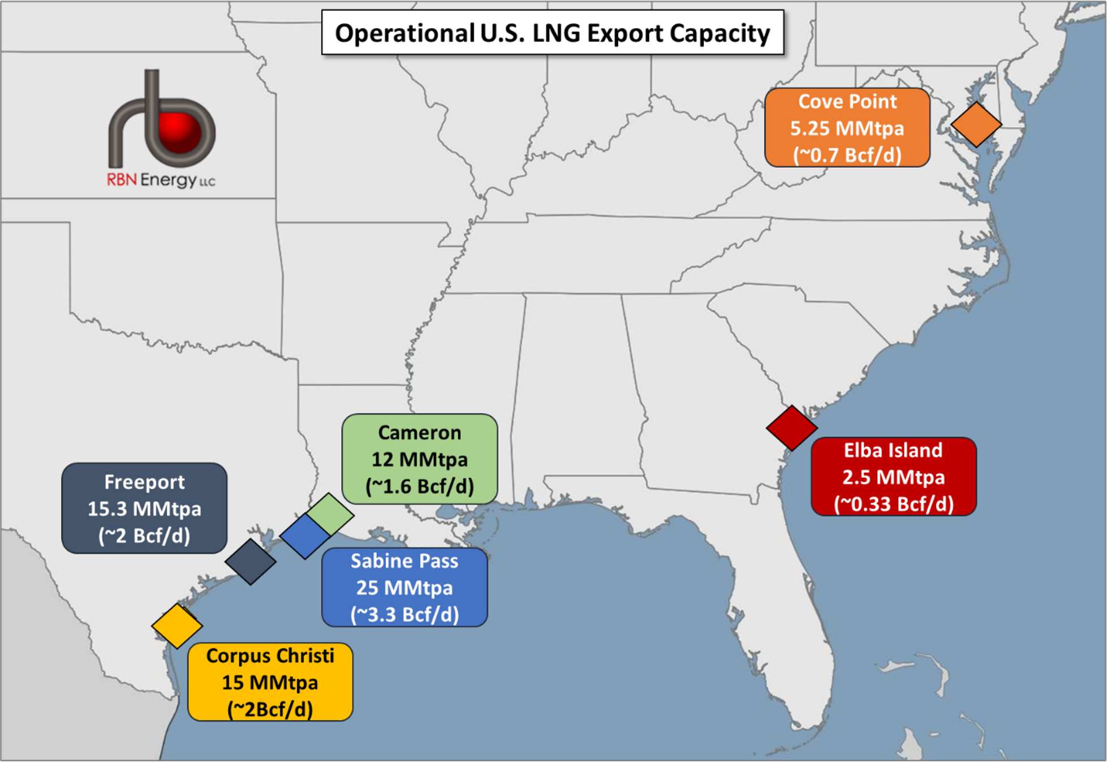

Slide 11
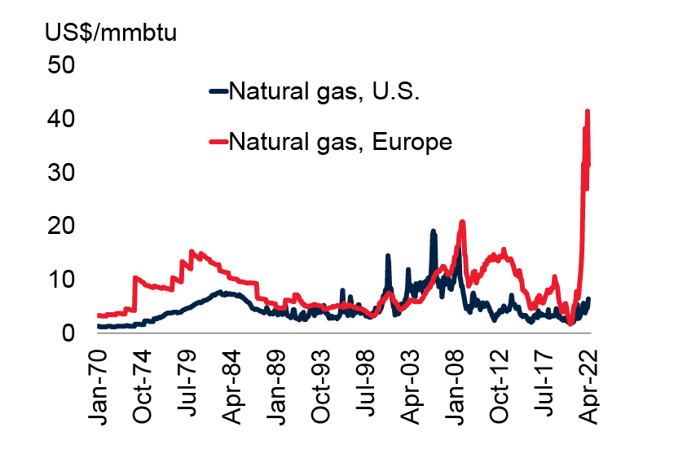

Slide 12
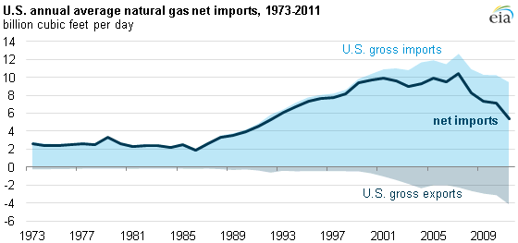

Slide 13
WHAT YOU CAN EXPECT
Already seeing higher gasoline prices at the pump
Electric bills this summer and winter will be higher than the past
Both price and energy consumption
Expect much higher natural gas prices this winter if markets stay where they are
Increased prices for plastics, fertilizers, and chemicals that use natural gas in their products, among many

