Slide 1
Lowe’s YMCA Top of the Lake Rotary March 20, 2025
https://youtu.be/TfcQw_baZCc?si=XkXdqHF7537E0ltP

Slide 3
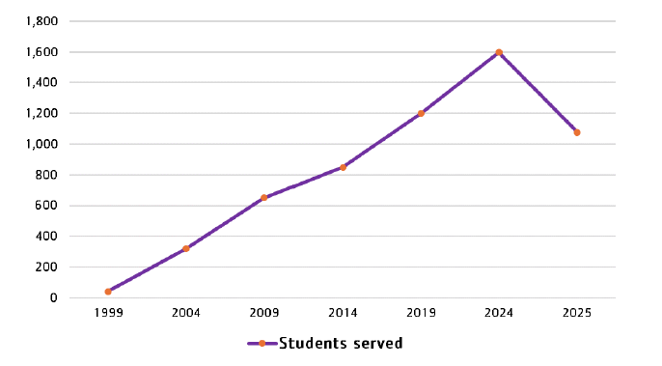

Slide 4
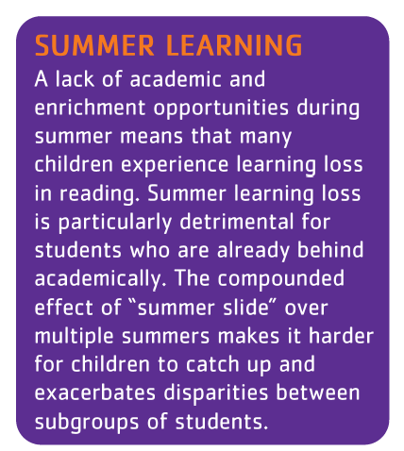
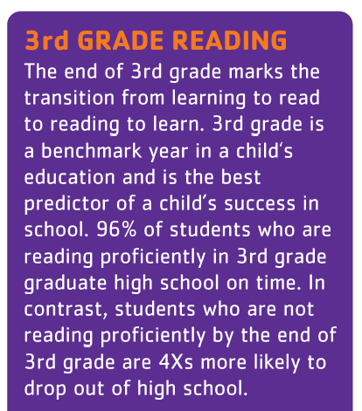
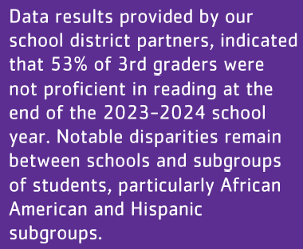

Slide 5
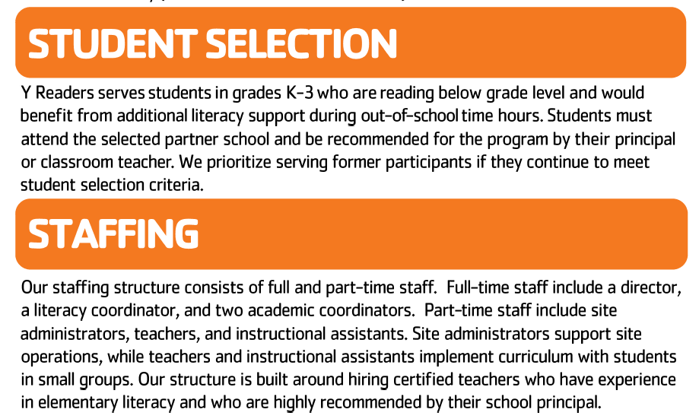

Slide 6
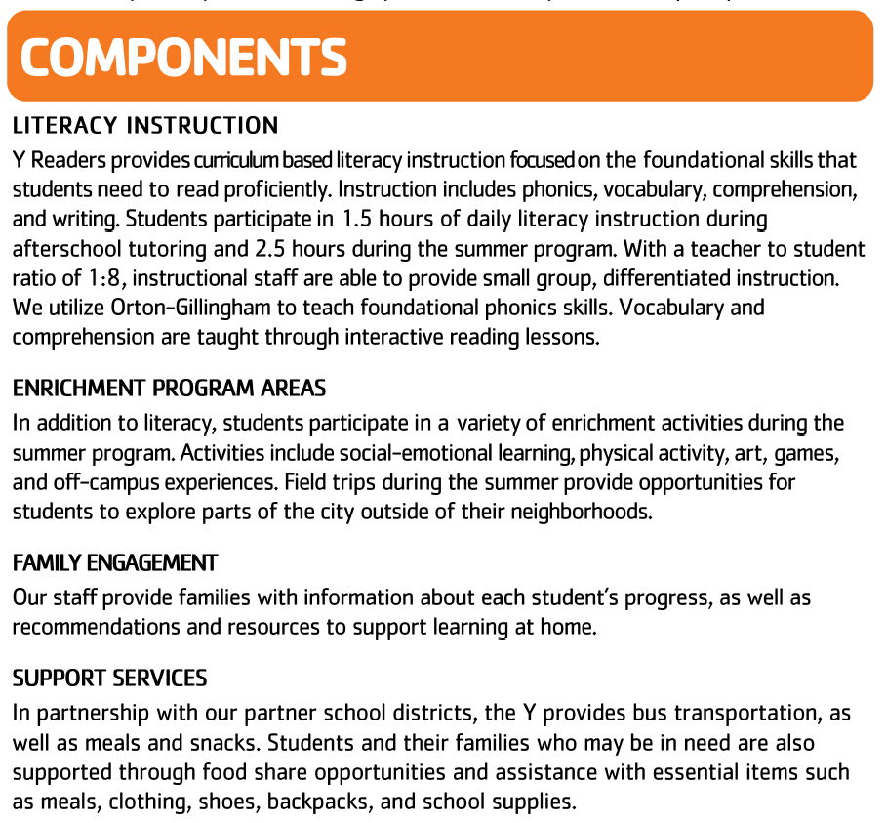

Slide 7
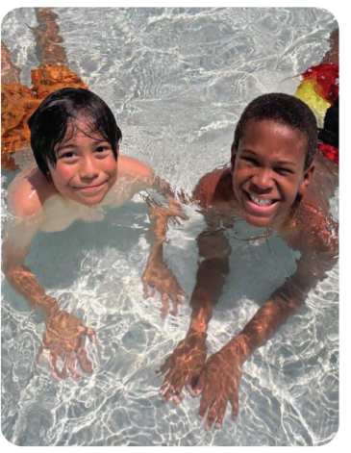
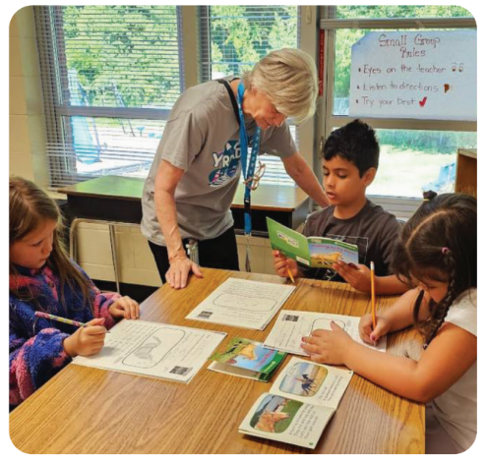
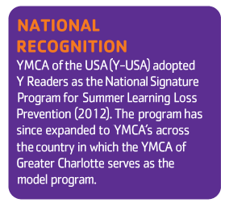

Slide 8
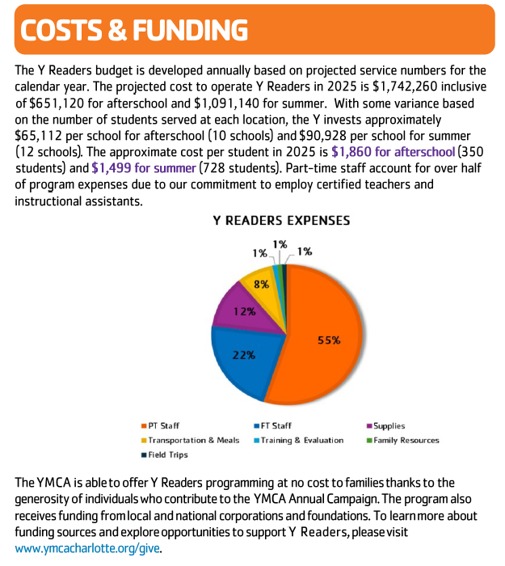

Slide 9
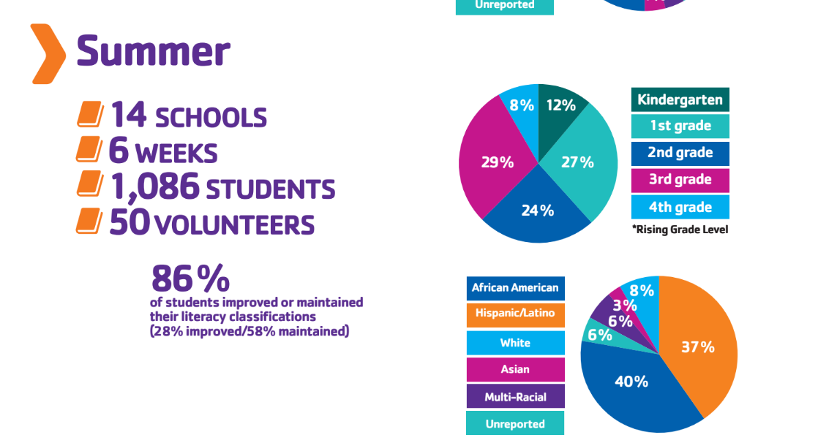
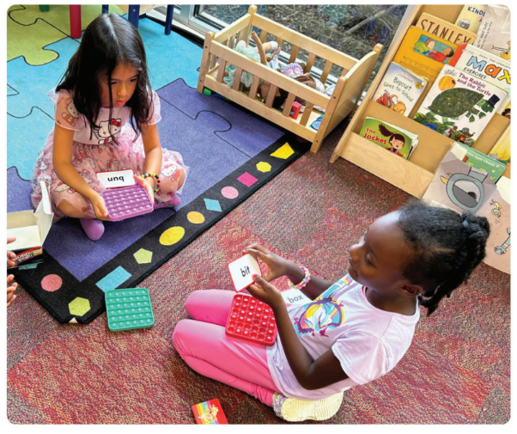

Slide 10
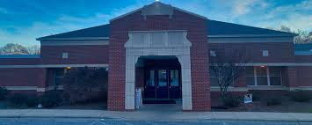
Park View Elementary School
217 W McNeely | Mooresville, NC 28115

Slide 11
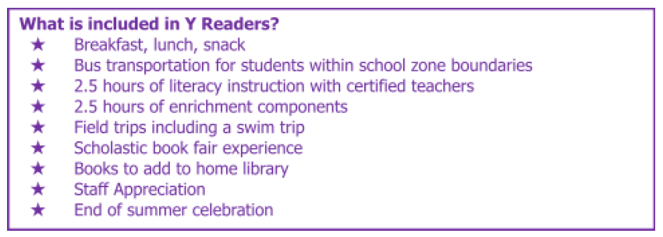
Dates: June 2 - July 10, 6 weeks
Hours: 8:00am - 3:00pm
Students: 64 students (2024 :: 44 Students)
Cost to serve: $1,499 per student : $95,936
Schedule:
8:00- 8:30a: Breakfast
8:30-11:30a: Literacy Instruction (including morning meeting & 2 brain breaks)
11:30-12:00p: Lunch
12:00-2:45p: Enrichment Program Areas (SEL, physical activity, art and diversity)
2:45-3:00p: Snack/Prepare for Dismissal
Staff:
1 Site Leader
4 Teachers
6 Instructional Assistants
2 Program Assistant
*1 teacher and 1 IA per class

Slide 12
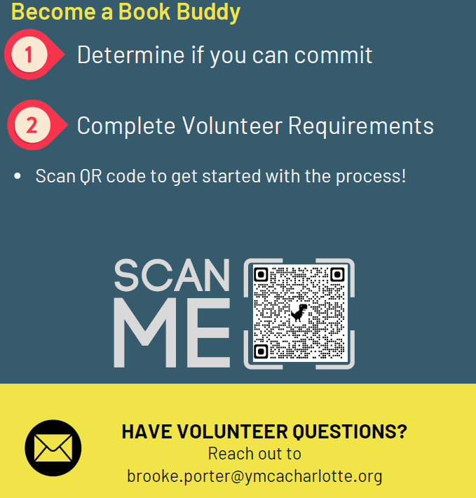
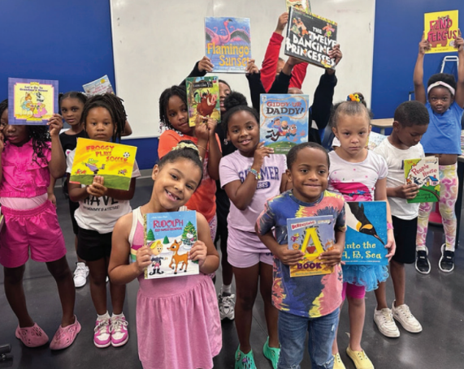

Slide 13
Y Readers Impact Story
I didn't know K prior to starting Summer school as she attended another elementary school within our district. When I first met her she seemed like she could be bubbly, work hard and benefit greatly from the program. However, she was very shy, didn't participate much and often didn't want to do a lot of the work required of the program. But after working with her slowly, gaining her trust and opening up she started to open up more, show more of her true self and found that she actually enjoyed the learning and experiences she would have with the Y Readers program. This program benefited K not only in growing academically but also nutritionally and through experiences. All of these have provided K the opportunity to learn and grow more wholly as a child and not experience the often Summer loss of not having a program like Y Readers. Thanks to Y Readers K is ready to start her next year in 2nd grade, more confident.

Slide 14
Y Readers Impact Story
C, a student who had just finished the first grade, has been such a special addition to our Y Readers program! After facing some rough times that no student should ever face throughout the school year, her academics suffered. Her classroom teacher made the recommendation for the Y Readers program and she was very apprehensive about coming. After a meeting with her anticipated Y Readers teacher and discussing all the fun that was in store, she became beyond excited and was counting down the days until the program began! While shy on the first day, she developed new friendships and became comfortable in her new classroom. Our writing block became her favorite time of the day where she felt as if she could tell any story she wanted to! She worked so hard each day to follow our CUPS writing checklist and demonstrate her new knowledge! Her determination and desire to improve was very evident within our classroom. Her success from the Y Readers program went way beyond academics, it built her confidence and taught her to believe in her own abilities. In addition, Y Readers create a safe space for C to come each day and feel supported!

Slide 15
Y Readers Impact Story
M started the program shy and quiet, with difficulties in reading and writing. I noticed his potential but realized he needed additional support and encouragement. Soon, he became more proficient at reading and identifying high-frequency words and started using his letter sounds to assist him in writing. I paired M with an outgoing student, which helped him open up and feel more connected with his peers. The smile on his face when he began independently identifying letter sounds brought so much joy to him and me. Throughout the program, M began to blossom! He had confidence when answering questions, participating in activities, and even asking to share his writing with the class! I have seen him become more engaged and excited to learn in the past six weeks.

Slide 16
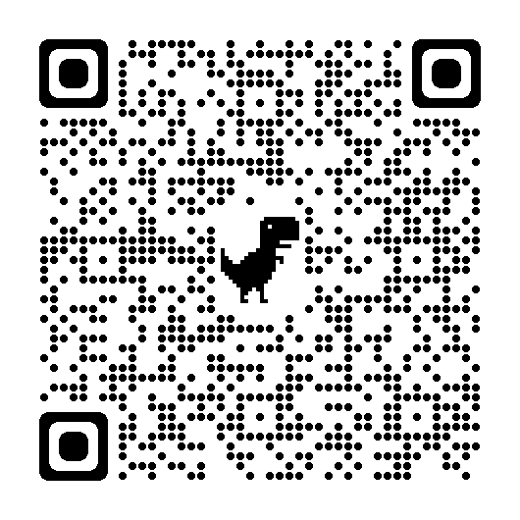
MAKE MIRACLES HAPPEN!
SCAN TO GIVE!

