Slide 1
A year of Rotary 2024-2025

Slide 2
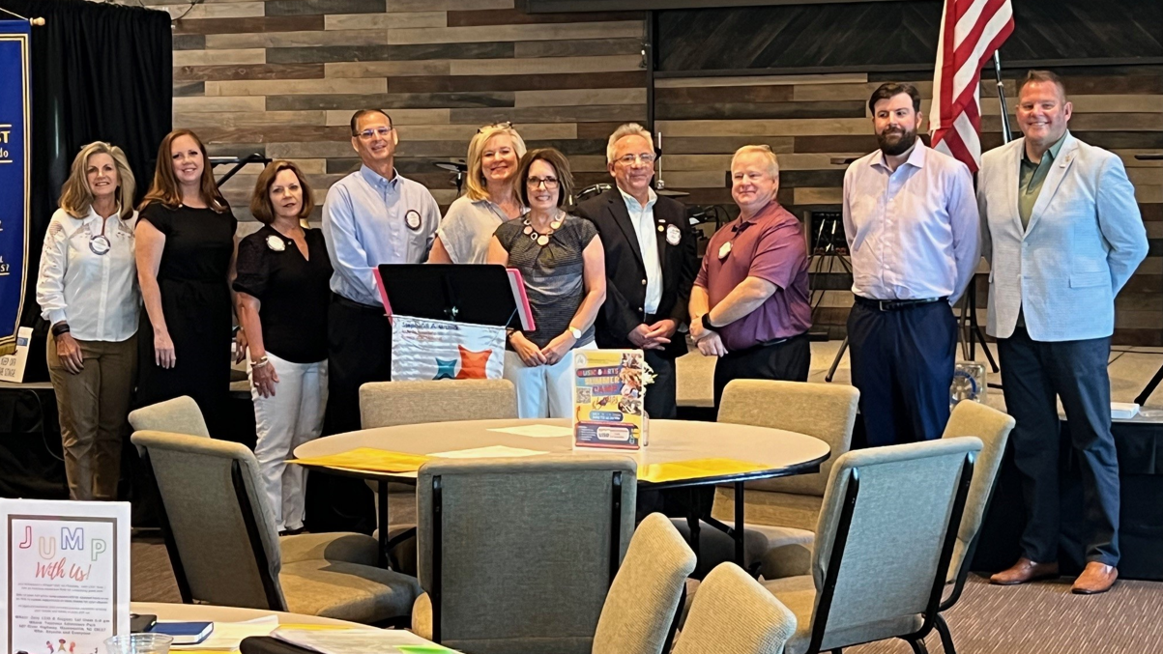

Slide 3
What did we do this year?
Strategic Plan put in place at beginning of year (Rotary Action Plan)
Purposeful Grant Application Process put in place
Huge Veterans Breakfast - Rockie Lynne attended and entertained
501C3 formed - TOTL Foundation Inc
Calendar put in place to keep track of deadlines and events for continuity
Sponsored three SFTL students
Succession/Continuity as a focus, documented processes in place for Chicken/Veterans/Fondo

Slide 4
What did we do this year?
Paul Harris Fellows awarded to Jeff and Lisa Cernuto for all of their contributions to Fondo.
Paul Harris Fellow awarded to Edward Jackson - prior to Distinguished Rotarian
Public Image - more publicity – more focus, telling our story!
Budget - passed and fine-tuned it to be easier to understand and read
Care Committee - put in place
Jeff Smith - more communication with the nearby clubs started (Statesville, Troutman, Mooresville) - also having a lot of discussions between our clubs and sharing ideas/concerns.
For continuity, Lisa, Brett/Mel, Me, Mindy, Tom are having joint discussions to keep the club going in a forward direction.
Rotary Tent and tables bought for awareness at events, along with invitation cards made to share

Slide 5
What did we do this year?
Ordered new Rotary T-Shirts for awareness at events; now ordering polos for marketing purposes
Sponsored 8 Veterans for
Queen City Flight of Honor
Brought in Sara Webb (LNHS) and discussions are in place to hopefully have an interact club next year!!
First club in Iredell County
Installed TWO Peace Poles
Club requested and Mayor declared World Polio Day October 24, 2025 –
Iredell County
Fondo Year 2 was a huge success - year 1 ($23,500) and year 2 ($43,500) - working on bigger event next year and getting Be Well Iredell to partner to bring it home closer.
20 of 20 goals were achieved for Rotary Citation

Slide 6
Goal: +2 New members added: Doug Loudin, Sara Webb, Ken Fletcher, Cory Knight, Brian Edenfield, and Carol Romano! We are so glad to have you as part of our club!

Slide 7
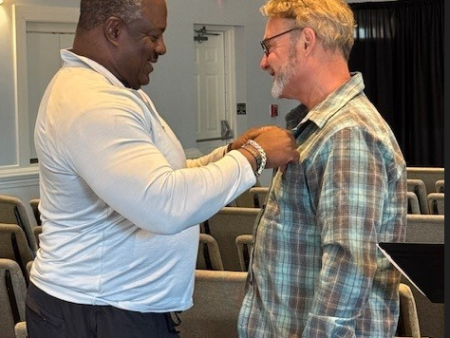
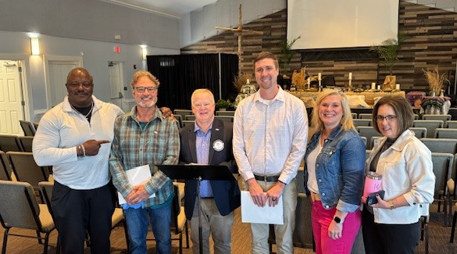
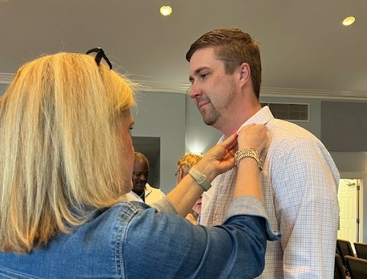

Slide 8
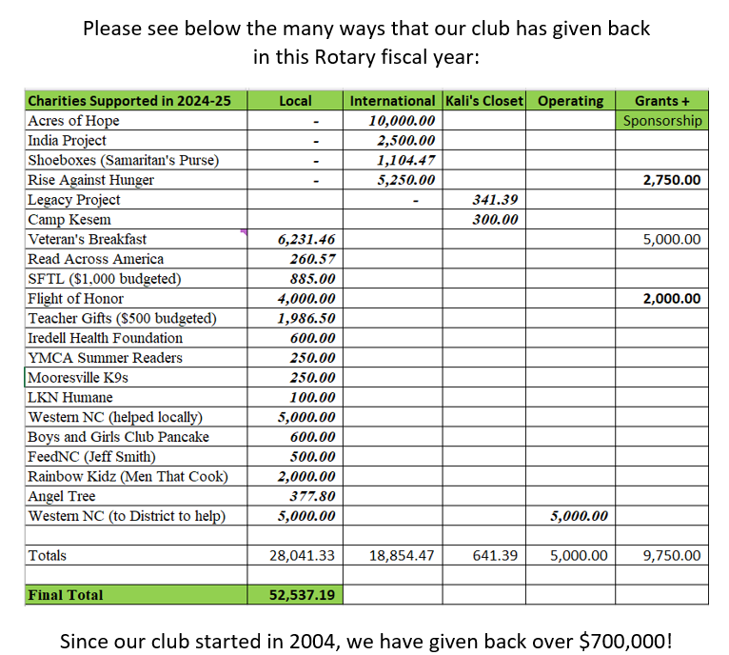

Slide 9
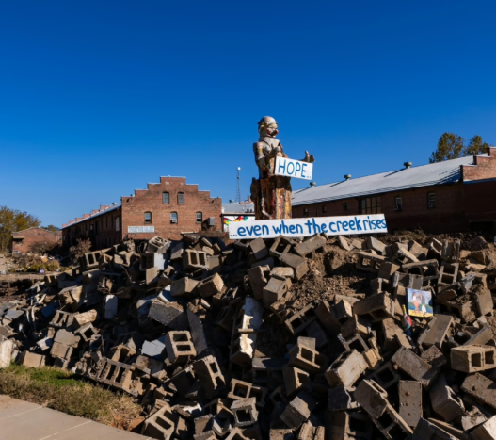
$10,000 in total relief money given to WNC

Slide 10
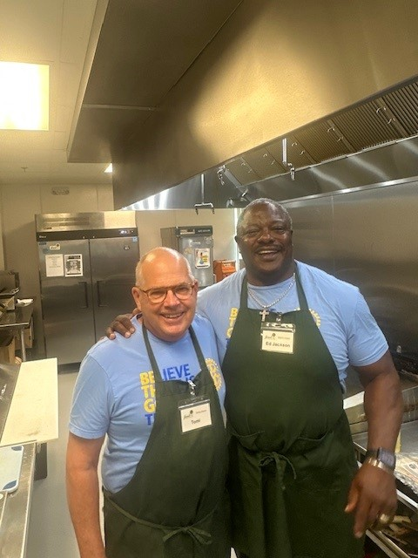
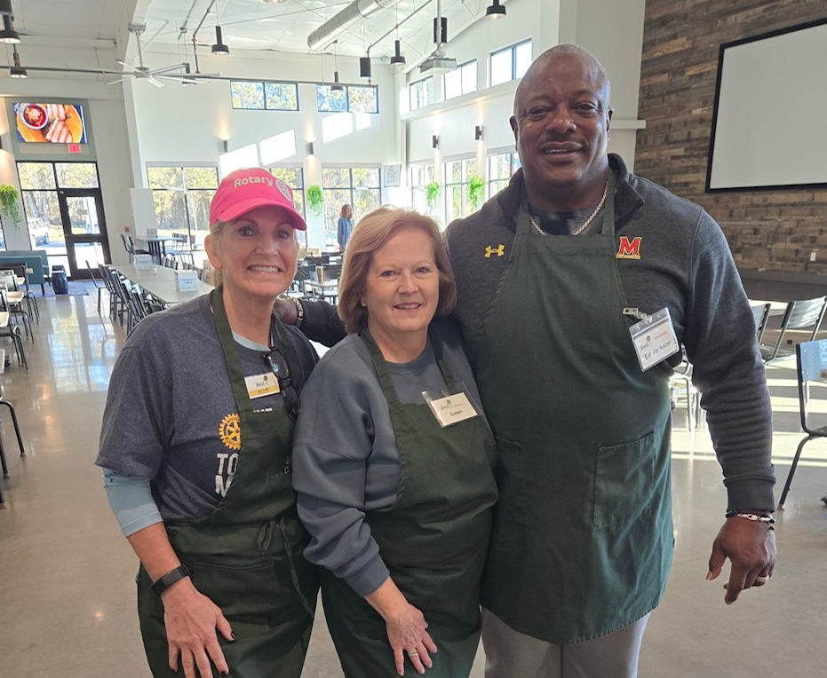

Slide 11
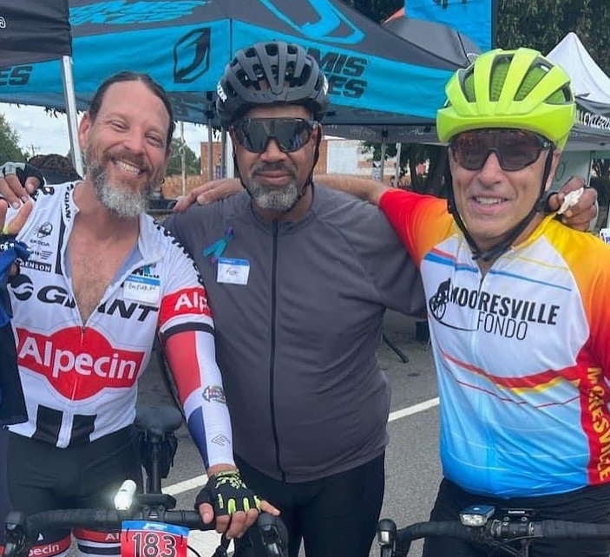
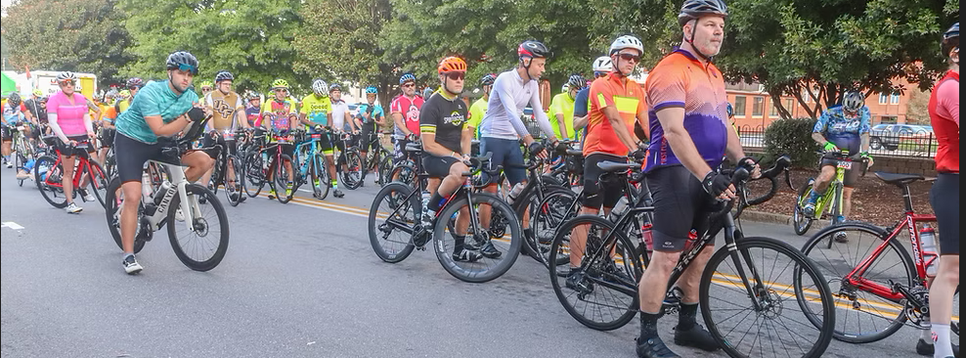
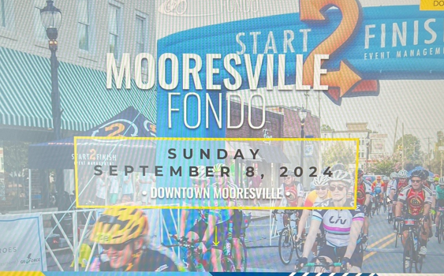

Slide 12
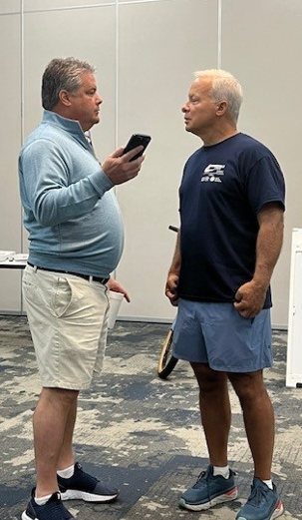
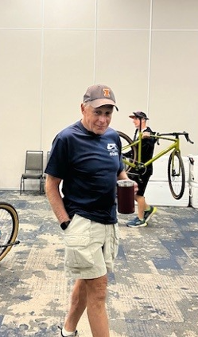
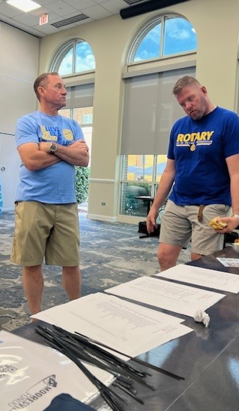

Slide 13
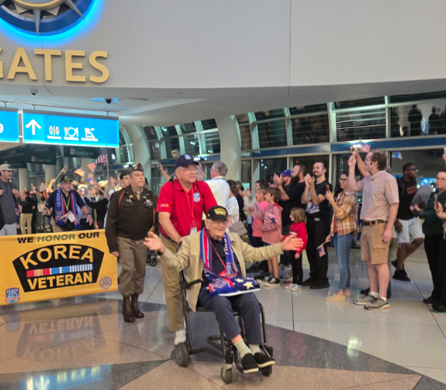

Slide 14
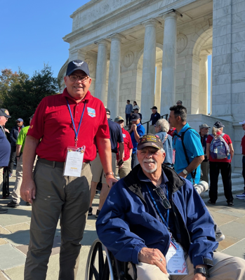
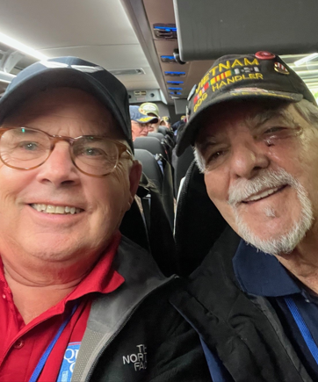
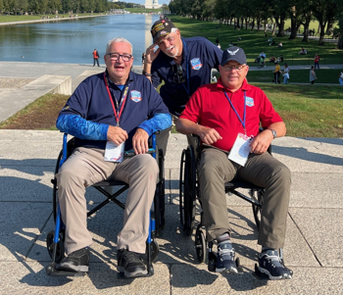
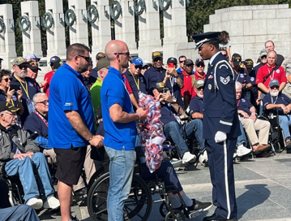

Slide 15
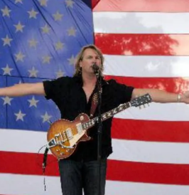
https://youtu.be/zqfyztkYP2U

Slide 16
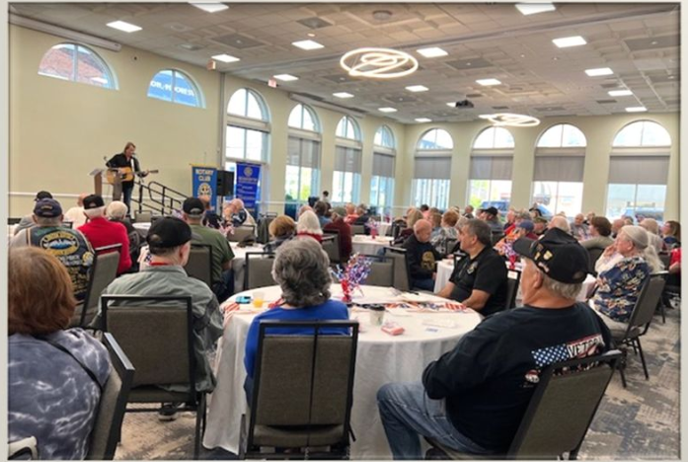
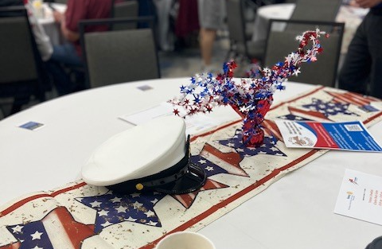
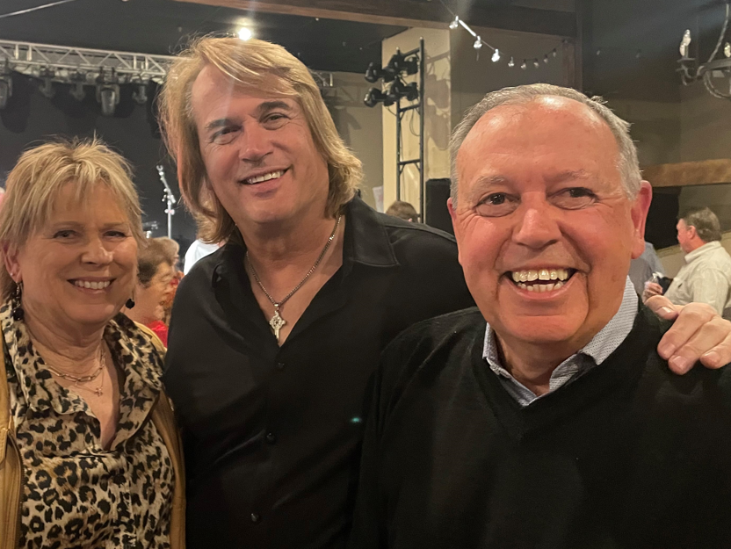
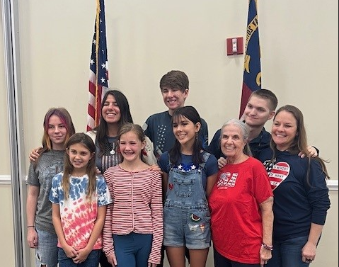

Slide 17
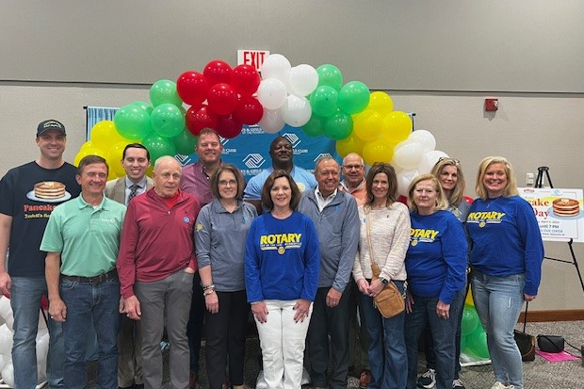
Boys & Girls Club Pancake Breakfast

Slide 18
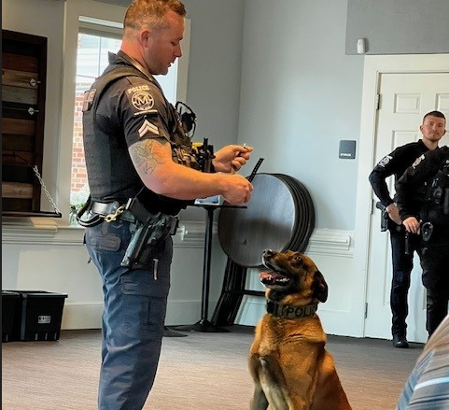
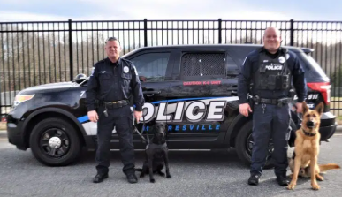

Slide 19
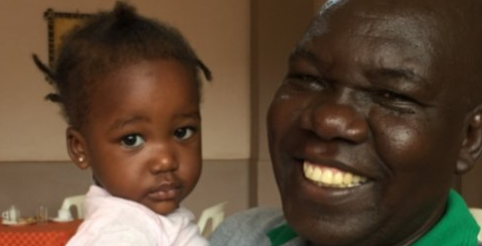

Slide 20
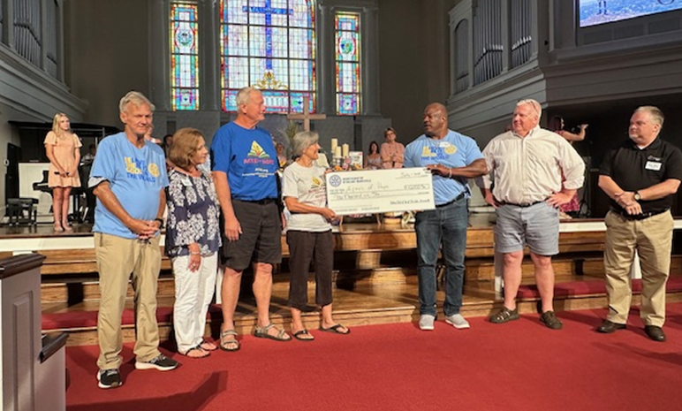

Slide 21
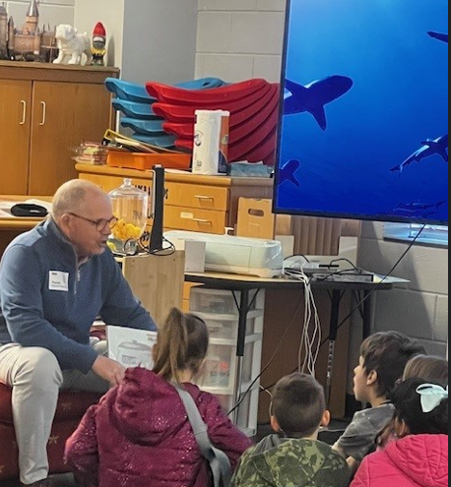
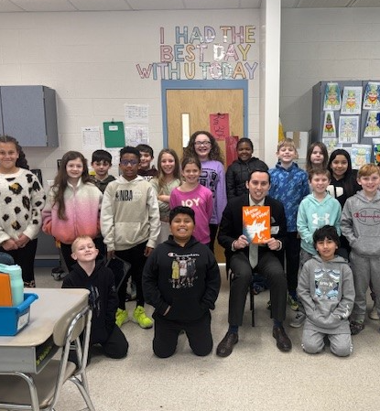

Slide 22
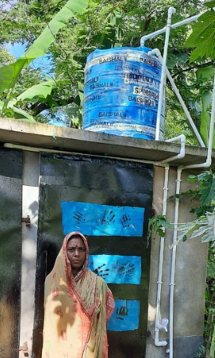
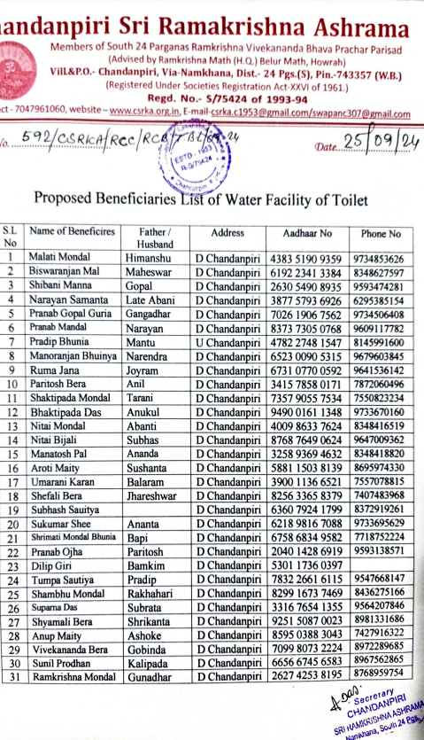
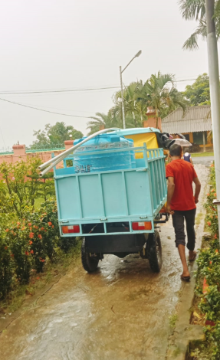

Slide 23
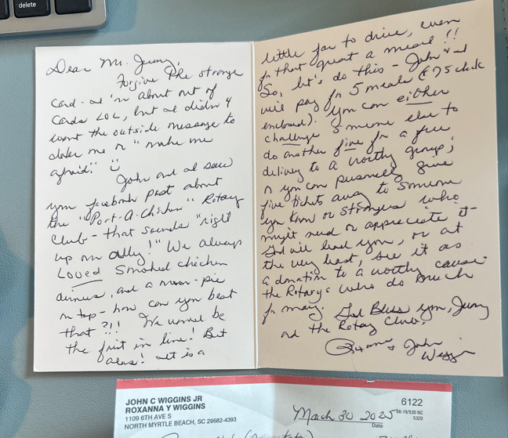
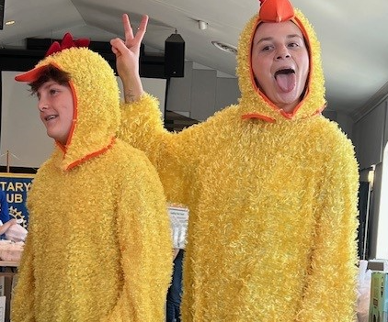

Slide 24
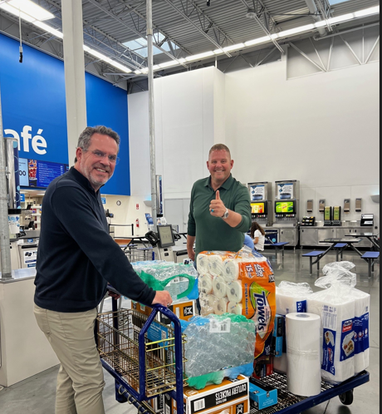
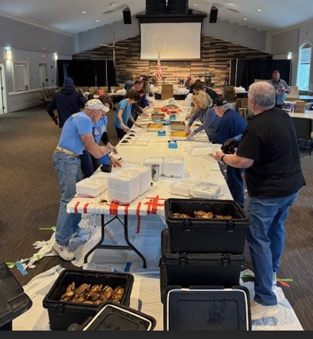

Slide 26
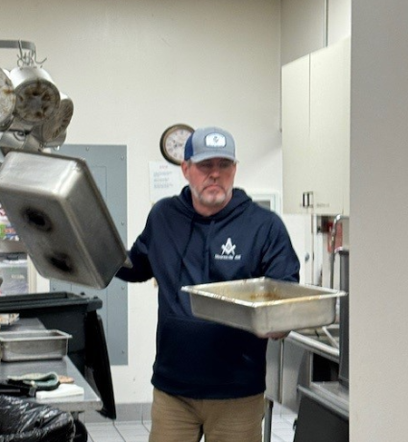
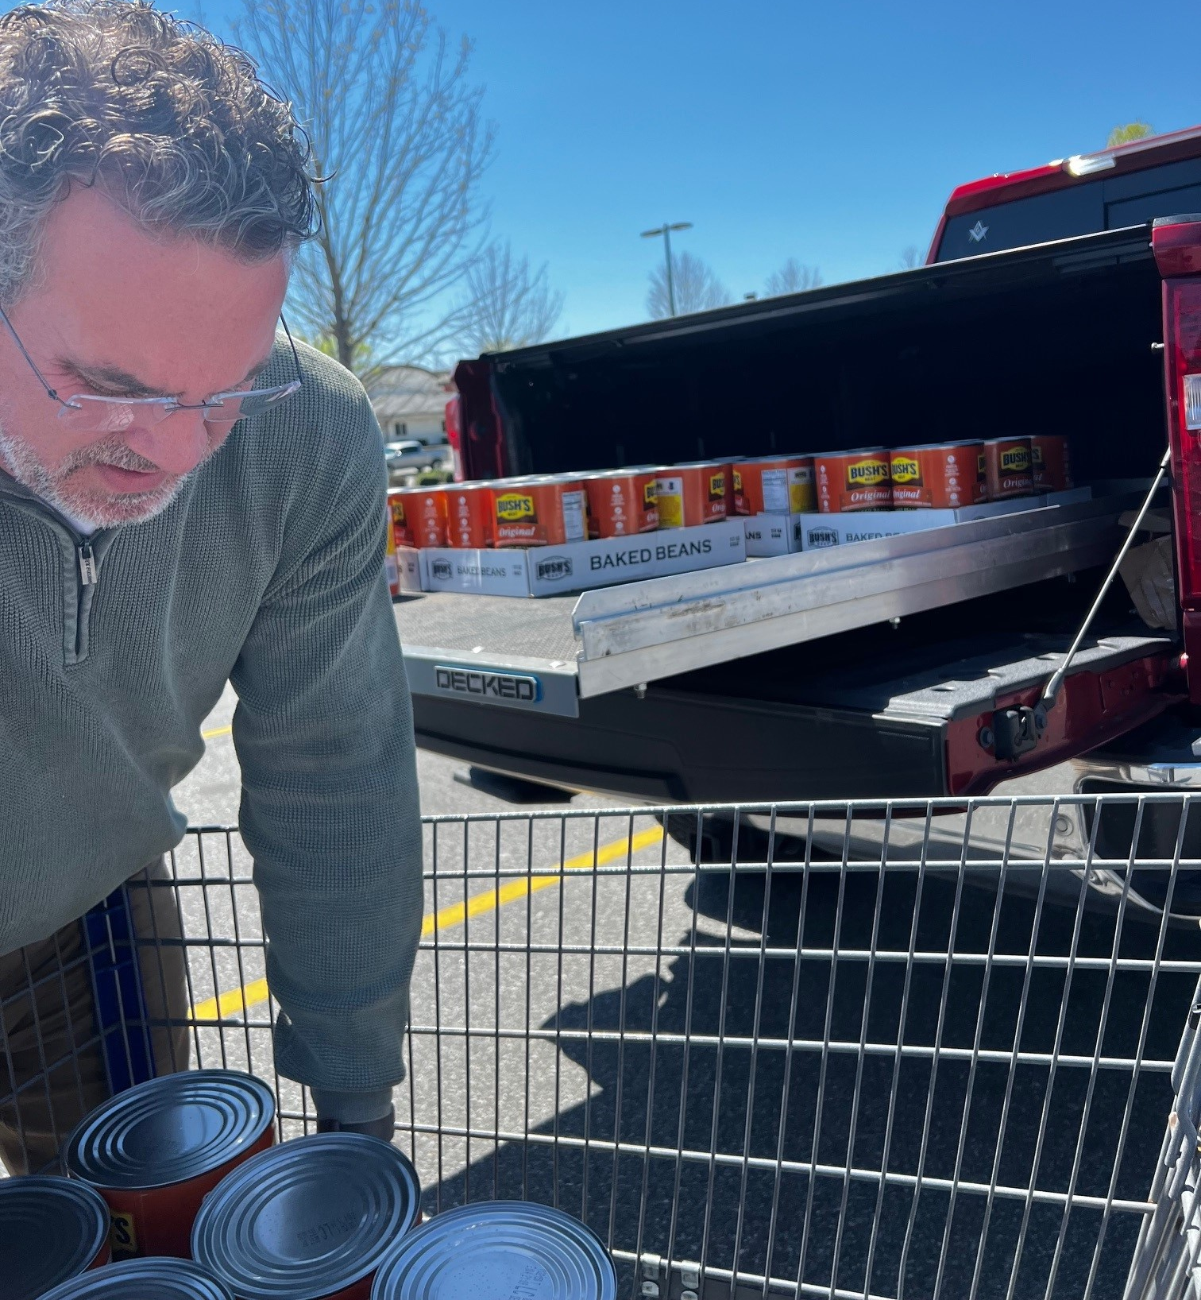

Slide 27
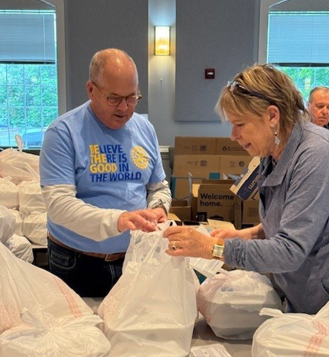
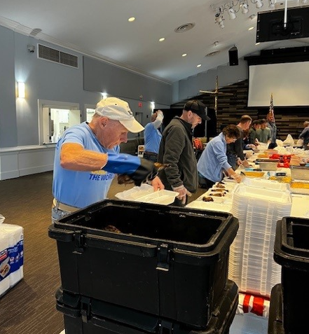

Slide 28
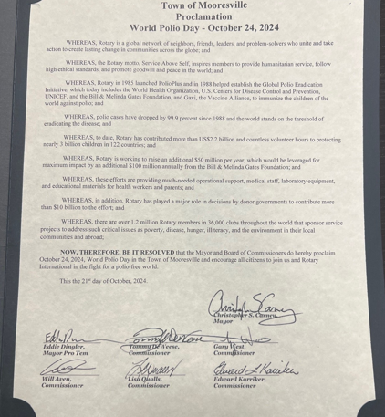
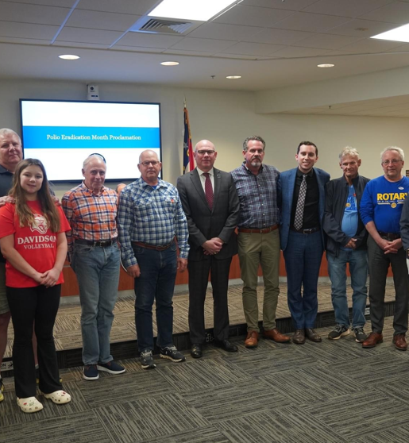
WORLD POLIO DAY

Slide 29
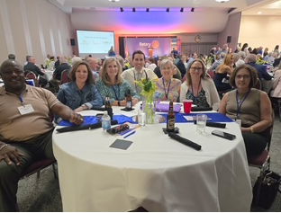
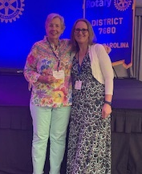
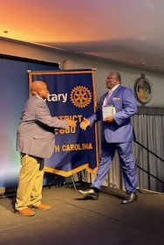
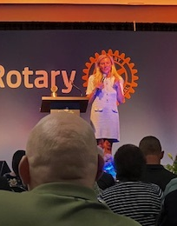
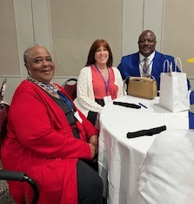
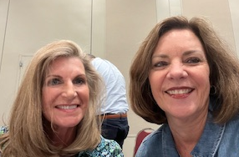
District Conference

Slide 32
WING DING!!

Slide 34
Service Above Self

Slide 35
And, about your year ……… 1. What was your scariest moment? 2. What was your worst moment? 3. What was your most memorable moment? 4. What was your most embarrassing moment? 5. What was your most proud moment? 6. What was your biggest accomplishment? 7. What was your funniest moment?
Notes:
Scariest Moment: Prior to my year starting - like a long time before - Chris Nichols told me that something "always" happens" during a President's year - not to worry.
Then I went the whole year until 6/12 and had two speakers show up (confused Tom and Tom)
Worst Moment: Chicken meltdown - got the wrong clamshells (for the 3rd time over to Sams & BJS) at 8 am prior to the first chickens coming off the grill.
Most memorable: Veterans Breakfast: Rockie Lynne Veterans Song when he asked all of the Vietnam vets to come up so everyone could give them an appropriate welcome home and thank them for their service.
Most embarrassing moment: Called Stewart Ervin the wrong name - Spencer not Stewart - he quit.
Most proud: When Anna Kate came home and told her Mom about the family that they served with during Rise Against Hunger.
Biggest accomplishment: 501c3 and peace poles
Funniest Moment: The text threads

Slide 38
https://youtu.be/uw2eitx9Ly0?si=pfLVpgmojRiz46zu

