Slide 1
The DEI Journey of the Rotary Club Of Salisbury
Presented By:
The Salisbury Rotary Club DEI Committee
A New Way Forward with G.U.I.D.E. FRIDAY, NOVEMBER 19, 2021

Slide 2
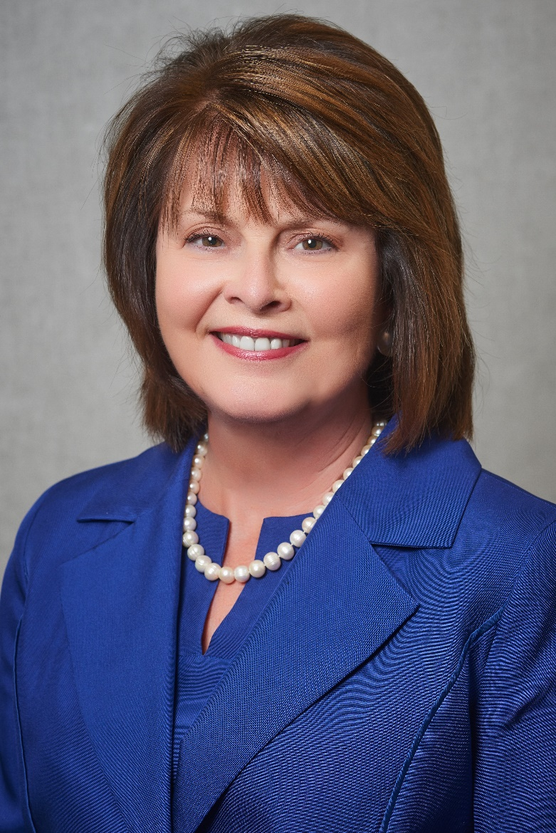
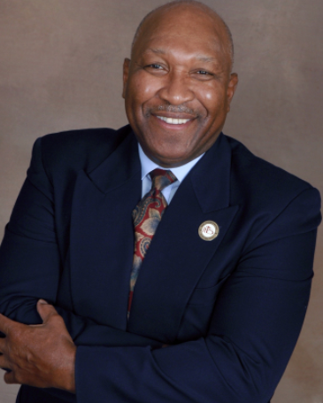
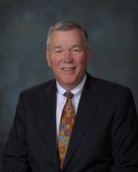
PRESENTERS FROM THE SALISBURY ROTARY CLUB
Dr. Carol Spalding
President, Rowan-Cabarrus Community College and Co-Chair of Salisbury Rotary Club
Dr. Vergel Lattimore
President, Professor of Pastoral Psychology and Counseling and Co-Chair of Salisbury Rotary Club
Ted Goins
President and Chief Executive Officer and President of Salisbury Rotary Club
Notes:
Ted Goins will introduce Dr. Spalding & Dr. Lattimore

Slide 3
Opening Remarks
Movement One:
History & Need to Change
Movement Two:
Study
Movement Three:
The Plan
Movement Four:
Implementation
Notes:
Ted Goins will summarize how the Salisbury Rotary’s Actions as movements of music to change the tune of the organization
2019 Call for Volunteers

Slide 4
Movement One: History & Need to Change
The Diversity, Equity & Inclusion Committee met with intentionality for several months to develop
a survey instrument to assess our members’ thinking about diversity, equity, and inclusion as it may pertain to our club.
Notes:
Ted Goins will discuss the history – 102 year old org, white and male for much of history
Rotary President – Steve Fisher leads with a REI Committee Initiative
A diverse committee is formed, meeting every other week for four months
A challenge and task to diversify and expand Rotary membership, with intentionality

Slide 5
Movement Two: Study
The Diversity, Equity & Inclusion Committee provided a safe space for the disclosure of feelings and personal perspectives.
Notes:
Dr. Spalding will discuss the survey results generated and critically vetted within the committee
An effort of collaboration and deep listening to varied views
The DEI provided a safe space for the disclosure of feelings and personal perspectives

Slide 6
Q6: What is the first thing that you think of when you hear the term "Black Lives Matter"?
3
Other - please specify:
That people of color are discriminated against and that systemic racism exists and this must fundamentally change drive by the white race
Black, Hispanic, old, young - not just all lives, but specifically lives that have been ignored
6
9
Confusion and misunderstanding what the statement means
7
A very much needed
4

Slide 7
Q7: When you look at the events at the Capitol in Washington, D.C., on January 6, 2021, what did you see?
Other - please specify:
Chaos
1
Terrorists & insurrectionists
Group of well-organized militants - delusional to what patriots are
People hiding behind the label "American" trying to interfere with and overthrow our government
Lack of honesty from media and government
9
11
A group of like-minded people following a cult like leader
8
White supremacists. This is a symbol of the greatest threat to our democracy and we need to address it nationally and locally.
Mostly white political extremists

Slide 8
Q8: Would you support a long-term diversity goal for our Salisbury Rotary Club team to be reflective of the makeup of the communities we serve?
25
4

Slide 9
Movement Three: The Plan
The Diversity, Equity & Inclusion Committee affirmed its mission
as consistent with the value stated
in the Rotary International Four-Way test.
Notes:
Dr. Lattimore will share the survey results with the wider membership, reflecting attitudes, views and expectations
Small group discussions allowed for wider feedback and survey commentary
All written comments were shared with members as a form of “truth reflection”
The DEI Committee affirmed its mission as consistent with the value stated in the Rotary International Four-Way test

Slide 10
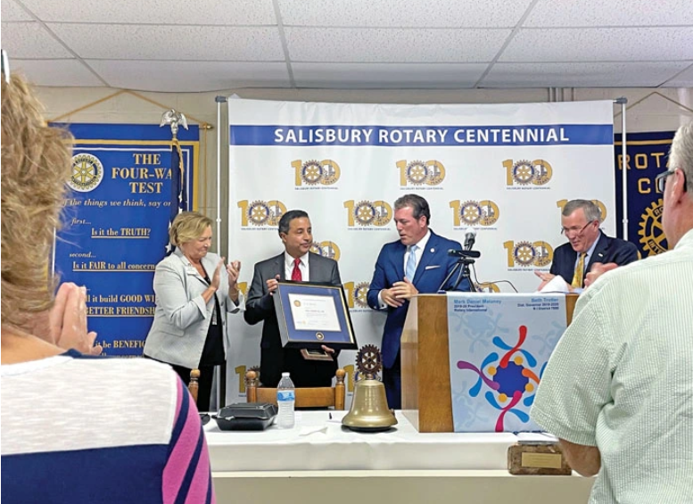
Movement Four: Implementation
The work of the Diversity, Equity & Inclusion Committee was embraced by the incoming executive leadership of the organization.
Photo of Recognition for
late Mayor Pro Tem O.K. Beatty
at the Salisbury Rotary Club
Notes:
Dr. Lattimore will share the work of the DEI Committee was embraced by the incoming executive leadership of the organization
An act of reckoning and reconciliation emerged regarding an historical membership injustice. The late Mayor pro tem O. K. Beatty was recognized and redressed
Diversity moments were instituted as part of the weekly program agenda
More research into the Salisbury Rotary DEI history and practice will be explored

Slide 11
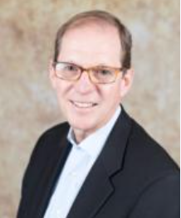
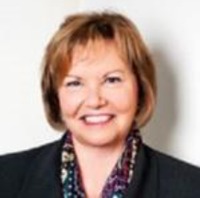
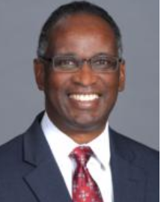
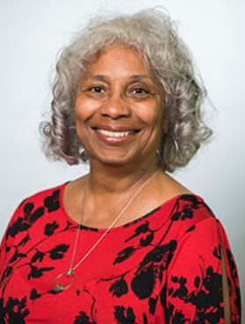
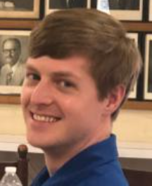
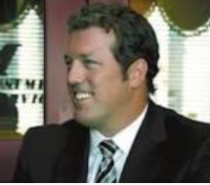
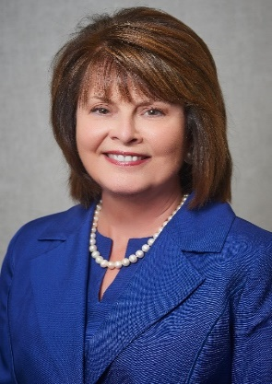
Special Thanks to Salisbury Rotary Diversity, Equity & Inclusion Committee Members
Greg Alcorn
John Everett
Hunter Fisher
Dr. Vergel Lattimore
Elaine Spalding
Patricia Ricks
Jessica Vess
Esther Atkins Smith
Steven Fisher
Dr. Carol Spalding

Slide 12
Closing Remarks Ted Goins

