Slide 1
The Global Holistic outlook

Slide 2
Global Holistic
A holistic approach means to provide support that looks at the whole person, not just their mental health needs. The support should also consider their physical, emotional, social and spiritual wellbeing.

Slide 3
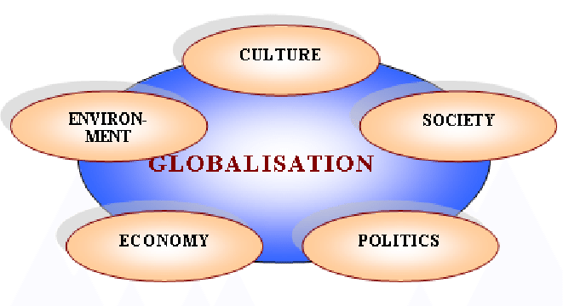
Holistic
PHILOSOPHY
characterized by comprehension of the parts of something as intimately interconnected and explicable only by reference to the whole.

Slide 4
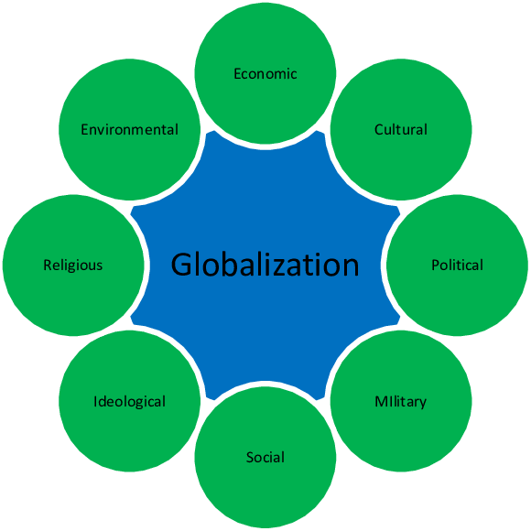
Holistic
MEDICINE
characterized by the treatment of the whole person, taking into account mental and social factors, rather than just the symptoms of a disease.

Slide 5
Based on a holistic analysis of global Mega Trends and regional policy pivot, the analyst has detailed the economic growth opportunities for businesses in 2022 and beyond.
This report* defines the context of these opportunities and the call to action for companies that should be leveraged for sustained growth. This research also delineates the key strategic imperatives for businesses that will be crucial to ensuring growth during these uncertain times.
* A Holistic Approach To Sourcing Around The World. McLane Global

Slide 7
Through these subtle yet real interactions of opposites, a new wonderful, higher-order, and creative synthesis can emerge. Thus, a 21st-century planner's greatest challenge will be encouraging that creative synthesis and holistic thinking and planning by controlling the mind's negative side while enabling the positive side to spring forth.
This interaction of opposites and attendant balance will provide the brilliant ideas needed for creation and the pragmatism for these ideas to survive.* *Global Economic Outlook Report (2022) International Monetary Fund

