Slide 1
Rotary Club, Noida
Club ID: 15376 || RI District: 3012

Slide 2




Slide 3
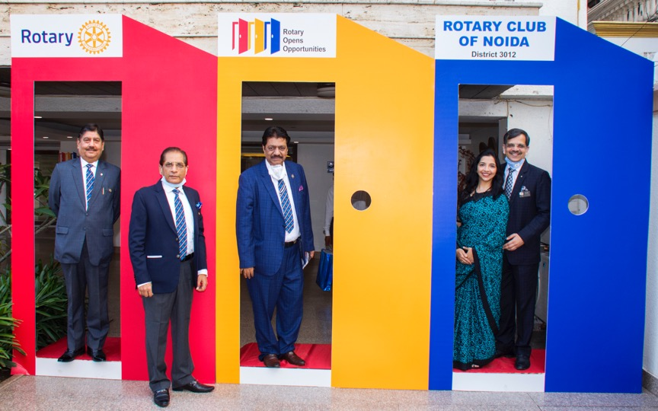

Slide 4


Slide 5
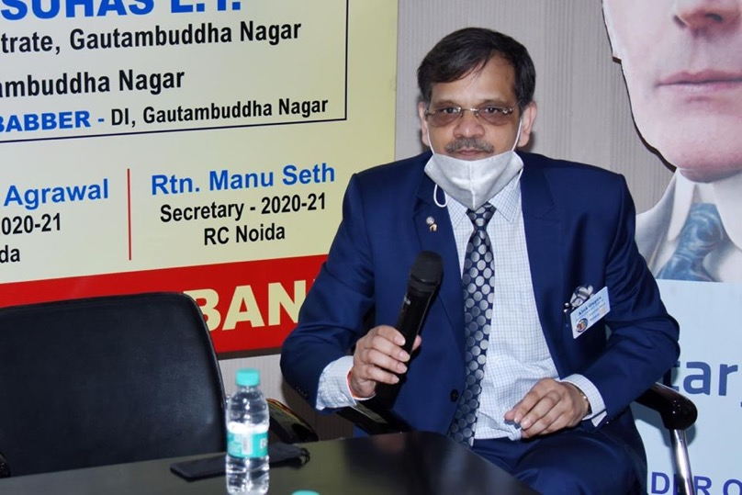
Rotary Noida plasma bank

Slide 6
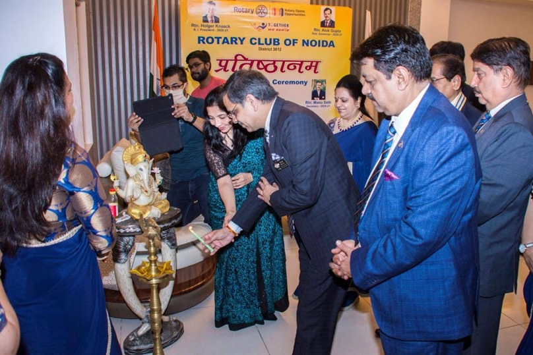
IMAGES

Slide 7
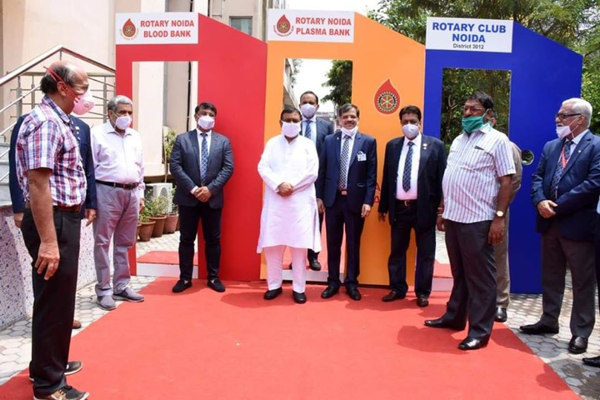

Slide 8
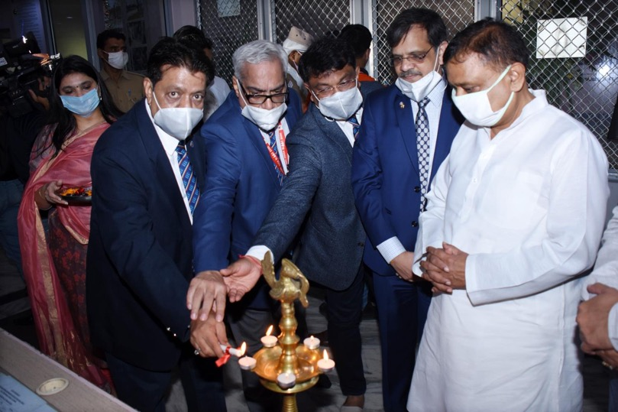

Slide 9
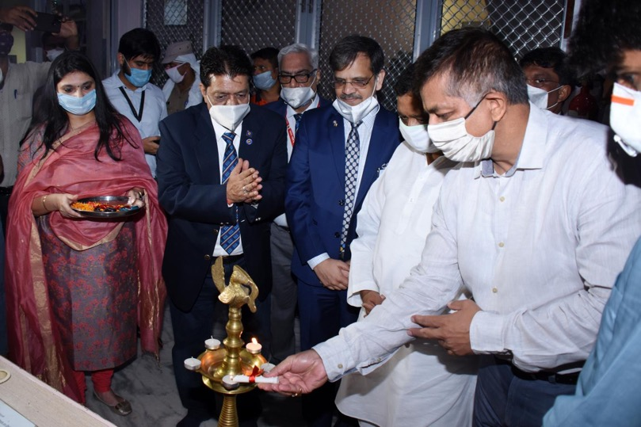

Slide 10
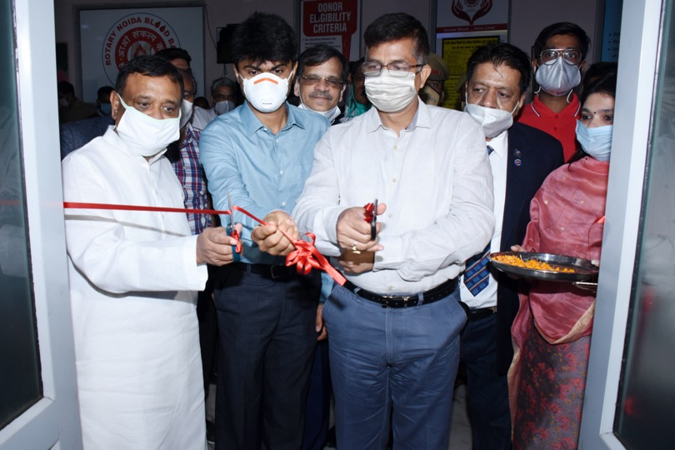
Inauguration by Dignitaries

Slide 11
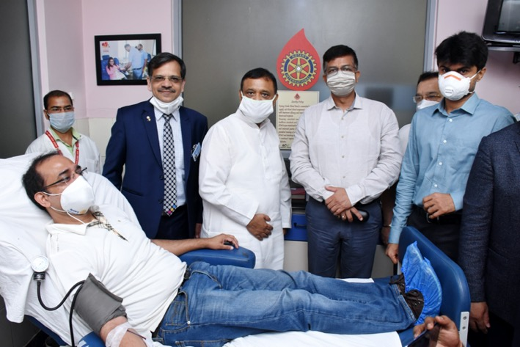
FIRST PLASMA DONOR

Slide 12
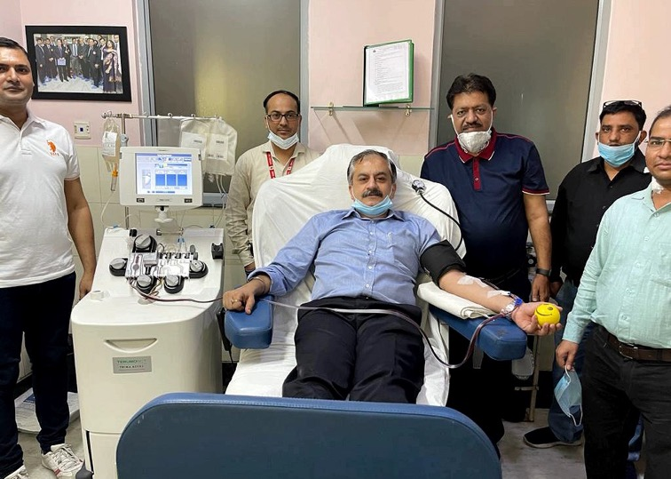
FIRST PLASMA DONOR

Slide 13


Slide 14
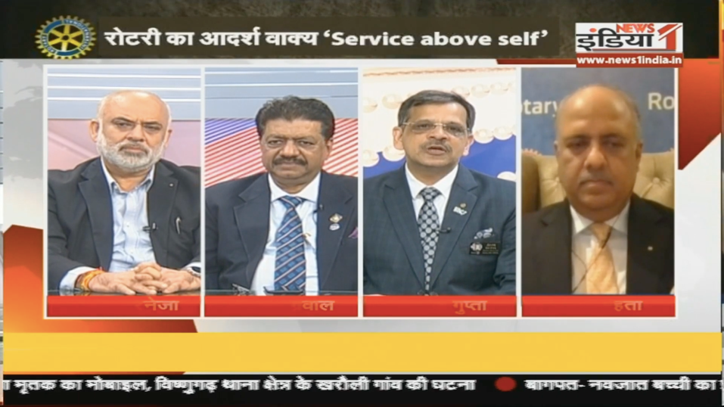

Slide 16
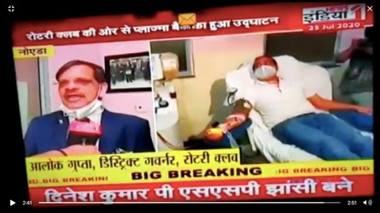
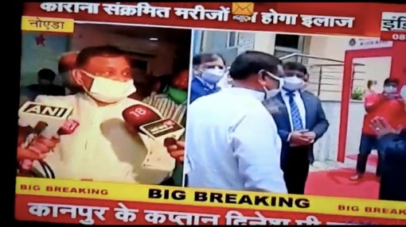
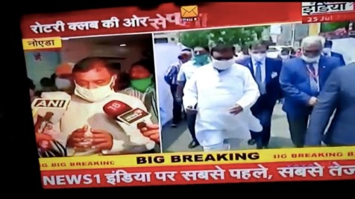

Slide 17
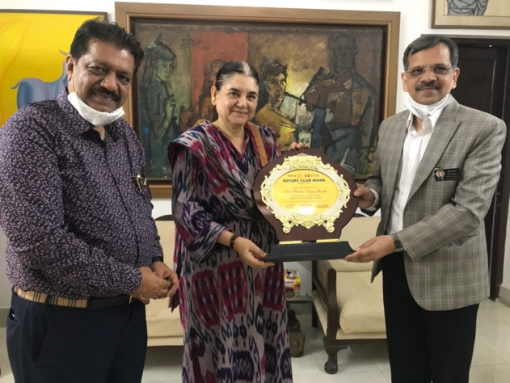
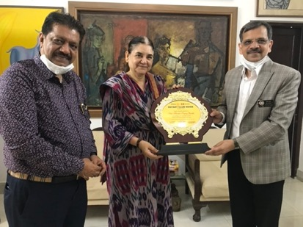
Felicitation: Smt.Maenka Gandhi

Slide 18
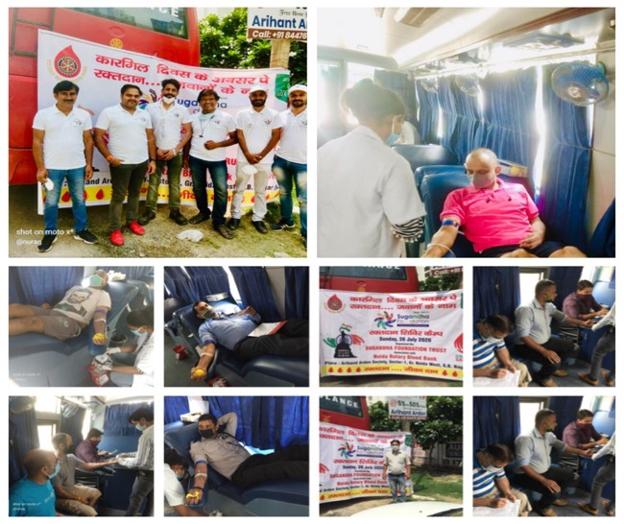

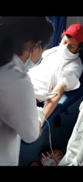
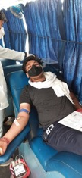

Slide 19
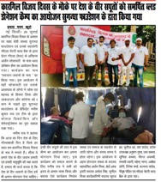
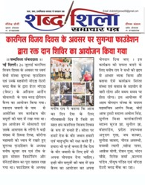
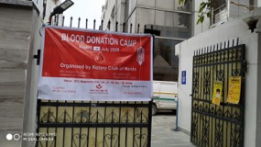
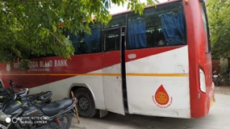
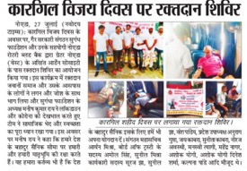
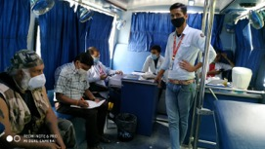
Media Coverage
5 Camps in
7 days

Slide 20


NATIONAL

Slide 21


INTER-NATIONAL

Slide 22



Slide 23

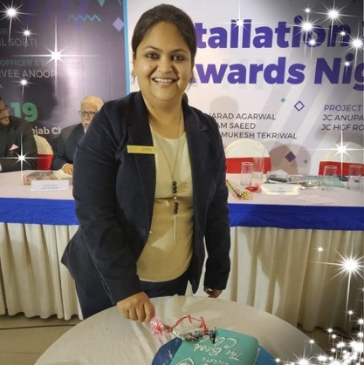
RCN TALKS : HEALTH | Mindfulness
RITU BHALOTIA : Story Teller

Slide 24


RCN TALKS: Well Being | YOUTH

Slide 25
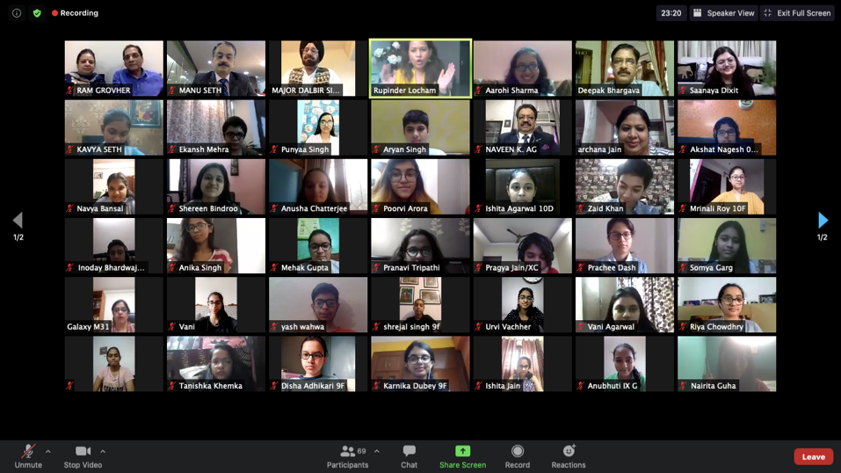

Slide 26
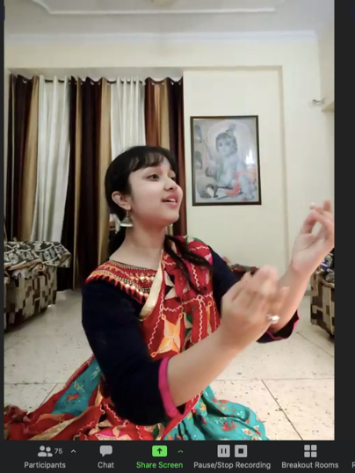
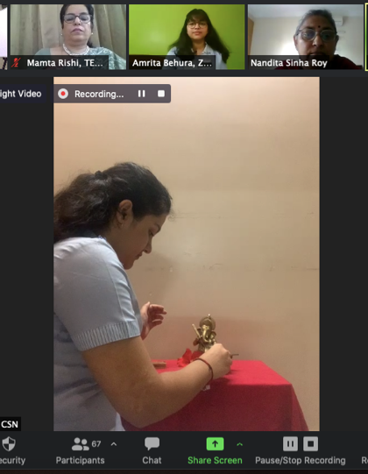

Slide 27
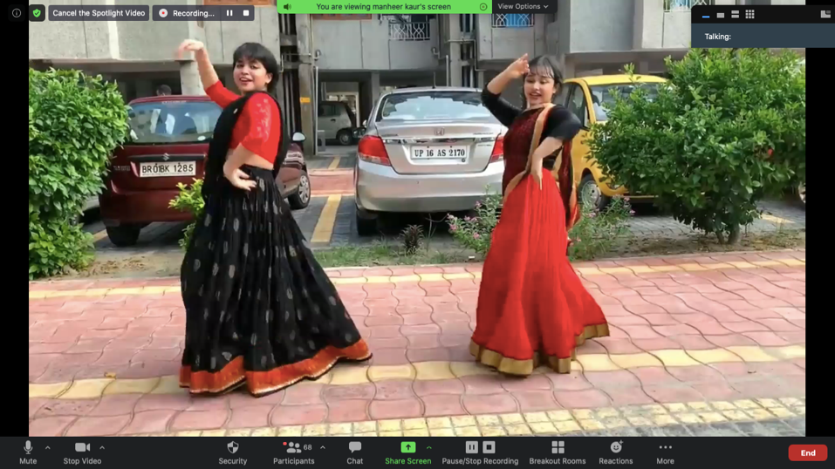

Slide 28
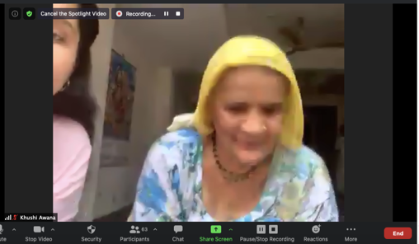
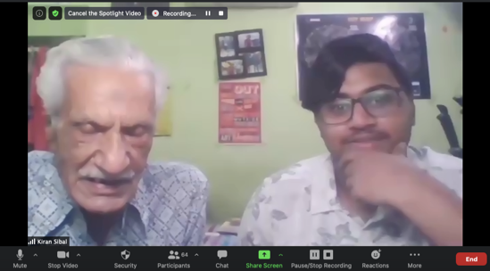

Slide 29
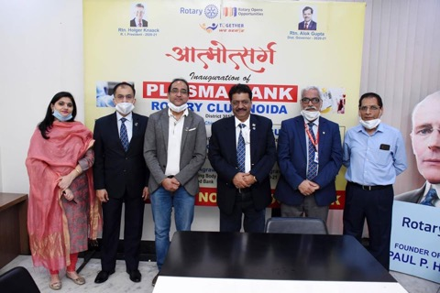
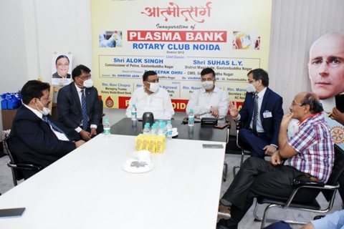

Slide 30
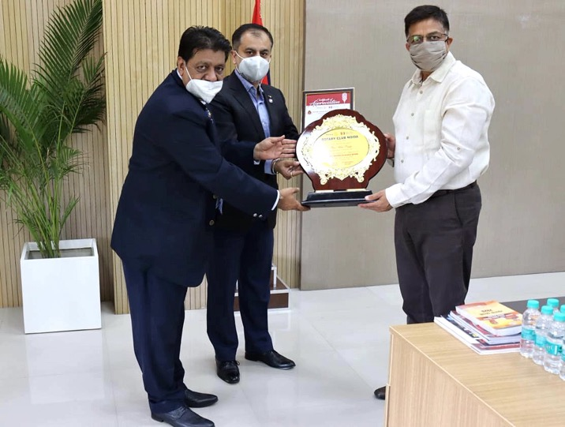
Felicitation image

Slide 31
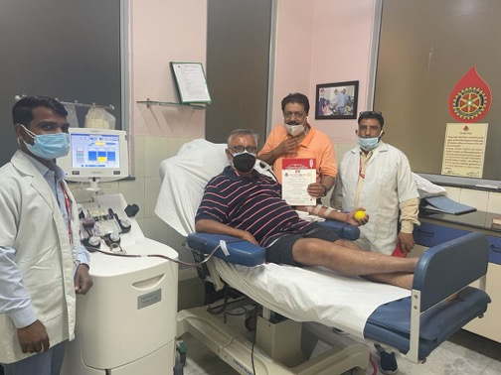
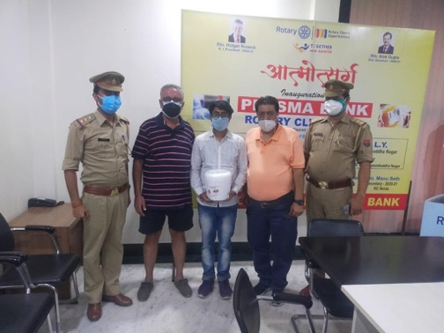

Slide 32
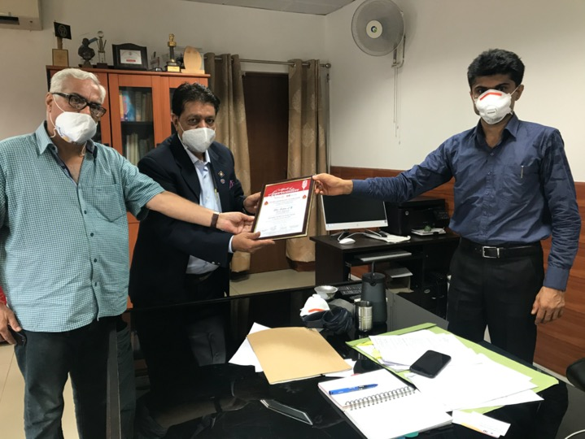
Felicitation image

Slide 33
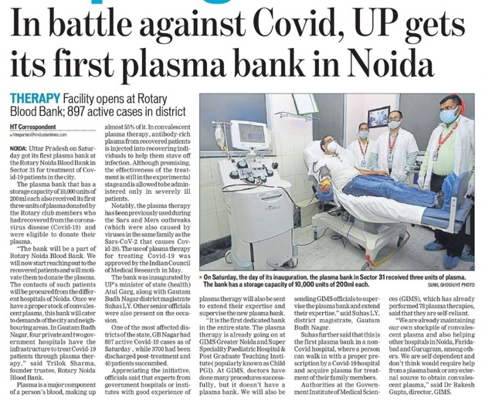
Coverage’s

Slide 34
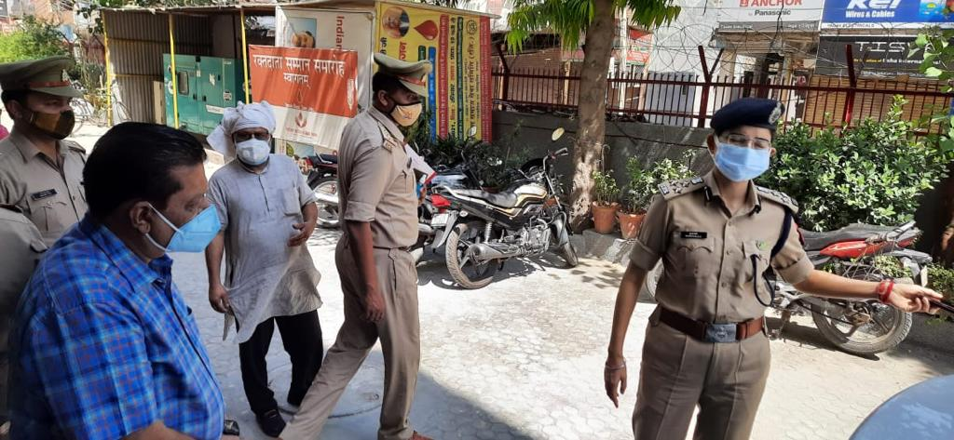

Slide 35
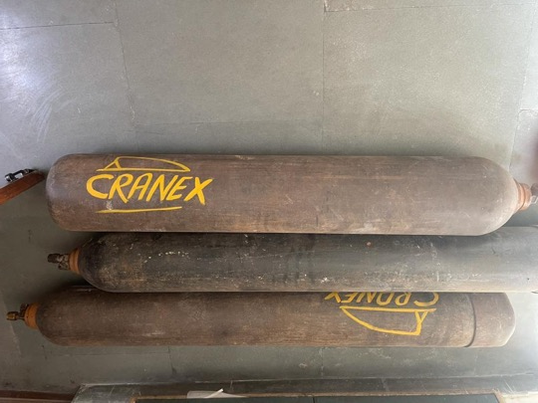
Supplies | Arrangement | Back-up’s
Hospital , Supply , Refill with the department and authorities

Slide 36
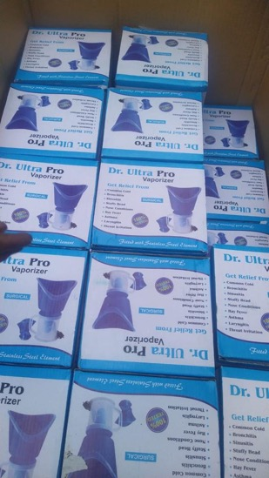
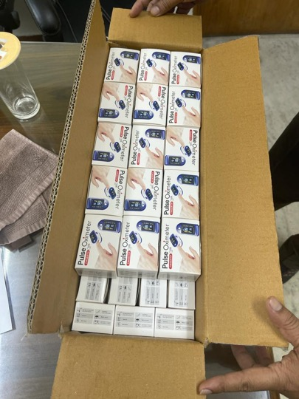

Slide 37
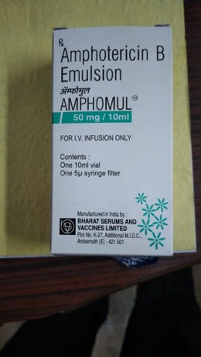
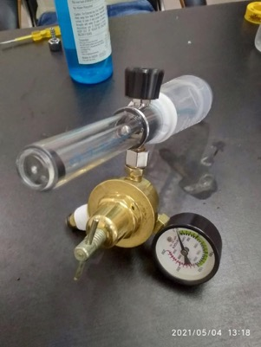
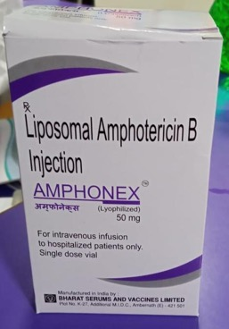
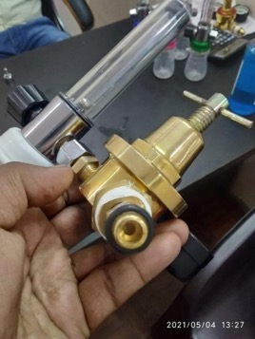

Slide 38
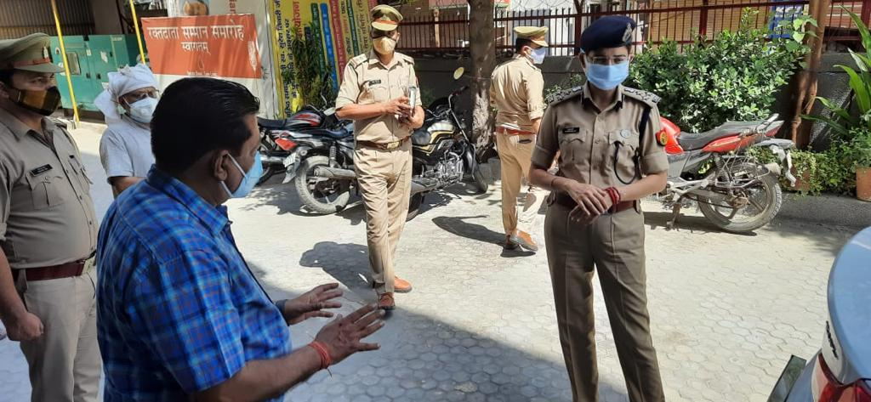

Slide 39


Slide 40
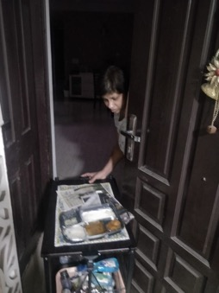
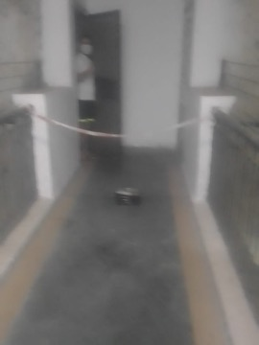
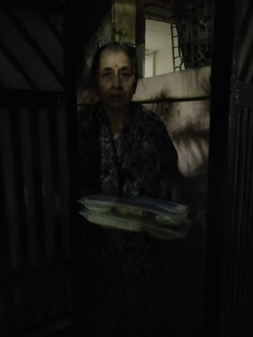



Slide 41





Slide 42


Slide 43



Slide 44


Slide 45


Slide 46


Slide 47



Slide 48


Slide 49
Electronic Covergae’s
You Tube
  https://youtu.be/vdYzn2jBsgs
Social media FB live
  https://www.facebook.com/RotaryClubNoida/videos/283237632953703/?t=3
  https://www.facebook.com/RotaryClubNoida/videos/733756487399734/?t=2
  https://www.facebook.com/RotaryClubNoida/videos/3874343255915990/?t=7
  https://www.facebook.com/RotaryClubNoida/videos/321240409054244/?t=2
  https://www.facebook.com/RotaryClubNoida/videos/3103405526392112/?t=2
  https://www.facebook.com/RotaryClubNoida/videos/766606354085996/?t=3
  https://www.facebook.com/RotaryClubNoida/videos/577268546491877/?t=3

Slide 50



Slide 51


Slide 52


Slide 53



Slide 54



Slide 55



Slide 56


Slide 57


Slide 58


Slide 59

rtn. Manu
SETH
Rtn. Naveen
Agrawal

Slide 60
RCN TEAM 2020-21
“together we serve”
Yanyavaad

