Slide 1
Hendersonville Rotary Club Partners 2017-2018

Slide 15
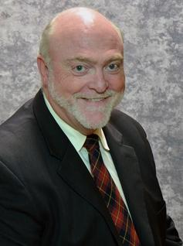
Ervin W. Bazzle
Attorney at Law
697-4327

Slide 27
Ken Adams

Slide 28
Bill Reese

Slide 35
Chuck and Teresa Edwards

Slide 37
Don Cooper

