Slide 1
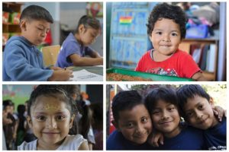
SAFE PASSAGE/CAMINO SEGURO
A Rotary Success Story
Where we are and where are we going

Slide 2
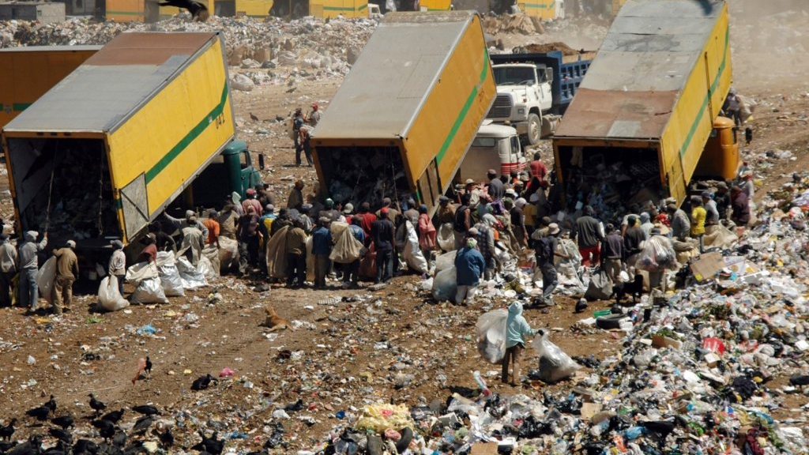
The World of Safe Passage
The largest garbage dump in all of Central America…
With over 10,000 individuals making a living picking garbage...
Notes:
Here is the Google Drive link to download the Virtual Tour video. https://drive.google.com/file/d/1y4ug1Vkwe-Ow1NzzBhExajX4ZMKUMyLh/view

Slide 4
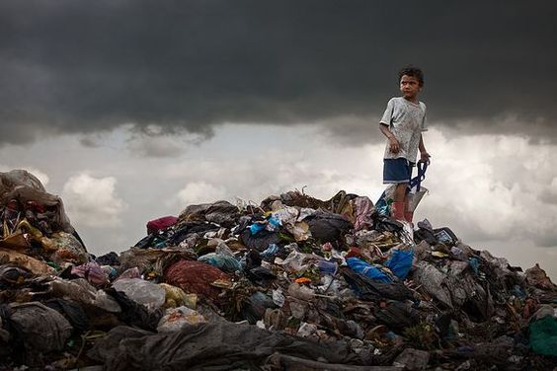
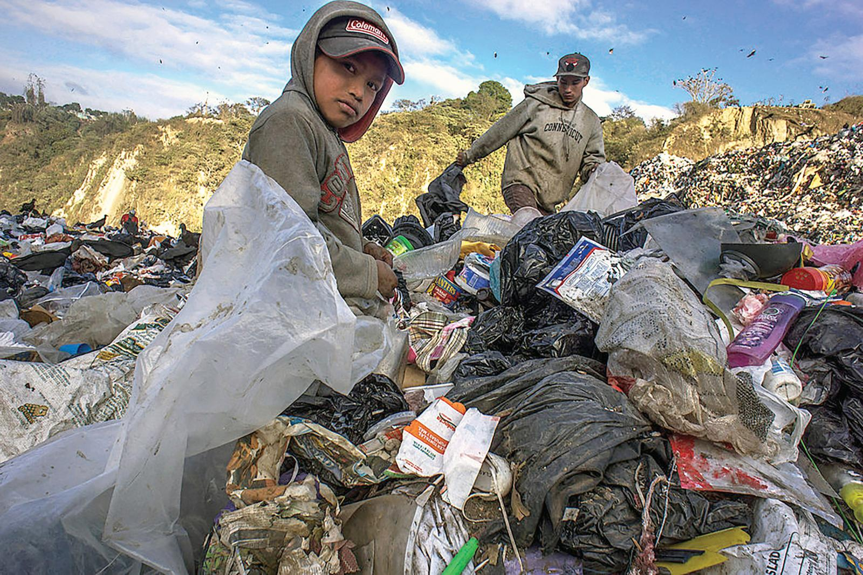
Some Facts About the Garbage Dump
Particulate pollution measures over 100 micrograms per cubic meter of air. EPA recommends a maximum annual level of just 75 micrograms per cubic meter.
Workers suffer from early onset cancers, emphysema, chronic congestion, headaches, and high rates of asthma and respiratory problems.
Of $3 earned in a day, “las Maras” or local gang members who control all economic activity in our community, will extort half of that. Sending a child to public school leaves $1 a day.
The zones around the dump present some of the highest rates of homicide, sex trafficking, drug addiction and gang violence in all the Americas.
$217,126
WHAT IS IT COMPRISED OF?

Slide 5
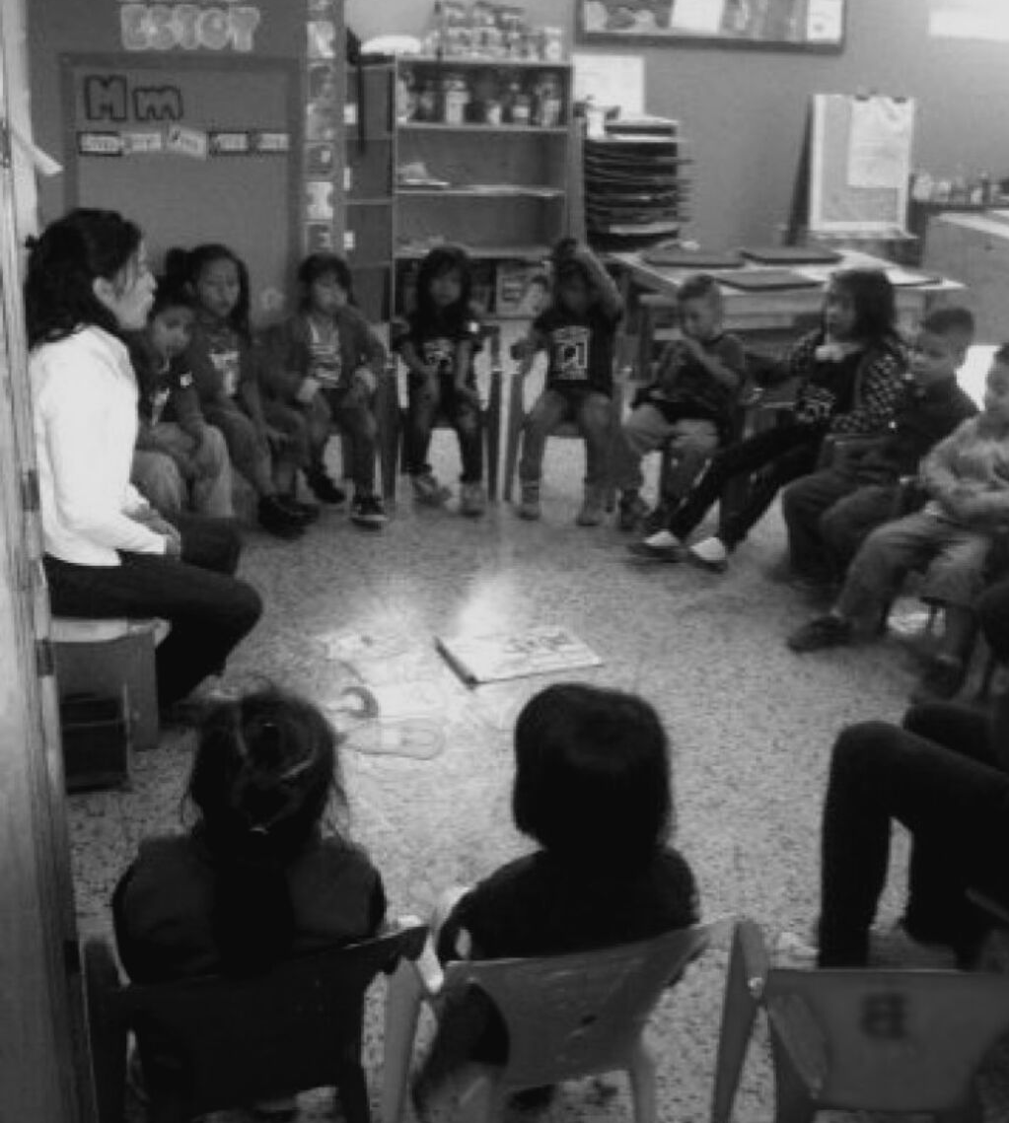
Who is Safe Passage Camino Seguro?
Full Day School up to grade 9 and High School half day academic support (with over 600 students and 1600 family members)
Meals and Nutritional Assistance
Professionally Staffed Walk-In Medical Clinic
Vocational and Post Grad Support Center
Adult Literacy Courses for Parents
Entrepreneurial Cooperative for Mothers to create goods and earn more
Family Counseling, Psychologists and Abuse Intervention
After School and Weekend Youth Activities, Workshops and Sports

Slide 6
Some Vital Statistics from Covid
60%
18%
Loss in income and usual economic activity due to the crisis and the closure of the dump
Increase in the rate of homicide, wrongful death and suicide in communities around the dump.
50%
11%
Reported increase in Interpersonal Violence among our families
Decrease in number of private sector jobs in Guatemala during Covid-19
< 5 %
670
Estimated Covid-19 Testing Rate for members of the dump community
Loss in contact days and face to face class time with students from March 2020 to January 2022

Slide 7
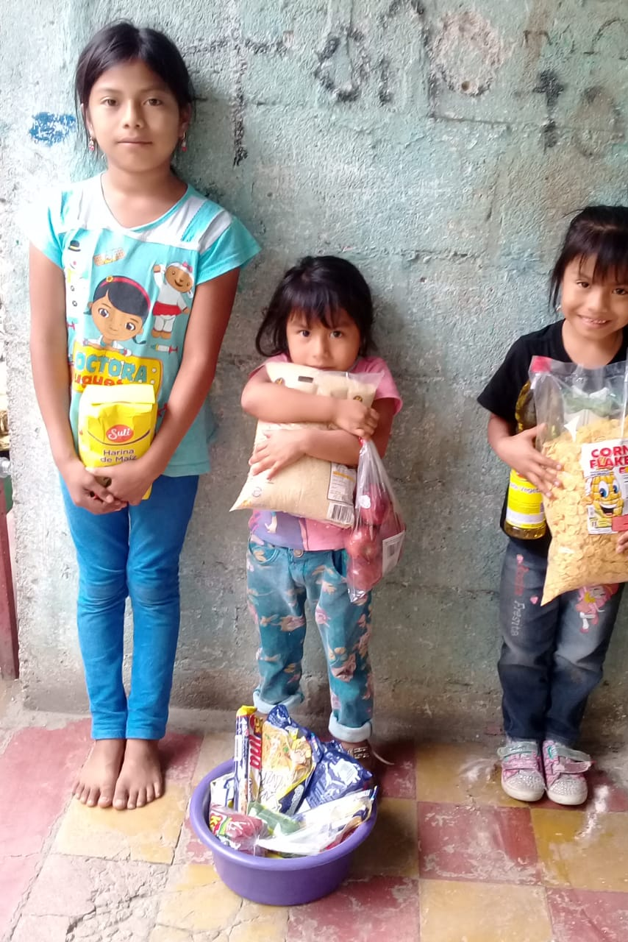
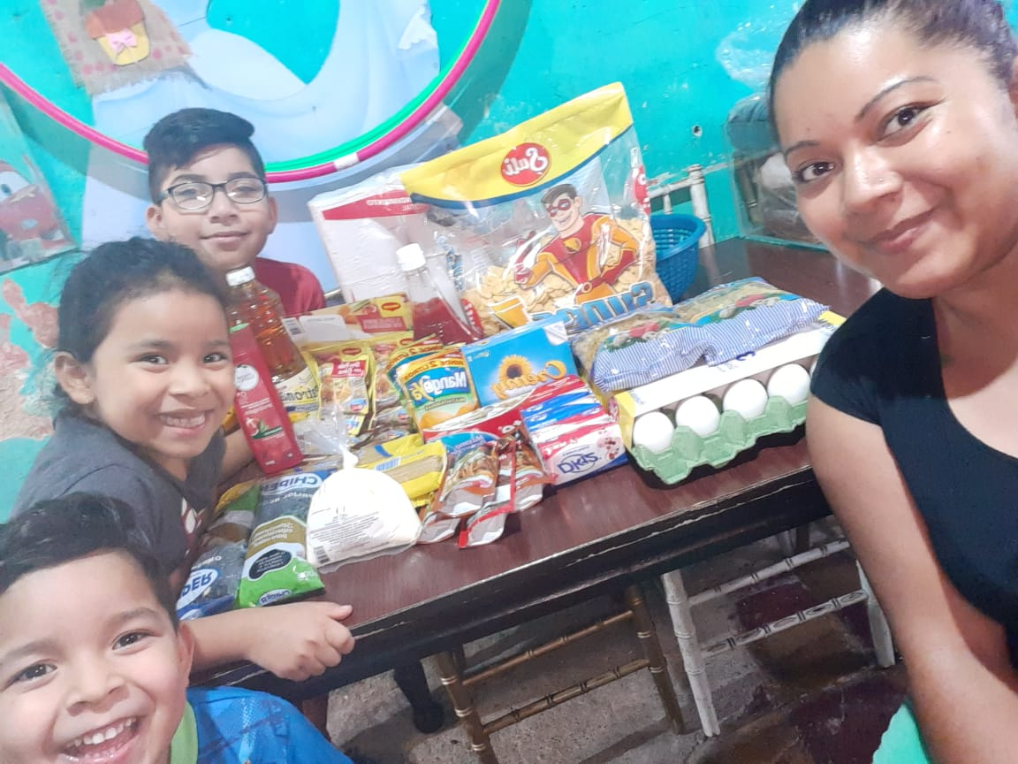
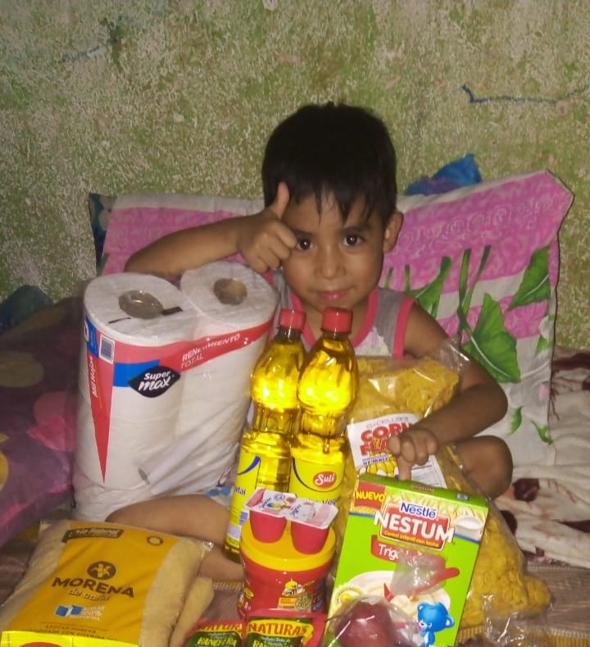
Providing Material Support

Slide 8
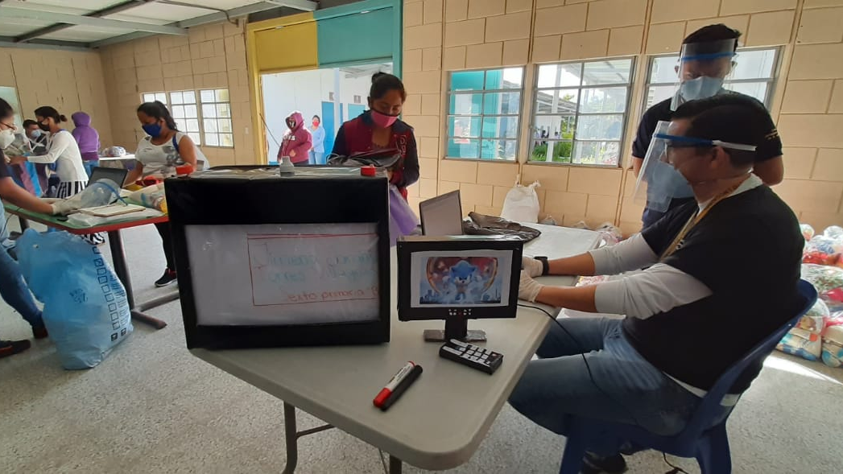
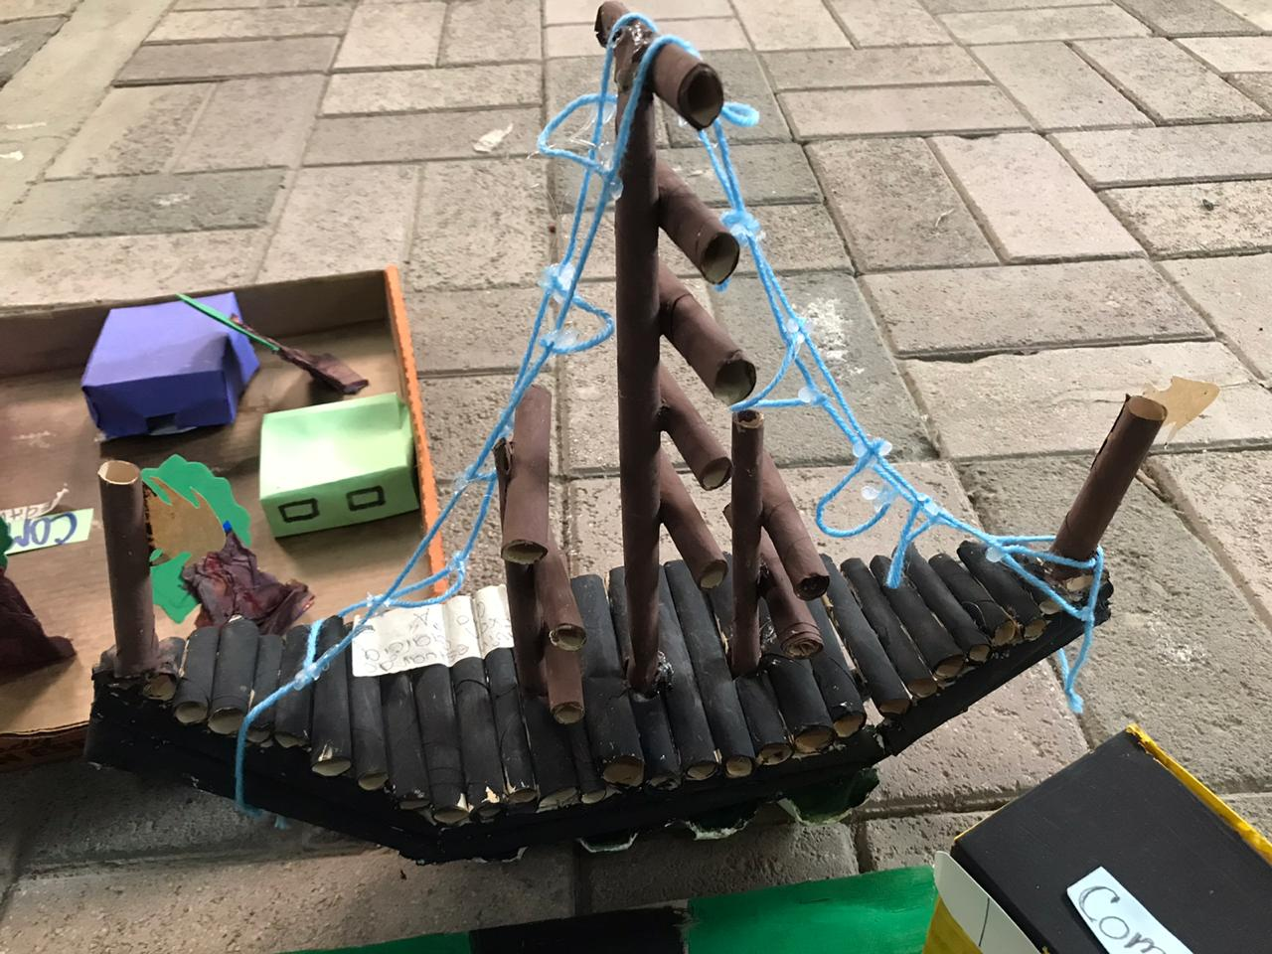
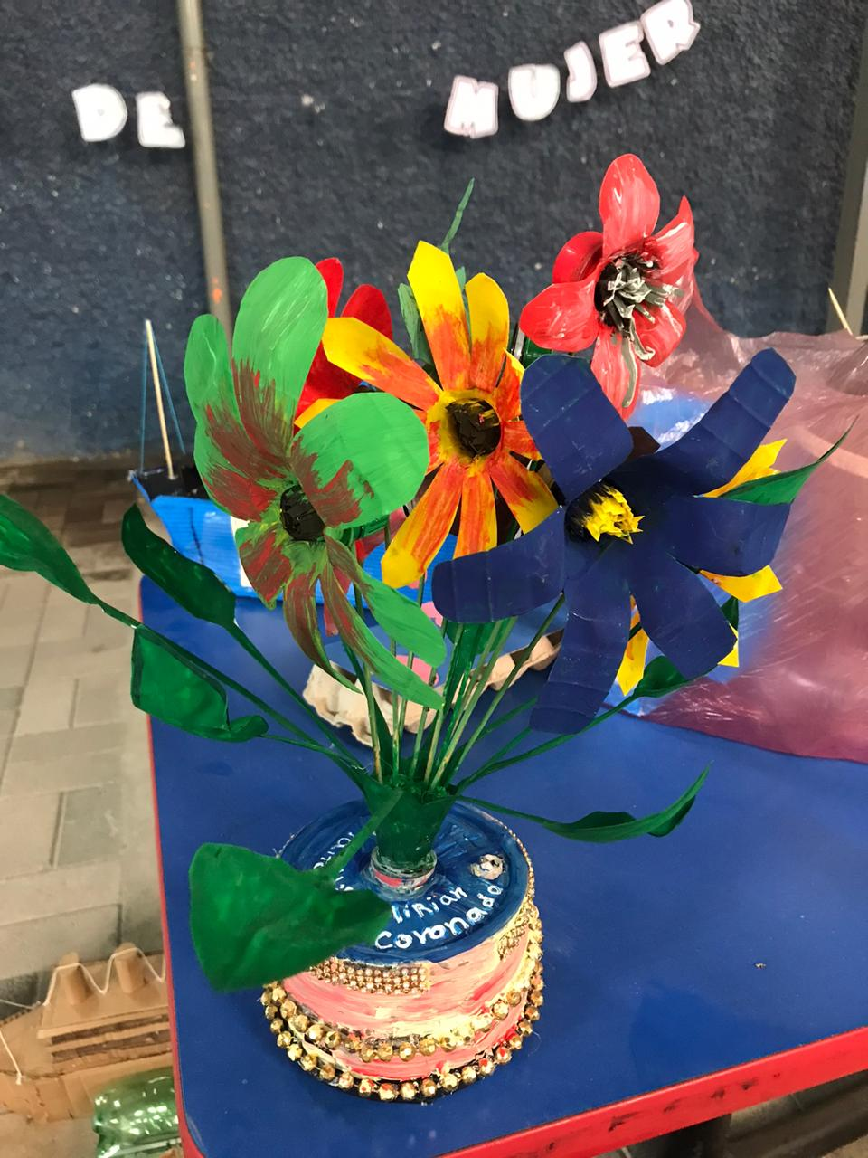
Distance Learning
Physical Packets/Hands on Projects
Use of smartphone technology to create instructional videos
Access to teachers by phone to answer questions and give feedback

Slide 9
Health and Wellness
Tele-medicine and Tele-psychology
Available office hours for access to Pediatrician and Psychologists
Social Workers
Pharmaceuticals
Regular communication with families to assess needs and mobilize resources to address crises
Call in Prescriptions to local pharmacy for families to acquire needed medication

Slide 10
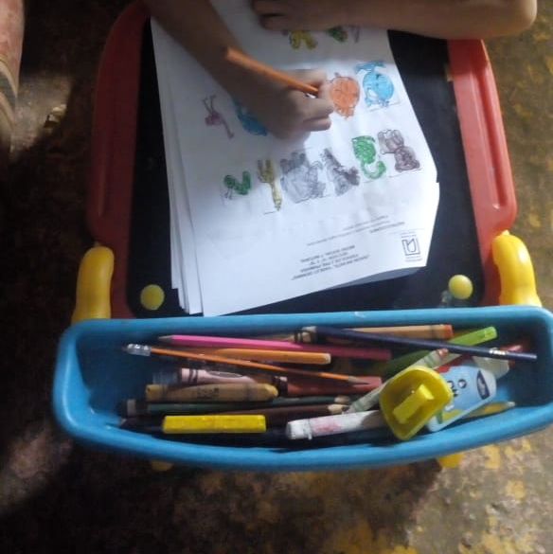
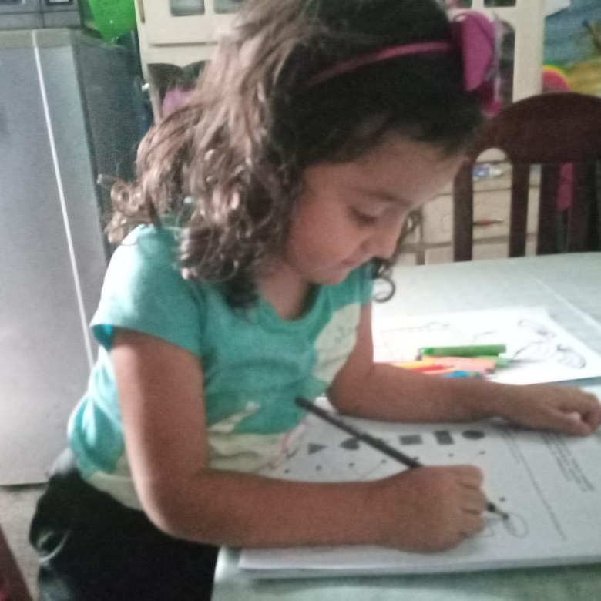
2020-22: Two Years of Distance Learning
93% Students Maintained in Program
88% Advancement Rate
96% Teacher Retention
Computers and Data for all Teachers
Training in Online Content Delivery
Learning Family Collaboratives
Teacher Ambassadors
Instructional Videos
3 Vaccination Clinics

Slide 11
17%
Estimated graduation rate for high school in the communities surrounding the garbage dump.
What is the test of a successful program? How do we measure the impact of our work?
92%
Successful grade advancement and HS graduation rate for our students in 2020-2022
88%
Successful placement rate in formal economy or higher ed after graduation

Slide 12
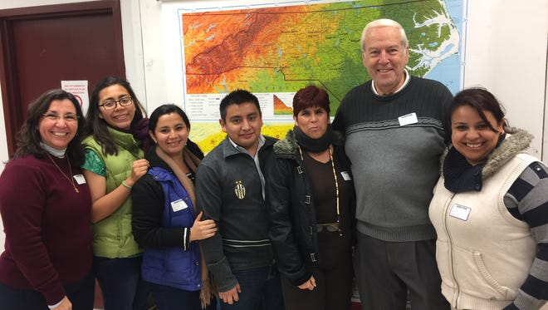
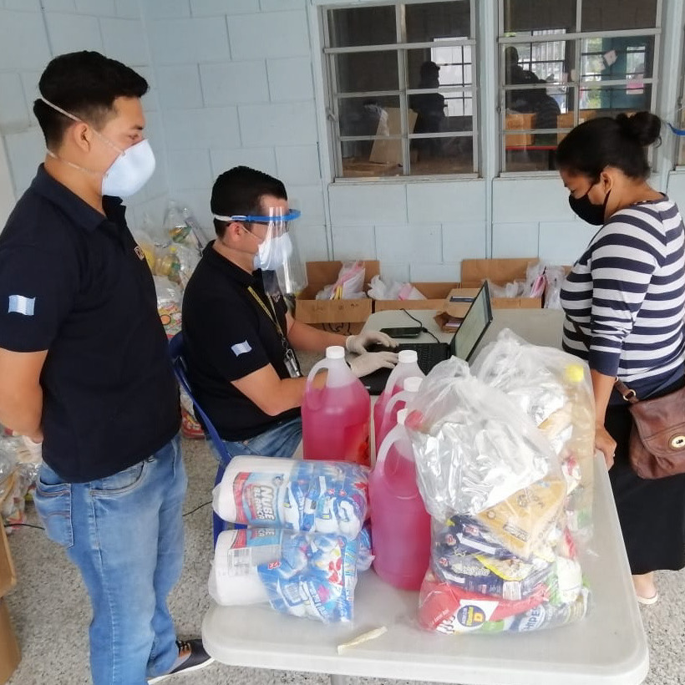
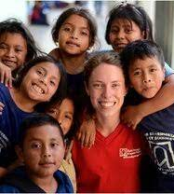
16 Years of Support and Partnership
2006 to 2014
New fleet of vehicles to transport students
Playgrounds for Preschool
2015 to 2019
Sanitation System
Food and school materials
Development and implementation of Expeditionary Learning
Trauma Informed Practice
2020 to present
Emergency food deliveries
Science Lab/Equipment
Computers and books
Teacher training (virtual learning)

Slide 13
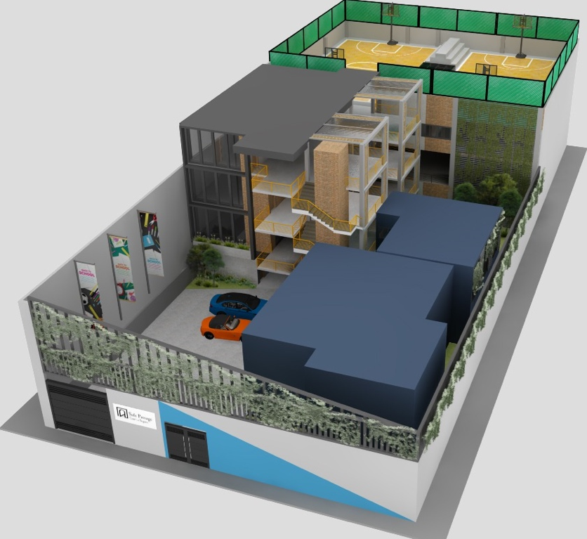
Innovative Learning Center
Fundraising for the new construction has been completed and permitting underway
Construction will begin in 2022 with opening in 2023
Facilities include classrooms for Middle School Grades, Health and Wellness Clinic, Media Literacy Center, Sports Facilities and Community Center
Lower utility and energy bills lead to more affordable maintenance and operations, and over time mitigate upfront costs of construction and sustainable systems.

Slide 14
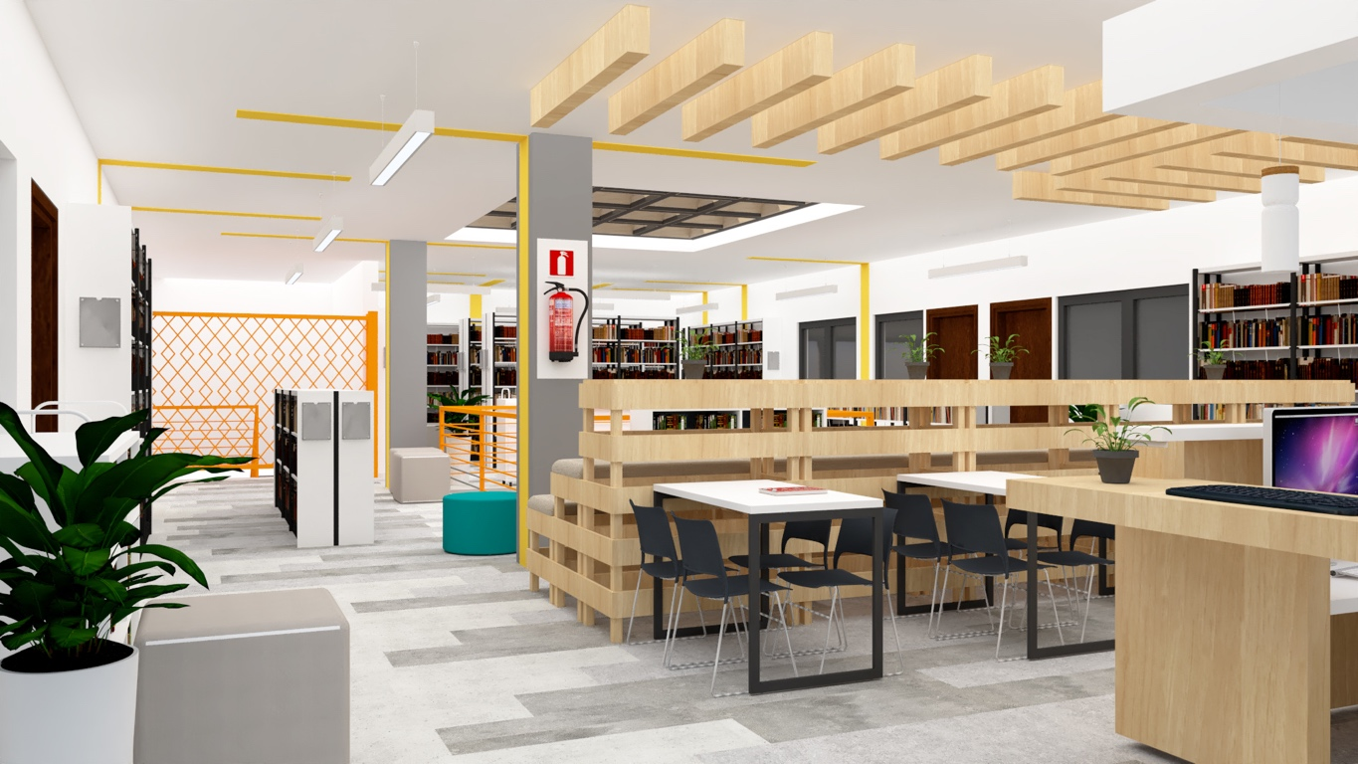
The design of our learning spaces moves beyond teacher-centered models to the students, who no longer just an audience, are allowed greater flexibility and individual learning support . Curiosity is encouraged and collaboration the key. Our space design promotes sharing of knowledge and provide multiple opportunities for interaction to discuss, shape and explore concepts.
Multi-Resource Center and Flexible Learning Commons

Slide 15
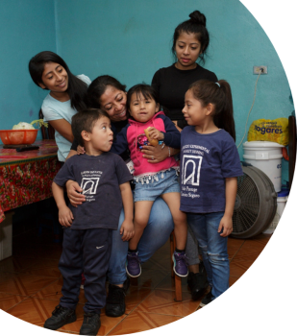
New Early Childhood Center
Pilot Program for 3-year-olds to commence in 2022
Aspiration is to expand the program downward in the coming years, adding an additional level per year
Combining childcare and full spectrum health, nutrition and developmental intervention with parental training
Early childhood center will form a bridge between lower ages and our existing pre-primary program (begins at age 4)

Slide 16
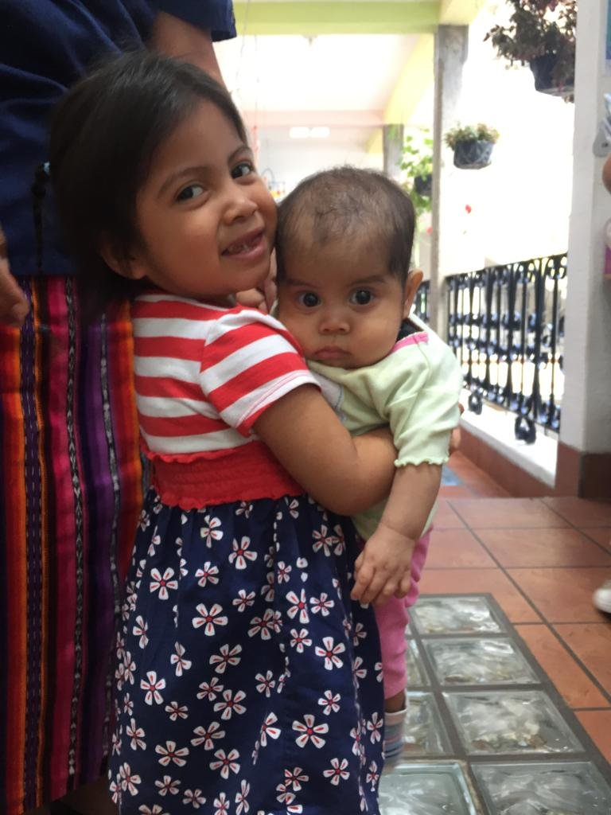
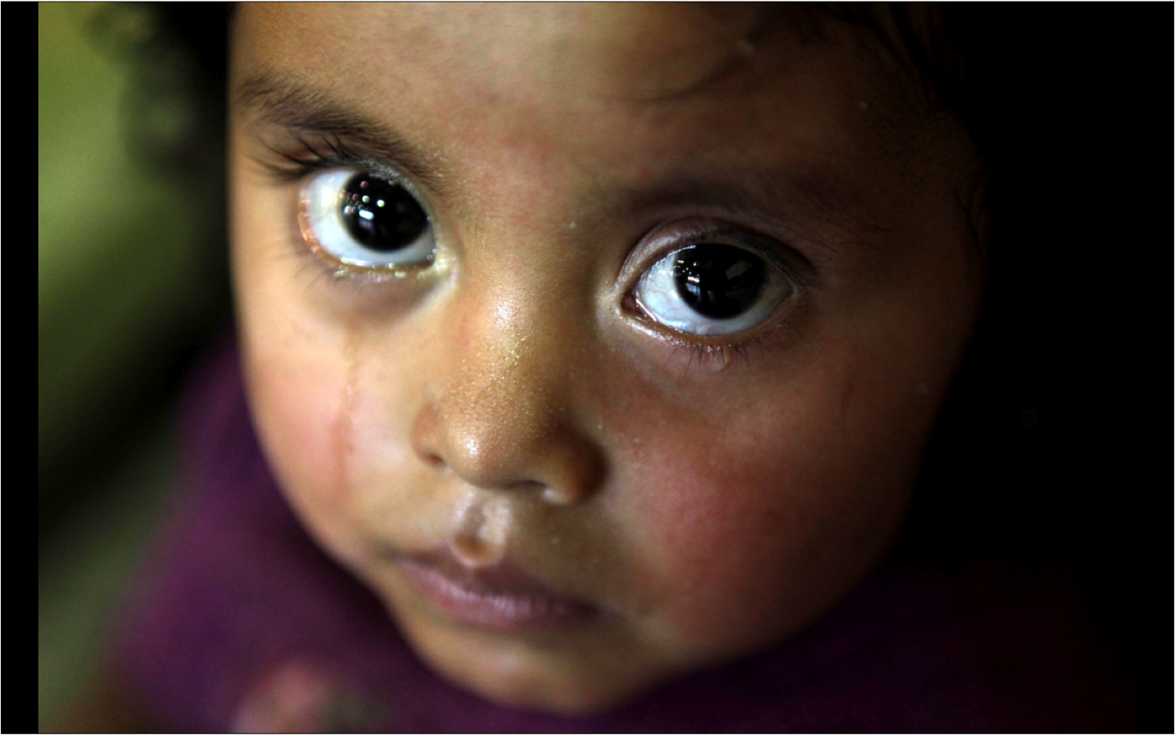
New Early Childhood Center:
an emergency need
There are no viable full day childcare options for families in our community
In many cases, mothers must decide between work and leaving children alone
The first thousand days of a child’s life represent the period where over 80% of their cognitive development occurs
At present young ones entering our Pre-Primary program at age 4 present developmental deficits averaging in the 30th percentile

Slide 17
On behalf of all of us at Safe Passage, thank you for your care and support.
Questions?
footer

