Slide 1
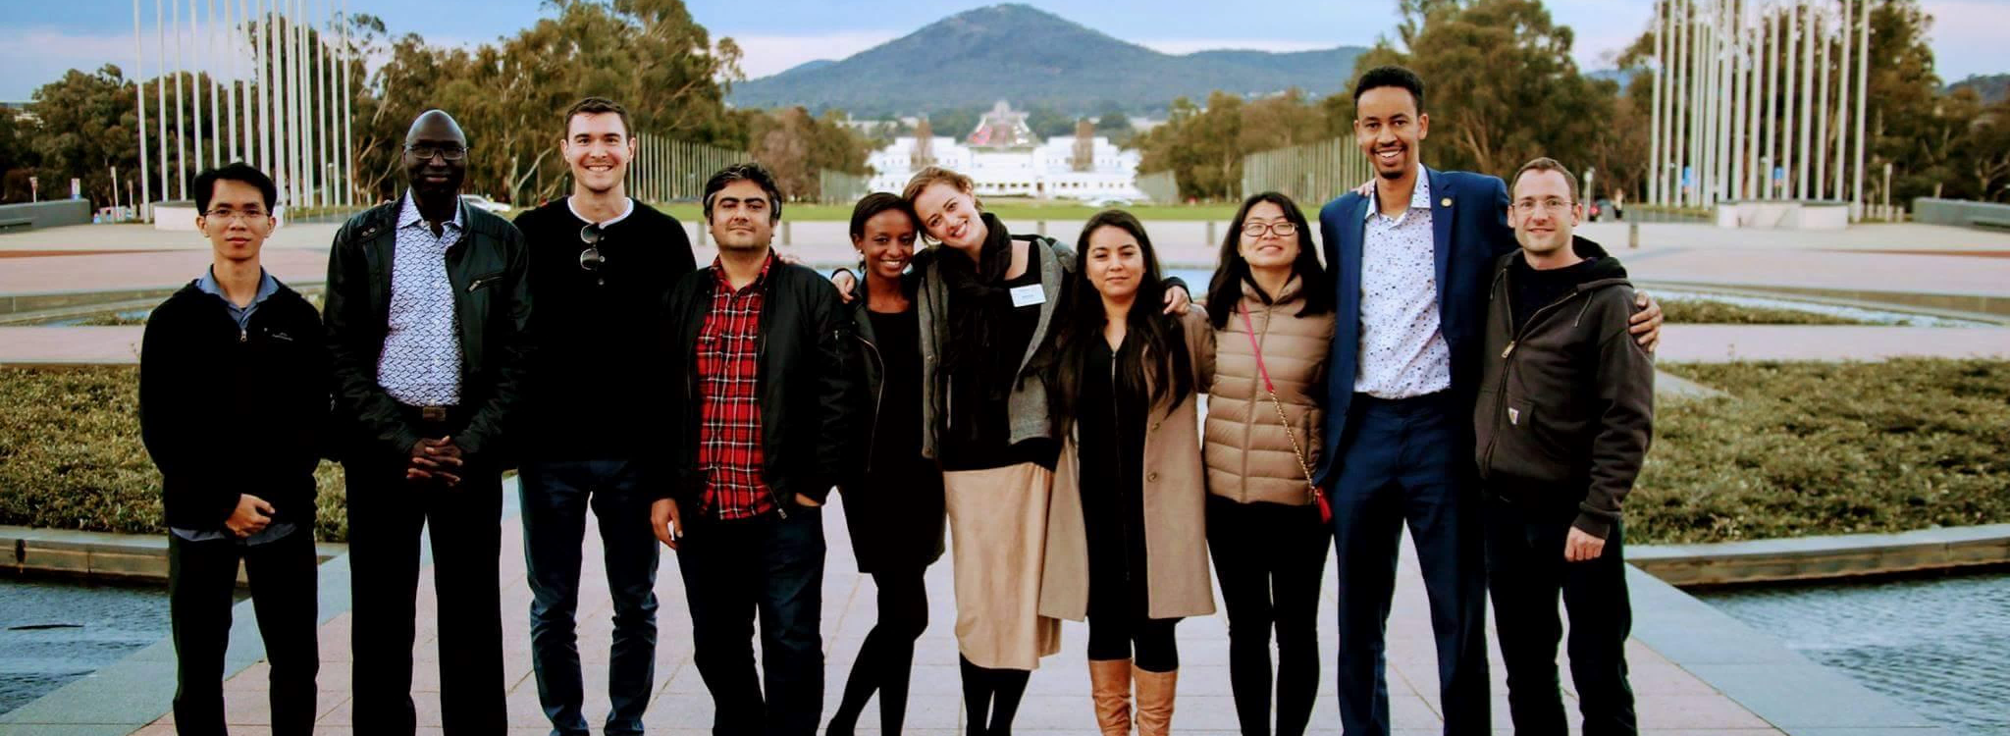
Rotary Peace Centers Fellowship
Notes:
In this presentation, you’ll learn about Rotary Peace Fellowships and the Rotary Peace Centers, hear from alumni who are working in the peace and development field, and find information on how to apply for a fellowship program.

Slide 2
Global Grant Scholarship vs.
Rotary Peace Fellowship?
Global Grant Scholarship
Peace Fellowship
Funded: by Club and District
Qualifications: Bach degree and acceptance letter.
Application process open year- round. For scholars with a Fall start, date must complete/send grant application to District by 15 May and then TRF by 30 Jun.
Selection: virtually any international university.
University Acceptance: Before selection
Decision: Foundation decision takes about 3-4 weeks.
Reports: Annual & final grant progress report by club.
Funded: Entirely by RI
Qualification: Bach. degree and three years field experience.
Application process season open only from Feb - Jun each year. Vetted applicants must reach District committee for interview by 1 Jun, endorsement to TRF by 1 July.
Selection: restricted to eight select universities offering Rotary fellow program.
University Acceptance: After selection
Decision: TRF decision takes four months, announced in November for July academic start.
Reports: None
Highly competitive !

Slide 3
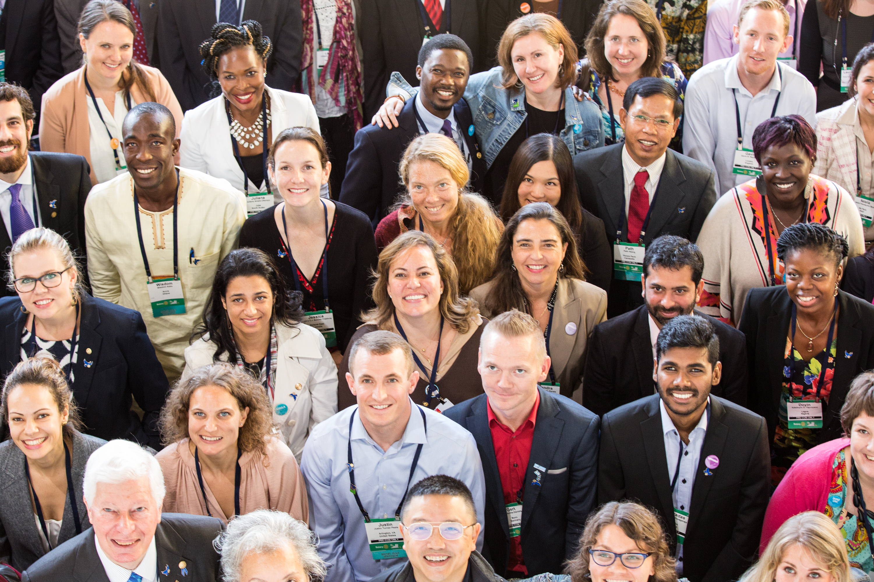
Rotary Peace Centers - Fellowships
The Rotary Peace Centers program has a vision of sustainable peace:
encompassing a network of peacebuilders and community leaders dedicated to preventing and resolving conflicts across the global community
Notes:
The Rotary Peace Centers program was established in 2002 with a vision of creating sustainable peace, by building networks of peace builders and community leaders dedicated to preventing and resolving global conflicts.

Slide 4
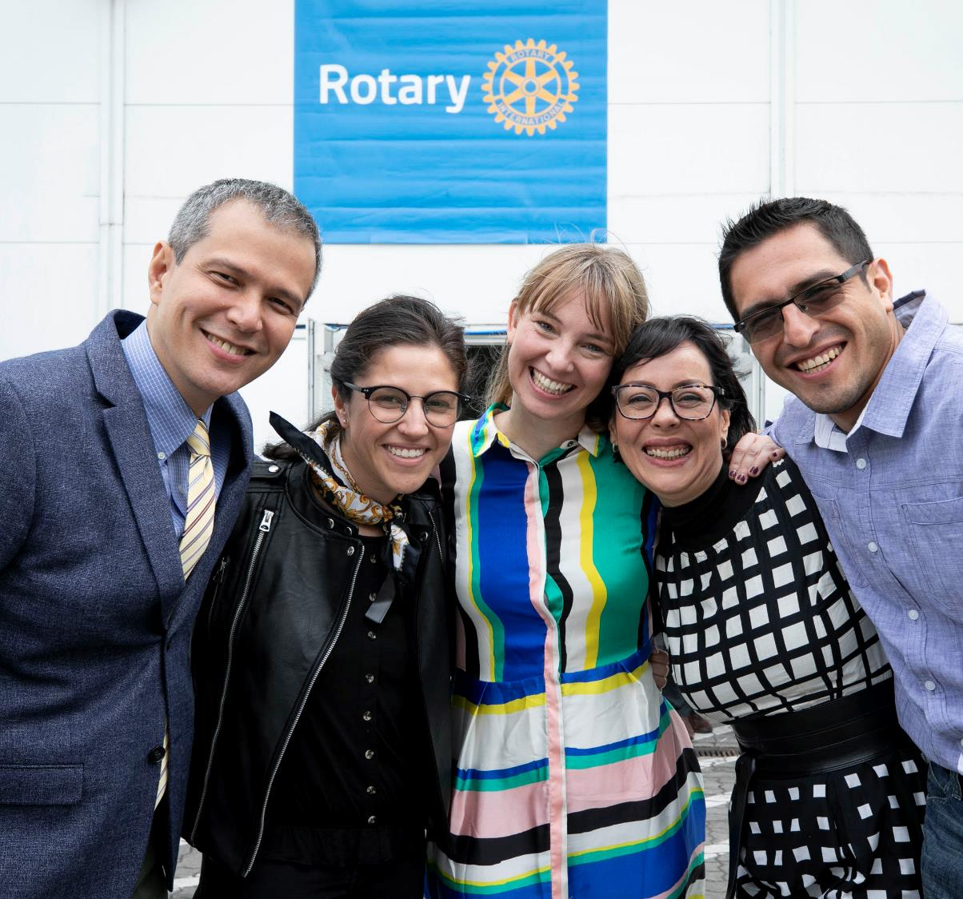
Rotary partners with eight leading universities to host Rotary Peace Center programs that empower, educate, and increase the capacity of peacebuilders.
Notes:
To serve this vision, Rotary has developed partnerships with eight renowned universities that host the Rotary Peace Centers. The centers empower, educate, and increase the capacity of peacebuilders through rigorous academic training, practice, and global networking opportunities.

Slide 5
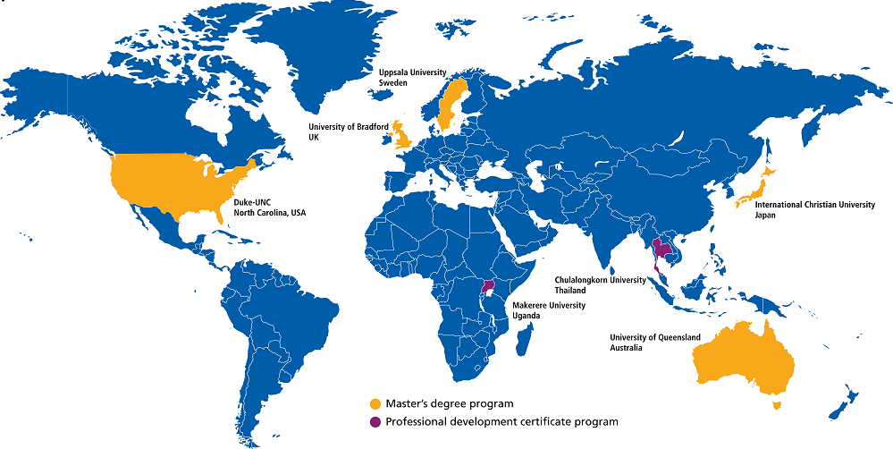

Rotary Peace Centers
Notes:
We have seven Rotary Peace Centers at eight universities.
Five centers offer master’s degrees in disciplines related to peace and development:
A joint program at Duke University and the University of North Carolina-Chapel Hill, USA
International Christian University, Japan
University of Bradford, England
University of Queensland, Australia
Uppsala University, Sweden
Two centers, at Chulalongkorn University in Thailand and Makerere University in Uganda, offer a professional development certificate in peace and conflict studies. The yearlong program blends online learning, classroom studies, and a social change initiative.

Slide 6
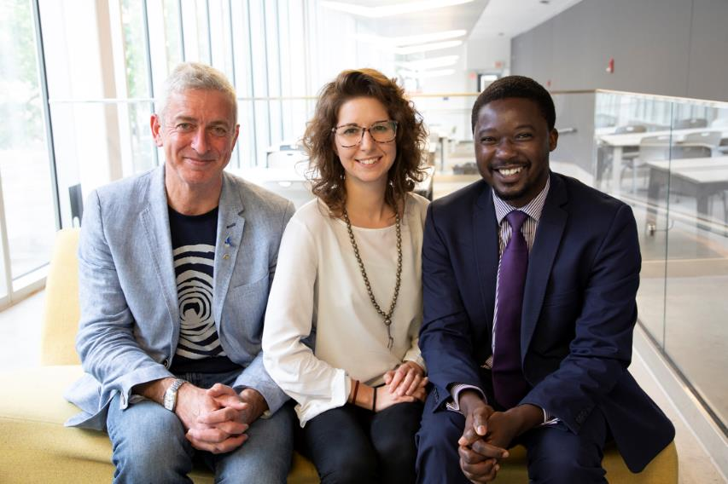
Master’s program:
Those near the start of their careers
50 fellows per year (10 per center)
15-24 month course
Certificate program:
Proven peace and development leaders
80 fellows per year (20 per cohort)
One-year program
Up to 130 Rotary Peace Fellows are chosen annually
Notes:
Up to 130 Rotary Peace Fellows are selected each year to earn a master’s degree or a professional development certificate.
The two programs were created to provide those near the start of their careers, as well as those with proven experience, with the educational opportunities that will further their careers in peacebuilding and development.
Each year, 50 fellows are assigned to a master’s program (10 per center) that lasts from 15 months to two years.
Up to 80 fellows are selected to participate in the one-year certificate program, with two cohorts of up to 20 fellows participating at each of the two certificate centers.

Slide 7
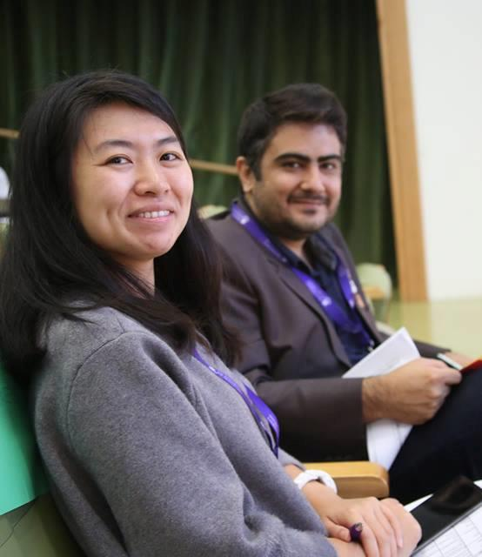
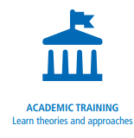
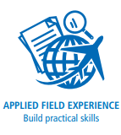

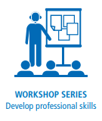
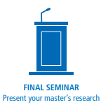
Master’s program
Fellowship components
Notes:
Teaching in the master’s programs is grounded in practical research. Students are enrolled graduate students with diverse backgrounds and professional experience.
Fellows selected for the master’s program benefit from:
Academic training with diverse curriculums. The centers build on the unique strengths of their university hosts and offer courses that examines peace and conflict through various frameworks. At all centers, the core coursework includes peace and conflict resolution with a focus on negotiation, mediation, human rights, or international development.
A fully funded applied field experience of 2-3 months that they design and carry out. It’s an opportunity to put theory into practice.
Opportunities to network with a cohort of diverse peace fellows as well as with Rotarians at home and in their host countries.
A Rotary-sponsored workshop series that helps them develop professional skills in resiliency.
The chance to present their research during an annual seminar hosted by the universities and local Rotarians.

Slide 8
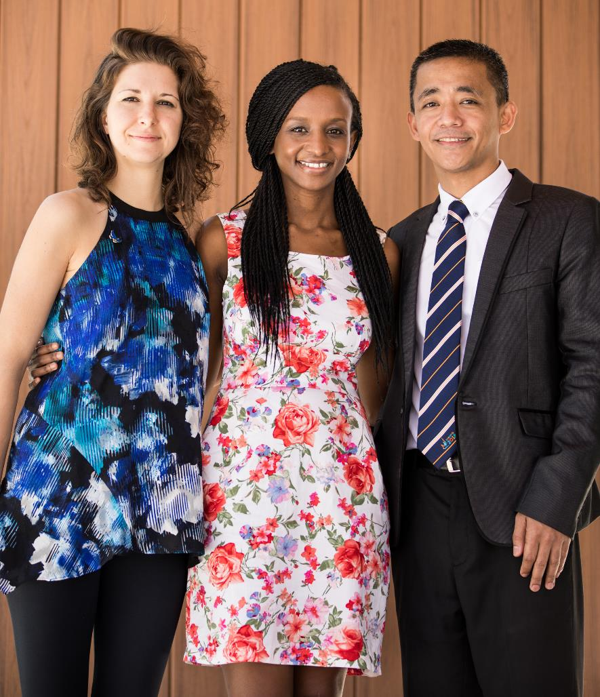
Master’s degree candidates must:
Be proficient in English
Have a bachelor’s degree
Have a strong and proven commitment to cross-cultural understanding and peace
Demonstrate leadership skills
Have at least three years of full-time experience in peace or development work
Notes:
The ideal master’s candidate is academically strong, has a bachelor’s degree in a related field, and has work experience in peace and development.
Candidates need to demonstrate a commitment to peace and conflict resolution, be able to undertake extensive reading and discussion in the pursuit of knowledge, and be able to actively participate within a diverse cohort of students.
After the program, candidates should be willing to share their own work and experience, staying in touch with peace fellows in their region and maintaining strong connections with Rotary members.
Master’s degree candidates must also:
Be proficient in English
Have a strong commitment to cross-cultural understanding and peace as shown through professional and academic achievements and personal or community service
Demonstrate leadership skills
Have at least three years of full-time experience in peace or development work

Slide 9
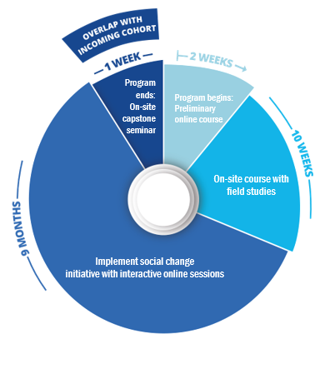
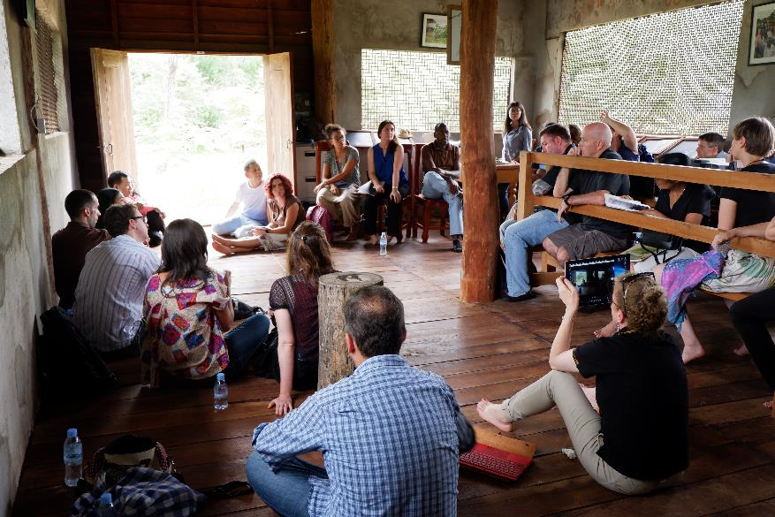
Certificate program
Fellowship components
Notes:
The professional development certificate program is aimed at people who are already working in a related field.
During the one-year program, students with diverse backgrounds and professional experience gain practical skills to promote peace in their communities and around the globe. Fellows complete field studies and they design and carry out a social change initiative.
Rotary selects a cohort of up to 20 peace fellows twice per year for each center. The cohorts will have some overlap to encourage a sense of community and increase networking opportunities.
The program includes:
An online preliminary course that provides baseline knowledge and sets expectations for incoming fellows
A 10-week on-site course that includes field studies
An independent project period during which fellows work on a social change initiative in their community or workplace. They receive interactive online sessions and mentorship.
A one-week capstone seminar for fellows to reflect and report on their Positive Peace efforts and the impact.

Slide 10
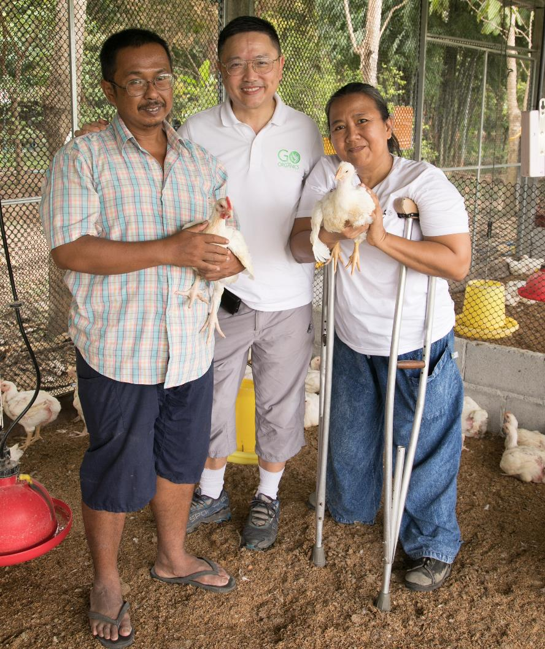
Certificate candidates must:
Be proficient in English
Have a bachelor’s degree
Have a strong and proven commitment to cross-cultural understanding and peace
Demonstrate leadership skills
Have at least five years of full-time experience in peace or development work
Be able to explain how their plan to promote peace aligns with Rotary’s mission
Candidates for Makerere University should
also either be from the region or working
in the area.
Notes:
The ideal candidate is a proven peace and development leader with at least five years of relevant work experience.
Candidates need to come to the program with an idea for a social change initiative to promote peace and development in the program region or their community. They also need a clear vision of how the fellowship experience and network will advance their peace work and increase their impact.
After the program, candidates should be willing to share their own work and experience, staying in touch with peace fellows in their region and maintaining strong connections with Rotary members.
Certificate candidates must also:
Be proficient in English
Have a bachelor’s degree
Have a strong commitment to cross-cultural understanding and peace as shown through professional and academic achievements and personal or community service
Demonstrate leadership skills
Be able to explain how their plan to promote peace aligns with Rotary’s mission
Candidates for Makerere University should also either be from the region or working in the area.

Slide 11
Master’s funding includes:
Tuition
Room and board
Travel to and from country of study
Internship expenses
Conference/research expenses
Insurance
Contingency fund
Certificate funding includes:
Tuition
On-campus accommodations
Travel to and from country of study
Field study expenses
Course materials
Insurance
Fellowship funding
Total average funding:
Master’s fellowship: US$75,000
Certificate fellowship: US$11,000
Notes:
The Rotary Peace fellowship is generous and comprehensive.
The fellowship funding includes tuition, accommodations, travel, and field experience expenses.

Slide 12
Timeline
2022 Rotary Peace Fellowship
Important Dates and Deadlines for Districts
January Complete all required trainings in the Rotary Learning Center; Submit district capacity survey; Appoint a subcommittee.
1 February - 15 May 2022 Rotary Peace Fellowship application opens. Recruit and connect with candidates using promotional materials and other resources for Rotarians on our website.
15 May Completed applications due. Staff will review all submitted applications and assign those that are eligible, qualified, and complete to Embark queues for endorsement consideration.
1-30 June Review applications and interview candidates. Submit an endorsement decision for each candidate in Embark.
1 July District endorsements due.
Notes:
The application process is a collaboration between candidates and their local Rotary district.
Candidates can access the online application beginning in February.
They must contact a Rotary district to request an interview and endorsement, which are required for consideration.
Candidates are encouraged to engage with a Rotary club to learn about Rotary’s work in their community and globally.
Candidates submit the online application to their district by 31 May. Districts send endorsed applications to Rotary by 1 July.
Between July and October, the Rotary Peace Centers Committee, composed of Rotarians and university representatives, screens applications and selects the ﬁnalists.
All applicants are notified of the results in November. Master’s finalists then apply to the university for acceptance.

Slide 13
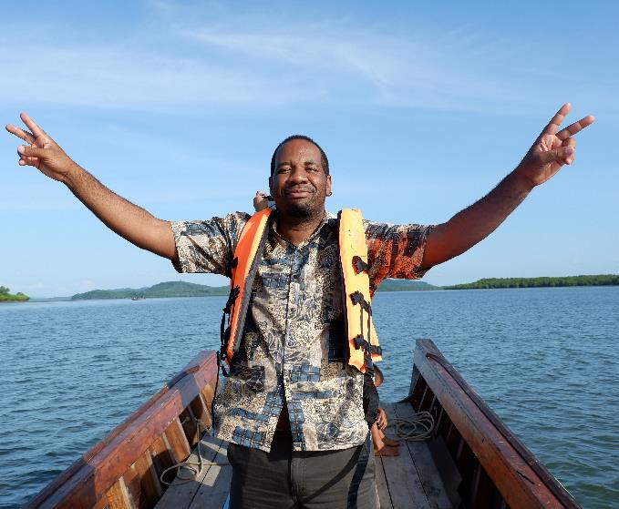
How to apply
Visit rotary.org/peace-fellowships to see the eligibility requirements and restrictions. Applications are available in February.
Research the curriculum and programs at each Rotary Peace Center. Prepare to rank two centers for the master’s program and choose one for the certificate program.
Connect with a local Rotary district to request an interview and endorsement, which are required.
Use the Club Finder to locate a club near you and engage with Rotary.
Submit the online application to the district by 15 May. You’ll be notified of the Rotary Foundation’s decision in November.
Once selected, master’s fellowship finalists must apply separately for university admission.
Notes:
The application process is a collaboration between candidates and their local Rotary district.
Candidates can access the online application beginning in February.
They must contact a Rotary district to request an interview and endorsement, which are required for consideration.
Candidates are encouraged to engage with a Rotary club to learn about Rotary’s work in their community and globally.
Candidates submit the online application to their district by 31 May. Districts send endorsed applications to Rotary by 1 July.
Between July and October, the Rotary Peace Centers Committee, composed of Rotarians and university representatives, screens applications and selects the ﬁnalists.
All applicants are notified of the results in November. Master’s finalists then apply to the university for acceptance.

Slide 14
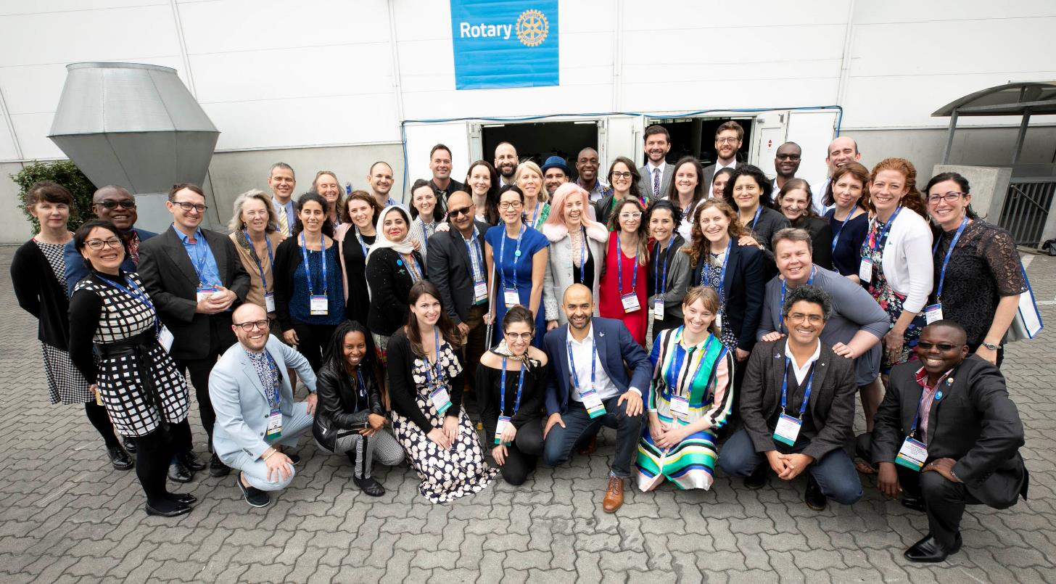
Rotary Peace Centers
For more information
https://www.rotary.org/en/peace-fellowships
Caption here. Replace the map image with a graphic from the web or your documents.

Slide 15
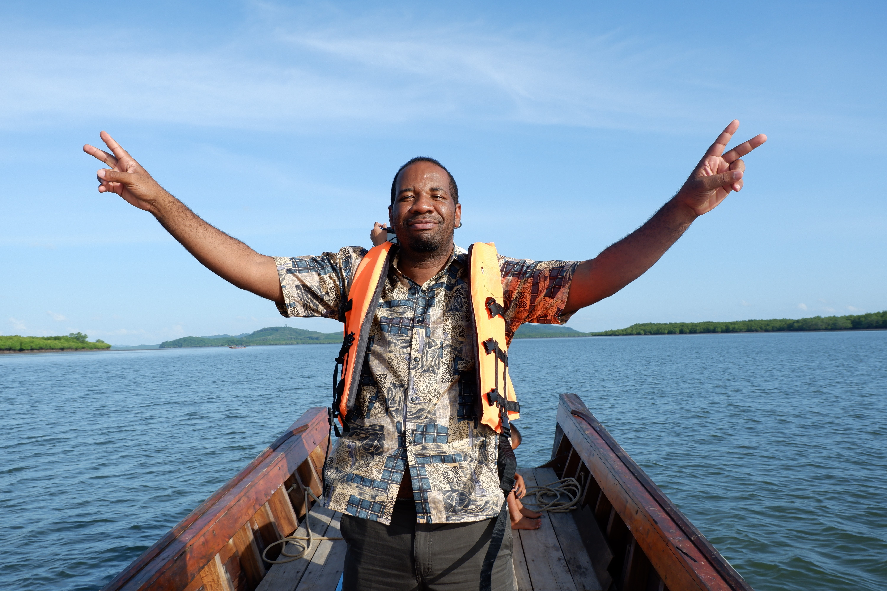
Resources
Visit www.rotary.org/en/peace-fellowships to access resources
For future applicants:
Application instructions
Tips to improve your application
Fellowship Guides (Master’s and Certificate)
Application checklist video
APPLICATION DEADLINE
  15 May to Rotary District
  1 July to The Rotary Foundation
Notes:
The Rotary Peace Centers website has many additional resources that are available online to assist you and potential applicants.
Application step-by-step instructions
A tips sheet for applicants to improve and strengthen their application
Master’s and Certificate program fellowship guides
The application checklist video

Slide 16
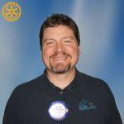
Rotary Peace Centers
For more information
Milton T Butterworth milton.butterworth@unchealth.unc.edu Cell: 828-551-5537 Rotary Club of Hendersonville
Caption here. Replace the map image with a graphic from the web or your documents.

