Slide 1
TRF is ROTARY’S Way of DOING GOOD IN THE WORLD
Notes:
What difference does one contribution make? It’s a raindrop, but If your contribution joins 1.2 million other Rotarian contributions, it becomes a river of Good Will.

Slide 2
Grants Management Seminar –
Global Grants,
What You Need to Know
John Davis
Dist 7670 Grants /Global Grants Chair
coljohnret@gmail.com
GMS 5 March 2022
v3

Slide 3
Goals of Presentation
Answer 5 Questions:
What is a Global Grant
What are the 3 types of Global Grants
What are the basic considerations
How Can Your Club Participate
What’s Important

Slide 4
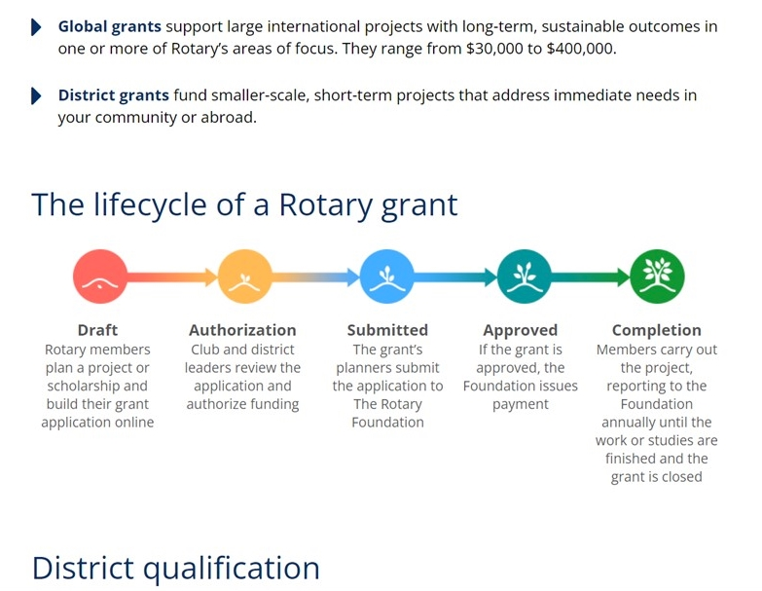
Grant Process

Slide 5
Three Types of Global Grants
Humanitarian project Address community needs and produce sustainable, measurable outcomes
Water and Sanitation construction projects, medical equip, rehab structures, educational equipment, furnishings (limited), etc.
Vocational Training Teams Build skills within a community by sending teams of professionals that will travel abroad to train or learn from host country they visit
Medical Teams (doctors, dentist, nurses)
School Teachers exchange
Scholarship Programs Fund international graduate-level study for a career within an Area of Focus

Slide 6
A Global Grant Is
Large, International project, value at least $30,000
Must have a Partnership with an overseas club and/or district
Responds to Community Needs & requires a Community Assessment
Align with one Rotary Areas of Focus
Measurable, Sustainable Outcome
Three sources of funds: Club, DDF & World Fund 80% match of DDF
Timing- Flexible, multi-year, no deadline

Slide 7
First Consideration-
Community Needs Assessment
Document the Need - Humanitarian and VTT applicants required to formally document the need
Describes Beneficiary Community
Demographics
Who conducted assessment
Methods
Community Participants
The need your project addresses
What is their need, not our perception of need? i.e. Toxic Charity
Project’s primary goal and how to accomplish
Challenges
Documented results are uploaded in your grant application
District grant funds may be used to fund assessment site visit

Slide 8
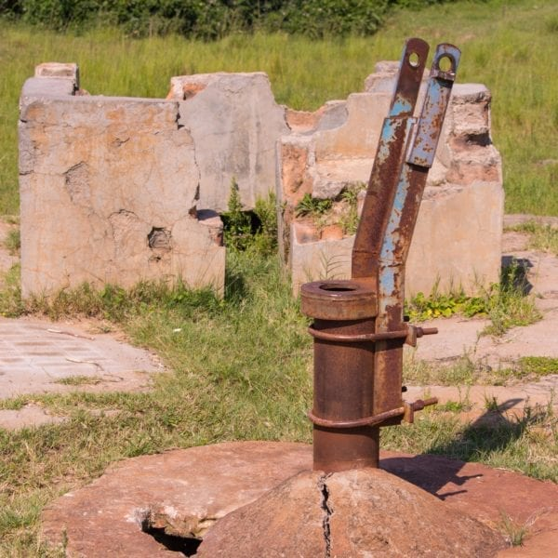
The Project Must be Sustainable
Sustainability – Giving a community the skills, knowledge and means to maintain project outcome for the long-term, after Rotary leaves
Locally sourced materials and products
Easy to maintain
Training
Timely Repairability & Affordable
Don’t create toxic charity
Nigeria - abandoned water well after 5 years
due lack of community maintenance

Slide 9
Rotary Areas of Focus
Your grant must meet Rotary Area of Focus criteria
(see TRF Rotary Grants Terms and Conditions)
Peace and Conflict Prevention/Resolution
Disease Prevention and Treatment
Water and Sanitation
Maternal and Child Health
Basic Education and Literacy
Economic and Community Development
Supporting the Environment (July 2021)
New

Slide 10
GLOBAL GRANT SCHOLARSHIPS
Must be Graduate level
Area of Study aligns with 1 of 7 Rotary Areas of Focus
Study periods of 1-4 years
Selected area of focus strongly relates to:
1. Previous work, volunteer, and study experience
2. Selected Academic program
3. Future career plans (immediate and long-range)
Host and international sponsor clubs
$30,000 minimum budget

Slide 11
How Can Your Club Participate
Is your club qualified? Attended the GMS?
Identify project, conduct needs assessment, a site visit*
Create strong partnership with host country club, the community and NGO
Partner with other Dist 7670 clubs $$$$
Outline your application “Global Grant Application Template”
Define project plan with clear partner roles and responsibilities, objectives and measurable outcomes in area(s) of focus
Define budget needs and start a funding campaign
Your application will be reviewed/approved by the Dist. 7670 Foundation Committee

Slide 12
“We’re Here to Help” coljohnret@gmail.com
How we are Structured
District Grants
John DeWitt
Grants Sub-
Committee Chair
john Davis
Scholarships TEAM
Next Slide
Global Grants
Humanitarian Grants
Peace Fellowships
Milton Butterworth
Vocational Training
Team

Slide 13
“We’re Here to Help” 2022-2023 Grant Team members
Rick Molland (Madison County) cell: 828 450 8040 rmolland@frontier.com
Rachel Hoskins (Franklin) cell: 828 421 2859 rhoskins@thefranklinpress.com
Fred Hartley (Tryon) cell: 828 244 1470 hartleyfred46@gmail.com
Jason White (Catawba Valley) cell:423 341 4965 whitejason17@gmail.com
Judy Chapman (Franklin) cell: 828 371 4511 jchapman@dnet.net
Paul Garner (Franklin) cell: 407 913 4216 paulgarnerrotary@gmail.com
Sarah Leatham (Hendersonville) cell: 828 606 1740
sarahleatham@gmail.com
“We’re Here to Help”

Slide 14
Applying for a Global Grant
Read !! the references found on TRF Grant Center web page sidebar
A Guide to Global Grants
Terms and Conditions for Rotary Foundation Grants
How to use the Grant Center
Use the Global Grant Application Template
To Start the application process:
Log in https://my.rotary.org
Tab “Take Action”, “Apply for Grants”, “Global Grants”
Tab “Tools” Start your grant application

Slide 15
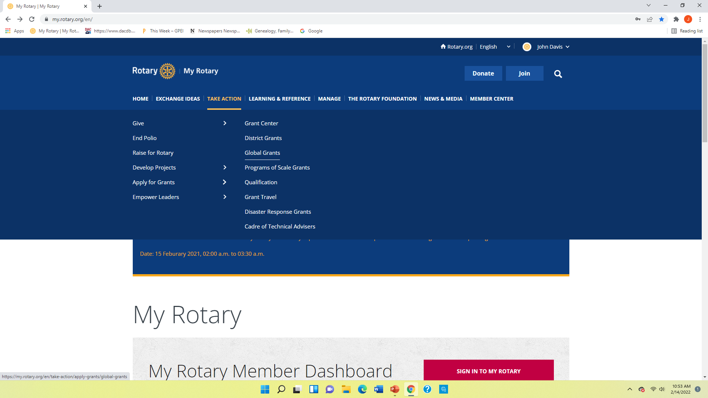

Slide 16
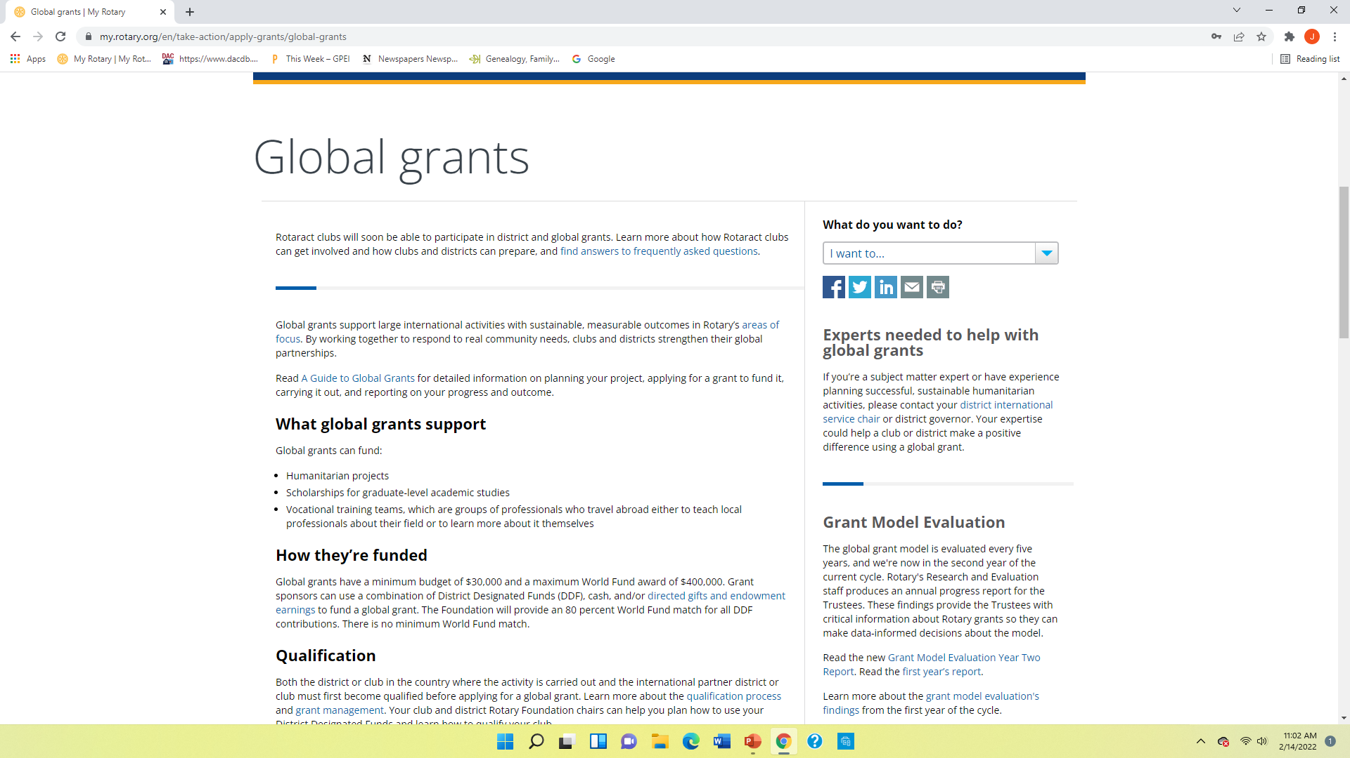

Slide 17
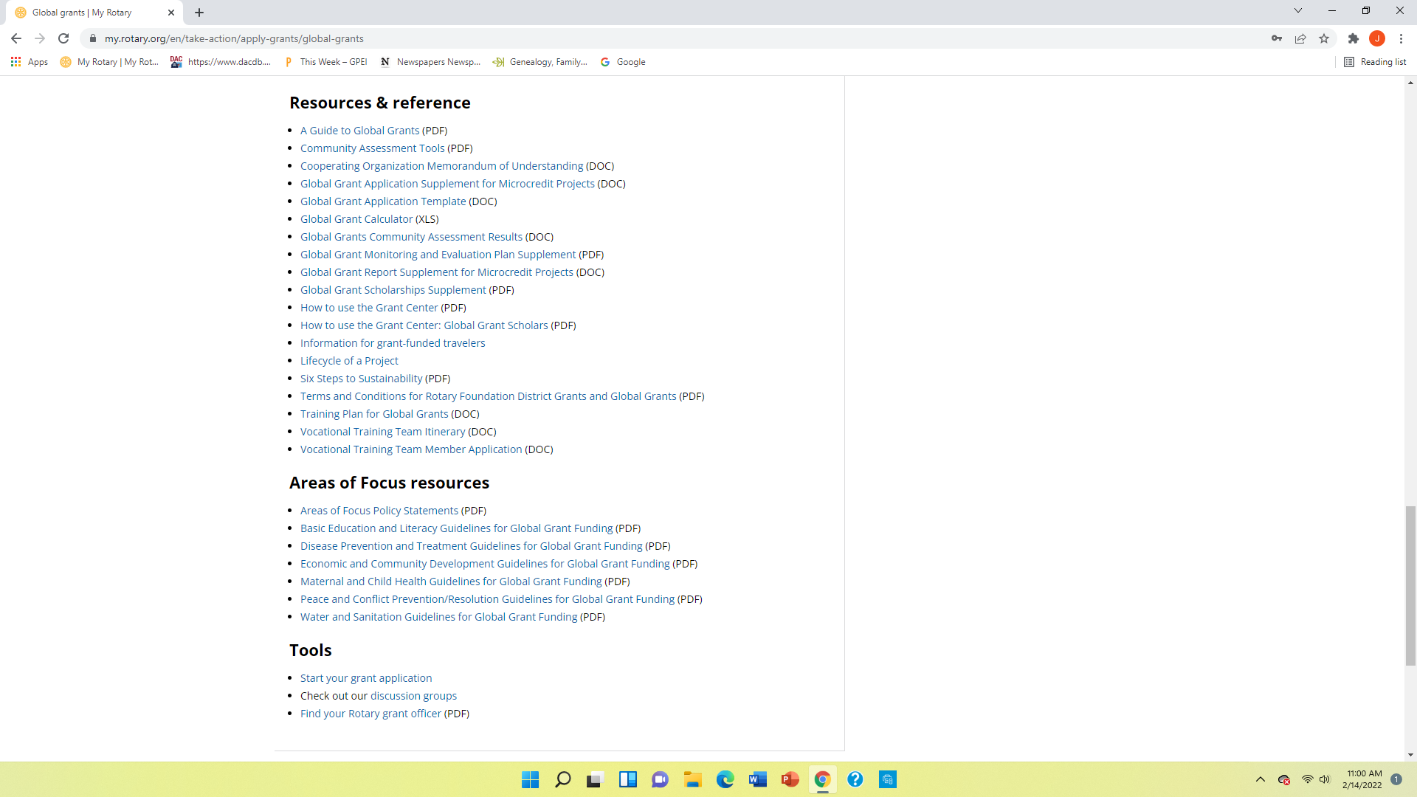

Slide 18
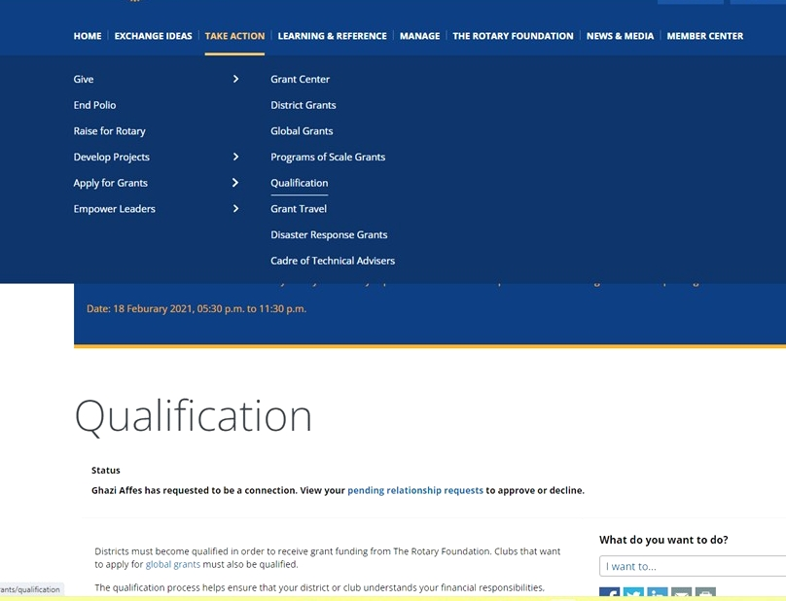

Slide 19
Understanding Your Funding
Three sources of funds:
Donor cash from clubs and individuals
District 7670 District Designated Funds (DDF)
Rotary Foundation World Fund “matching funds”
How it works: World Fund will match DDF $1 with $0.80
Example
Club Cash $ 8,000 W.F. Match
7670 DDF $ 15,000 = $15,000 x $0.80
W.F. Match $ 12,000
Total $ 35,000
Note: TRF will charge a 5% fee on all of your cash donations if sent and held at The Rotary Foundation.
Clubs $84.8
Value Added
Clubs
$8,000
World Fund
$12,000
DDF
$15,000

Slide 20
Global Grant Life Cycle
Draft - Partners plan project and draft application on TRF website
Authorization - Both Clubs and their district leaders must sign off on the application and the use of funds
Submit - Grant planners submit application to TRF
TRF Approval & Payment -TRF Regional Grants Officer (RGO) will review and approve. Then forward payment instructions and grant payment to your selected bank acct.
Execution Phase - Partners carry out the project Keep good records!
Reports- Annual progress reports to TRF (Final report with in two months of completion )

Slide 21
What’s Important
Needs Assessment
Solid Partnership
Good Planning
Communications
Good Stewardship
Timely Reports
Get to know your Regional Grants Officer at TRF

Slide 22
Good Stewardship “Responsible and careful management of Rotary Foundation grant funds”
Did your project -
Meet the objectives and measurable outcomes of the grant application?
Meet the goal of the Area of Focus?
Use grant funds according to approved budget?
Will your project outcome be sustainable overtime?
Then provide detailed documentation and accounting data -
Evidence of completion - project activity photos, brochures, news articles, etc
Spreadsheet or journals summarizing line items expenditures
Copies of receipts, purchase orders
Bank statements, cleared checks
Submit Progress Reports with documentation to the Rotary Foundation every 12 months and final report within 2 months of completing grant.
Dist 7670 Stewardship Committee will audit your final report before it is signed off and forwarded to TRF

Slide 23
LESSONS LEARNED
PATIENCE
The planning and application process may take many months.
TRF may challenge your project’s need’s assessment, sustainability, training and required partner MOU.
UNDERSTAND
Your host partner’s culture. It will be different. They may be hesitant to act, slow to communicate (poor Internet), and have convoluted banking system. Be patient !

Slide 24
Where Are The Opportunities
Partner with another Dist 7670 club
Attend *Rotary Project Fairs -
Google : Project fairs/ My Rotary
Web Search
Google: Rotary matching grants website
Friendship Exchange Trips
Engage NGO or charitable org
Attend Rotary International Convention- Taiwan
For Scholarships Go where the students are “Universities”
*Note: may use Dist Grant funds.

Slide 25
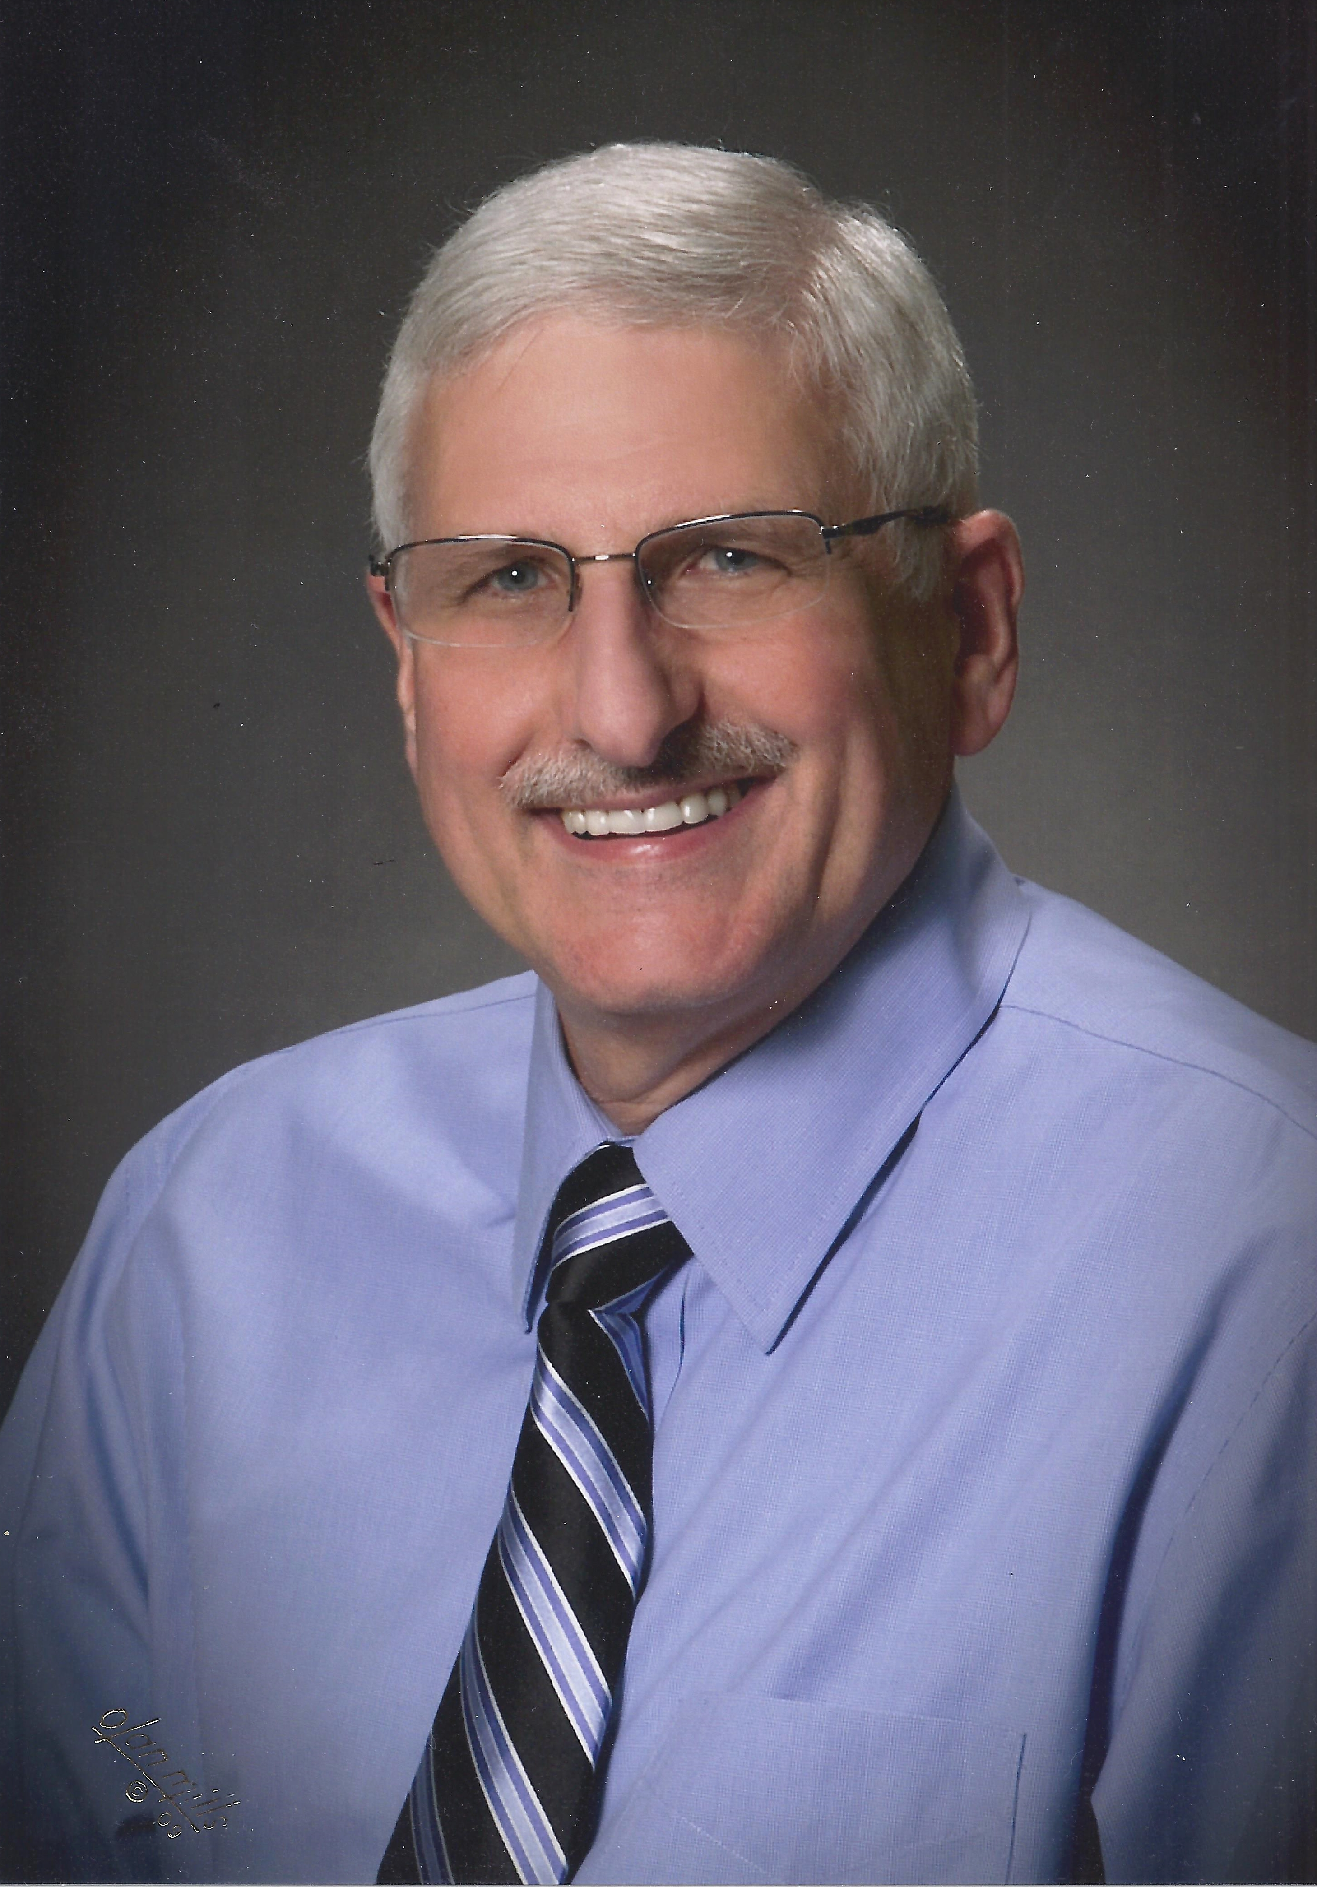
If In Doubt Call Me
John Davis
Email: coljohnret@gmail.com
Ph (828) 754-3044
Cell (910) 964-0719

