Slide 1
Grants Management Seminar –
Global Grants
Bob Felt
Dist 7670 Grants /Global Grants Chair
robertfelt@bellsouth.net
GMS/ 28 September 2019
v3

Slide 2
Goals of Presentation
Answer 4 Questions:
What is a Global Grant
What are the basic considerations
How Can Your Club Participate
What’s Important

Slide 3
A Global Grant Is
Large, International project, value at least $30,000
Partnership with overseas clubs and districts
Responds to well-defined Community Needs
Aligned to Rotary Areas of Focus
Measurable Sustainable Outcome
Three sources of funds: Club, DDF & World Fund
Timing- Flexible, multi-year, no deadline

Slide 4
First Consideration-
Community Needs Assessment
Document the Need - Humanitarian and VTT applicants required to formally document the need
Describes Beneficiary Community
Demographics
Who conducted assessment
Methods
Community Participants
The need your project addresses
What is their need, not our perception of need?
Project’s primary goal and how to accomplish
Challenges
Documented results are uploaded in your grant application
District grant funds may be used to fund assessment site visit

Slide 5
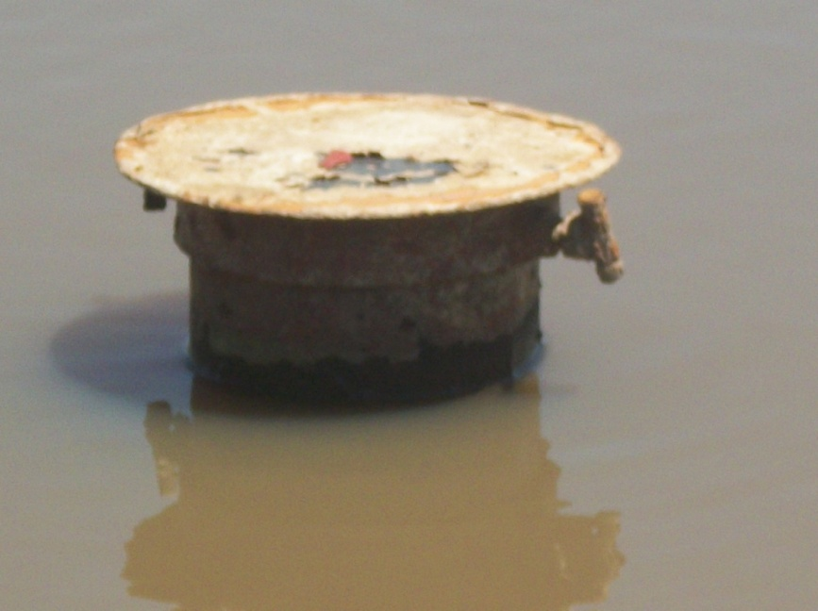
Must be Sustainable
Sustainability – Giving a community the skills, knowledge and means to maintain project outcome for the long-term, after Rotary leaves
Locally sourced materials and products
Training
Don’t create toxic charity
Africa (2009) - 70% of wells
abandoned after 5 yrs due to
expensive operating cost and/or
poor maintenance
Abandoned water well

Slide 6
Rotary Areas of Focus
Your grant must meet Rotary Focus Area criteria
Peace and Conflict Prevention/Resolution
Disease Prevention and Treatment
Water and Sanitation
Maternal and Child Health
Basic Education and Literacy
Economic and Community Development

Slide 7
Three Types of Global Grants
Humanitarian project Address community needs and produce sustainable, measurable outcomes
Water and Sanitation construction projects, medical equip, vehicle, rehab structure, educational equipment, furnishings, etc
Vocational Training Teams Build skills within a community by sending teams of professionals that will travel abroad to train or learn from host country they visit
Medical Teams (doctors, dentist, nurses)
School Teachers exchange
Scholarship Programs Fund international graduate-level study for a career within an Area of Focus

Slide 8
How Can Your Club Participate
Is your club qualified?
Identify project, conduct needs assessment, a site visit
Create strong partnership with host country club, the community and NGO
Partner with other Dist 7670 clubs $$$$
Outline your application “Global Grant Application Template”
Define project plan with clear partner roles and responsibilities, objectives and measurable outcomes in area(s) of focus
Define budget needs and start a funding campaign
Your application will be reviewed/approved by the Dist. 7670 Foundation Committee

Slide 9
“We’re Here to Help” robertfelt@bellsouth.net
District Grants
John DeWitt
John DeWitt
Bob Felt
Grants Chairman
Bob Felt
Scholarships Bob Felt
John Davis
Global Grants Chair
Bob Felt
Humanitarian Grants
Bob Felt
Jim Efland
Volunteer Training
Teams
John DeWitt
Joe Castro

Slide 10
Applying for a Global Grant
Read !! the references found on TRF Grant Center web page sidebar
A Guide to Global Grants
Terms and Conditions for Rotary Found. Grants
How to use the Grant Center
Use the Global Grant Application Template
Start the application process
Log in https://my.rotary.org
Tab “Take Action”, “Apply for Grants”, “Global Grants”
Tab “Tools” Start your grant application

Slide 11
Understanding Your Funding
Three sources of funds:
Donor cash from clubs and individuals
District 7670 District Designated Funds (DDF)
Rotary Foundation World Fund “matching funds”
How it works: World Fund will match club cash from
donors at 50 cents on the dollar, matches DDF $1 for $1
Example W.F. Match
Club Cash $ 8,000 x 50% = $4,000
7670 DDF $ 15,000 x 100% = $15,000
Total $ 23,000 + $19,000 = $42,000 Total Value
Note: TRF levies a 5% fee on all cash donations sent and held at the foundation.
Use the Global Grant Calculator !
Clubs $84.8
Clubs
$8,000
Value Added
World Fund
$19,000
DDF
$15,000

Slide 12
Global Grant Life Cycle
Draft - Partners plan project and draft application on TRF website
Authorization - Both Clubs and their district leaders must sign off on the application and use of funds
Submit - Grant planners submit application to TRF
TRF Approval & Payment -TRF Regional Grants Officer (RGO) will review and approve. Then forward payment instructions and grant payment to your selected bank acct.
Execution Phase - Partners carry out the project Keep good records!
Reports- Annual progress reports to TRF (Final report with in two months of completion )

Slide 13
What’s Important
Needs Assessment
Solid Partnership
Good Planning
Communications
Good Stewardship
Timely Reports
Get to know your Regional Grants Officer at TRF

Slide 14
Good Stewardship “Responsible and careful management of Rotary Foundation grant funds”
Did your project -
Meet the objectives and measurable outcomes of the grant application?
Meet the goal of the Area of Focus?
Use grant funds according to approved budget?
Will your project outcome be sustainable overtime?
Then provide detained documentation and accounting data -
Evidence of completion - project activity photos, brochures, news articles, etc
Spreadsheet or journals summarizing line items expenditures
Copies of receipts, purchase orders
Bank statements, cleared checks
Submit Progress Reports with documentation to the Rotary Foundation every 12 months and final report within 2 months of completing grant.
Dist 7670 Stewardship Committee will audit your final report before it is signed off and forwarded to TRF

Slide 15
LESSONS LEARNED
PATIENCE
The planning and application process may take many months.
TRF may challenge your project’s sustainability, training and required partner MOU.
UNDERSTAND
Your host partner’s culture. They may be slow to communicate (poor Internet) or hesitant to act, have convoluted banking system

Slide 16
Where Are The Opportunities
Partner with another Dist 7670 club
Attend Project Fairs - there are currently 11 fairs listed *
Google : Project fairs/ My Rotary
Web Search
Google: Rotary matching grants website
Friendship Exchange Trips
Engage NGO or charitable org
Attend Rotary International Convention- Honolulu!!
*Note: may use Dist Grant funds.

Slide 17
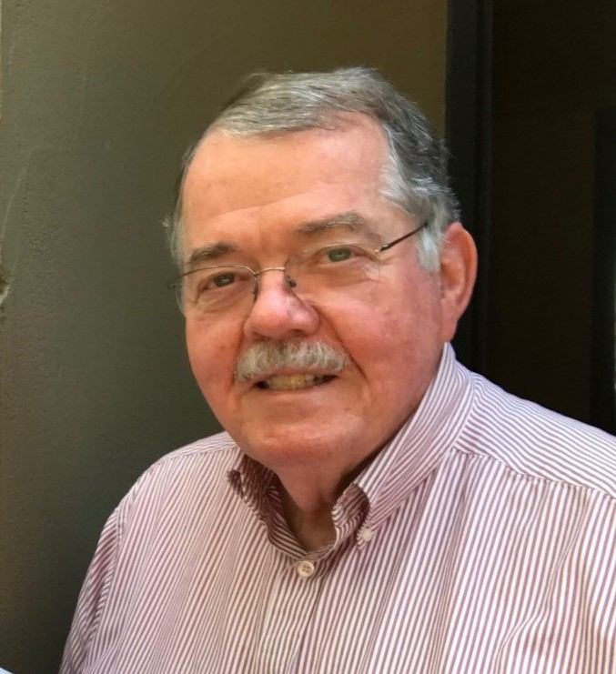
If In Doubt Call Me
Bob Felt
Email: robertfelt@bellsouth.net
Cell: 703-915-2796

Slide 18
Questions and Collaboration
Questions
&
Open Mic

