Slide 1
Finding Global Grant Opportunities: International and Within the United States

Slide 2
All You Need to Know for the next Six Slides
Rotary7670.org
Left-hand side of the screen, third grey button down
click on Global Grant Opportunities and all information will be available to you.
District Global Grant Opportunities
International Global Grant Opportunities
District 7670 Club International Service Chairs
The Rotary Foundation Cadre of Technical Advisors
Project Fairs
All of the slides in this presentation
Notes:
All you need to write down is Rotary7670.org. This is this location where all the information is ready and waiting for you, to take the first step toward your clubs Global Grant. If you want to partner with a club first

Slide 3
Resources at the International Level
ROTARY DISCUSSION GROUPS
ROTARY ACTION GROUPS
INTERCOUNTRY COMMITTEES
PROJECTS FAIRS
ROTARY FELLOWSHIPS
Notes:
Rotary Discussion Groups - a forum where members can exchange project ideas and request help. A place to find others who share your interests and activities, connect with project partners, and tap into the diversity of global perspectives that is Rotary.
Rotary Action Groups - Networks of Rotary members and others who are experts in a particular field that can help clubs and districts with their projects
Intercountry Committees - Networks of Rotary clubs or districts in two or more countries that work together on service projects, forming new clubs, and other activities
Project Fairs - Rotary’s project fairs connect clubs that are seeking international service projects with those that are interested in collaborating with global partners. Project fairs typically last two to three days and may include visits to service projects or opportunities to experience the local culture
Rotary Fellowships - Independent social groups with a shared interest in a hobby, recreational activity, or profession

Slide 4
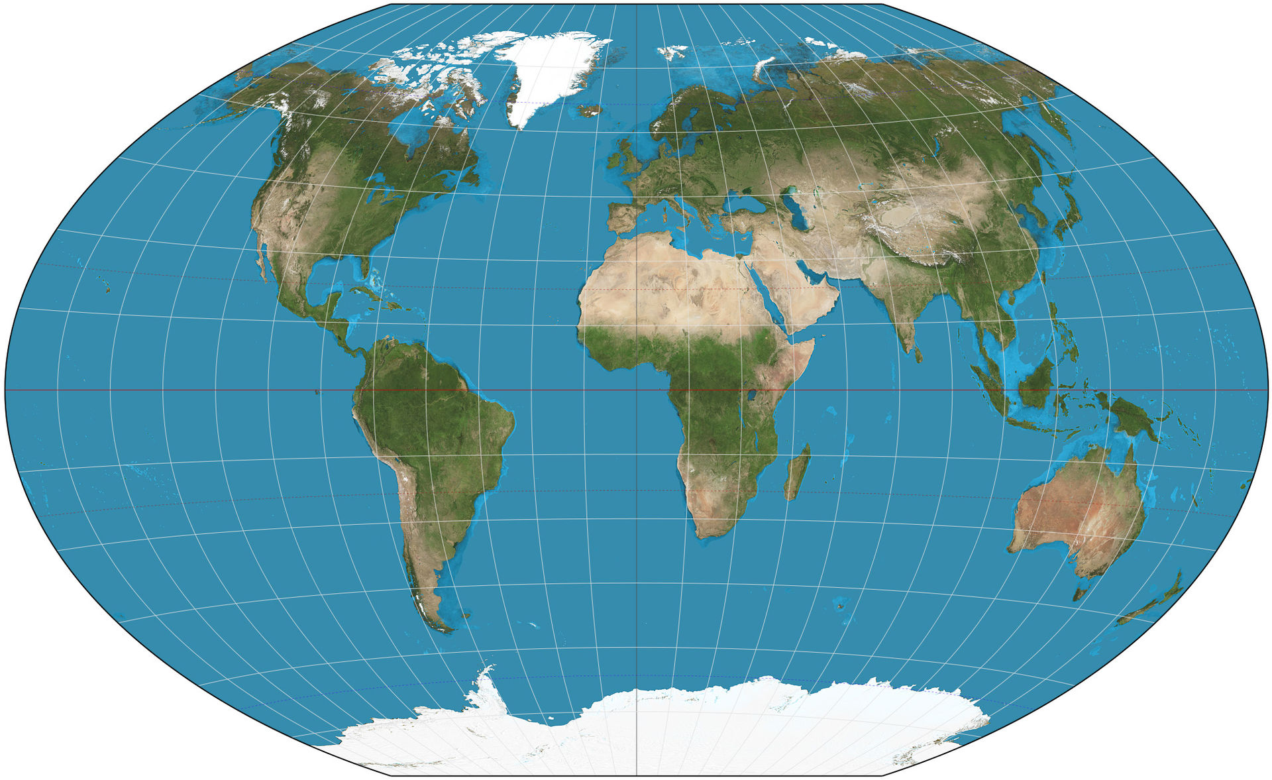
Project Fairs 2020/2021
Virtual Project Fairs
West Africa - November 13 – 19 2020
Ecuador – November 13 – 19, 2020
Uniendo America – January 28 – 30, 2020
Peru – September 18 – 26, 2021
In Person Project Fairs
Medellin, Colombia – February 4-6, 2020
Padua, Italy – March 24 – 28, 2021

Slide 5
Resources to Consider within the United States
Partner With Another District
Friendship Exchange Trips
Attend District Conferences
Rotarians and Rotaractors
Rotary Community Corps and Rotary Reps.
TRF Cadre of Technical Advisors
Non-Governmental Organizations or Charitable Organizations
Notes:
Partnering with another district is a wonderful way to leverage funding of multiple clubs toward a common goal.
Friendship Exchange allows participants to take turns hosting one another in their homes and clubs. It promotes international understanding, builds lasing friendships, opportunities for active project involvement and support, as well as a great way to find partners for grants.
Attending your district conference enables for you to hear about other club projects, both in and out of your district.
Rotarians and Rotaractors - You have a whole network of talent and expertise in your backyard, or I should say, in your district Rotary clubs. Use Dacdb to sort by profession or ask your District International Service Chair for help in locating an expert in the field you need. Rotaractors are also a good source of information and viable partners in putting together service projects, so don’t forget to include them in your network.
Rotary community Corps is a group of non-Rotarians who share our commitment to changing the world through service projects. Rotary Reps are individuals selected by the RI president to help inspire and motivate participants at each district conference. May be approached throughout the year also for guidance and help.
TRF Cadre of Technical Advisors is composed of volunteer Rotarians from around the world who have technical and professional expertise on one of more of Rotary’s seven areas of focus. They provide assistance and technical expertise to Rotarians planning and implementing projects.
Work with non-governmental or charitable organizations that are already experts in the field of your project’s area of focus. Organizations that already partner with Rotary International – American Cancer Society, Cooperative for (WHO, Bill and Melinda Gates Foundation, Dig Deep)

Slide 6
Collaborating Partners with Rotary International

Slide 7
Non-Governmental Organizations
The TOP 20
01 BRAC
02 The Wikimedia Foundation
03 Acumen Fund
04 Danish Refugee Council
05 Partners in Health
06 Ceres
07 CARE International
08 Médecins Sans Frontières
09 Cure Violence
10 Mercy Corps
11 Apopo
12 Root Capital
13 Handicap International
14 IRC
15 Barefoot College
16 Landesa
17 Ashoka
18 One Acre Fund
19 Clinton Health Access Initiative
20 Heifer International
https://www.ngoadvisor.net/top100ngos

Slide 8
TAKE ACTION
Notes:
Find your passion and connect it to a project that results in sustainable and measurable outcomes, in one or more of Rotary’s seven areas of focus, while increasing your reach with partners through Global Grants!

