Slide 1
In Memoriam April 20, 2024

Slide 2
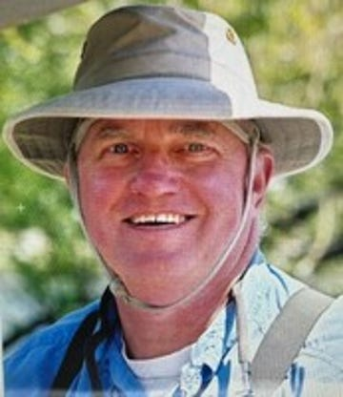
Frank S. Smith III
March 9, 1941—January 19, 2024
Degree in Applied Mathematics
from NC State University
Attended Harvard Business School
Founder and Owner - Hunter Banks Company, premier fly fishing retail stores
Rotary Club of Asheville
Paul Harris Fellow and a Sustaining Member

Slide 3
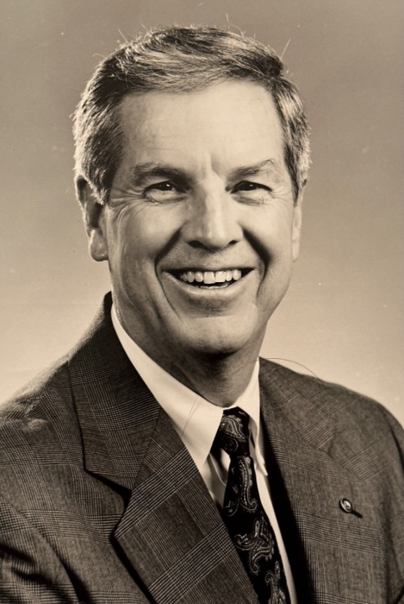
Charles E. Reiley (Chuck)
December 4, 1939—October 22, 2023
Degree from Wake Forest University
Retired from Bell South
Rotary Club of Asheville
Past District Governor of District 7670
Past President of Rotary Club of Asheville
Paul Harris Fellow, Paul Harris Society, Sustaining Member, Benefactor,
Major Donor, Meritorious Service Award

Slide 4
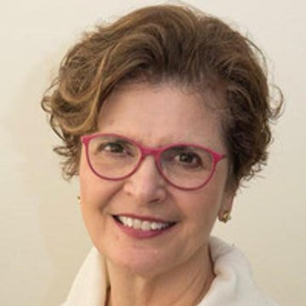
Carol Lee King
December 16, 1945—January 1, 2024
Degree in Accounting from UNC Asheville
Owner of Carol King & Associates CPA firm
Rotary Club of Asheville
First Female Governor of Rotary District 7670
Past President of Rotary Club of Asheville
Paul Harris Fellow, Paul Harris Society, Sustaining Member, Benefactor,
Bequest Society, Major Donor,
ALUMNI of Rotary

Slide 5
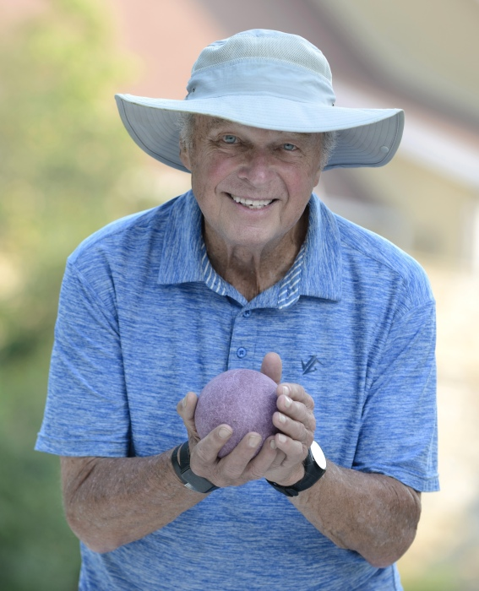
Luther Ernest Barnhardt, Jr
September 8, 1933—March 10, 2024
Phi Beta Kappa, Duke University
Duke University Medical School Radiologist
Rotary Club of Asheville-Biltmore

Slide 6
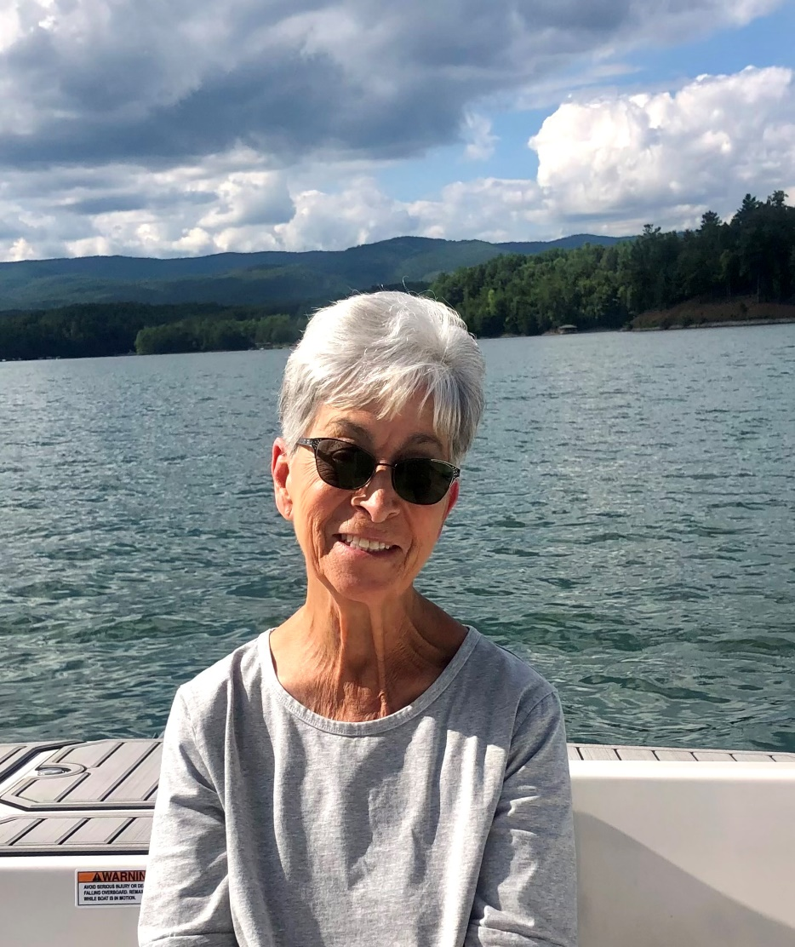
Dianne Mastandrea
August 16, 1942—January 11, 2024
Employee at Deerfield Episcopal Retirement Community
Rotary Club of Asheville—Biltmore
Paul Harris Fellow

Slide 7
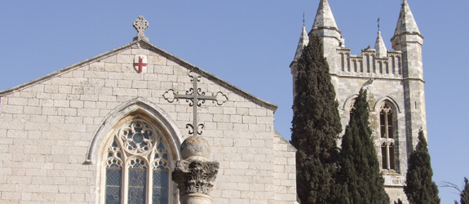
The Very Reverend Doctor Sidney Ross Jones (Ross)
1940-2023
Episcopal Parish Priest for more than 50 years
Dean of St. George’s College in Jerusalem
for four years
Rotary Club of Asheville-Biltmore
Past President
Paul Harris Fellow

Slide 8
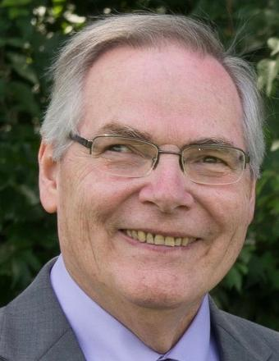
William Michael Winters (Bill)
May 7, 1949—September 3, 2023
Masters in Business Administration
Retired from Kaiser Permanente
in Baltimore and Laurel, Maryland
Rotary Club of Asheville—Biltmore

Slide 9
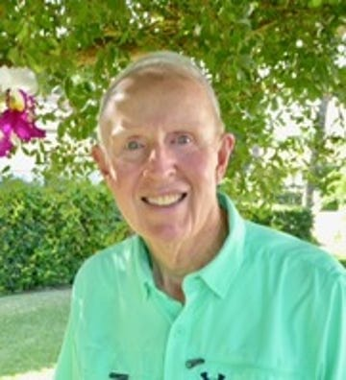
Samuel Jerome Crow (Jerry)
April 25, 1937—November 6, 2023
Emory University
and Wake Forest University Law School
Commissioned to the
Judge Advocate General’s Corps, US Army
Lawyer
Rotary Club of Asheville-Biltmore

Slide 10
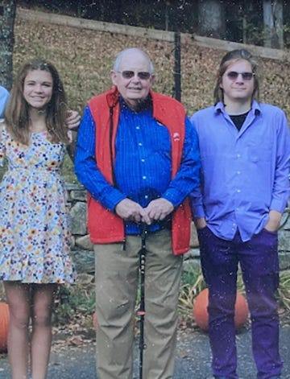
Dr. Shirley Collins Browning
August 24, 1939—May 10, 2023
BS and Masters from University of Kentucky
PhD from University of Connecticut
Professor of Economics , Associate Vice Chancellor for Academic Affairs, UNC Asheville
Served in US Army
Asheville Breakfast Rotary Club
Past President: 1990-1991
Paul Harris Fellow, Paul Harris Society,
Sustaining Member,
Benefactor, Bequest Society

Slide 11
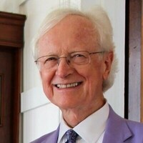
Richard Davis Howe (Rick)
May 6, 1939—March 27, 2024
BS and MA in Education from Appalachian State
PhD from University of California
Assistant to the Chancellor and Professor, College of Education at Appalachian State University
Rotary Club of Boone
6 Terms as President of Rotary Club of Boone
2 terms as District Governor of District 7670
Raised over $10 million for The Rotary Foundation

Slide 12
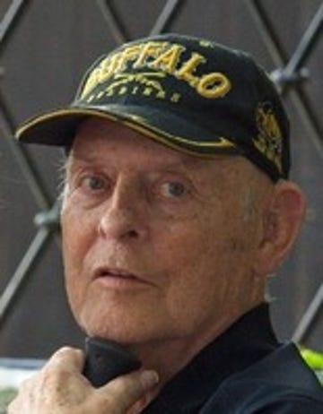
Benjamin Wilson Covington III (Ben)
January 14, 1939—July 31, 2023
BA from West Point, Masters in National Security, National War College
ABD from Columbia University
Colonel in US Army
Professor of Philosophy and English Literature at West Point
Rotary Club of Boone Sunrise

Slide 13
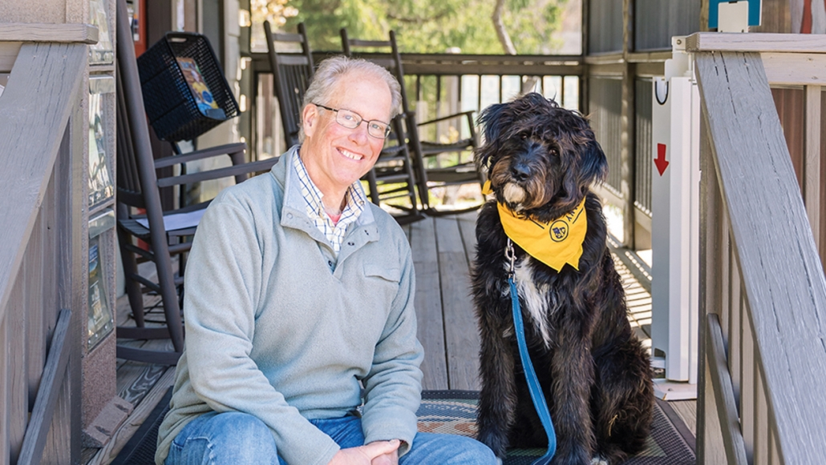
Thomas Taulbee
May 24, 1960—November 26, 2023
University of Miami
Chamber Executive,
Cashiers Area Chamber of Commerce
Rotary Club of Cashiers Valley

Slide 14
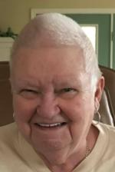
Nancie Wilson
October 4, 1943—November 12, 2023
BA in Psychology,
MA in Counseling Psychology
University of Central Florida
Psychology Instructor at
Southwestern Community College
Investigative Reporter
Rotary Club of Franklin
Past President 2013-2014
Paul Harris Fellow, Sustaining Member

Slide 15
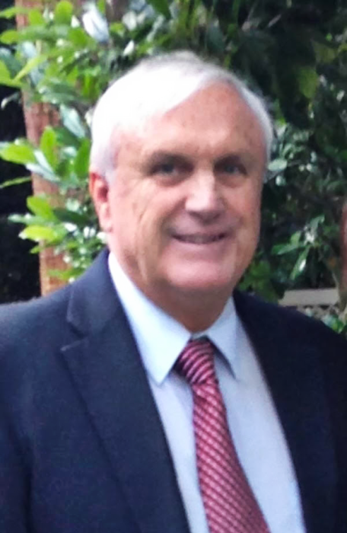
John Richard Hubsch
1951– June 9, 2023
Florida State University
Special Agent with the US Government
Rotary Club of Franklin
Paul Harris Fellow

Slide 16
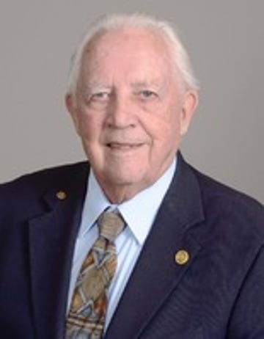
Gerald Leroy Liedl (Jerry)
March 2, 1933– November 12, 2023
BS in Metallurgical Engineering, and PhD, Purdue University
Professor of Engineering, Purdue University
Rotary Club of Hendersonville
Paul Harris Fellow, Sustaining Member
21 Years in Previous Rotary Clubs

Slide 17
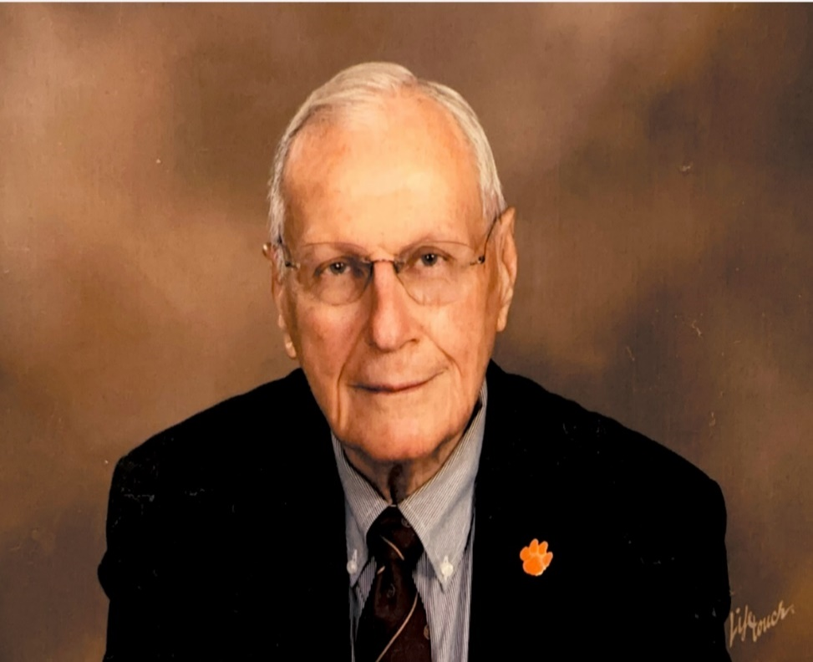
Henry Gustavus Hoffmeyer
July 25, 1933—January 4, 2024
Retired from BellSouth
Rotary Club of Hendersonville-Four Seasons
Rotarian of the Year: 1988-1989 and 2015-2016
Meritorious Service Award,
Service Above Self Award
Paul Harris Fellow, Paul Harris Society, Benefactor, Major Donor
27 Years in Previous Rotary Clubs

Slide 18
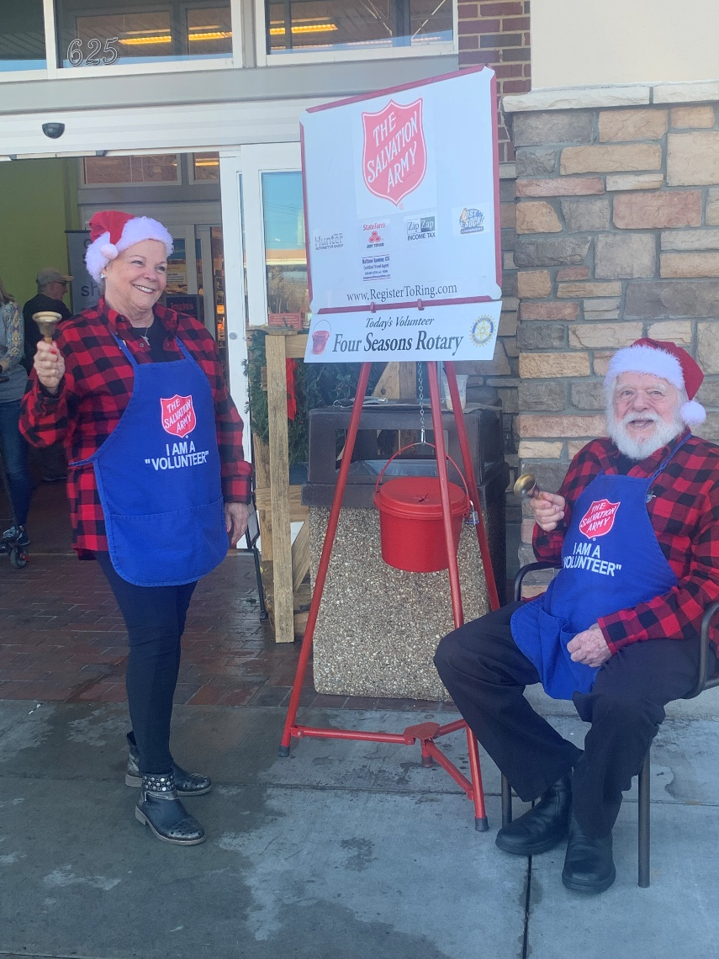
Roger Dean Hull
August 18, 1936– August 18, 2023
US Coast Guard
Honorary Member
of
Rotary Club of Hendersonville—Four Seasons
Rotary International Spouse Award,
Paul Harris Fellow

Slide 19
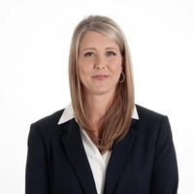
Regina Dawn Waller
May 3, 1981– March 9, 2024
Graduate, NC School of Banking
Manager, First Horizon
Rotary Club of Hickory Sunrise
Past President

Slide 20
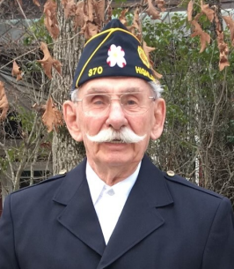
George Salman Schmitt
September 25, 1930—April 22, 2023
Served in the US Navy
Owner and founder of Schmitt Building Contractors
Rotary Club of Highlands
Past President
Paul Harris Fellow, Sustaining Member

Slide 21
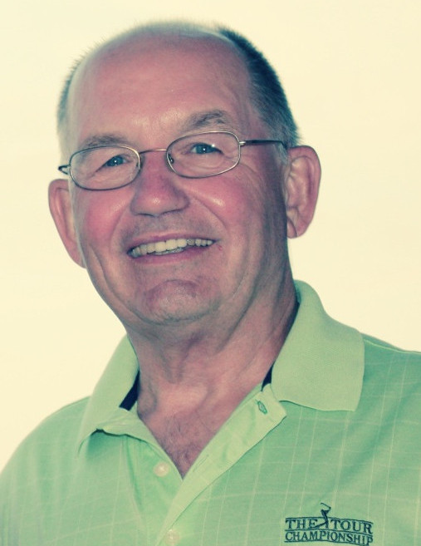
Thomas Sligh Stribling (Tom)
December 8, 1942—January 31, 2024
BS in Marketing from University of Alabama
Graduate of Stanford University
Executive Program
Lieutenant Commander, US Navy
Retired from Pfizer, Inc.
Rotary Club of Highlands
Sustaining Member

Slide 22
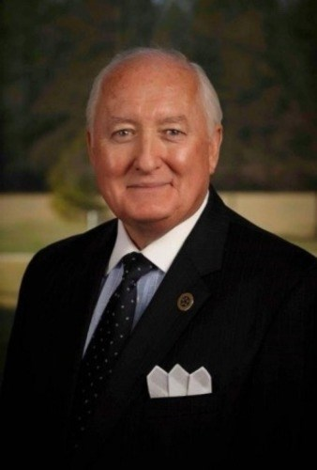
Robert Alexander Ingram
December 6, 1942—March 24, 2023
BS in Business Administration,
Eastern Illinois University
Retired from GlaxoWellcome
Rotary Club of Highlands

Slide 23
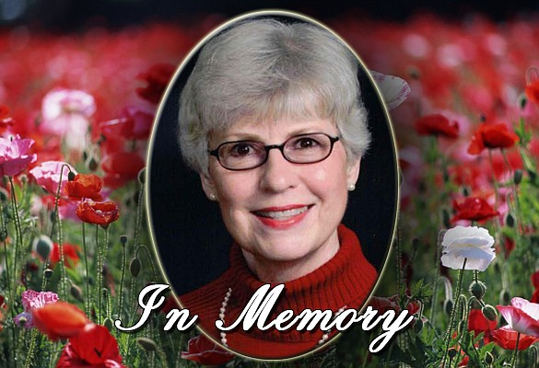
Diane Baxter Brogden
March 10, 1944—February 22, 2024
Chapel Hill University
Pharmacist
Lincolnton Sunrise Rotary Club
Past President
Charter Member

Slide 24
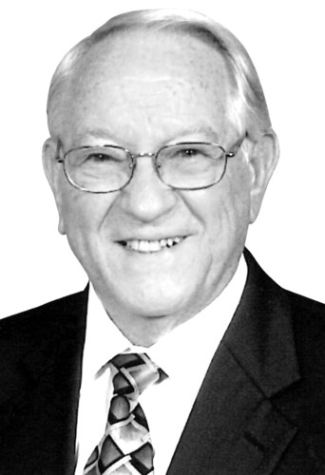
Reverend Doctor Bob D. Shepherd
Died April 30, 2023
Retired from Baptist ministry in 1994
Vice President for Academic Achievement,
Gardner-Webb University
Rotary Club of Morganton
Rotarian of the Year: 1990
Paul Harris Fellow, Sustaining Member
Rotary Member for 60 years

Slide 25
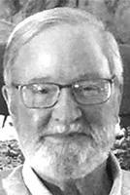
Richard Quill Griffin
December 7, 1945—January 3, 2024
BS in Biology, Florida State University
PhD from Southern College of Optometry
Served in the US Navy
Optometrist
Rotary Club of Spruce Pine

Slide 26
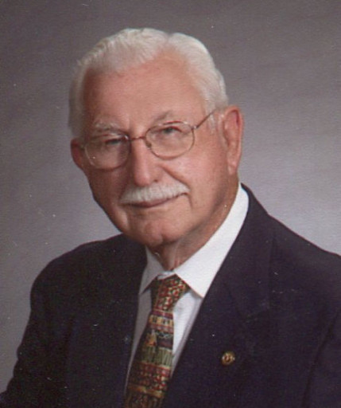
Dwight J Caudle (Tony)
March 18, 1925– March 17, 2023
US Navy, WWII
Sergeant on the North Carolina Highway Patrol for 38 years
Rotary Club of Waynesville
Paul Harris Fellow, Sustaining Member
ALUMNI of Rotary
Waynesville Rotary gives an annual “Tony” Award in his honor for someone who exemplifies Service Above Self

Slide 27
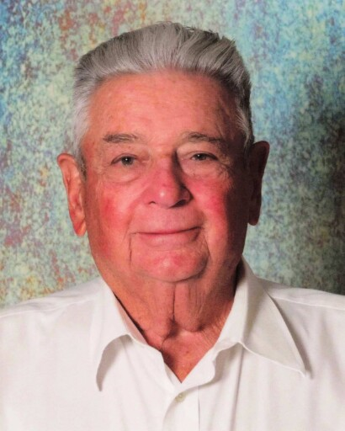
Colonel John Victor Hawkins
June 30, 1931—February 13, 2024
University of Colorado
Colonel, US Air Force
Rotary Club of Waynesville

Slide 28
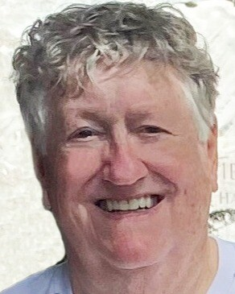
Robert Arthur Herrmann (Bob)
January 2, 1944—February 29, 2024
Retired as a State Farm Agent
Rotary Club of Waynesville
Past President
Paul Harris Fellow, Sustaining Member, Bequest Society
22 Years in Previous Rotary Clubs
Rotarian for 40 years

Slide 29
In Memoriam April 20, 2024

