Slide 1
Rotary
Foundation &
Grants Management
Seminar
District 7670 – September 29, 2018
Notes:
Session leader – please add the title of the session here.

Slide 2
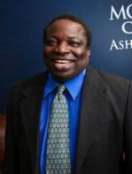
Welcome – DG Isaac Owolabi

Slide 3
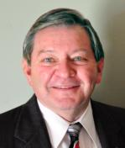
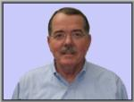
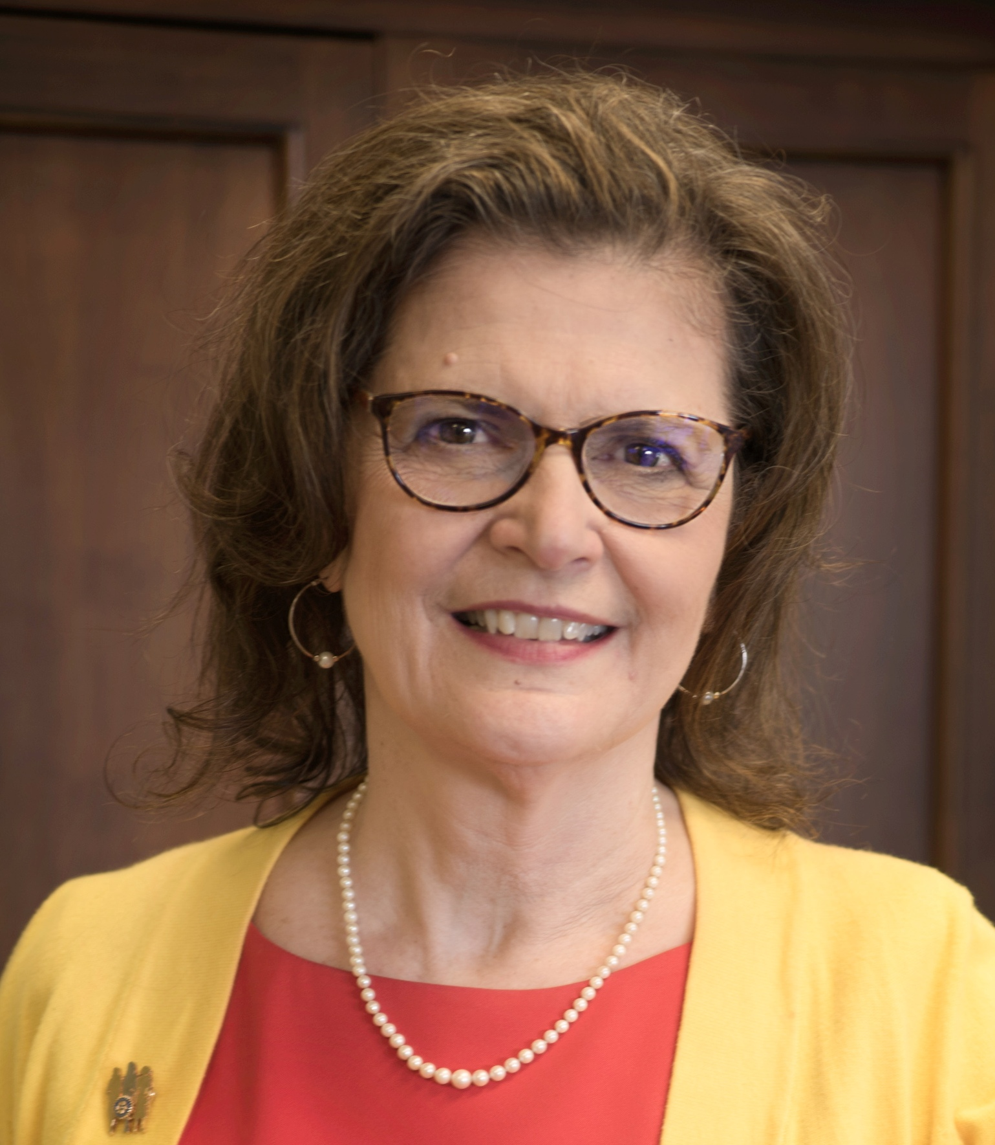
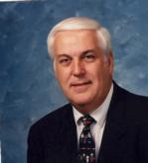
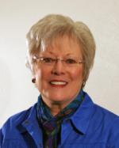
District Foundation Leadership
Gary Dills - Giving
Bob Felt – Grants Chair
Carol King DRFC
John Dewitt – District Grants
Nancy Brooks - Stewardship

Slide 4
GRANT and FOUNDATION
SEMINAR
Fundraising
PDG Gary Dills

Slide 5
TOPICS FOR TODAY
Review 2017-18 efforts
Annual fund
PolioPlus: UPDATE ON CASES
Goals for 2018-19:
How do clubs raise funds?

Slide 6
How did we do in 2017-18?
Annual Fund: $164.38 per capita/$361K; all clubs
EREY: 91.4% ($25 or more)
PolioPlus: $35.50 per capita; $77,994; 4 non-giving clubs!!!!!!!!
Rotary Direct: 212; grow to 234!!

Slide 7
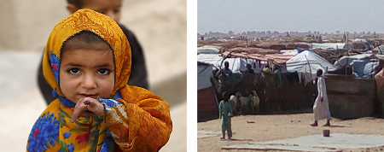
Polio Today
1988
2018
Notes:
In 1988, more than 350,000 people were stricken by polio, nearly 1,000 new polio cases every day.
Since the global initiative began 30 years ago, Rotary and it’s partners have reduced polio cases by more than 99.9% worldwide.
In 1988, 125 countries had polio cases, in 2018 there are only 3 endemic countries, Pakistan, Afghanistan, and Nigeria.

Slide 8
Polio cases 2013-2018 (as of 8 August)
Notes:
This slide illustrates the dramatic decline in polio cases over the past several years and indicates the progress we continue to make.
To date in 2018, 11 polio cases have been reported in Afghanistan and 3 in Pakistan.
Last year, 2017, 22 polio cases were reported: Pakistan (8), Afghanistan (14).
In 2014, we celebrated one of the world’s greatest achievements in global health: India being certified as polio-free. India was once considered the hardest place on earth to stop polio because of its dense population and challenges with sanitation. India’s success proves polio can be stopped in even the most challenging conditions.

Slide 9
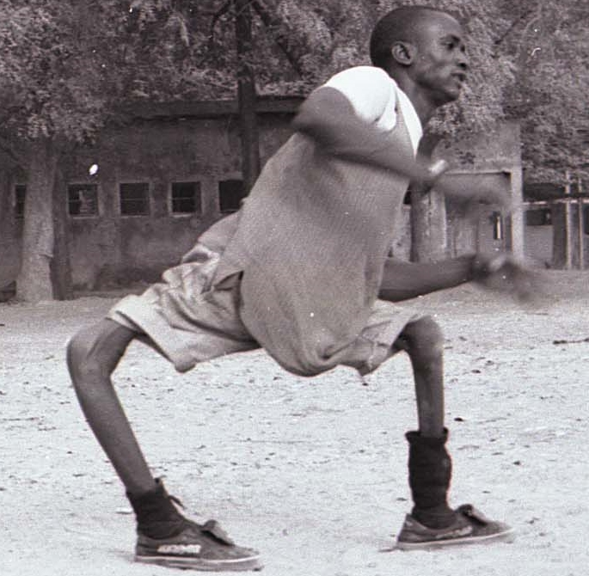
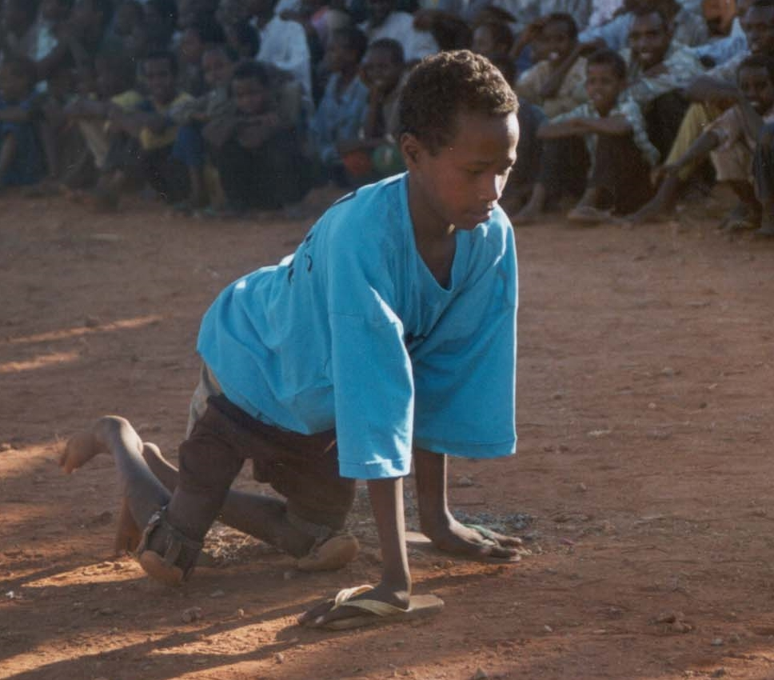
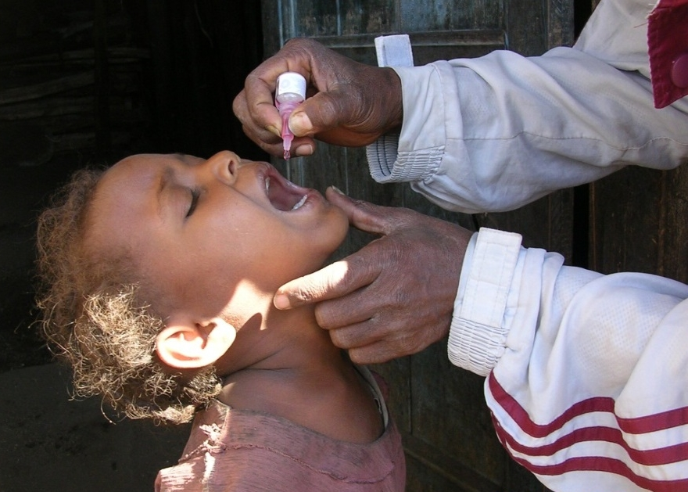
Polio
Paralysis for life
Primarily affects children
Preventable with vaccines
Notes:
Polio is:
Caused by the poliovirus
Can cause lifelong paralysis
Primarily affects children under age 5
Incurable
Can be prevented by a safe and effective vaccine

Slide 10
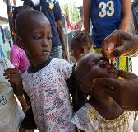
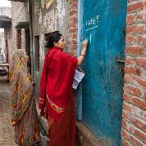
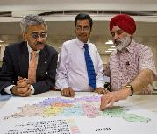
Polio Immunization Campaigns & Surveillance Continues/Intensifies
More than
450 MILLION
CHILDREN
in up to 60 countries immunized every year
Approximately
150,000
POLIO-FUNDED WORKERS
in up to 70 countries
Essential
DISEASE SURVEILLANCE ACTIVITIES
in more than 70 countries
Notes:
Over the next couple of years, hundreds of millions of children will continue to be immunized against polio to protect the gains we have made in up to 60 countries which requires over 150,000 polio workers all supported by the Global Polio Eradication Initiative.
And as cases continue to decline, methods to detect the disease are already intensifying by testing samples from people AND expanding activities to detect virus in sewer systems in an increasing number of high risk countries to be absolutely sure there is no poliovirus. If a virus is found in the sewage system, an expert committee of the partnership determines if an immunization response is needed.

Slide 11
Countdown to History Goal for PolioPlus
District goal = 20% of DDF
Goal 2018-19
US$50 million
Club goal = US$1500
Gates Foundation
$72
=
$108
YOUR $36
DONATION
+
Notes:
Contributions of cash and District Designated Funds will help meet the goals of our fundraising campaign. Contributions to PolioPlus qualify for Paul Harris Fellow and Major Donor recognition.
All clubs are being asked to contribute at least US$1500 and Districts are being asked to contribute 20% of their DDF.
Districts that annually give 20% or more of the DDF to PolioPlus will receive certificates of appreciation, and district that give 20% of their DDF, dating back to 2013-14 until polio eradication is certified, will be recognized on a plaque at Rotary world headquarters.

Slide 12
World Polio Day 24 October
Notes:
One way to Learn, Share and Donate is through World Polio Day by hosting a special event or tuning into the livestream on 24 October.
Clubs and districts are encouraged to register their events at endpolio.org where you will find updates and resources related to World Polio Day.

Slide 13
GOALS THIS YEAR
PolioPlus: Minimum of $30 per capita; expect $36; all clubs participate!!!!!
Annual Fund Goal: $170 per capita (3% increase)
Rotary Direct – USE IT!!; increase 10%
EREY ($25 or more): Goal: 100% -- this is doable
PHS – Add at least one per club!!!
Identify Candidates for Major Donor, Bequests, Benefactors, and Major Gifts
PDG Carol and PDG Gary will work

Slide 14
RESOURCES
Rotary Foundation videos
Publications
Annual Reports
Rotary Foundation Facts
Rotary Foundation Reference Guide
My Rotary Fundraising page
Rotary Direct frequently asked questions
Contact PDG Carol or PDG Gary, AGs
Notes:
Recommended resources:
Rotary videos: Videos produced by Rotary International’s broadcast media department are viewable at www.vimeo.com/rotary; most can be embedded or downloaded. Be sure to search for “Our Causes” to find most TRF videos.
The Rotary International/Rotary Foundation Annual Report: Online report of the major events and achievements of the 2016-17 Rotary year, along with highlights from audited financial statements (https://www.rotary.org/en/annual-report-2017).
Rotary Foundation Facts: This brochure, suitable for general distribution, gives a brief, statistical overview of the Foundation, its programs, and contribution information.
The Rotary Foundation Reference Guide: https://www.rotary.org/myrotary/en/document/rotary-foundation-reference-guide
My Rotary Fundraising page: www.rotary.org/myrotary/en/learning-reference/learn-topic/fundraising
Rotary Direct: The Foundation’s recurring-giving program has a list of answers to frequently asked questions.

Slide 15
GENERATING ANNUAL FUND SUPPORT
Set fundraising goals
Engage new members
Hold a fundraiser for a Rotary area of focus
Recognize club members
Basic rule: Tell the story and ASK
How does you club raise funds?
Notes:
Now that you know why it’s important to support the Annual Fund, here are a few ideas for helping your club have a strong Annual Fund.
1. Set fundraising goals: Clubs that set a goal achieve higher levels of giving than clubs that do not. Consider setting at minimum an Annual Fund and PolioPlus goal.
2. Engage new members: Connect your new members with our Foundation’s good works by sharing videos, images, and statistics that show the Foundation at work. Ask new members to participate in a Foundation-funded project or invite them to support the Foundation through Rotary Direct, the Foundation’s recurring giving program.
3. Hold an area of focus fundraiser: Let your community know about the great work of Rotary by holding a fundraiser for one of our six areas of focus. This is a great opportunity to give an update about a project that your district or club is doing in one of the six areas of focus. For fundraising ideas, visit the Fundraising page in the Learning & Reference section of My Rotary.
Go to the Learning & Reference drop-down menu, choose Learn by Topic, then Fundraising.
4. Recognize club members: Set aside time to thank club members for their contributions. A thank-you card can show appreciation and lead to continued support.
Ask: What other methods for generating support have been successful in your club?

Slide 16
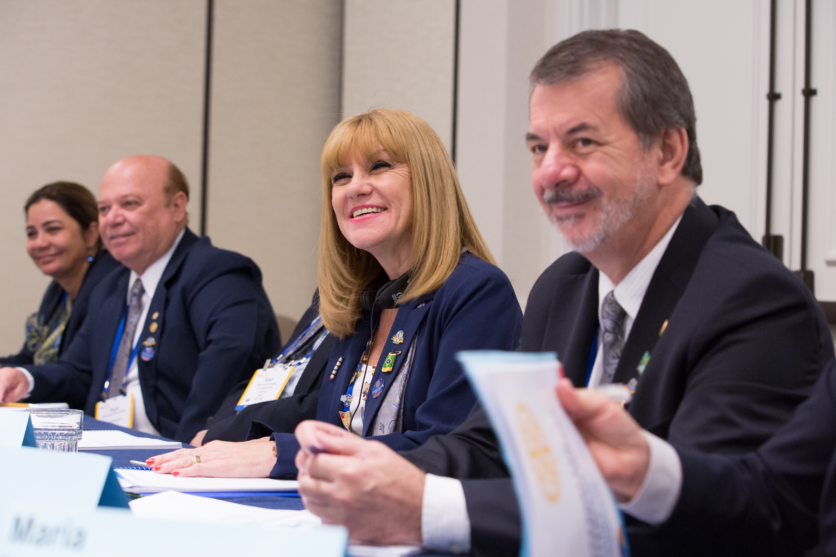
DOING GOOD IN THE WORLD REQUIRES FUNDING FOR OUR FOUNDATION AND POLIOPLUS
AND THAT MEANS YOU AND ME

Slide 17
DISTRICT
GRANTS
John Dewitt
Dist 7670 Districts Grants Chair

Slide 18
DISTRICT GRANTS
District grants fund small-scale, short-term activities that address needs in your community and communities abroad.
Each district chooses which activities it will fund with these grants.
The decision as to amount of each grant and any priorities is determined by the District governor 18-19.
She will let all clubs know at Pre-Pets.

Slide 19
What district grants support
You can use district grants to fund a variety of district and club projects and activities, including:
Humanitarian projects, including service travel and disaster recovery efforts
Scholarships for any level, length of time, location, or area of study
Youth programs, including Rotary Youth Exchange, Rotary Youth Leadership Awards (RYLA), Rotaract, and Interact
Vocational training teams, which are groups of professionals who travel abroad either to teach local professionals about their field or to learn more about it themselves

Slide 20
ROTARY POLICIES – District Grants
Support local and international projects, scholarships, vocational training teams, and related travel
May allocate up to 3 percent of the grant award for grant-related administrative expenses such as bank fees, postage, software, and an independent financial assessment
May allocate up to 20 percent of the grant for contingencies, but all projects and activities added to the grant post-approval must be pre-approved by the District Grants committee.
May fund projects and activities in Rotary and non-Rotary countries and geographic areas where permitted by applicable governing laws and in accordance with Foundation policies

Slide 21
ROTARY POLICIES – District Grants
continued
May fund scholar and vocational training team orientation and grant management seminars
May fund travel to and participation in Rotary project fairs to help districts identify project partners
Clubs can work together to fund larger projects, but one club must accept financial responsibility
Excellent process to use district grants to develop a global grant.

Slide 22
LOCAL PROCEDURES
This years grants final reports due to committee within 30 days of completion
Committee members will review and if complete will send to Stewardship committee for final approval to release funds
If not complete, report will be sent back to club
Deadline is May, 15, 2019, to allow time for RI as part of request for new grants, unless grant after that date
The committee will review all new district grants and make recommendation to District Governor and Foundation Chair
By June 1 to allow Clubs to begin projects on July 1, 2019
There will be at least 5 members appointed to this committee

Slide 23
Items to remember!!!
Some mistakes that hold up payment
Getting everyone to sign that were included in the application Including photos of activity
Proof that Rotary signage is evident at event or project
Include copies of checks, invoices and any supporting documents
Be sure that what you proposed in grant has been implemented or document that you have received approval for any changes.

Slide 24
DISTRICT
GRANTS
John Dewitt
Dist 7670 Districts Grants Chair

