Slide 1
GLOBAL
GRANTS
Bob Felt
Dist 7670 Grants /Global Grants Chair
robertfelt@bellsouth.net

Slide 2


Slide 3
So You Want To “Do Good in the World”
…….. Global Grant

Slide 4
A GLOBAL GRANT IS…
Large project
International Partnership, minimum $30,000
Sustainable , measurable outcome
Aligned to Rotary Area of Focus
Responds to valid defined community needs
Three sources of funds: Club, Dist DDF & World Fund
Flexible, multi year

Slide 5
Dist 7670 Global Grant Portfolio (2017-2018)
Seven grant projects
Haiti- Ambulance for New Hope (Franklin Daybreak)
Philippines - Cardiac Treatment to Children (Pisgah Forest)
Bolivia – Furnishing Foster Home (Highlands-Mountaintop)
Peru – Ocoto Alto Sanitation Toilet Project (Franklin)
Guatemala- Enhanced Expeditionary Learning (Black Mtn.)
Peace Scholarship- Univ. of St Andrews (Lenoir)
India *- Computer Lab Equipping (Denver Lake Norman)
Funding = $378K total funds invested
$83K donor cash
$125 DDF contribution
$170K “match” from TRF World Fund
* Still in TRF review

Slide 6
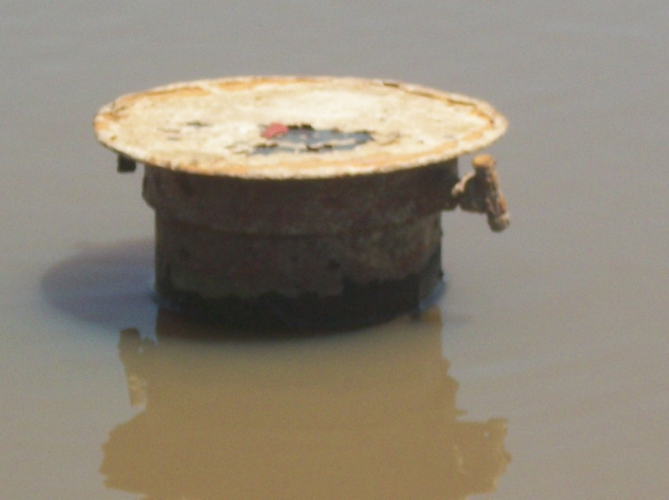
Essential Attribute – Sustainability
Sustainability – Giving a community the skills, knowledge and means to maintain project outcome for the long term, after we leave
  Locally sourced materials and products
  Training
Don’t create toxic charity
In 2010 - 70% of wells in central Africa abandoned after 5 yrs due expensive operating cost, complicated nature of project and poor maintenance.

Slide 7
Essential Attribute - Area of Focus
Your grant must meet Rotary criteria
  Peace and Conflict Prevention/Resolution
  Disease Prevention and Treatment
  Water and Sanitation
  Maternal and Child Health
  Basic Education and Literacy
  Economic and community development

Slide 8
Essential Attribute – Needs Assessment
New requirement 2018
Humanitarian and VTT applicants must formally document community needs assessment
  Describes Beneficiary Community,
  Demographics,
  Who conducted assessment,
  Methods ,
  Community Participants
  The need your project addresses (it’s their need, not our perception of)
  Project’s primary goal and how accomplish
  Challenges
District grant funds can be used to conduct assessment

Slide 9
Three Types of Global Grants
Humanitarian project
Address community needs and produce sustainable, measurable outcomes
    Water and Sanitation construction projects
Vocational Training Teams
Build skills within a community by sending teams of professionals that will travel abroad to train or learn from host country they visit
Medical Teams (doctors, dentist, nurses)
School Teachers
Scholarship Programs
Fund international graduate-level study for a career within an Area of Focus

Slide 10
TAKE ACTION
Is your club a qualified to receive grants?
Create strong partnership with host country club, the community and NGO
  Team with other Dist 7670 clubs
Formal Needs Assessment through site visit, ENGAGE THE COMMUNITY
Define project plan with clear objectives, measurable outcomes in area(s) of focus
Define budget needs and start funding campaign
Start application early , there are 50 + questions in the application
Your application will be reviewed by the Dist. Foundation Committee

Slide 11
APPLYING FOR GLOBAL GRANTS
Read the references
  “A Guide to Global Grants “
  “Terms and Conditions for Rotary Found. Grants”
  “How to use the Grant Center”
Online application process https://my.rotary.org
  Tab “Take Action”, “Apply for Grants” , “Global Grants”
  Tab “Tools” Start your grant application-

Slide 12
“We’re here to help”
District Grants
John DeWitt
John DeWitt
Bob Felt
TBD
Grants Chairman
Bob Felt
Scholarships Bob Felt
John Davis
Global Grants Chair
Bob Felt
Humanitarian Grants
Bob Felt
Jim Efland
Volunteer Training
Teams
John DeWitt
Joe Castro

Slide 13

FUNDING
Three sources of funds:
  Donor Cash from clubs and individuals
  District 7670 District Designated Funds (DDF)
  Rotary Foundation World Fund “matching funds”
TRF matches cash from clubs and outside donors at 50% and Dist DDF at 100%
TRF also levies a 5% fee on donor cash sent to the Foundation.
The Global Grant Calculator will simplify bottom line calculation
“Unique from
District Grant
Projects”
Download the Global Grant Calculator to your desktop . It is a valuable tool for balancing your funding strategy to meet the project’s budget requirements.

Slide 14
Global Grant Life Cycle
Application Draft & Authorization
Plan & build online application
Leadership review and authorize funds and forward to The Rotary Foundation
Review, Approval & Payment
Regional Grants Officer & Foundation staff review and approve
Forward payment instructions and grant payment to selected bank
Execution Phase
Partners carry out the project Keep good records!
Annual Reporting
Make annual progress report to Foundation
Final Report
Final report to Foundation upon completion*
  *Stewardship will audit and certify final reports prior to submission to TRF

Slide 15
LESSONS LEARNED
Have Patience
The process may take months.
  TRF will most likely challenge your project’s sustainability, training and required partner MOU.
  Understand your host partner’s culture. They may be slow to communicate and hesitant to act or may have poor internet access

Slide 16
OPPORTUNITIES
Partner with another Dist 7670 club
Attend Project Fairs *
https://rotaryserviceblog.org/?s=project+fair
Search the Web
https://www.matchinggrants.org/Matching Grants. org
Friendship Exchange Trips
Engage NGO or charitable org
Attend Rotary International Conference
*Note: can use Dist Grant funds.

Slide 17
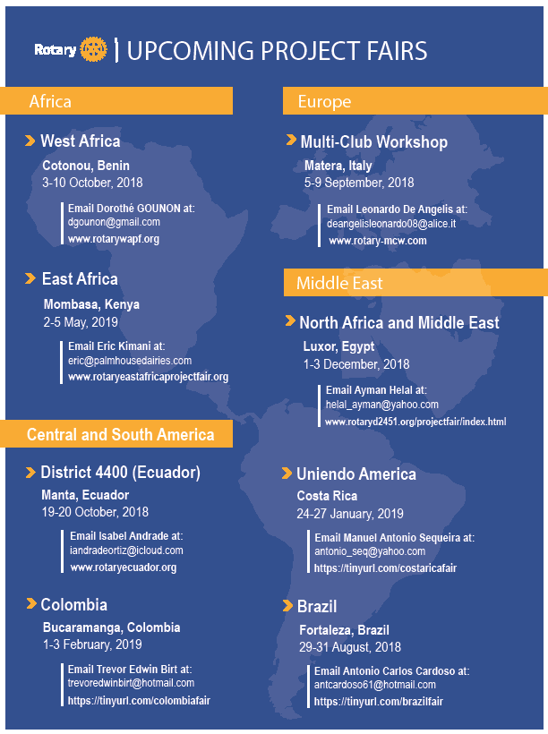
2018-2019
Project Fair Schedule
Project FAIRS
https://rotaryserviceblog.org/?s=project+fair

Slide 18
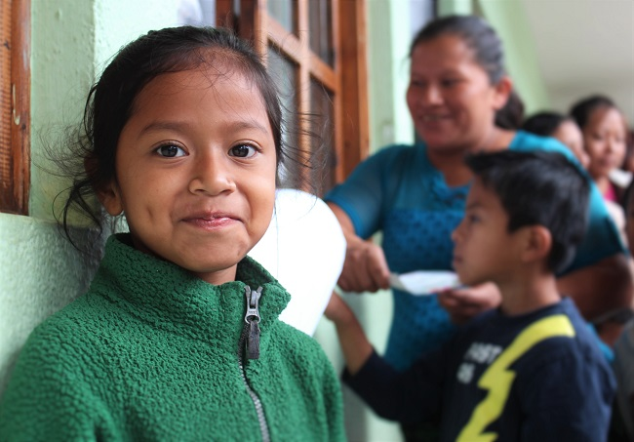
Global Grant Example (VTT)
Partner Clubs: Black Mountain & Guatemala-Las Americas
Type: VTT
Area Focus: Basic education and literacy
Funds : $70,000 (clubs $30,300; DDF$12,500; World Fund $27,200)
Object: Build Guatemalan educators’ skills through visits to and interchange with teachers from Buncombe Co. schools
Need: Empower the poorest at risk Guatemalan children, creating opportunity through education
POC: Dr John DeWitt
Guatemala- Enhancing Expeditionary Learning
At Seguro (Safe Passage) School

Slide 19
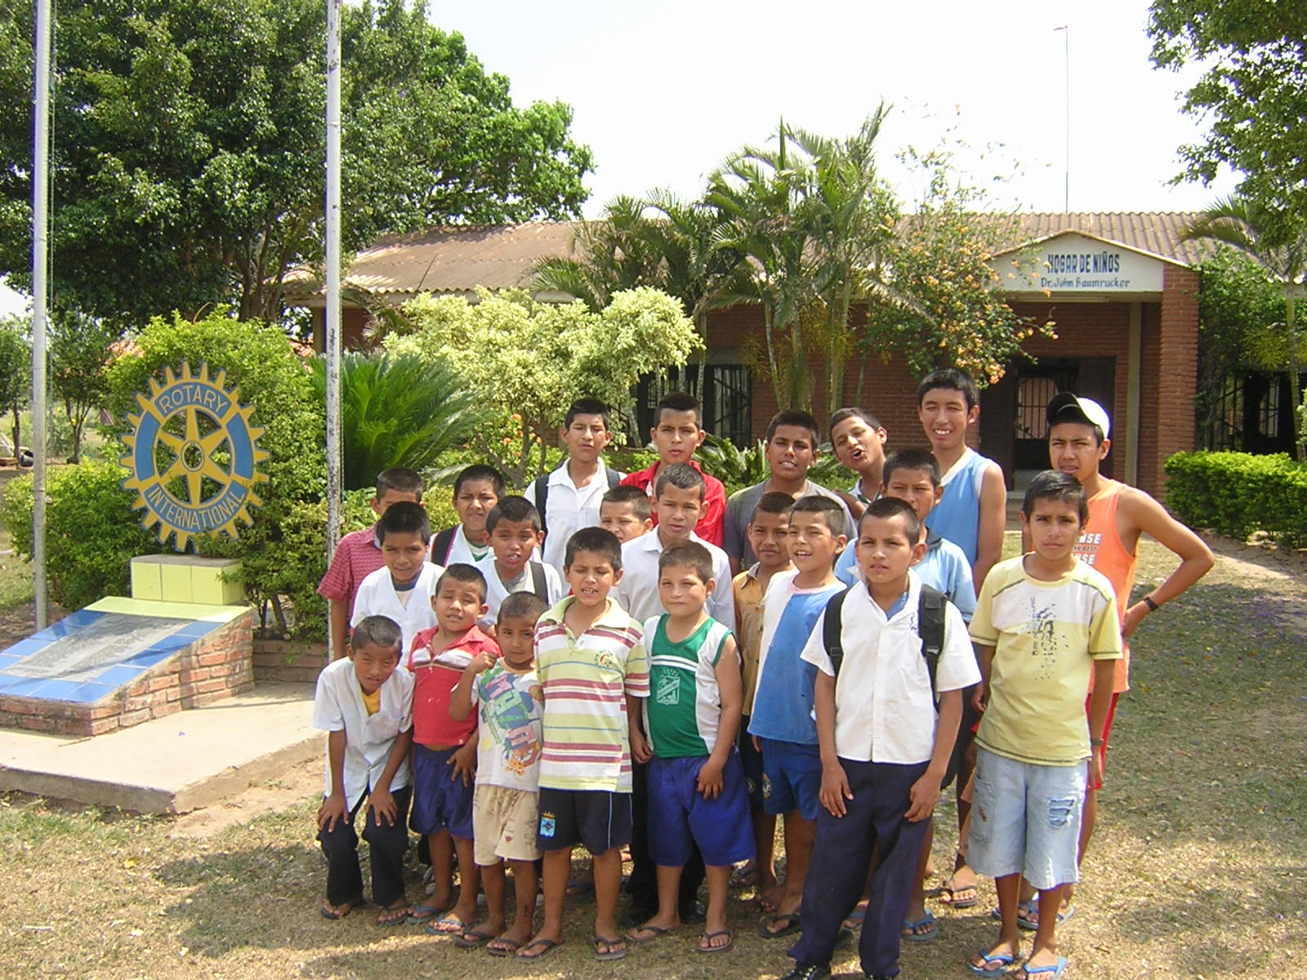
Global Grant Example (Humanitarian)
Partner Clubs: Highlands-Mtntop & Montero Bolivia
Type: Humanitarian
Area Focus: Economic/Community Development
Funds : $ 40,000 (clubs $11,675, DDF $11,250, World Funds $17,075)
Object: Equip for guest house , provide training and employ young men
Sustainable: measurable outcome: income from guest house
Need: Training young men in service industry
POC: Dr John Baumrucker Highlands-
MtnTop
Bolivia - Furnishings for Foster Home

Slide 20
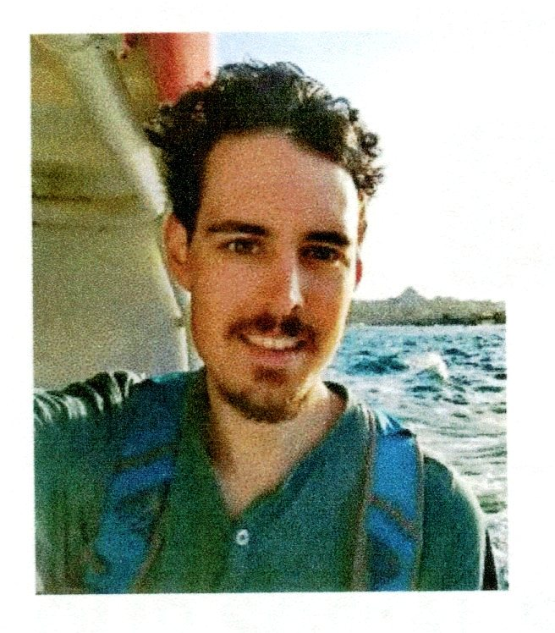
Global Grant Example (Scholarship)
Partner Clubs: Lenoir, St Andrews Scotland
Type: Scholarship
Area Focus: Peace & Conflict Prevention/ Resolution
Funds : $ 30,816 (clubs $4,000, DDF $12,408, World Funds $14,408)
Object: Provide masters degree /education in international peace and conflict prevention at Univ. St Andrews Scotland
Need: International Peace Building
POC: John Davis , Lenoir
Univ. St Andrews, Scotland
William Hunter

Slide 21
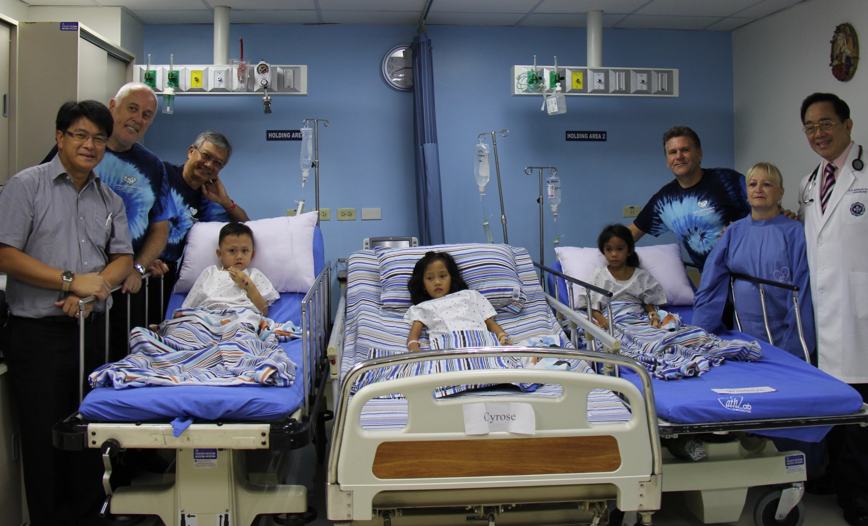
Global Grant Example (Humanitarian)
Partner Clubs: Pisgah Forest & Makati West, Manila
Type: Humanitarian
Area Focus: Disease Prevention and Treatment
Funds : $109,500 (clubs $5,000, non Rotarian $3,000, DDF $48,750, World Funds $52,750)
Object: Provide surgical equipment for and perform life-saving heart surgery for poor children
Need: save lives, provide quality of life
POC: Jose Castro
Philippines - Heart Surgery for Filipino Children

Slide 22
Questions and Collaboration
Ok Now It’s Time for Audience Participation

Slide 23
GLOBAL
GRANTS
Bob Felt
Dist 7670 Grants /Global Grants Chair
robertfelt@bellsouth.net

Slide 24
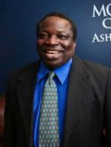


DG Isaac Owolabi

Slide 25
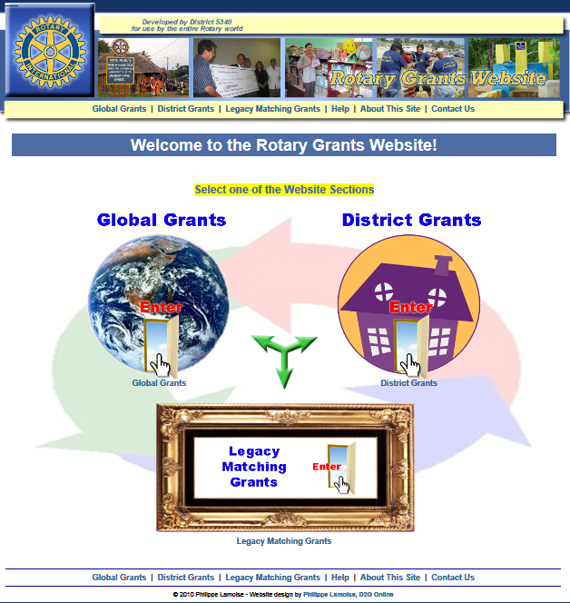
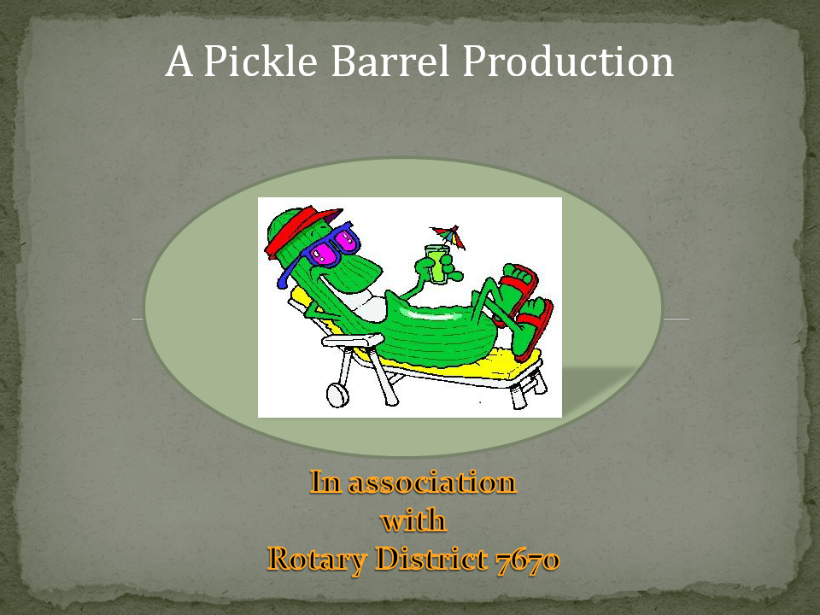
Travel Safely
https://www.matchinggrants.org/Matching Grants. org

Slide 26
Backup

Slide 27
Travel safely

Slide 28
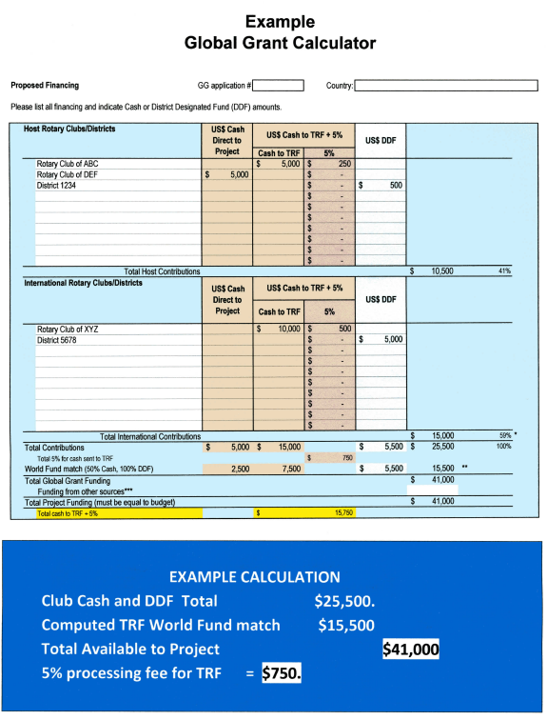
Backup
$10,500
Host Partner Cash & DDF Total
The District Approval Process
$15,000
Intl. Partner Cash & DDF Total
$15,500
TRF World Fund Match
$41,000
Total Funds to Project
Send $15,750 Total Cash to TRF (Cash and the $750 Fee)

