Slide 2
Object of Rotary
The Object of Rotary is to encourage and foster the ideal of service as a basis of worthy enterprise and, in particular, to encourage and foster:
FIRST: The development of acquaintance as an opportunity for service;
SECOND: High ethical standards in business and professions; the recognition of the worthiness of all useful occupations; and the dignifying of each Rotarian’s occupation as an opportunity to serve society;
THIRD: The application of the ideal of service in each Rotarian’s personal, business, and community life;
FOURTH: The advancement of international understanding, goodwill, and peace through a world fellowship of business and professional persons united in the ideal of service.

Slide 3
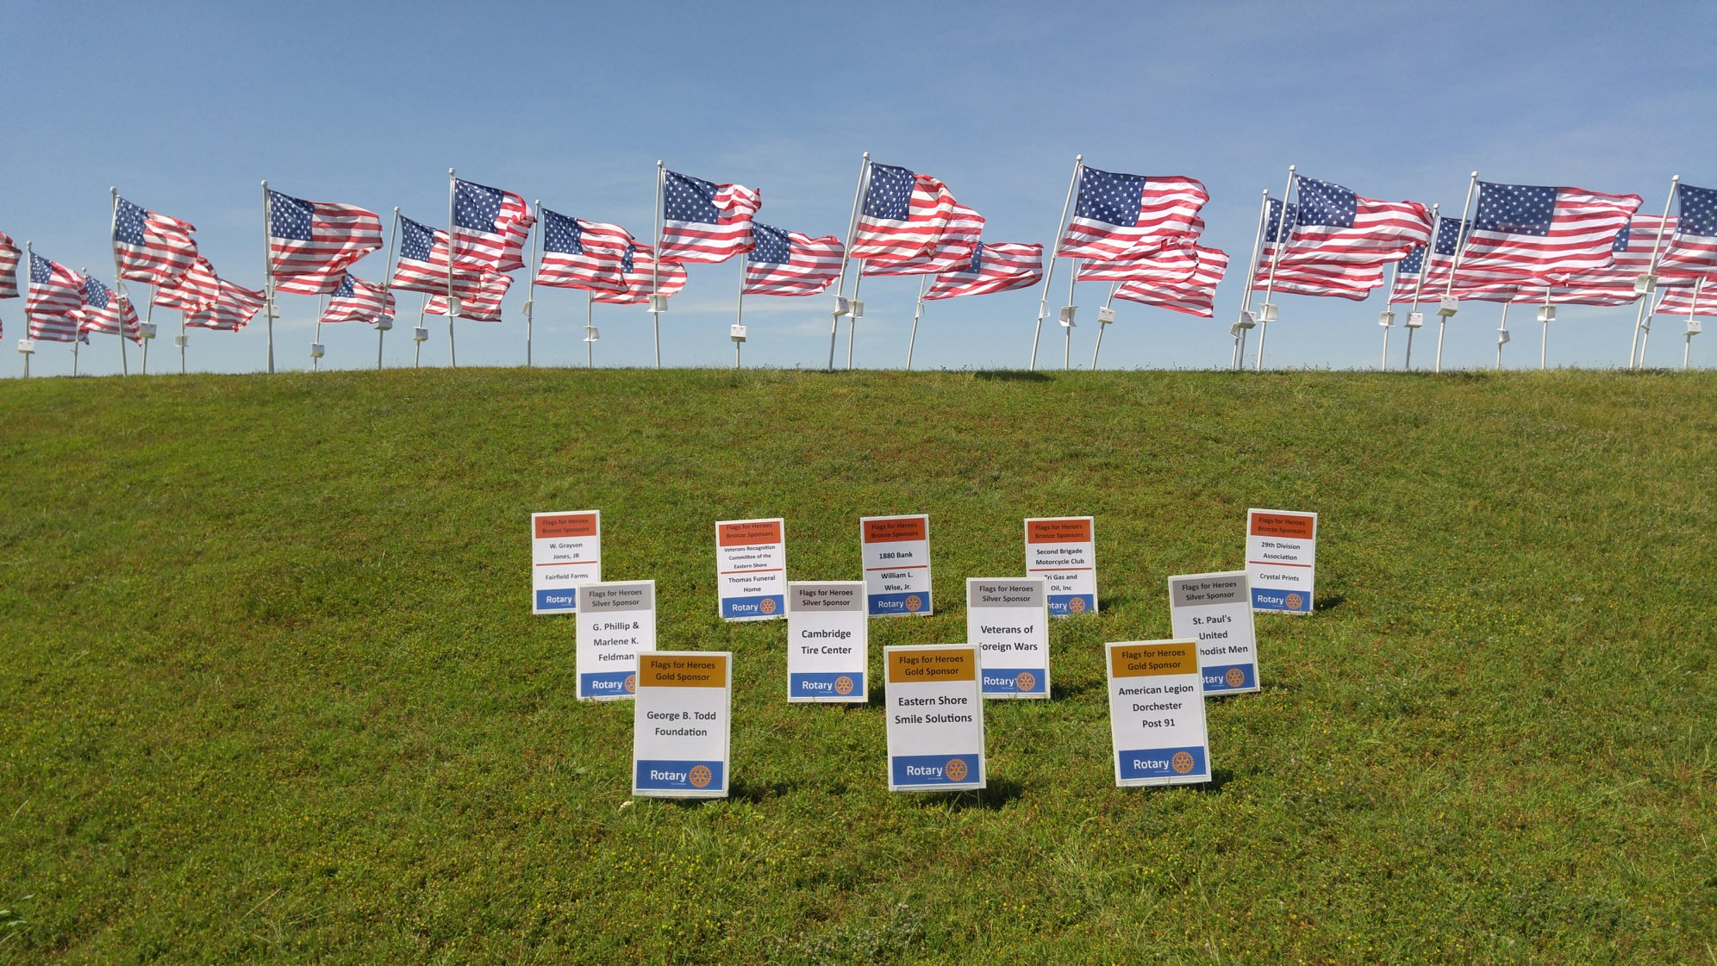
Flags for Heroes

Slide 4
Rotary is a global network of 1.4 million neighbors, friends, leaders, and problem-solvers who see a world where people unite and take action to create lasting change – across the globe, in our communities, and in ourselves.
Solving real problems takes real commitment and vision. For more than 110 years, Rotary's people of action have used their passion, energy, and intelligence to take action on sustainable projects. From literacy and peace to water and health, we are always working to better our world, and we stay committed to the end.
Learn more about our structure and our foundation and our strategic vision.
Our mission
We provide service to others, promote integrity, and advance world understanding, goodwill, and peace through our fellowship of business, professional, and community leaders.
Vision statement
Together, we see a world where people unite and take action to create lasting change — across the globe, in our communities, and in ourselves.

Slide 5
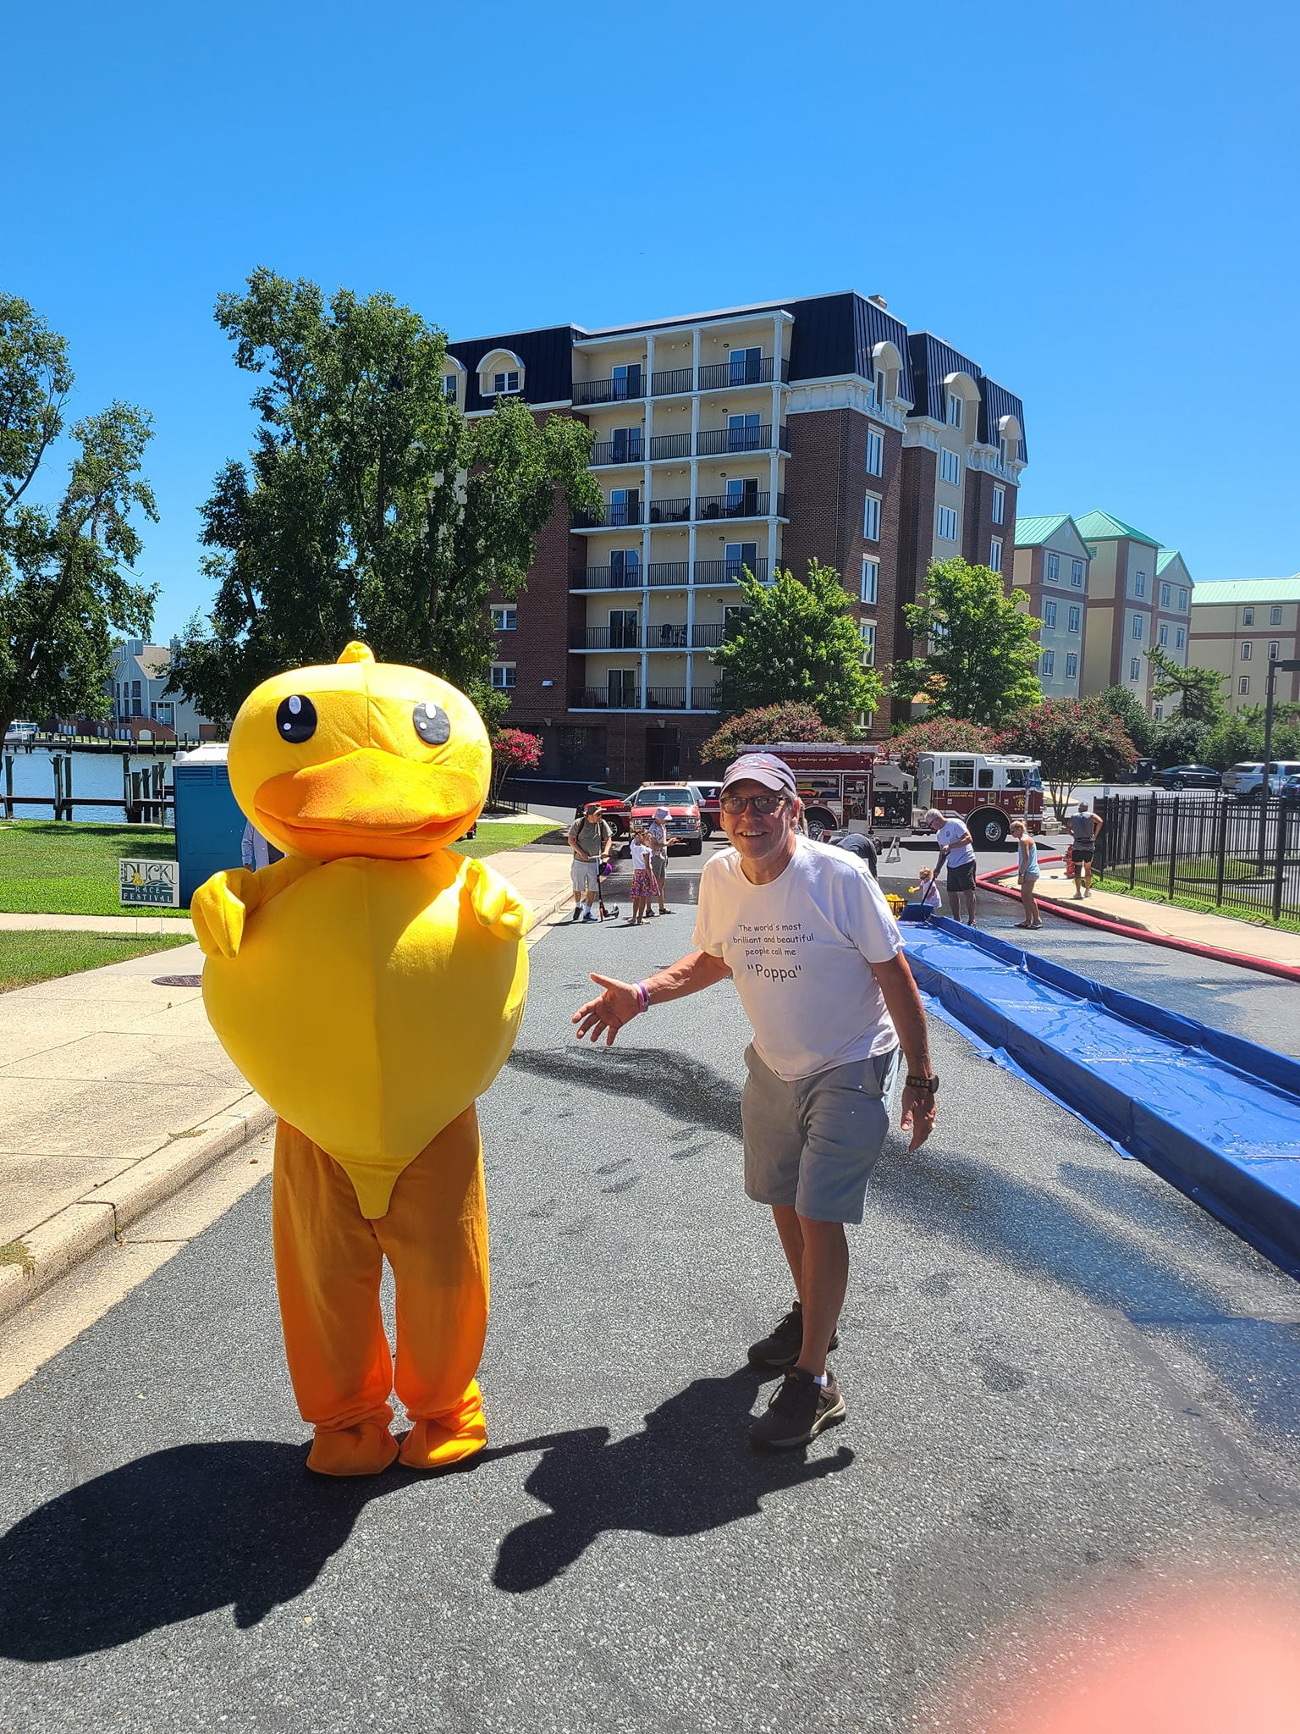
Cambridge MD Duck Race

Slide 6
Rotary is a global network of 1.4 million neighbors, friends, leaders, and problem-solvers who see a world where people unite and take action to create lasting change – across the globe, in our communities, and in ourselves.
What we do
Rotary members believe that we have a shared responsibility to take action on our world’s most persistent issues. Our 46,000+ clubs work together to:
Promote peace
Fight disease
Provide clean water, sanitation, and hygiene
Save mothers and children
Support education
Grow local economies
Protect the environment
Get involved

Slide 7
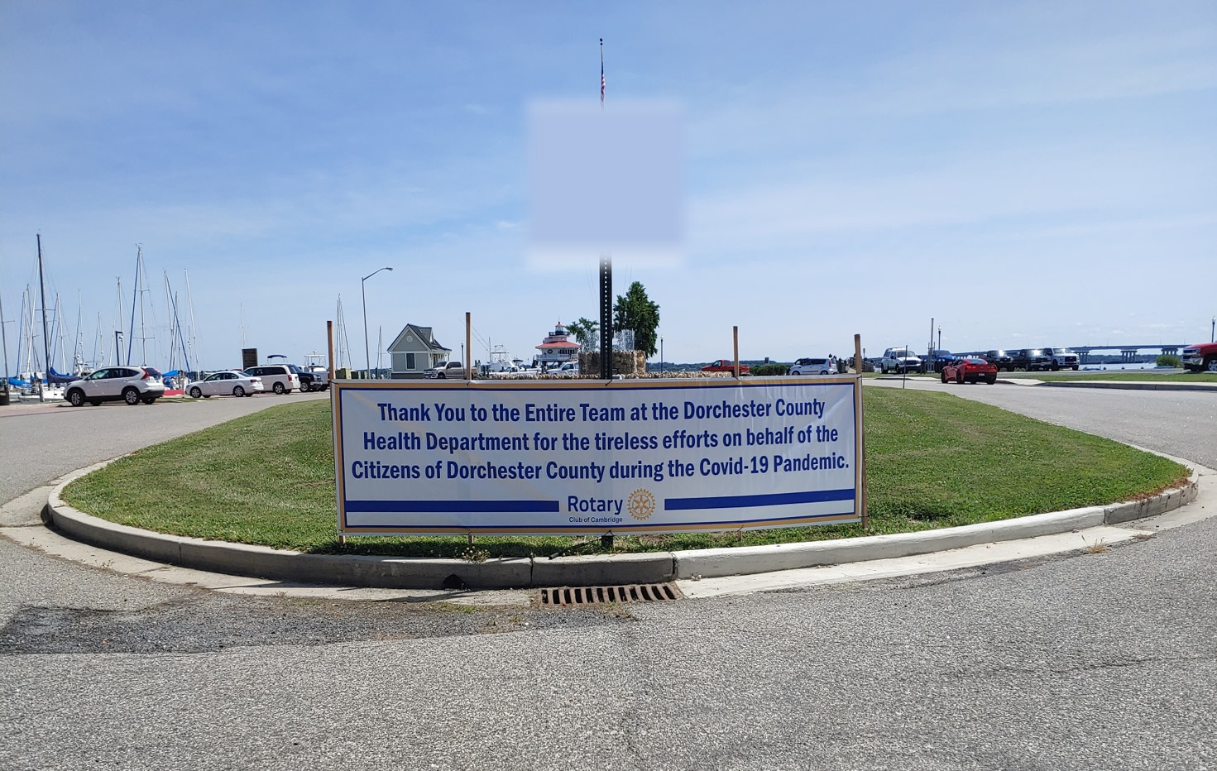

Slide 8
20 Reasons to Join Rotary
Friendship: In an increasingly complex world, Rotary provides one of the most basic human needs: the need for friendship and fellowship. It is one of two reasons why Rotary began in 1905.
Business Development: The second original reason for Rotary's beginning is business development. Everyone needs to network. Rotary consists of a cross section of every business community. Its members come from all walks of life. Rotarians help each other and collectively help others.
Personal Growth and Development: Membership in Rotary continues one's growth and education in human relations and personal development.
Leadership Development: Rotary is an organization of leaders and successful people. Serving in Rotary positions is like a college education. Leadership: - learning how to motivate, influence and lead leaders.
Citizenship in the Community: Membership in a Rotary club makes one a better community citizen. The average Rotary club consists of the most active citizens of any community.

Slide 9
20 Reasons to Join Rotary
Continuing Education: Each week at Rotary there is a program designed to keep one informed about what is going on in the community, nation, and world. Each meeting provides an opportunity to listen to different speakers and a variety of timely topics.
Fun: Rotary is fun, a lot of fun. Each meeting is fun. The club projects are fun. Social activities are fun. Serving others is fun.
Public Speaking Skills: Many individuals who joined Rotary were afraid to speak in public. Rotary develops confidence and skill in public communication and the opportunity to practice and perfect these skills.
Citizenship in the World: Every Rotarian wears a pin that says, "Rotary International." There are few places on the globe that do not have a Rotary club. Every Rotarian is welcome - even encouraged - to attend any of the 33,000 clubs in over 200 nations and geographical regions. This means instant friends in both one's own community and in the world community.
Assistance when Traveling: Because there are Rotary clubs everywhere, many a Rotarian in need of a doctor, lawyer, hotel, dentist, advice, etc., while traveling has found assistance through Rotary.

Slide 10
20 Reasons to Join Rotary
Entertainment: Every Rotary club and district has parties and activities that provide diversion in one's business life. Rotary holds conferences, conventions, assemblies, and institutes that provide entertainment in addition to Rotary information, education, and service.
The Development of Social Skills: Every week and at various events and functions, Rotary develops one's personality, social skills, and people skills. Rotary is for people who like people.
Family Programs: Rotary provides one of the world's largest youth exchange programs; high school and college clubs for future Rotarians; opportunities for spouse, involvement: and a host of activities designed to help family members in growth and the development of family values.
Vocational Skills: Every Rotarian is expected to take part in the growth and development of his or her own profession or vocation; to serve on committees and to teach young people about one's job or vocation. Rotary helps to make one a better doctor, lawyer, teacher, etc.
The Development of Ethics: Rotarians practice the 4-Way Test that governs one's ethical standards. Rotarians are expected to be ethical in business and personal relationships.

Slide 11
20 Reasons to Join Rotary
Cultural Awareness: Around the world, practically every religion, country, culture, race, creed, political persuasion, language, color, and ethnic identity is found in Rotary. It is a cross section of the world's most prominent citizens from every background. Rotarians become aware of their cultures and learn to love and work with people everywhere. They become better citizens of their countries in the process.
Prestige: Rotary members are prominent people: leaders of business, the professions, art, government, sports, military, religion, and all disciplines. Rotary is the oldest and most prestigious service club in the world. Its ranks include executives, managers, professionals - people who make decisions and influence policy.
Nice People: Rotarians above all are nice people - the nicest people on the face of the earth. They are important people who follow the policy of "it is nice to be important, but it is more important to be nice.”
The Absence of an” Official Creed": Rotary has no secret handshake, no secret policy, no official creed, no secret meetings, or rituals. It is an open society of men and women who simply believe in helping others.
The Opportunity to Serve: Rotary is a service club. Its product is serving. Rotarians provide community service to both local and international communities. This is perhaps the best reason for becoming a Rotarian: the chance to do something for somebody else and to sense the self-fulfillment that comes in the process and the return of that satisfaction to one's own life. It is richly rewarding.

Slide 12
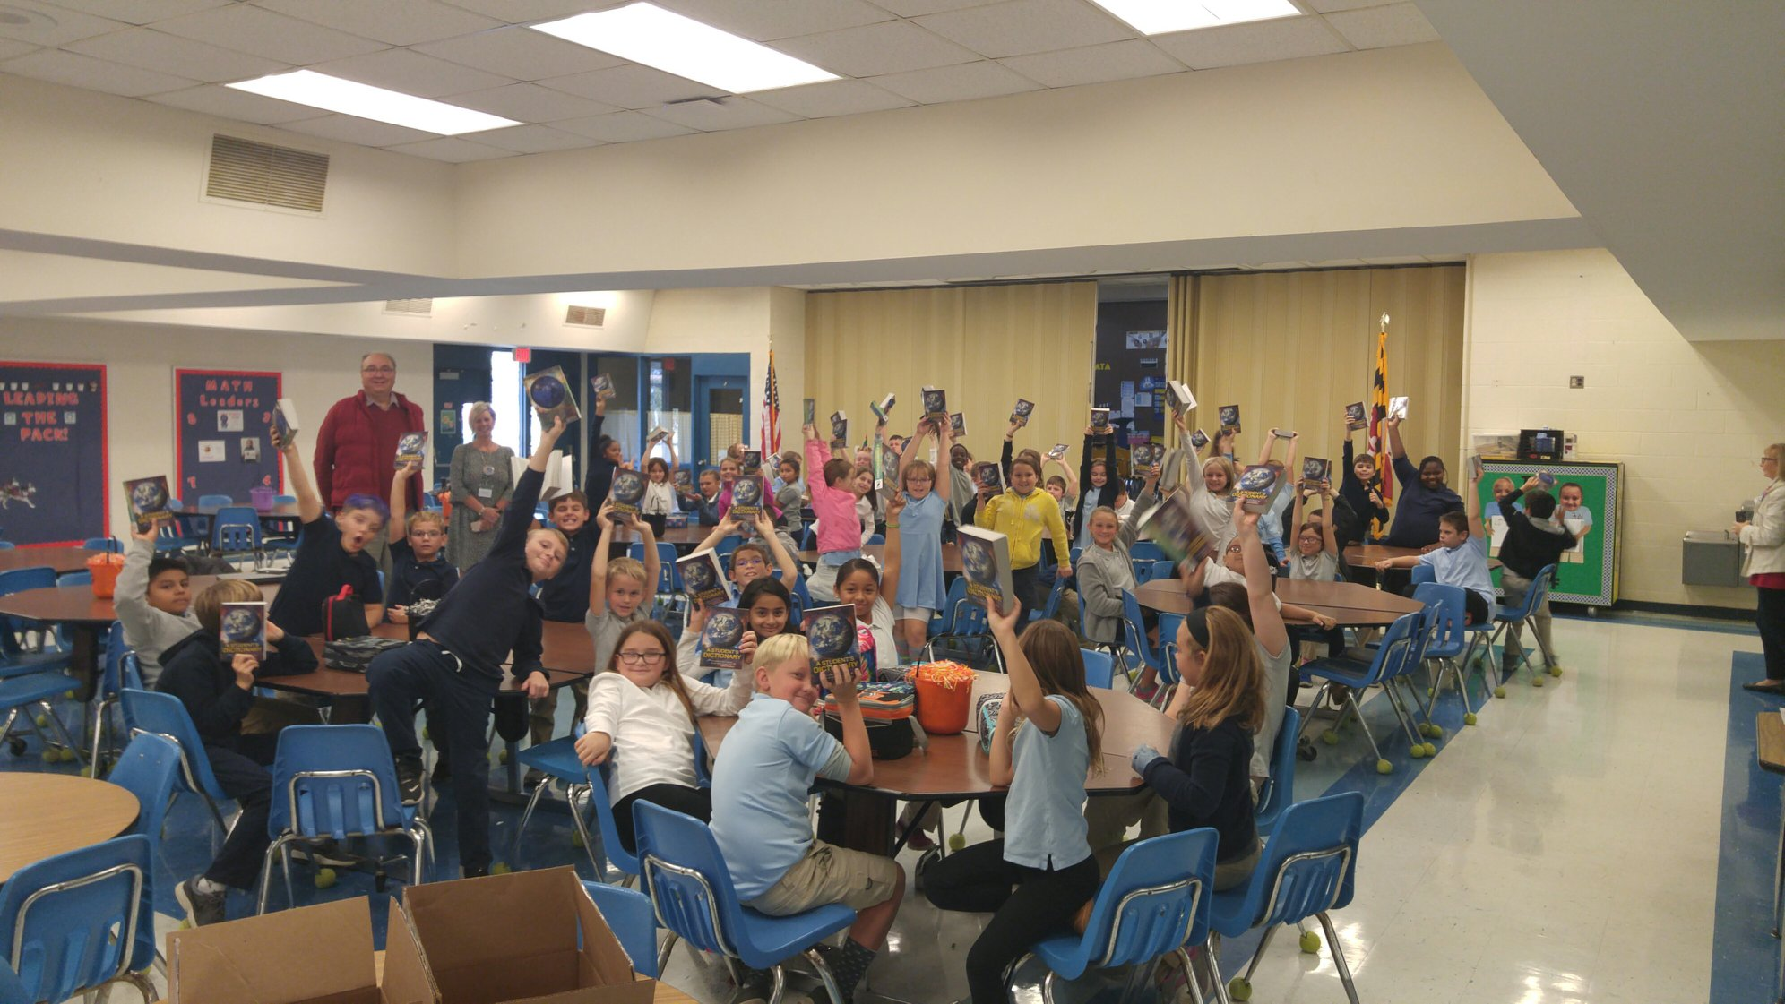
Dictionaries for 3rd grade DCPS students- sponsored by Rotary

Slide 13
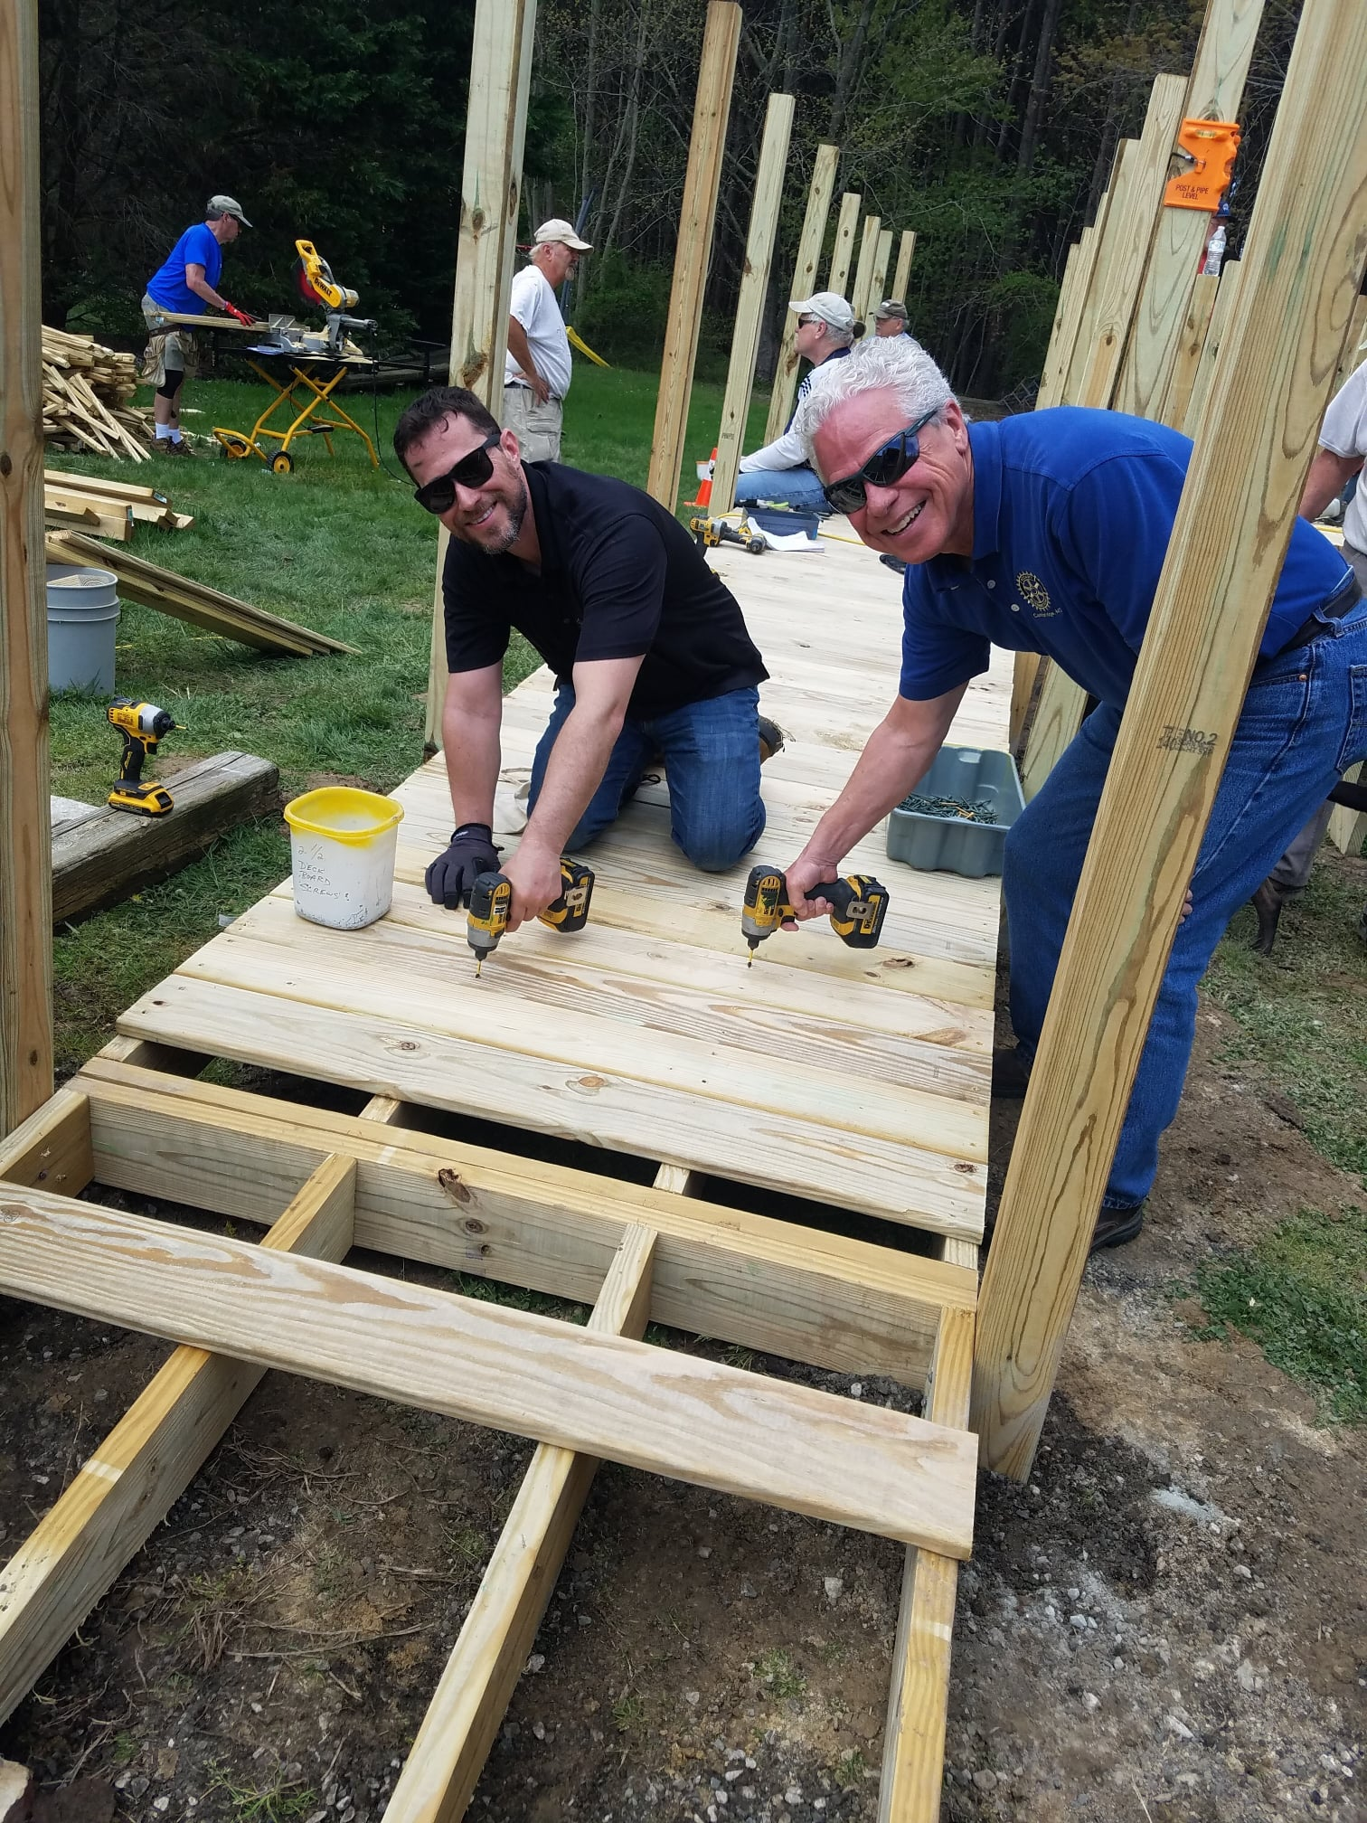
Cambridge Rotary volunteering with Chesapeake Housing Mission

Slide 14
Rotary Club of Cambridge Community Contributions
Cambridge Little League
Children’s Christmas/Angel Tree
Dictionary Project
Dorchester Lacrosse
Girl’s State
Habitat of Dorchester County Toolboxes
Imagination Library through United Way of the Lower Eastern Shore
Iron Club of Maryland
Long Wharf Fountain
Meals of Hope
Rescue Fire Company through our Annual Duck Festival
Rotary International Foundation
Rotary Youth Leadership Awards
Student of the Semester and Teacher of the Year Awards
Veterans Programs
Various organizations through monthly Happy Dollar Donations

Slide 15
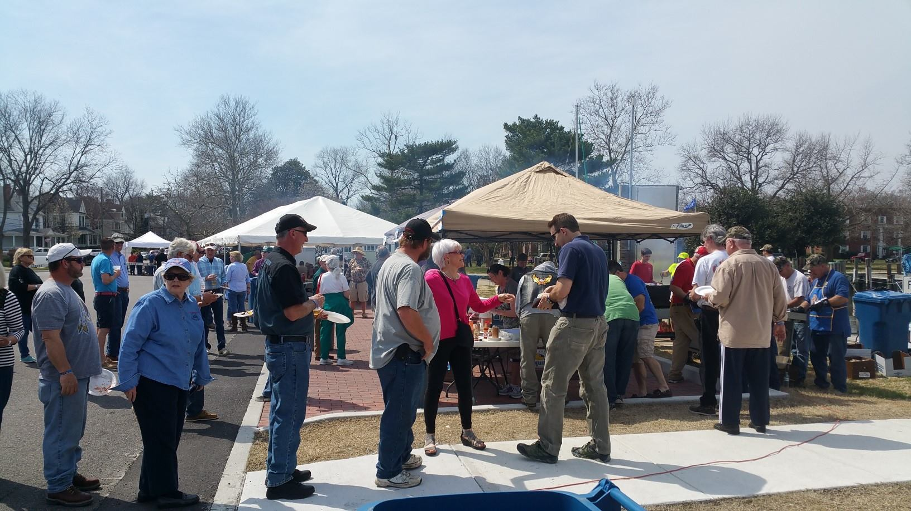
Cambridge Rotary Oyster Festival

Slide 17
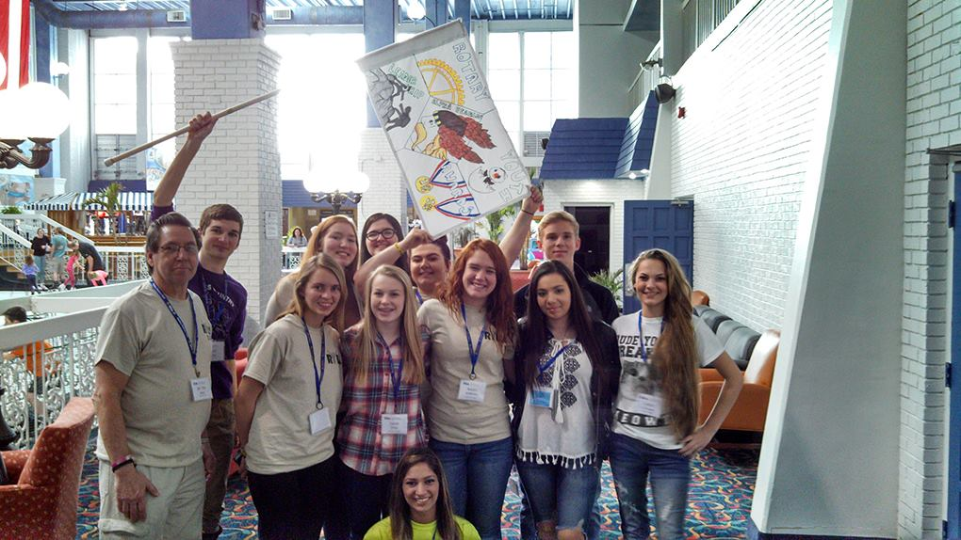
Rotary Youth Leadership Awards

Slide 19
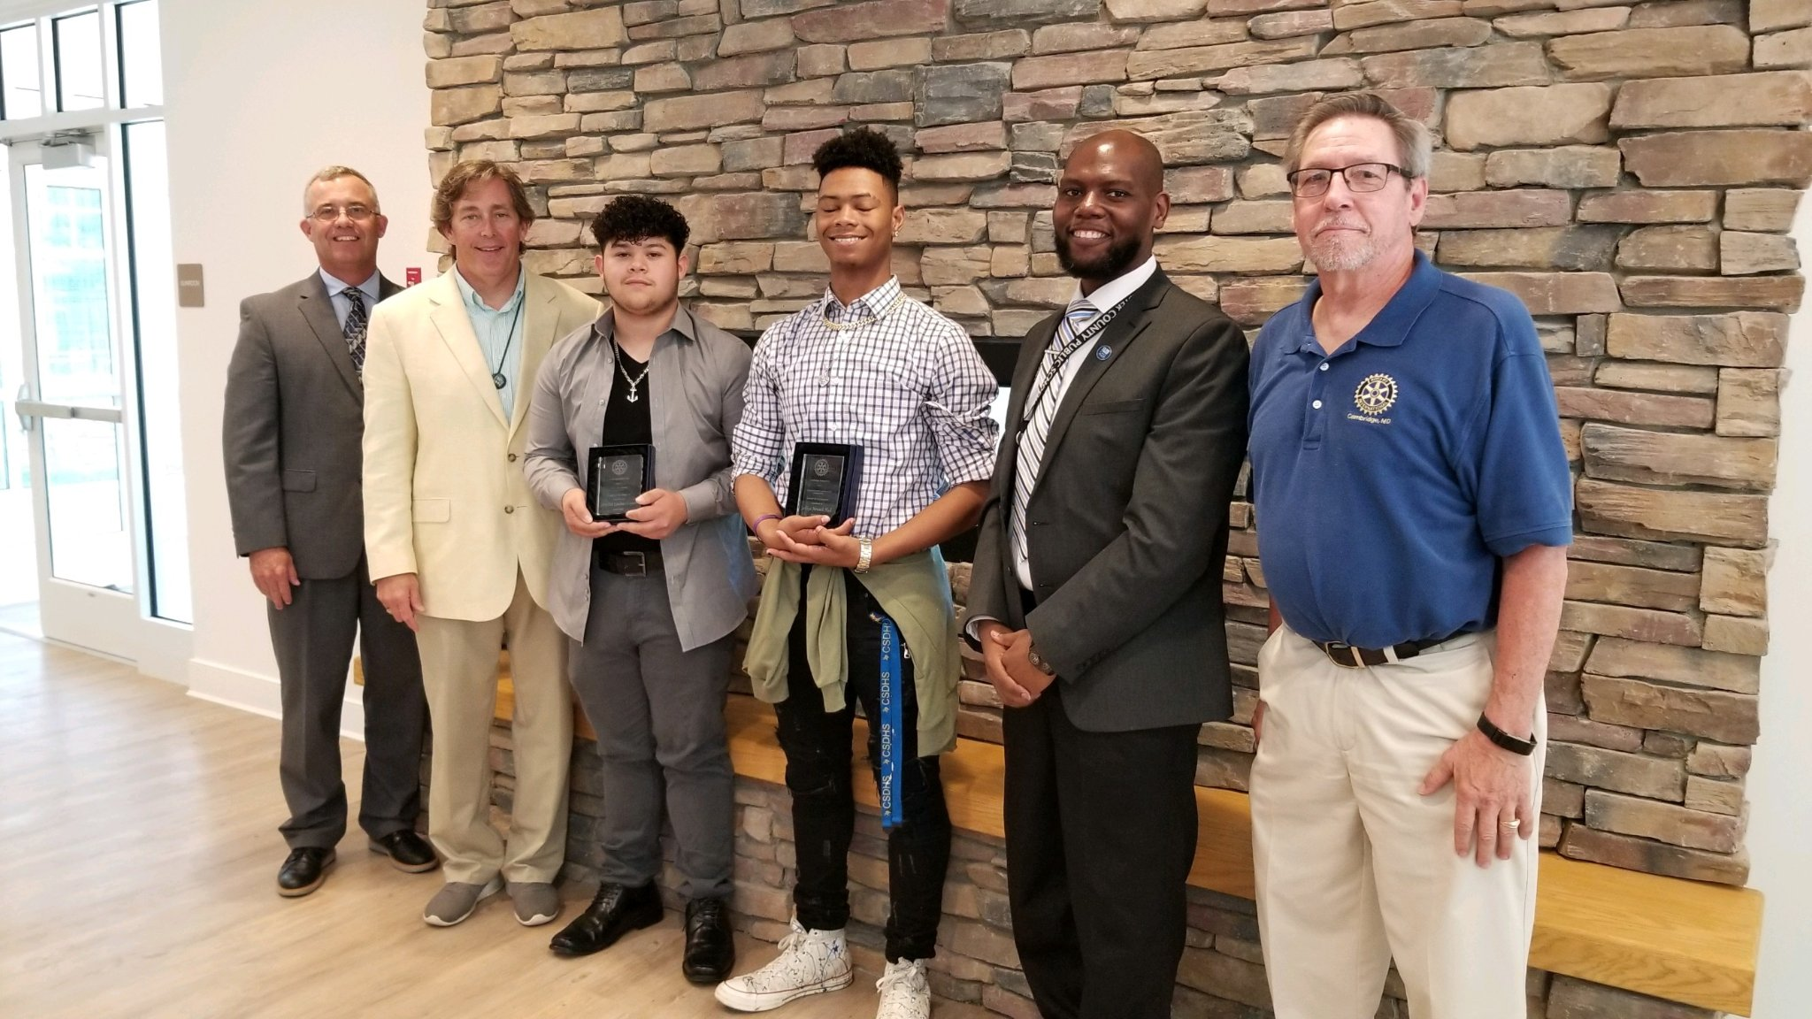
Students of the Semester

Slide 21
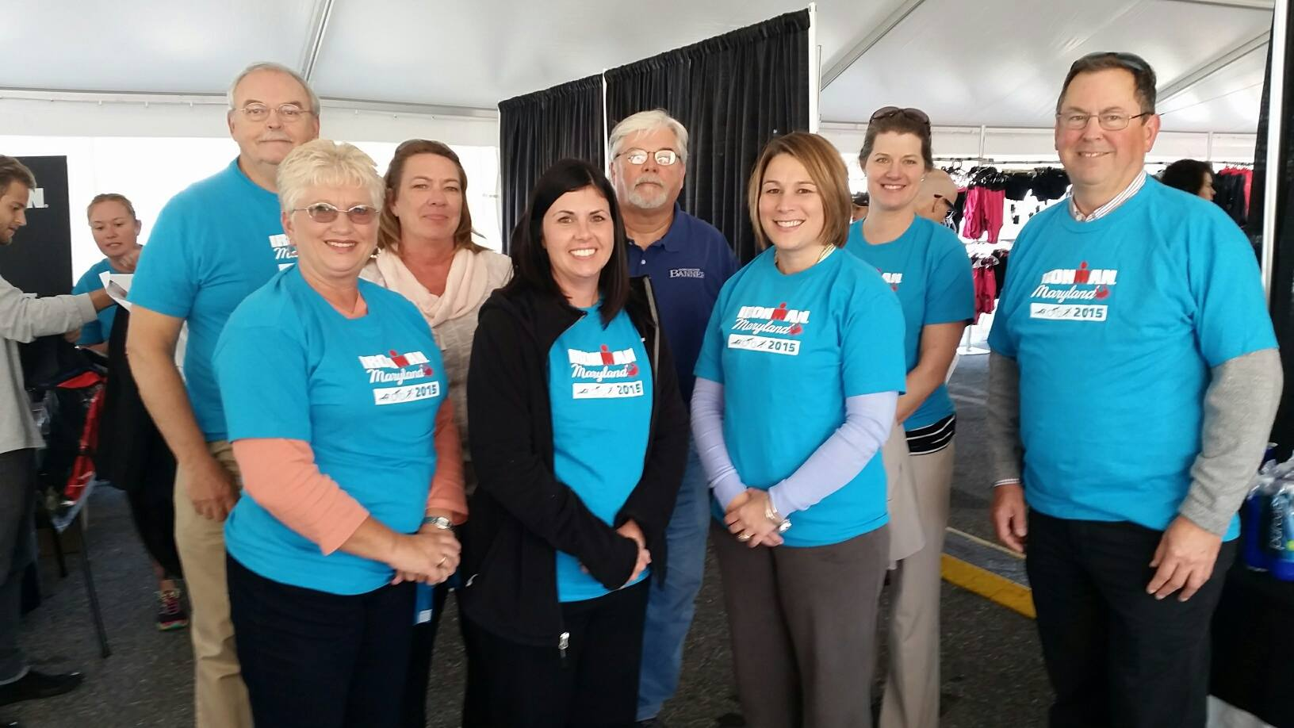
Rotary volunteers at Ironman

