Slide 1

Discover Rotary Event
(insert club name (s) here)

Slide 2
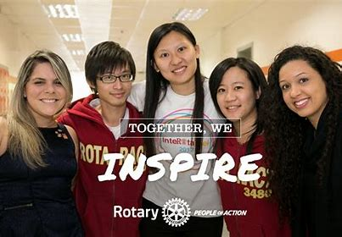
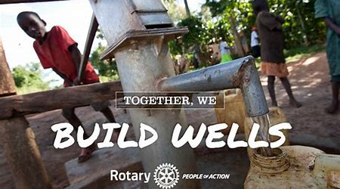
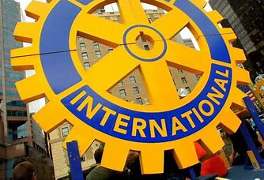

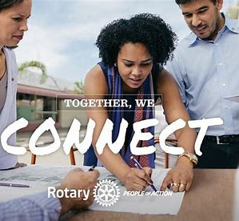
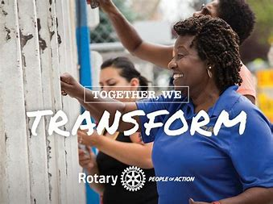
What Is Rotary? People Of Action
Notes:
To answer the question what is Rotary… We are the largest most financially sound membership organization whose logo is recognized in more countries than any other in the world. Every minute of every day we feed, we house, we vaccinate, educate, advocate, comfort and provide services. This is Rotary!

Slide 3
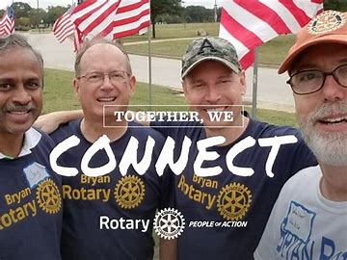
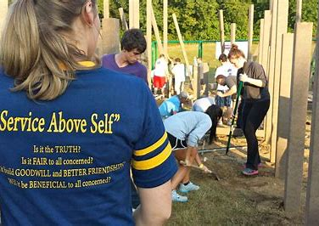
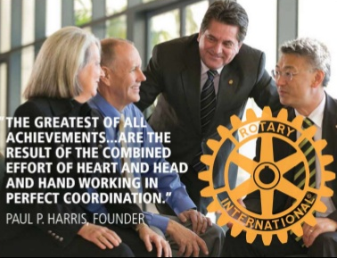

What is Rotary?
1.2 million Rotarians – 35,000 Clubs – 200 Countries
“Service Above Self”
Notes:
Rotary is a membership organization that does service. We are a global network of business and professional leaders. We do humanitarian service projects and encourage high ethical standards. We strive for goodwill and peace in the world. There are 1.2 million of us in 35,000 clubs in over 200 countries around the world. Our motto is Service Above Self.

Slide 4
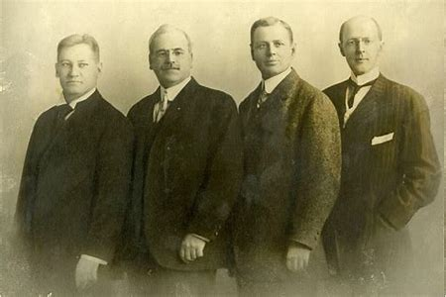
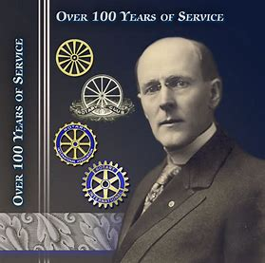
From left: Gustavus Loehr, Silvester Schiele, Hiram Shorey and Paul Harris.
Paul Harris
The first Rotary Club was organized in 1905, by Chicago Attorney Paul Harris.
The original four-member club met for fellowship in rotation at member’s offices…thus the name ROTARY.
Notes:
Great history in how Rotary got started. Paul Harris an attorney in Chicago gathered some friends in 1905 for fellowship and it grew from there. Their first reason for being was FELLOWSHIP. Meetings were rotated from office to office and that’s how Rotary got its name.

Slide 5
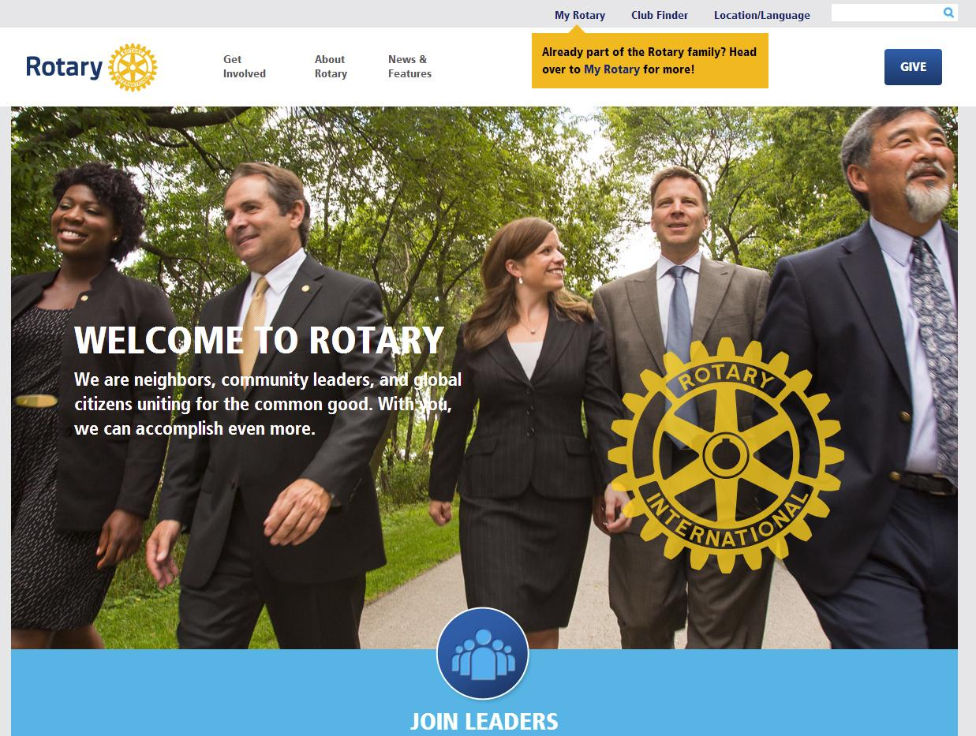

Neighbors, friends, and problem solvers share ideas and take action to create lasting change.
Notes:
Put simply, Rotary is where neighbors, friends, and problem solvers share ideas and take action to create lasting change. It can be a life-changing experience because of the extraordinary people you will meet. Rotarians who will be a mentor and role model for you and who will help you build your business network.

Slide 6
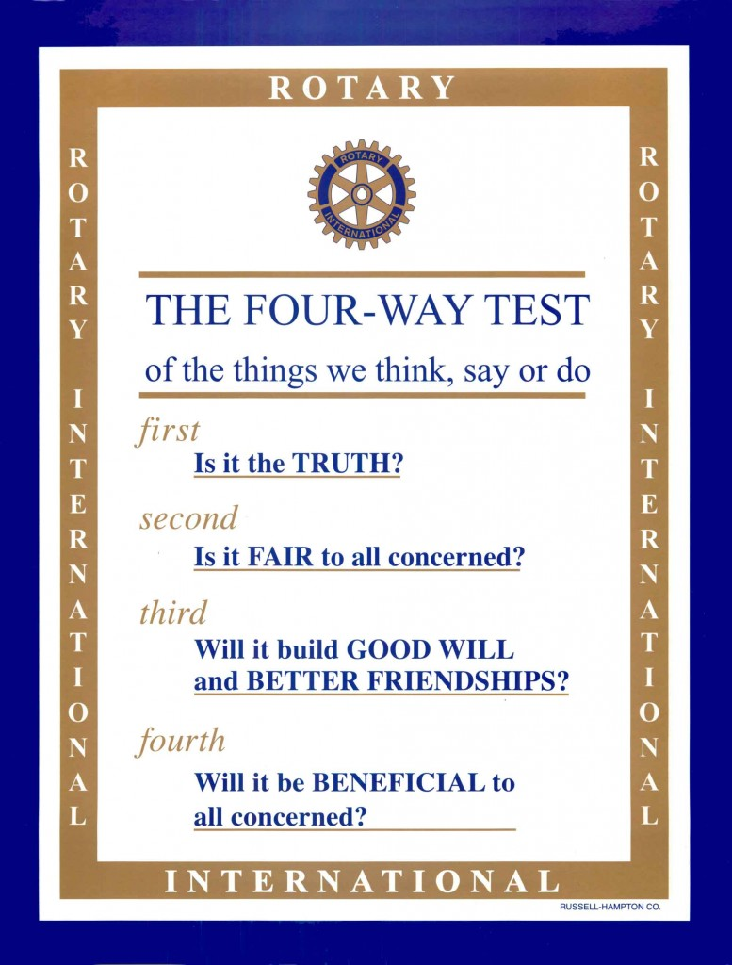
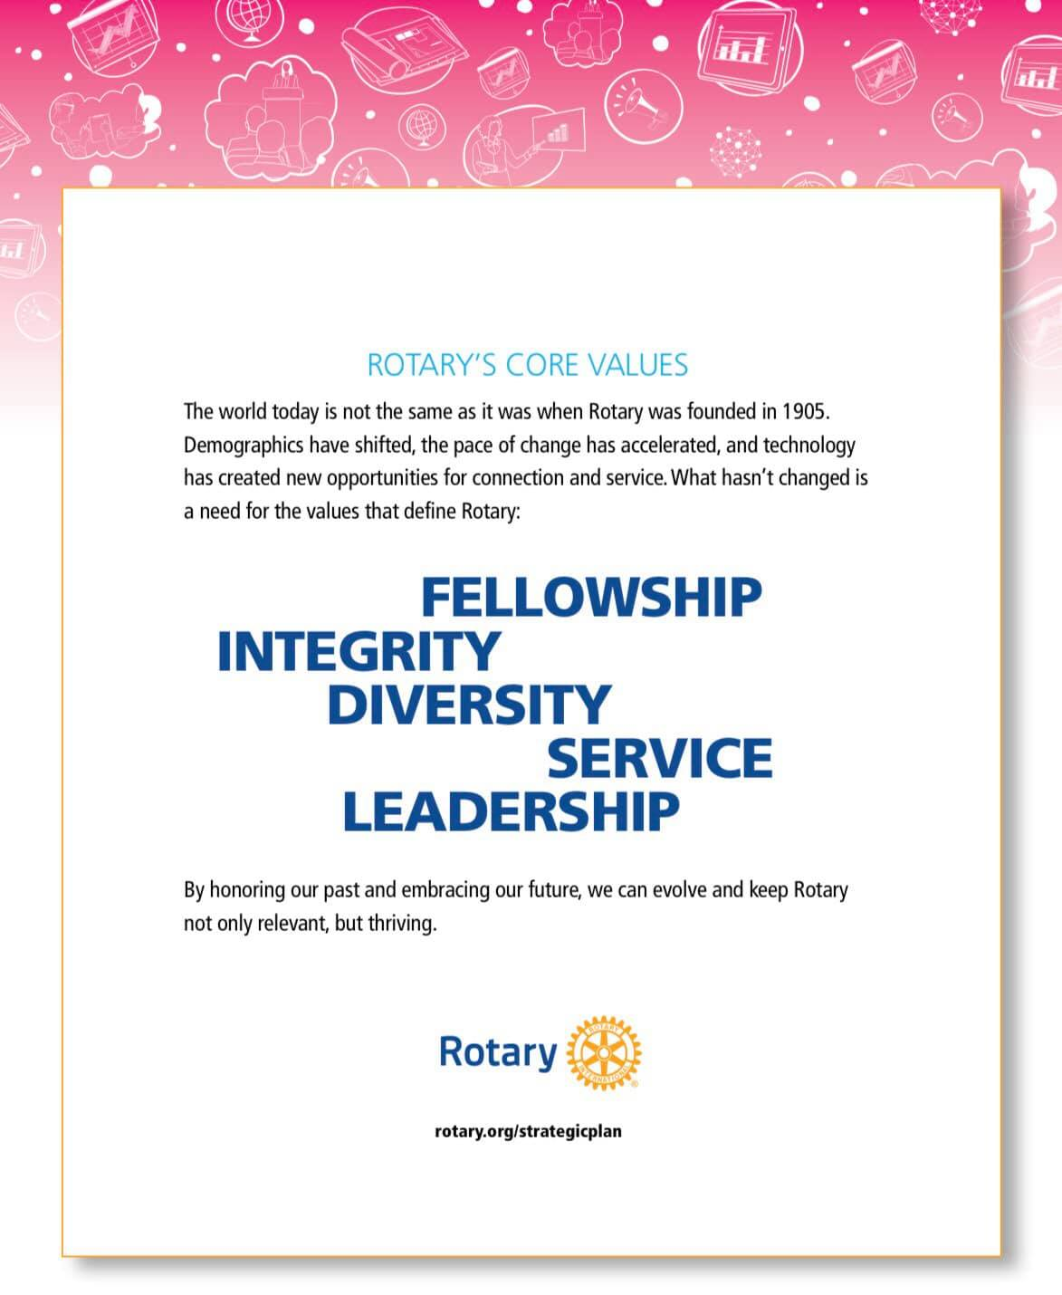
Rotary’s Core Values & Four-Way Test
Notes:
The Four Way Test is used by Rotarians world-wide as a moral code for personal and business relationships. It can be applied to almost any aspect of life by asking four simple questions…Is it the truth, is it fair to all concerned, will it build good will and better friendships, will it be beneficial to all concerned. Now some Rotarians have added a 5th question, is it fun? Because while we work hard on our projects, we also like to have fun. The four way test goes hand in hand with Rotary’s Core Values. The world today is very different than it was when Rotary was founded in 1905. But what hasn’t changed are our core values of fellowship, integrity, diversity, service and leadership.

Slide 7
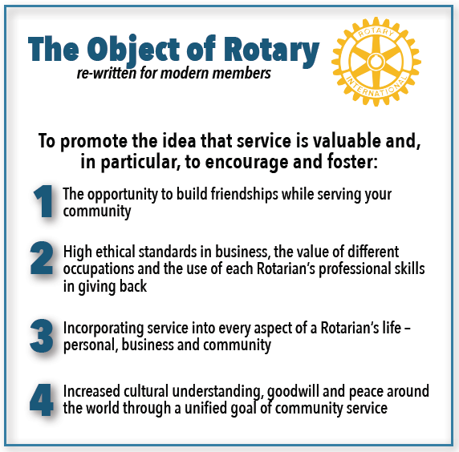
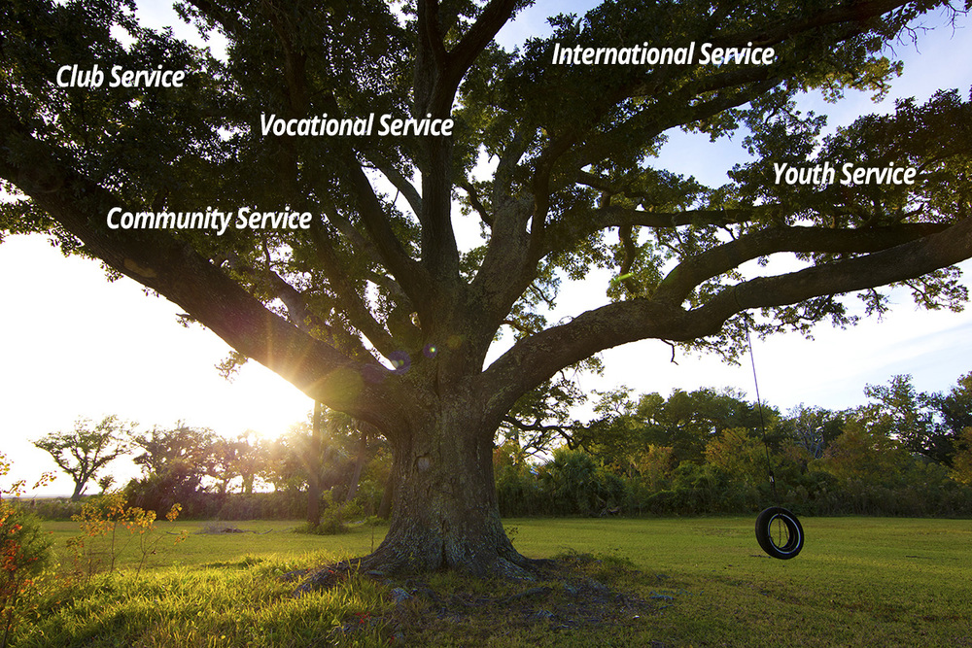
We implement the Object of Rotary through Five Avenues of Service
Notes:
The Object of Rotary is four principles developed over the years to provide Rotarians with a strong, common purpose and direction. They serve as a foundation for our relationships with each other and the action we take in the world. The Object of Rotary comes to life through Five Avenues of Service which are the branches of a deeply rooted membership organization, and they are: Club Service, Vocational Service, Community Service, International Service and Youth Service. This is how we reach out and make a difference in people’s lives around the world and right here at home.

Slide 8
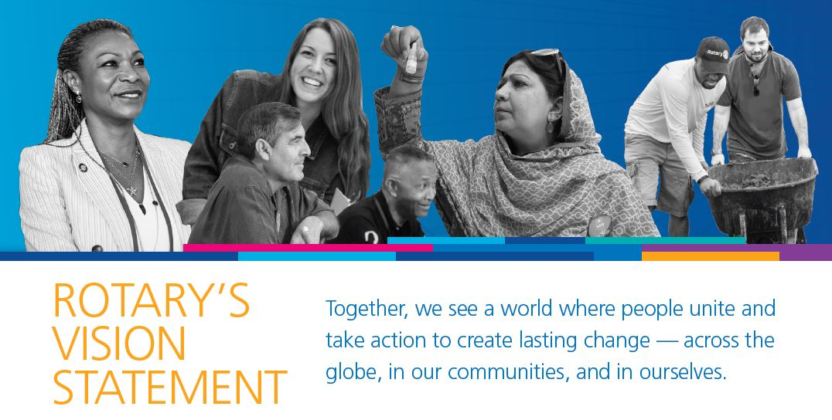
$200 Million and 16 Million
Volunteer Hours
Rotarians invest more than $200 million and 16 million volunteer hours every year.
Notes:
Rotarians are people of action because we are guided by a strong vision. Together, we see a world where people unite and take action to create lasting change – across the globe, in our communities, and in ourselves. Each year, Rotarians invest more than $200 million and 16 million volunteer hours to promote peace, fight disease, provide clean water, save mothers and children, support education and grow local economies.

Slide 9

The Rotary Foundation
At the 1917 convention, the outgoing president proposed setting up an endowment “for the purpose of doing good in the world”. The initial investment of $26.50 has grown to transform millions of lives around the world.
91% of funds are spent on program awards and operations
FY 21 – 22 Support
  $150M to Polio Plus
  $73M to Global Grants
  $27M to District Grants
  $17M to Other Grants and Disaster Response Grants (e.g. Ukraine, Turkey/Syria earthquake and Pakistan)
Rated 100% and 4 stars by Charity Navigator – the highest rating possible!
Notes:
The Rotary Foundation maintains the highest possible rating and distributes 91% of collected funds on programs and operations.

Slide 10


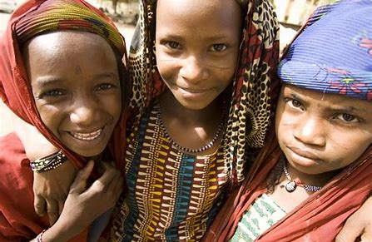

$4 billion spent on life-changing projects
Notes:
The Rotary Foundation promotes world understanding and peace. Since it was founded more than 100 years ago, the Foundation has spent more than $4 billion on life-changing, sustainable project from preventing disease to providing clean water, supporting education, growing local economies, saving mothers and children and promoting peace.

Slide 11
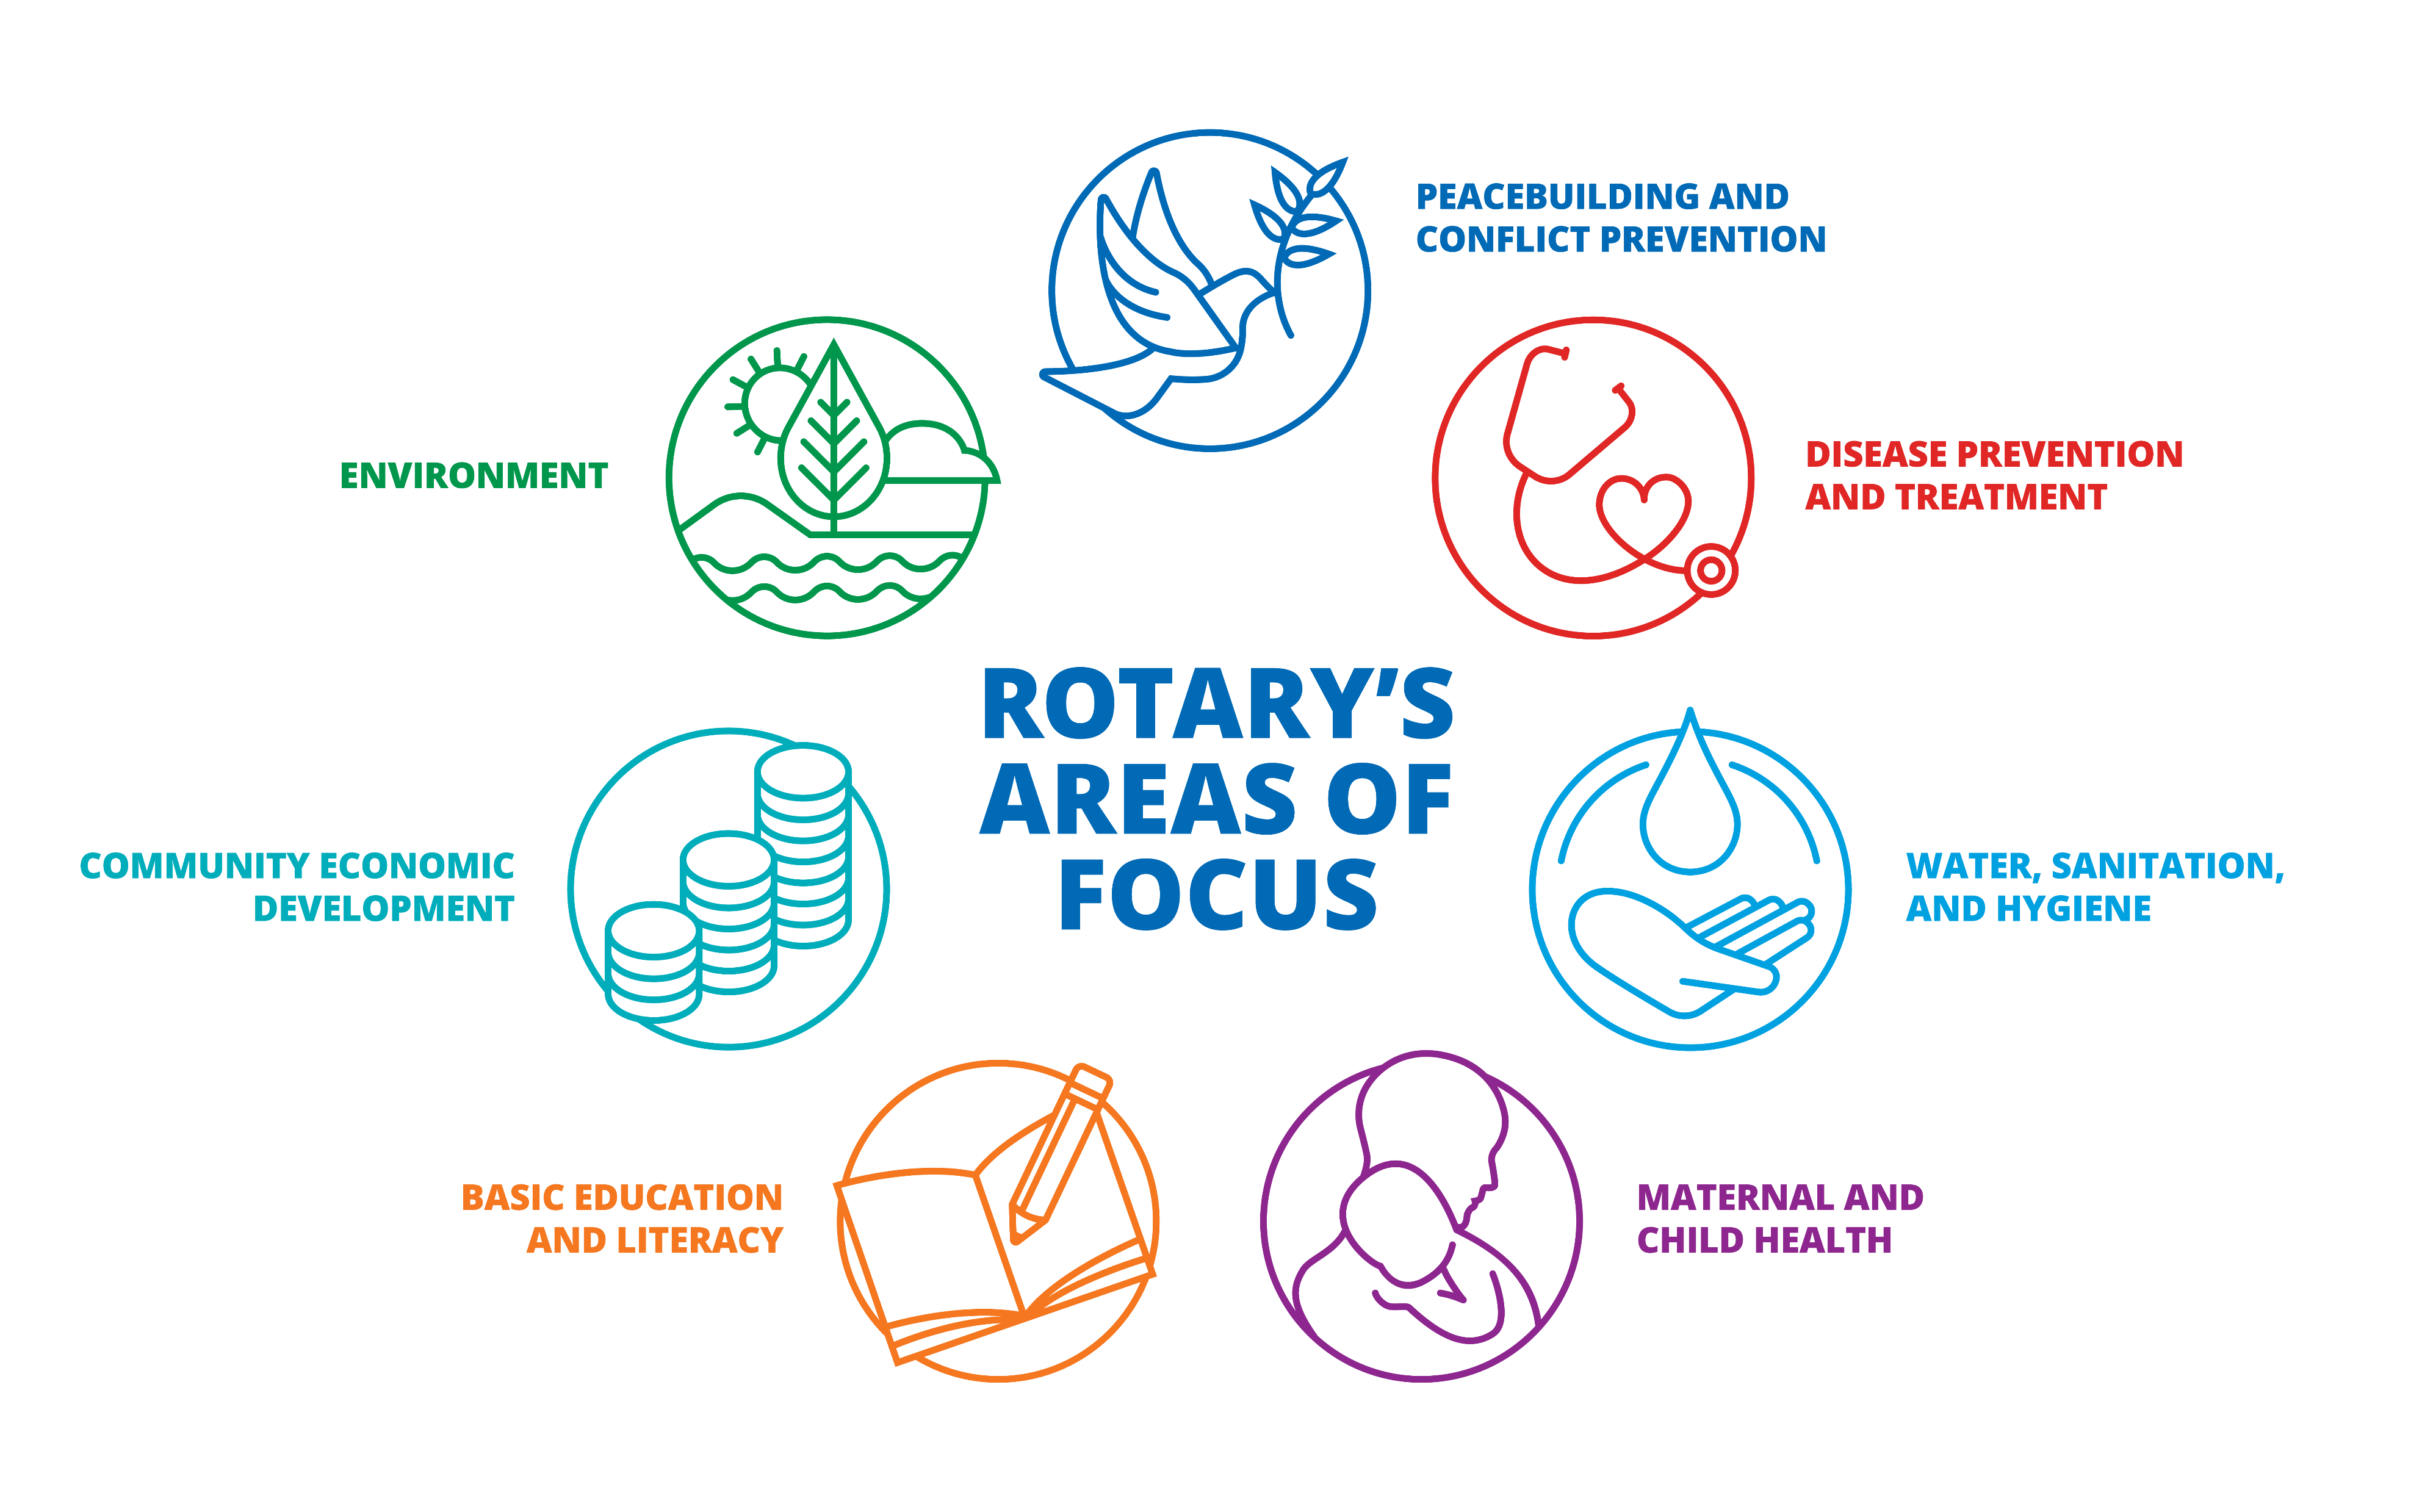
Seven Areas Of Focus
Peace & Conflict Prevention
Education & Literacy
Disease Prevention & Treatment
Water Sanitation & Hygiene
Community Economic Development
Maternal & Child Health
Supporting The Environment
Notes:
Seven Areas of Focus help us build international relationships, improve lives, create a better world, support peace and end polio forever. All critical humanitarian issues Rotarians have been working on for many years.

Slide 12
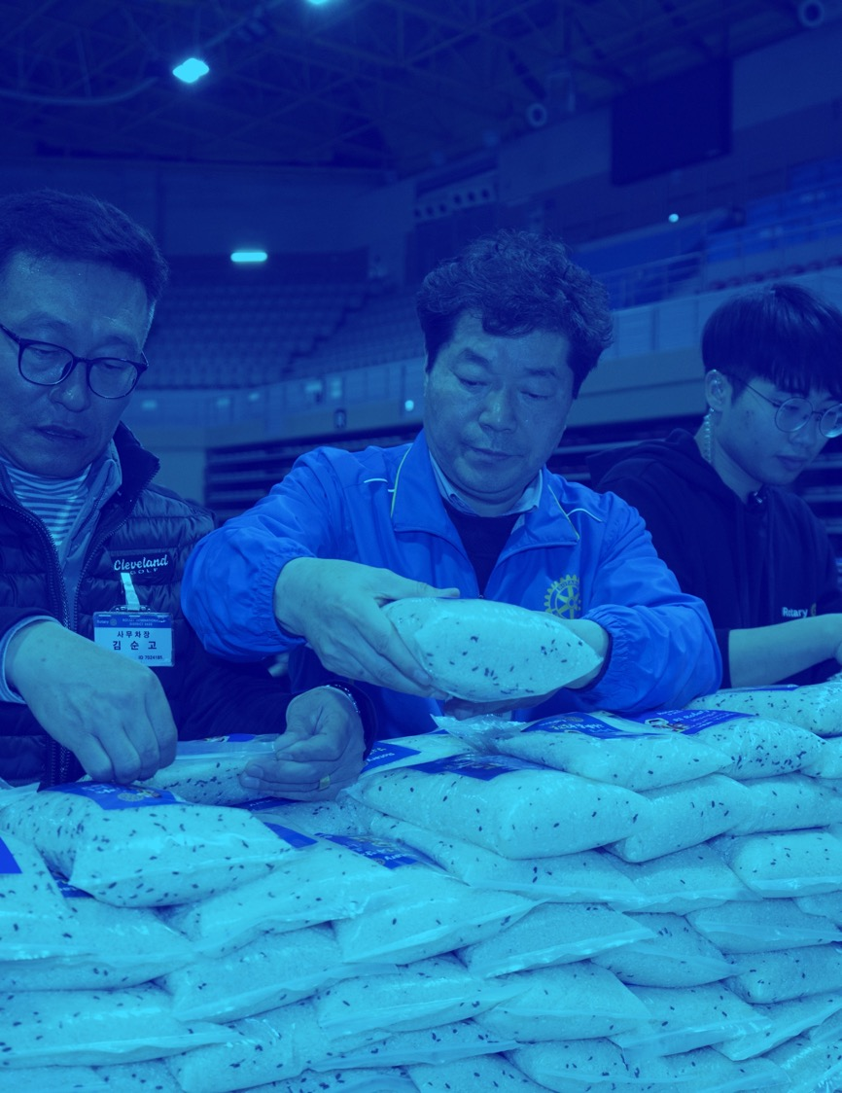
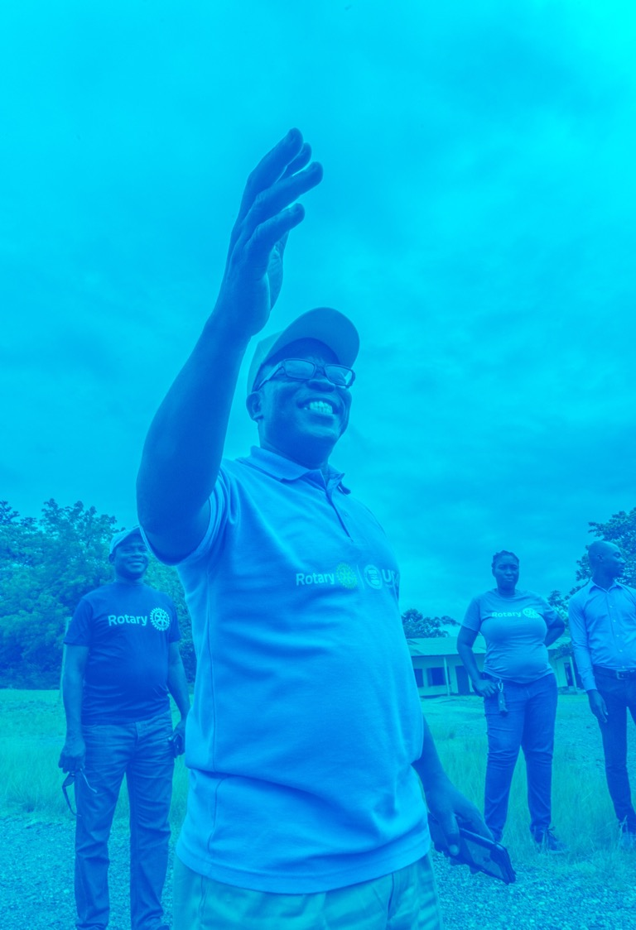
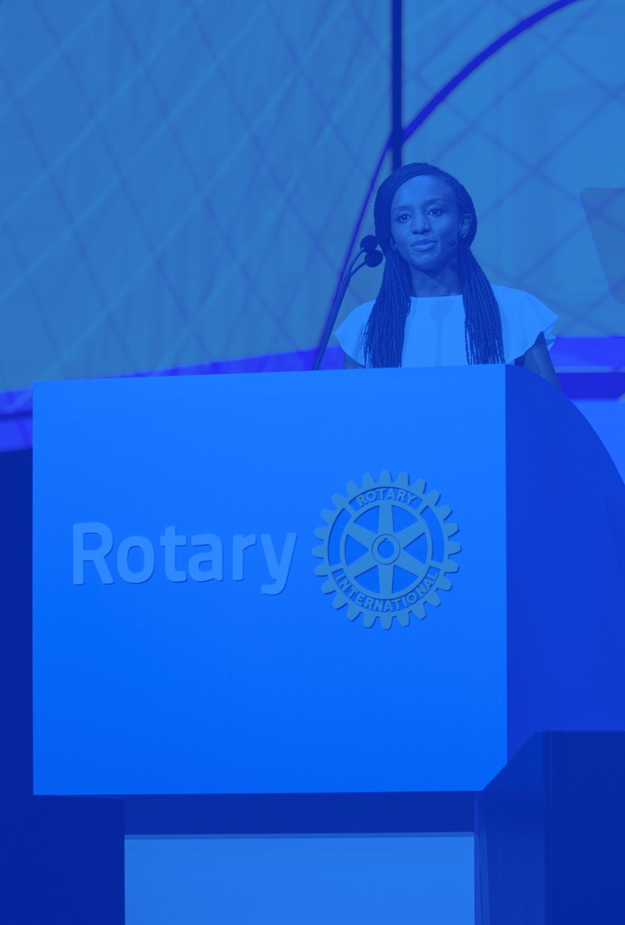
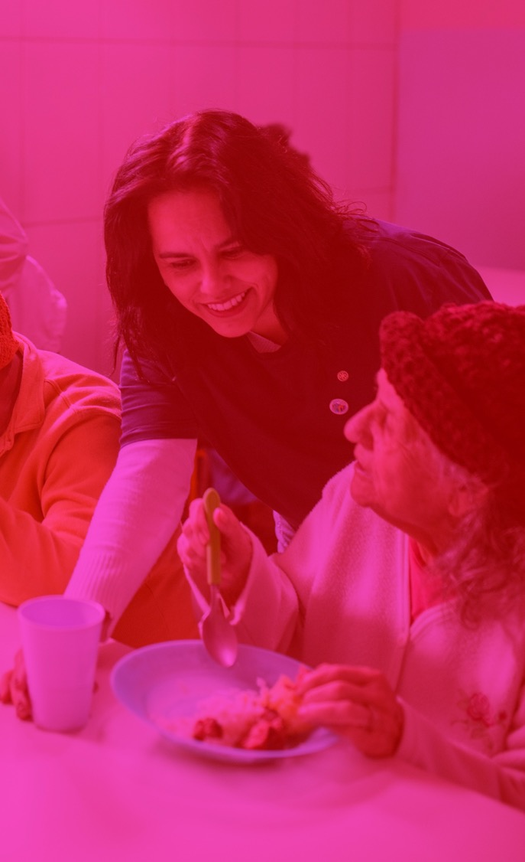

Rotary
Builds Peace
Rotary believes that if concerned citizens
work together to create peace locally,
we can create lasting change globally.
Notes:
As a humanitarian organization, peace is a cornerstone of our mission. We believe when people work to create peace in their communities, that change can have a global effect.
By carrying out service projects and supporting peace fellowships and scholarships, our members take action to address the underlying causes of conflict, including poverty, discrimination, ethnic tension, lack of access to education, and unequal distribution of resources.

Slide 13
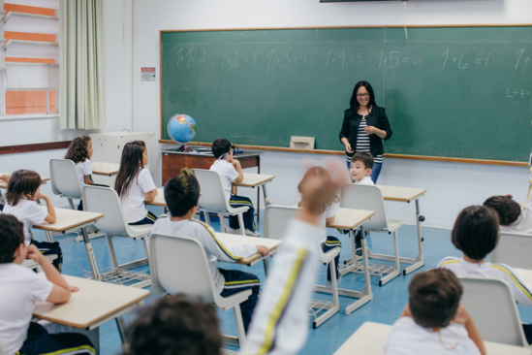
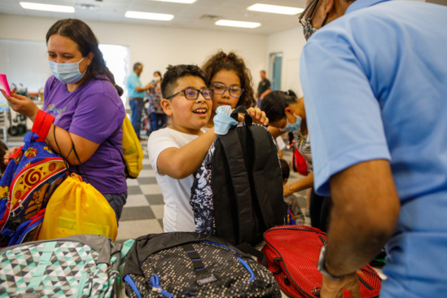
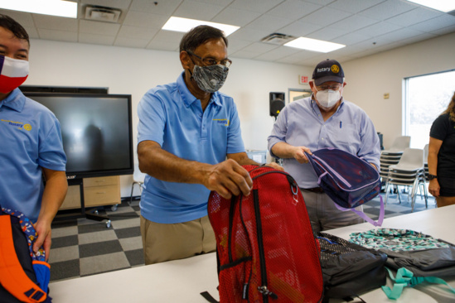

Education and Literacy
More than 775 million people over the age of 15 are illiterate. That’s 17 percent of the world’s adult population.
Our goal is to strengthen the capacity of communities to support basic education and literacy, reduce gender disparity in education, and increase adult literacy. We support education for all children and literacy within children and adults.
Notes:
“When you teach somebody how to read, they have that for a lifetime. It ripples through the community, one by one.” Rotary clubs help to promote this area of focus through Coaching Teachers, Mentoring Students, Training education providers and faculty, Raising local and international funds for Scholarship programs.

Slide 14
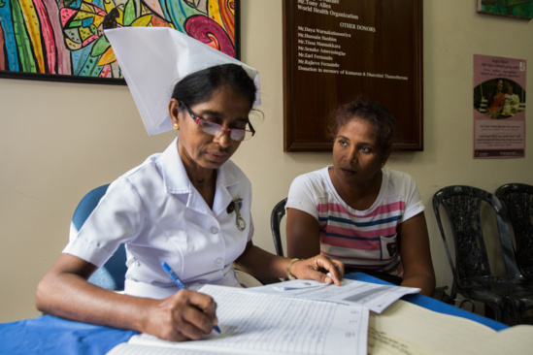

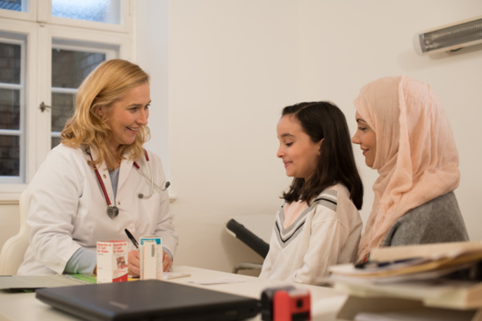
Disease Prevention & Treatment
We believe good health care is everyone’s right. Yet 400 million people in the world can’t afford or don’t have access to basic health care.
Our members combat diseases like malaria, HIV/AIDS, Alzheimer’s, multiple sclerosis, diabetes, and polio. Prevention is important, which is why we also focus on health education and bringing people routine hearing, vision, and dental care.
Notes:
Disease results in misery, pain, and poverty for millions of people worldwide. That’s why treating and preventing disease is so important to us. We lead efforts both large and small. We set up temporary clinics, blood donation centers, and training facilities in underserved communities struggling with outbreaks and health care access. We design and build infrastructure that allows doctors, patients, and governments to work together.

Slide 15
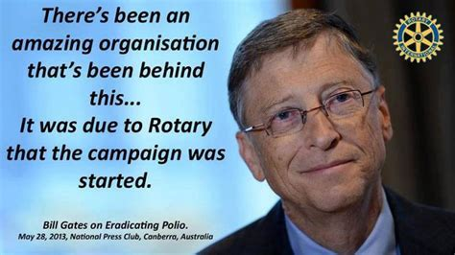

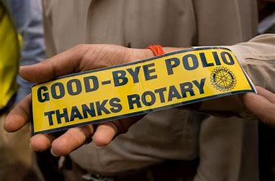
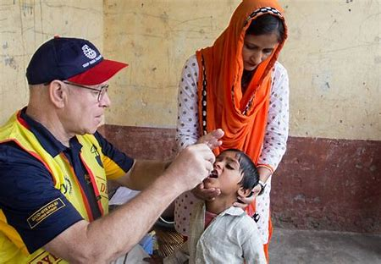
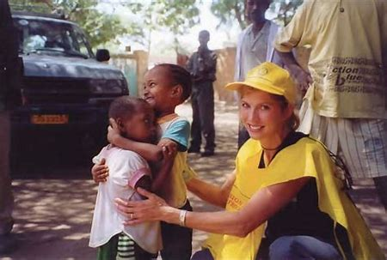
99.9% Reduction Of Cases Worldwide
Notes:
The Rotary Foundation is best known for its work to end polio in the world. Polio Plus was launched in 1985 and has reached a 99.9% reduction in the number of Polio cases world-wide. The Bill & Melinda Gates Foundation joined Rotary in 2017 to commit $450 million to end polio.

Slide 16
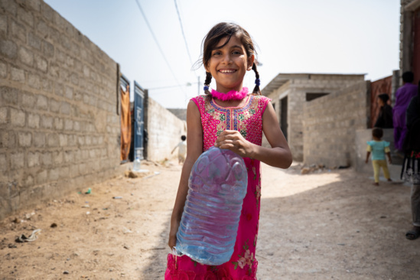

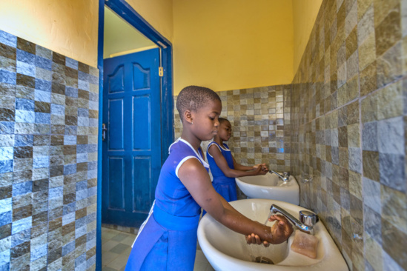
Water Sanitation & Hygiene
Clean water, sanitation, and hygiene education are the basic necessities for a healthy environment and a productive life.
Through water, sanitation, and hygiene (WASH) programs, Rotary’s people of action mobilize resources, form partnerships, and invest in infrastructure and training that yield long-term change.
Notes:
When people have access to clean water and sanitation, waterborne diseases decrease, children stay healthier and attend school more regularly, and mothers can spend less time carrying water and more time helping their families.

Slide 17
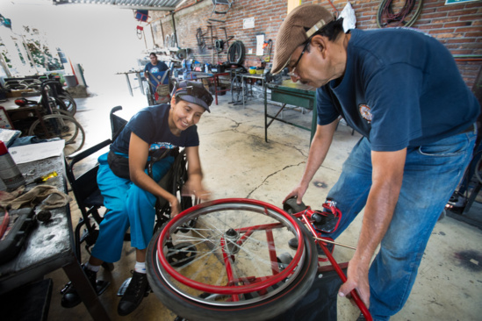
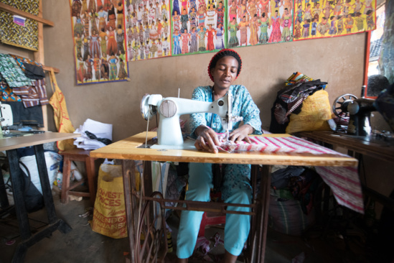
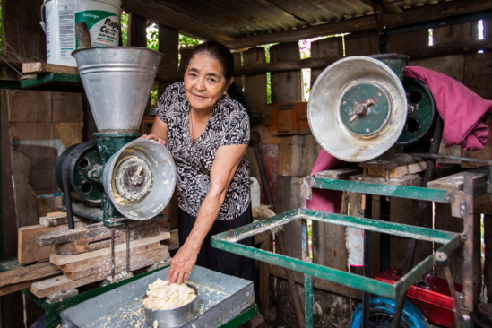

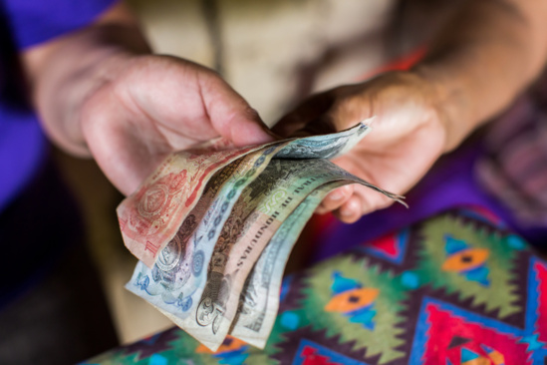
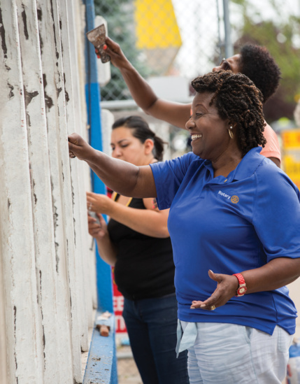
Community Economic Development
Nearly 800 million people live on less than $1.90 a day. Rotary members are passionate about providing sustainable solutions to poverty.
Our members and our Foundation work to strengthen local entrepreneurs and community leaders, particularly women, minorities, and impoverished communities.
We provide training and access to well-paying jobs and financial management institutions.
Notes:
Rotary members train people to become resources for their community, offering networking activities, advice on new business development, and mathematics and financial management training.

Slide 18
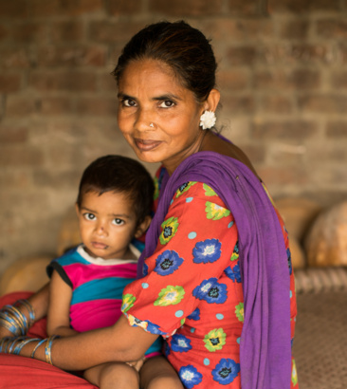

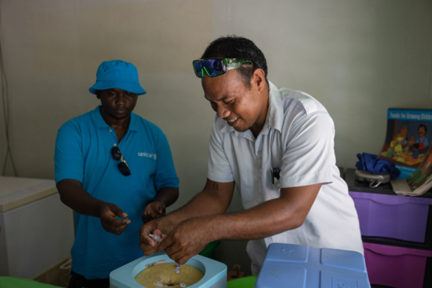
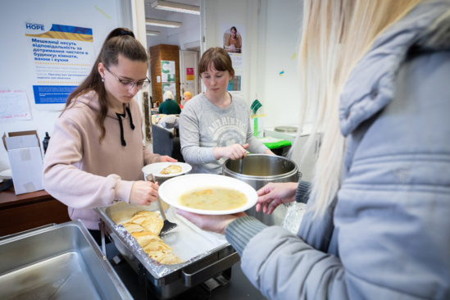
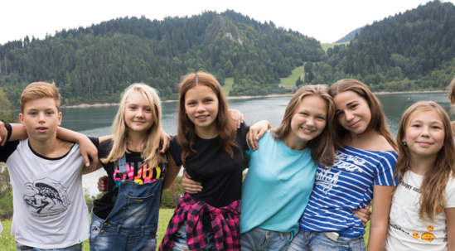
Maternal & Child Health
Rotary makes high-quality health care available to vulnerable mothers and children so they can live longer and grow stronger.
We expand access to quality care, so mothers and children everywhere can have the same opportunities for a healthy future. An estimated 5.9 million children under the age of five die each year because of malnutrition, inadequate health care, and poor sanitation — all of which can be prevented.
Notes:
Rotary provides education, immunizations, birth kits, and mobile health clinics. Women are taught how to prevent mother-to-infant HIV transmission, how to breast-feed, and how to protect themselves and their children from disease.

Slide 19

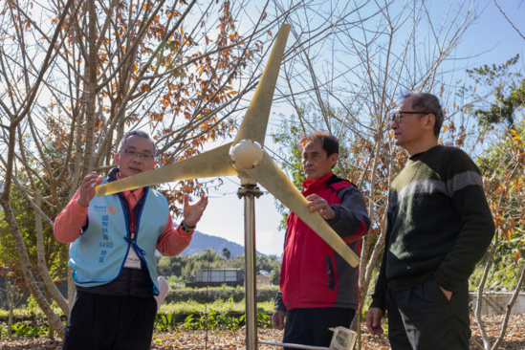
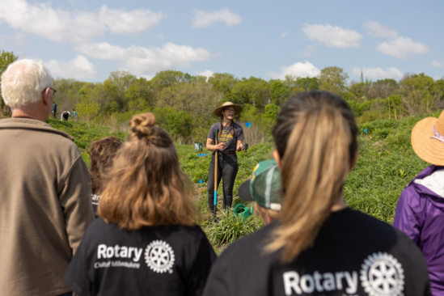
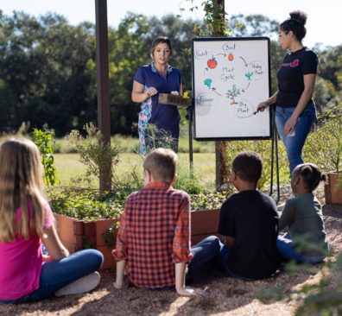

Supporting The Environment
Rotary shares an interest in protecting our common legacy: the environment.
We are committed to supporting activities that strengthen the conservation and protection of natural resources, advance ecological sustainability, and foster harmony between communities and the environment. We empower communities to access grants and other resources, embrace local solutions, and spur innovation in an effort to address the causes and reduce the effects of climate change and environmental degradation.
Notes:
Rotary members are tackling environmental issues the way they always do: coming up with projects, using their connections to change policy and planning for the future.

Slide 20
History of your Rotary Club

Slide 21
Club service Projects

Slide 22
Club Community Partners

Slide 23
Meeting information/ Format

Slide 24
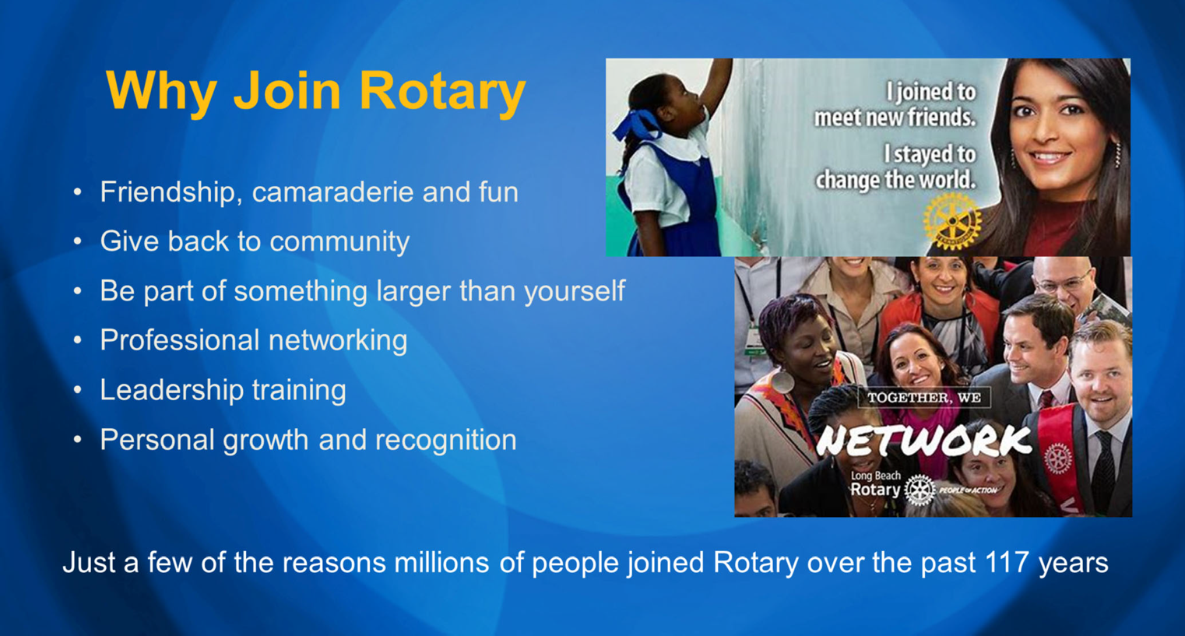
Notes:
There are many good reasons to join Rotary. Life‐long friends, making the community a better place, being part of something larger than yourself, networking, leadership and personal growth. These are just a few of the reasons why millions of people have joined Rotary over the past 120 years.

Slide 25
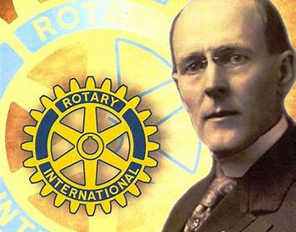
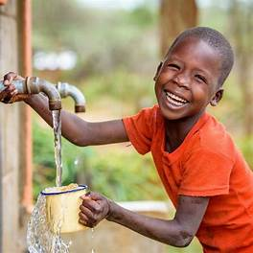
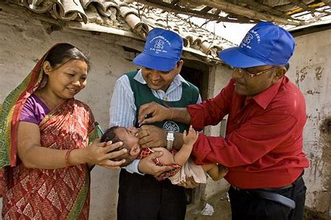
“If you have the love of your fellow men in your heart, my friend, you are a potential Rotarian.”
Notes:
Paul Harris said it best when describing what it takes to be a Rotarian when he said, “if you have the love of your fellow men in your heart, my friend, you are a potential Rotarian.”

Slide 26
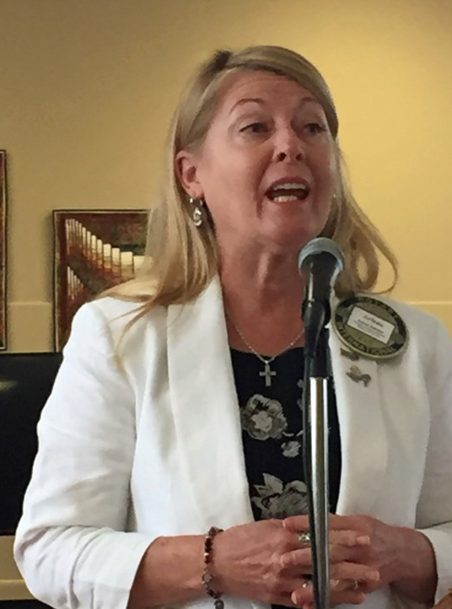



How To Join Rotary
New members become quickly involved in club activities, events, and consider leadership positions.
Notes:
There is a process for joining Rotary. Membership is by invitation from a Rotarian. You submit a completed membership proposal form and when the board of directors approves your membership, you are inducted into the club. You are assigned a new member mentor. But most important of all…you become quickly involved in club activities and events and eventually we encourage all new members to consider a leadership position in the club.

Slide 27


What Could You Bring To Rotary?

Slide 28


What Could Rotary Bring To You?

Slide 29


Thanks for your interest in (Your Club Name)
Notes:
Thanks for your interest in joining Rotary

