Slide 1
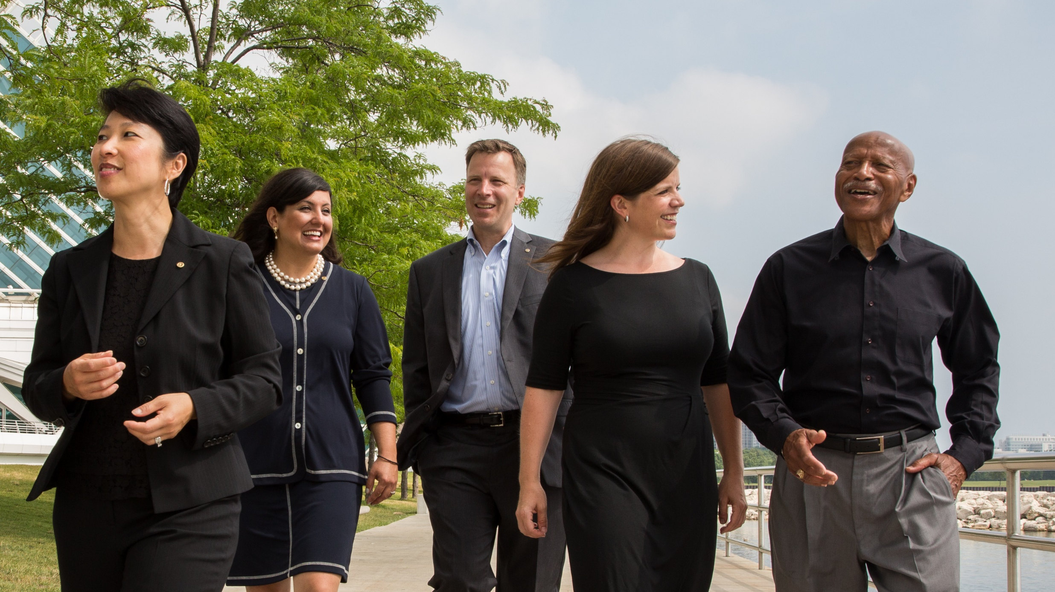
Rotary Fellowships

Slide 2

What are Rotary Fellowships?
Groups of any interested individuals who connect to explore shared interests in:
Recreational Activities
Hobbies
Sports
Vocations
Rotary History & Culture
Notes:
Rotary Fellowships are international, independently organized groups of any interested individual who share a common hobby, recreational interest, or profession. Rotary Fellowships give their members the opportunity to have fun, make new friends around the world, and enhance their experience in Rotary.

Slide 3

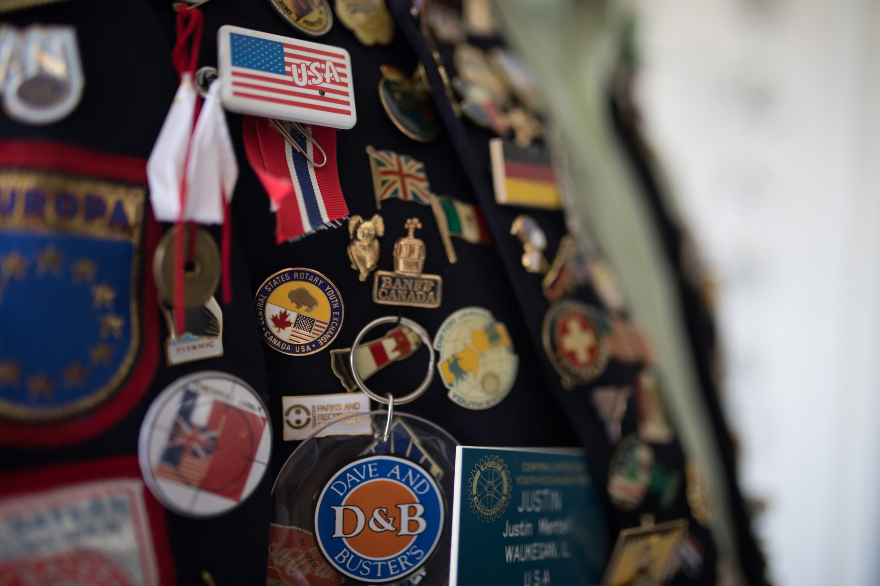
Examples of Rotary Fellowships
More than 80 Rotary Fellowships are now officially registered with Rotary International
Notes:
Many fellowships also use their special interests to serve others. For example, the Fellowship of Canoeing Rotarians has organized cleanups of polluted rivers; members of the International Computer Users Fellowship of Rotarians have hosted training sessions for Rotarians and the general public; and members of the International Fellowship of Rotarian Scuba Divers join local Rotary clubs to undertake service projects on each of their diving trips.

Slide 4

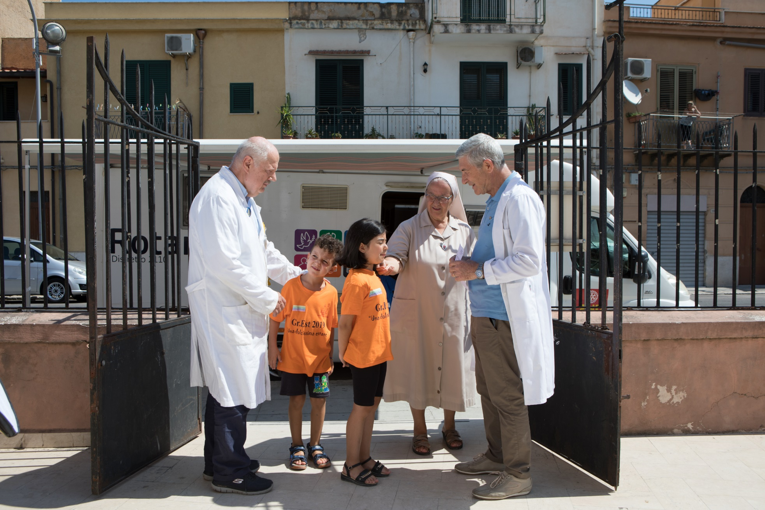
Examples of Rotary Fellowships
Notes:
Here’s just a small sampling of Rotary Fellowships:
Skiing Fellowship
Yachting Fellowship
International Fellowship of Rotarian Musicians
International Fellowship of Rotarian Doctors and Health Professionals
Antique Automobiles Fellowship

Slide 5


Examples of Rotary Fellowships
The International Golfing Fellowship of Rotarians(IGFR) hosts tournaments around the world.
Golfing Fellowship
IGFR maintains connections with 13 different chapters from Lithuania to the United States.
Golfing Fellowship
Notes:
While most day-to-day fellowship activities may take place online or through correspondence, the most successful fellowships facilitate regular opportunities for members to interact in person. For example, many of the sporting fellowships hold regional matches and world tournaments. Fellowships related to travel or excursions plan destination trips, while vocational fellowships often plan get-togethers at professional conferences and seminars. These types of activities will help maintain existing members’ interest in the fellowship and in Rotary, and will also attract new members.

Slide 6
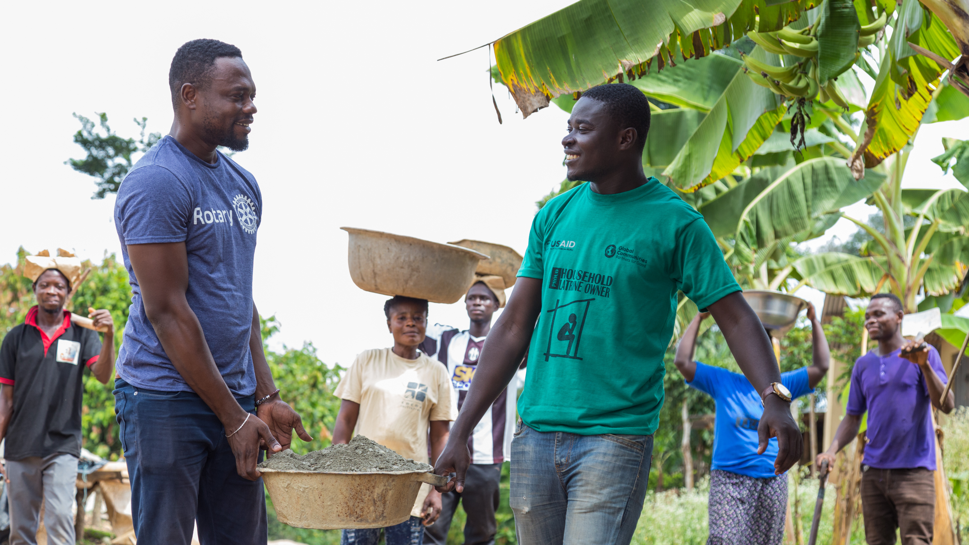
Get involved

Slide 7
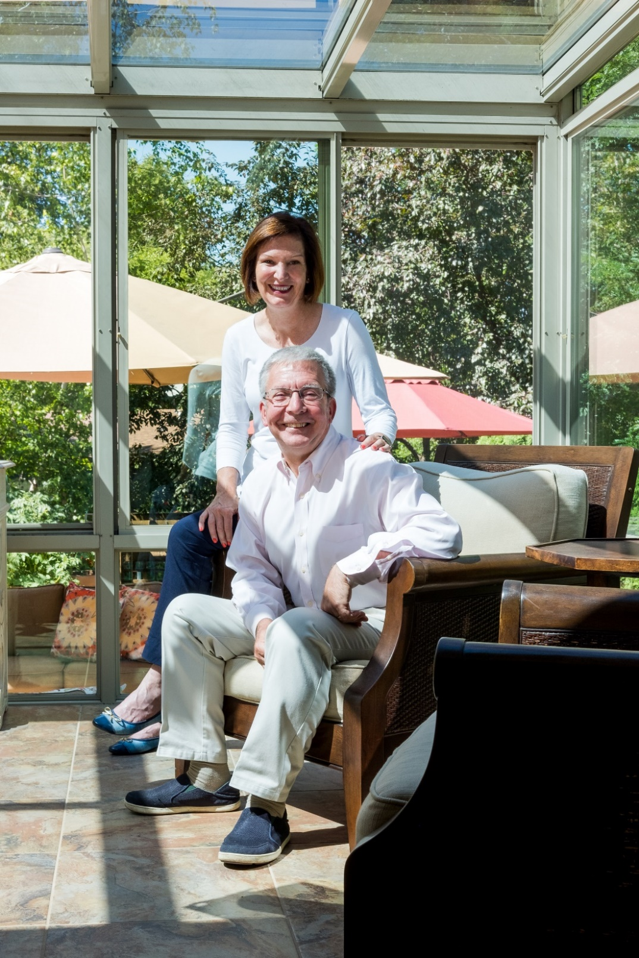
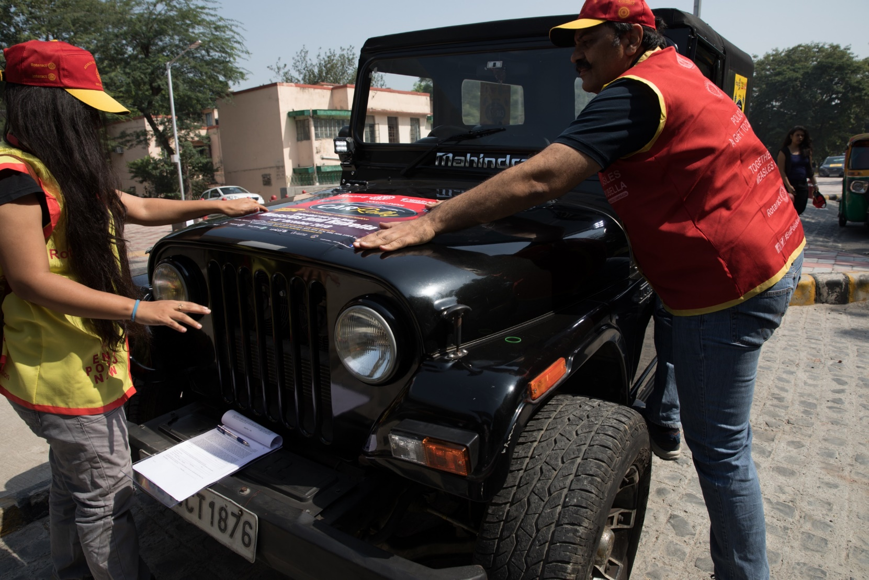
Benefits of Rotary Fellowships
Fellowships engage the family of Rotary through shared interests
International Travel and Hosting Fellowship
Notes:
To recap, Fellowships
Enrich the Rotary experience beyond a club or district;
Encourage engagement with other Rotarians, Rotaractors, program participants, and alumni from a variety of cultures and regions;
Unite people with a common interest from all over the world, which helps facilitate long-term friendships and a better understanding of the world.
Fellowships also further vocational development through acquaintance with others of the same profession.
They also allow individuals to explore new opportunities for service

Slide 8
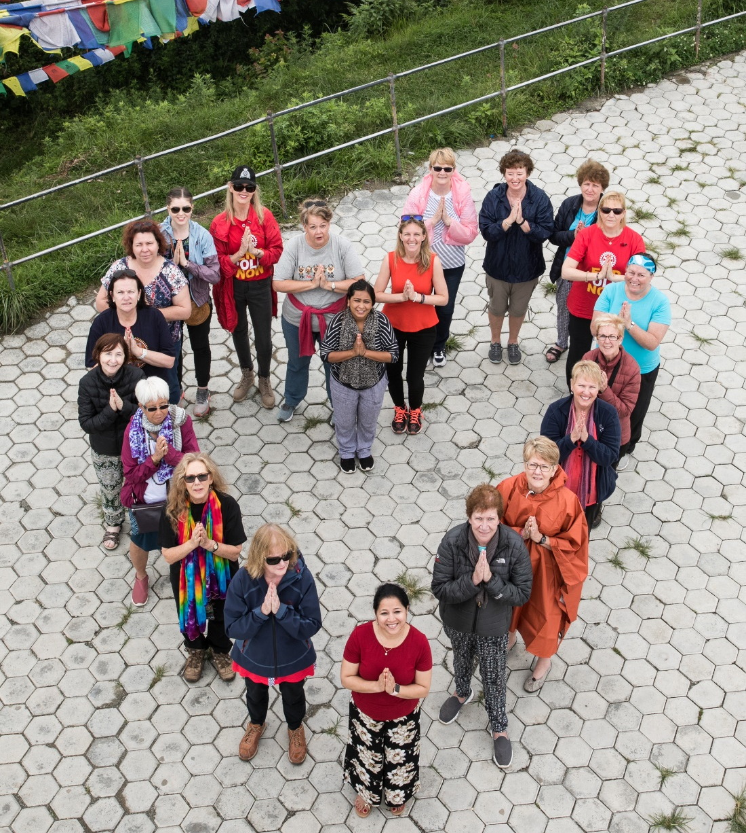
Join a fellowship
Join a Fellowship by contacting a group that interests you. The full list of Fellowships can be found online: www.rotary.org/fellowships

Slide 9
Promoting Fellowships
Publicize events and activities organized by Fellowships on your club or district website
Invite local Fellowship officers to speak at a club meeting, virtual meeting, or district conference about their activities and related service work
Seek out Rotarians who are outstanding in their professions or are enthusiastic about a hobby and encourage them to join fellowships or develop new ones.
Notes:
Promoting Fellowships is a responsibility that we can all share as a way both to grow and promote Rotary.
Publicize events and activities organized by Fellowships on your club or district website
Invite local Fellowship officers to speak at a club meeting or district conference about their activities and related service work.
Seek out Rotarians who are outstanding in their professions or are enthusiastic about a hobby and encourage them to join fellowships or develop new ones.

Slide 10
Organize a New Fellowship
Interested in starting a new international Fellowship on a new topic? Go to www.rotary.org/fellowships where you can find all the steps on how to get started.
You will need:
At least 25 potential members, representing at least five countries
Completed application form with a clear explanation of the group’s purpose
Copy of the group’s proposed bylaws
List of proposed officers and their responsibilities
Notes:
Rotary International has established specific policies for forming a Rotary Fellowship. RI rigorously evaluates each prospective group before deciding whether to formally recognize it. However, each fellowship operates independently of RI, with its own rules, dues requirements, and administrative structure.

Slide 11
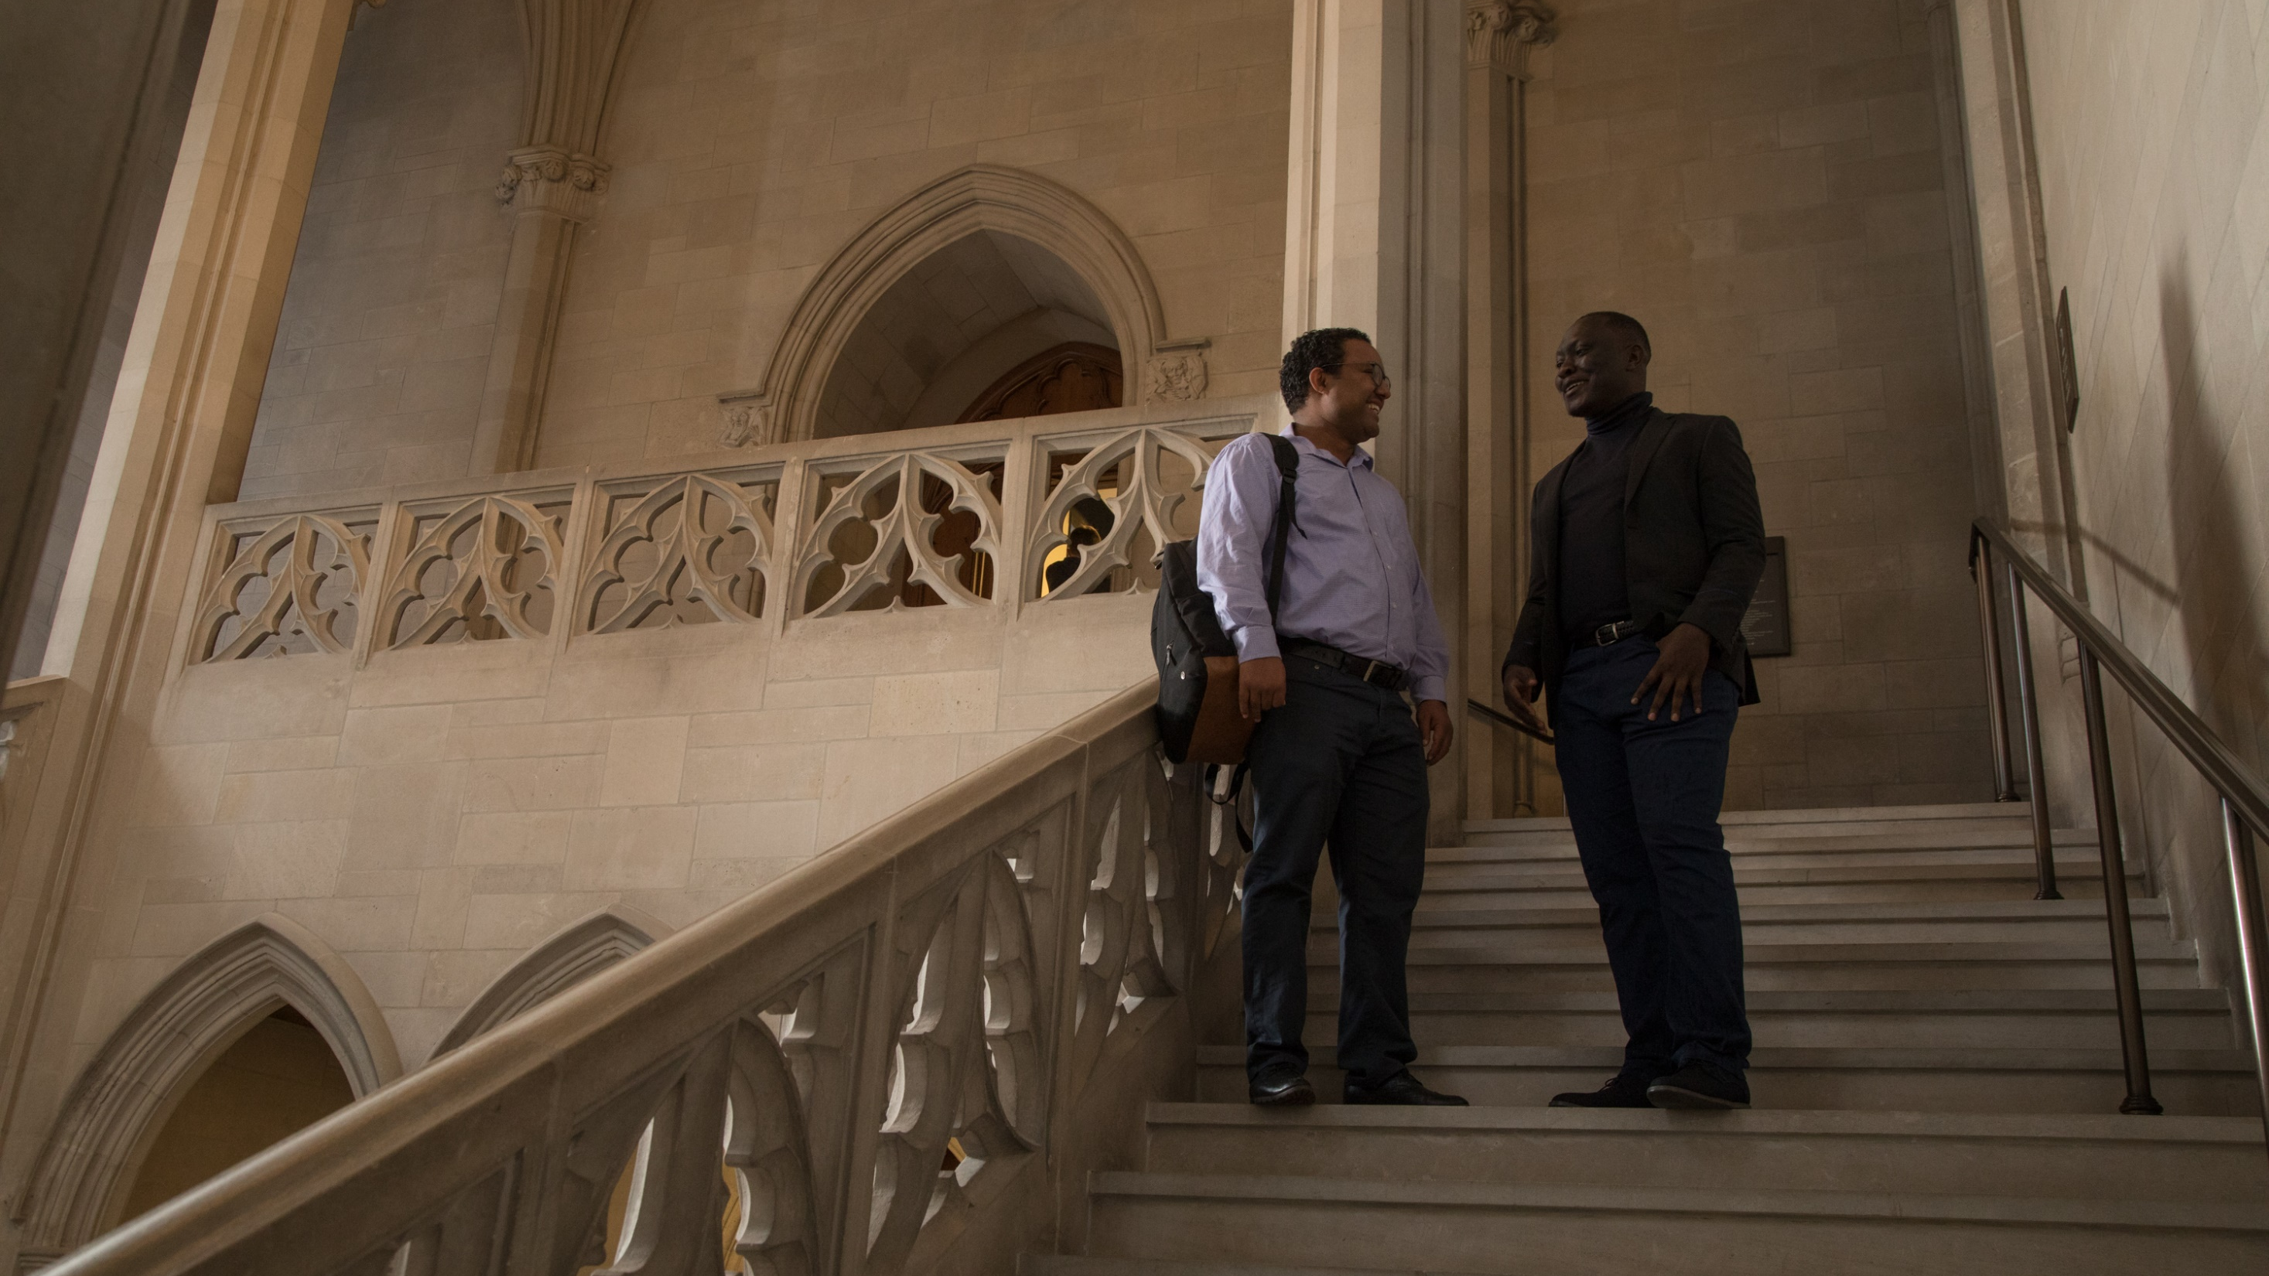
resources

Slide 12
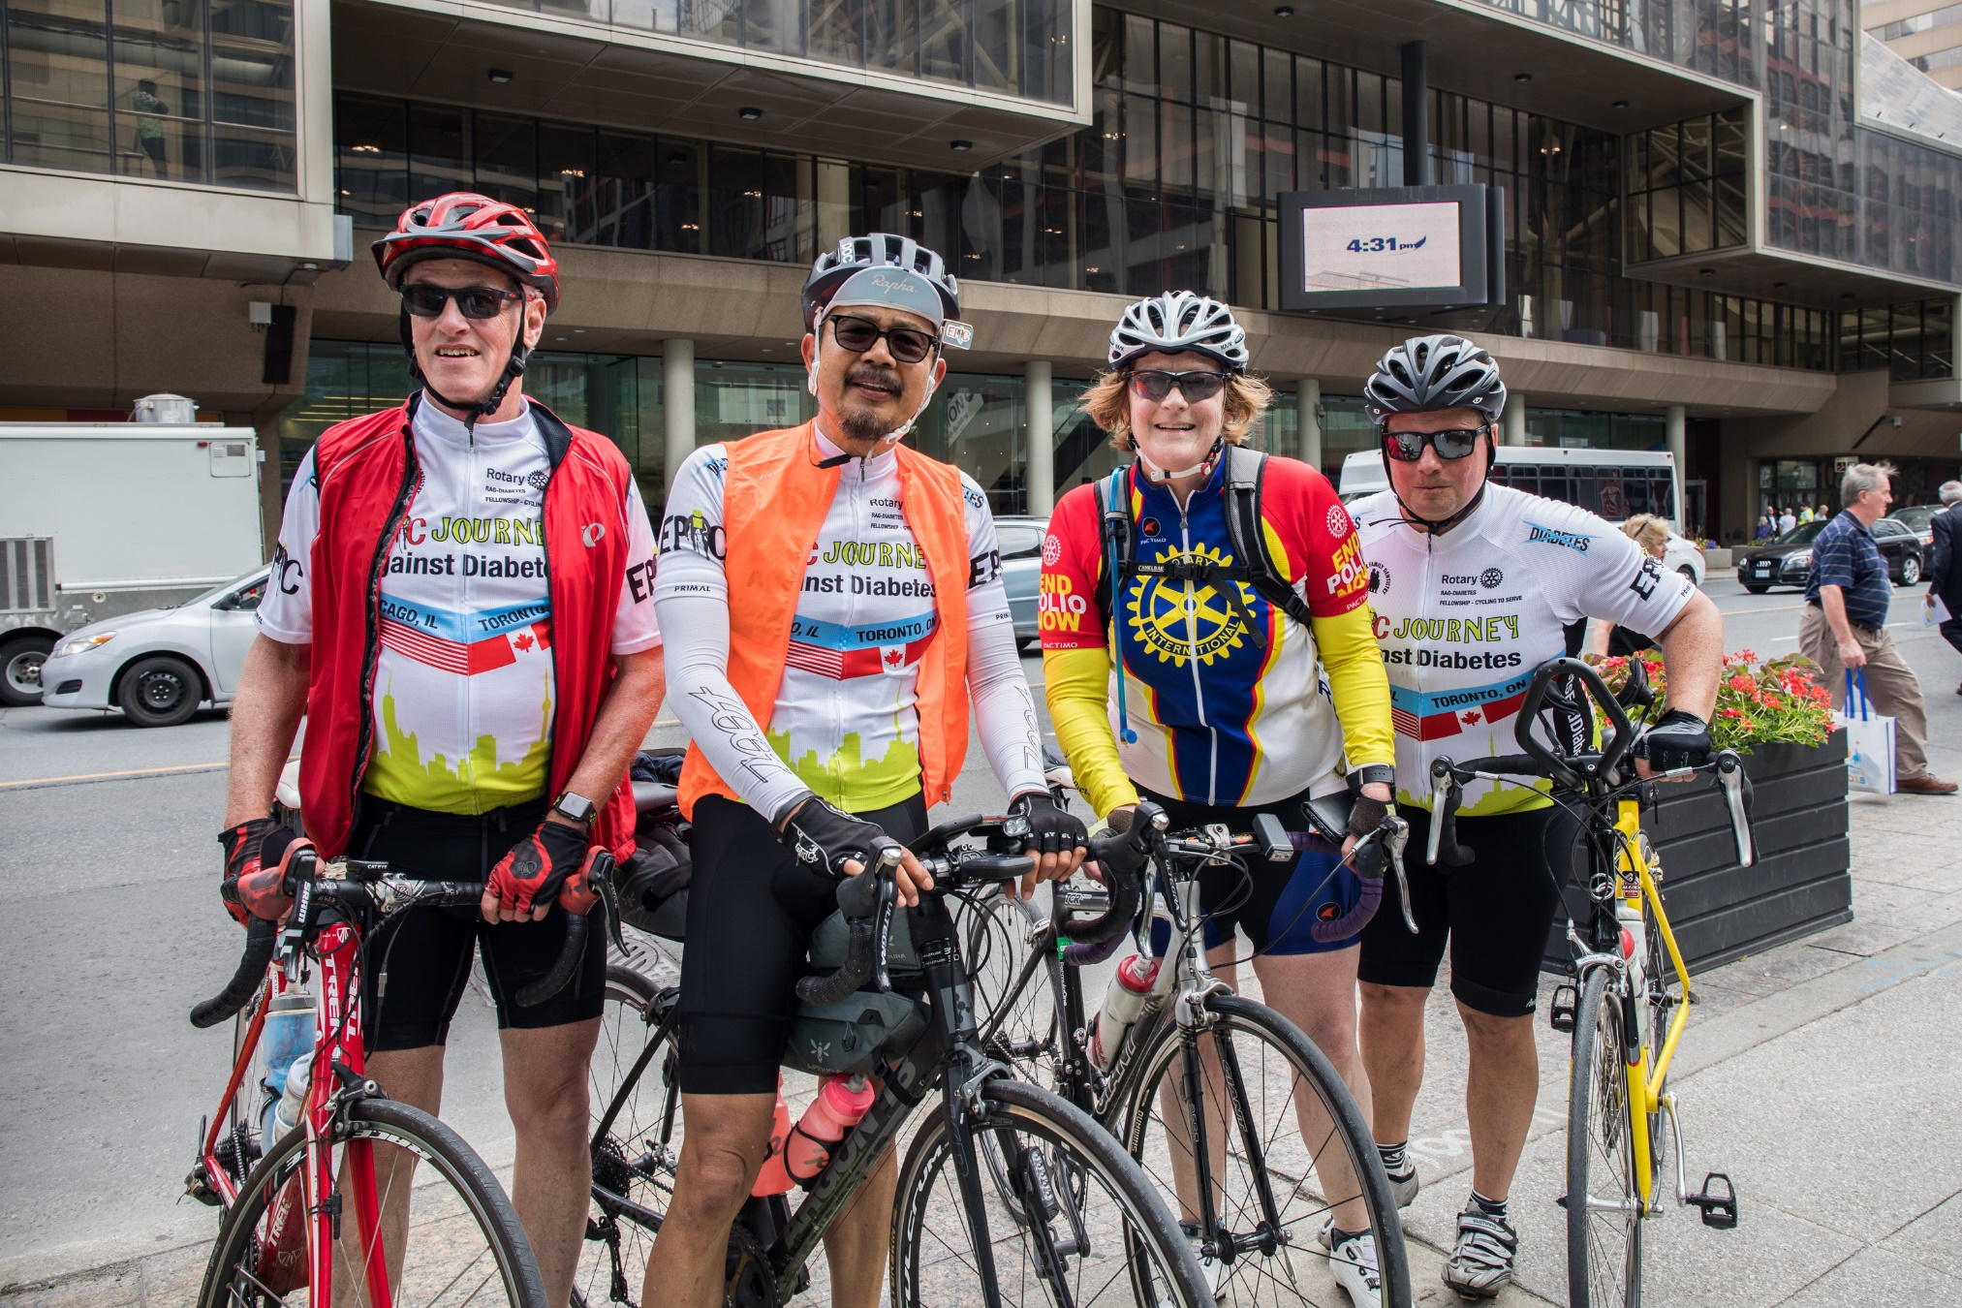
Resources
For general program information, visit www.rotary.org/fellowships.
Here you’ll find the following
downloadable resources:
Rotary Fellowships Flier
Rotary Fellowships Application Form
Notes:
Outside of the resources listed here, you should look into contacting:
Rotary Fellowship Officers, who can provide a wealth of advice about organizing a new group. Many fellowships have been in operation for decades, and their leaders are knowledgeable about the best ways to structure new groups, promote existing ones, and successfully lead international entities. Consult the Rotary Fellowships Officer Directory for contact information.
Rotary’s Service and Engagement staff handle general inquiries about the Rotary Fellowships program and refer interested Rotarians to specific fellowships. In addition, staff members regularly contact fellowship officers with relevant Rotary news and information about the program, offer advice on issues such as promotion, recruitment, and event planning, and help publicize Rotary Fellowships activities around the world.

Slide 13
QUESTIONS

Slide 14

Contact Rotary international
Rotary Service and Engagement
Email: rotaryfellowships@rotary.org

