Slide 1
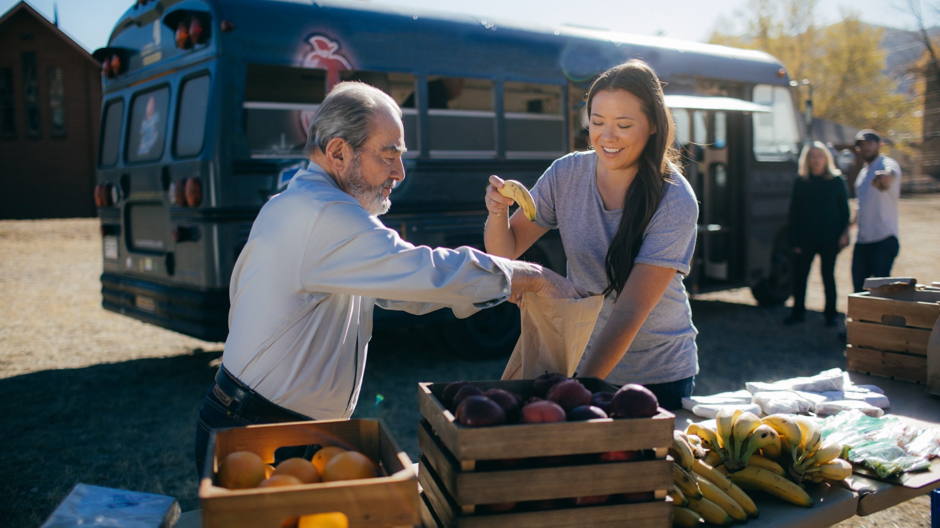
RotarY Action Groups

Slide 2
Rotary Action Groups
Who are they?
Groups organized internationally by Rotarians, Rotaractors, and Peace Fellows with professional experience and subject matter expertise in a specific concentration.
What do they do?
Help clubs and districts plan and implement large-scale projects in a particular area of service.
Why do they do it?
Because they have relevant expertise and experience in a particular type of service activity.
Notes:
Rotary Action Groups are independent internationally organized Rotary-affiliated groups, whose members have expertise in a specific concentration.
They use their expertise to help clubs and districts plan and implement large-scale community development and humanitarian service projects in the area of their expertise.

Slide 3
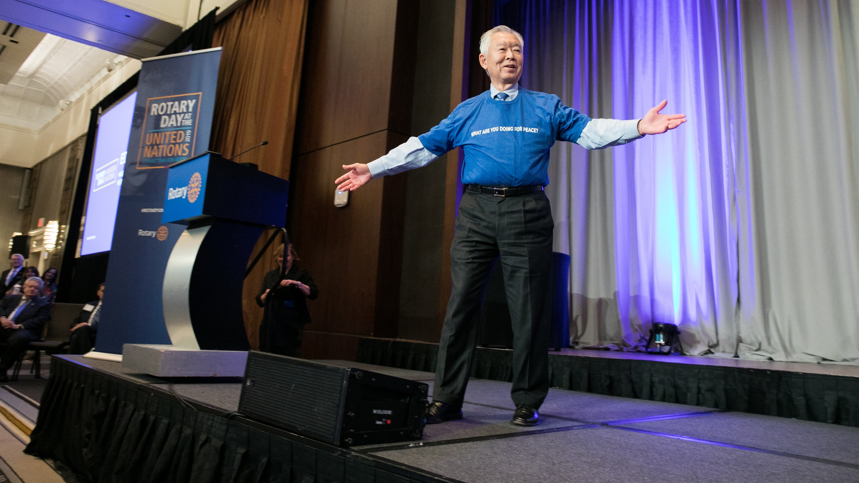
2018-19 Action Group Statistics
25
Rotary Action Groups
27,000
action group members worldwide
140
Countries represented
by members
600
average size of
each Rotary
Action Group
Notes:
As of October 2019, there are 25 RI recognized Rotary Action Groups, each of them holds a unique expertise in a particular service area, such as peace, water and sanitation, Alzheimer's, microfinance, health education, addiction prevention, disaster assistance and more.
- There are 27000+ action group members worldwide. The Rotary Action Group for Population and Development, RFPD, reports the largest membership figures with 13,500 members.
- Average size of each action group is 600 (excluding RFPD)
-Action group members represent more than 140 countries around the world

Slide 4
Rotary Action Groups per Rotary’s Areas of Focus
Disease Prevention & Treatment
Addiction Prevention
Alzheimer’s/Dementia
Blindness Prevention
Blood Donation
Diabetes
Family Health/AIDS
Health Education and Wellness
Hearing
Hepatitis
Malaria
Mental Health
Multiple Sclerosis
Polio Survivors
Peacebuilding & Conflict Prevention
Domestic Violence Prevention
Peace
Water, Sanitation, & Hygiene
Water and Sanitation
Maternal & Child Health
Clubfoot
Population and Development
Community & Economic
Development
Disaster Assistance
Endangered Species
Microfinance
Basic Education & Literacy
Literacy
Action Groups aligning with more than one area
Environmental Sustainability
Food Plant Solutions
Slavery Prevention
Notes:
Most Action Groups view themselves not only as specific subject-matter resources, but as resources in an Area of Focus.
*The above list of action groups per area of focus is self-identified.

Slide 5
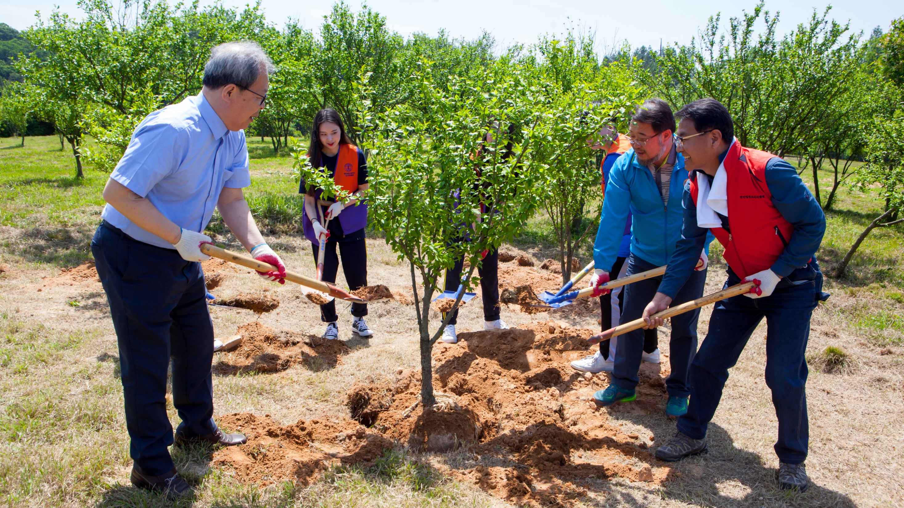
Why rotarY action groups?
Notes:
Let’s talk about Rotary Action Group’s strategic importance to Rotary.

Slide 6
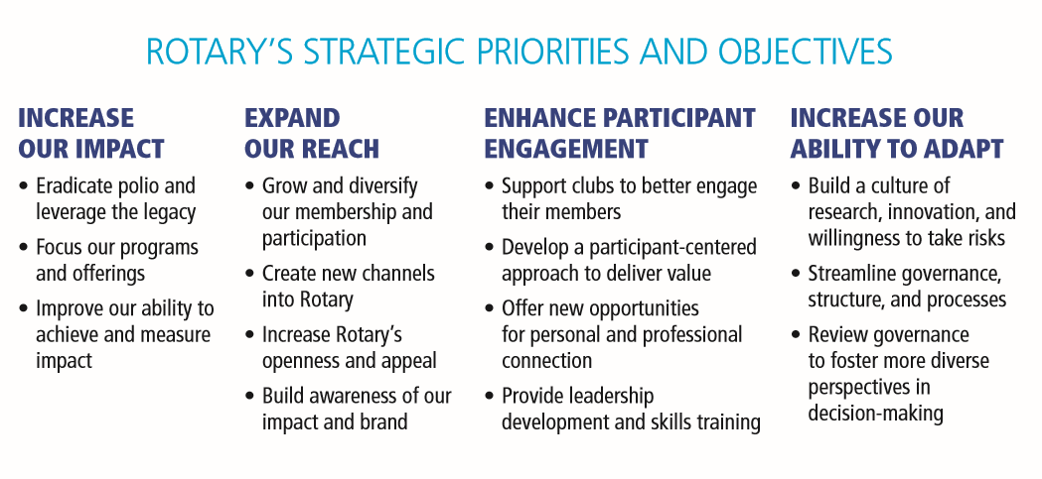
Action Groups support Rotary’s strategic objectives
√
√
√
√
√
√
√
√
√
Notes:
Action groups align with Rotary’s Action Plan by supporting three of Rotary’s Strategic Priorities:
Increasing Our Impact – by bringing expertise, partners, funds, and other resources to Rotary-led projects, they enhance Rotary’s impact around the world.
Expanding Our Reach – By providing alternate opportunities for participation (i.e. participation beyond the club structure, participation through a cause), they grow and diversify our members and participants and they increase Rotary’s appeal.
Large-scale high impact projects supported by action groups help build awareness of Rotary’s impact and brand.
Enhancing Participant Engagement – Action groups help deepen engagement by offering meaningful service opportunities for members and participants. They also offer opportunities for personal and professional connection at the local and global level. They offer leadership opportunities to family of Rotary outside the RI’s hierarchical leadership structure.

Slide 7
Action Groups Enhance Rotary’s Impact and Public Image
Rotary Action Groups
Expertise + Partners + Funds + Other resources
High impact + Large scale + Sustainable projects
Great publicity for Rotary clubs(s)
Notes:
Action Groups enhance Rotary’s impact and public image
By joining Action Groups, your club members will be able to connect with likeminded Rotarians and other participants outside their own club and engage in service activities in the areas that they are most passionate about. By allowing opportunities to connect and serve outside the club structure, Action Groups help diversify and improve the Rotary experience of your club members.
Also, Action Groups can help clubs scale up smaller projects to larger, higher impact, more sustainable international initiatives as they bring technical expertise, partners, funds, and other resources to projects. These high impact projects advances a club’s public image first and foremost and helps develop stronger clubs with more engaged members pioneering innovative, impactful service projects.

Slide 8

Annual Service Impact of Action Groups
2018-19 Rotary year:
Supported 1642 projects last year.
~82 TRF Global Grant projects.
21 of 25 action groups have assisted with at least one TRF Global Grant.
Raised $890,000 for projects.
Notes:
Let’s look at some annual statistics to provide concreate examples of Action Groups’ aggregate service impact.

Slide 9
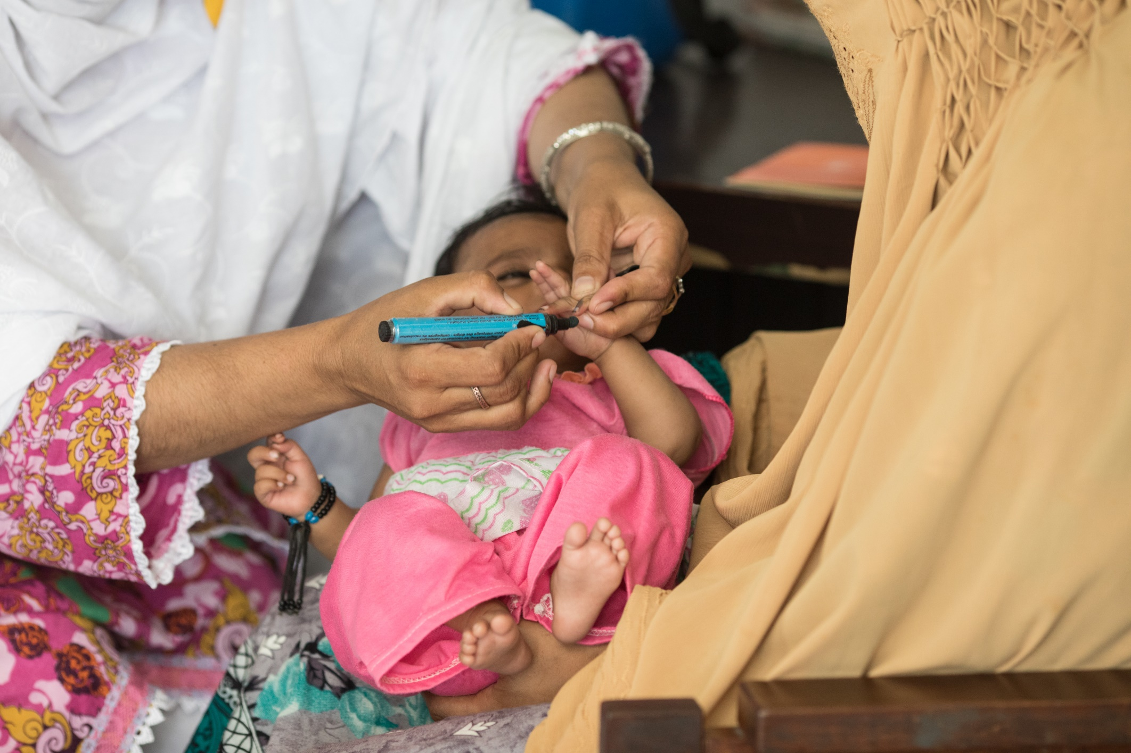
Rotary Action Group for Family Health and AIDS Prevention (RFHA)
Signature Program: Rotary Family Health Days
Three-day annual event provides comprehensive health services to:
400,000+ beneficiaries
350+ sites across Africa & parts of India
The program leverages
5000+ Rotarians
400+ Rotary clubs
Notes:
Let’s look at some examples of high impact projects led by our Action Groups of action.
A large-scale program that provides comprehensive health services in hundreds of locations across Africa and parts of India.
Each year, more than 5,000 Rotarians participates in the program last year, providing health services to 400,000+beneficiaries across 350+ sites. Offered services includes immunizations, screenings for HIV/AIDS, TB, malaria, diabetes, blood pressure, cancers and more.
The program is executed through an interdependent public/private partnership in each country that includes hundreds of Rotary clubs, the in-country Ministries of Health, the CDC, USAID, hundreds of NGO implementing partners, and private sector companies.
The program gives Rotary great exposure to third party organizations, and its scope and impact results in tremendous publicity for Rotary. The campaigns are covered broadly on local and national radio and TV.

Slide 10
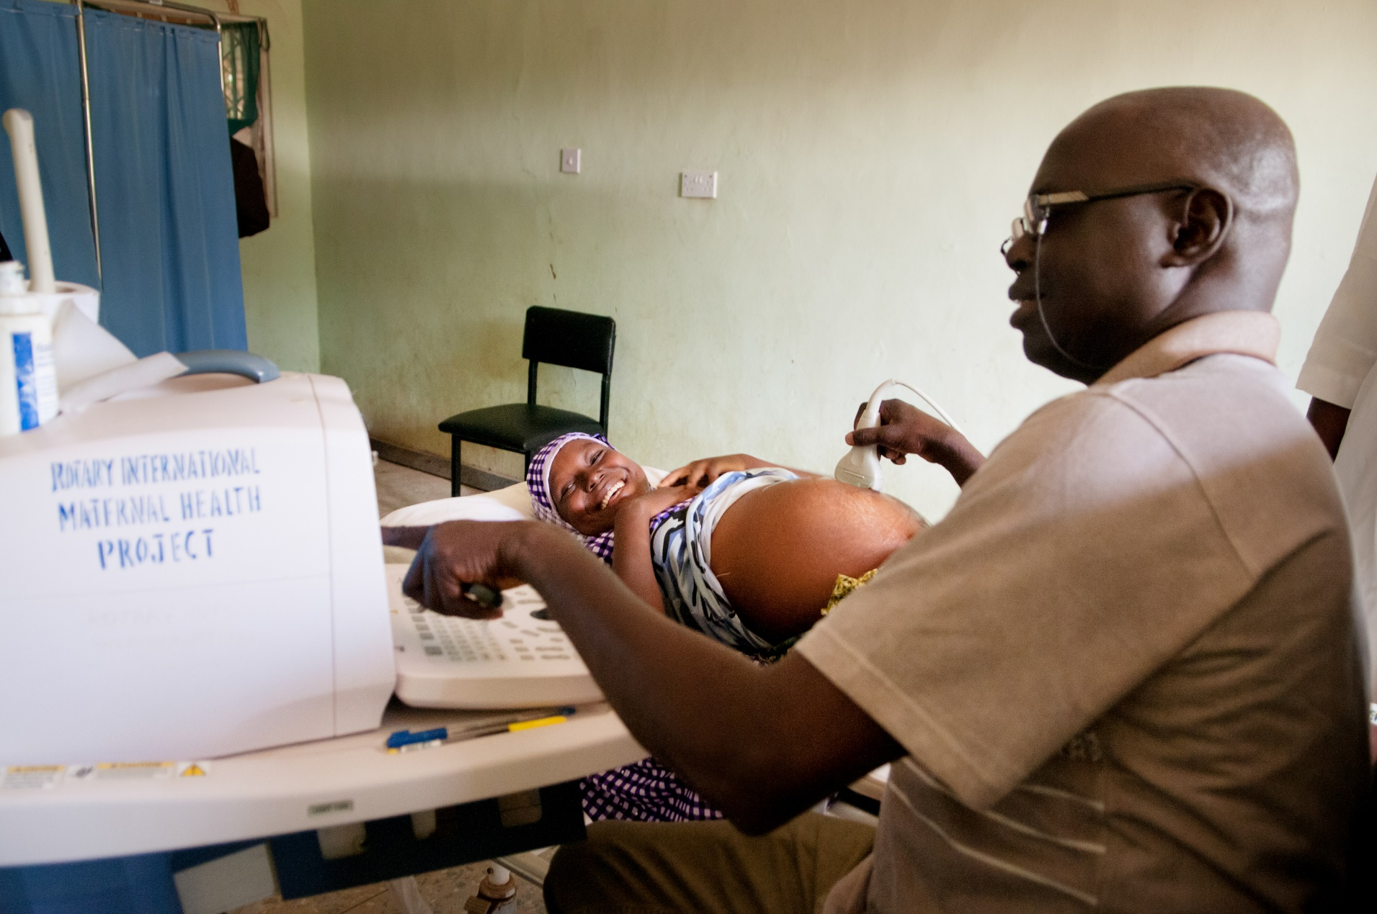
Rotary Action Group for Population and Development (rfpd)
Focuses on improvement of maternal and child health through training of health professionals, provision of medical supplies, surgical interventions, and public awareness.
*RFPD’s program reduced maternal mortality by 60% and newborn mortality by 15% in participating hospitals.
Notes:
Another high impact program that enhances Rotary’s public image around the world is led by Rotary Action Group for Population and Development’s (RFPD). This program focuses on reducing maternal and newborn mortality in rural areas of Nigeria. Started as a pilot in 10 hospitals between 2005 and 2010, this program has been scaled up to 25 hospitals in Nigeria. RFPD’s program has proven to be highly impactful with a 60% reduction in maternal mortality rates and 15% reduction of newborn mortality in par
This multi-faceted program includes public awareness, training of health workers, provision of medical equipment, and surgical interventions.
Several districts in Germany, Nigeria, and Austria, and hundreds of Rotarians participate in this program. Through the action group’s connections, this program leverages generous grants from the German Government. Only last year, the program leveraged a half million dollar grant from the German Government.
---
Several regional governments have adopted RFPD’s model statewide. RFPD is currently working towards integrating this model into the health system of the Nigerian national government.
The RFPD also implemented this program in Pakistan and working towards a replication in other countries as well.
The program engages thousands of Rotarians and non-Rotarians, and its scope and impact enhances Rotary’s public image around the world.

Slide 11
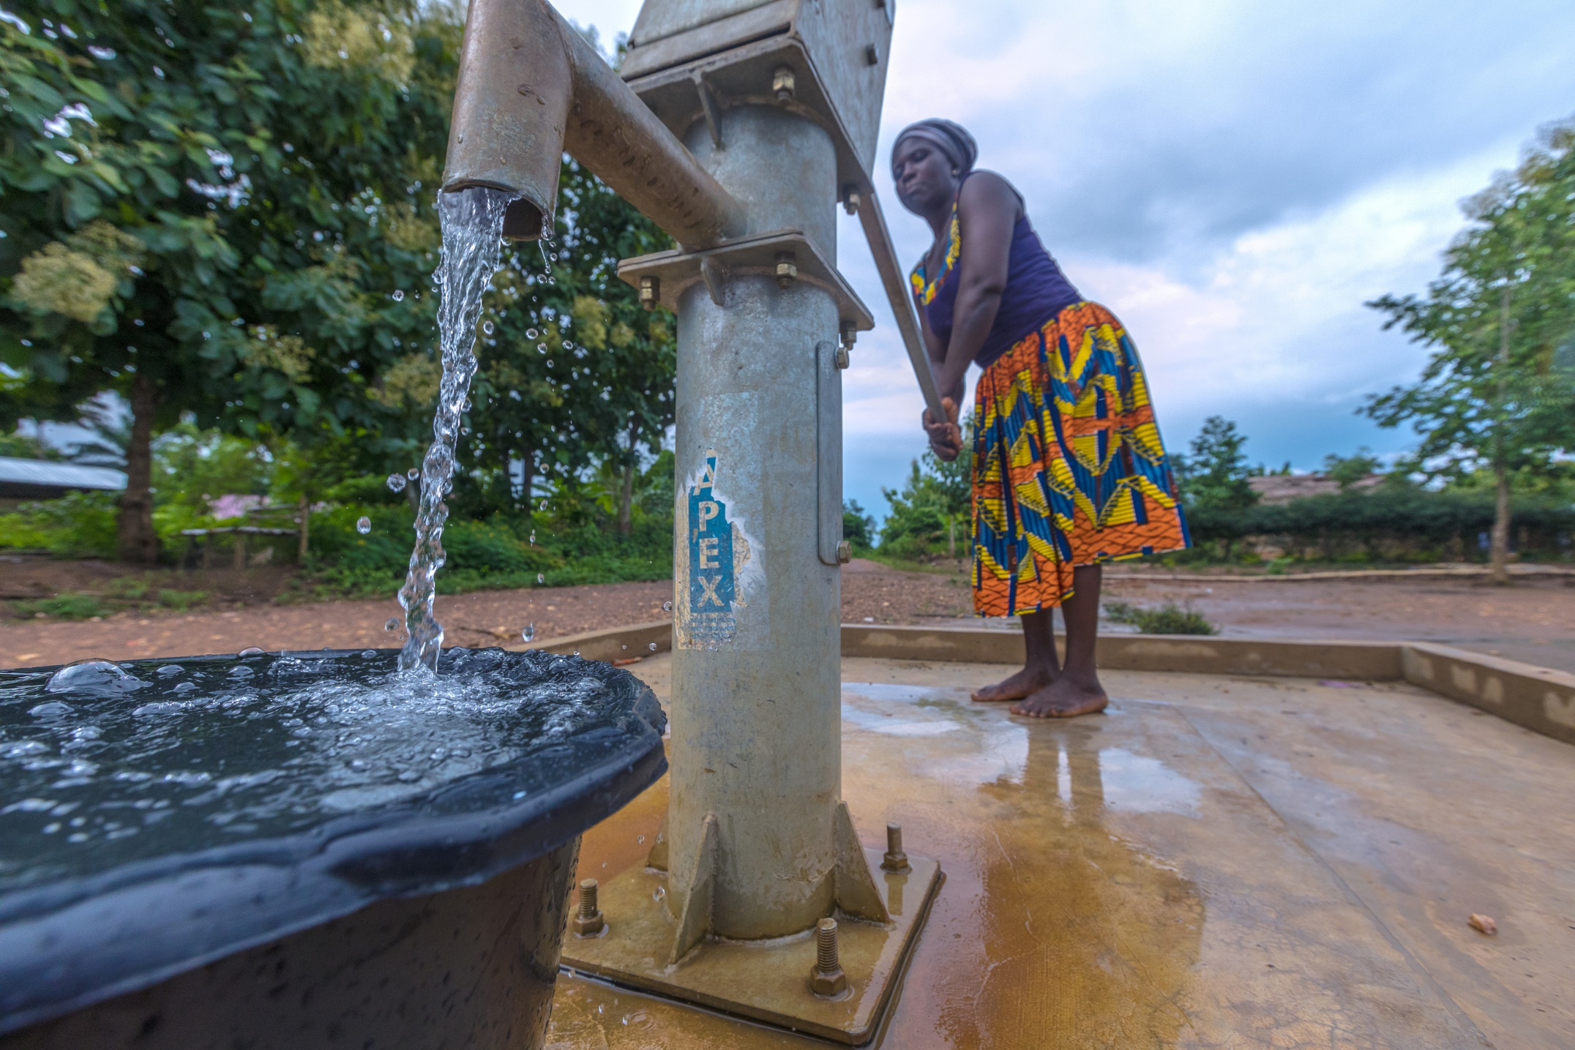
Water and Sanitation Rotary Action Group (wasrag)
Functions as an expert consulting entity to help clubs and districts undertake WASH projects.
Facilitates collaboration between Rotary clubs on projects related to water and sanitation.
Identifies “best practices” and “lessons learned”.
Provides access NGOs & alternative sources of funding.
Help find partners and appropriate technologies for your project.
PHOTO
Notes:
Another high impact project that enhances Rotary’s public image is led by the Water and Sanitation Rotary Action Group’s (WASRAG).
WASRAG functions as an expert consulting entity to help clubs and districts undertake WASH projects.
WASRAG:
Facilitates collaboration between Rotary clubs on projects related to water and sanitation.
Identifies “best practices” and “lessons learned”.
Provides access to NGOs & alternative sources of funding.
Helps find partners and appropriate technologies for your project.

Slide 12
Action Groups Engage Members and Participants
By equipping our members and participants with a global platform to leverage their professional expertise for humanitarian service.
By offering leadership opportunities to our members, Rotaractors, and Peace Fellows.
By giving members and participants platforms for virtual and in-person connection for service and partnership.
By offering members and participants opportunities to make a sustainable impact through various service areas.
Notes:
In addition to enhancing Rotary’s impact and public image, Action Groups also engage our members and participants. [Slide]

Slide 13

Service Opportunities for members and participants beyond their club/country
Action Groups give our members and participants opportunities to engage in activities outside of their own clubs, districts, and countries

Slide 14
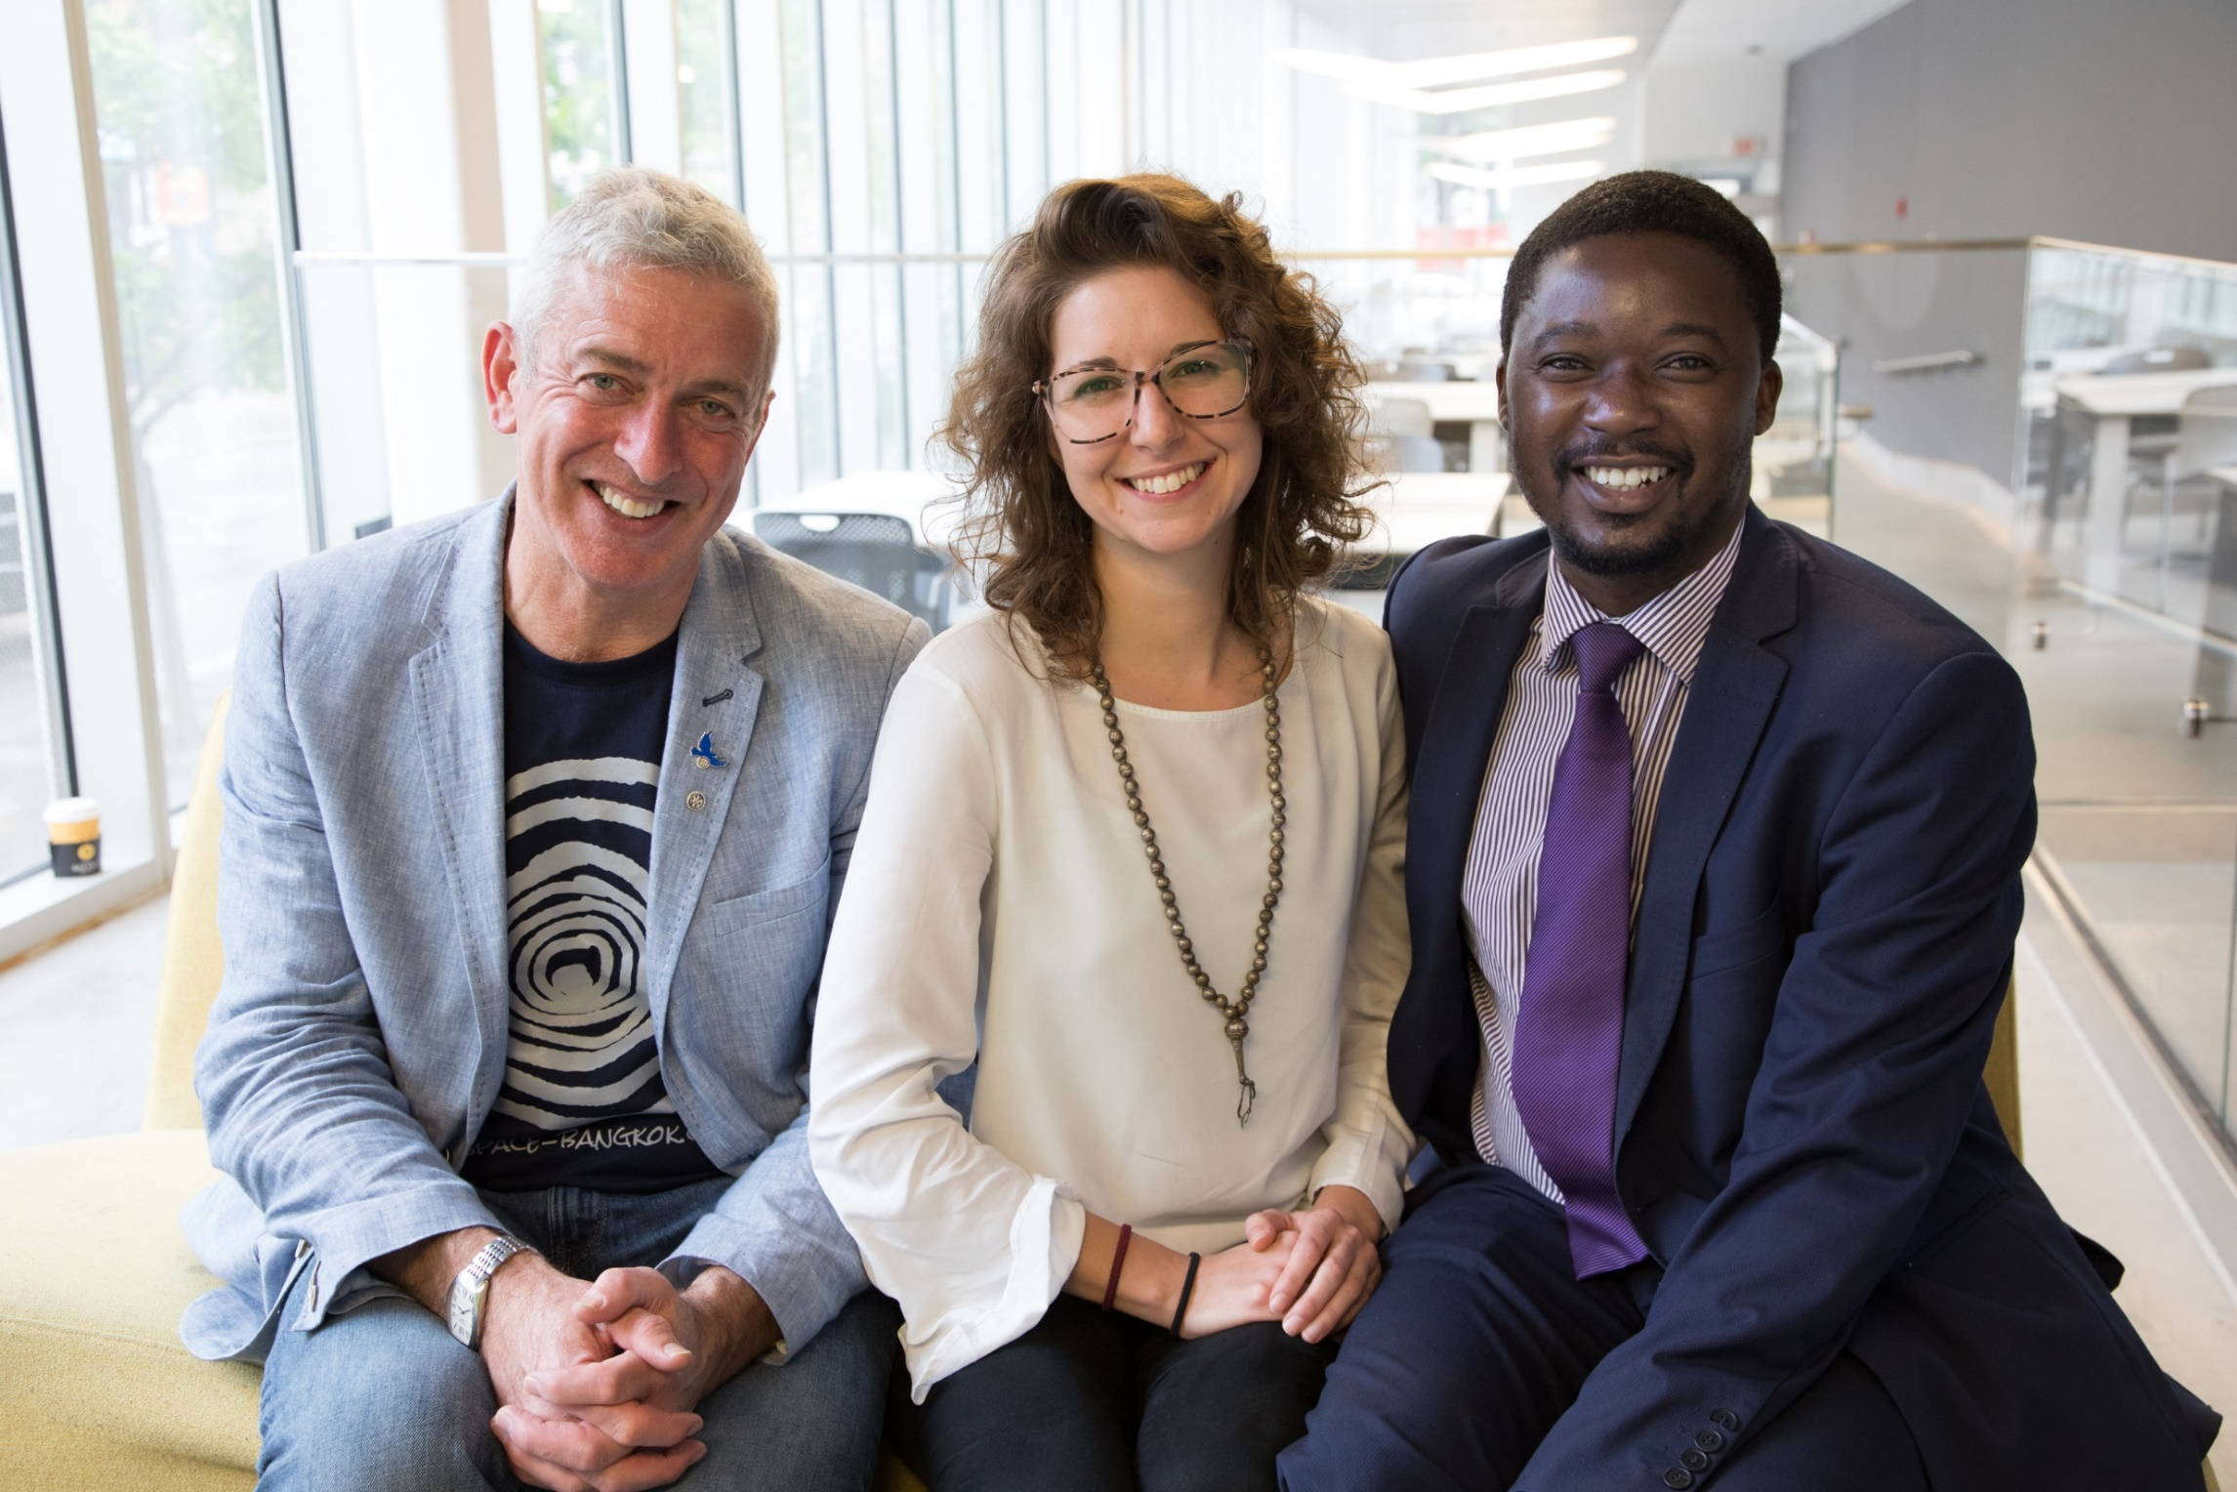
Connect with likeminded members and participants & initiate Partnerships
Through their Action Group membership, our members and participants connect with likeminded individuals from around the world, meet and network with them in person during Rotary events and activities, and initiate partnership.

Slide 15
Action Groups Empower Our Members and Participants
Action Groups empower our members and participants to form Rotary-affiliated international groups around pivotal issues.
Any Rotarian, Rotaractor, or Peace Fellow may propose a new Action Group if he/she have brought together at minimum 50 people from five countries who have expertise in a specific concentration.
Prospective groups must submit an action plan demonstrating this expertise in the group and providing a detailed plan about how the group will support clubs and districts globally.

Slide 16
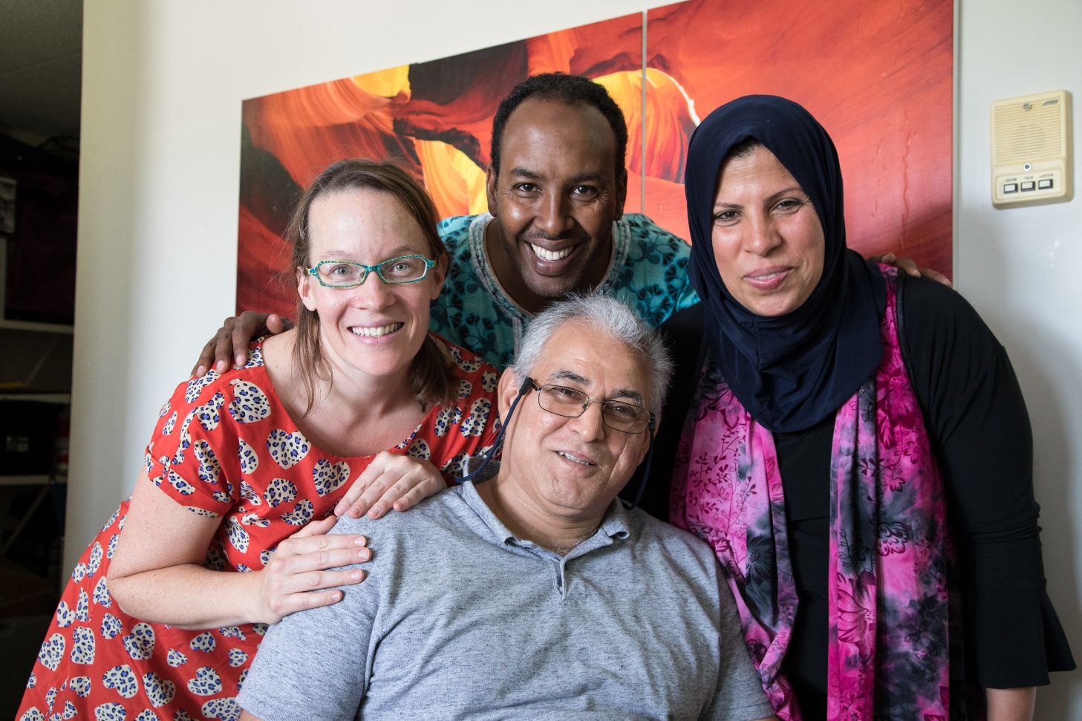
Action Groups Engage Rotary Alumni
Notes:
Action Groups also engage our program participants and alumni.
Often times, it is challenging to keep alumni involved and connected with Rotary for various reasons.
Action Groups keep Rotary alumni engaged through their service interests. Also, Action Groups membership requires less commitment and smaller financial commitments which makes it appealing for our alumni to join. For example, Peace Rotary Action Group is very good at engaging our Peace Fellows and alumni. WASRAG and Malaria Rotary Action Group do great job engaging Rotaractors.

Slide 17
Action Groups attract new and skilled members
Rotary Action Group collaborations with organizations with technical field expertise
New skilled members join Rotary
Notes:
Action Groups also serve as membership development resources.
Large-scale successful programs spearheaded by Action Groups enhance Rotary’s prestige, bring publicity, and attract new members.
Through their collaborations with external organizations, Action Groups expose Rotary to their cooperating partners which often attract new Rotary members.
More importantly, the members we gain through Action Groups’ partnerships with external organizations tend to hold specific expertise or skills and go on to become important assets for Rotary.

Slide 18
Action Groups support Global Grants and
District Resource Networks
Action Groups help clubs/districts:
assess the need in communities
establish monitoring and evaluation plans
compile global grant applications
identify international and/or cooperating partners
raise funds for a prospective global grant
incorporate government organizations and other regional and national institutions
Notes:
Action Groups support Global Grants and District Resource Networks
Often times, global grant applications submitted by clubs and districts lack community assessments, or an established plan to monitor and evaluate the projects that they are planning to carry out. They also struggle finding international and cooperating partners as well. Action Groups can serve as resources in all of these areas.
All these listed on this slide are crucial for the sustainability and long-term success of our large-scale initiatives and all the Action Groups that I presented on today support clubs and districts in all of these areas.

Slide 19
Action Group’s Benefits to Rotary
Bring technical expertise, partners, and funds to projects.
Enhance Rotary’s impact and public image.
Give members and participants opportunities to engage in service activities outside of their own clubs, districts, and countries.
Provide networking opportunities with likeminded Rotarians and participants from around the world.
Empower our members and participants and engage our alumni.
Support global grants and district resource networks.
Notes:
To summarize the benefits of Action Groups to Rotary:
Bring technical expertise, partners, and funds to projects.
Enhance Rotary’s impact and public image.
Give members and participants opportunities to engage in service activities outside of their own clubs, districts, and countries.
Provide networking opportunities with likeminded Rotarians and participants from around the world.
Empower our members and participants and engage our alumni.
Support global grants and district resource networks.

Slide 20
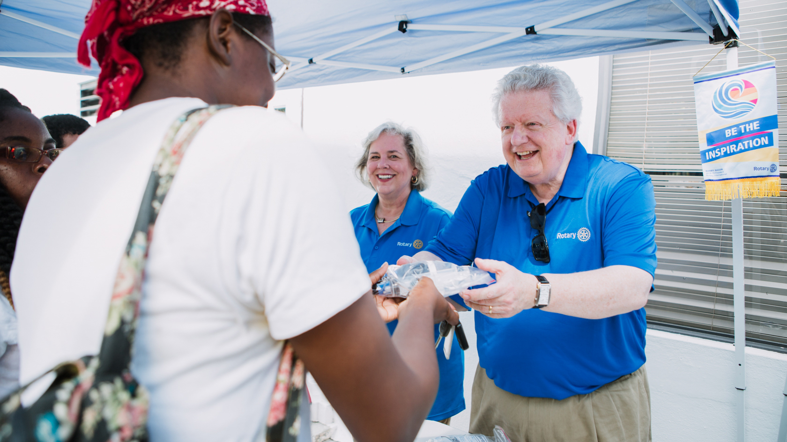
Get involved

Slide 21
How to get involved and work with Action Groups
Visit www.rotary.org/actiongroups to find more information about individual Action Groups.
Connect directly* with a Rotary Action Group to:
    Request assistance for project planning and implementation;
    Identify partners, resources, best practices within a specific area of service;
    Join a group of interest and/or lend your expertise;
    Invite a local Action Group member to speak to your club or district.
    *Contact information for each group can be found in the Action Groups Directory on Rotary.org.
Use your district resource network to connect with local Action Group members and tap into their expertise in your projects.

Slide 22
QUESTIONS

