Slide 1
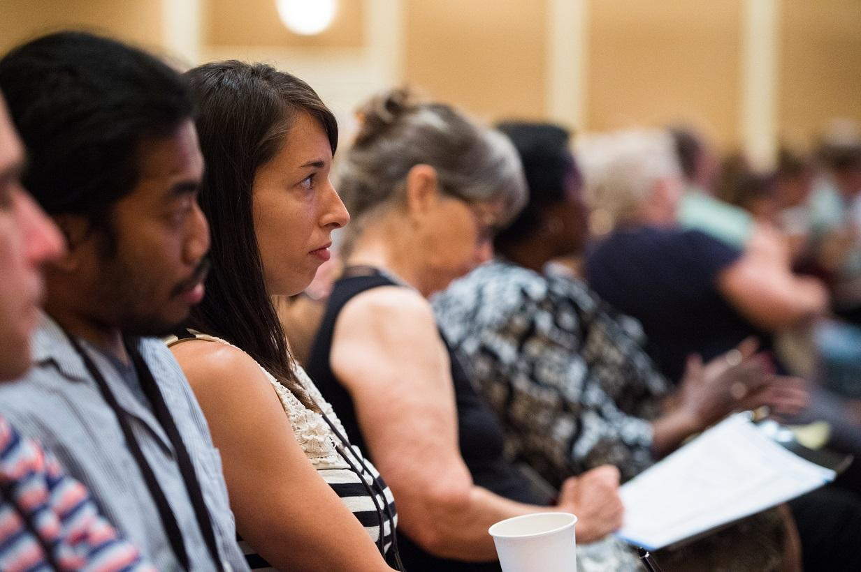
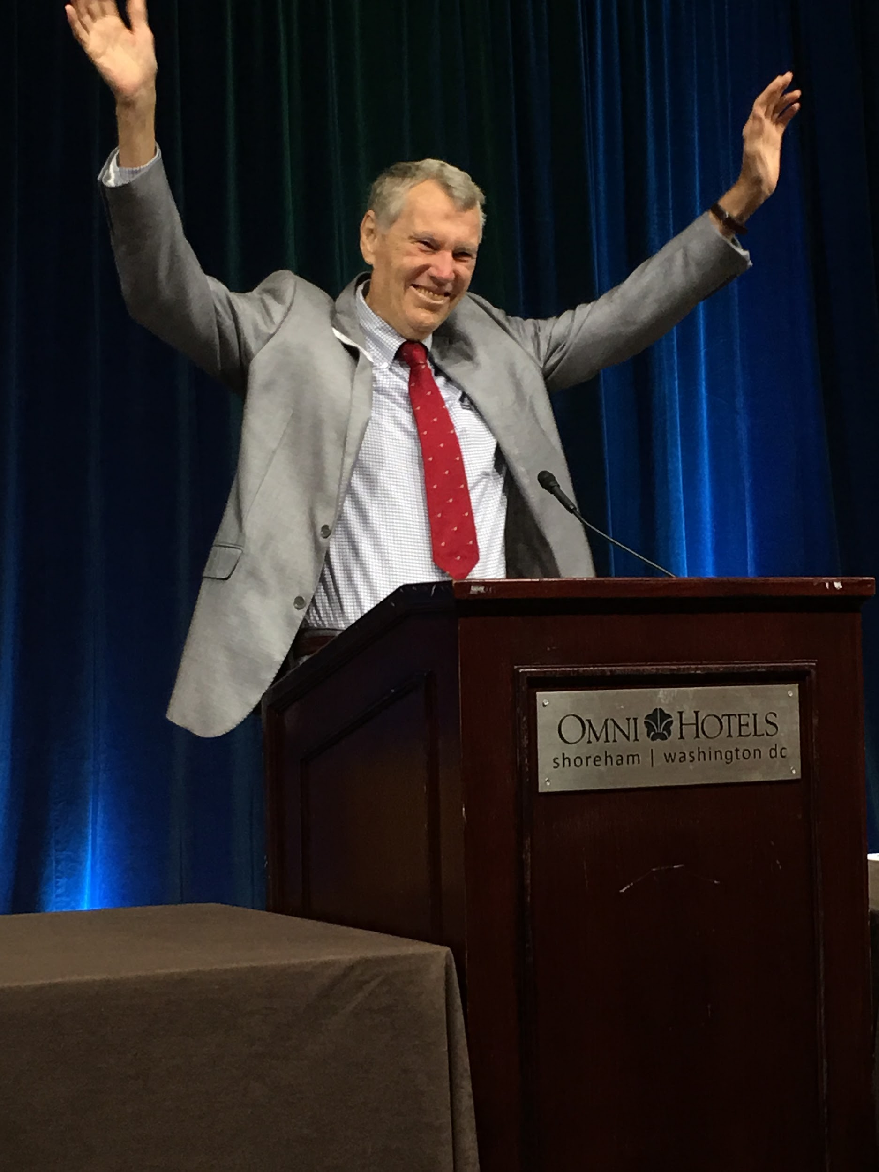
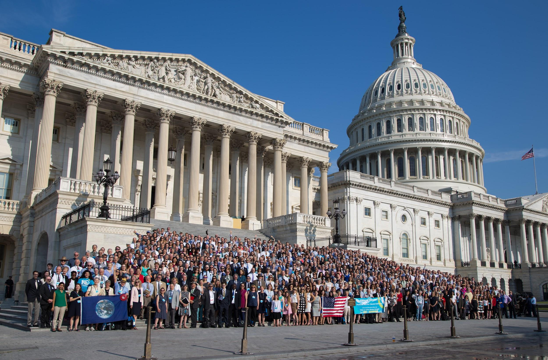
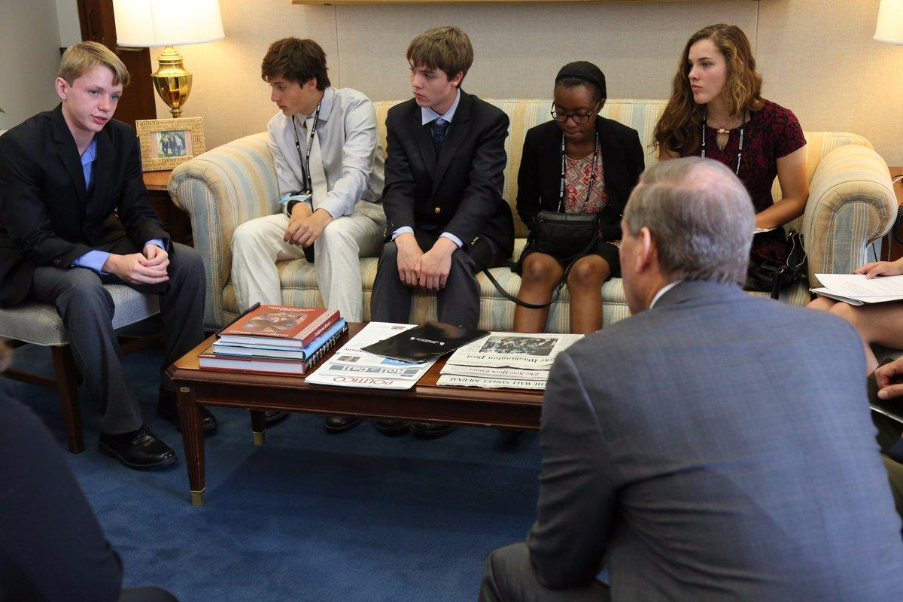
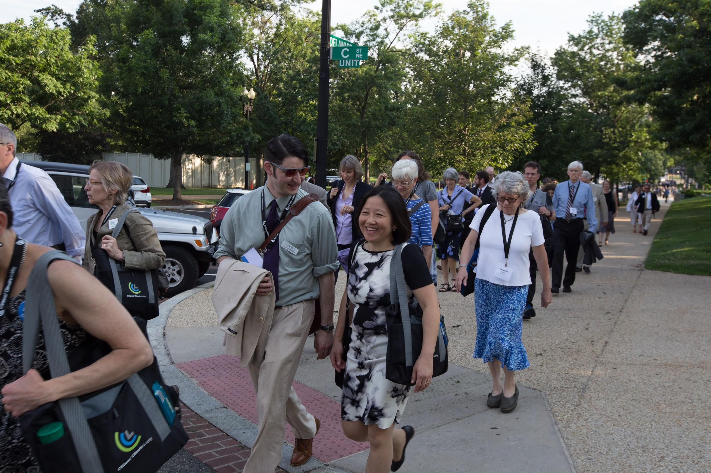
Energy Innovation and Carbon Dividend
The Best First Step To Addressing Climate Change
Presented to Columbia Town Center Rotary Club
August 12, 2020
By Cliff Strawitch and Jeff Turner
Notes:
MISSION: Drive the CCL call-to-action - Advocate CFD to your elected officials.
Through your presentation, your audience should come to their own realization that
advocating CFD and working with CCL is the MOST EFFECTIVE way they can help.
(for a shorter presentation, delete the (1) slides with just one question, and (2) all REMI slides except for summary )
(for conservatives, don’t show the first 2 videos)
Introduce yourself and tell your story (how is global warming impacting you and what made you a climate activist).
Tell the audience the outline of your presentation
Brief review of global warming facts.
Carbon fee and dividend, how it works, and why it’s the best solution
The REMI Report - How CFD would impact jobs, economy, household income, lives saved, and emissions
Citizens climate lobby’s singular mission is to pass CFD in Congress - it will succeed
I’ll show some videos to re inforce these points
<your name here> suggests that the audience members could also give this talk if they were to join CCL Presenters. CCL has an active Speakers Bureau.
<more info>
Use storytelling. This is how humans have always connected to one another. Tell your story to connect to your audiences’ values. For more info, read up on Jonah Sachs.
Katharine Hayhoe tells us to not use the word “Science”. Use the word, “Facts”. A fact is defined as: a thing that is indisputable
If you are talking to a Rotary club, frame your talk in the context of the Rotary’s “four way test”.
Economists worldwide agree that CFD is the fastest, cheapest, simplest, fairest, most transparent, and by far most effective solution.

Slide 2
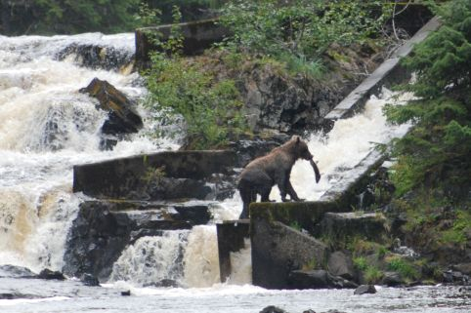
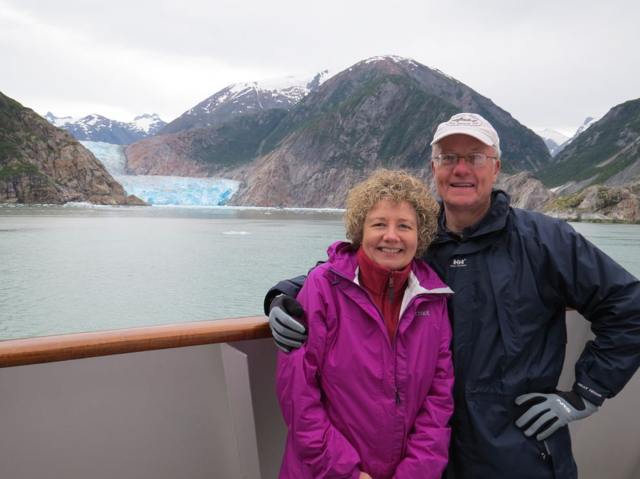
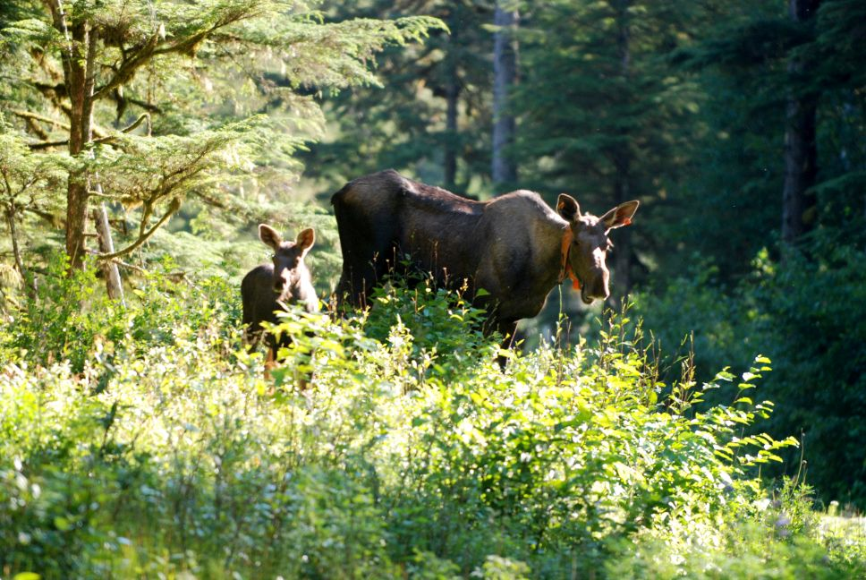
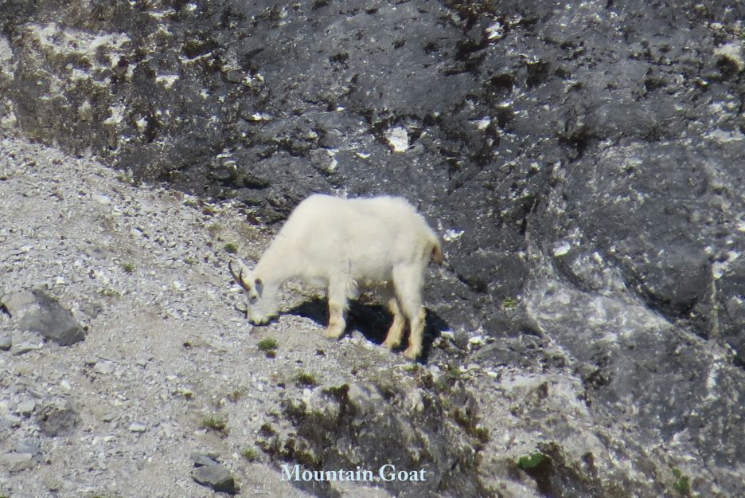
Every morning I awake torn between a desire to save the world and an inclination to savor it. This makes it hard to plan the day.
But if we forget to savor the world, what possible reason do we have for saving it? In a way, the savoring must come first.
-E.B. White
Retired physicist
Since I care deeply about the natural world I resolved to do what I can to address climate change.
Since I’m a parent, I wanted to be able to tell my kids that I did all that I could to give them a better future.
Notes:
My wife and I were savoring the world in Alaska a few years ago and were absolutely awestruck by what we saw. And everywhere we went we saw evidence of climate change and how it is changing this amazing place. There are around 100,000 glaciers in Alaska and 99% of them are receding. Permafrost is melting. Ocean level rise is forcing native americans to move their homes and change their ways of life in many other ways. Animal habitats are changing
All of what we saw moved me to try to do something about climate change and I was happy when I found Citizens Climate Lobby.
2

Slide 3
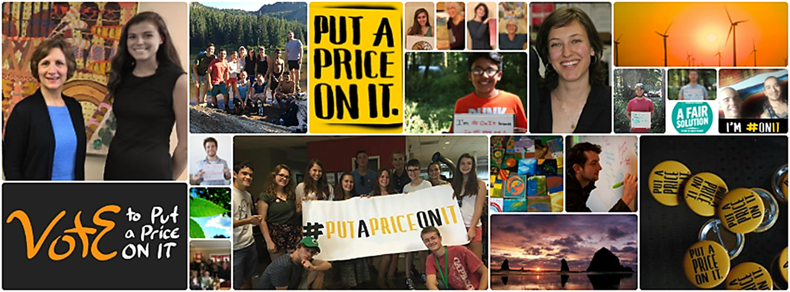
CCL: BECOMING AN ENGAGED CITIZEN
CCL founded by Marshall Saunders 11 years ago: Marshall was an award winning Rotarian.
CCL is:
Non-Partisan with over 180,000 members
Member representation in all 435 congressional districts
Empowered and trained to lobby and outreach
SINGLE FOCUSED ADVOCACY –> Energy Innovation and Carbon Dividend Act
Notes:
...DISCUSS METHOD AND TRAINING
To lobby respectfully…no enemies…share appreciation…listen…find common ground…
SINGLEY FOCUSED ON CARBON FEE & DIVIDEND
Segue: In my research on Rotary I learned that Rotary leadership has already focused on action on climate change.
3

Slide 4
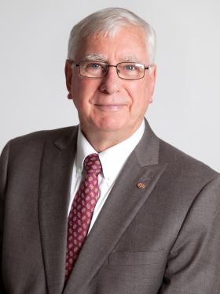
Rotary Past Int’l. President
Ian Riseley ‘17-18
“Environmental degradation and climate change threaten us all. They are having a disproportionate impact on those who are most vulnerable, those to whom Rotary has the greatest responsibility.”
Still emphasized by RI presidents to date.
Notes:
“In 1990, then-RI President Paulo Costa called upon all Rotarians to preserve planet Earth. Through that theme, he hoped to awaken Rotary’s ecological conscience. By committing to planet Earth, he said, we sealed our commitment to the future.
Today, environmental degradation and climate change threaten us all. They are having a disproportionate impact on those who are most vulnerable, those to whom Rotary has
the greatest responsibility. Yet environmental issues barely register on the Rotary agenda.
The time is long past when environmental sustainability can be dismissed as not Rotary’s concern. It is, and must be, everyone’s concern.”
Segue: Four Way Test
4

Slide 5
Rotary Club
Four-Way Test Applied to Climate Change
Man-made climate change is real.
Man-made climate change is unfair to all.
If we fix it, we will build good will and benefit all human beings.
Notes:
Bonding with an organization or group requires the presenter to research the group they’ll be speaking with. On this slide, the presenter should discuss what values CCL shares with the group and show appreciation for what the group is doing.
Segue: What is the scientific consensus on climate change.
5

Slide 6
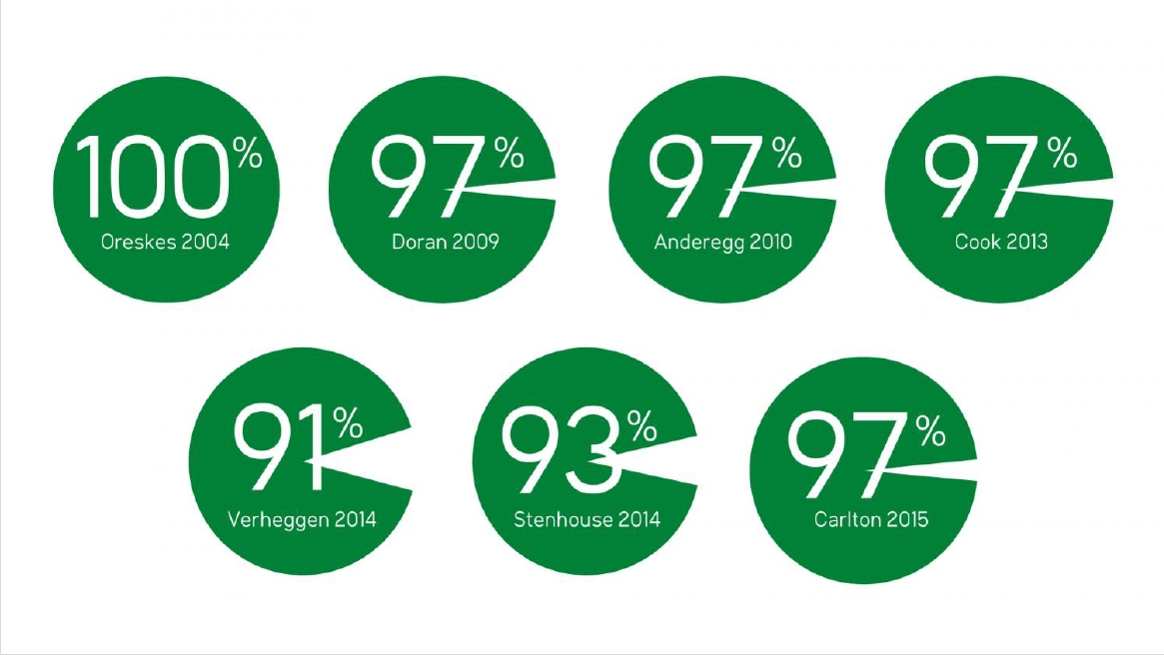
Scientific Consensus on Global Warming
97% of climate scientists agree:
Global warming is real
It’s caused by increased greenhouse gases
Human activity is causing almost all the increase.
97% are convinced
Results of 6 separate studies of scientific consensus
Notes:
Ten years ago, even 2 or 3 years ago, this talk would have been about scientific findings and whether climate change is really a big problem. No more.
Today, 97% of climate scientists agree:
Global warming is real
It’s caused by increased greenhouse gases
Human activity is causing almost all the increase.
There really is no longer a scientific debate. The world scientific community is in agreement. All national and international “Academies of Science” agree. None disagree. It’s unequivocable, and the vast majority of former skeptics are nodding their heads, too.
IPCC (2007). Summary for Policymakers. In: Climate Change 2007: The Physical Science Basis.
Seque: what are the local effects we are experiencing here in the Mid-Atlantic?
From CCL’s Laser Talk: Where Scientists Stand On Climate
You want proof? Seven different research groups looked into this over the last 10 years, examining thousands of papers and/or asking hundreds of scientists directly for their position on climate change. They found that between 91 and 100 percent of published climate scientists agreed, based on the evidence, that human-caused global warming is occurring. The average was about 97 percent. [1] Not only that, but the National Academy of Sciences and their counterparts from 79 other nations also agree, as do all major American member organizations of physicists, chemists, meteorologists, and astronomers. Not a single one claims that human-influenced global warming is in doubt. Not one. [2]
This is important, because when people learn how strong the scientific agreement really is, they are more inclined to transcend political affiliations and support public policy solutions to climate change. [3]
https://climate.nasa.gov/scientific-consensus/
http://www.opr.ca.gov/facts/list-of-scientific-organizations.html
http://environment.yale.edu/climate-communication/article/scientific-consensus-on-climate-change-as-a-gateway-belief/

Slide 7
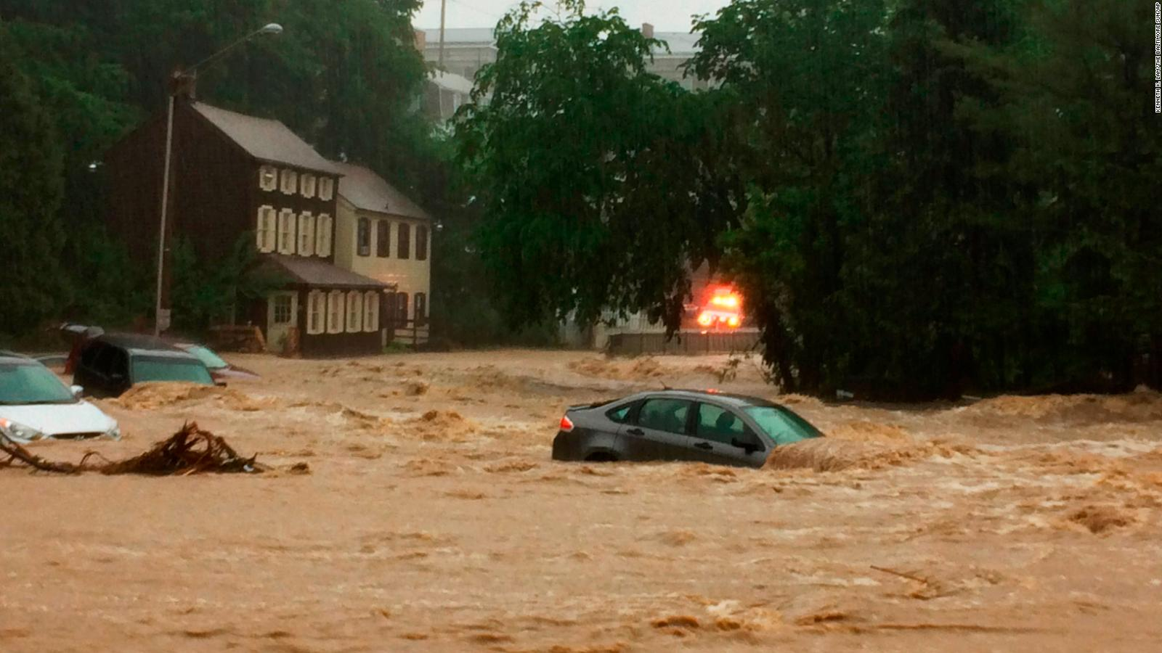
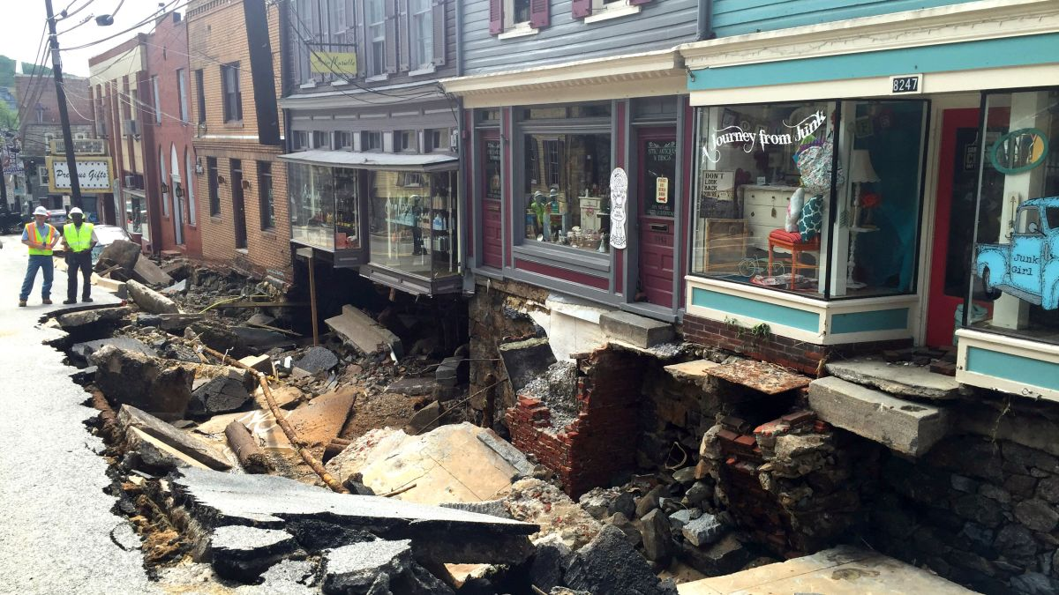
Ellicott City Hit By 1,000 Year Floods in July 2016 and May 2018
A 2017 National Climate Assessment found that heavy rain events are increasing nationally due to climate change, and the greatest increases will occur in the Midwest, upper Great Plains and the Northeast (which includes Maryland)
On the day of the 2018 flood, the National Weather Service received a gauge report of 9.7 inches in Ellicott City in 2 hours.
Many other factors contributed to the flood:
Replacement of uphill permeable surfaces with impermeable surfaces.
Ellicott City sits at the bottom of a topographic funnel.
Inadequate storm water management to keep up with development.

Slide 8
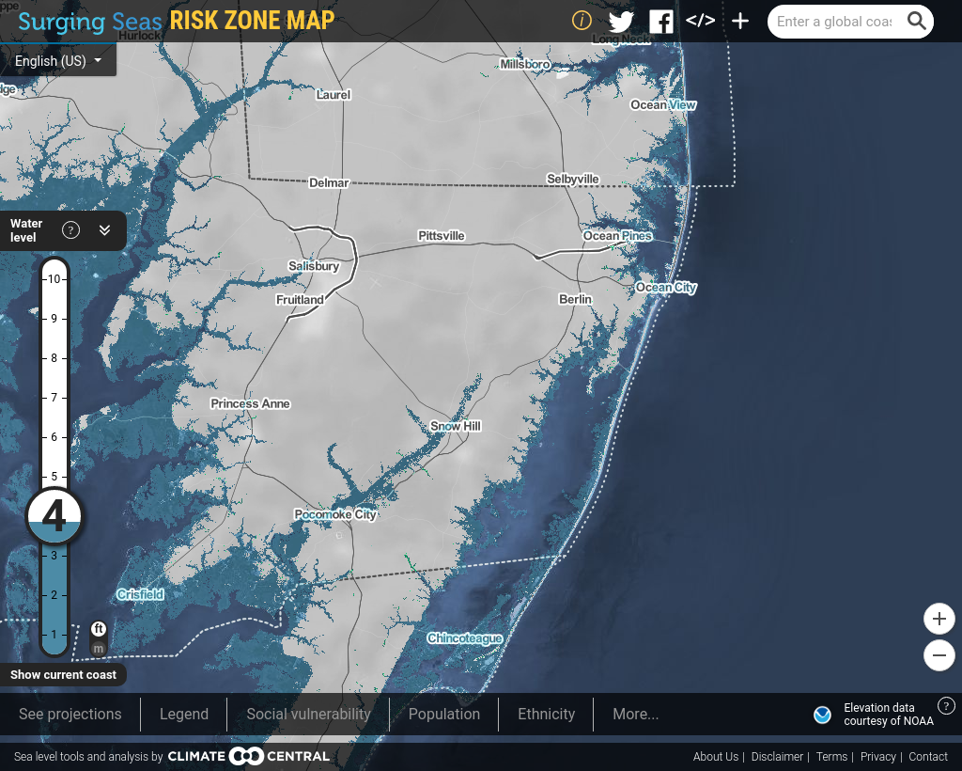
- Around 39,000 people live in areas of Maryland below 4 feet elevation above sea level.
For these areas there is a 99% risk of at least one flood taking place between today and 2050 in the Maryland area.
Causes: land sinking, ocean rise, storms.

Slide 9
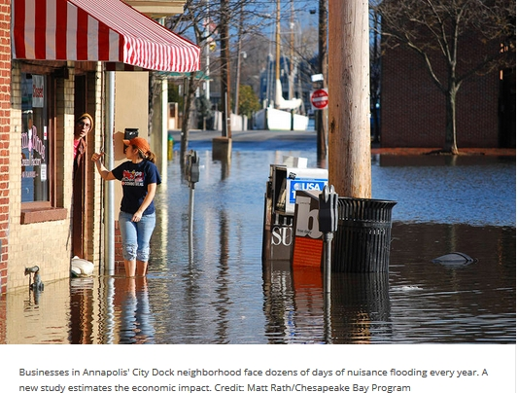
Fair Weather Flooding in Annapolis
So called “Fair Weather” flooding (aka nuisance flooding) is flooding that is not related to a storm surge or excessive rainfall.
Wind direction, high tide, climate change and natural land sinking all push additional water toward the shore, contributing to floods.
Annapolis experienced 63 days in 2017 that topped the National Oceanic and Atmospheric Administration’s threshold for coastal flooding.
Average of 5 days each month
A groundbreaking study* estimates in 2017, Annapolis businesses suffered $86,000 to $172,000 in lost business due to nuisance flooding at City Dock.
* Downloaded from http://advances.sciencemag.org/ on February 21, 2019.

Slide 10
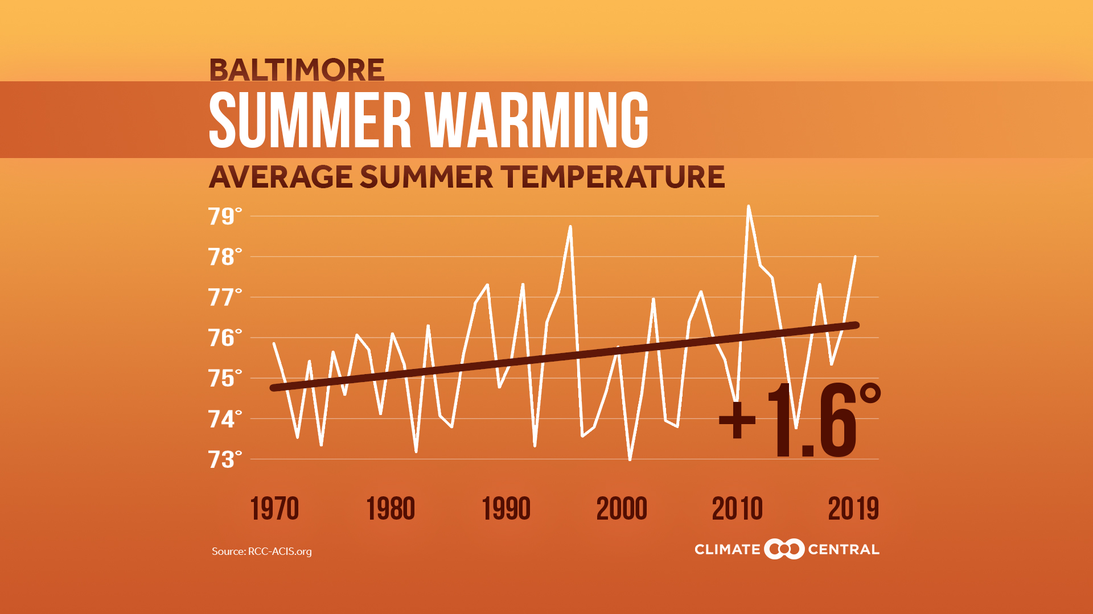
Summer Temperatures in Baltimore Are on the Rise

Slide 11
Rotary International’s Six Focus Areas
Promoting Peace
Fighting disease
Providing clean water
Saving mothers and children
Supporting education
Growing local economies
Which of these efforts by Rotary are in danger from climate change?
All of them
Notes:
Segue: There is a way to address this:
Technology to provide carbon free power
Means to reduce our current dependence on fossil fuels.

Slide 12
There Is Ample Room For Hope!
We have the technologies that can replace fossil fuel power generation:
Solar, wind, nuclear, other.
Power storage has been demonstrated.
Grid scale power storage subject of current BEST Act bill before Congress
We have many well studied legislative approaches to reduce carbon emissions.
These approaches create jobs, improve health and don’t damage the economy.
Some of these approaches have already succeeded in California as well as in other countries.
We only lack the political will to demand this from our government!
Governments follow their constituents lead.
Notes:
What are our legislative options to address our dependence on carbon fuels?

Slide 13
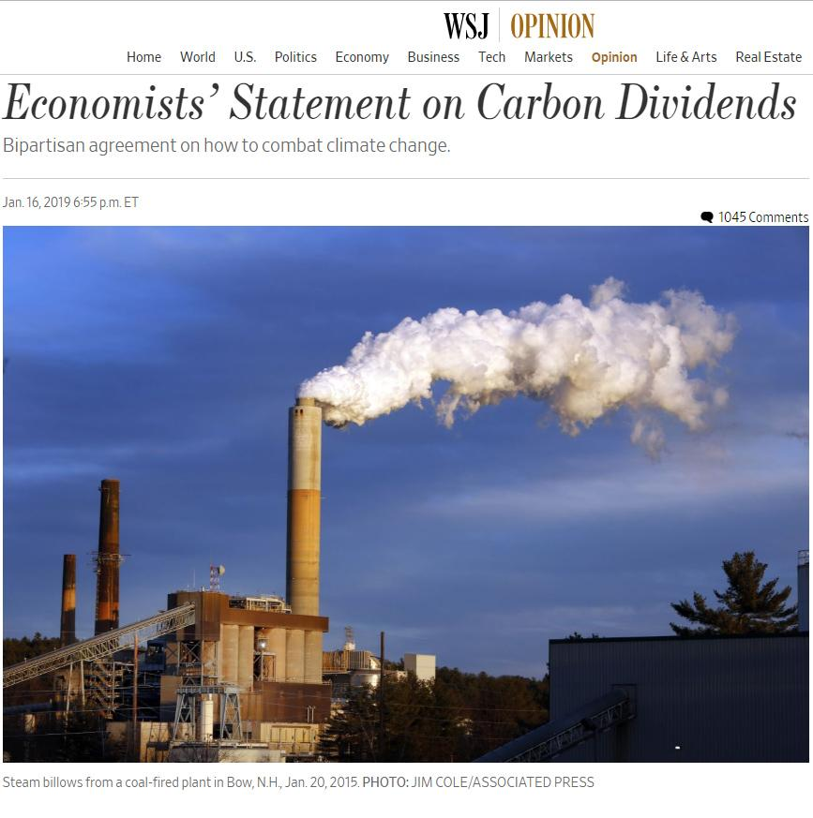
What do economists recommend?
Use Powerful Market Forces!
3508 U.S. Economists
4 Former Chairs of the Federal Reserve (All)
27 Nobel Laureate Economists
15 Former Chairs of the Council of Economic Advisers
2 Former Secretaries of the U.S. Department of Treasury
Notes:
I have a handout for the Economists Statement right from the CLC web page: https://www.clcouncil.org/economists-statement/
I stress that this includes Chairs of PRESIDENTS Council of Economi Advisers from Presidents Obama and Clinton, but also from Presidents Ford, Reagan, George HW Bush and George W Bush. This is a broad cross-section of economists.
I start by setting up the Economists statement in the WSJ – and describing it over the next few slides – instead of starting with our bill.
https://www.wsj.com/articles/economists-statement-on-carbon-dividends-11547682910
https://www.clcouncil.org/economists-statement/
13

Slide 14
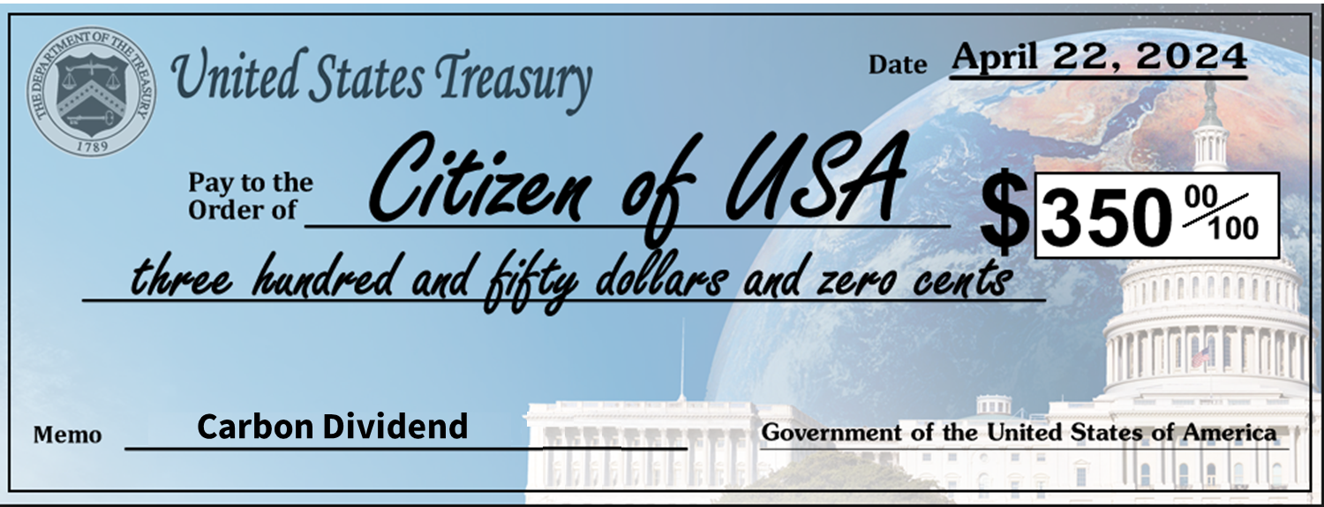
Carbon Fee
Carbon Dividend
The Basic Elements:
Equal share to adults, half share to kids under 19
The Details:
Carbon Border Adjustment
Agriculture
Exemption
Limited
Regulatory Adjustment
Notes:
Fortunately, there is now a bipartisan bill before Congress that is based on exactly this strategy.
The Energy Innovation & Carbon Dividend Act is now before Congress. It’s the first promising piece of legislation supported by members on both sides of the aisle that has earned the full backing of CCL and all of us who are determined to change the game.
The border correction protects American business for good imported from countries that don’t have a similar price on carbon.
There will be a narrow regulatory pause on only the greenhouse effect of CO2 for 10 years. This avoids doubling up on penalties, it gives the policy a chance to meet ambitious targets, and it provides predictability to businesses so they can plan change. If the targets aren’t met, this legislation makes sure those regulations snap back in full force after the evaluation.
The Energy Innovation and Carbon Dividend Act of 2019 provides a refund of carbon fee costs in fuels — chiefly diesel fuel — used on farms.
14

Slide 15
These are the very real
Benefits...
Effective in reducing emissions
Good for People
Creates Jobs, builds the economy
Bipartisan
Revenue Neutral
Notes:
Fortunately, there is now a bipartisan bill before Congress that is based on exactly this strategy.
The Energy Innovation & Carbon Dividend Act is now before Congress. It’s the first promising piece of legislation supported by members on both sides of the aisle that has earned the full backing of CCL and all of us who are determined to change the game.
40% less carbon emissions by 2030 (12 years) and 90% by 2050
295,000 lives saved after 10 years
2.1 million jobs after 10 years
$3,450 dividend for a family of 4 after 10 years
Now go back and compare the Bill against the likes/dislikes that audience raised in the Climate Solution Attributes discussion exercise . .
Highlight that for conservatives this Bill has a lot to like . . .
Now set the stage for the concluding discussion session. . . . .
15

Slide 16
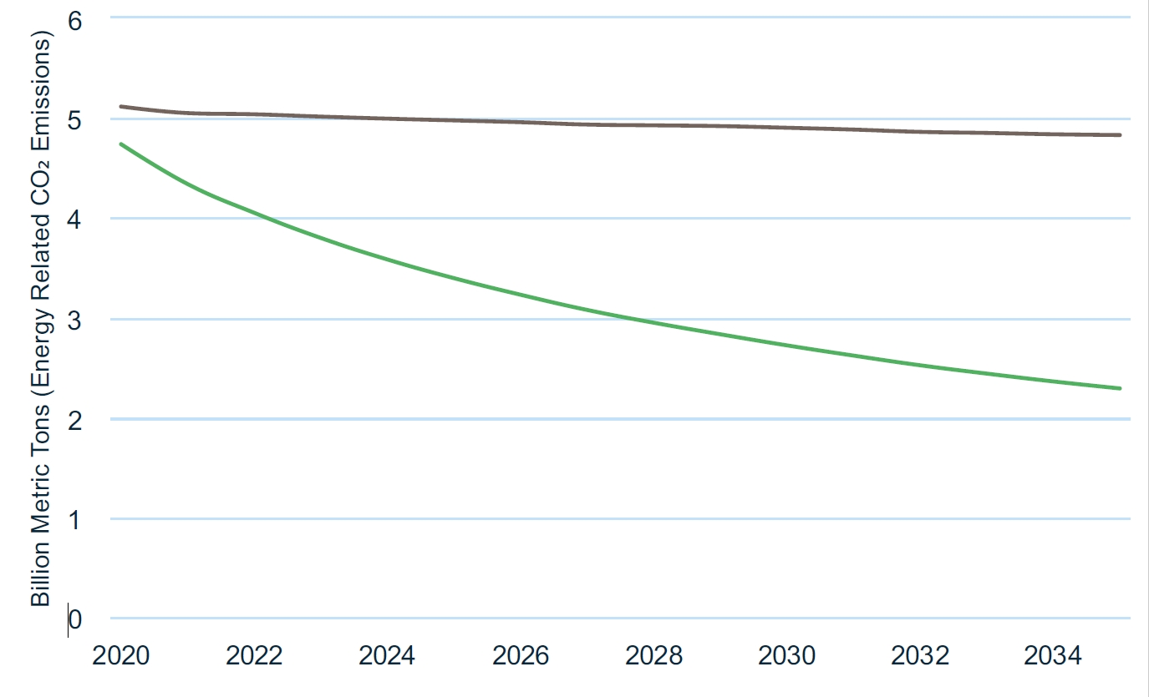
RFF Carbon Calculator Results Emission Impact of EICDA
Resources for the Future Model Predicts 52% CO₂ Reduction
CO₂ emissions reduced by 52% of business as usual
Business as usual
4.83 Billion Metric Tons
It’s Effective!
EICDA
2.29 Billion Metric Tons
Based on Goulder-Hafstead E3 Model of Stanford University and RFF

Slide 17
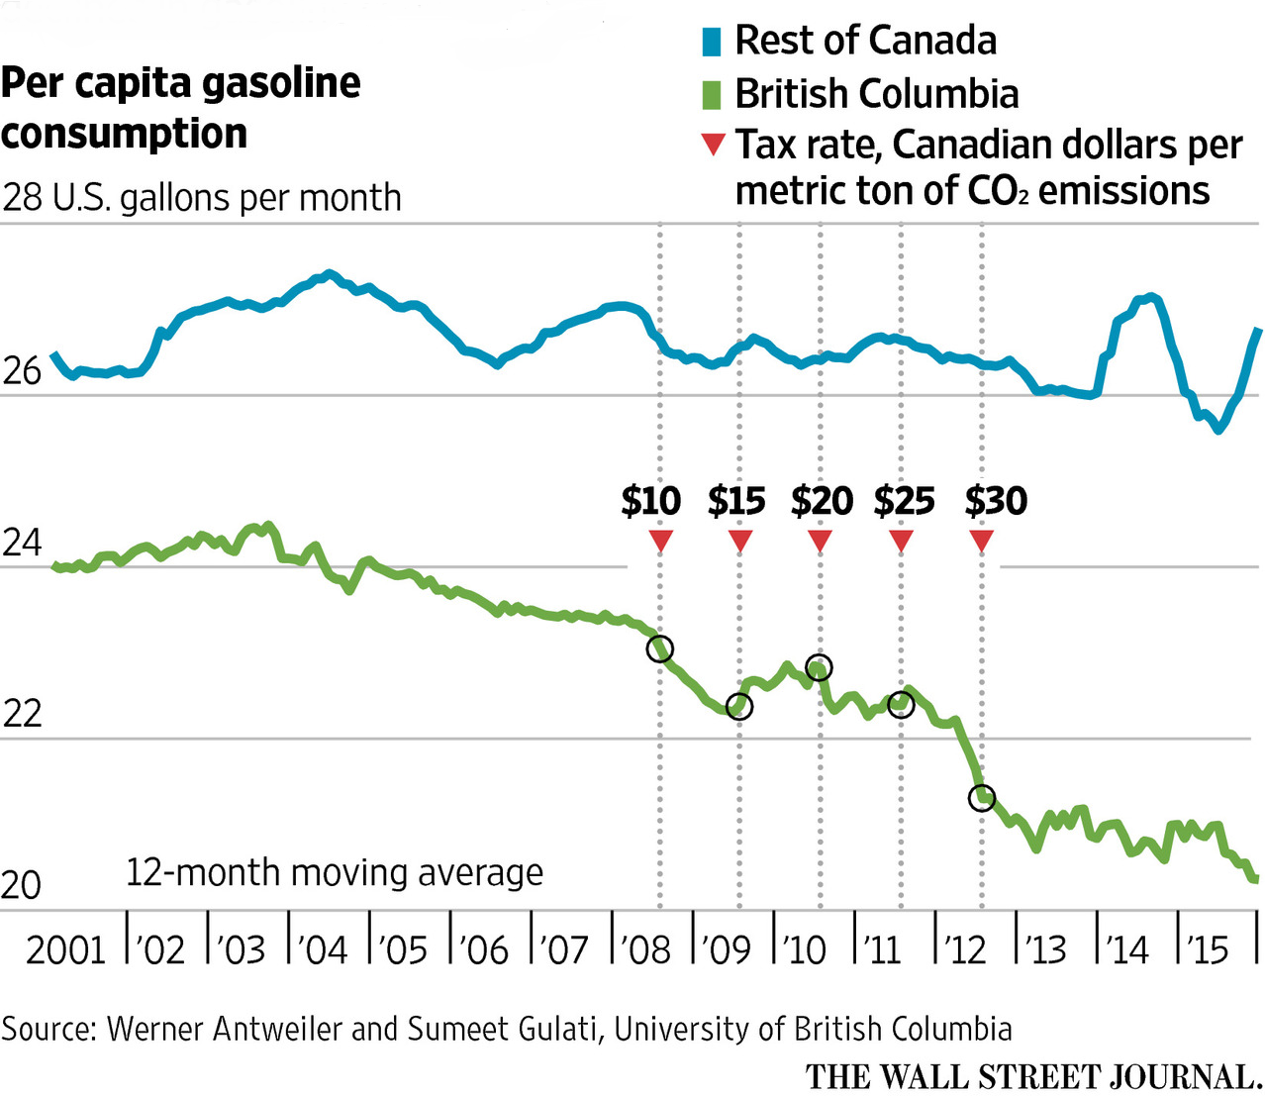
Proven Success in BC, Canada
Increasing fee with time
Fuel use down
BC faster GDP growth than the rest of Canada
Jobs up
Popular
Carbon tax in place now for all of Canada
Notes:
Has CFD worked elsewhere?
Dozens of countries have tried various forms of carbon tax.
The best example is British Columbia!
BC sales of liquid fuels were moving in lock-step with the rest of canada before CFD
BC’s fuel consumption has since fallen by 17.4% per capita (and fallen by 18.8% relative to the rest of Canada).
BC’s GDP kept pace with the rest of Canada’s over that time
The fee started low at $5/ton and rose gradually to $30/ton
It’s quite popular in the country because all the money is returned
The economy has grown faster in BC than in the rest of Canada with CFD in place

Slide 18
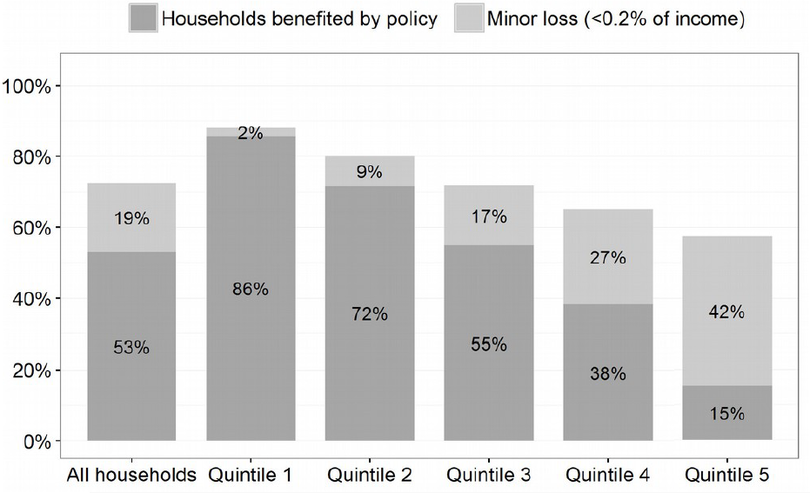
Household Impact Study
It’s Fair: The most vulnerable generally do well
Notes:
In February 2016, CCL commissioned a study to assess the net financial impact on U.S. households of a $15/ton of CO2 carbon fee in which all proceeds minus administrative costs are returned to households on a per-capita basis.
The study was completed by Kevin Ummel, an independent researcher at the International Institute for Applied Systems Analysis and author of a separate, earlier study estimating household carbon emissions with zip-code level detail.
The purpose of the study was to respond to questions from members of Congress about how their own constituents would fare under CCL’s Carbon Fee and Dividend proposal.
More information on the study and an FAQ are available here, https://citizensclimatelobby.org/household-impact-study/
You can see that 86% of low income households (Quintile 1) come out ahead and another 2% suffer only a 0.2% of income loss.
Minority households do especially well because on average they have lower income and/or more people per household, both associated with a lower footprint. Since the dividend formula is per capita, households with more members generally see higher net benefit.
You can see that most people come out ahead, and the poorest families gain the most, up to 7% of their income. In contrast, the richest people more or less break even.
That’s because low income people buy less stuff, and most of the carbon we use is embedded in the products we buy like our food and clothing, not the fuel we use to drive or cool our homes.
As Danny Richter, our Legislative Director says, with carbon fee and dividend, winners win big, and losers lose small. Most people benefit and those that don’t, lose so little that they won’t even notice it.

Slide 19
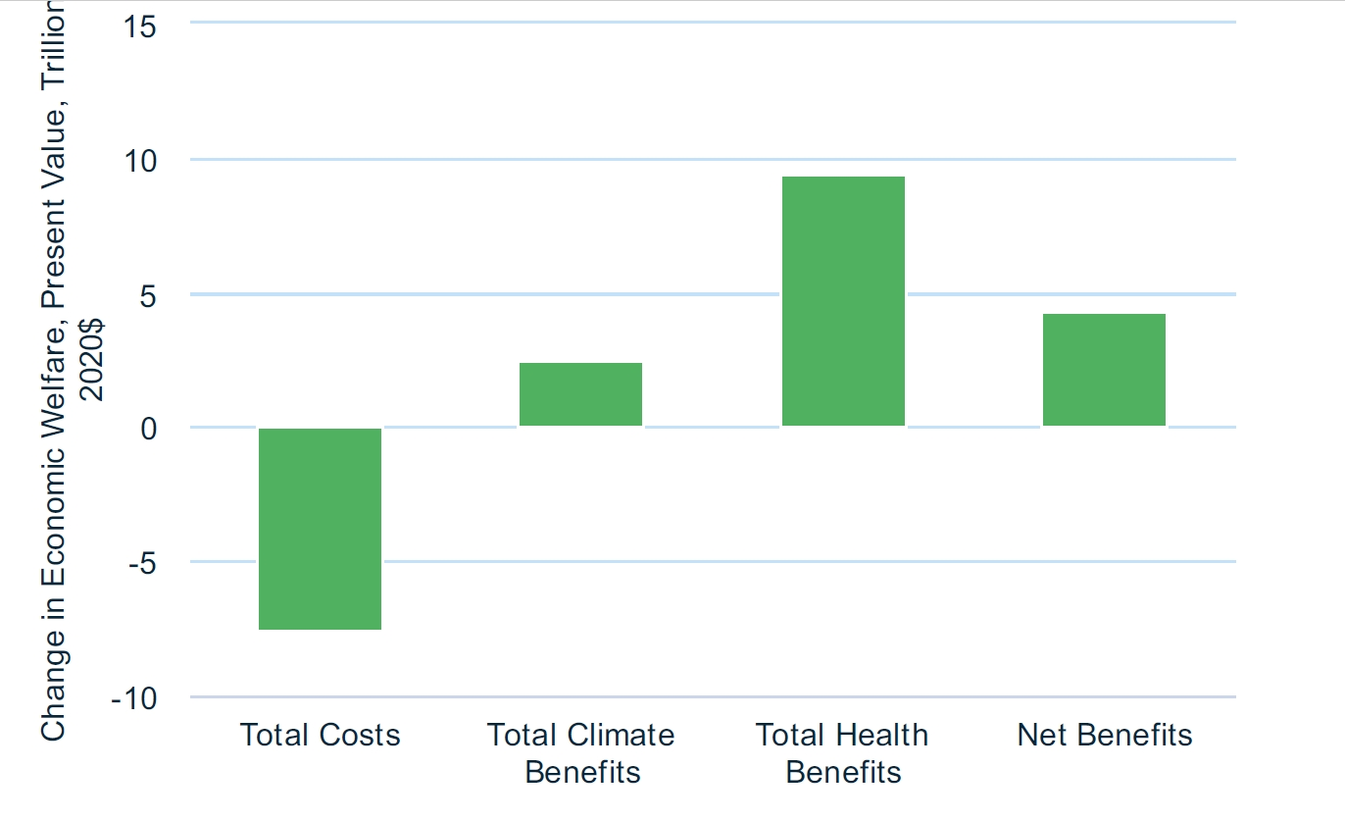
RFF Carbon Calculator Results: Net Benefits of EICDA
Good for the economy!
Notes:
Government costs are due to the fact that fossil fuel corporations will have less income after paying the carbon tax and therefore the governent income tax on that will be reduced.

Slide 20
Individual Actions We Can All Take
Talk about climate change! As long as climate change remains a taboo topic we will never discuss it and develop solutions. See Katherine Hayhoe’s TED Talk: https://www.ted.com/talks/katharine_hayhoe_the_most_important_thing_you_can_do_to_fight_climate_change_talk_about_it?language=en
Write or call your State and National representatives asking them to support energy conservation, renewable energy and efforts to reduce CO₂ emissions (like Energy Innovation and Carbon Dividend)
Join organizations working on reducing CO₂ emissions, like www.citizensclimatelobby.org This adds your name & voice to their lobbying & education efforts.
Become well educated on the issue, based on science, not pundits or fossil fuel companies’ PR. Read “Merchants of Doubt” by Naomi Oreskes. On-line, subscribe to www.dailyclimate.org (free)

Slide 21
Individual Actions We Can All Take
Sign up for Neighborhood Solar: Locally contact: Neighborhood Sun at: https://neighborhoodsun.solar/
Join Rotary Int’l’s new Environmental Sustainability Rotary Action Group at http://esrag.org
Consider reducing your consumption of red meat. The feeding and raising of beef emits ~10% of GHG emissions worldwide.
Read “Drawdown: The Most Comprehensive Plan Ever Proposed To Reverse Global Warming” by Paul Hawken for many other ideas.

Slide 22
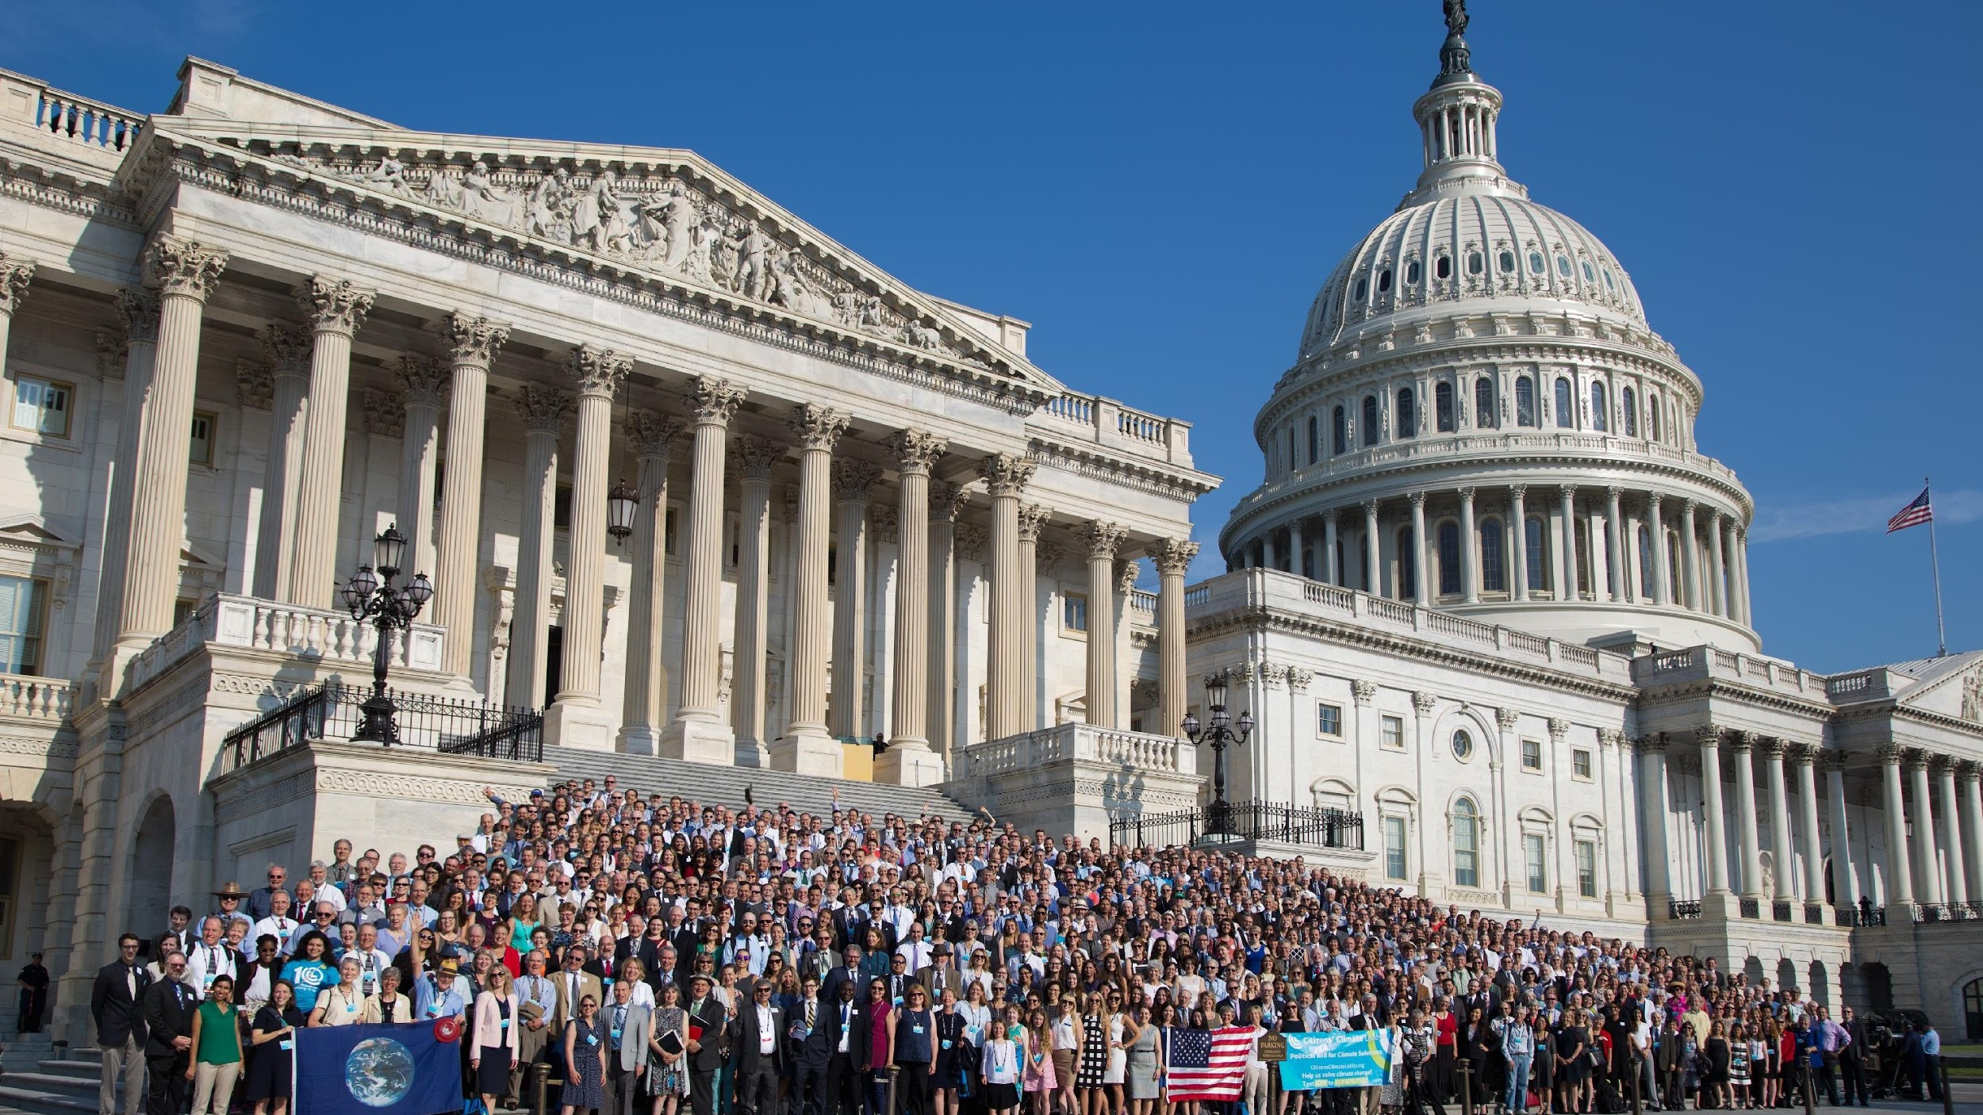
Thank You!
Notes:
Close by thanking everyone for their time
22

Slide 23
CONTACT US
cliff.strawitch@citizensclimatelobby.org
citizensclimatelobby.org
Notes:
Share your contact information
23

