Slide 1
Charles County Rotary Club, August 2019 Paul Billeter, Professor of Biology, CSM … Bee Campus USA & Bee City USA Thanks to Alli Steger (Calais), Chris Zabriskie, Turner Coggins, Tony Jernigan…

Slide 2
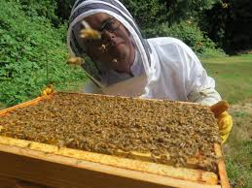
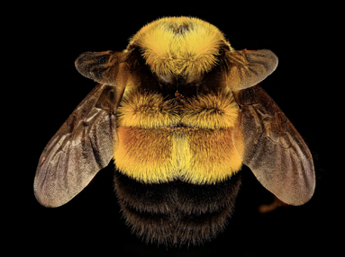
WHAT IS BEE CAMPUS USA?
Small non-profit, Ashville, NC (Subsumed by Xerces Society)
79 campuses, 33 states
3 colleges in MD: CSM, Washington College (Chestertown) , Salisbury U

Slide 3
Link to Bee Campus USA (or just google “Bee Campus USA”) Link to CSM Bee Campus (or just google “CSM Bee Campus”) email: pabilleter@csmd.edu and I’ll send you a copy of the ppt
What’s it all about?
The universal goals of pollinator restoration efforts are outlined by the Xerces Society.
PLANT PLANTS: Restore native plants that feed native pollinators.
PROVIDE HOMES: Supply the habitats that native pollinators require.
REDUCE PESTICIDES: Minimize use of herbicides and insecticides.
EDUCATE: Create public awareness and understanding of efforts to restore pollinators.
Also, creates sense of community in an extraordinary way.

Slide 4
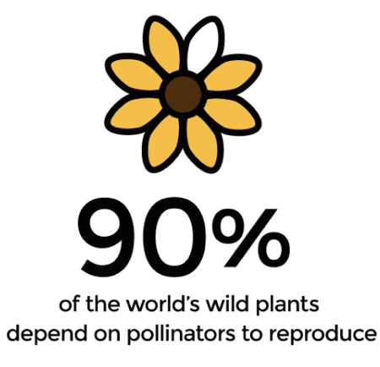
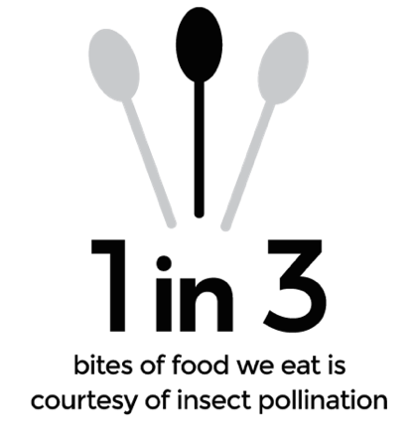
Pollinators are in decline and …
Actually a potentially catastrophic eco-problem !!!

Slide 5
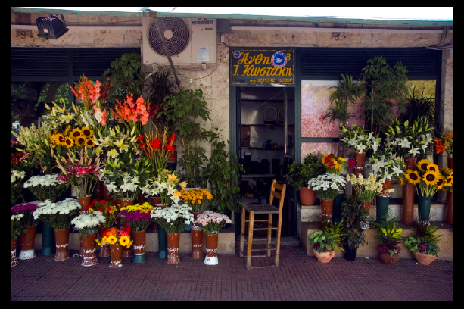
Agriculture, monoculture, introduced ornamentals, and pesticides …
…have decimated indigenous ecosystems.

Slide 6
BC’s HISTORY AT CSM 6 months
Pretty ordinary genesis, ontogeny and evolution
Stumbled on it ~ Dec 1st revising Zoology Insect lectures
Looked cool
Contacted Chair and Dean (my bosses)
They agreed and told me to explore it more
OK, why not?
Contacted MD’s king bee: Sam Droege USGS,
Started to organize
Was totally surprised by the enthusiasm on campus…

Slide 7
The CSM community was surprisingly enthusiastic !!!
Gardening is #1 hobby in USA. Citizens, neighbors, voters, customers, etc. love flowers.
Escape your computer, get out in the dirt, beautify your home and community.
Restore Charles County’s Indigenous Ecosystems.

Slide 8
Bio sub-Dept: Lori Crocker, Tracey Stuller, Jean Russ, Terry Jordan, Bill Wultich, Others: Tony Jernigan(VP), Eileen(VP), Maureen (Prez), Michelle Goodwin (VP) Art: George Bedell Bonnie Castlebury (ART Dept) Other Fac: David Walker, Christine A-L, Michelle Simpson (HUM) Superstars: Jen Everhart, Laura Robbins, Brent Burdick, Luke Gustafson Students: SGA, Sustainability Club Also: Marcy Gannon and Kid’s Learning Center Many others. We need specific helpers. Feel free to volunteer. paulb@csmd.edu
We organized, reorganized, sought funding and the project mushroomed…

Slide 9
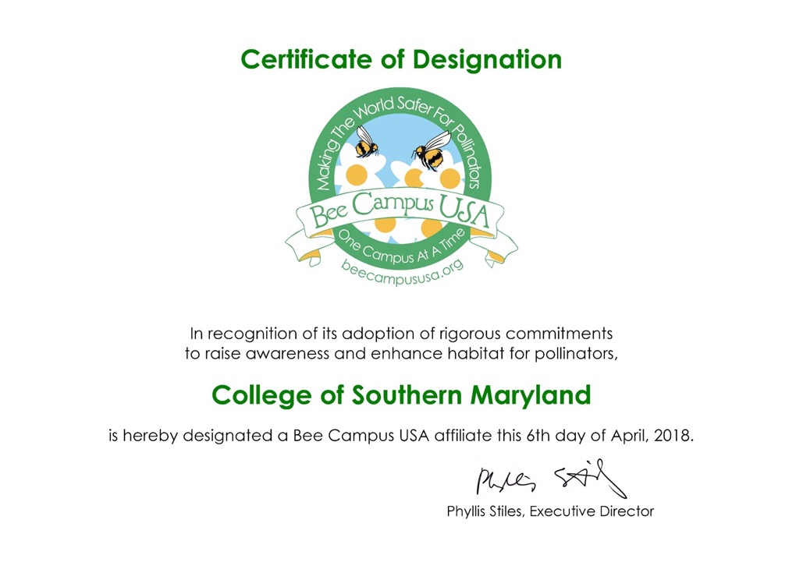
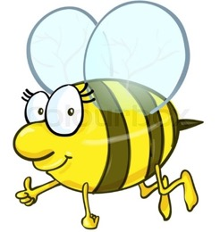
4 months later

Slide 10
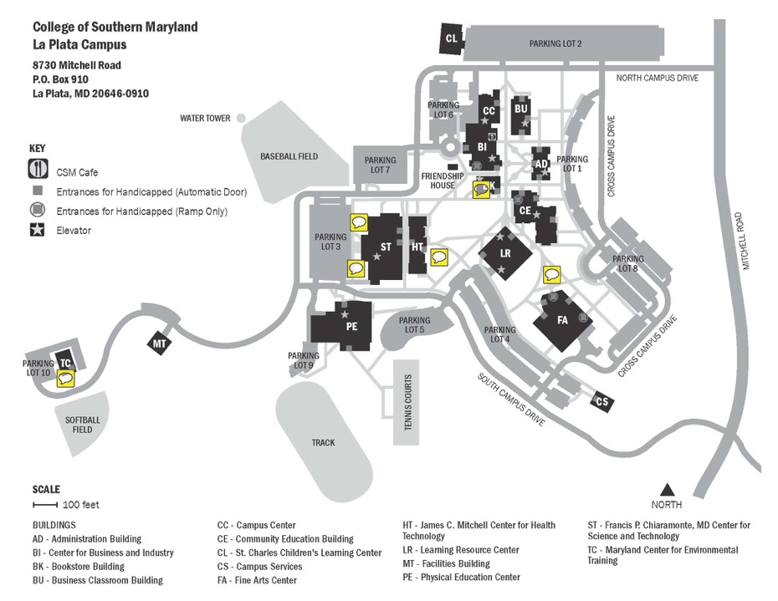
Site Selection
LAPL
LEON
PRIN
soon
HUGH

Slide 12
Everyone wants to save the bees
Highly decentralized and is/ought be that way. Very much bottom > up.
Resident’s houses.
Soil Conservation District planted 5 acres under grant from CBT.
There’s also Bee City USA .
Master Gardeners, Audubon Society, Extension Service. Brent Luke Lynne
CSM should probably focus on Education and Awareness .
Town of La Plata can join Bee City USA. --Danielle Mandley
WELCOME TO LA PLATA: A COMMUNITY FRIENDLY TO THE BIRDS AND BEES”

Slide 13
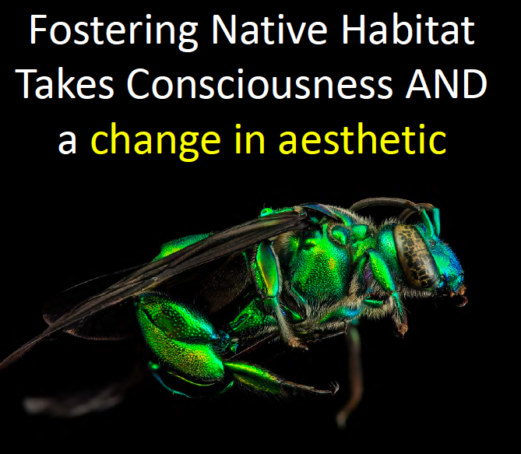

Slide 14
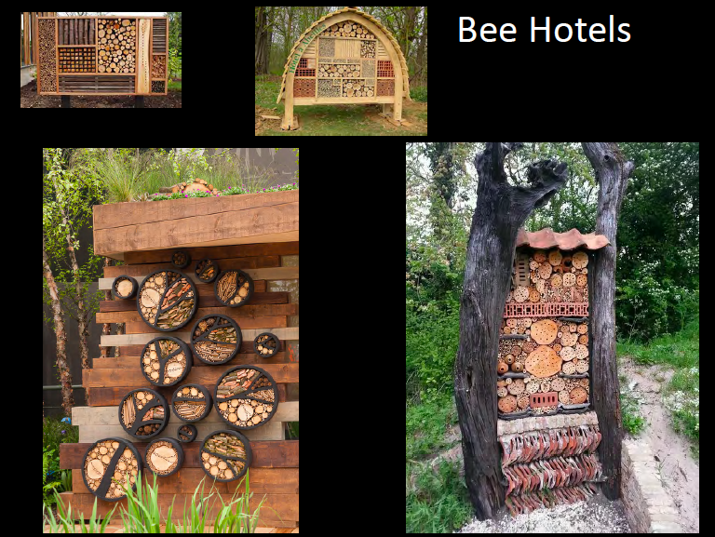
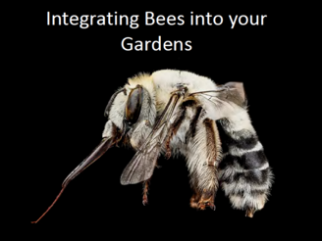
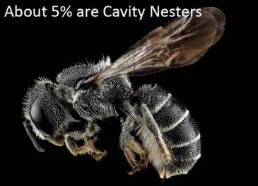
Habitat, Art, Sculpture

Slide 15
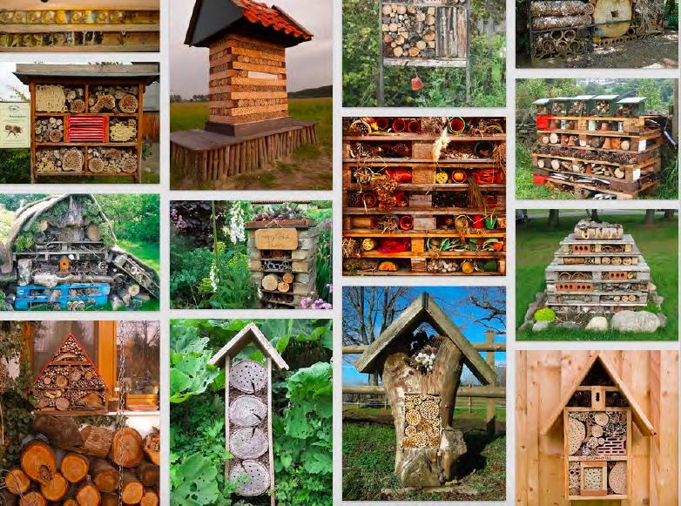
Habitat, Art, Sculpture. Boy Scouts, school kids, community groups, etc.

Slide 16
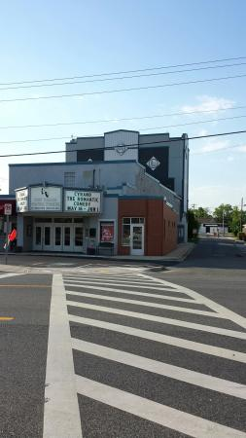
Signage is important

Slide 17
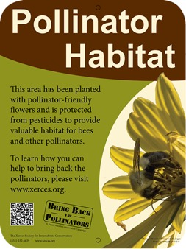

Slide 18
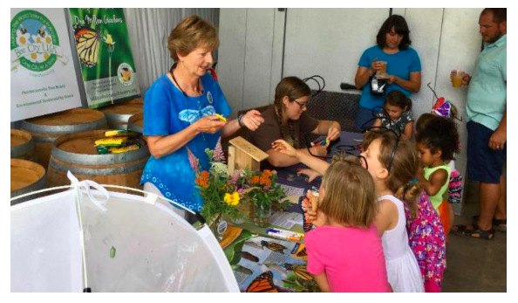
And, there’s this…

Slide 19
and this…

Slide 20
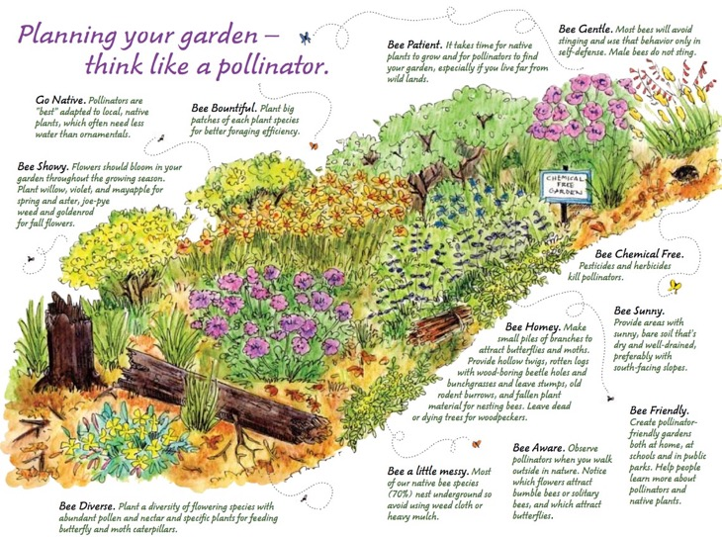
Long- term Plans
Expand on our first year accomplishments at CSM.
“Scale up” in La Plata Town and Charles Co.
Maybe PRIN and LEON?
Memorial Garden for Belva Loughlin- Jensen

Slide 21
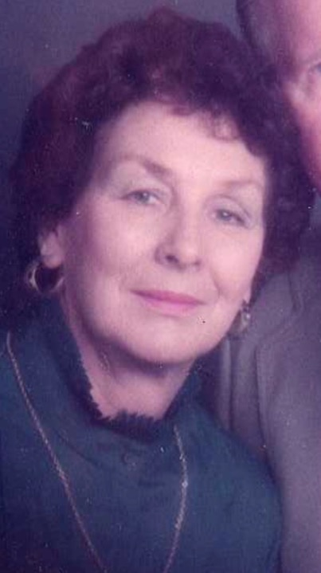
A CCCC Founder (one of 5 key people in college’s birth) > Inspirational educator > Pioneer in fostering women in science > Ardent environmentalist > Started Biology, Nursing, Horticulture, PAT & ERT, etc. > President of local Garden Clubs > Advisor to Allison Ferguson Foundation > Lewis and Clark… >Travel Study…
Dr. Belva Loughlin-Jensen, Ph.D.

Slide 22
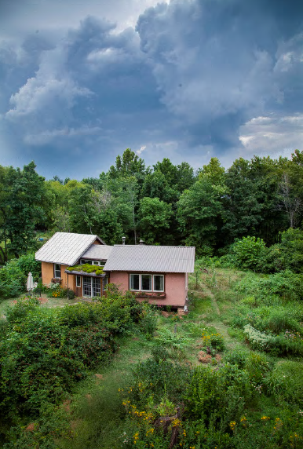
Sam Droege USGS

