Slide 1
DISTRICT 7620 of ROTARY INTERNATIONAL District Committee Chairs Meeting
Quarterly Information Meeting
District Governor Jimmie Gorski - 2020-2021
Wednesday, August 19, 2020
6:30 - 8:30pm

Slide 2
AGENDA
6:20 to 6:30 pm – Cocktail, Appetizer & Fellowship
6:30 to 6:35 pm – Welcome by DG Jimmie
6:35 to 8:20 pm – Committee Chairs Introduction, Brief Report & Information
Sharing & Collaboration
8:20 pm to 8:30 pm – Closing by DG Jimmie

Slide 3
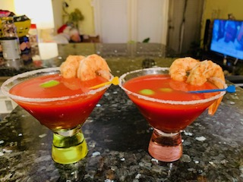
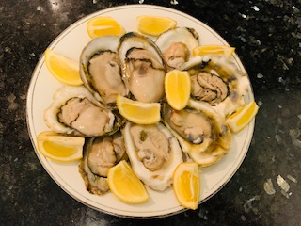
Fellowship (click w/ music)
Cocktail & Fellowship
Appetizer & Fellowship

Slide 4
District Committee Chairs
by Program Name
Alumni Program - Roxanne Suratgar
CART Program – Bob Bokma
District Conference 2021 – Sue Weber
Digital Marketing Program – Ken Solow & Sean McAlister
Disaster Aid USA – Paul Mahata & Bob Grill
Education Committee – Ayse Orellana, Chris Zabriskie, Pam Kreis & Geetha Jayaram
Four-Way Test Program – Matt May
Finance Committee – Sheldon Ray
Hunger Program – Pam Kreis
Interactor & RYLA Program – Marilyn Nevy Cruz
Int’l Service Program – May O’Brien & Sharon Taylor
Membership Chair – Jennifer Coppit
Peace Fellowship Program – Kristin Post
Polio Plus Program – Bob Parkinson
Public Relations Action Plan – Ashley Waters
RI Global Grants Scholarship Program – Jennifer Hara
Rotaract Program – Monique Toussaint
Rotary Newsletter – Bob Nelson
The Rotary Foundation – Rich Glover
Youth Exchange Program – Ric Meyer

Slide 5
Alumni Program by Roxanne Suratgar
Identification of Potential Alumni
Develop brief material to introduce the 7620 to the Alumni to share via
Article in RI’s magazine
Organize a networking event, as was held in the past at the Bulgarian Embassy, as soon as social distancing allows
Based on information about the Alum identify a few clubs for formal introduction and potential sponsor through membership chairs at each club. Understand their preferences: morning, lunch or evening, formal or informal, costs of membership.
Notes:
Alumni Program by Roxanne Suratgar
Identification of Potential Alumni:
Using the Alumni report generated through RI’s website
FB outreach to RI International to identify people coming to DMV area
RI’s chairs for Alumni
2. Develop brief material to introduce the 7620 to the Alumni to share via:
Email
Dedicated FB group
Letters
Article in RI’s magazine
Organize a networking event, as was held in the past at the Bulgarian Embassy, as soon as social distancing allows
5. Based on information about the Alum identify a few clubs for formal introduction and potential sponsor through membership chairs at each club. Understand their preferences: morning, lunch or evening, formal or informal, costs of membership.

Slide 6
CART Program by Bob Bokma
What committee is doing
Committee and their positions
Activities of CART Chair
Deposits
Plans for 2020-2021
Notes:
CART Program by Bob Bokma
What is CART? Coins for Alzheimer’s Research Trust.
The CART Fund: Gave out $1m in grants to 5 researchers this past Rotary year/ May 2020.
What committee is doing:
Discuss ways to extend CART to more Clubs.
Committee and their positions:
The District Committee has 6 members. I am also expecting to add to the District CART Committee several point people in the participating Clubs.
Activities of CART Chair:
Three emails to Clubs to encourage them to sign up via the new MyCARTFund.org portal.
A number of clubs have signed up for MyCARTFund.org for directly managing their donations.
So far there are 6 Clubs with a MyCARTFund.org user.
Includes a new email to Club Presidents to encourage them again to identify a CART coordinator in their Club, and get them signed up on MyCARTFund.org, and to suggest that they ask for a CART speaker to present at one of their virtual meetings, as possible.
Have received 4 requests for presentation!
Work with District Administrative officer on the District webpage. It now has on the District Projects webpage a section entitled: “CART (Coins for Alzheimer’s Research Trust) is alive and well in District 7620!” In addition, some background information and several links are provided.
Several postings on District and Gaithersburg Rotary Club Facebook pages.
Deposits:
Deposits 2019-2020: $5,409.81. Second in the Northern Division
Deposits thus far this Rotary Year (2020-2021): $54.00. Second in the Northern Division. So far, only two Clubs have made deposits this year. Some Clubs are holding funds. I know of a couple.
Plans for 2020-2021:
Continue communications with Clubs and offer to participate and present in their meetings.
Seek innovative ways to fundraise and to accept donations using cash apps such as Zelle.

Slide 7
District Conference Program by Sue Weber
District Conference Dates are locked in
We are working on:
The two-day agenda
Guest speakers
New & Unique breakouts Sessions
Local tours and activities will be offered
Hands on experience will be related to Hunger.
4-Way Speech contest, Club Awards and Memorial will be part of the program.
Notes:
District Conference Dates are locked in April 23-April 24, 2021 Venue: The Graduate Annapolis if held face to face. Will have a Plan B in the wings and ready in case we have to go virtual. We are working on: *The two-day agenda *Guest speakers *New & Unique breakouts Sessions Hospitality Suites & House of Friendship will be in full force. Local tours and activities will be offered (Tour Capital, historic tours, tour of Naval Academy, Haunted Pub Crawl, etc...) Hands on experience will be related to Hunger. 4-Way Speech contest, Club Awards and Memorial will be part of the program. Team: Sue Weber Dave Vogel Carolyn Richards Henry Riser Ashley Waters

Slide 8
District Digital Marketing Program by Ken Solow
From: Ken Solow <KSolow@PinnacleAdvisory.com> Sent: Sunday, August 16, 2020 8:37 PM To: Jimmie Gorski <jimmiegorski@comcast.net> Subject: District Chairs Meeting
Hi Jimmie,
Looking forward to the COG meeting tomorrow. I'm sure your team will do a great job.
I believe you've called a District Chairs meeting for Wednesday evening. As you know, I have no report to the group as our marketing efforts have been suspended until we get more clarity on the COVID situation. I would appreciate if you could share this brief report with the rest of the group.
I will use the extra time on Wednesday to prepare for an important business meeting I must attend on Thursday. If I can be of any additional assistance to you please let me know.
Warmest Regards,
Ken Solow
Kenneth R. Solow, CFP, Chairman of the Investment Committee Pinnacle Advisory Group, Inc.
410-995-6630 Office'
410-952-9637 Cell

Slide 9
Disaster Aid USA and Rotary Clubs Keep Fighting COVID-19 By Bob Grill, President of Disaster Aid USA; and Paul Mahata, Chair, District Disaster Relief Committee
Disaster Aid USA and a dozen Rotary clubs, in coordination with District Disaster Relief Committee, continue to fight COVID-19. We are providing Personal Protective Equipment (PPE) using club contributions and funds from district 7620 and The Rotary Foundation. Three DDF grants (worth $30K) and a recently approved Global Grant project (worth $57K) are helping Carroll Hospital, PG County Doctors Hospital, and 18 local nursing homes. The clubs supporting these projects are: Mount Airy, Bonds Meadow, Westminster, Sykesville-South Carroll, PG County, Southern Frederick County, Fredericktowne, Howard West, Columbia Town Center, Bethesda Chevy Chase, Montgomery Village, Potomac, and BWI Airport club. The unique multi-club teaming arrangement is behind the success of these projects. The PPE helps the health workers stay safe in hospitals and nursing homes. As a “Collaborating Partner” of Rotary International, DAUSA also remains ready to help the victims of disasters caused by natural causes such as Hurricanes, Tornados, Floods, and Earthquakes.
In order to expand our capability to provide disaster relief, we have taken concrete steps to raise funds. At this time funds are urgently needed for fighting COVID-19 and for providing disaster assistance. For this reason, Disaster Aid USA is seeking donations now. Disaster Aid USA is a Rotary Club project providing aid and assistance when disaster strikes within and outside the United States. We appreciate the support from Rotary clubs and individual Rotarians. Please earmark your donation "COVID-19” or “General” and mail to: Disaster Aid USA, 9817 Lanham Severn Road, Lanham, MD 20706, or donate online using the website www.disasteraidusa.org via PayPal or going to link disasteraidusa.networkforgood.com/
For any questions, feel free to contact Bob Grill, President & Co-founder, Disaster Aid USA bob.grill@disasteraidusa.org Tel: 410-956-7344; or Paul Mahata, Chair, District Disaster Relief Committee, Pmahata@verizon.net

Slide 10
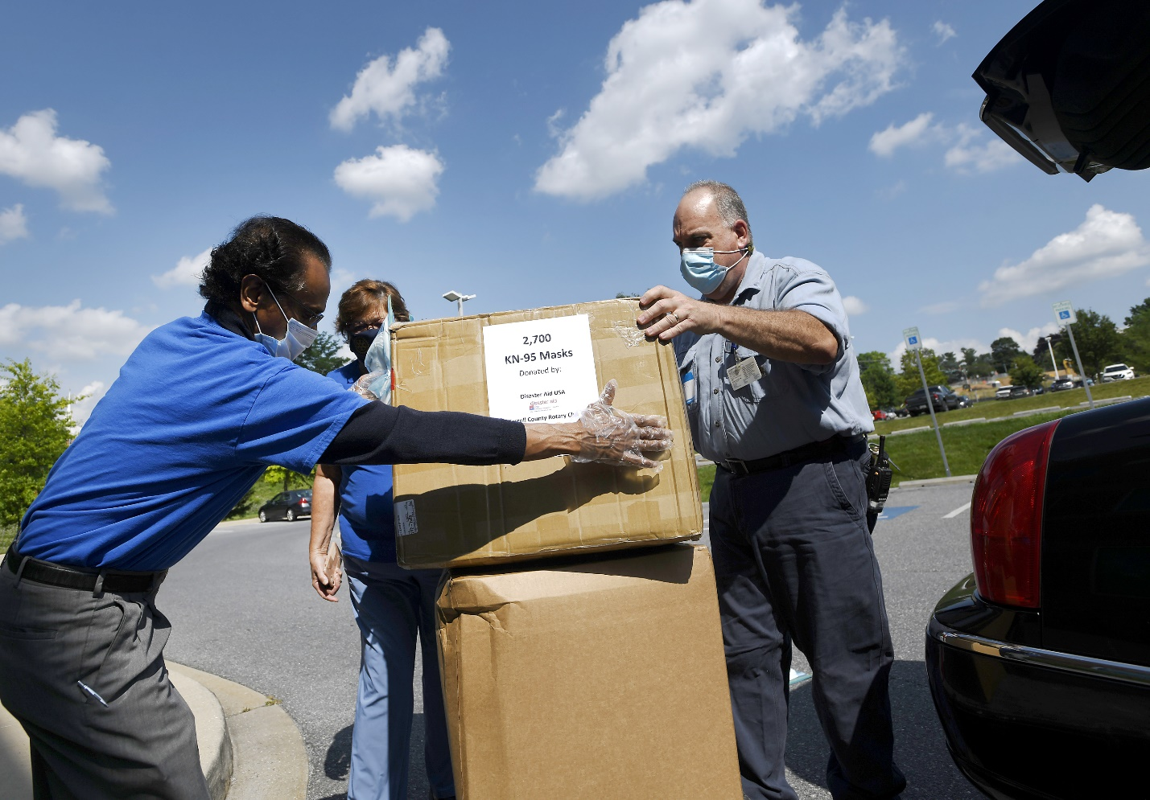
Disaster Aid USA and Rotary Clubs Keep Fighting COVID-19 By Bob Grill, President of Disaster Aid USA; and Paul Mahata, Chair, District Disaster Relief Committee
Courtesy: Carroll County Times/ Photo by Dylan Slagle
Hospital gets mask donation: Carroll County Times, July 9, 2020. Carroll Hospital staff Frank Johnson, right, helps unload a donation of 2,700 KN-95 respirator masks dropped off by Paul Mahata, left, of Disaster Aid USA and Mary Jo Burkett, Past President of Mt. Airy Rotary Club at Carroll Hospital.

Slide 11
Environmental Committee by Chris Puttock
Recently DG Jimmie Gorski asked me to head up the Environmental Committee (EC) for our district. I am also the Chair of the Environmental Sustainability Rotary Action Group (ESRAG; www.esrag.org ), including our international youth group Climate Solutions Coalition (CSC). The Mission of the EC is to be an expert resource for Rotary in our District, to prepare environmental projects, particularly with the new area of focus (AOF) “Supporting the Environment”. I do not see the environment as separate from the other six AOF but as intricately connected to all, as clearly recognized by the 17 United Nations Sustainable Development Goals. You may have noticed that to be funded by TRF, projects must be clearly centered in an AOF. The new AOF becomes eligible for TRF funding on July 1, 2021 (once the funding has been restored after being exhausted by the COVID-19 pandemic). Until then funding for projects will need to come from DDF and club-matched funds. I am in the process of forming the Environmental Committee.
I have contacted 20 interested Rotarians. My goal is to have five action teams, including:
clean air, clean soils, and clean water
biodiversity, ecosystem restoration, and food production
transforming the linear to circular economy (including plastics, reduce, reuse, recycle, and carbon net zero Rotary)
clean energy production and use (including solar, wind, water, e-transport and e-buildings
zoonotic, mycornotic and phytonotic human diseases and population health, Members of these teams will be available to speak on these action topics to Rotary clubs in our District.
The Objective of the EC is to help our Interact, Rotaract and Rotary Clubs and the District, formulate local, district wide, nationwide, and global projects. Our environmental goal is also a humanitarian one for a healthy, prosperous, sustainable future. Examples of potential projects include:
. Participate in local, national and international days
o International Coastal Cleanup Month – September 2020: collecting trash destined for the Bay
o Maryland Day – March 25, 2021
o Earth Day - April 22, 2021 – theme: Restore Our Earth
o UNEP World Environment Day - June 5, 2021 – UNEP 2020 theme: Time for Nature

Slide 12
Environmental Committee by Chris Puttock
Continue supporting PRIP Ian Riseley’s tree planting projects and develop new projects to encourage native pollinators by converting abandoned fields to wildflower meadows, and to support more pollinator gardens in schools.
Provide a collection point for feral freon in Baltimore. Tradewater, Inc. will remove the freon for incineration in Chicago. Freon is a very potent greenhouse gas; 1 ton of destroyed freon is equivalent to taking 10,000 vehicles from our roads for a year.
Reduce food waste in school and teach about composting (Lunch out of Landfills program)
Extend oyster reef restoration. From 2010 to 2014 the EC (also with PDG Doug Parkinson, Rtn Steve King) constructed an oyster reef in St. Mary's River in collaboration with St. Mary’s Watershed Association and St. Mary’s College
Produce a database of all projects district-wide connected to the environment
Establish International projects such as: coconut palms for windbreak protection in Bangladesh, reforestation in Mindanao Philippines, coral reefs enhancing fisheries in Tamilnadu India, u.s.w. I believe that all projects that we undertake should provide environmental STEM/STEAM education, encourage monitoring for effective conservation, and establish partnerships with local, national, and international organizations. Christopher F Puttock D7620 Environmental Committee Chair August 19, 2020
I believe that all projects that we undertake should provide environmental STEM/STEAM education, encourage monitoring for effective conservation, and establish partnerships with local, national, and international organizations.
Christopher F Puttock
D7620 Environmental Committee Chair
August 19, 2020

Slide 13
Dinner Buffet & Fellowship

Slide 14
Finance Committee by Sheldon Ray
Members:
Sheldon Ray, Chair
Rich Glover, Co-Chair
Sharon Taylor, Treasurer
Eric Dallavalle
Kevin Freese
David Gough
Sonia Lu
The finance committee oversees the various accounts, budgets, banking, cash flow, income statements, balance sheets and investments of District 7620. District accounts include the operating account, the Rainy Day Fund (reserve funds), the DDF account (deposit and disbursement of RI funds) and the Project Trust Fund (accepts and disburses charitable funds for special projects).
This Rotary year the committee plans to adopt a more formal policy for the committee. It will address expense reimbursements, rules for disbursements from the Project Trust Fund, investment guidelines and other clarifications. The intent is to impose clearer guidelines for district finances and to pass these on to future committee members.

Slide 15
Four-Way Test Program by Matt May
Click HERE to Find The Program Details

Slide 16
Hunger Relief Initiative by Pam Kreis
Our vision is to increase the engagement by District 7620 Rotary Clubs in addressing food insecurity, especially locally.
Increase the number of clubs conducting food-related service projects
Convert project activities into number of meals equivalent
Collect information about food related projects, volunteers involved, etc.
Strategy
Challenge to Clubs
Matrics for Success
Feed 10 Million
Summary
Notes:
Our vision is to increase the engagement by District 7620 Rotary Clubs in addressing food insecurity, especially locally.
Increase the number of clubs conducting food-related service projects
Convert project activities into number of meals equivalent
Collect information about food related projects, volunteers involved, etc.
Strategy
Let District 7620 Rotary clubs do what they do best
Identify needs in their communities
Develop service projects that engage both Rotarians and members of their communities
in meeting those needs
Look for innovative ways to break the cycle of food insecurity
Identify other organizations to partner with
Challenge to Clubs
Continue food-related projects that have been successful
Add additional projects
If your club does not have a food-related service project, consider adding one
Collect and submit data so we can measure our success
Look for projects that are more than just handing out meals.
Partner with community gardens, local farms, and food centers
Join with other Rotary clubs to expand your impact
Share your successes with the community through PR
Metrics for Success
District to survey clubs
What food-related projects during 2019-20 including number of meals, number of Rotarians/Volunteers, hours, cost?
What food-related projects already planned for 2020-21.
District to establish guidelines for determining meal equivalents and reporting
District to use reported projects to create a District Showcase
Use the District newsletter “Open Forum”
Send Showcase to AG’s and club presidents
District to assist with PR
District Chair to present results of projects at the April 23-24 District Conference
Feed 10 Million
District 7620 is participating in this Zone 33-34 parallel project
Use #Feed 10Million in club PR
Their goal is for the combined efforts of all clubs (1700+) in Zones 33 and 34 to reach 10
million meals served during this Rotary year
In summary, our goals are
Raise awareness of our local populations that are food insecure
Increase the number of District 7620 Rotary club service projects addressing food insecurity, and
Add substantially to Zone 33-34 Feed 10Million project

Slide 17
District International Service Committee Program by May O’Brien & Sharon Taylor
The DISC’s initial goals are:
To create a network of Rotarians who enjoy meeting other international-minded Rotarians in our District and around the world. As a first step, the DISC is sending out a survey to all clubs to identify ISC chairs to create a listserv
To provide hands-on service opportunities and in-country friendship exchanges
To encourage every club in our District to take on one or two international service projects
To mentor clubs that do not have an International Service Committee and want to start one
To mentor new International Service chairs
To provide training on how to apply for district and global grants
To help clubs find international partners for international projects
To identify technical experts willing to provide guidance to other clubs,
To connect with Rotary Action Groups, Inter-Country Committees, DISCs around the world, RI International Service Partners, and other districts and organizations to widen our resource network
To support the District Rotary Foundation Chair, the District Grants Committee, and clubs with resources for international projects and
To promote RI’s mission and areas of focus by showcasing successful international service projects.
The DISC hopes to inspire more individuals to join Rotary to support our humanitarian causes and to align with Rotary's strategic plan for the next five years: to increase our impact, expand our reach, enhance participant engagement, and increase our ability to adapt.
Notes:
In light of the Covid-19 pandemic and RI’s June 2020 announcement of a significant reduction in The Rotary Foundation’s funding for international humanitarian grants, our District felt a forward-looking strategic plan for international service was needed. In August, District Governor Jimmie Gorski, with the endorsement of DRFC Rich Glover, created a District International Service Committee (“DISC”), with Sharon Taylor of the Annapolis Rotary Club and May Yoneyama O’Brien of the Washington, DC Rotary Club appointed as co-chairs.
The DISC’s first goal is to create a District-wide network and clearinghouse for international resources -- including potential projects, funding partners, technical experts, and training materials -- and to provide a platform to share news about international grants, travel opportunities, and interesting speakers. We aim to partner for greater impact to better serve communities globally.
In 2017-18, RI President Ian Riseley called on Rotary Districts to institute a District International Service Chair to build a district resource network of Rotarians with expertise in RI’s areas of focus. He challenged Districts to work with clubs to develop high impact, high quality, and sustainable global grants by leveraging local Rotarian expertise and by establishing connections with international partners.
An informal DISC organizing committee started meeting in July and August to create a schedule and set priorities for the new committee. The committee is composed of internationally-minded Rotarians from Annapolis, Washington, DC, Bethesda-Chevy Chase, Parole and Metro Bethesda clubs with help from the Alexandria club’s former 7610 DISC chair-elect, as well as PDG Rich Carson.
A critical first step was to seek the advice of Rotary International HQ and ask DISC guru Bill Gormont to provide direction about how to get started. Bill Gormont led the 2020 RI Virtual Convention Break-out on “District Resource Networks Make International Service and District International Service Projects Successful,” where several DISC chairs spoke. He also urged us to connect with Rotary Action Groups (e.g., Peace, Micro-Finance, Environmental Sustainability, WASH). The RAGs and other Rotary fellowship groups provide Rotarians an opportunity to make personal and professional connections beyond our local communities or country. With the diminishing philanthropy economy and the new competitive environment for Rotary Foundation grant funds, he advised clubs to start looking for partners outside of Rotary.
The DISC’s initial goals are:
To create a network of Rotarians who enjoy meeting other international-minded Rotarians in our District and around the world. As a first step, the DISC is sending out a survey to all clubs to identify ISC chairs to create a listserv
To provide hands-on service opportunities and in-country friendship exchanges
To encourage every club in our District to take on one or two international service projects
To mentor clubs that do not have an International Service Committee and want to start one
To mentor new International Service chairs
To provide training on how to apply for district and global grants
To help clubs find international partners for international projects
To identify technical experts willing to provide guidance to other clubs,
To connect with Rotary Action Groups, Inter-Country Committees, DISCs around the world, RI International Service Partners, and other districts and organizations to widen our resource network
To support the District Rotary Foundation Chair, the District Grants Committee, and clubs with resources for international projects and
To promote RI’s mission and areas of focus by showcasing successful international service projects.
The DISC hopes to inspire more individuals to join Rotary to support our humanitarian causes and to align with Rotary's strategic plan for the next five years: to increase our impact, expand our reach, enhance participant engagement, and increase our ability to adapt.

Slide 18
District Polio Plus Committee Status Report by Bob Parkinson
Committee Members
Billy Louis Chair – RC of Prince Georges County
Bob Sartwell – RC of Lake Shore-Severna Park
Sonia Liu – RC of Metro Bethesda
Ken Weiss – RC of Gaithersburg
John Reid – RC of Potomac
Bob Parkinson – RC of Lexington Park
Goals
Conduct Event on Polio Day
Committee Members connect with all clubs in the district encouraging contributions to PP project.
Zone 33 Objectives (From PDG Chuck Davidson)
Every club has PolioPlus goal in RCC of at least $45 per member
Every club contributes to PolioPlus
Every club considers a public awareness fund-raising project in its community to assist in achieving their PolioPlus goal
Every district transfers at least 20% DDF to polio
Total DDF + cash Zone-wide is $2 million
(words in red are new for 2020-21)

Slide 19
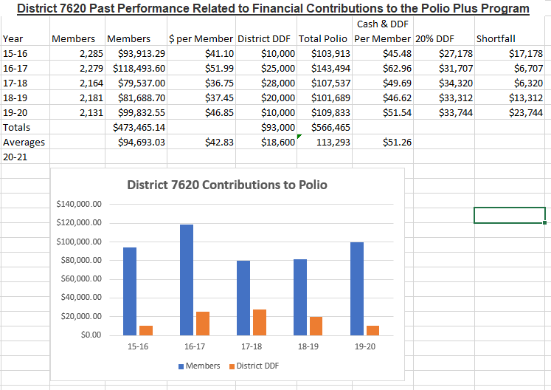
District Polio Plus Committee Status Report by Bob Parkinson
District Polio Plus Committee Status Report by Bob Parkinson

Slide 20
District Polio Plus Committee Status Report by Bob Parkinson
Where we are - Goal 1:
Polio Day Agenda - estimating 80 minutes total time, breakdown as follows 1145 - 1200 System Test and panelist instructions 1200 - 1210 Intro - DG Jimmie and Billy 1210 - 1230 PDG Chuck Davidson – Zone 33 Polio Co-Chair 1230 - 1250 Dr. Saffron – World Health Organization 1250 - 1300 Wrap Up
Notional Schedule 14 Aug - Billy provide update to DG
18 Aug - Draft Announcement available for team review 21 Aug - Sept Newsletter input to Bob Nelson
25 Aug - Draft Flyer and Registration Paragraph available for team review 27 Aug - Comments on Flyer due 17 Aug - 30 Sept - Outreach to AGs and Clubs
21 Sep - Oct Newsletter input to Bob Nelson
5 Oct - Finalize Polio Day Plans 15 Oct (est.) - Dry run and discussion of event sequence, etc. (Need coordination with Ashley)
15 Oct - DG Jimmie pmail to all members reminding them of the Polio Day event 24 Oct - Conduct our “finest hour” for Polio 2020-21

Slide 21
District Polio Plus Committee Status Report by Bob Parkinson
Where we are - Goal 2
Past performance for all clubs has been downloaded from MyRotary for past 5 years
Committee members have been assigned to work with area governors and their clubs
Club data will be provided to committee members and AGs on request starting 20 August
Content of elements to discuss with clubs is in work to be discussed at next committee meeting
Commence engagement with clubs in September and touch each club by March 2021
Presentation on the approach will be made at the AG meeting on the 17th
Paring of AGs and PP Committee Members
Area 1 Suzanne Green Bob Sartwell 240-334-8243
Area 2 Delores Edwards Bob Sartwell
Area 3 Temrah Okonski Billy Louis 240-334-8243
Area 4 Dawn Wittfelt Ken Weiss 301-219-3098
Area 5 Tiffany Ahalt Ken Weiss
Area 6 Frank Senk John Reid 703-909-7305
Area 7 Mandy Warfield John Reid
Area 8 Heidi Webb Sonia Liu 240-480-5800
Area 9 Bill DuBoyce Billy Louis 240-334-8243
Area 10 Sue Webber Bob Parkinson 301-751-2114
Area 11 Ray Streib Bob Parkinson
Area 12 Barbara Thompson Bob Parkinson

Slide 22
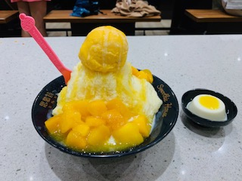
Dessert & Fellowship

Slide 23
District Public Relations Action Plan by Ashley Waters
This action plan will serve as a guiding document for District 7620 leadership as it works towards the advancement of Rotary International President Holger Knaackand Rotary 7620 District Governor Jimmie Gorski’s goals. With internal and external
foci, this plan will use the successes of 7620’s strong history to integrate additional best practices to streamline district volunteer efforts and collaboration and to share the story and impact of Rotary.
RI PRESIDENT EMPHASES
New Innovative Club Models
Club Strategy Conversations
Smart Membership Recruitment
End Polio Now
7620 DISTRICT GOVERNOR GOALS
Helping Those Who Serve
Fighting Hunger
Improving Membership Growth

Slide 24
District Public Relations Action Plan by Ashley Waters
ACTION 1: Showcase the various membership styles and opportunities to support future Rotarians in their search for the best fit
Use social media to enhance knowledge of membership styles
Employ paid digital marketing practices to increase awareness as needed
Work with District Membership chair to support membership variety efforts
ACTION 2: Grow District knowledge of advanced PR efforts
Continue direct area and club conversations to help clubs with PR needs
Host advanced PR trainings to support “next-level” community engagement and awareness efforts for clubs with strong presence
Reduce hurdles for Club PR efforts (i.e. recruitment and training of PR Chairs and Committees)
Continue to increase brand alignment in club materials and promote resources within Brand Center
ACTION 3: Market District initiatives with comprehensive approaches
Market End Polio Now event in October
Market and promote Feed 10 Million Hunger effort
Grow the idea of advanced notice and planning for marketing success with District leadership

Slide 25
Rotary International Global Grants Scholarship Program by Jennifer Hara
One Global Grants Scholarship (click for application) for $30,000 will be awarded by Rotary District 7620 for an academic year. This award will be granted for graduate level studies at overseas university programs which support sustainable, high impact outcomes in one of Rotary’s seven areas of focus.
Completed District 7620 Global Grants Scholarship applications packets must include the following:
Completed Global Grants Scholarship Application
Letter of Support/Sponsorship from a Rotary club in District 7620 ( A listing of all District 7620 Rotary clubs can be found at http://www.rotary7620.org/ Click on “Where Clubs Meet” to find contact information.)
Offer Letter from the college or university where you will be studying abroad. If your Offer Letter has not yet arrived, you must notify the Global Grants Scholarship Committee Chair, Jennifer Hara at hara128@hotmail.com
Transcripts for all degrees earned
Resume/CV
Timeline for Global Grants Scholarship Application Process and Selection
October 31: Students submit completed applications and supporting documents to a qualified Rotary Club in our District.
November: Clubs review applications, interview applicants, and select their nominee.
January 1: Deadline for all individual Clubs to submit a letter of sponsorship and completed application packet to Jennifer Hara, hara128@hotmail.com, District Global Grants Scholarship Committee Chair.
Incomplete application packets will not be considered for further review.
January-February: If selected as a finalist, applicants will be contacted for an interview by the District Global Grants Scholarship Committee Chair.
March: Interviews will be conducted and scholarship recipients notified of their scholarship award by the District Global Grants Scholarship Committee Chair.
May 1: Scholarship recipient notifies the District Global Grants Scholarship Committee Chair of scholarship acceptance to begin RI approval and funding. Alternate scholarship recipient notified of award if necessary. The confirmed scholar will be proposed to the International Host Club and to Rotary International for evaluation and funding ninety days before travel is to begin.
June-August: Scholarship paper work will be completed and approved by Rotary International Foundation.
August-September: Scholarship funding will begin once received from the Rotary International Foundation.
Jennifer Hara, Chair, Global Grants Scholarship Committee, Rotary Club of Washington DC
Dr. William Duboyce, Rotary Club of Historic Prince George’s County
Ayse Kadayifci-Orellana, Rotary Club of Metro Bethesda
Brent Tolbert-Smith, Rotary Club of Catonsville
Lois Jarman, Rotary Club of Smoketown Brunswick

Slide 26
Rotary District Newsletter Committee by Bob Nelson
SUMMARY
The ROTARY District Newsletter Committee publishes the “Open Forum,” a monthly publication for Governor Jimmie Gorski that highlights the accomplishments of the District and clubs and provides information about upcoming events. The newsletter is typically 8 to 15 pages in length.
GOALS
A goal for the year is to increase the number of clubs providing articles and photos so there is greater coverage across the District.
COMMITTEE MEMBERS
Bob Nelson, PDG, Editing and Layout
Nancy Mason, PAG, Editorial Review
Sonia Liu, Review and Distribution

Slide 27
Appreciate the Importance of The Rotary Foundation Rich Glover, PDG & DRFC
Appreciate the Importance of The Rotary Foundation
"Five-Part Learning Series" 08/25/2020
Rich Glover, PDG & DRFC
Click here for Details
The Rotary Foundation by Rich Glover

Slide 28
D7620 Youth Exchange Program 2020-2021 by Ric Meyer
Chair: Ric Meyer, RC of Annapolis
Co-Chair: Susan Glover, Carroll Creek
Alumni (Rotex) Chair: Andrea Downing, Capitol Hill
Diversity & Inclusion Chair: Landon Fortenberry, Washington (Rotaract)
Inbound Chair: vacant
Inbound Co-Chair: vacant
Outbound Chair: Cindy Harrison, International Friendship
Outbound Co-Chair: vacant
Short-Term Chair: Chris Perlick, Leonardtown
2020-2021 Goals
Fill Committee vacancies and add new people the committee. Vacancies: Inbound Chair & Co-Chair, Outbound Co-Chair. New positions: e.g. PR/website
Messaging
ensure that District and Club Leaders understand that we’re pausing from sending students abroad and hosting this year
and we will be busy recruiting 2021-2022 candidates, plus volunteers and clubs.
Each Long-Term student engages with 2,000 people (est.)
Long-Term Program
to send 10 students abroad (i.e. sponsor) and host 10. Five students deferred from 2020-2021; thus the increase in numbers. Expectation: these 20 students will engage with 40,000 people (est.)
introduce new online application
Short-Term Program
recruit three students
introduce new online application
First semester (fall): online/video meetings
RC Youth Exchange Officers & Counselors meeting week 1st September
candidates & parents/guardians informational meeting
interviews: second-third week November
Second Semester: to be determined
Launch 7620 Rotex Group; currently 69 names. 13/69 (19%) are Rotaractors or Rotarians. Goal: get at least 20 more to join Interact, Rotaract, or Rotary
Launch Diversity & Inclusion Project. Mission: to recruit candidates and volunteers who reflect the full diversity of our region: ethnicities, national origins, sexual orientations, physical abilities, etc.
North American Youth Exchange Conference Feb. 2021, Crystal City, VA; 500 attendees

Slide 29
~ The End ~
Thank you for your enthusiasm and strong support! Our next virtual District Chairs Meeting is scheduled on Wednesday, November 18 from 6:30 to 8:30pm. We look forward to seeing you again.

Slide 30
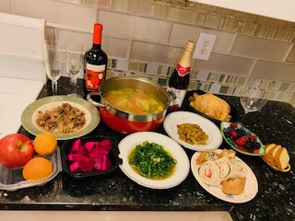
Five-Course Virtual Dinner Menu
Shrimp Cocktail Oyster Appetizer Dinner Buffett Ice Cream Dessert
District Committee Chairs
Meeting Program Chair &
Director DG Jimmie Gorski
Asst. Director & Producer Sonia Liu
Technical Support Sue Weber
Technical Support Sonia Liu

