Slide 1
Rotary: Engaging Youth Matters

Slide 2
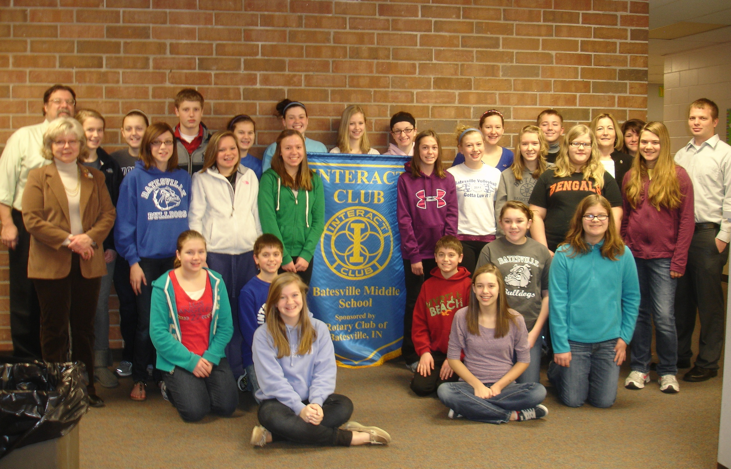
About
Interact
Interact is Rotary International’s service club for young people ages 12 to 18. Interact clubs are sponsored by individual Rotary clubs, which provide support and guidance, but they are self-governing and self-supporting. Rotary club sponsors mentor and guide Interactors as they carry out projects and develop leadership skills.
Rotaract
Rotaract originally began as a Rotary International youth program in 1968 at Charlotte North Rotary Club in Charlotte, North Carolina, United States, and has grown into a major Rotary-sponsored organization of over 10,904 clubs spread around the world and 250,792 members in 184 countries.
Let’s understand our “why”

Slide 3
How has the pandemic affected Interact and Rotaract clubs?

Slide 4
How can we retain and obtain new members?
Engage: Leadership Training
Engage: Service
Engage: Fundraisers
Notes:
Promote brand and mission
Donor = Customer
No secret formula for success

Slide 5
Engagement
Help our young Rotarians
Give them a “seat the table”
Communicate often
Share resources
Invite them to service events

Slide 6
Collaborate
Make these clubs true partners

Slide 7
What can you do
Make a list, and check it twice!
Virtual Movie Nights
Virtual Meetings including speakers and activities such as virtual health and mindfulness events
Virtual elections
Virtual induction of officers and new members
Virtually rewarding members for work well done
Mentoring – connecting with youth and providing one-on-one mentoring sessions

Slide 8
Remember: Interactors and Rotaractors are future Rotary Club Founders and Members!

Slide 9
Thank You
AG Suzanne Green – suzannegreen@ymaryland.org phone: (410) 322-8525
AG Heidi Webb – heidi@greenkitefundraising.com phone: (240) 328-8254
District Rotaract Chair Monique Toussaint – rotarianmonique@gmail.com
District Interact and RYLA Chair Marilyn Cruz – mncruz10@gmail.com

