Slide 1
Making Rotary Meetings Safe:
In-Person and Online Format Options

Slide 2
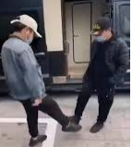
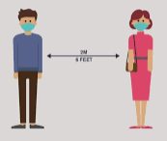
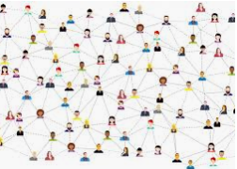
New Normal

Slide 3
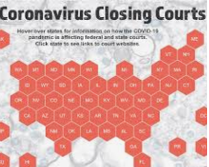
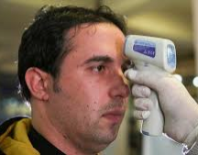
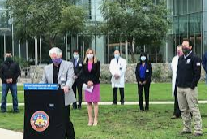
Stay Safe

Slide 4
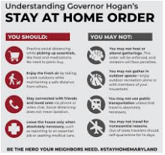
Public Health Plans

Slide 5
Engagement
Rotary Government Business Non-Profits
Explore programs
Invite speakers
Partner
Create stories
Create fundraisers
Contact schools
Use social media
Send emails
Happy hours
Call members
Publish accomplishments
Award achievements
Invite new members

Slide 6
On-Line Meeting
Keeping members informed
Share future plans
Address issues of fundraising
Maintain comradery
Keep up the momentum
Stay positive
Increase membership
Strengthen friendships

Slide 7
PLATFORMS
TheFreeConference

Slide 8
Etiquette Tips
Virtual Meeting Etiquette Business Etiquette
Use the video option when possible You should know the person
Dress appropriately Start with a short greeting
Stage your video area Be mindful of the receiver's preferred style of communication
More light is better Keep the conversation short
Look into the camera Be careful with abbreviations
Stay focused on the meeting - Never send bad news via IM
avoid multi-tasking
Mute your microphone when Don't change meeting times or not speaking venues in an IM
Be mindful of background noise and activity Be aware of a status message
Open and close the meeting on time End conversations with a short closing
Send out an agenda

Slide 9
Lock Your On-Line Meetings

Slide 10
Have Fun
Remind Rotarians
A crisis is just that
Life will go forward
We will overcome
Let’s do it together

Slide 11
The Future… Predictions?

Slide 12
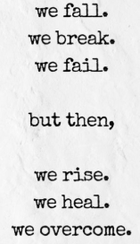
A Better Future…Rotary Focus
Intent | Covid-19
Peace and conflict prevention/resolution | Yes
Disease prevention and treatment | Yes
Water and sanitation | Yes
Maternal and child health | Yes
Basic education and literacy | Yes
Economic and community development | Yes

Slide 13
Questions/Comments
AG Sue Weber
sailorsue02@aol.com
410-507-6020
AG Frank Senk
grc.fsenk@gmail.com
215-527-7468

