Slide 1
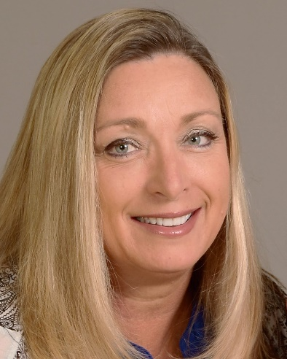
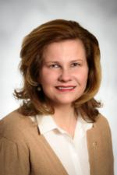
TEAM COVID-19
Recovery Initiative
DISTRICT 7620 VISION WEBINAR SERIES
Retaining & Attracting Members During COVID-19 Recovery
Dawn Wittfelt, Assistant Governor, Carroll County
Tiffany Ahalt, Assistant Governor,
Frederick County

Slide 2
TEAM COVID-19
Recovery Initiative
Boosting D7620 and Rotary Reputation
Now, more than ever it is imperative to let our communities know who we are and the amazing things we do throughout the world
When Clubs cannot meet in person and social events are not an option we must rely on both social media and traditional promotional channels to get our message out
Our communities need to know: What we do
Why we care – What’s your why
What opportunity we provide them
This Webinar summarizes the COVID-19 Recovery Initiative Vision Paper #2 BOOSTING D7620 AND ROTARY REPUTATION

Slide 3
TEAM COVID-19
Recovery Initiative
Boosting D7620 and Rotary Reputation
Your Club’s public image and reputation affect EVERYTHING about your club
Membership & Attendance
Fundraising & Giving
Events & Projects

Slide 4
TEAM COVID-19
Recovery Initiative
Video and Online Conferencing
The engagement, people we have, projects we do, and the impact we have are the reasons people join and stay in Rotary
Our May Survey indicated 87% are conducting online video meetings, 75% indicated somewhat or very concerned about returning to in-person meetings.
That is great!
Do you record your meetings to post on social media or your website?
Do you follow a pre-determined and professional agenda?
Do you have interesting and informing speakers?
Is your contact info front and center or easy for a guest to find?
Are you inviting guests to attend your online meeting?
How are you inviting guests to attend?
Personal phone call invitation, email invitation with meeting link, social media invitation?

Slide 5
TEAM COVID-19
Recovery Initiative
Social Media
Our social media platforms must be attended to on a regular basis
Short, no more than 30 second videos showing what you are doing in the community and your why
Photos showing actions, and not just handing someone a check
Announcing your upcoming speakers and tagging them, as well as asking them to share your post
Invitations for attending your online meetings
Announcements of your fundraiser or virtual event and why someone would want to participate
Thank you videos from scholarship recipients or organizations you have done a project with
Is your club affiliated with local Chambers of Commerce? Make it visible
Showcase your projects

Slide 6
TEAM COVID-19
Recovery Initiative
Print
Print is not dead!
Press releases – be short and specific. Have names listed and spelled correctly.
Advertise in local directories – business association, chambers, etc.
Post cards – reach out to your community, invite them to your virtual event or fundraiser
Rack cards – convenience stores, dry cleaners, grocery store bulletin boards
Posters – store fronts, local businesses
Letters – direct mail

Slide 7
TEAM COVID-19
Recovery Initiative
News Media
Commercials – check with local community media centers
Billboards
TV
Radio
Press Release

Slide 8
TEAM COVID-19
Recovery Initiative
Where to find content
Rotary.org/brand center
Approved Logos and guidelines
Templates
Videos
Articles
Rotarian Magazine

Slide 9
TEAM COVID-19
Recovery Initiative
Questions?

