Slide 1
Rotary People of Action
ENGAGES MEMBERS IN ACTIVE SERVICE
DISTRICT GRANT
Help a community

Slide 2
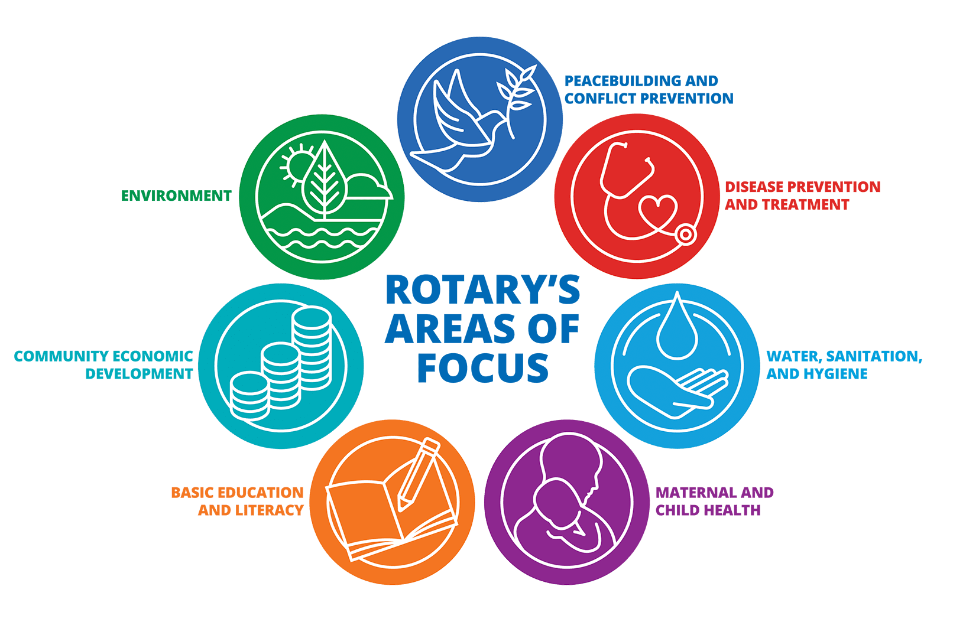
ROTARY ACTION PLAN: IMPACT, REACH, ENGAGEMENT AND ADAPT
DISTRICT GRANT
Help a community
GLOBAL GRANT
Make a bigger impact
OUR ACTION IS SERVICE ABOVE SELF

Slide 3
THE ROTARY FOUNDATION Funds Our Service Action
ENGAGES MEMBERS IN ACTIVE SERVICE
DISTRICT GRANT
Help a community
GLOBAL GRANT
Make a bigger impact

Slide 4
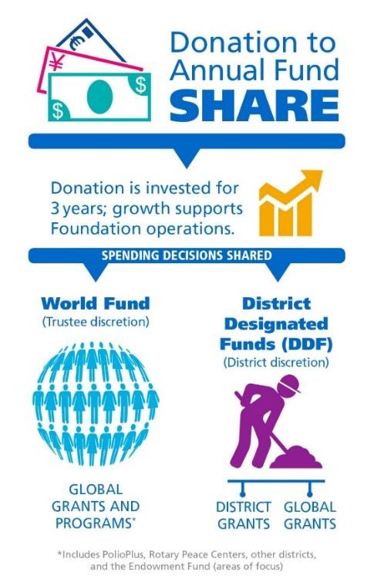
How Clubs & Rotarians Develop DDF
Annual Fund-SHARE – generates DDF, supports district and global grants
Polio eradication
Charity Navigator has given The Rotary Foundation it’s highest rating for 14 straight years

Slide 5
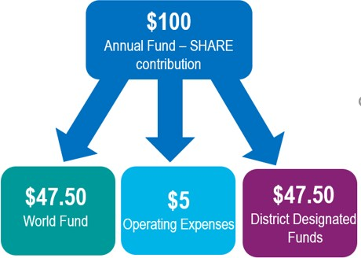
Annual Fund SHARE
<<<<<HELD for 3-years

