Slide 1

FOUNDATION BASICS
(TRF)
Notes:
Welcome Message

Slide 2
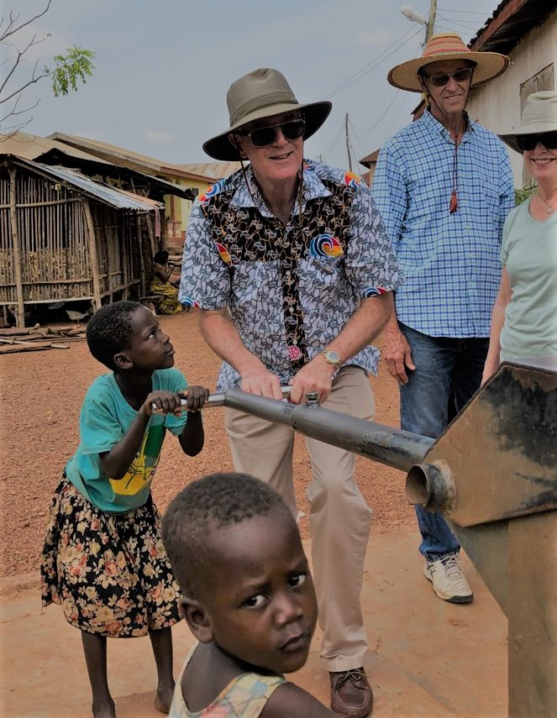

Objectives
Why Should Rotarians Give to The Rotary Foundation?
World Benefits of Giving
The Rotary Foundation Basics
Ways to Give & Get Member Recognition
District and Global Grants Overview
Types of Grant Programs
Sources of Foundation Education

Slide 3
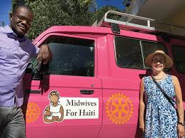
Key Takeaways
The Rotary Foundation Helps Clubs and Rotarians Serve their Community and Communities Around the World.
Education/Awareness Increases Giving
Participation in Grant Projects Strengthens Clubs
Help Rotary Make History - Support Polio Eradication

Slide 4
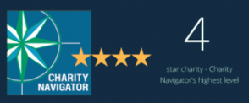
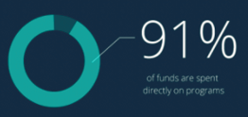
Why Give to The Rotary Foundation?
Helps Clubs ‘Do Good in the World’

Slide 5
TRF IS A GREAT CHARITY
Charity Navigator which ranks and evaluates charities gives TRF 4 Stars, its highest rating
Top marks in financial management, accountability and transparency
TRF spends:
  90.5% of its funds on projects
  6.4% on fundraising
  2.9% on administration

Slide 6
History of Foundation
Created in 1917
Nonprofit, Tax-Exempt Organization
Mission:
  Promote World Understanding
  Peace Through Humanitarian Programs
  Cultural Exchange

Slide 7
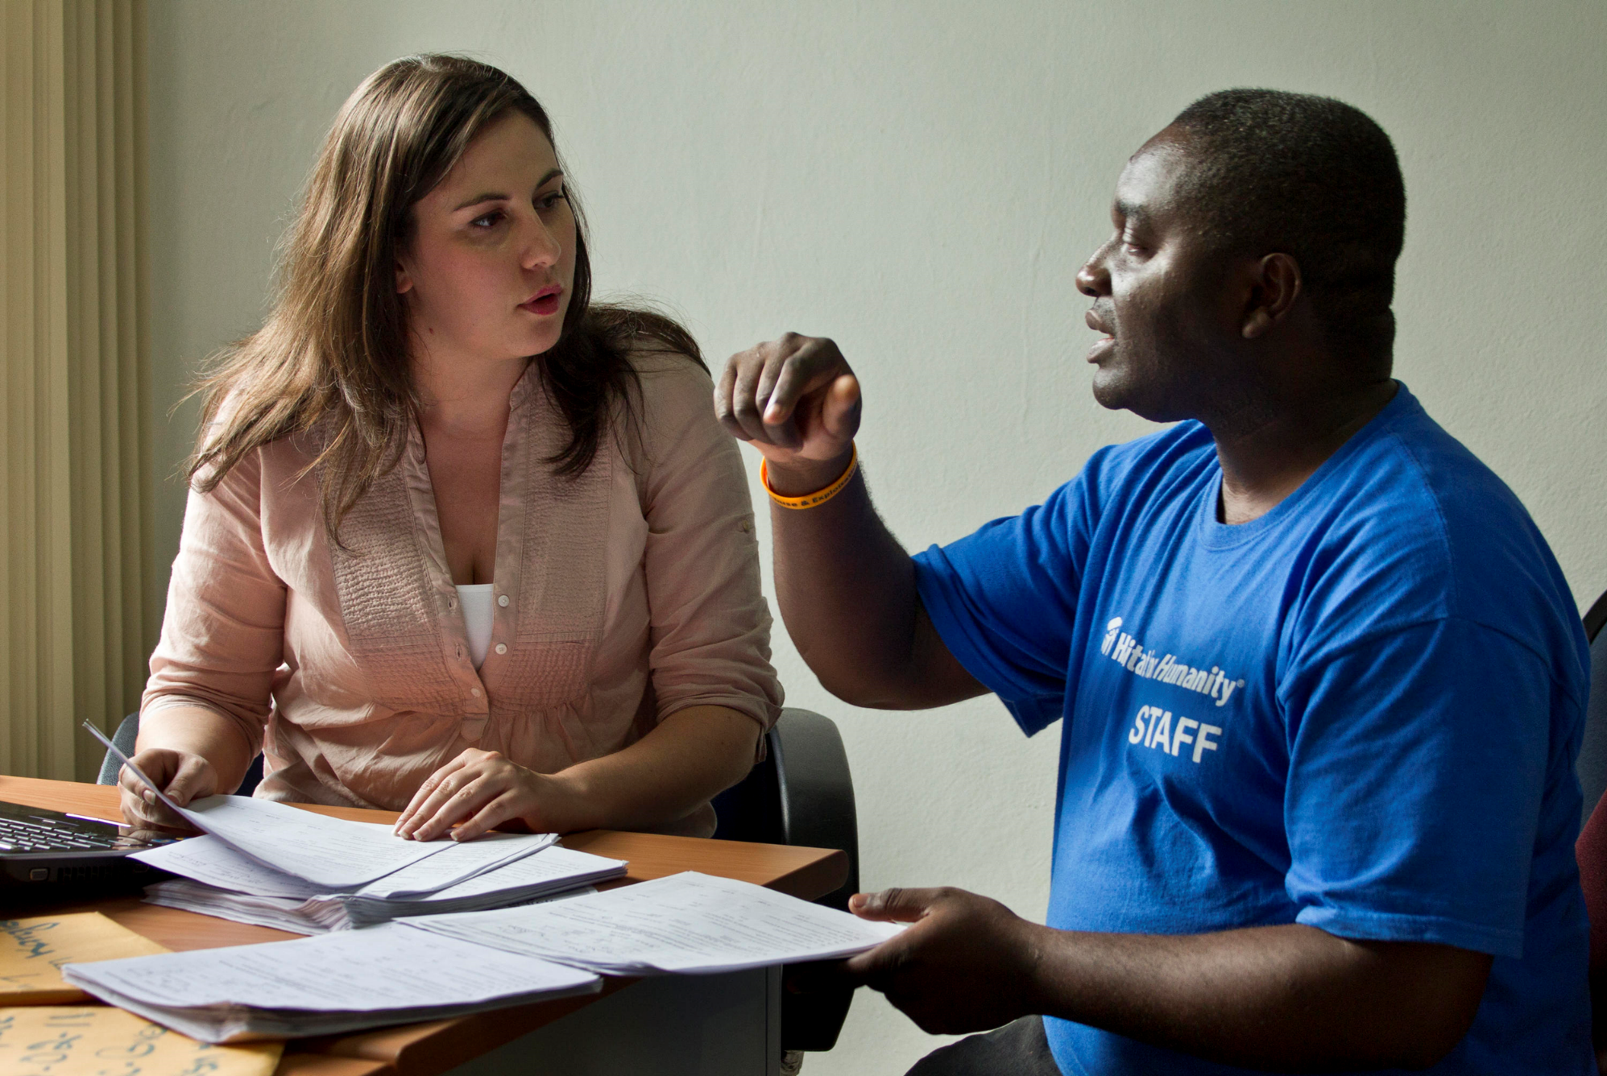
The Rotary Foundation
Mission Statement
The Rotary Foundation helps Rotarians:
to advance world understanding, goodwill, and peace by improving health, providing quality education, improving the environment, and alleviating poverty.

Slide 8
Examples of Benefits of Giving
Vocational training for teachers in South Africa
Clean water and toilets for schools in India
Research in Italy on new treatments to reduce infant mortality worldwide
Peace-building seminars in Uganda to combat ethnic conflict
Anti-malaria programs in Mali
Elimination of Polio
Doctor Training in Israel

Slide 9
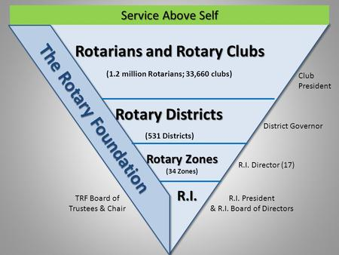
How does the McLean Club fit into the Rotary Foundation Structure?
1.2 M Rotarians; 36,400 Clubs
214K Rotaractors, 11K Clubs

Slide 10
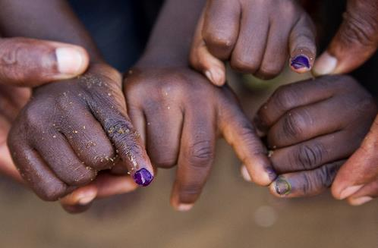
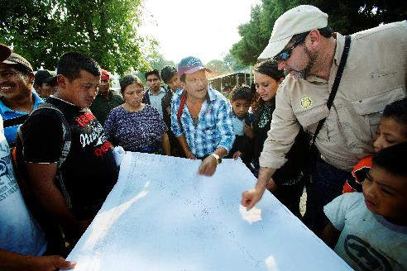
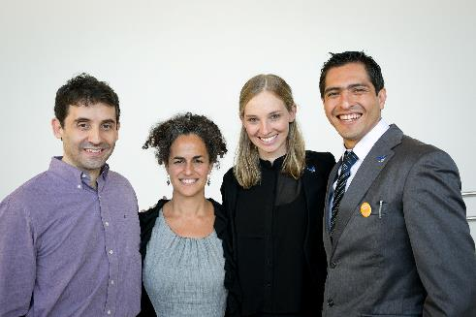
The Rotary Foundation
PolioPlus Fund
End Polio Now
Annual Fund
For Support Today
Endowment Fund
To Secure Tomorrow

Slide 11
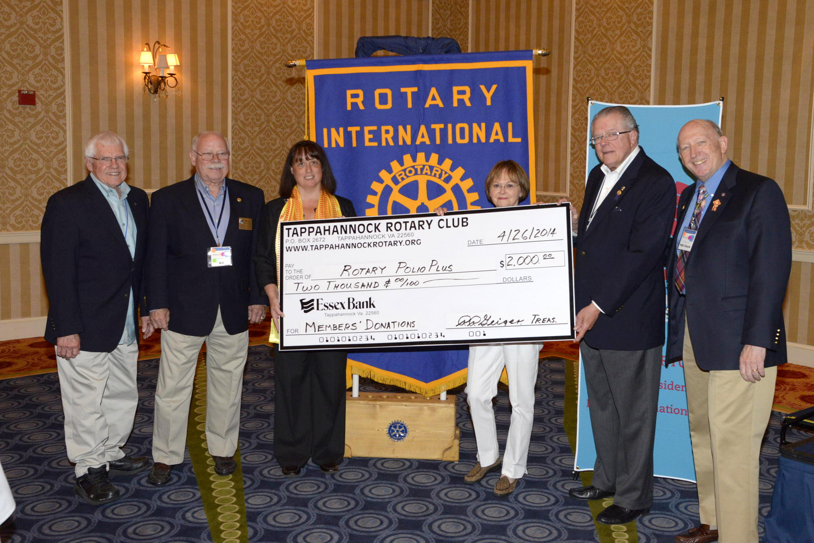

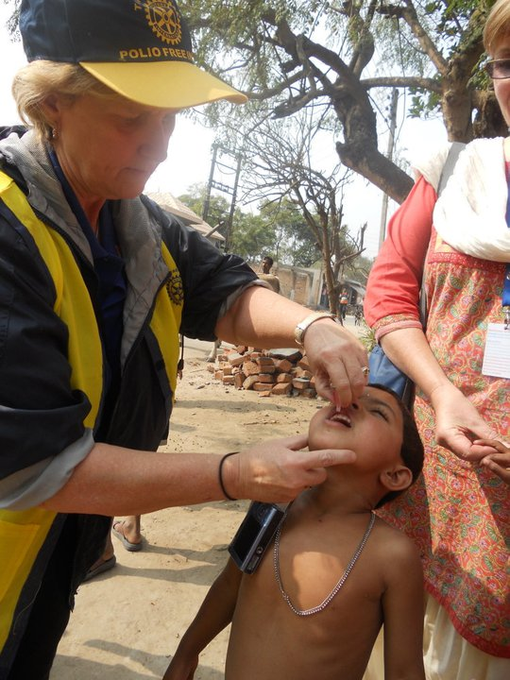
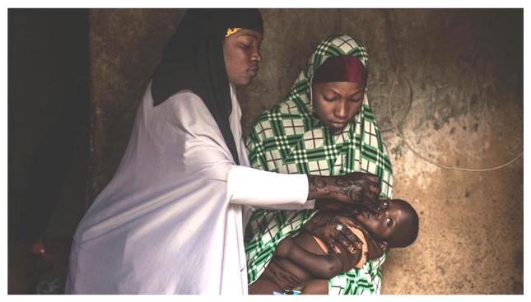
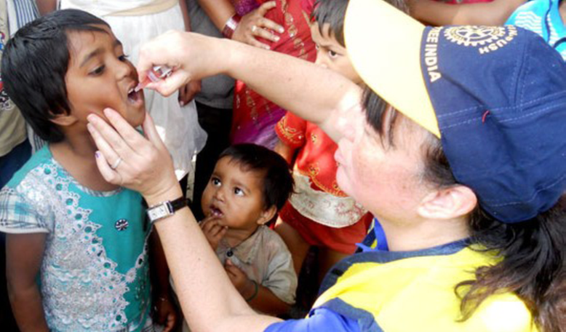
END POLIO NOW: MAKE HISTORY TODAY
Notes:
Rotary’s own financial support for PolioPlus will be magnified by an agreement with the Bill & Melinda Gates Foundation.
From 2013 to 2018, every $1 that Rotary commits in direct support of polio immunization (up to $35 million per year) will be matched by an additional $2 from the Gates Foundation. This means contributions to Rotary’s PolioPlus program will have three times the impact.

Slide 12
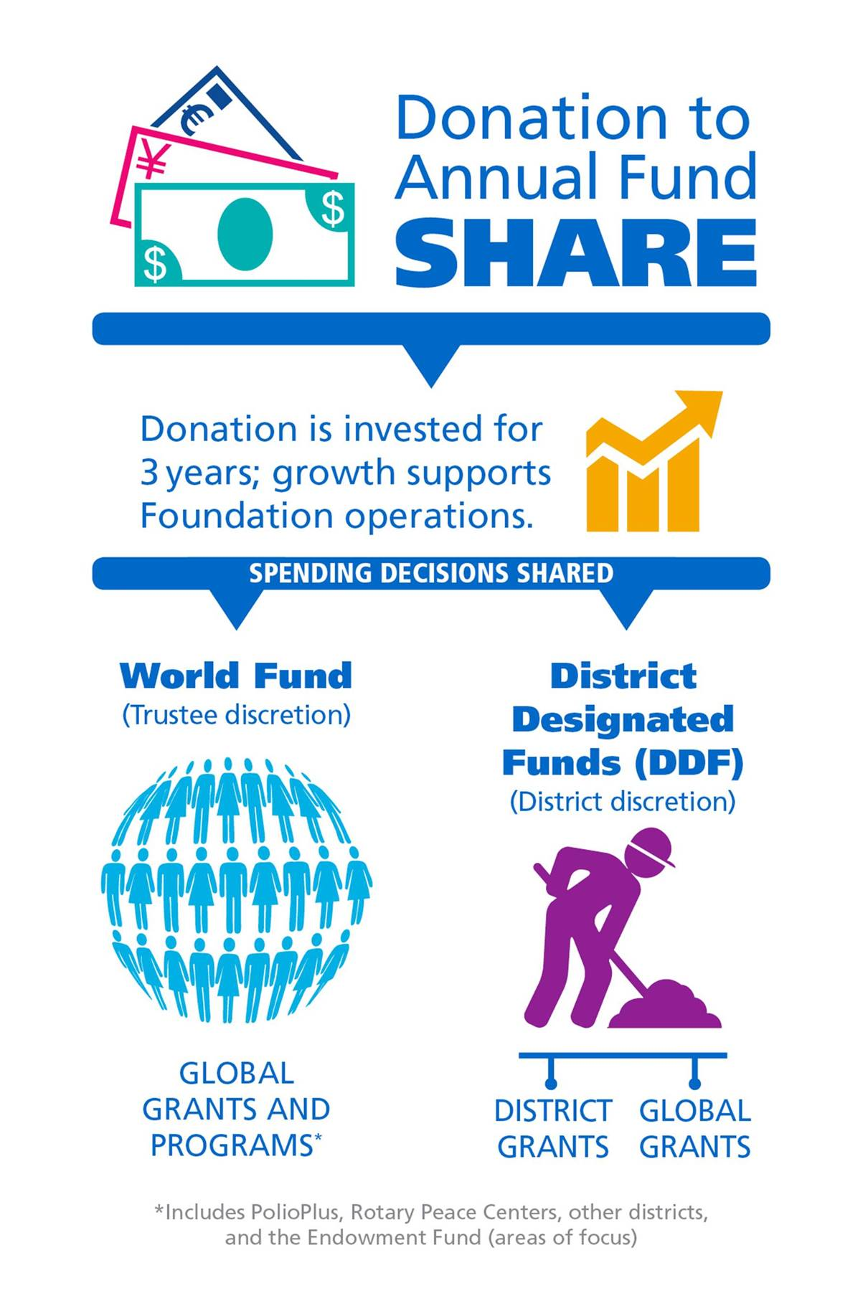
Annual Fund SHARE

Slide 13
Annual Fund
SHARE
$1,000
Earnings pay for
TRF
administration
YEAR 1
5% = $50
YEAR 2
YEAR 3
S
World Fund
District Designated Fund (DDF)
47.5% = $475
47.5% = $475
Share

Slide 14

Areas of Focus

Slide 15
Previous Foundation Grants (2019)
Preventing Disease $40.3 Million
Clean water $20.9 Million
Education $12.5 Million
Economic Development $11.7 Million
Maternal/Child Health $8.9 Million
Promoting Peace $3.4 Million
TOTAL $97.8 Million

Slide 16
Types of Member Contributions & Recognition
Rotary Foundation Sustaining Member ($100)
Paul Harris Fellow ($1,000)
Multiple Paul Harris Fellow ($2,000-$9,999)
Paul Harris Society ($1,000 annually)
Benefactor ($1,000 contribution to Permanent Fund)
  or a Provision for the Permanent Fund in estate plan)
Bequest Society (at least $10,000 in estate plan)
Major Donor (at least $10,000 in outright giving)
Arch C. Klumph Society (at least $250,000 in giving)

Slide 17
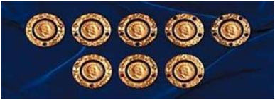
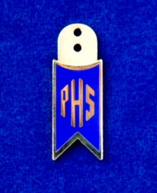
Donor Recognition Saying Thank You!
Paul Harris Fellow
Paul Harris Society
Rotarians can achieve PHF Levels through PHF +8:
Personal Contributions
Receiving Points from other Rotarians
Club and District Match Programs
A Rotarian receives PHS recognition when they notify TRF of their intention to contribute $1,000 cash each year to the Annual Fund, PolioPlus, or Approved Global Grants

Slide 18
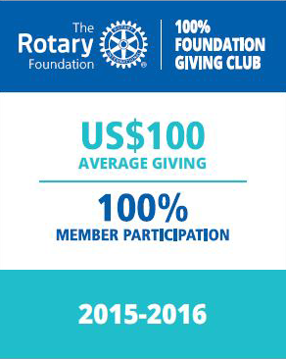
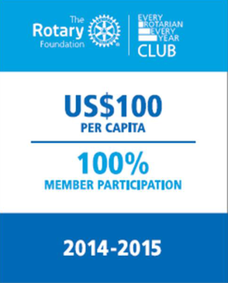

CLUB RECOGNITION
100% Foundation Giving Club
100% Members Give to any TRF Fund as of June 30;
$100+ Average. $25 minimum
100% Every Rotarian Every Year
100% Members Give to Annual Fund as of June 30;
$100 average, $25 Minimum
100% Paul Harris Society Club
100% Members Give to any TRF Fund except Endowment as of June 30;
$1,000+ Minimum

Slide 19

How Does The Endowment Work?
Gifts Are Invested Forever
Generate Earnings In Perpetuity
Personalize Your Gift
Long Term Impact
Numerous Funding Opportunities

Slide 20

Donor Recognition “Benefactor”
Saying Thank You!
Benefactor is the recognition of individuals and or couples for an outright gift or future commitment through estate plans of $1,000 or more to the Endowment Fund.

Slide 21
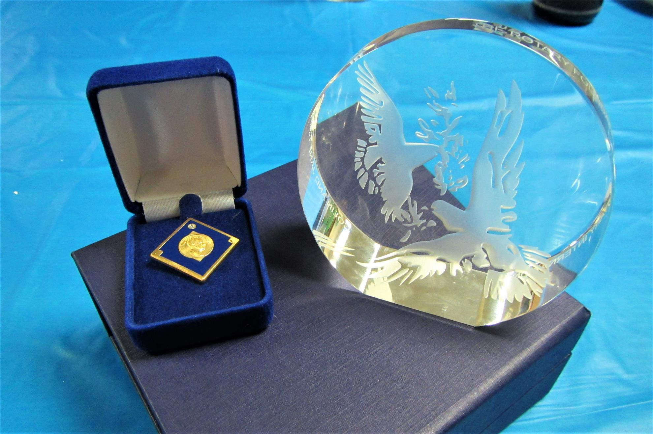
Major Donor Recognition
Saying Thank You!
Major Donor recognition is achieved through cumulative contributions by individuals or couples and cannot be combined with recognition points.
  Major Donor Level One $10,000 to $24,999
  Major Donor Level Two $25,000 to $49,999
  Major Donor Level Three $50,000 to $99,999
  Major Donor Level Four $100,000 to $249,999

Slide 22
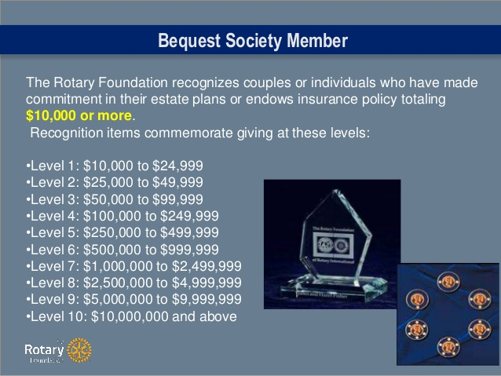
Donor Recognition
Saying Thank You!
Bequest Society recognizes individuals or couples who have made a commitment in their estate plans totaling $10,000 or more to the endowment
Bequest Society Level One $10,000 to $24,999
Bequest Society Level Two $25,000 to $49,999
Bequest Society Level Three $50,000 to $99,999
Bequest Society Level Four $100,000 to $249,999
Bequest Society Level Five $250,000 to $499,999
Bequest Society Level Six $500,000 to $999,999
*Bequest Gifts are Revocable *

Slide 23
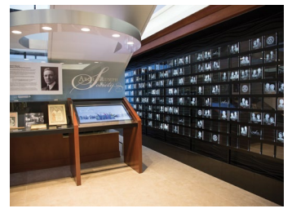
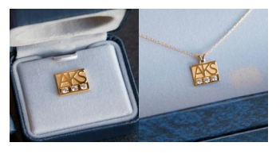
Donor Recognition “AKS”
Saying Thank You!
Arch Klumph Society is the recognition of individuals or couples whose personal cumulative giving is $250,000 or more.
  New members are invited to a special induction ceremony. The Arch Klumph Society Gallery resides on the 17th floor of Rotary International World Headquarters in Evanston, Il. Portraits, biographies, and videos are housed in this special recognition gallery.
  Trustees Circle $250,000 to $499,999
  Chair’s Circle $500,000 to $999,999
  Foundation Circle $1Million to $2,4999,999
  Platinum Trustees Circle $2.5Million to $4,999,999
  Platinum Chair’s Circle $5 Million to $9,999,999
  Platinum Foundation Circle $10 Million and above

Slide 24

Donor Recognition
“Legacy Society”
Saying Thank You!
Legacy Society is the recognition of individuals and or couples who have substantiated a future gift of $1 Million or more to the Endowment.
Legacy Society members receive special recognition items and all the benefits provided to Bequest Society members.

Slide 25
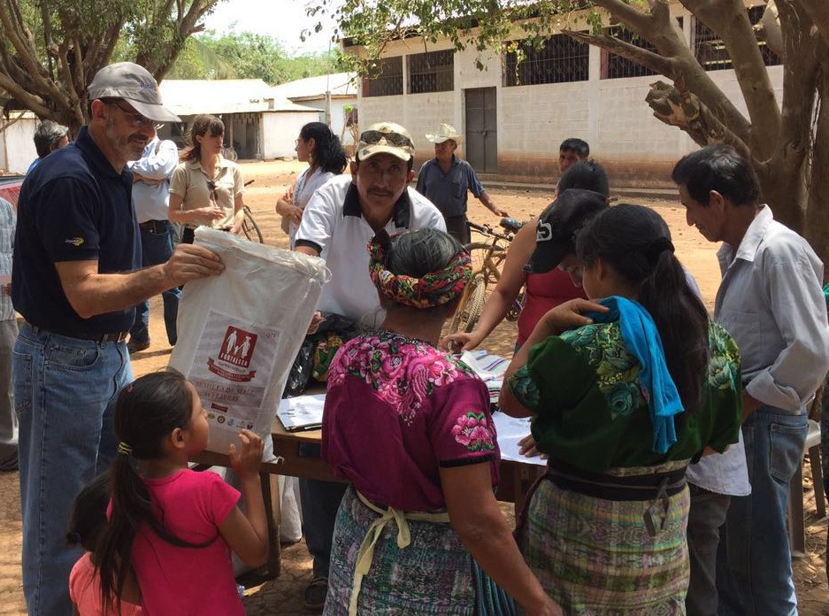
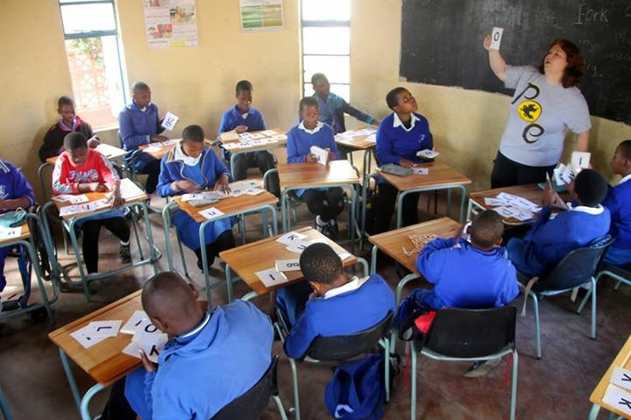
Rotary Foundation Programs
EDUCATION
  Global Scholarships
  District Scholarships
  Vocational Training Teams
  Peace Fellowships
GRANTS
  Global
  District
Notes:
Humanitarian Grants are categorized into District and Global. The funding is allocated for District and Global Grants differently.
District Grants
Local or international activities
Local decision making, broader guidelines
Smaller activities and projects
Global Grants
Align with one of the Areas of Focus
Long term, sustainable benefits
Measurable results
Budgets of at least $30,000
Educational Programs
VTT – Vocational Training Teams
Global Scholarships
Peace Fellowships
District Scholarships

Slide 26
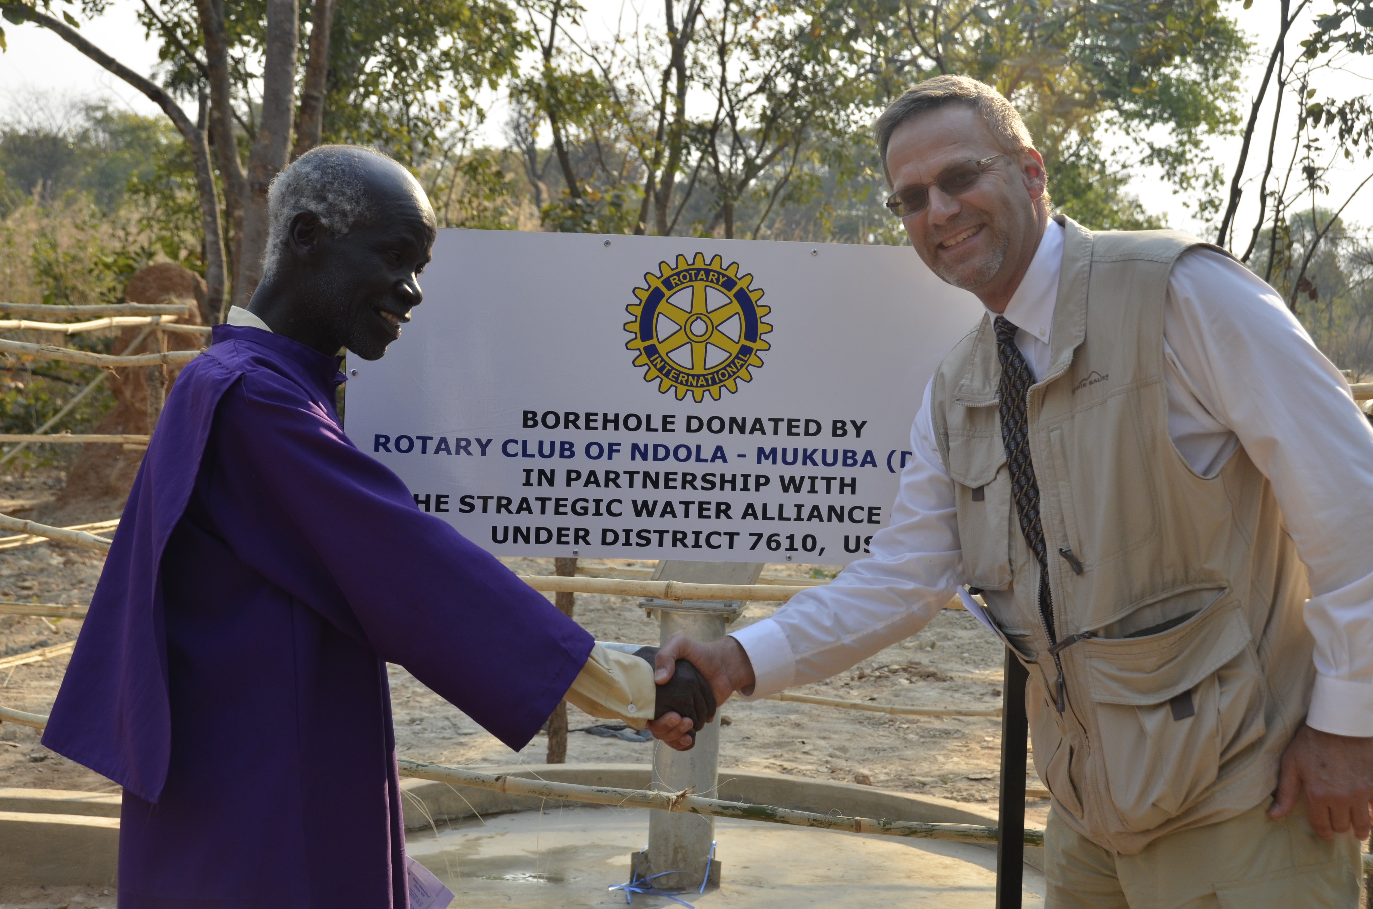
Features of Global Grants
Meet Goals of Areas of Focus
Involve Rotary clubs in two districts
Have long term sustainable benefits
Produce measurable results
Minimum budget of $30,000
Online application through TRF
Clubs must be qualified

Slide 27
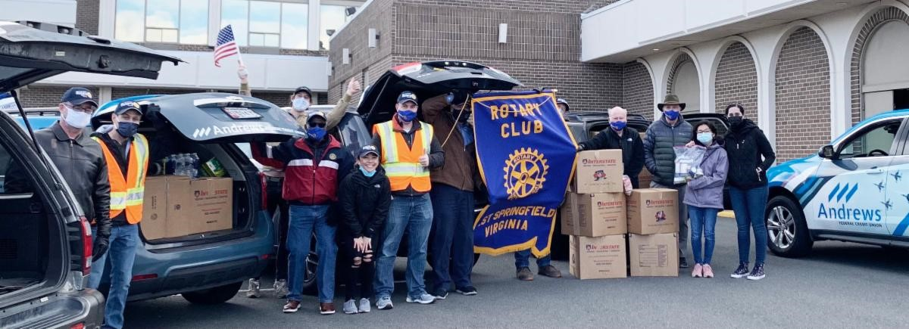
District Grants
Single block grant – process varies by district
Based on district spending plan submitted to TRF
Can fund with up to 45% of current year’s DDF
Same uses as global grant but less restrictive:
  Smaller scale; short term
  Area of focus not required but recommended
  Can be local or international
  Partner club not required
  No World Fund match

Slide 28
Funds Not Allowed For:
The purchase of land or buildings
Construction or renovation
Salaries, stipends, or honoraria for individuals
Post-secondary education activities, research, or professional development

Slide 29
Scholarships
Global Grant:
Funded by global grant – meets same criterion
  Areas of Focus
  Must meet $30,000 minimum
Recipient studies at foreign institution
Studies are graduate level
District Grant:
Funded by DDF
Smaller scale
Can be local or international
Can be any level

Slide 30
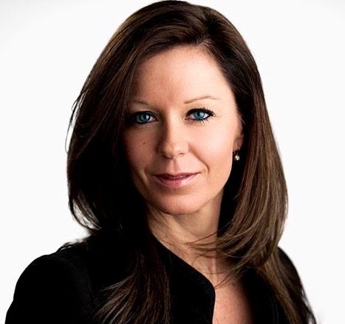

GLOBAL GRANT SCHOLARSHIPS
Graduate level
Study periods of 1-4 years
Alignment with the areas of focus
  Previous work, volunteer, and study experience
  Academic program
  Future career plans (immediate and long-range)
Host and international sponsors
$30,000 minimum budget
Clubs recruit candidates

Slide 31
OVERALL WE CAN DO BETTER
In 2018-19 our District gave $877,198 to TRF
After 3 years (2021-22), we will receive back $438,599
Remember that this year (2020-2021), we are only receiving back $264,500 because we contributed less three years ago

Slide 32
The Rotary Foundation Resources
Rotary Support Center 866-976-8279
Rotary Videos
My Rotary.org
  Reports, Forms, Information
Rotary Learning Center
  Online, On Demand
Rotary Publications
  The Rotary Foundation Reference Guide
  Understanding Foundation Recognition Points
  Annual Reports
  123 Contribution Form
  Rotary Direct FAQ’s
Rotary Staff

Slide 33
Thank You!

