Slide 1
Club Overview

Slide 2
Club Leadership
Committee Chairs & Club Services
Foundation Chair – Johnny Chapman
Membership – Erica Lengermann
OO – Annette Gutsmiedl, Pete Eisert
Scholarships – Georgia Graves & Rich McCary
Programs – Rich Langguth, Christina Krogh
Strategic Water Alliance – Andrew Wade
Grants –
Public Relations/Website – Lorie Grooms and Jim Church
Photography – Dave Kirby
Gun Raffle – Dave Evans
Service Projects – Will Danzler
New Generations – Pete Eisert
Rotary Club
President – Dave Humphries
Past Pres. – Pete Eisert
Pres-Elect – Dave Evans
Secretary – Dave Evans
Treasurer – Debby Bailey
Sgt-at-Arms – John Ohrnberger
Dulles Foundation Club
Jim Church
Rich McCary
Satish Chauhan
Andrew Wade
Jerry Guido

Slide 3
Our Beneficiaries, Charities and Partners
Beneficiaries & Charities
Four local charities:
ECHO,
ServiceSource
ARC of NOVA
ARC of Loudoun
Scholarship recipients
Cops and Kids
Shelter Box
Rotary Foundation
Strategic Water Alliance
Honor Air
Interact
Club Grants
Partners
German Armed Forces Command
Fraternal Order of Police, Lodge 69
Strategic Water Alliance
Interact Clubs
ECHO
ServiceSource
ARC of NOVA
ARC of Loudoun
District 7610
Holt International

Slide 4
Club Finances
Rotary Club of Dulles International Airport
Treasurer: Debby Bailey
Purpose:
Receive, administer and disperse the Club operating budget
Collect dues and pay bills for the day to day activities of the Club that are not associated with charitable contributions or disbursements
Dulles Foundation Cub
Treasurer: Rich McCary
Purpose:
Act as 501c3 to receive, administer and disperse charitable funds
Responsible for all charitable project funding – Club members run the committees and the DFC manages the money
The DFC is managed by Rotary Club members for the benefit of our donors and beneficiaries

Slide 5
Club Activities Timeline
Wine Dinner
Annual Forecast
OO*
German Beer Night & Walk for Water
2016
Jan | Feb | Mar | Apr | May | Jun | Jul | Aug | Sep | Oct | Nov | Dec
Scholarship Goals
Honor Air
Annual Forecast
Cops and Kids
And
Christkindlmarket
Honor Air
2017
Jan | Feb | Mar | Apr | May | Jun | Jul | Aug | Sep | Oct | Nov | Dec
OO
Scholarship Awards
Interact Stipends
Scholarship Checks
*OO – Opportunities Open Golf Tournament

Slide 6
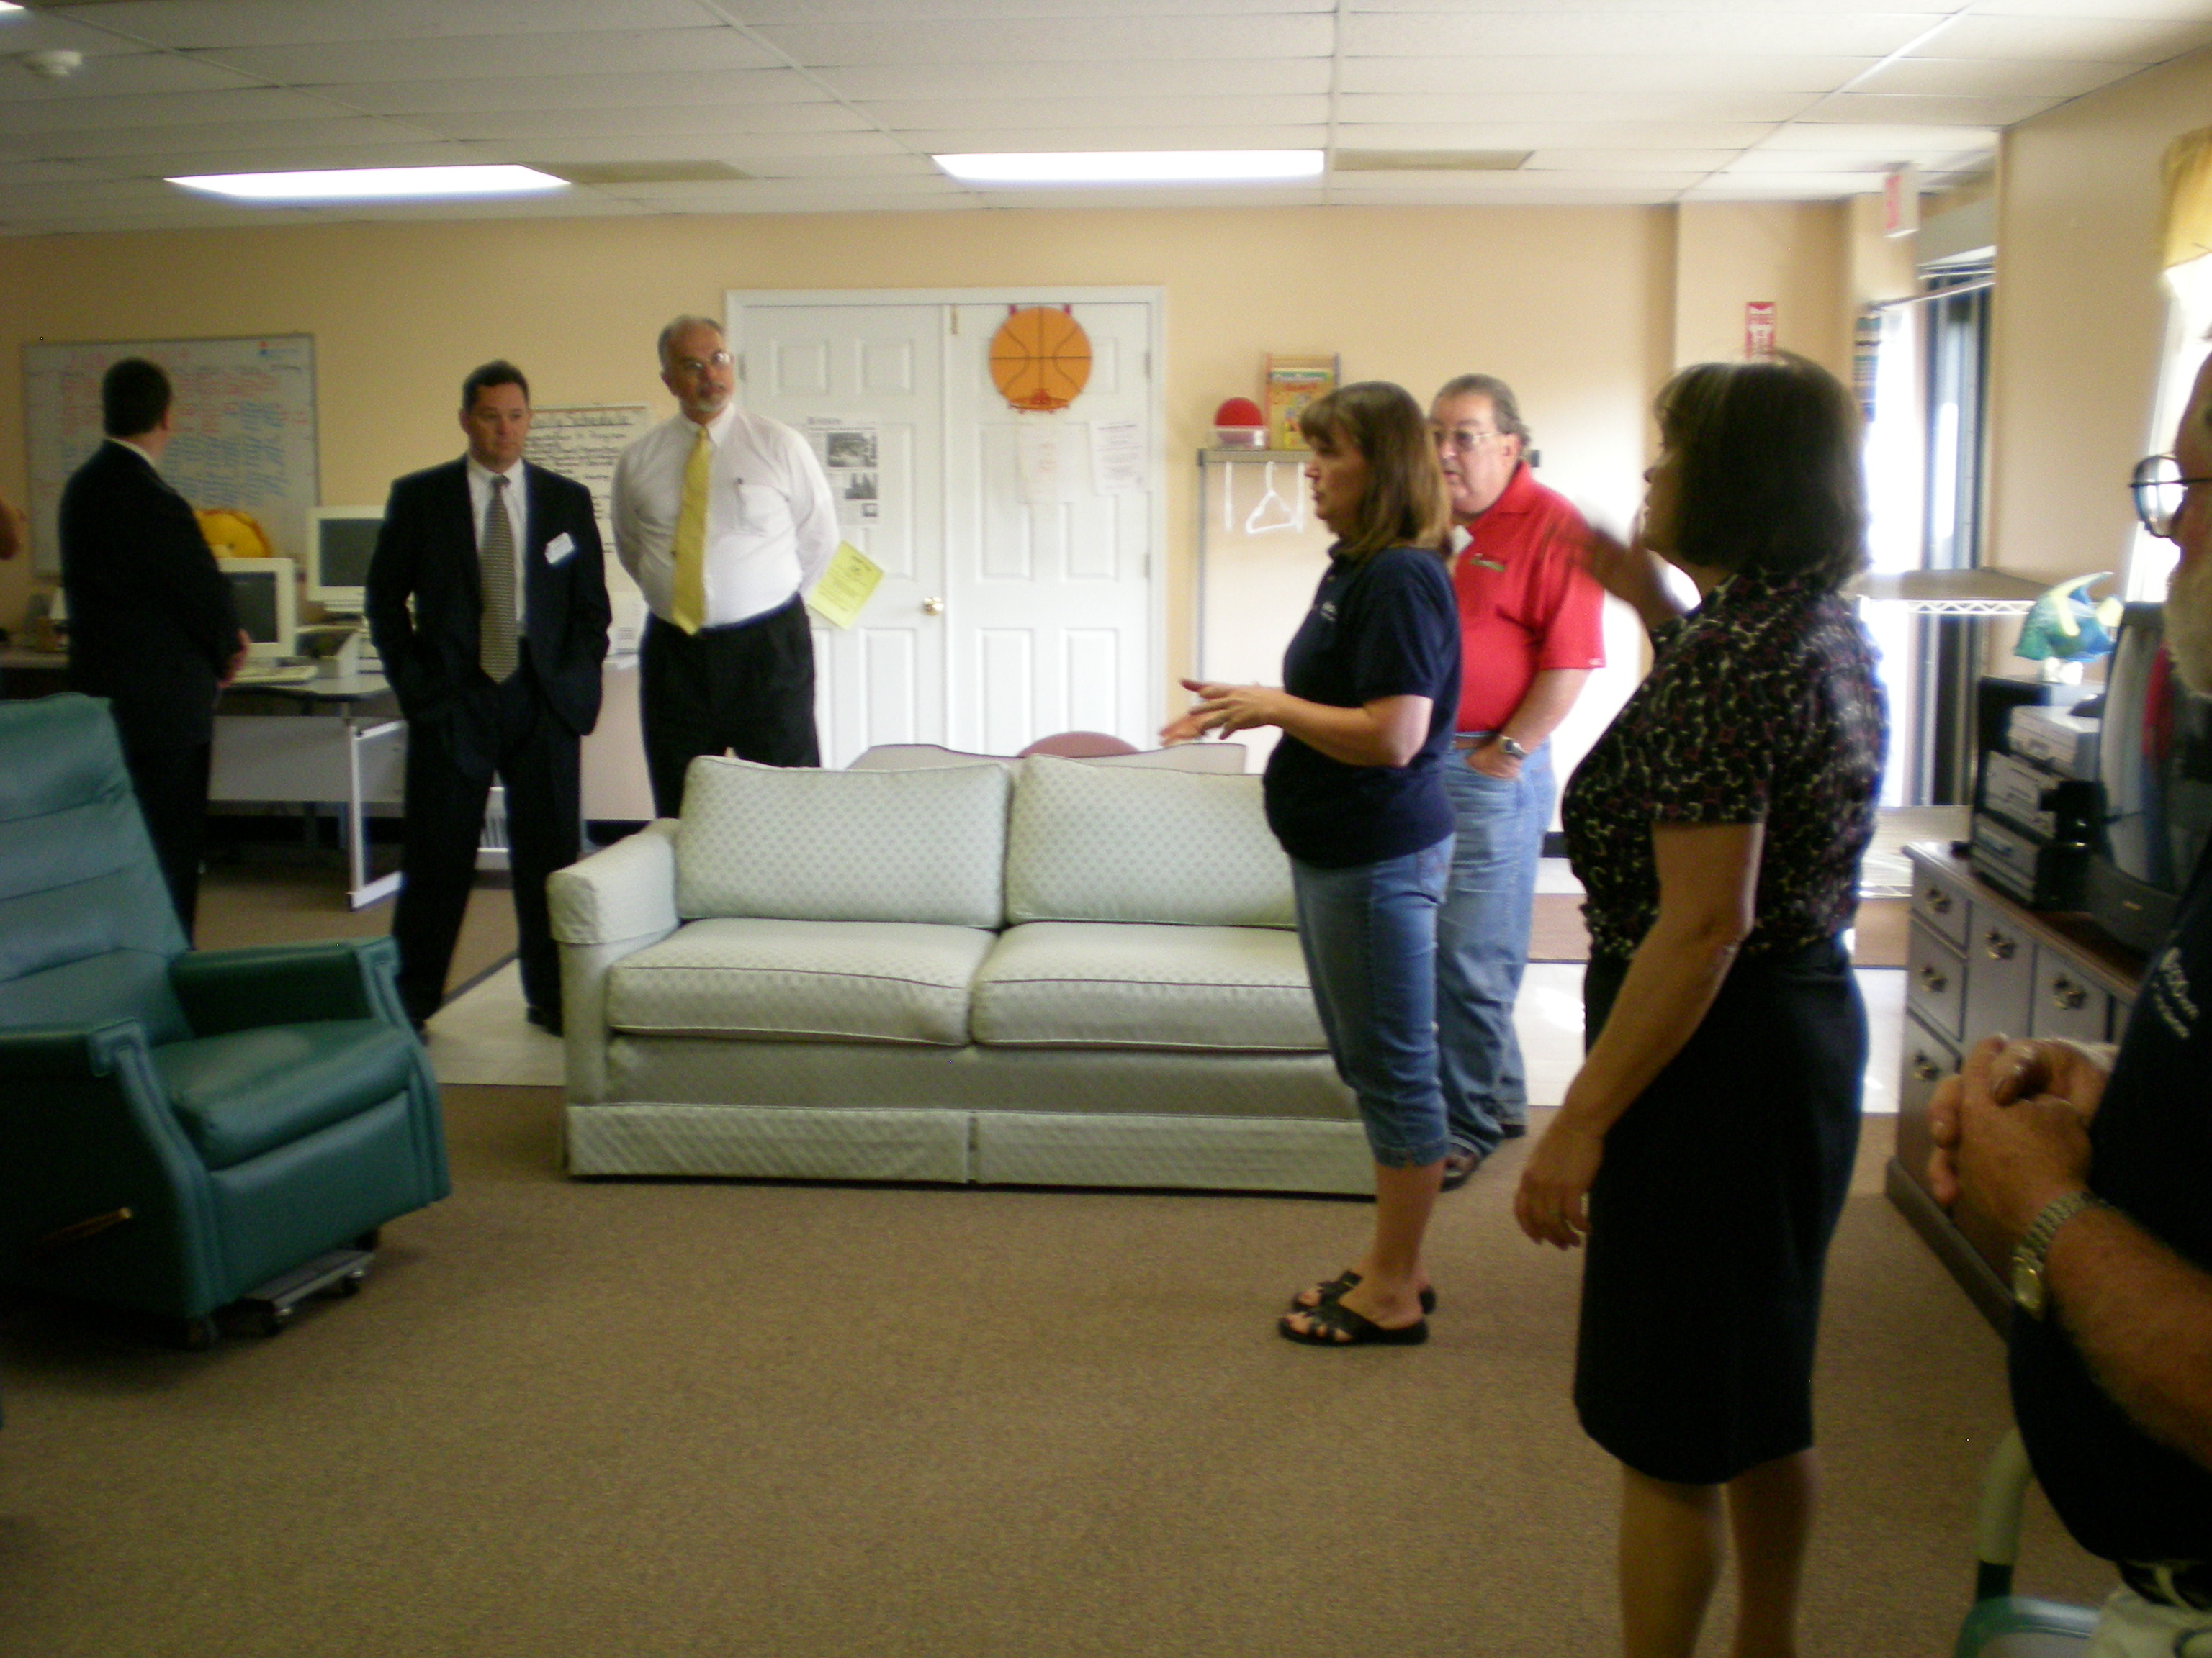
Opportunities Open
Committee
Events
Chair: Annette Gutsmiedl
3 October 2016
Discussion Points
Committee members
Marketing materials
Sponsorships
Ticket sales
Volunteers

Slide 7
German Oktoberfest
Committee
Events
Host: Oberst Joachim W. Bohn
22 September 2016
Discussion Points
Attendance encouraged
We have a great mutually supportive relationship with the GFAC

Slide 8
Christkindlmarket
Committee
Events
Host: Oberst Joachim W. Bohn
December 2016
Discussion Points
Attendance encouraged
Fun, fellowship, shopping

Slide 9
Scholarships
Committee
Events
Chair: Georgia Graves & Rich McCary
Committee formation December 2016
Selections May 2017
June – July breakfast with recipients
Budget
Budgeted: $10,000
Discussion Points
New committee members are welcome

Slide 10
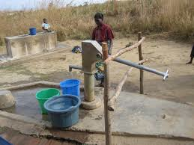
Strategic Water Alliance
Committee
Events
Chair: Andrew Wade
Walk for Water 25 September at Burke Lake Park
Budget
$ 12,000 to Foundation
$ 100 Club contribution
Discussion Points
More member engagement encouraged

Slide 11
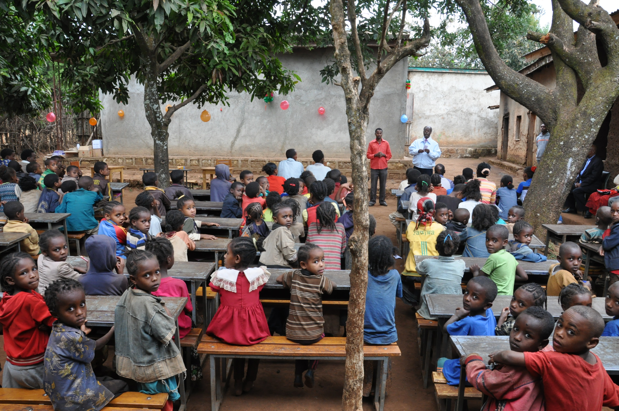
Grants
Committee
Events
Migrant Children Bangalore India
Past Grants:
Ethiopia Hearing Impaired School
Womens’ Income Generation – Uganda
Family Preservation - Ethiopia
Chair: Will Danzler
Discussion Points
We raise money for this – minor expense with a big payoff
Grant writing is the major exercise
Club member participation is needed

Slide 12
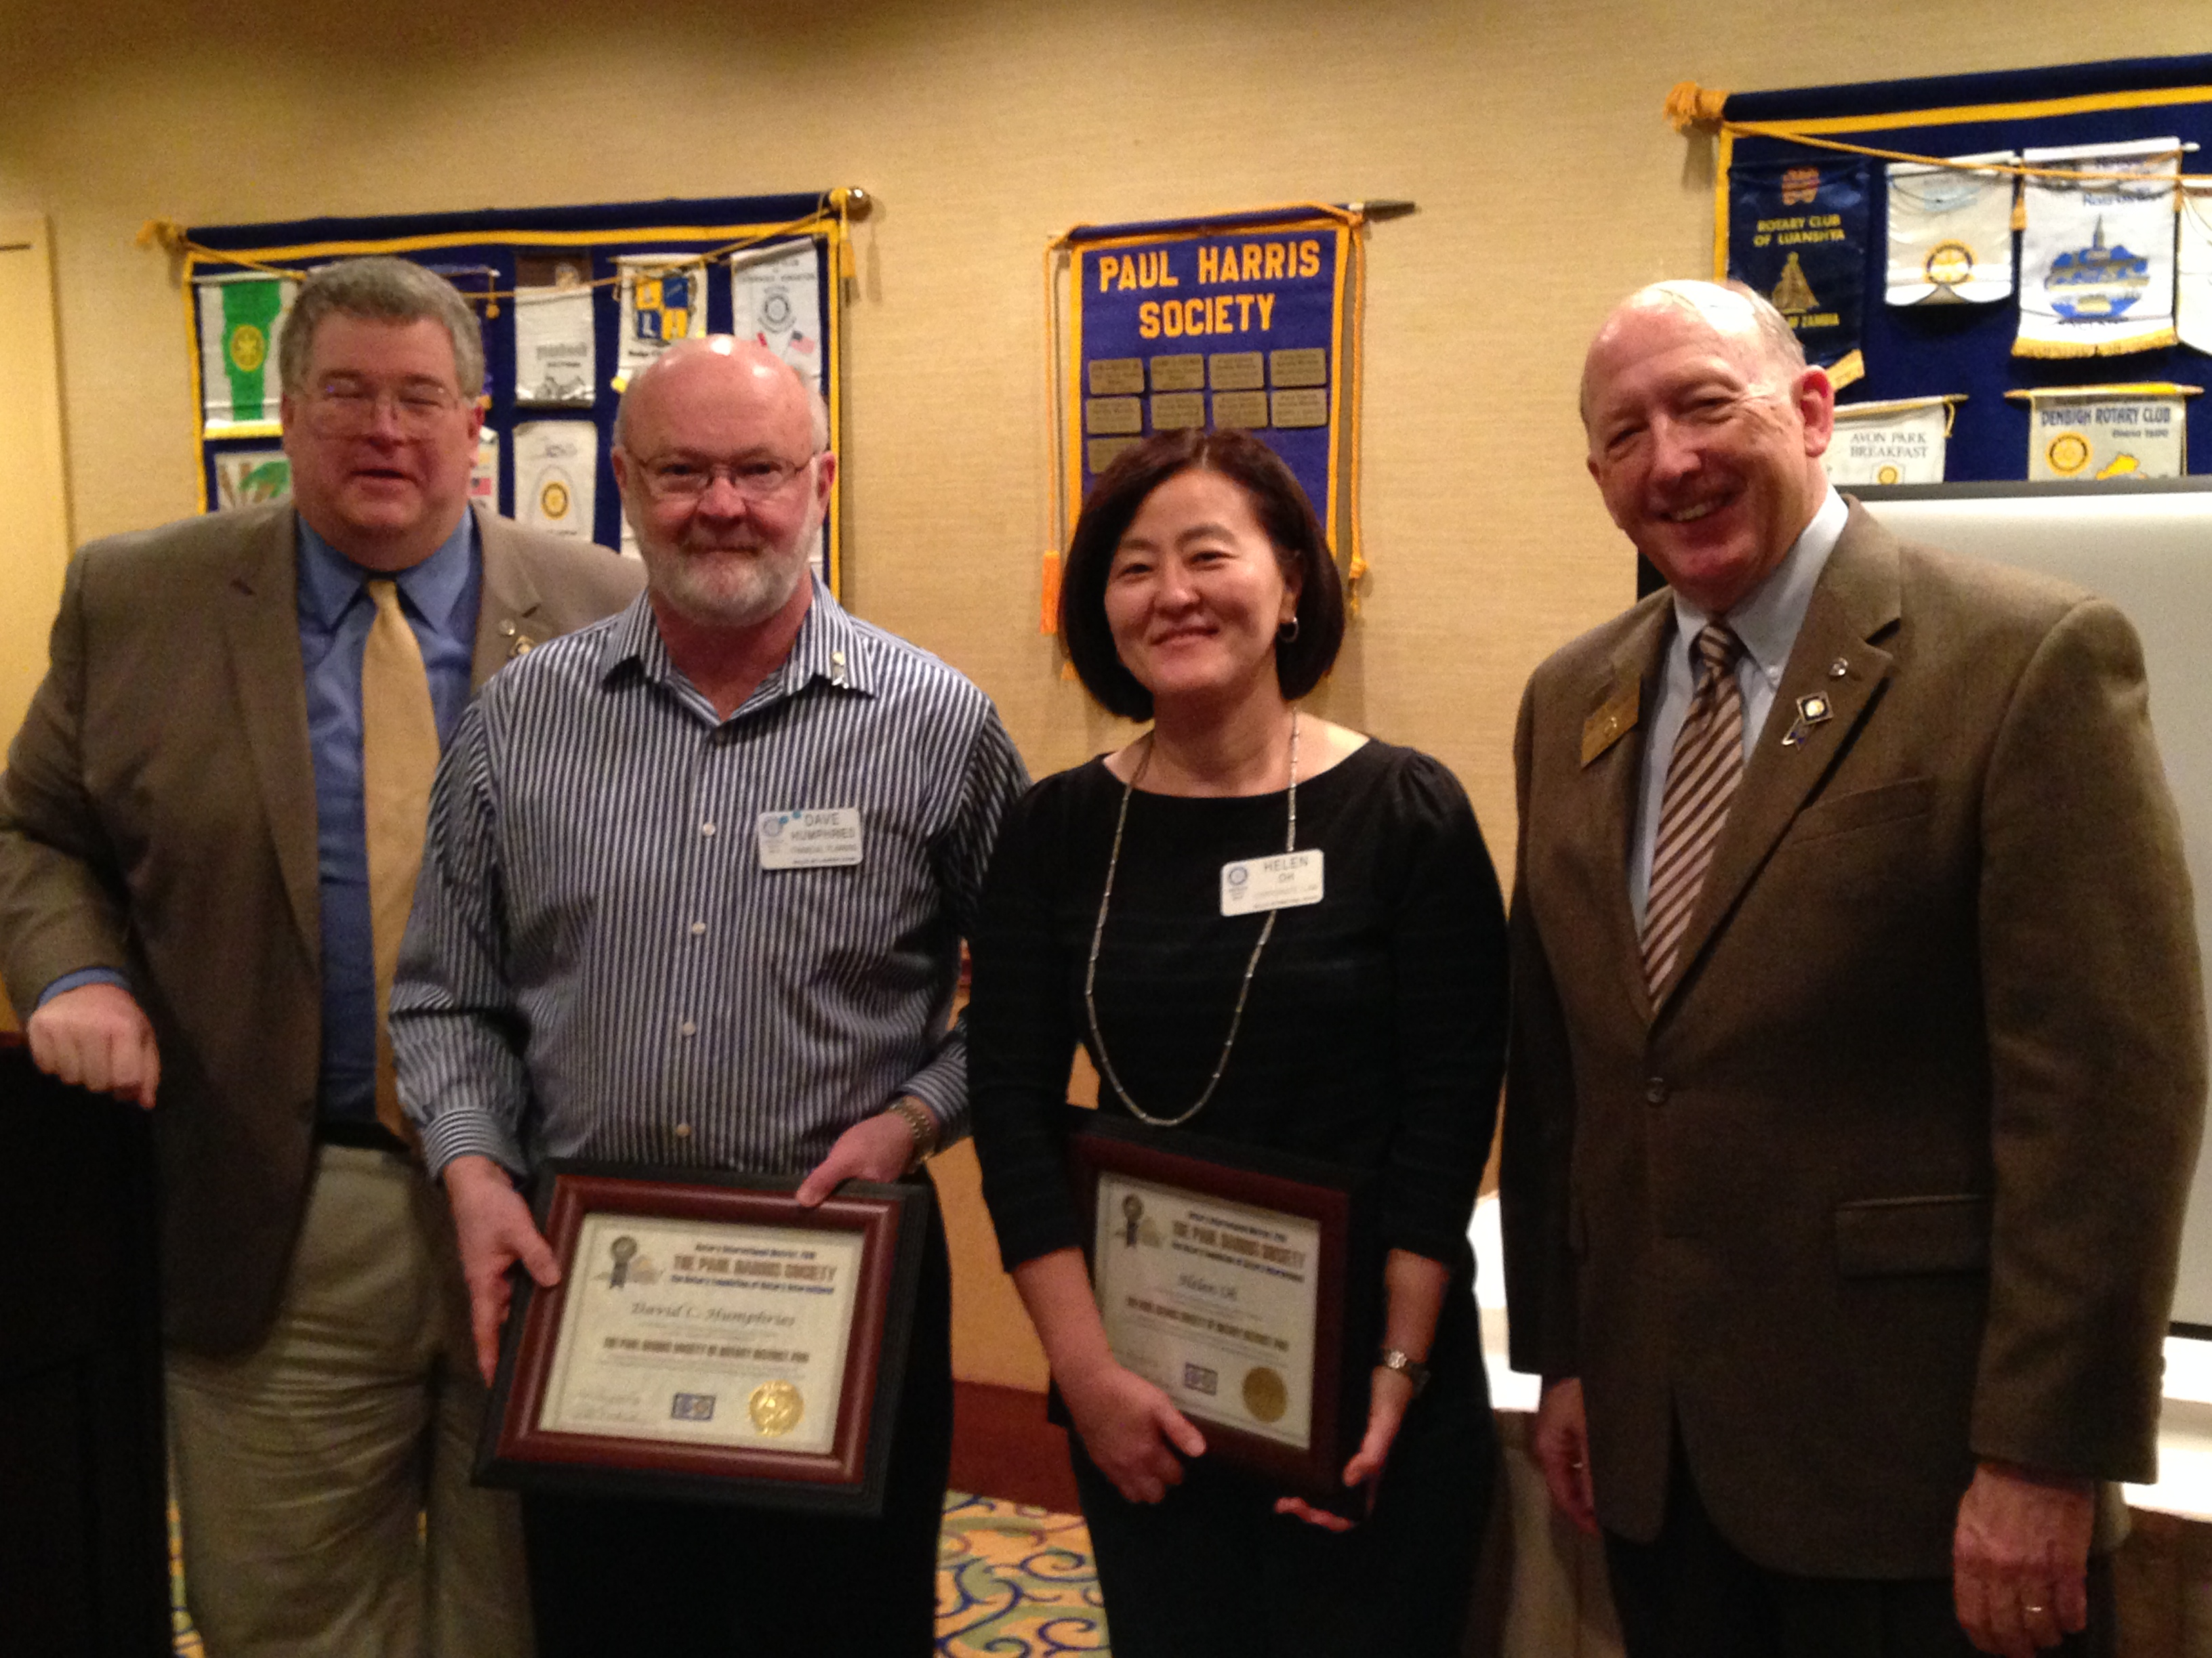
Rotary Foundation
Committee
Chair: Johnny Chapman
Budget
Goal: $ 12,000
Discussion Points
Ask Johnny why this is a good idea!

Slide 13
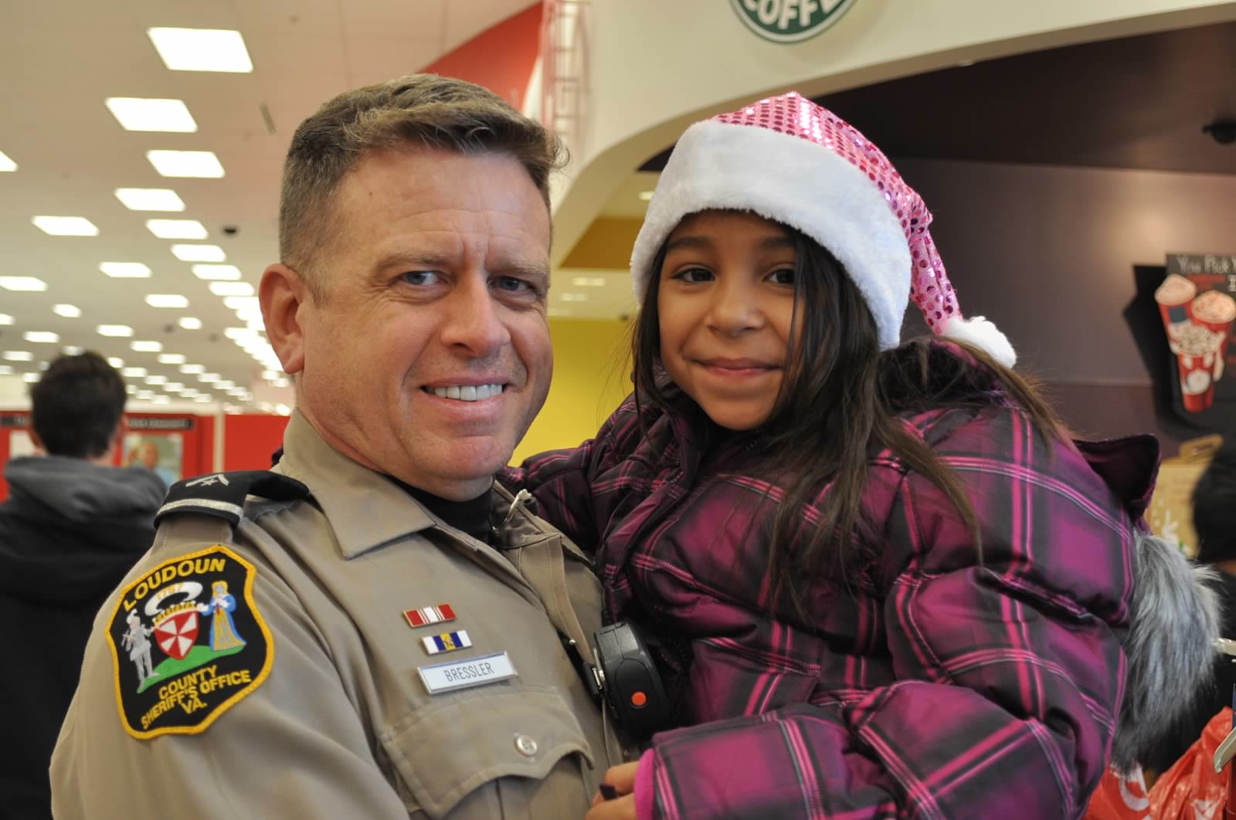
Cops and Kids
Committee
Events
Chair: John Ohrnberger
December 2016
Discussion Points
This is a member supported event --- time and activity
Support for this event helps provide @120 children and their families with a happy Christmas season

Slide 14
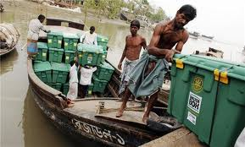
Shelter Box
Committee
Events
Wayne Chiles is the District POC
Wayne has supported us a numerous activities to help with public outreach
Chair:
Discussion Points
Great and noble cause.

Slide 15
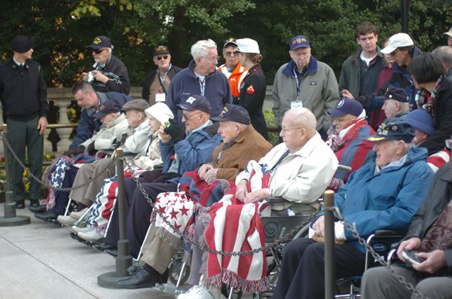
Honor Air
Committee
Events
Chair:
October 2016 and May 2017
Budget
$ 500
Discussion Points
We have paid for oxygen for the vets.

Slide 16
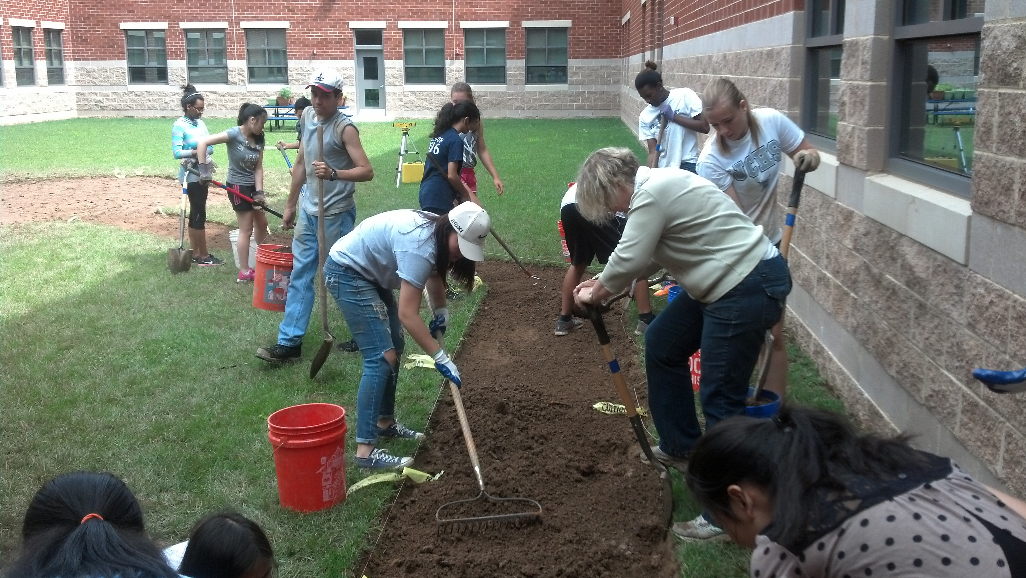
Interact
Committee
New Generations Chair: Pete Eisert
Events
Entering the summer season so there will be a lull in activity until the fall.
Budget $1800
Purpose: to teach and inspire high school students to adopt the Rotary ethic and dedication to service above self.
- John Champe HS
- Tuscarora HS

Slide 17
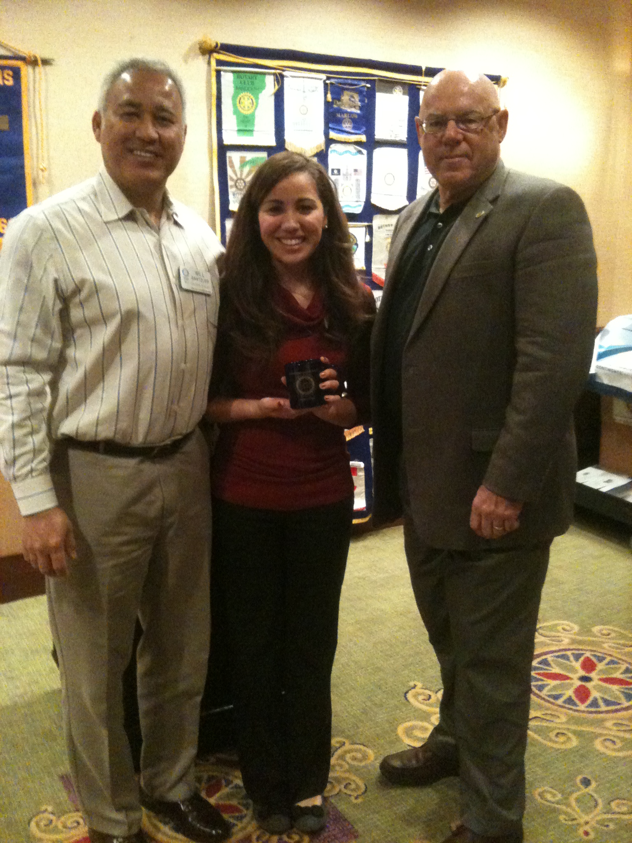
Speakers
Committee
Events
Chair: Rich Langguth, Christina Krogh
Three Fridays/month
Discussion Points
Everyone can help bring in good speakers

Slide 18
Scouting
Committee
Events
Chair:
Rotary Day?
We sponsor:
Crew 58
Pack 0965
Pack 1151
Pack 1158
Troop 1158
Discussion Points
This is a sponsorship
Little club member engagement
Should/can we do more?

Slide 19
Membership
Committee
Events
Chair: Erica Lengermann
What’s next?
Discussion Points
Goal: Become a 50 member club?

Slide 20
Public Relations, Website and Social Media
Committee
Events
Chair: Lorie Grooms
Member: Jim Church
Capture upcoming events – OO, Oktoberfest, Cops and Kids, etc.
Discussion Points
This is a growth area: We can use your help to enhance our marketing and public outreach.
Messaging and connectivity to our other social media outlets in important
Contributors?
Public relations
Member access and information
Calendar

Slide 21
Public Relations, Website and Social Media
Committee
Events
Chair: Lorie Grooms
Member: Jim Church
Capture upcoming events – OO, Oktoberfest, Cops and Kids, etc.
Discussion Points
This is a growth area: We can use your help to enhance our marketing and public outreach.
Messaging and connectivity to our other social media outlets in important
Contributors?
Public relations
Member access and information
Calendar

Slide 22
Photography
Committee
Events
Chair: Dave Kirby
Friday meetings, special events
Discussion Points
Additional photographers?
This helps with our messaging and pubic outreach
This is part of how we tell our story

Slide 23
50/50
Committee
Events
Chair: Rich Langguth
Every Friday meeting.
Budget
Discussion Points
Potential revenue: $3600
Goal: $1800
Contributions from members fund the activity.
Win some, give some

