Slide 1
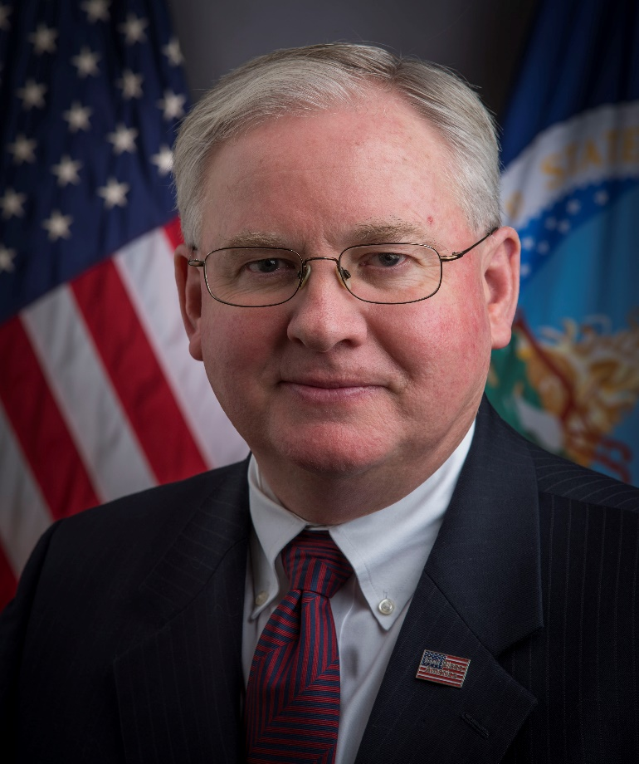
Curtis M. Anderson
Rotary Club of Bailey’s Crossroads
Classification: Consultant and Business Coach

Slide 2
Summary
Born Albuquerque, NM
Lived in Sumatra, Beirut, England, Singapore, Houston, Philadelphia, Los Angeles, Tulsa, Northern VA
Married 1986 to Margaret Cummisky
Two sons: Daniel and Julian
One dog: Bambi
Mother-in-Law: Yoshie Cummisky
Mother: Georgia Anderson (Houston)

Slide 3
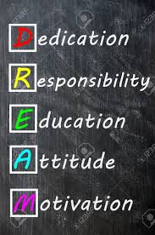
Concepts to Live By
Focus, Communicate, Motivate
Integrity, Compassion, Courage, Professional Service
Be a Doer, Not a Viewer
The Answer is “YES” Somehow

Slide 4
Rotary Four Way Test
Of the things we think, say or do
1. Is it the TRUTH?
2. Is it FAIR to all concerned?
3. Will it build GOODWILL and BETTER FRIENDSHIPS?
4. Will it be BENEFICIAL to all concerned?

Slide 5
Taurus
Known for being reliable, practical, ambitious and sensual, the people born under the Zodiac Sign Taurus have an eye for beauty. They tend to be good with finances, and hence, make efficient financial managers.
Positive Qualities of Taurus: Practicality, Artistic bent of mind, Stability, Trustworthiness, Generosity, Humanity and Loyalty.
Negative Qualities of Taurus: Self-Indulgence, Laziness, Stubbornness, Prejudice, Limited Outlook, Possessiveness.

Slide 6
Year of the Dog
One born in the Year of Dog has a straightforward characteristic. In their career and love, they are faithful, courageous, dexterous, smart and warm-hearted. They know how to keep secrets and inspire other people's confidence. Those people make good leaders. If they fall in love with someone, they would not change. They can be terribly stubborn with the right things.

Slide 7
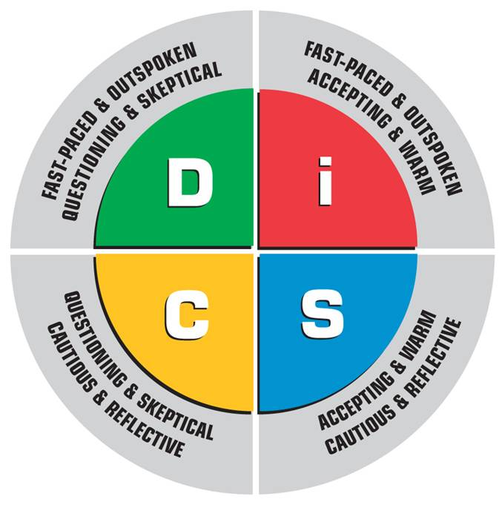
DISC Profile Dominance-Influence-Steadiness/Supportive-Compliance/Conscientious
Natural Style
SDCI
Adapted Style
IDCS

Slide 8
Birth Order Makes a Difference?
First Born: Perfectionist, Leader, Responsible, Highly motivated to succeed, Strong need for approval from people in charge
Middle Born: Rebellious, Adaptable, Mediators, Prefer compromise over conflict, Independent and resourceful, Insecure, Secretive
Last Born: Social, Outgoing, Financially irresponsible, Manipulative, Spoiled or babied to the point of helplessness

Slide 9
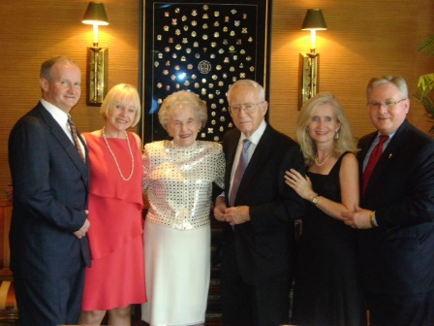
Youngest, Middle, Oldest
Sister – Laurie (NJ) + 5 years
Brother – Gary (Chicago) + 3 years
Curtis
Sister – Denise (Houston) – 7 years

Slide 10
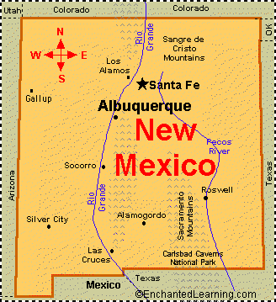
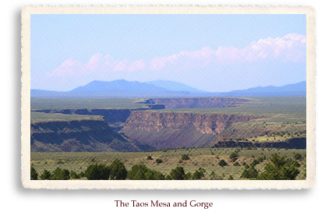
New Mexico
Born in Albuquerque, NM
Grandparents in Belen and Deming, NM
Parents married in NM
Father college at New Mexico School of Mines in Socorro, NM
Family Cabin in San Cristobal/Taos, NM

Slide 11
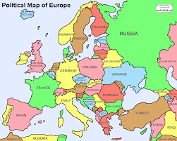
Family Origins
Norway
Sweden
Germany
Austria
England
Scotland
Ireland

Slide 12
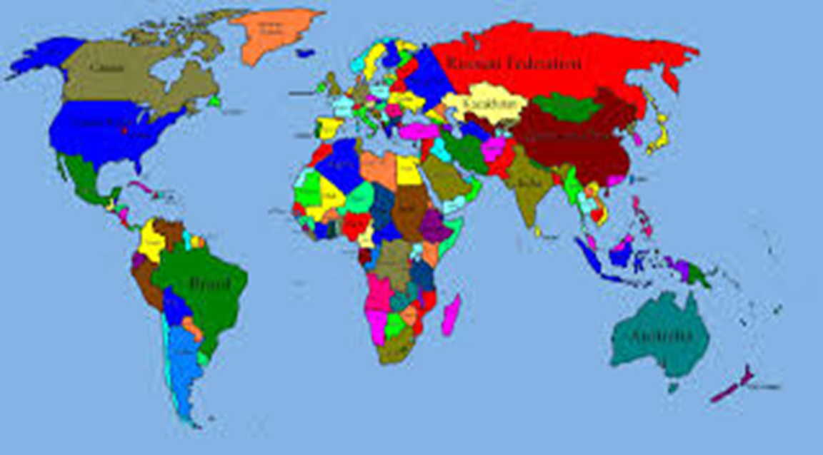
Where I have lived and Schooled
0-2: Rumbai, Sumatra, Indonesia
2-3: Beirut, Lebanon
3-13: Cobham, Surrey, England
13-14: Singapore
14-17: Houston, Texas
College: University of Pennsylvania, Philadelphia, PA
Law School: University of Southern California, Los Angeles, CA

Slide 13
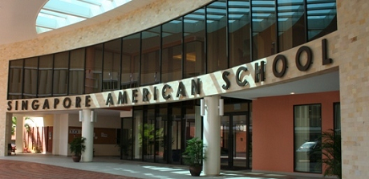
Formal Education
England – Spinney/Dane Court/KGS – Hockey Captain
Singapore – SAS – Cross-Country; Soccer
Houston – Robert E. Lee – Soccer Club
Philadelphia – Penn/Wharton – Acct./Econ
Crew; Rep. to Wharton Bd. of Overseers
Los Angeles – USC- Law – Intl/Nat. Res.
Ocean Thermal Energy Conversion
Licensed in CA and OK; U.S. Sup. Ct.

Slide 14
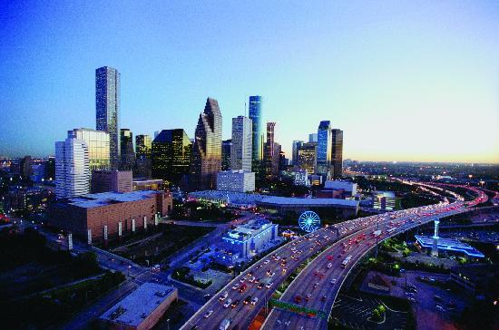
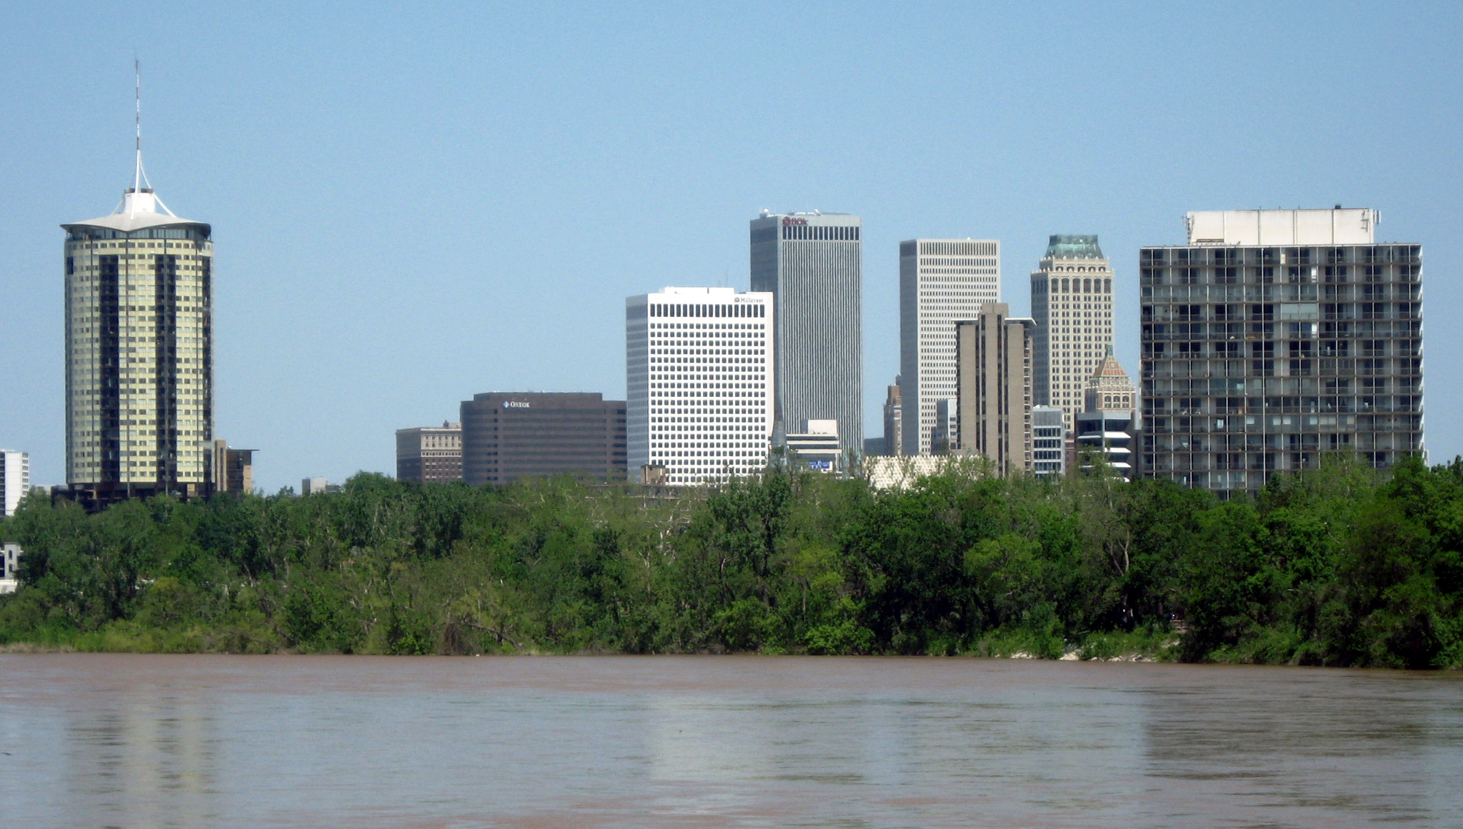
Lived and worked
Houston, TX
Tulsa, OK
Los Angeles, CA
DC Metro area

Slide 15
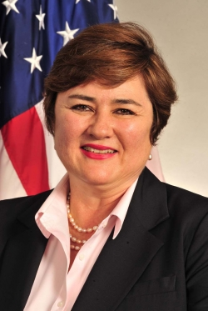
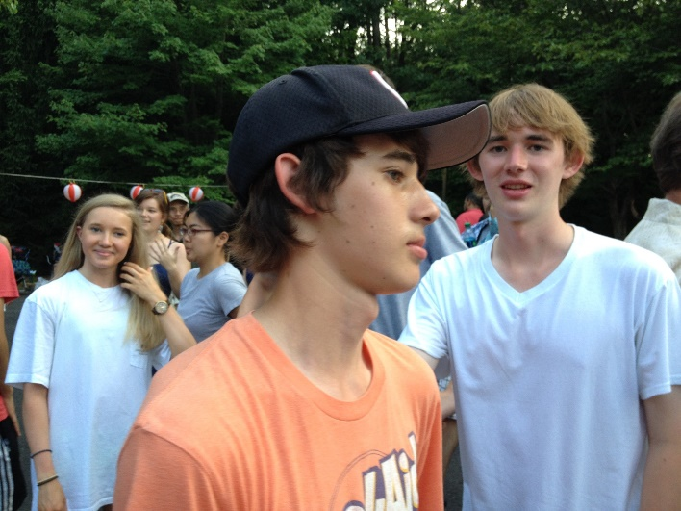
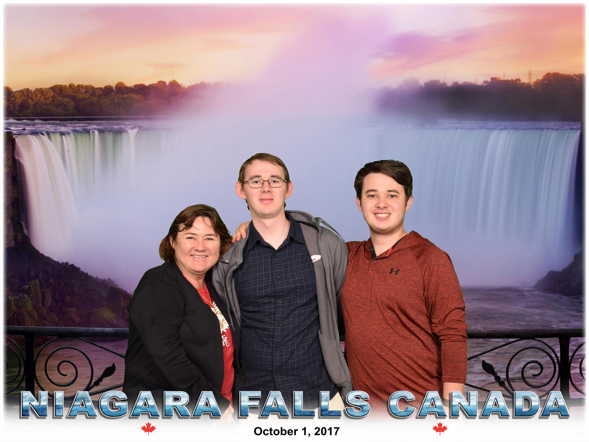
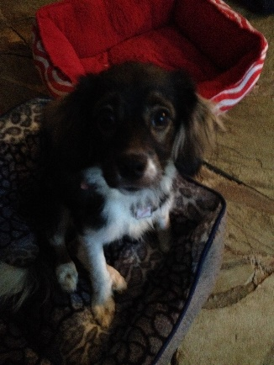
Memories
50 States (49 overnight) + 3 territories
19 Countries (Europe, Asia, N. America)
Kingston Grammar School Field Hockey
Normandy, France (10th Grade Summer)
First paid job for Intl Consultant (10th Grade)
Robert E. Lee Soccer
Dale Carnegie Course
Williston, ND (Summer after college)
Lake Tahoe (with family, MLC)
Meeting my wife; wedding (1986)
P.A.D. IJ – 100th Year
Daniel (1995)
Julian (1998)
Diamond/Scruffy/Sapphire/Bambi
Placing all my schedule Cs
Speaking at NRECA in San Diego

Slide 16
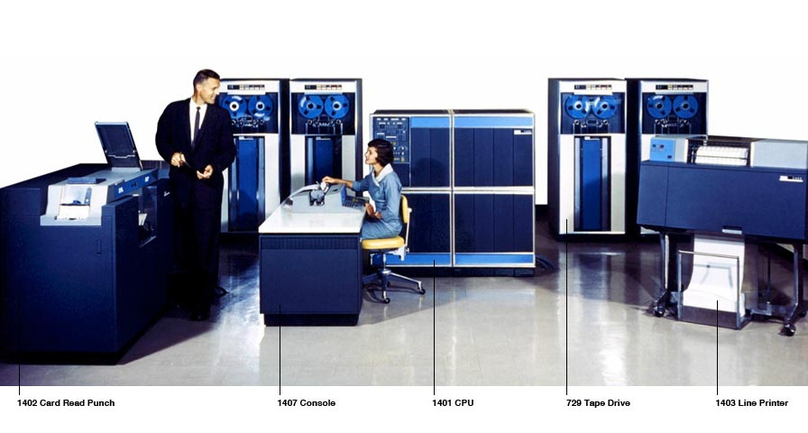
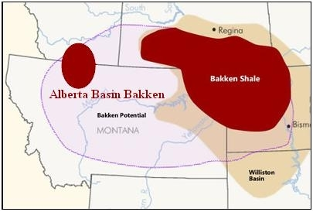
Pre-Professional Experience
Managed Intl Mailing; Lawn; Babysitter
Newspaper delivery
Data Input/Digitizer/Asst. Computer Operator
Summer Intern at C&L
Cable Layer
Litigation Asst./Research Asst.
Law Clerk

Slide 17
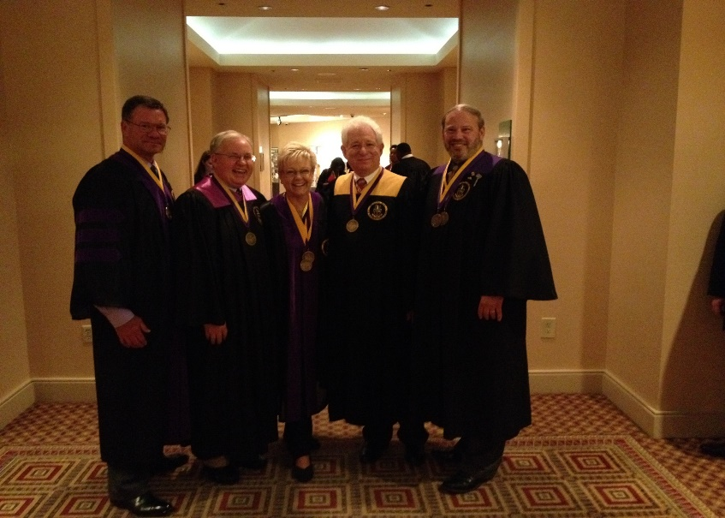
Civic Involvement
Leadership Tulsa
Hugh O’Brian Youth Foundation
Tulsa Business Development Ctr.
SE Tulsa Jaycees
Intl Council of Tulsa
Community Residences, Inc.
Little River Soccer Club – Coach
United Way of National Capital Area
American Society of Association Executives
Congressional Schools of Virginia
Sleepy Hollow Citizens Assn
GOP
Fairfax County Federation of Citizens Associations
BSA 875
Phi Alpha Delta Law Fraternity, International
Rotary International

Slide 18
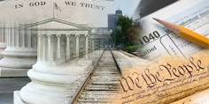
Professional Experience
Private Sector
Government Sector
Not for Profit Sector
Paid Staff
Volunteer Board Member
Volunteer
Board Chair, COS, CFO, General Counsel, Deputy Administrator, Secretary, Treasurer

Slide 19
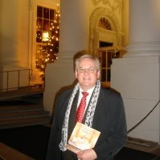
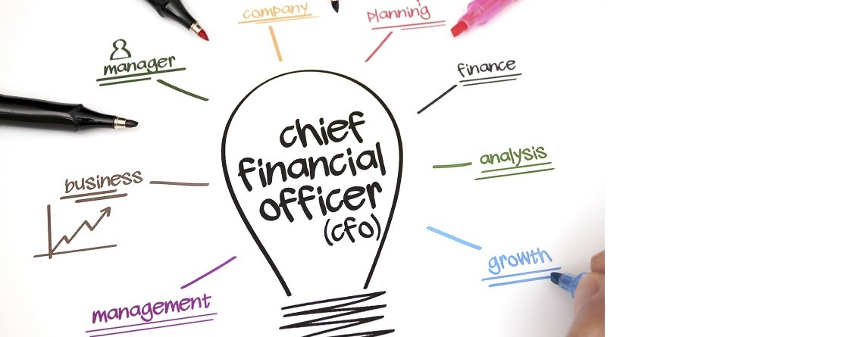
Professional Experience
Associate Attorney (HAKG&D, Tulsa)
Attorney-Advisor (DOI, DC)
Secretary to the Board (FCA/FCSIC, Mclean)
Legislative Intern (Barbara Vucanovich, Capitol Hill)
CFO & GC (NASDA, DC)
Dep. Administrator/Acting Admin. (USDA/RUS, DC)
VP & GC (MELE Associates, Rockville/DC)
Strategic Advisor and Consultant
Life and Health Insurance (AFLAC/Bankers Trust)
Chief of Staff (RHS, RUS)

Slide 20
Practical Experience
Strategic Planning
Finance & Accounting
Operations
Profit & Loss
Best Practices
Legal
IT & Systems Cost Control
Board of Directors
Non-Profits & Public Sector
Project Management
Team Building

Slide 21
Some Successes
Engineered turnaround of international law fraternity: Initiations grew 100% first year and net equity increased 40%.
Upgraded reporting for $10B in annual loans and grants: Improved visibility of core data, contributing to approximately 1/2% average annual default rate. Reduced SFH delinquency rate from 28% to 5%.
Improved the financial strength of national association: instituted new procedures, a new chart of accounts, adopted new accounting software changed accounting methodology from cash to accrual basis, created a financial procedures’ manual, and implemented new written and verbal communication with board members concerning financial status and procedures.
Organized and moved 10,000 linear feet of files during the pandemic.

Slide 22
Some Successes
Strategic Planner:
Phi Alpha Delta Law Fraternity, International
National Association of State Departments of Agriculture (NASDA)
USDA Rural Utilities Service (RUS)
Team Builder:
Phi Alpha Delta Law Fraternity, International
MELE Associates, Inc.
NASDA
RUS
USDA Rural Housing Service

Slide 23
BXRC Successes
Joined BXRC 10/31/2014 (Balenger, Bailey)
Treasurer 7/2015 to 6/2017 (Henderson, Feld)
Vice President 7/2017 to 6/2018 (S. Wasko)
President-Elect 7/2020 to 6/2021 (Polson)
Update to BXRC Bylaws Completed 2/19/2021
Pre-PETS Completed 3/2/2021
CPETS2021 3/6/2021
Pilot Dues and Fees Proposal Approved 4/9/2021
Completed RLI Training 4/23/2021
Grant Management Seminar 4/24/2021
Rotarian of the Year 2021

Slide 24
Anderson’s Management and Leadership Philosophies
Focus, Communicate, Motivate (FCM)
Doers, not viewers
Delegate, don’t abdicate
Persistence overcomes resistance
Follow the money
Time is money
If you can think it, it can be
If you think it is impossible, it is (for you)
Have a sense of urgency
Don’t let the perfect get in the way of the good
There is no sense doing well that which does not have to be done at all
To complete big goals, divide them into several manageable tasks
Intentions and words are good, actions and results count.

Slide 25
Anderson’s Personal Philosophies
Golden Rule: Treat others as you would want others to treat you.
Platinum Rule: Treat others as they want to be treated.
Money only buys convenience, it does not buy character.
Integrity, Compassion, Courage and Professional Service.
The answer is YES, somehow.
The important things in life come from the heart, not the mind.
A Scout is trustworthy, loyal, helpful, friendly, courteous, kind, obedient, cheerful, thrifty, brave, clean, and reverent.

Slide 26
The Answer is “YES” Somehow

Slide 27
Rotary Vision Statement
“Together, we see a world where people unite and take action to create lasting change — across the globe, in our communities, and in ourselves.”
- RI Board of Directors 6/2021

Slide 28
General Theme for the Year: Designing for the Future by Building on Strong Foundations.

Slide 29
General Theme for the Year: Designing for the Future by Building on Strong Foundations.
1. Increase Club membership – Focus on FUN
a. Retain existing members
b. Recruit 5-10 new regular members (10-3-1 rule)
c. Establish subsidiary clubs/types of membership
2. Fundraising
a. Mustang Raffle – START YOUR ENGINES
b. Review supplemental fundraising opportunities
c. New Mustang members to take on some functions
3. Move into the Future
a. Hybrid/Bimodal (both in person and Zoom)
b. Upgrade accounting systems
c. Policies and Procedures Manual
HAVE FUN!!

Slide 30
Goals for the Year: in MyRotary Goals
Club Membership – 65
Leadership Development participation – 2
District Conference attendance – 10
District Training participation – 3
Annual Fund contributions - $5,000
Interact clubs – 1
RYLA participation – 2
Strategic Plan – Yes
Online presence – Yes
Social activities – 6
Update website and social media – 2 x per month
Media stories about club projects – 4 for the year
HAVE FUN!!

