Slide 1

BXRC Club Meeting: 27 August, 2021
Rotary Club of Bailey’s Crossroads
KaThandi Project

Slide 2
Welcome!
      Designing for the Future by Building on Strong Foundations
Welcome
    Chat before the bell rings
0730 Bell Rings
Rise for the Pledge of Allegiance
    Ben Hester

Slide 3
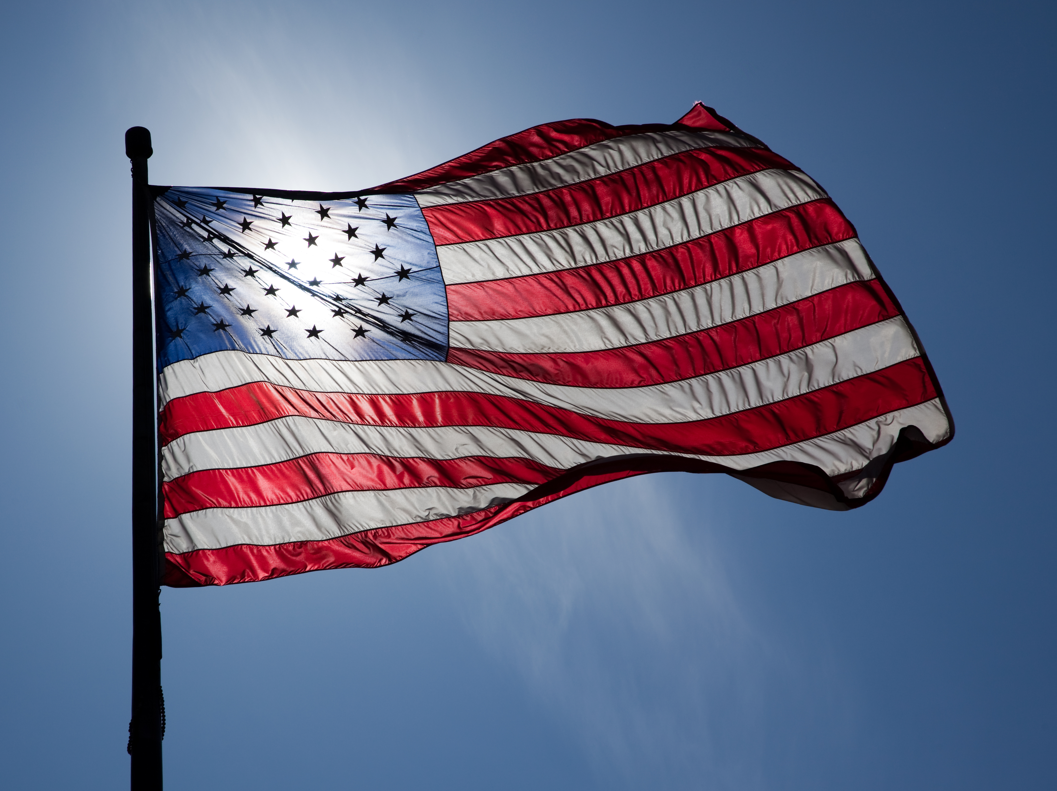
Flag
This Photo by Unknown Author is licensed under CC BY-ND

Slide 4
Welcome!
      Designing for the Future by Building on Strong Foundations
    Invocation: Kathleen Kaspar-Paty
    Birthdays: None this week
    Anniversaries: Judy McDermott - 8/25/2015
    Gloria Rubin – 8/29/2014
    John Holtzclaw – 9/1/2004
    Song: Joe Luquire
    Guests: Welcome to our guests!
    Announcements:
      Kabultec: volunteer Afghan Refugees today, Saturday and Sunday from 9 AM – 4 PM. See Nasrine’s email for items to donate

Slide 5
MUSTANG NEWS
      Designing for the Future by Building on Strong Foundations
    Joe, Dennis and Sam
      As of August 26, 2021:
        $ 8,475 Individual
        $ 13,775 Car side
        $ 5,950 Websites
        $ 9,075 Media
        $ 29,975 Mailing
        $ 8,900 Mail Chimp
        $ 76,150 Grand Total

Slide 6
Mustang Raffle Car-Side Events
      Designing for the Future by Building on Strong Foundations
      Upcoming Opportunities:
        9/4: Old Bust Head Brewery, Vint Hill Farms
        9/6: Clifton Lion’s Club, Clifton
        9/11: City of Falls Church Festival
        9/11: Stonebridge Fall Festival, Woodbridge
        9/18: Warrenton
        9/25 and 26: Occoquan Fall Festival

Slide 7
Announcements
      Designing for the Future by Building on Strong Foundations
      Upcoming Programs and Events:
        8/27 – Ka Thandi Challenge – Michelle Peters, Tijani Musa, Pamela Danner (McLean Rotary Club)
        9/1 – BXR Board of Directors meeting via Zoom (Curtis)
        9/3 - Community Partners Benefit CSB Clients - Lee Ann Dispirito, Fairfax County Community Services Board
        9/10 - Unite2Light - Solar lighting for off grid communities and for the homeless – Megan Birney

Slide 8
Announcements
      Designing for the Future by Building on Strong Foundations
      Upcoming Programs and Events:
        9/17 - MicheLo project 2021 - When governments and communities experience discourse is when humanity must shine and be the light of hope – Michelle Peters
        9/22 - Membership Mixer, Dogfish Head Alehouse (Tijani)
        9/24 – Fairfax County Animal Control – Earit Powell
        10/1 – Club Forum #2
        10/7 – DG Dinner at Wildfire at 7:00 pm (Neesa)
        10/8 – DG visit at BXR meeting

Slide 9
TODAY’S SPEAKER
Designing for the Future by Building on Strong Foundations
KaThandi Project
Meesh Peters
Tijani Musa

Slide 10
50/50 Drawing for BXRC Foundation
Designing for the Future by Building on Strong Foundations
50/50 Drawing

Slide 11
Conclusion
Stand for the 4-way Test
Of the things we think, say, or do
Is it the TRUTH?
Is it FAIR to all concerned?
Will it build GOODWILL and BETTER FRIENDSHIPS?
Will it be BENEFICIAL to all concerned?

Slide 12

Rotary Club of Bailey’s Crossroad

