Slide 1

BXRC Club Meeting: 24 September, 2021
Rotary Club of Bailey’s Crossroads
Fairfax County Deer Management Program

Slide 2
Welcome!
      Designing for the Future by Building on Strong Foundations
Welcome
    Chat before the bell rings
0730 Bell Rings
Rise for the Pledge of Allegiance
    Kathleen Kaspar-Paty

Slide 3

Flag
This Photo by Unknown Author is licensed under CC BY-ND

Slide 4
Welcome!
      Designing for the Future by Building on Strong Foundations
    Invocation: Juanita Balenger
    Birthdays: None to report
    Anniversaries: John Thomas (9/24/2004)
    Song: Joe Luquire
    Guests: Welcome to our guests!
    Announcements:
      Dues
      KaThandi Challenge – Raised $1,100 toward $2,500 to be matched
      DG Dinner
      Dogfish Head Ale House Mixer

Slide 5
MUSTANG NEWS
      Designing for the Future by Building on Strong Foundations
    Joe, Dennis and Sam
      As of September 23, 2021:
        $ 9,425 Individual
        $ 31,075 Car side
        $ 6,625 Websites
        $ 11,350 Media
        $ 39,125 Mailing
        $ 8,900 Mail Chimp
        $106,500 Grand Total
        $ 83, 230.95 Cash Balance (9/1)

Slide 6
Mustang Raffle Car-Side Events
      Designing for the Future by Building on Strong Foundations
      Upcoming Opportunities:
        WE NEED SELLERS, CASHIERS and CHASE CAR
        9/25 and 26: Occoquan Fall Festival, 10 am – 5 pm BOTH days
        10/17: Crafts-n-Drafts, Manassas, 11 am – 4pm
        Katie’s anyone??

Slide 7
Announcements
      Designing for the Future by Building on Strong Foundations
      Upcoming Programs and Events:
        10/1 – Club Forum #2
        10/6 – BXRC Board Meeting 7 pm – DG Pat Borowski
        10/7 – DG Dinner at Wildfire at 7:00 pm (Neesa)
        10/8 – DG 7610 Pat Borowski
10/15: Glasgow MS - Victor Powell, Principal,
10/22: Palestinian Doctors in the Advanced Trauma Life Support (ATLS) Course - Walter Ruby
10/29: Ghosts, Goons and a Bunnyman – Cindy Bennett

Slide 8
Announcements
      Designing for the Future by Building on Strong Foundations
      Upcoming Programs and Events:
11/5: Native American Heritage Month – Jean Hovland
11/12: Rotary Foundation Month – Polly Rosenstein, Area 9
11/19: Introduction Speech – Justin Carwile
12/3: Justice HS - Tiffany Narcisse, Principal, 12/10: Election Update and Forecast – Tom Davis
12/17: Introduction Speech – Shona Person

Slide 9
TODAY’S SPEAKER
Designing for the Future by Building on Strong Foundations
Fairfax County
Deer Management Program
Sgt. Earit Powell

Slide 10

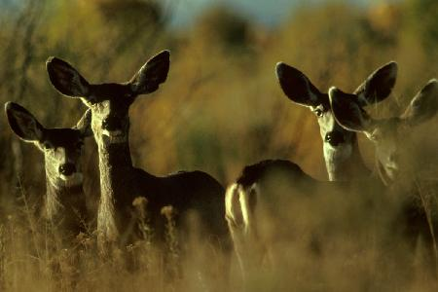
FAIRFAX COUNTY DEER MANAGEMENT PROGRAM
Sergeant Earit Powell, Animal Protection Police
Fairfax County Police Department, Animal Services Division

Slide 11
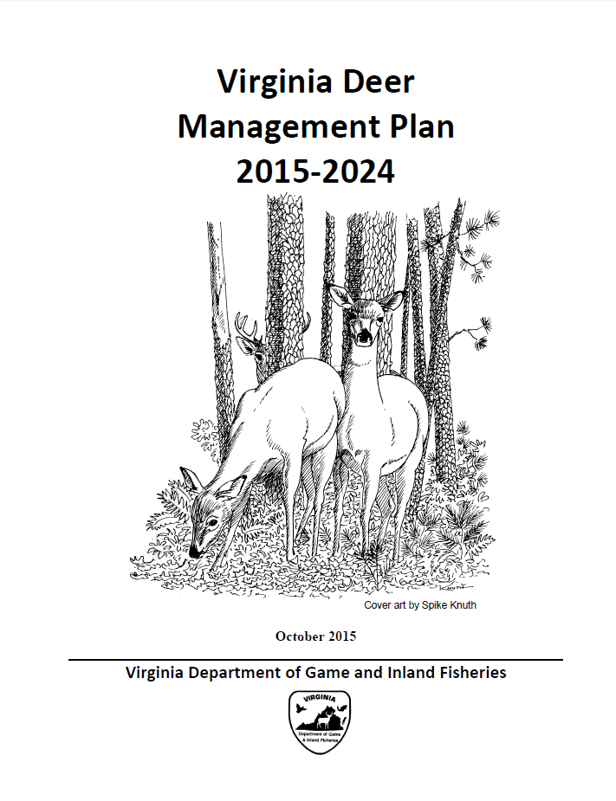
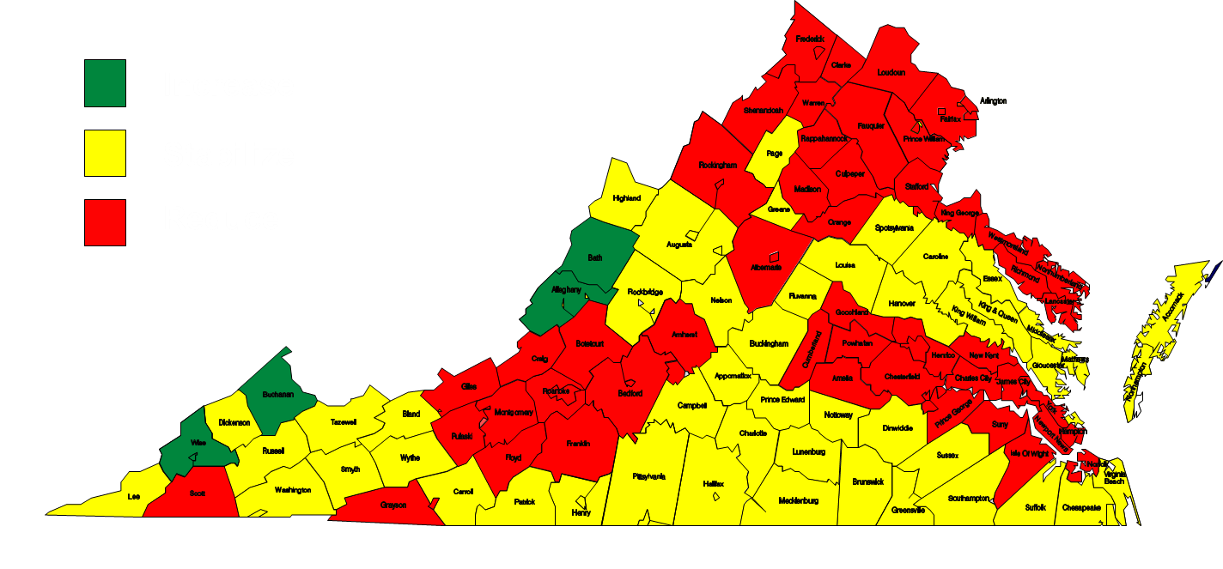
Virginia Deer Management Plan (2015-2024)
Deer Population Objectives
Population Goal: Manage local deer populations to balance the varied needs and reasonable expectations of a diverse human community (cultural carrying capacity), the requirements of a biologically diverse ecosystem, and the anticipated future social/ecosystem demands. Hunting is the preferred population management method, where appropriate and feasible.

Slide 12
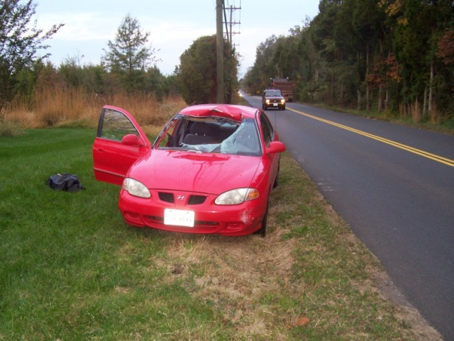
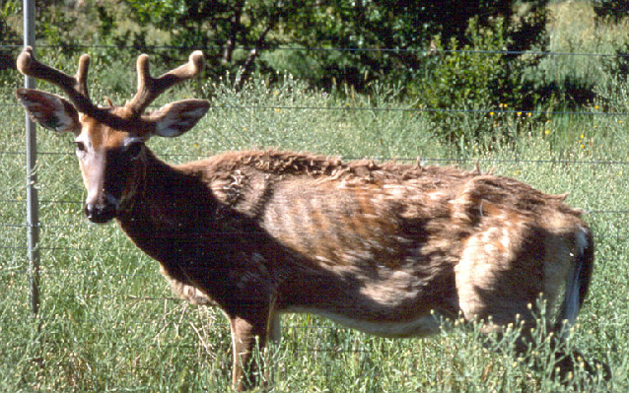
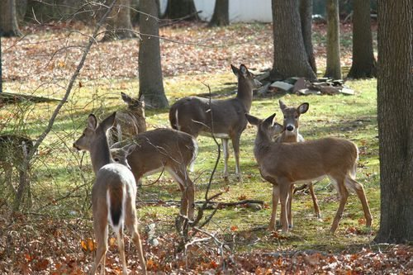
Fairfax County Deer Management Program
  Approved by the Fairfax County Board of Supervisors in 1998
  Implemented by the Fairfax County Police Department in collaboration with the Fairfax County Park Authority, NOVA Parks, and other stakeholders
  Safety Concerns
  Health Concerns (public health and herd health)
  Ecological Damage

Slide 13
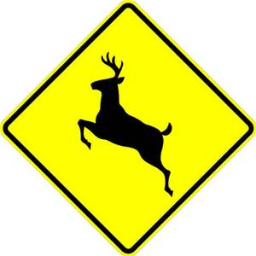
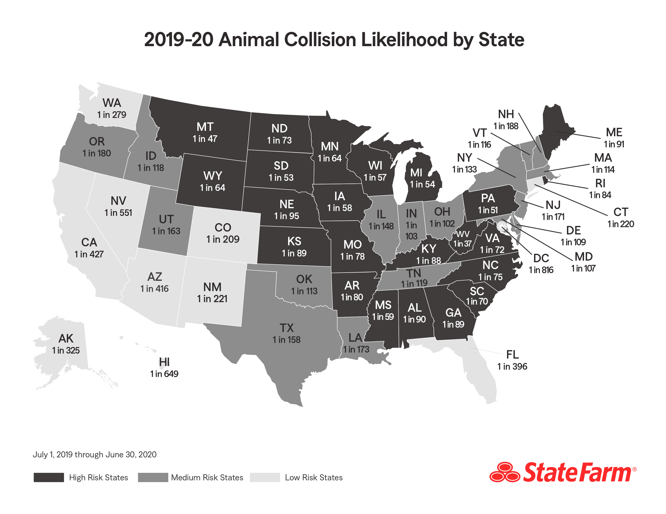
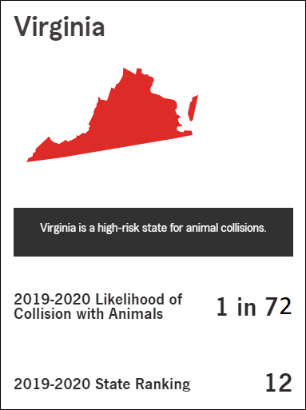
Deer-Vehicle Collisions
https://newsroom.statefarm.com/animal-collision/

Slide 14
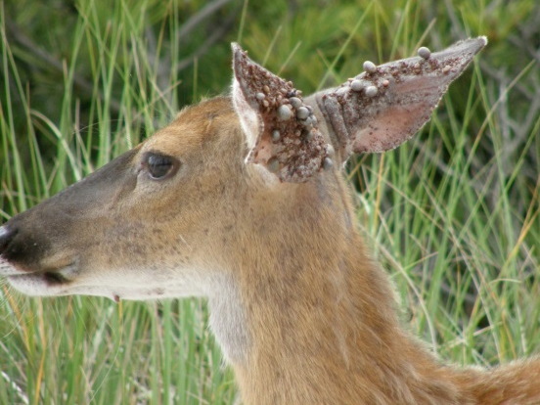
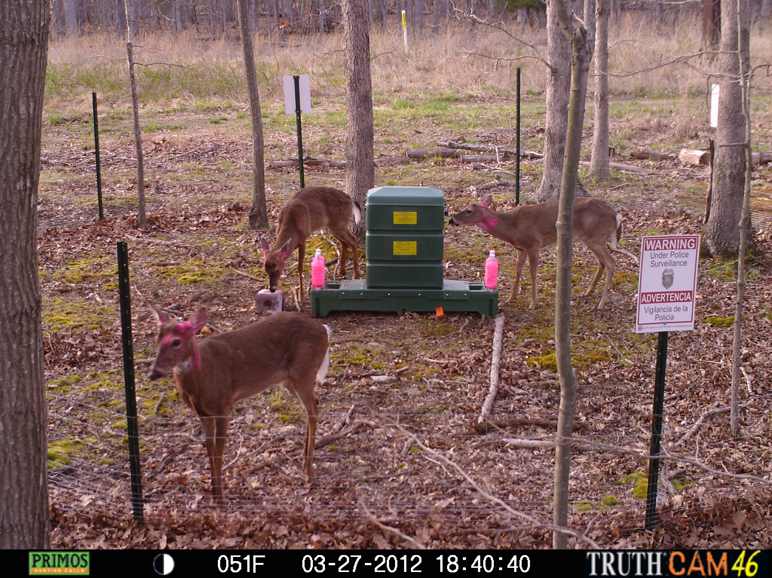
Wildlife and Public Health
Dense deer populations are inferred to be one of the principal factors in the increase of ticks in many urban environments leading to public concern over disease transmission.
Adult ticks feed and mate primarily on deer but the deer themselves do not serve as a source of infection for the Lyme disease bacterium.
The presence of deer has been correlated with tick populations to variable degrees and some studies have found that reduction of deer populations to very low thresholds may reduce tick abundance; however, the relationship between deer populations and incidence of Lyme disease remains unclear.
https://www.fairfaxcounty.gov/wildlife/fairfax-county-4-poster-pilot-study

Slide 15
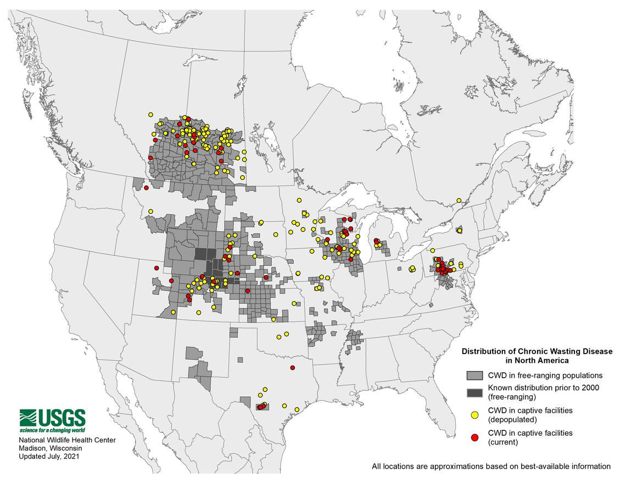
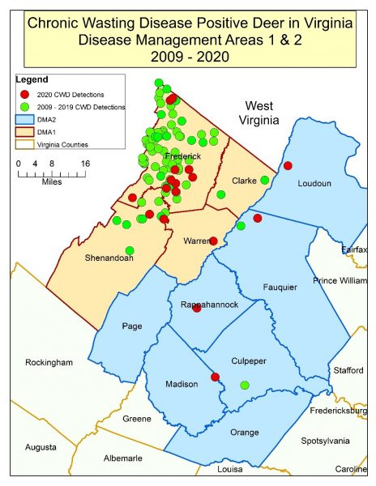
Deer Herd Health - Chronic Wasting Disease

Slide 16
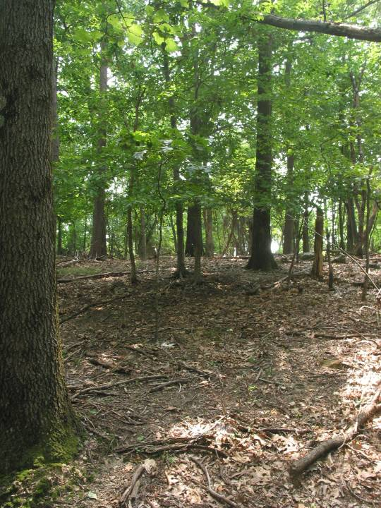
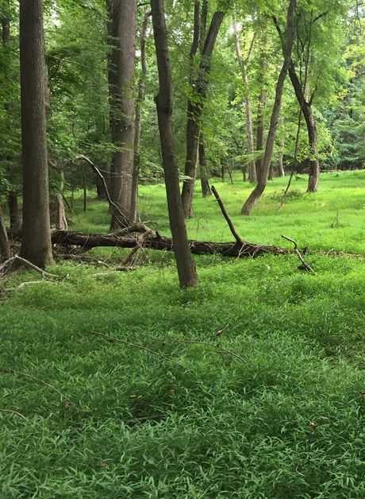
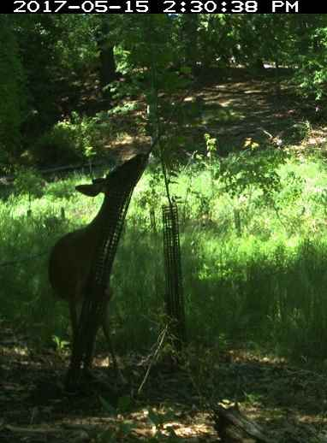
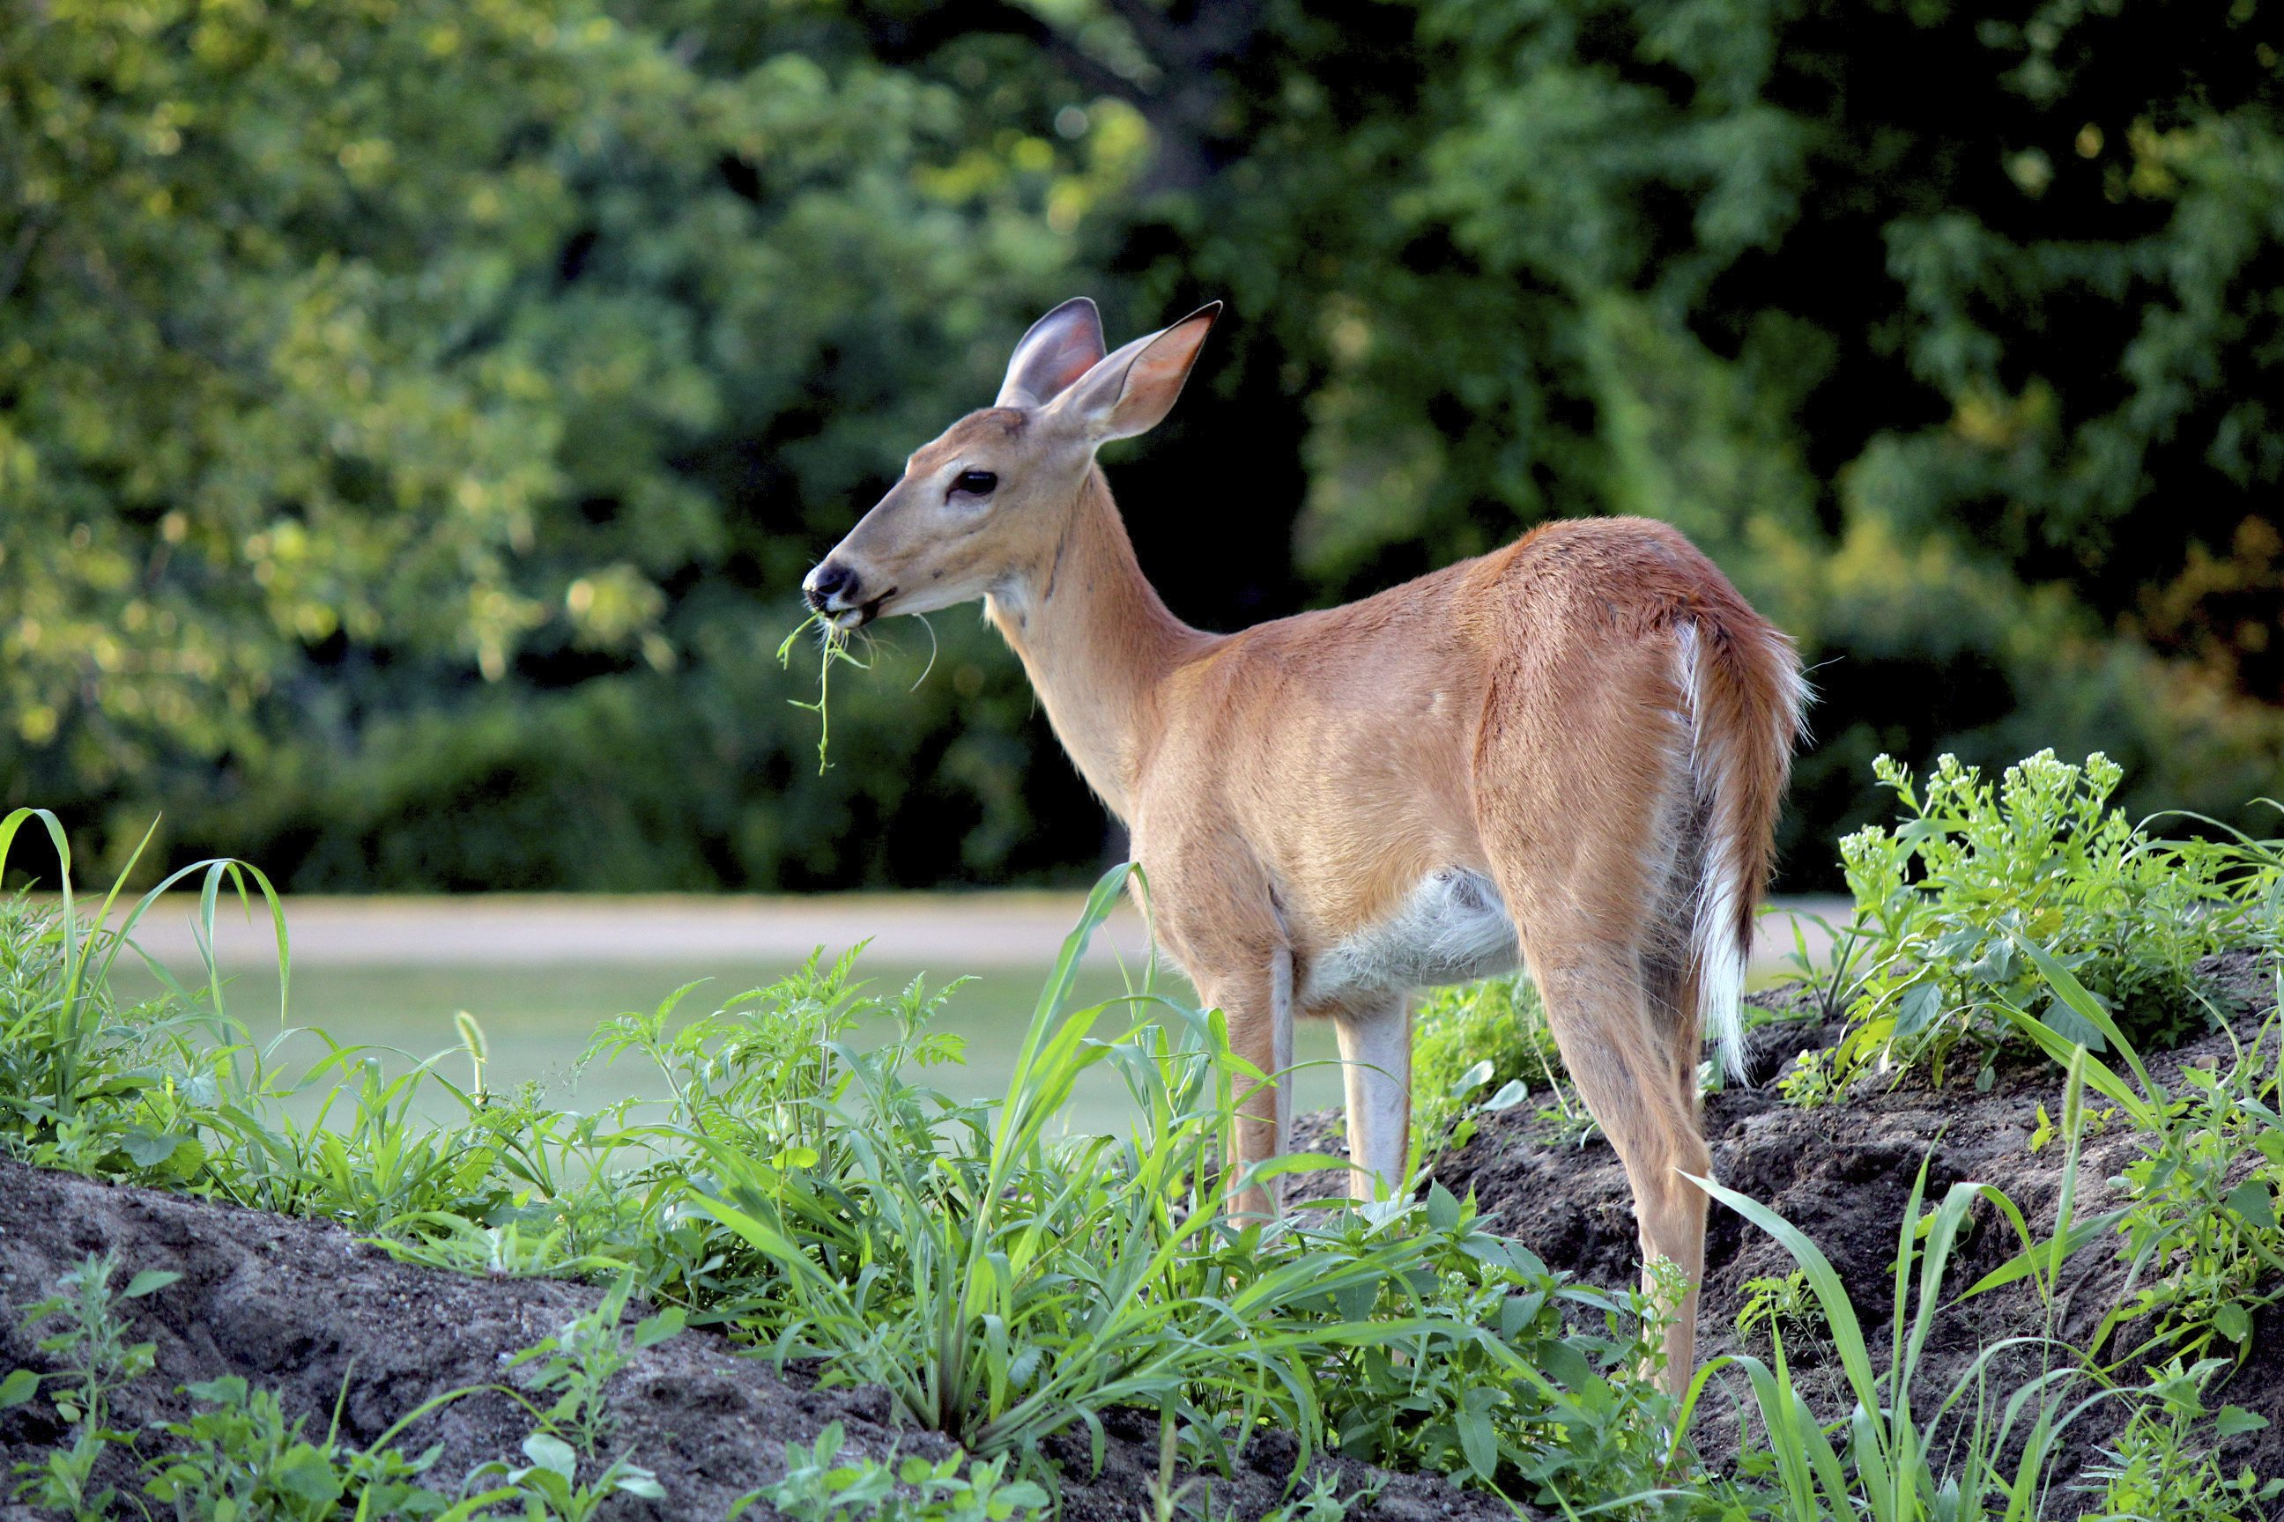
Ecological Impacts
    Consumption of seedlings and saplings hinders forest regeneration
    Forest structure impaired, understory layers removed and overstory simplified
    Forest composition changed for decades
    Loss of Ecosystem Services
    (clean water, clean air)
    Loss of biodiversity

Slide 17
Fairfax County Deer Management Program
Based on best practices for deer management, deer census data, environmental impact studies, and peer-reviewed scientific literature
Utilization of current state-approved deer population control tools:
Archery
Firearms managed hunts
Sharpshooting
Utilization of currently available deer management tools:
Humane Exclusion, Repellency and Habitat Modification
Collaboration with Private & Public Property Owners

Slide 18
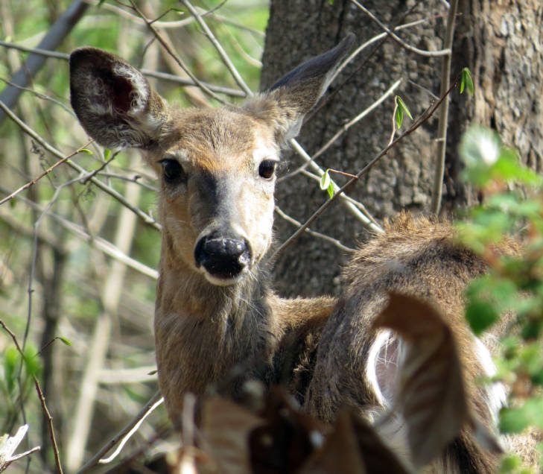
Fairfax County Deer Management Program - Archery
Operated on public lands - Approximately 100 parks and county properties in the program (>80% of county parkland)
Upcoming FY 2022 Program Dates:
September 11, 2021 – February 19, 2022
Hunting is allowed Monday through Saturday
(no Sunday hunting in parks)
Legal hunting hours: 30 minutes prior to sunrise until
30 minutes past sunset
Parks remain fully open to the public
Zero safety incidents since program’s inception

Slide 19



Fairfax County Deer Management Program - Archery
All participants must comply with state regulations including game licensing and Hunter Safety Education as mandated by the Virginia Department of Wildlife Resources
Must complete course through the International Bowhunter Education Program
Must pass archery qualifications with their bow at specified ranges to be eligible

Slide 20
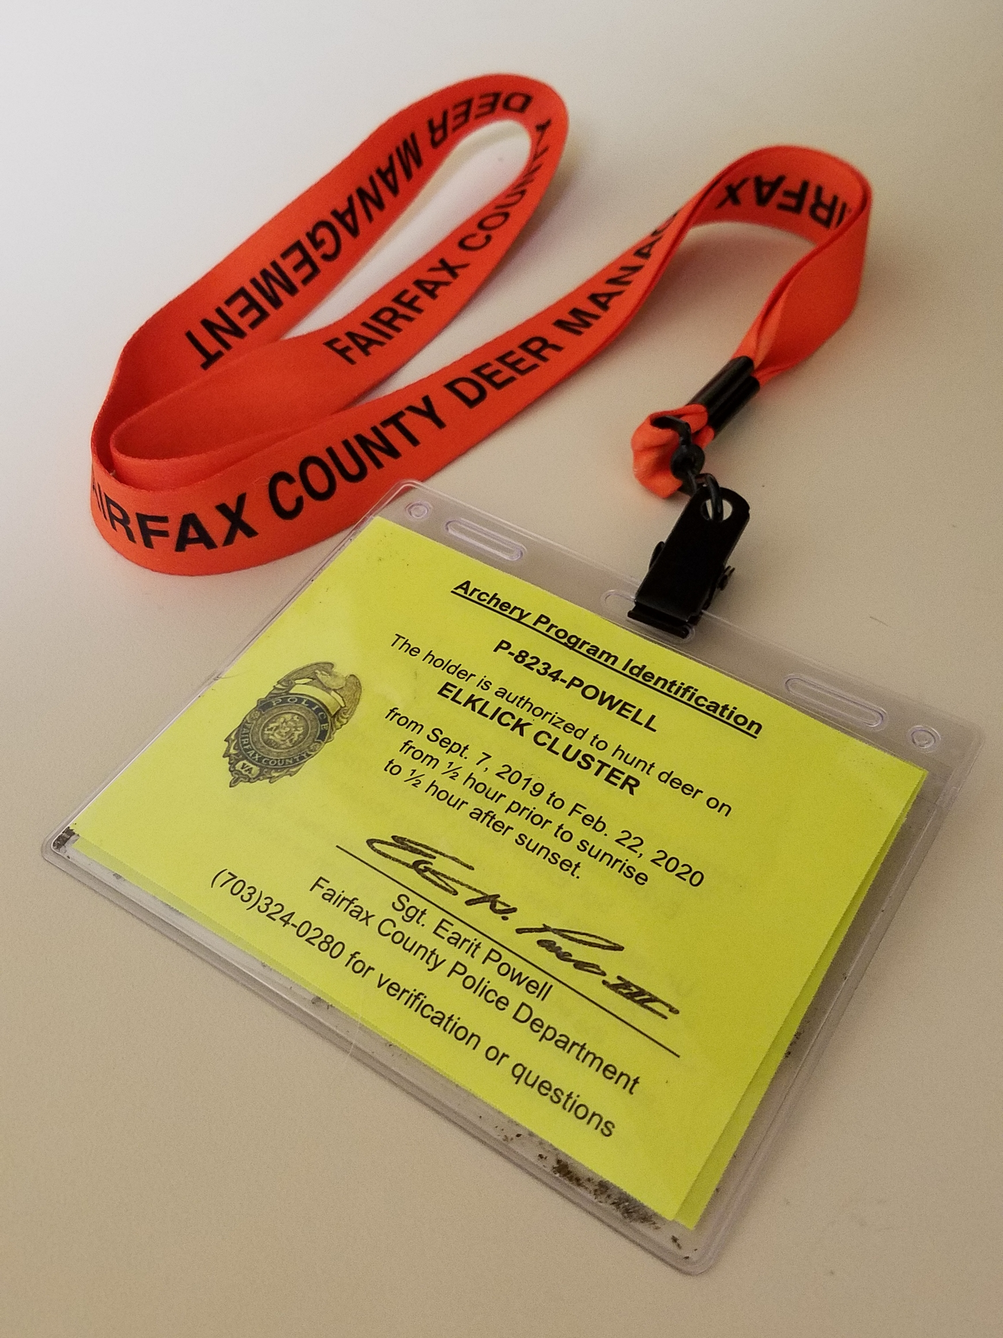
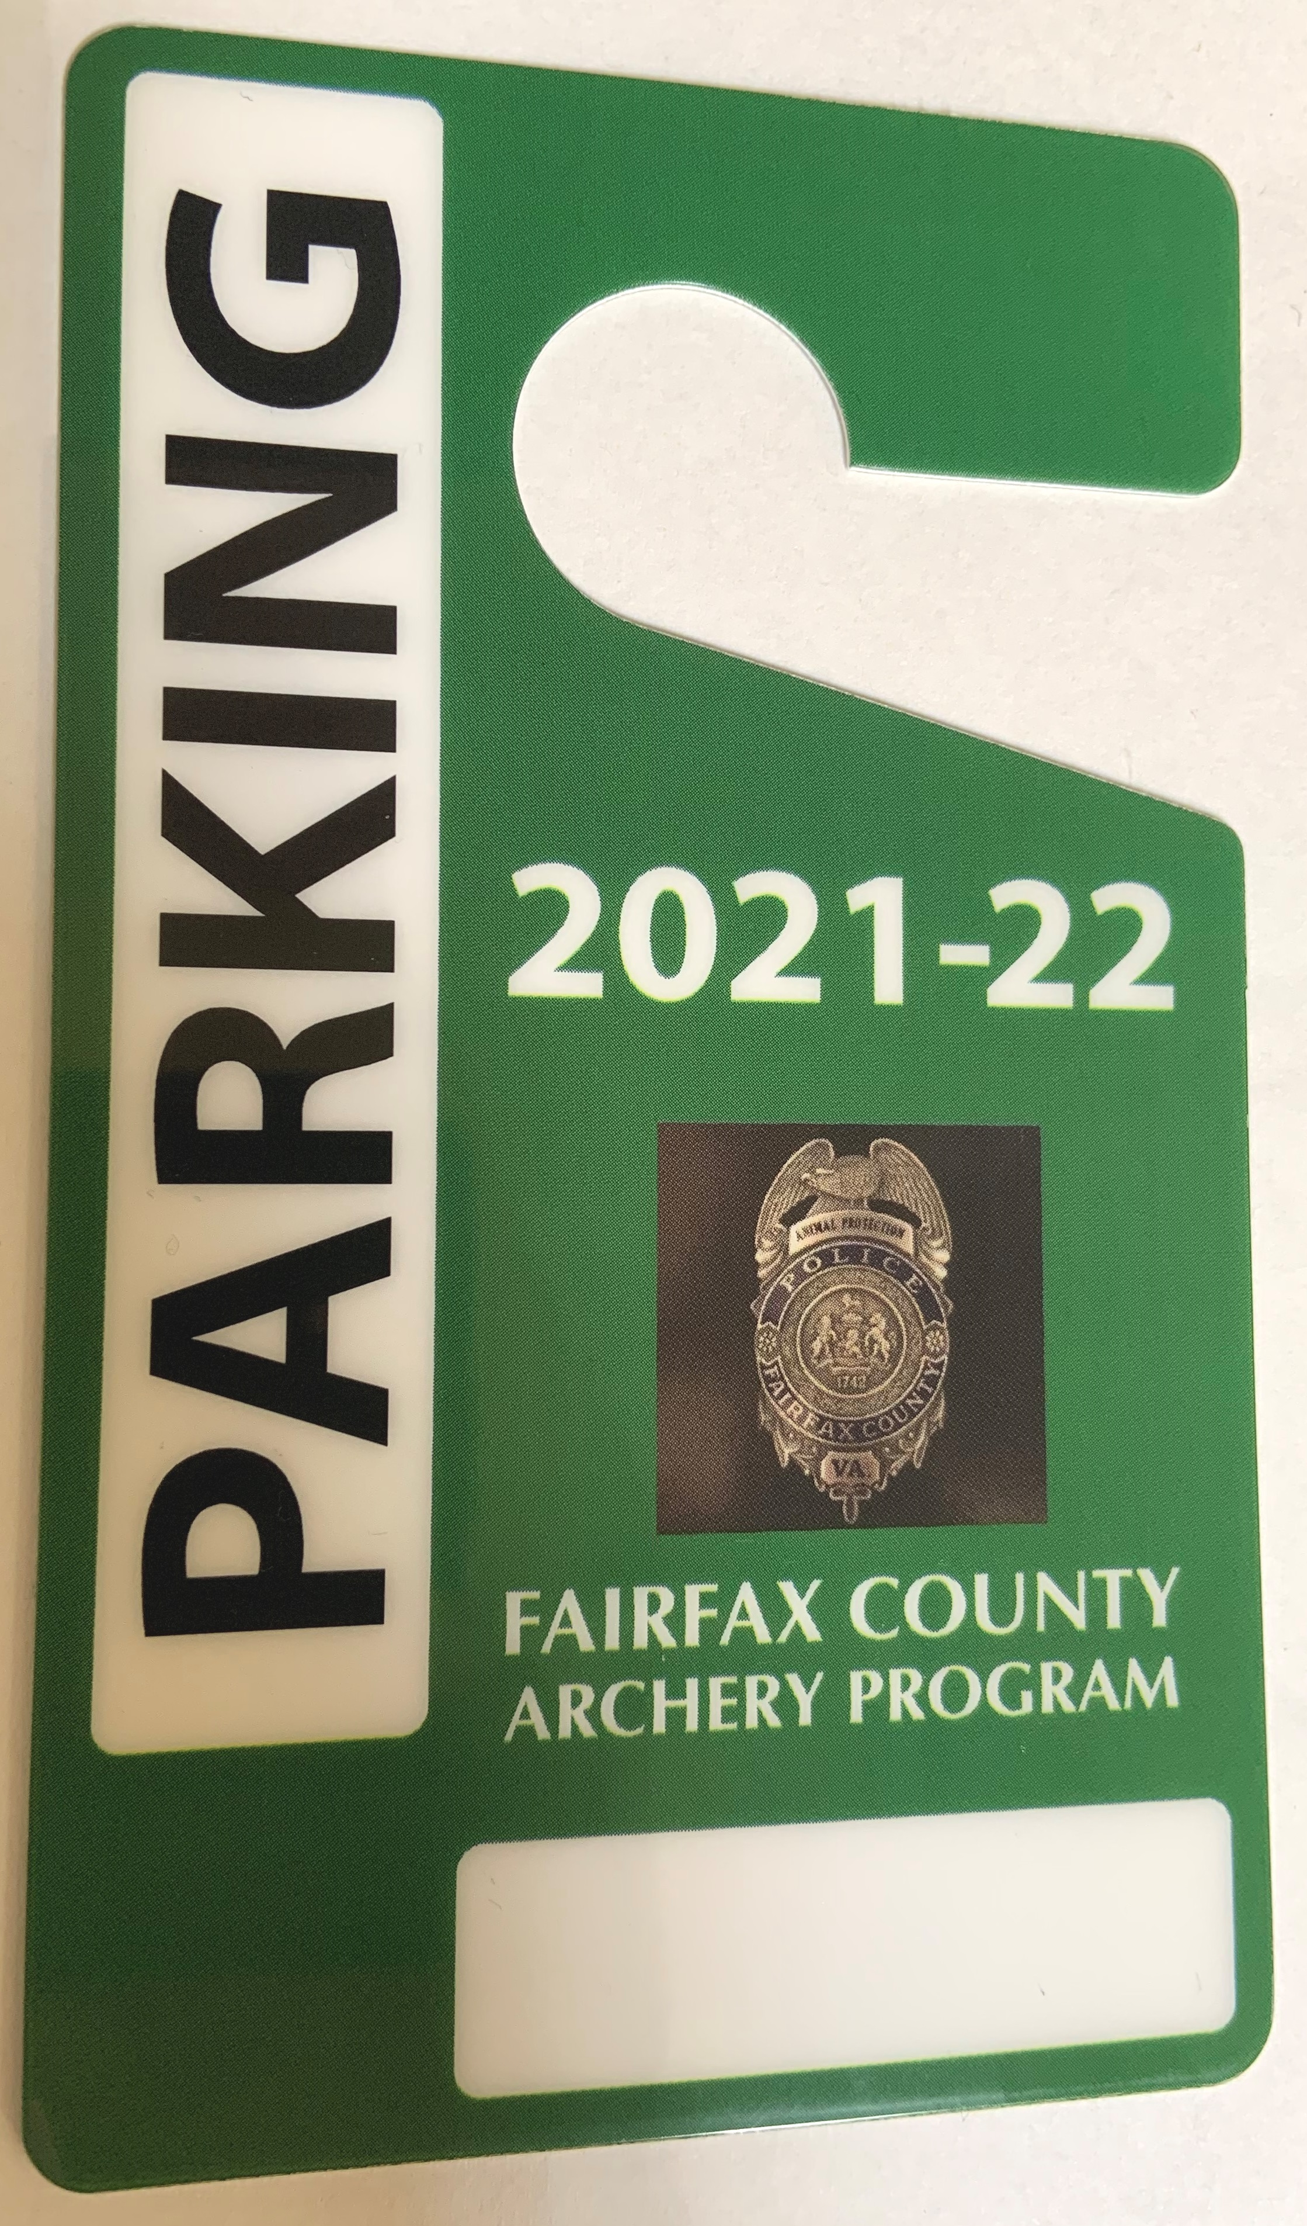
Fairfax County Deer Management Program - Archery
When on-site:
Archery Program ID
  Each hunter is issued a unique ID # and lanyard
  Must be worn on the outside of clothing while:
    Entering and exiting the park
    During any scouting, tracking, set-up or take down activities
  This ID number must be visible on equipment:
    All arrows
    Tree stands
    Game/trail cameras
    Parking tag with ID number hung on rear-view mirror
    DPOP permit copy kept in glove box

Slide 21
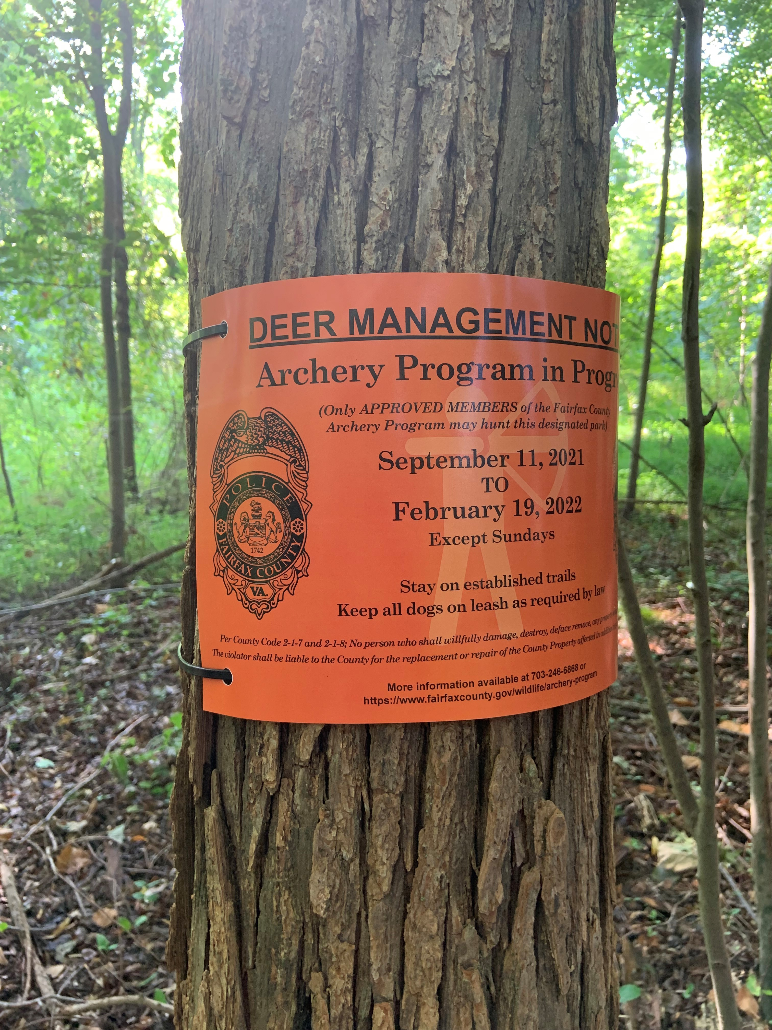
Fairfax County Deer Management Program - Archery
Archery program signs (left/center) are posted at park entrances and trailheads. Hunters can only park at authorized parking areas labeled with signs (right).

Slide 22
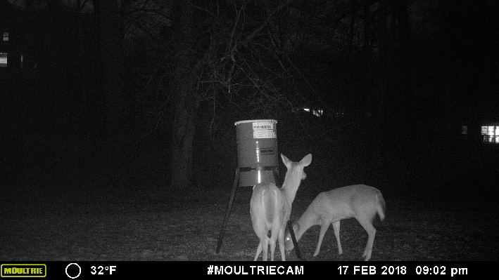
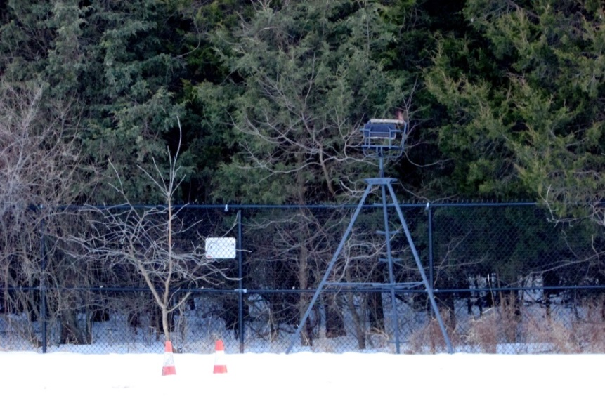

Fairfax County Deer Management Program - Sharpshooting
Night-time operations conducted by Fairfax County Police Department
Park is secured and operation is conducted when parks are closed to the public
Shooting at static locations over bait from elevated position, such as a ladder stand or lift, using ground as natural backstop
Night-vision equipment, thermal imaging and suppressed firearms
Camera stations set up at each location to monitor deer
Venison donated to local food banks, including Hunters for the Hungry

Slide 23

Fairfax County Deer Management Program
Public Notification
Notification letters mailed to property owners adjacent to approved park sites (>22,500 letters for FY 2022)
Public information meetings/webinars
HOA and Civic Association Meetings
Press releases, county blogs (FCPD and OPA) and videos (Channel 16, Fairfax County YouTube)
Fairfax County Deer Management website
Deer Management Program signs
https://www.fairfaxcounty.gov/wildlife/deer-management-program

Slide 24
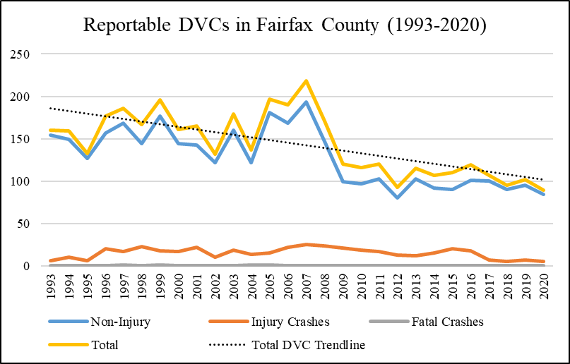
Deer Management Data Collection - Deer-Vehicle Collisions
Fairfax County Reportable Deer-Vehicle Collisions
Year | Non-Injury | Injury Crashes | Fatal Crashes | Total
1993 | 154 | 6 | 0 | 160
1994 | 149 | 10 | 0 | 159
1995 | 127 | 6 | 0 | 133
1996 | 157 | 20 | 0 | 177
1997 | 168 | 17 | 1 | 186
1998 | 144 | 23 | 0 | 167
1999 | 177 | 18 | 1 | 196
2000 | 144 | 17 | 0 | 161
2001 | 143 | 22 | 0 | 165
2002 | 122 | 10 | 0 | 132
2003 | 160 | 19 | 0 | 179
2004 | 122 | 14 | 1 | 137
2005 | 181 | 15 | 1 | 197
2006 | 168 | 22 | 0 | 190
2007 | 193 | 25 | 0 | 218
2008 | 147 | 24 | 0 | 171
2009 | 99 | 21 | 0 | 120
2010 | 97 | 19 | 0 | 116
2011 | 103 | 17 | 0 | 120
2012 | 80 | 13 | 0 | 93
2013 | 103 | 12 | 0 | 115
2014 | 92 | 15 | 0 | 107
2015 | 90 | 20 | 0 | 110
2016 | 101 | 18 | 0 | 119
2017 | 100 | 7 | 0 | 107
2018 | 90 | 5 | 0 | 95
2019 | 95 | 7 | 0 | 102
2020 | 84 | 5 | 0 | 89
Reportable Deer-Vehicle Collisions Fairfax County (TREDS data)

Slide 25
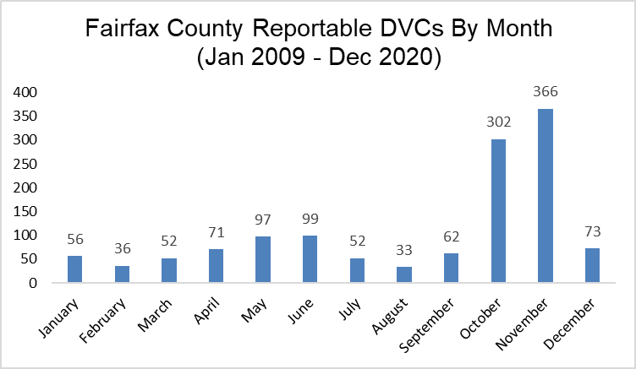
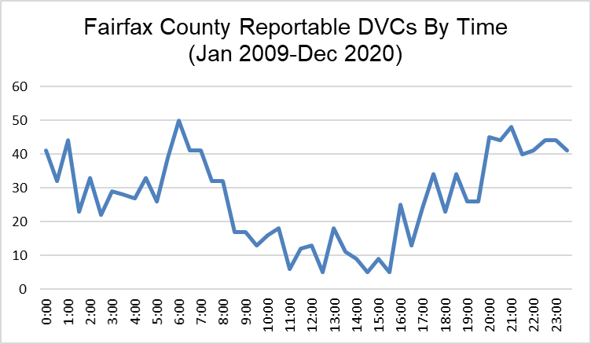
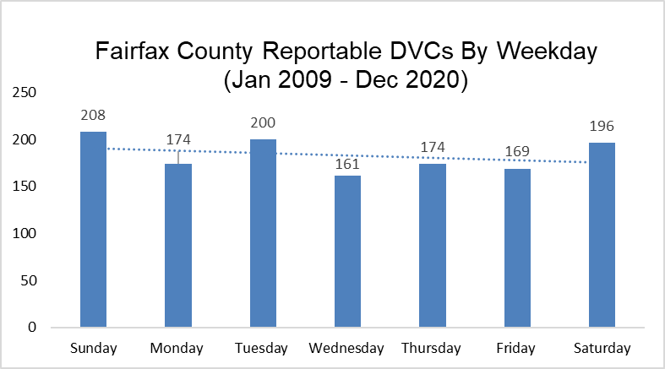
Deer-Vehicle Collision Trends
Reportable Deer-Vehicle Collisions Fairfax County (TREDS data)

Slide 26
26
Deer Management Data Collection – Camera Surveys
Standardized approach based on Jacobson et al. (1997) using infrared-triggered cameras to estimate deer at a bait station.
Restrictions on time of year that baited camera surveys can be conducted.
  Should be conducted post-fawning season but prior to antler drop (May to January)
  State regulations prohibit feeding deer after Sept 1. and through the end of the hunting season (April in Fairfax County).
  Allows consistency in sampling and comparison among parks over time to establish trends.
    Does not represent a complete census or exact number of deer.
    Not used to set bag limits in individual parks.

Slide 27
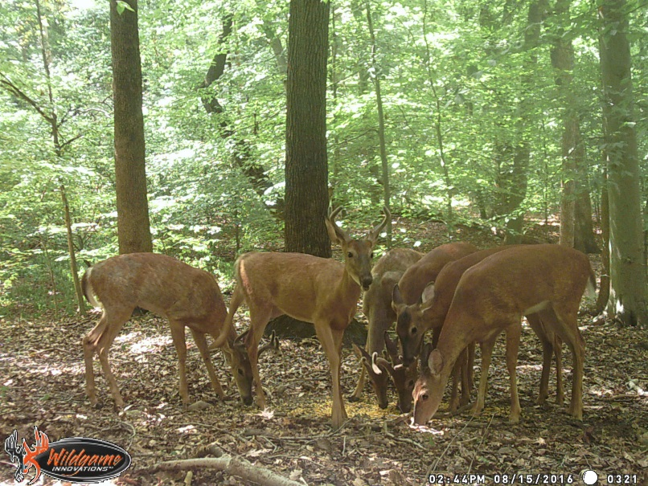
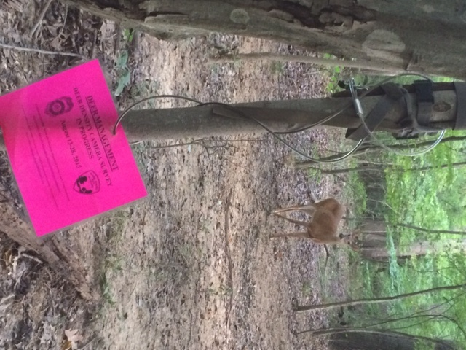
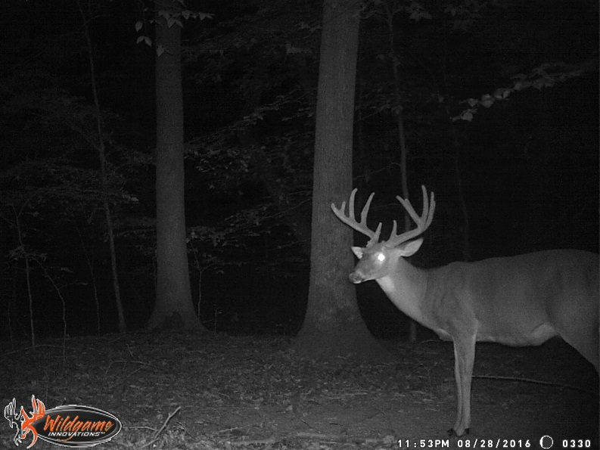
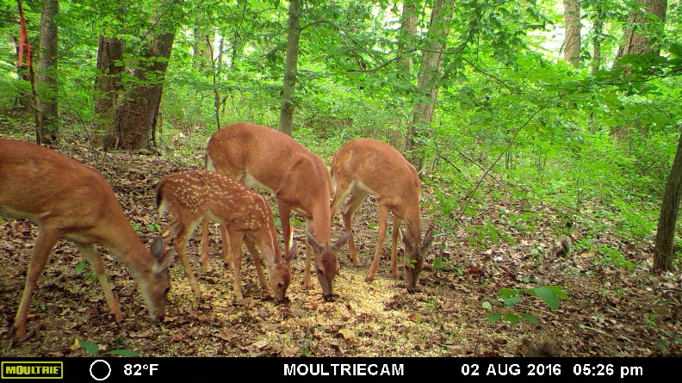
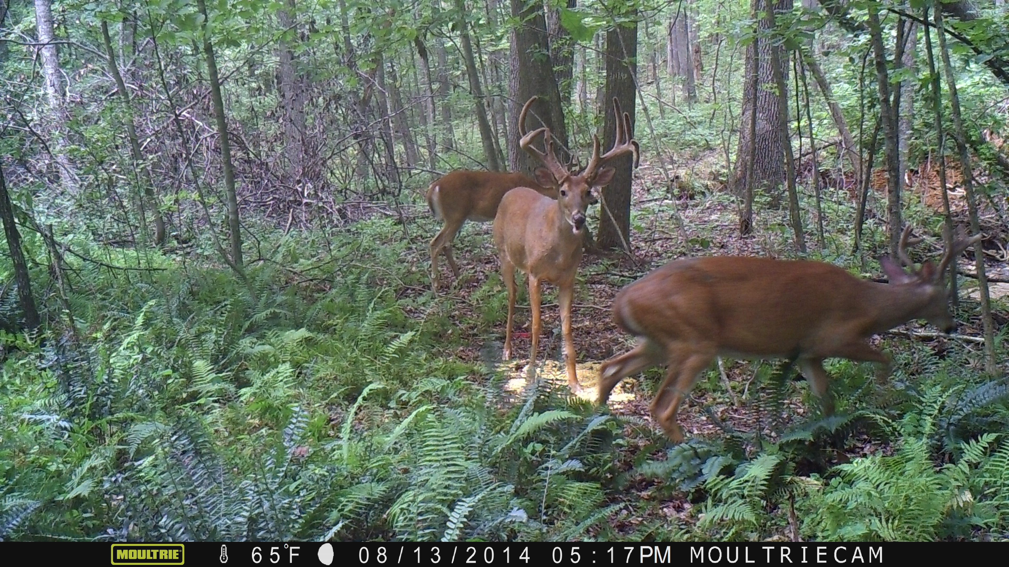
Deer Management Data Collection – Camera Surveys
Jacobson, H.A., J.C. Kroll, R.W. Browning, B.H. Koerth, and M.H. Conway. 1997. Infrared-triggered cameras for censusing white-tailed deer. Wildlife Society Bulletin 1997, 25(2):547-556.

Slide 28
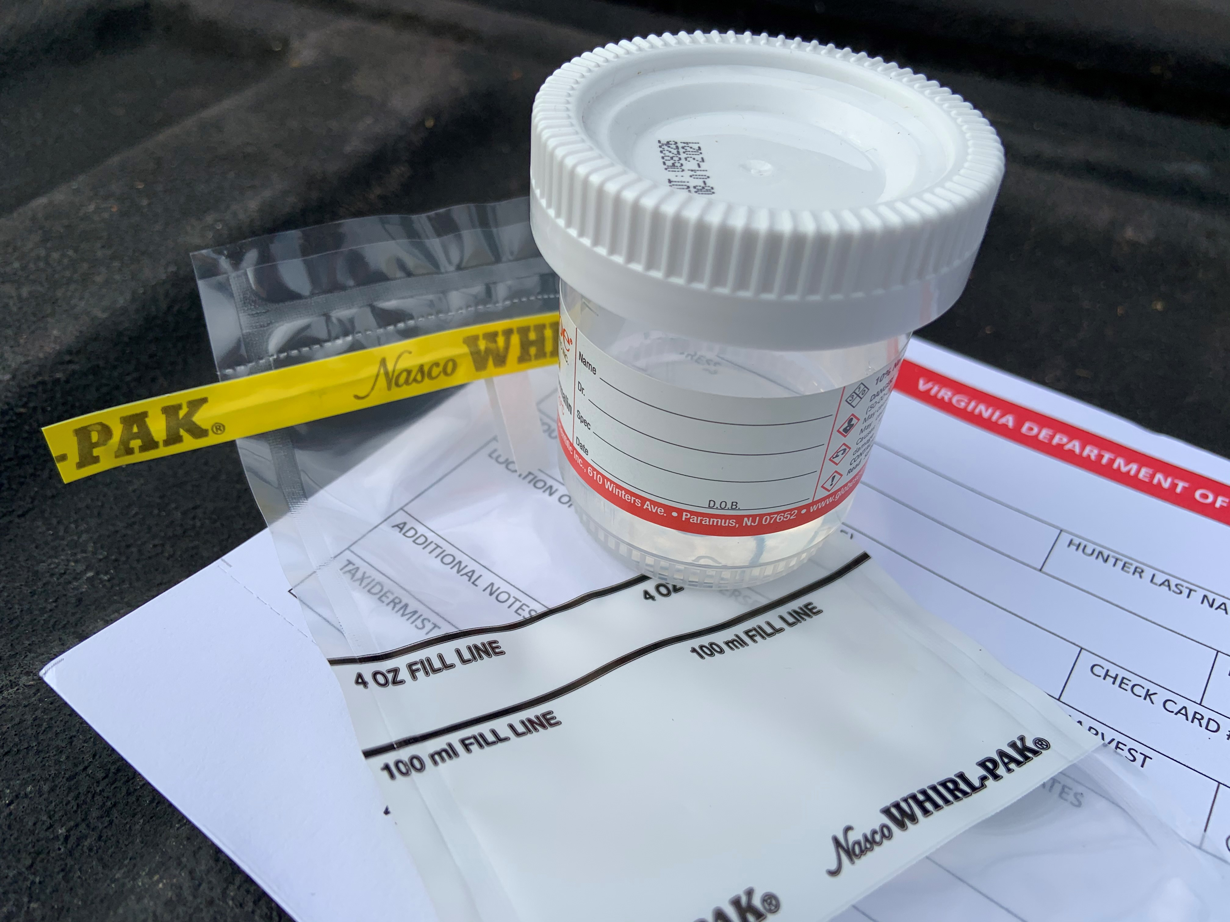
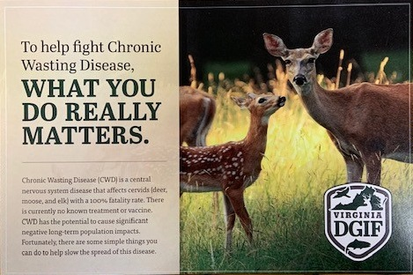
Deer Management Data Collection - CWD Surveillance
Staff conducted sampling of white-tailed deer for CWD surveillance from hunter-harvested deer dropped off at CWD freezer stations and from sharpshooting from October 2020 – March 2021.
Staff were trained by DWR personnel and followed agency guidelines for the sampling of deer and testing for CWD.
Medial retropharyngeal lymph node samples were collected from 132 deer harvested in 55 parks, plus 2 deer dispatched by Animal Protection Police.
Samples were submitted to the Wisconsin Veterinary Diagnostics Laboratory for CWD testing.
All results came back as “Not Detected.”
All test results were reported to the DWR State Wildlife Veterinarian and Wildlife Disease Biologist.

Slide 29
Fairfax County Deer Management Program
Archery Program Harvests (FY 2021)
Archery Program Locations | Archery Harvest
 | Doe | BBª | Antlered Buck | Antlerless Buck | Total
Accotink Stream Valley Cluster | 40 | 10 | 11 | 0 | 61
Bull Run Marina Cluster | 7 | 4 | 4 | 0 | 15
Bull Run Regional Park Cluster | 30 | 3 | 11 | 0 | 44
Clifton Cluster | 15 | 3 | 8 | 0 | 26
Colvin Run Cluster | 24 | 6 | 10 | 0 | 40
Cub Run Cluster | 49 | 11 | 24 | 0 | 84
Elklick Cluster | 36 | 3 | 18 | 0 | 57
Fairfax Station Cluster | 22 | 2 | 6 | 0 | 30
Fountainhead Cluster | 20 | 4 | 6 | 0 | 30
Great Falls Cluster | 47 | 7 | 13 | 1 | 68
Huntley Meadows Cluster | 41 | 5 | 11 | 0 | 57
Lake Accotink Cluster | 10 | 5 | 3 | 0 | 18
Laurel Hill Cluster | 51 | 7 | 21 | 1 | 80
Pohick Stream Valley Cluster | 24 | 0 | 6 | 0 | 30
Reston Cluster | 39 | 2 | 21 | 1 | 63
South Run Cluster | 14 | 2 | 6 | 0 | 22
Sugarland Cluster | 37 | 10 | 14 | 0 | 61
Vienna Cluster | 24 | 4 | 9 | 0 | 37
Archery Sex Ratio & Yearly Total | 530 | 88 | 202 | 3 | 823
Sharpshooting Operation Locations | Sharpshooting Harvest
 | Doe | BBª | Antlered Buck | Antlerless Buck | Total
Annandale Community Park | 4 | 1 | 6 | 1 | 12
Bren Mar Park/Turkeycock Run Stream Valley | 1 | 1 | 2 | 1 | 5
Chapel Road Park | 2 | 1 | 0 | 0 | 3
Frying Pan Farm Park | 4 | 2 | 4 | 0 | 10
Green Spring Gardens | 1 | 0 | 0 | 0 | 1
Huntley Meadows Park | 16 | 3 | 4 | 2 | 25
Sharpshooting Sex Ratio & Yearly Total | 28 | 8 | 16 | 4 | 56
FY21 Deer Management Program Non-Recovery Total: 8.44%

Slide 30
30
Fairfax County Deer Management Program
Summary Statistics (FY 2021)
Harvest Method | Harvest | Percent Total Harvest
Archery | 823 | 93.63%
Sharpshooting | 56 | 6.37%
FY21 Total Program Harvest | 879 | 100.00%
Sex Ratio Percentage by Harvest Method | Doe | BBª | Antlered Buck | Antlerless Buck
Archery | 64.40% | 10.69% | 24.54% | 0.36%
Sharpshooting | 50.00% | 14.29% | 28.57% | 7.14%
Sex Ratio Percentage (Total Harvests) | 63.48% | 10.92% | 24.80% | 0.80%
Antlerless vs. Antlered Deer Totals | Harvest |  | Total Harvest | Antlerless Percentage
 | Antlerless | Antlered
Archery | 621 | 202 | 823 | 75.46%
Sharpshooting | 40 | 16 | 56 | 71.43%

Slide 31
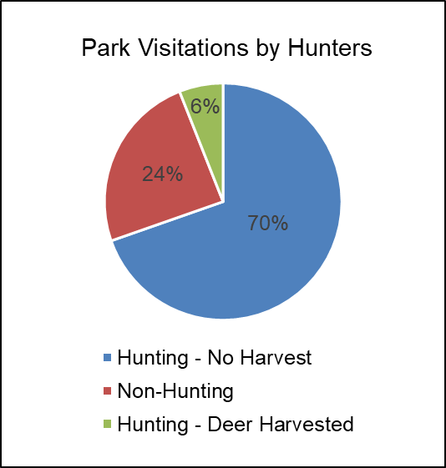
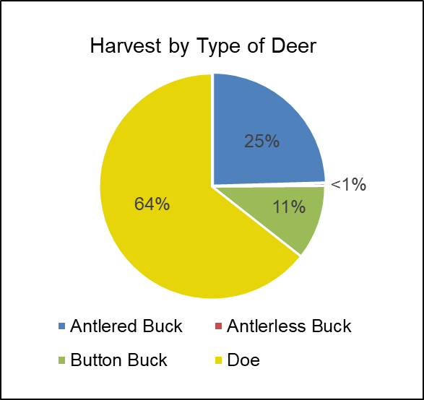
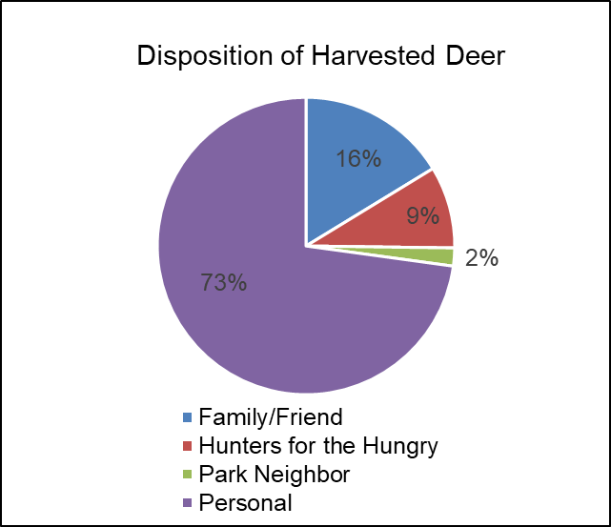
Fairfax County Deer Management Program
Summary Statistics (FY 2021)

Slide 32
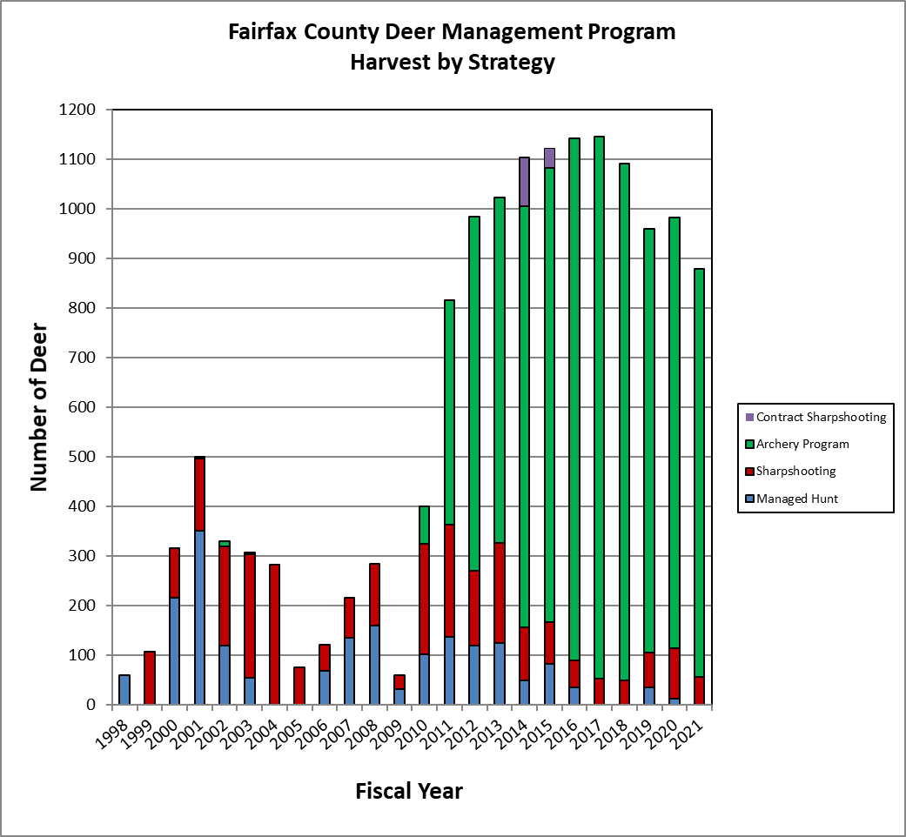
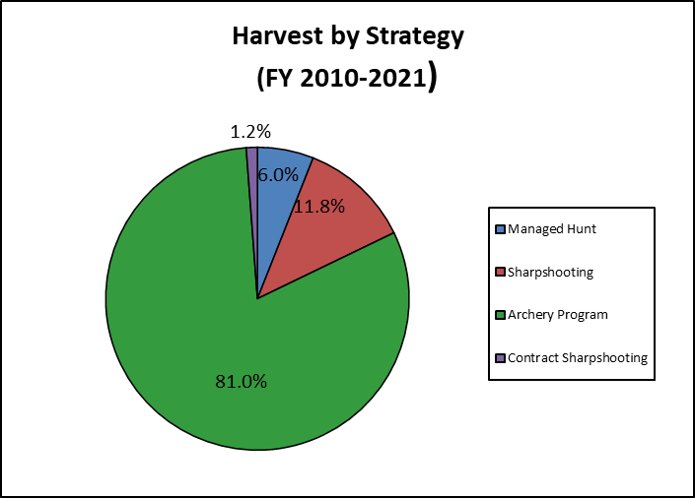
32
Program Harvest Totals (FY 1998-2021)

Slide 33
FAIRFAX COUNTY DEER MANAGEMENT
CONTACTS AND RESOURCES
Katherine Edwards
Fairfax County Police Department
Wildlife Management Specialist
703-246-6868
katherine.edwards@fairfaxcounty.gov
Fairfax County Animal Protection Police 703-691-2131
Virginia Wildlife Conflict Helpline (855) 571-9003
Monday – Friday 8:00AM-4:30PM (DWR & USDA Wildlife Services)
Deer Management Program website:
https://www.fairfaxcounty.gov/wildlife/deer-management-program
Sergeant Earit Powell
Fairfax County Police Department
Animal Protection Police
703-324-0280
earit.powell@fairfaxcounty.gov

Slide 34
50/50 Drawing for BXRC Foundation
Designing for the Future by Building on Strong Foundations
50/50 Drawing

Slide 35
Conclusion
Stand for the 4-way Test
Of the things we think, say, or do
Is it the TRUTH?
Is it FAIR to all concerned?
Will it build GOODWILL and BETTER FRIENDSHIPS?
Will it be BENEFICIAL to all concerned?

Slide 36

Rotary Club of Bailey’s Crossroad

