Slide 1
BXRC Club Meeting: 23 July, 2021
Rotary Club of Bailey’s Crossroads
Mustang Sales

Slide 2
Welcome!
Welcome
Chat before the bell rings
0730 Bell Rings
Rise for the Pledge of Allegiance
Sam Macharia

Slide 3
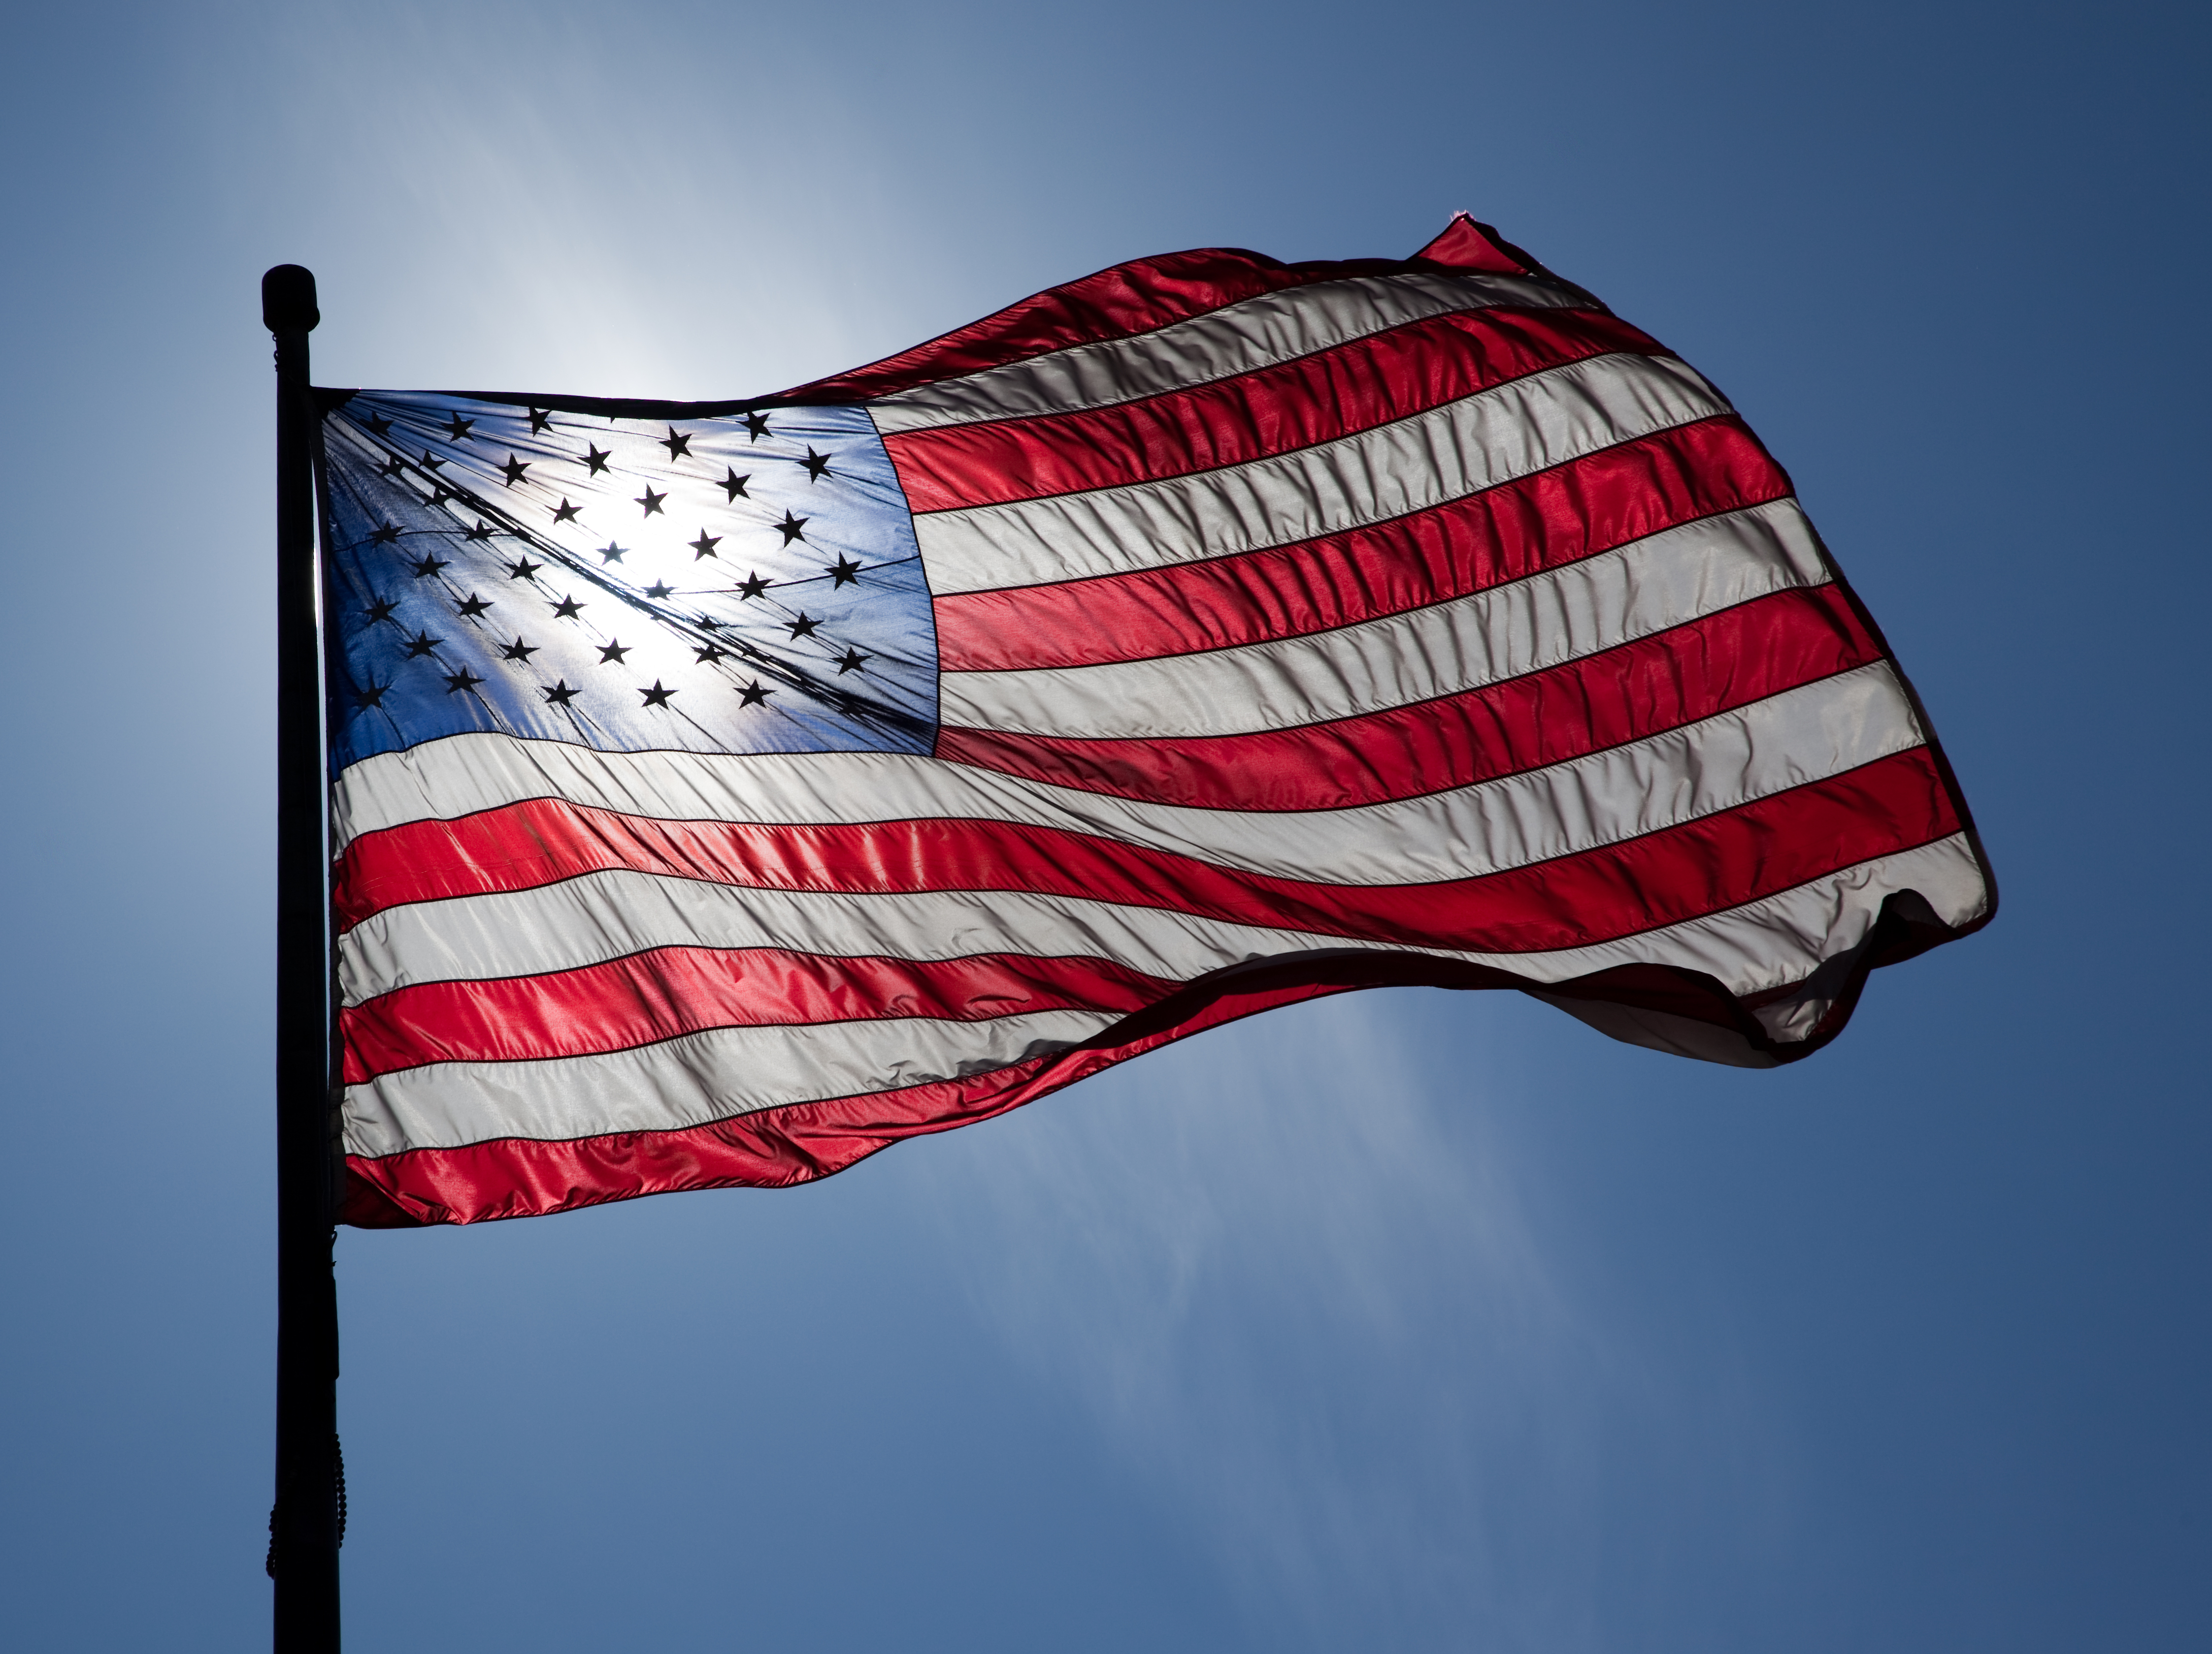
Flag
This Photo by Unknown Author is licensed under CC BY-ND

Slide 4
Welcome!
Invocation: Sam Macharia
Birthdays: Rob Cannon (7/22)
Song: Kathleen Kaspar-Paty
Guests: Marcia Miranda, Tony Gul, Melvin Witten
Announcements:
Marcia Miranda, Managua Rotary Club and Country Director of Empowerment International,
Mustang news – Sam and Dennis.
As of 22 July: Total - $40,975; $6,600 individual, $10,775 car side, $12,075 online, $5,500 advertisements, and $6,025 via mail

Slide 5
Mustang Raffle Car-Side Events
Designing for the Future by Building on Strong Foundations
Upcoming Opportunities:
7/24 – Katie’s in Great Falls 6:30 am – 9:00 am
7/25 – Fairfax Corner across from Chico’s
5:30 pm to 9:30 pm
7/31 – Fairfax Corner across from Chico’s
5:30 pm to 9:30 pm
8/7 - Fairfax Corner across from Chico’s
5:30 pm to 9:30 pm
8/14 – Fairfax Corner across from Chico’s
5:30 pm to 9:30 pm

Slide 6
Announcements
Designing for the Future by Building on Strong Foundations
Upcoming Programs and Events:
7/25 – Mason District Park Social –
5:00 pm at Tennis Courts; 6:00 pm Picnic at Amphitheater; 7:30 pm Sean Healy Celtic Trio at Amphitheater
7/30 – Introduction Speech - Christine Hunter
8/4 – Board Meeting
8/6 – China’s Maritime Claims: Sovereignty and Power - Dr. Bernard Cole and Dr. Christine Watson
8/7 – The Great Assembly – Moose Lodge
Noon to 2 pm. Invited to Bull Roast Following
8/13 – Ka Thandi Challenge – Tijani Musa
8/13 – Dogfish Head Alehouse Social 4:30 pm
8/20 – Cindy Metcalfe, Master Gardener on Fall Gardening

Slide 7
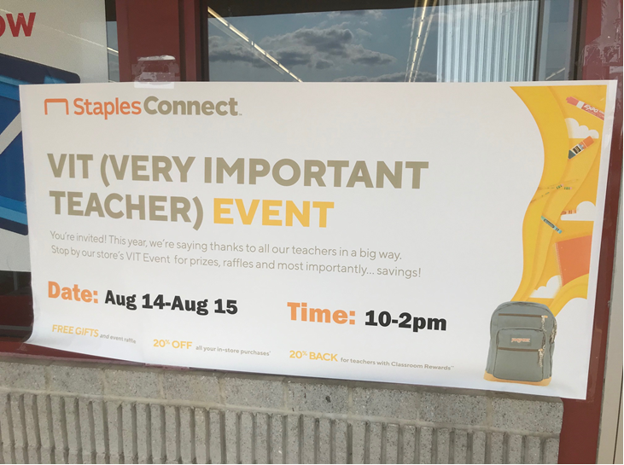
Announcements
Designing for the Future by Building on Strong Foundations

Slide 8
TODAY’S SPEAKER
Designing for the Future by Building on Strong Foundations
Techniques for Selling Mustang Raffle Tickets
Ian Charles and Rob Cannon

Slide 9
Conclusion
Stand for the 4-way Test
Of the things we think, say, or do
Is it the TRUTH?
Is it FAIR to all concerned?
Will it build GOODWILL and BETTER FRIENDSHIPS?
Will it be BENEFICIAL to all concerned?

Slide 10
Rotary Club of Bailey’s Crossroad

