Slide 1

BXRC Club Meeting: 17 September, 2021
Rotary Club of Bailey’s Crossroads
MicheLo Update

Slide 2
Welcome!
      Designing for the Future by Building on Strong Foundations
Welcome
    Chat before the bell rings
0730 Bell Rings
Rise for the Pledge of Allegiance
    Juanita Balenger

Slide 3
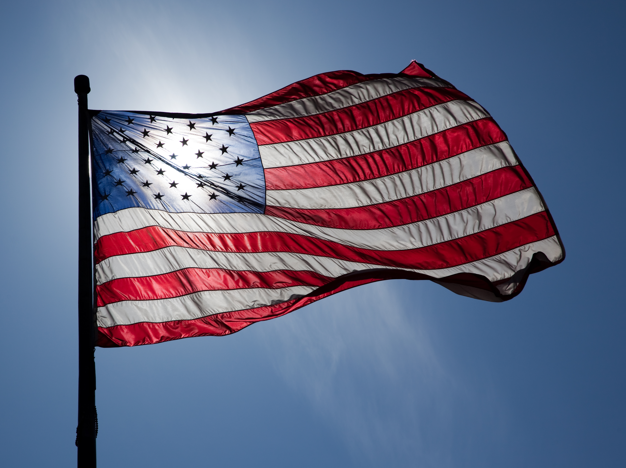
Flag
This Photo by Unknown Author is licensed under CC BY-ND

Slide 4
Welcome!
      Designing for the Future by Building on Strong Foundations
    Invocation: Sam Macharia
    Birthdays: None to report
    Anniversaries: None to report
    Song: Joe Luquire
    Guests: Welcome to our guests!
    Announcements:
      Dues
      KaThandi Challenge – Mustang match up to $2,500
      DG Dinner
      Dogfish Head Ale House Mixer

Slide 5
MUSTANG NEWS
      Designing for the Future by Building on Strong Foundations
    Joe, Dennis and Sam
      As of September 17, 2021:
        $ 8,500 Individual
        $ 26,200 Car side
        $ 6,250 Websites
        $ 10,750 Media
        $ 38,200 Mailing
        $ 8,900 Mail Chimp
        $ 98,900 Grand Total
        $ 83, 230.95 Cash Balance (9/1)

Slide 6
Mustang Raffle Car-Side Events
      Designing for the Future by Building on Strong Foundations
      Upcoming Opportunities:
        WE NEED SELLERS, CASHIERS and CHASE CAR
        9/18: Warrenton
        9/25 and 26: Occoquan Fall Festival

Slide 7
Announcements
      Designing for the Future by Building on Strong Foundations
      Upcoming Programs and Events:
        9/22 - Membership Mixer, Dogfish Head Alehouse (Tijani)
          https://www.eventbrite.com/e/baileys-crossroads-rotary-club-networking-event-tickets-166707914861?aff=ebdssbeac
          5:30 pm to 7:00 pm
        9/24 – Fairfax County Animal Control – Earit Powell
        10/1 – Club Forum #2
        10/6 – BXRC Board Meeting 7 pm – DG Pat Borowski
        10/7 – DG Dinner at Wildfire at 7:00 pm (Neesa)
        10/8 – DG 7610 Pat Borowski

Slide 8
Announcements
      Designing for the Future by Building on Strong Foundations
      Upcoming Programs and Events:
10/15: Glasgow MS - Victor Powell, Principal,
10/22: Palestinian Doctors in the Advanced Trauma Life Support (ATLS) Course - Walter Ruby
10/29: Ghosts, Goons and a Bunnyman – Cindy Bennett

Slide 9
Announcements
      Designing for the Future by Building on Strong Foundations
      Upcoming Programs and Events:
11/5: Native American Heritage Month – Jean Hovland
11/19: Introduction Speech – Justin Carwile
12/3: Justice HS - Tiffany Narcisse, Principal, 12/10: Election Update and Forecast – Tom Davis
12/17: Introduction Speech – Shona Person

Slide 10
TODAY’S SPEAKER
Designing for the Future by Building on Strong Foundations
MicheLo project 2021 –
When governments and communities experience discourse is when humanity must shine and be the light of hope – Michelle Peters

Slide 11
50/50 Drawing for BXRC Foundation
Designing for the Future by Building on Strong Foundations
50/50 Drawing

Slide 12
Conclusion
Stand for the 4-way Test
Of the things we think, say, or do
Is it the TRUTH?
Is it FAIR to all concerned?
Will it build GOODWILL and BETTER FRIENDSHIPS?
Will it be BENEFICIAL to all concerned?

Slide 13

Rotary Club of Bailey’s Crossroad

