Slide 1
BXRC Club Meeting: 9 July, 2021
Rotary Club of Bailey’s Crossroads
1st CLUB FORUM

Slide 2
Welcome!
Welcome
Chat before the bell rings
0730 Bell Rings
Rise for the Pledge of Allegiance
Michelle Peters

Slide 3
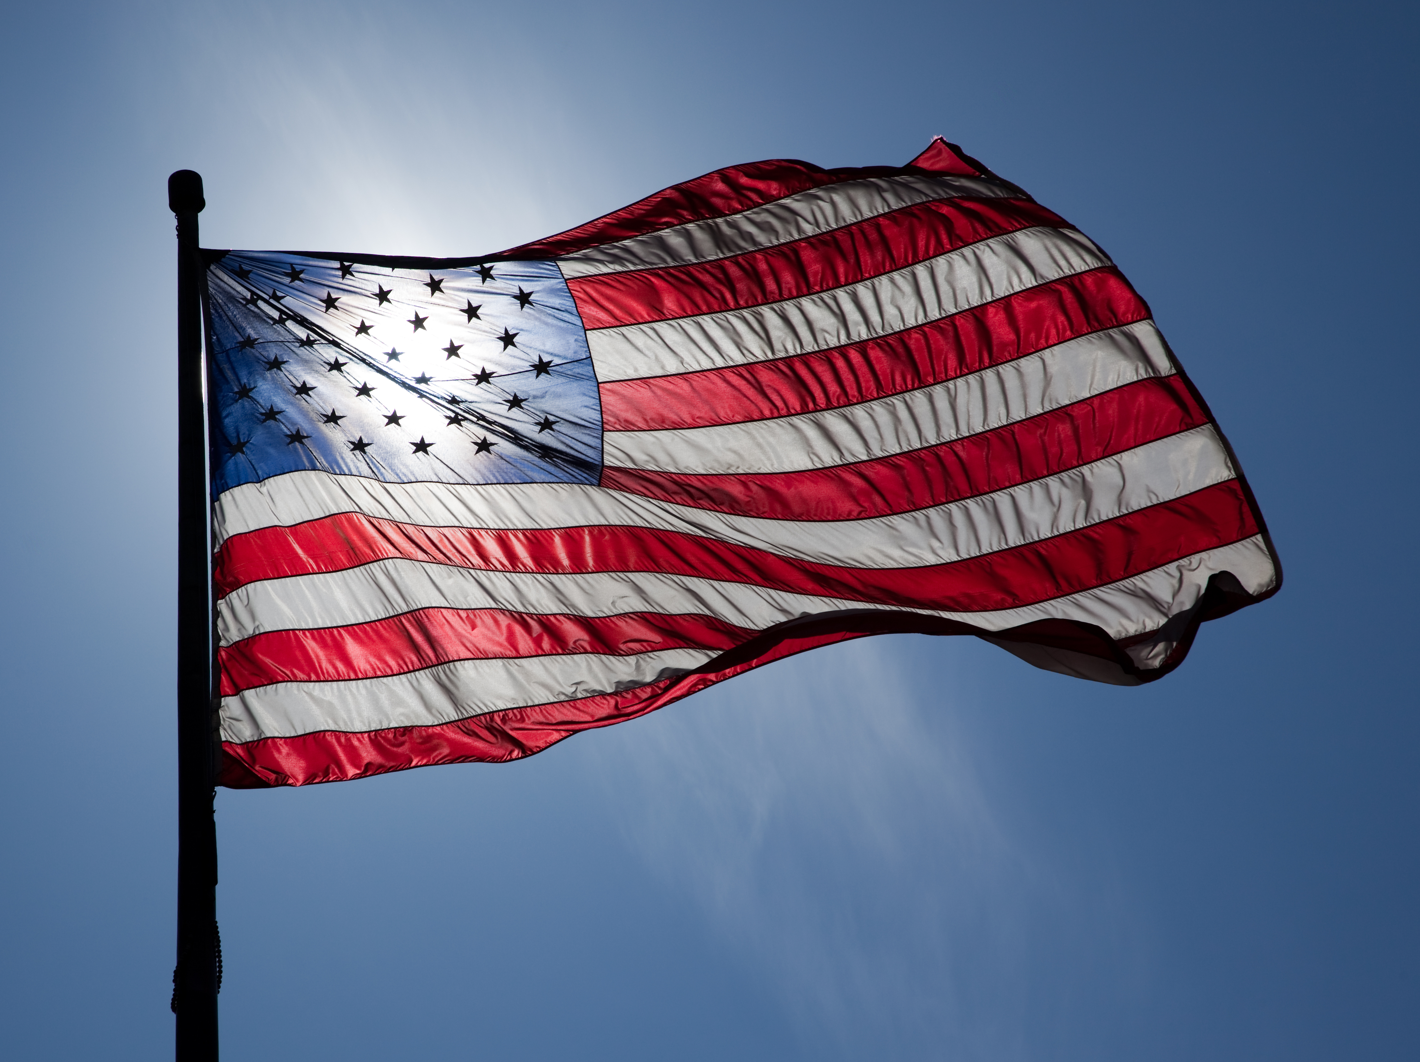
Flag
This Photo by Unknown Author is licensed under CC BY-ND

Slide 4
Welcome!
Invocation: Juanita Balenger
Birthdays: Susan Lydick (7/10), Kathleen Kaspar-Paty (7/15); Rob Cannon (7/22)
Song: Kathleen Kaspar-Paty
Guests: Tony Gul, Melvin Witten, Vilma Blanco-Pacheco
Announcements:
Mustang news – Sam and Dennis.

Slide 5
Announcements
Designing for the Future by Building on Strong Foundations
Upcoming Programs:
7/23 – Techniques for Selling Mustang Raffle Tickets - Ian Charles/Rob Cannon
7/25 - Come one come all for a family picnic and entertainment at Mason District Park at 6:00. The address is : 6621 Columbia Pike. Bring chairs or blanket and your own dinner. Please bring no wine or beer. The Sean Healy Celtic trio will start at 7:30 in the amphitheater. See you there!
7/30 – Introduction Speech - Christine Hunter

Slide 6
TODAY’S SPEAKER
Designing for the Future by Building on Strong Foundations
BXRC Citizens of the Year – The Outreach Program - Michelle and Bobby Polito

Slide 7
Conclusion
Stand for the 4-way Test
Of the things we think, say, or do
Is it the TRUTH?
Is it FAIR to all concerned?
Will it build GOODWILL and BETTER FRIENDSHIPS?
Will it be BENEFICIAL to all concerned?

Slide 8
Rotary Club of Bailey’s Crossroad

