Slide 1

BXRC Club Meeting: 13 August, 2021
Rotary Club of Bailey’s Crossroads
Cuba

Slide 2
Welcome!
      Designing for the Future by Building on Strong Foundations
Welcome
    Chat before the bell rings
0730 Bell Rings
Rise for the Pledge of Allegiance
    Sam Macharia

Slide 3
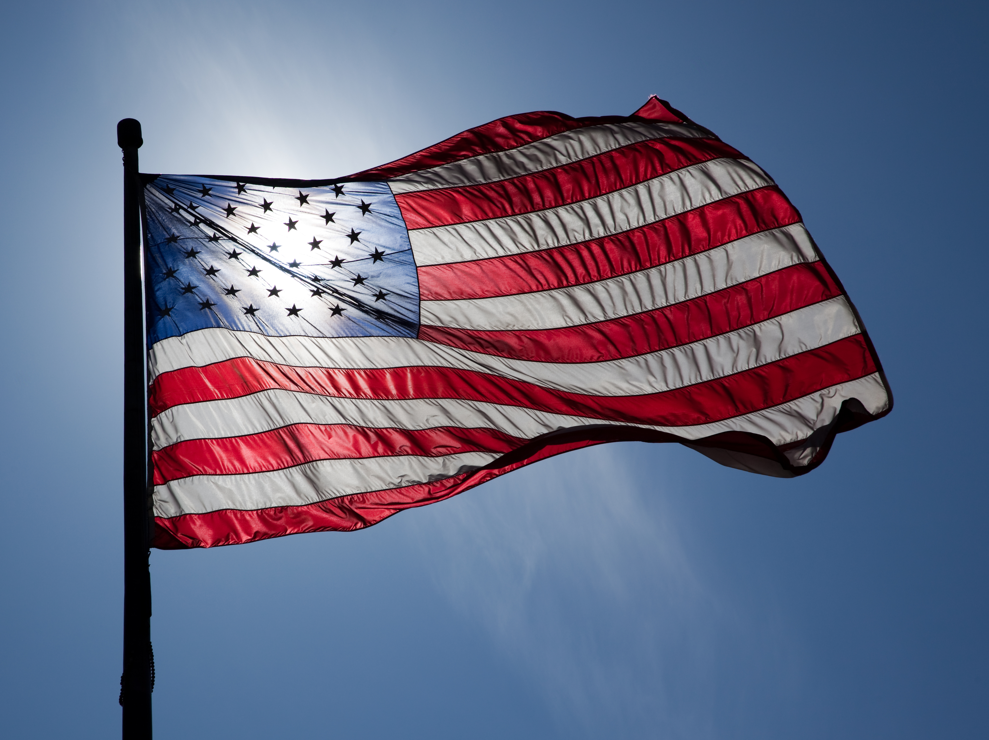
Flag
This Photo by Unknown Author is licensed under CC BY-ND

Slide 4
Welcome!
      Designing for the Future by Building on Strong Foundations
    Invocation: Kathleen Kaspar-Paty
Birthdays: Not this week
Rotary Anniversaries: Ben Hester (8/13/85); Max Gross (8/16/05); Kathleen Kaspar-Paty (8/16/19)
    Song: Joe Luquire
    Guests: TBD
    Announcements:
      Recap on The Great Assembly, Saturday, August 7, Noon to 2 pm at Moose Lodge
      Need volunteers for Saturday, August 14 at Fairfax Corner

Slide 5
MUSTANG NEWS
      Designing for the Future by Building on Strong Foundations
    Joe, Dennis and Sam
      As of August 12, 2021:
        $ 7,450 Individual
        $ 13,250 Car side
        $ 5,950 Websites
        $ 6,825 Media
        $ 21,025 Mailing
        $ 8,875 Mail Chimp
        $ 63,375 GrandTotal

Slide 6
Mustang Raffle Car-Side Events
      Designing for the Future by Building on Strong Foundations
      Upcoming Opportunities:
        8/14 – Fairfax Corner across from Chico’s and Sweetwater Tavern
          5:30 pm to 9:30 pm

Slide 7
Announcements
      Designing for the Future by Building on Strong Foundations
      Upcoming Programs and Events:
        8/13 – The Billy Price and his Charm City Rhythm Band (Blues)
          6 pm picnic; 7:30 pm music
        8/20 – Fall Container Gardening - Cindy Metcalfe, Master Gardener
        8/27 – Ka Thandi Challenge – Michelle Peters, Tijani Musa, Pamela Danner (McLean Rotary Club)

Slide 8
Announcements
      Designing for the Future by Building on Strong Foundations
      Upcoming Programs and Events:
        9/3 - Community Partners Benefit CSB Clients - Lee Ann Dispirito, Fairfax County Community Services Board
        9/10 - Unite2Light - Solar lighting for off grid communities and for the homeless – Megan Birney
        9/17 - MicheLo project 2021 - When governments and communities experience discourse is when humanity must shine and be the light of hope – Michelle Peters

Slide 9
TODAY’S SPEAKER
Designing for the Future by Building on Strong Foundations
2021 can be Cuba’s 1989, America’s Special Relationship with the American people – Jason Poblete

Slide 10

Learn More at:
https://www.globallibertyalliance.org/
Courthouse Square
510 King Street, Suite 340
Alexandria, VA 22314

Slide 11
Questions?:
https://www.globallibertyalliance.org/
Courthouse Square
510 King Street, Suite 340
Alexandria, VA 22314

Slide 12
50/50 Drawing for BXRC Foundation
Designing for the Future by Building on Strong Foundations
50/50 Drawing

Slide 13
Conclusion
Stand for the 4-way Test
Of the things we think, say, or do
Is it the TRUTH?
Is it FAIR to all concerned?
Will it build GOODWILL and BETTER FRIENDSHIPS?
Will it be BENEFICIAL to all concerned?

Slide 14

Rotary Club of Bailey’s Crossroad

