Slide 1
Welcome!
Designing for the Future by Building on Strong Foundations
DISTRICT 7610 COVID REQUIREMENTS
1. All attendees to wear masks. This places everyone, vaccinated and unvaccinated, on the same status. Post this requirement on your website, Facebook page, club newsletters, meeting announcements, and in direct communique to your members. Remind all invited guests and speakers of this requirement. 2. Keep a respectable social distance during indoor meetings. If food is served, avoid buffet-style. Masks can be removed for eating and drinking only and put back on once eating or drinking is finished. 3. Please provide hand sanitizers, tissues, sanitary wipes and masks at your locations. Wipe down podiums and microphones after each person’s use. 4. As much as possible, meet in outdoor settings or rooms with adequate outside ventilation. 5. Continue hybrid-meeting formats. We do not want to abandon our Rotarian-members who do not feel comfortable, yet, coming to in-person meetings. 6. Please remember the COVID status requirements of neighboring municipalities and states; and that businesses, and all other organizations have the right to require mass-wearing by patrons, visitors, participates, attendees and the like.

Slide 2
BXRC Club Meeting: 8 October 2021
Rotary Club of Bailey’s Crossroads
District 7610 Governor Pat Borowski

Slide 3
Welcome!
Welcome
Chat before the bell rings
0730 Bell Rings
Rise for the Pledge of Allegiance

Slide 4
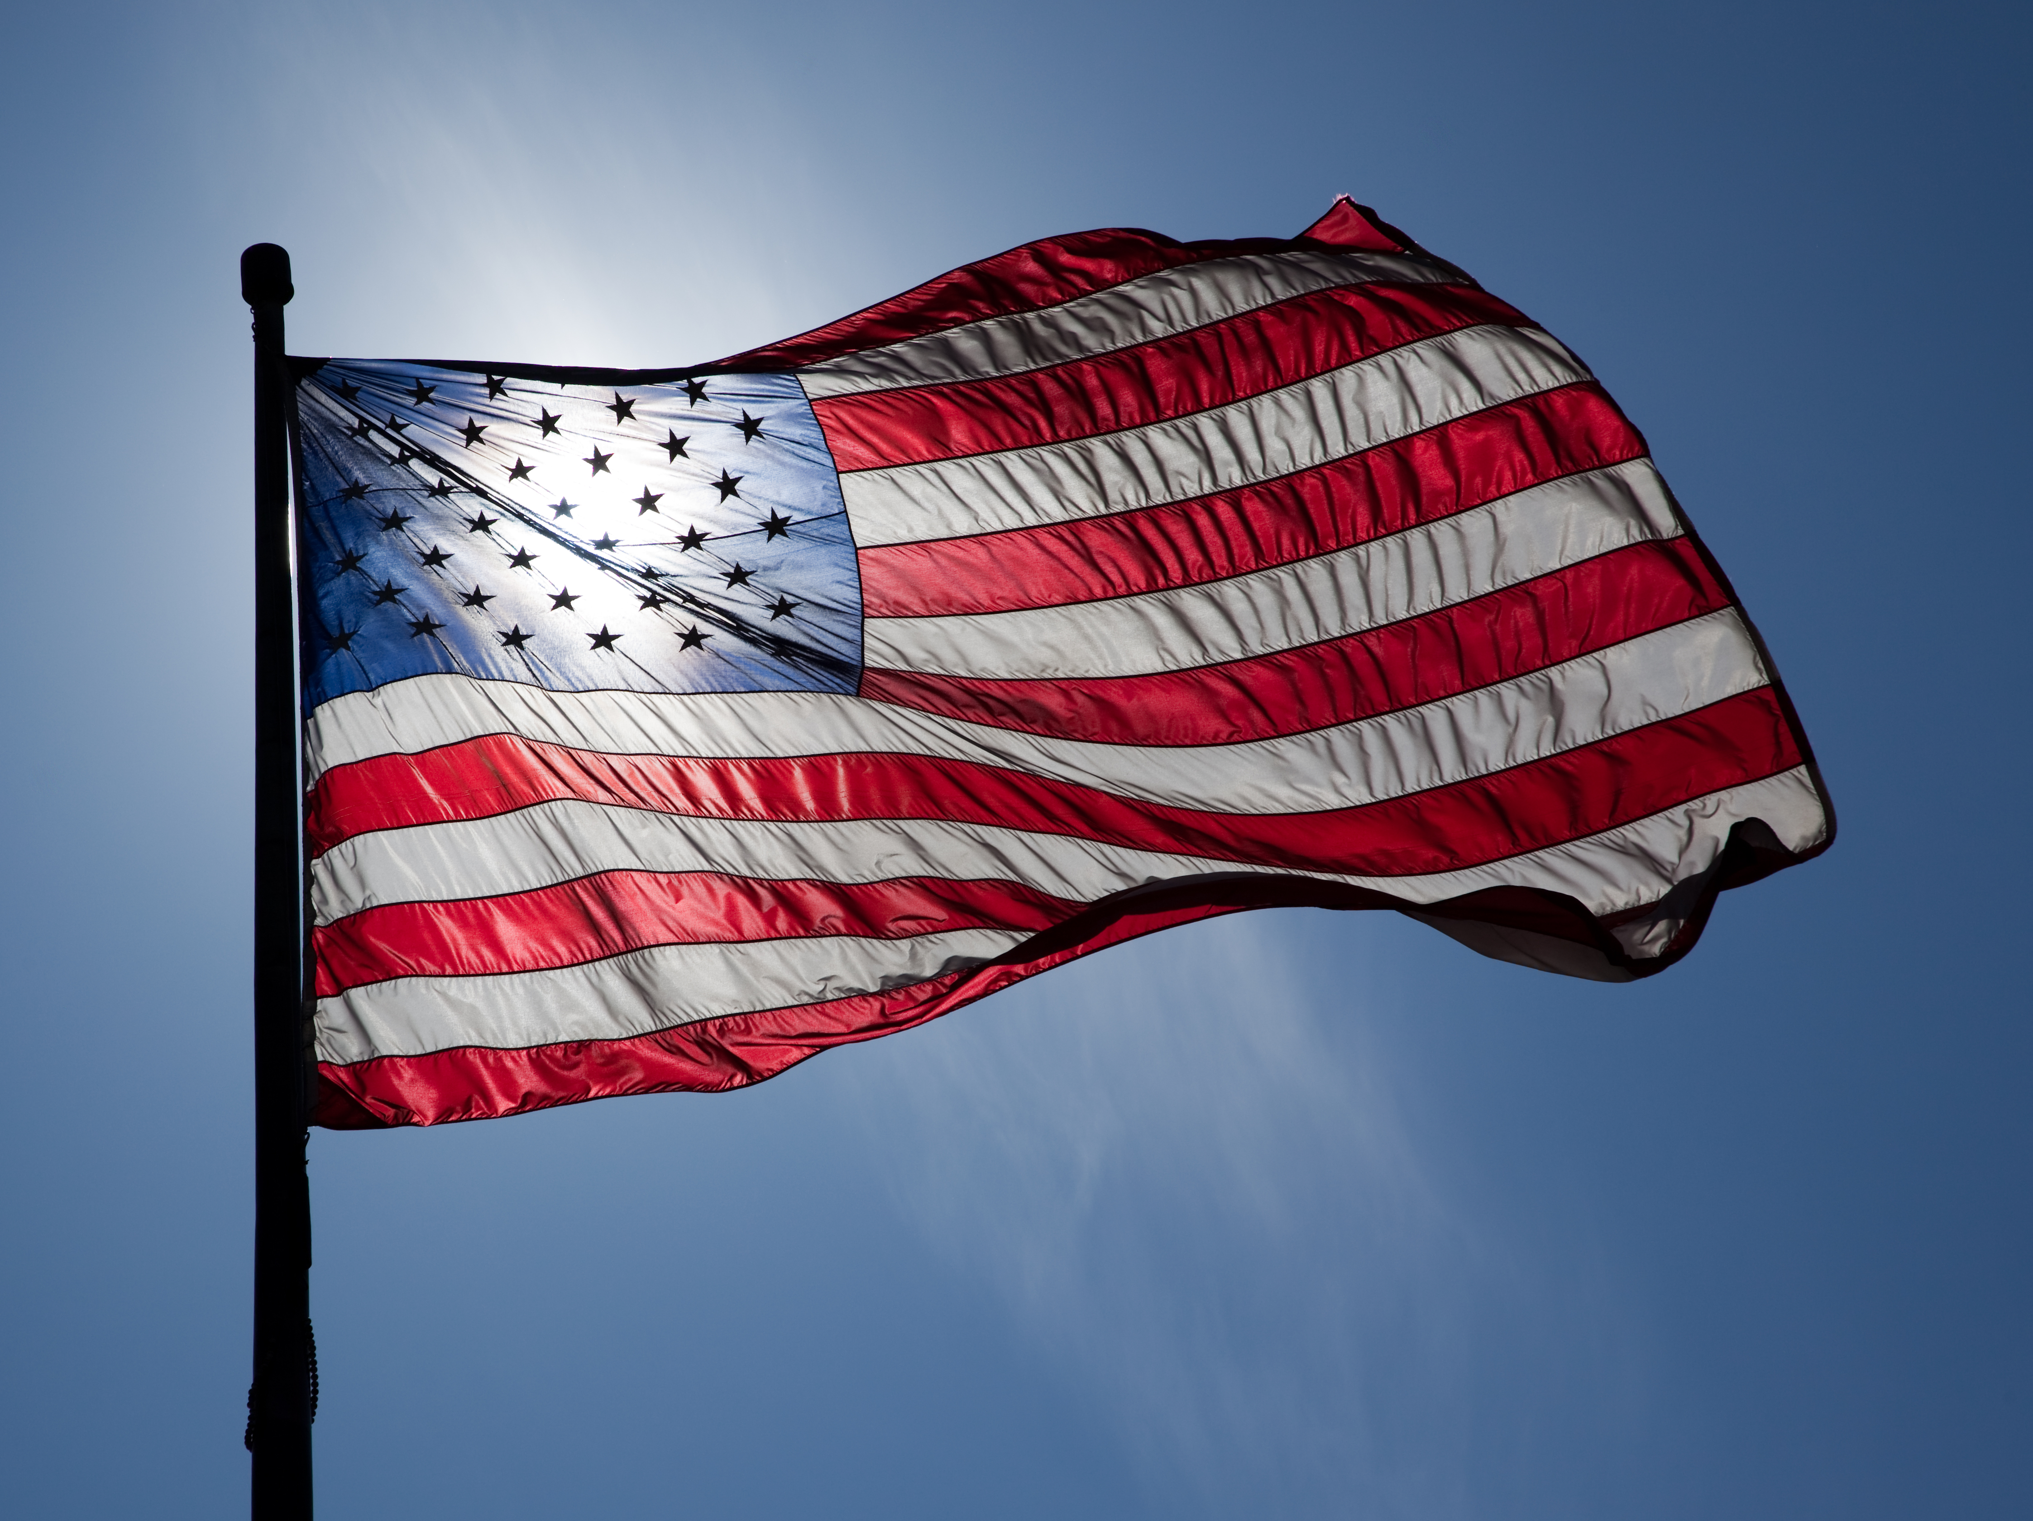
Flag
This Photo by Unknown Author is licensed under CC BY-ND

Slide 5
Invocation
Designing for the Future by Building on Strong Foundations
Invocation:

Slide 6
Announcements
Designing for the Future by Building on Strong Foundations
Birthdays: John Thomas (10/9)
Anniversaries:
Song: Joe Luquire
Guests: Welcome to our guests!
Announcements:
DG Nominations due 11/19/2021
RLI Training is available online (Zoom)
Masks

Slide 7
Welcome!
Designing for the Future by Building on Strong Foundations
DISTRICT 7610 COVID REQUIREMENTS
1. All attendees to wear masks. This places everyone, vaccinated and unvaccinated, on the same status. Post this requirement on your website, Facebook page, club newsletters, meeting announcements, and in direct communique to your members. Remind all invited guests and speakers of this requirement. 2. Keep a respectable social distance during indoor meetings. If food is served, avoid buffet-style. Masks can be removed for eating and drinking only and put back on once eating or drinking is finished. 3. Please provide hand sanitizers, tissues, sanitary wipes and masks at your locations. Wipe down podiums and microphones after each person’s use. 4. As much as possible, meet in outdoor settings or rooms with adequate outside ventilation. 5. Continue hybrid-meeting formats. We do not want to abandon our Rotarian-members who do not feel comfortable, yet, coming to in-person meetings. 6. Please remember the COVID status requirements of neighboring municipalities and states; and that businesses, and all other organizations have the right to require mass-wearing by patrons, visitors, participates, attendees and the like.

Slide 8
MUSTANG NEWS
Designing for the Future by Building on Strong Foundations
Joe, Dennis and Sam
As of October 7, 2021:
$ 10.300 Individual
$ 41,425 Car side
$ 7,150 Websites
$ 12,775 Media
$ 39,725 Mailing
$ 8,900 Mail Chimp
$120,275 Grand Total
$ 126,550.00 Cash Balance (9/30/2021)
DRAWING DATE: 11/11/2021 AT 11:00 AM

Slide 9
Mustang Raffle Car-Side Events
Designing for the Future by Building on Strong Foundations
Upcoming Opportunities:
WE NEED SELLERS, CASHIERS and CHASE CAR
10/16: Cars and Coffee, Matt Curry’s, Kingstown, 8 am – 10:30 am
10/17: Crafts-n-Drafts, Manassas, 11 am – 4pm
Katie’s anyone??

Slide 10
Announcements
Designing for the Future by Building on Strong Foundations
Upcoming Programs and Events:
10/13 – New Member/Membership HH – Pistone’s; 5:30 to 7:30 pm
10/15: Glasgow MS - Victor Powell, Principal,
10/22: Palestinian Doctors in the Advanced Trauma Life Support (ATLS) Course - Walter Ruby
10/29: Ghosts, Goons and a Bunnyman – Cindy Bennett

Slide 11
Announcements
Designing for the Future by Building on Strong Foundations
Upcoming Programs and Events:
11/5: Native American Heritage Month – Jean Hovland
11/12: Rotary Foundation Month – Polly Rosenstein, Area 9
11/19: Introduction Speech – Justin Carwile
11/26: Santa Claus
12/3: Justice HS - Tiffany Narcisse, Principal, 12/10: Election Update and Forecast – Tom Davis
12/17: Introduction Speech – Shona Person

Slide 12
TODAY’S SPEAKER
District 7610 Governor
Pat Borowski
BXRC’s Own

Slide 13
Conclusion
Stand for the 4-way Test
Of the things we think, say, or do
Is it the TRUTH?
Is it FAIR to all concerned?
Will it build GOODWILL and BETTER FRIENDSHIPS?
Will it be BENEFICIAL to all concerned?

Slide 14
Rotary Club of Bailey’s Crossroad

