Slide 1

BXRC Club Meeting: 06 August, 2021
Rotary Club of Bailey’s Crossroads
China

Slide 2
Welcome!
      Designing for the Future by Building on Strong Foundations
Welcome
    Chat before the bell rings
0730 Bell Rings
Rise for the Pledge of Allegiance
    Juanita Balenger

Slide 3

Flag
This Photo by Unknown Author is licensed under CC BY-ND

Slide 4
Welcome!
      Designing for the Future by Building on Strong Foundations
    Invocation: Kathleen Kaspar-Paty
    Birthdays: Not this week
    Song: Joe Luquire
    Guests: TBD
    Announcements:
      The Great Assembly, Saturday, August 7, Noon to 2 pm at Moose Lodge; Bull Roast to follow
        Volunteers
        Prospective Member Opportunity
      Kevin Sun approved for membership by Board
      Breakfasts $13.00 starting August 13, 2021

Slide 5
MUSTANG NEWS
      Designing for the Future by Building on Strong Foundations
    Joe, Dennis and Sam
      As of August 5, 2021:
        $ 7,400 Individual
        $ 12,950 Car side
        $ 5,950 Websites
        $ 6,825 Media
        $ 11,350 Mailing
        $ 8,875 Mail Chimp
        $ 53,350 GrandTotal

Slide 6
Mustang Raffle Car-Side Events
      Designing for the Future by Building on Strong Foundations
      Upcoming Opportunities:
        8/7 - Fairfax Corner across from Chico’s
          5:30 pm to 9:30 pm
        8/14 – Fairfax Corner across from Chico’s
          5:30 pm to 9:30 pm

Slide 7
Announcements
      Designing for the Future by Building on Strong Foundations
      Upcoming Programs and Events:
        8/7 – The Great Assembly – Moose Lodge
          Noon to 2 pm. Invited to Bull Roast Following
        8/13 – Cuba – Jason I. Poblete, Global Liberty Alliance
        8/13 – The Billy Price and his Charm City Rhythm Band (Blues)
          6 pm picnic; 7:30 pm music
        8/20 – Fall Gardening - Cindy Metcalfe, Master Gardener
        8/27 – Ka Thandi Challenge – Michelle Peters, Tijani Musa, Pamela Danner (McLean Rotary Club)

Slide 8
Announcements
      Designing for the Future by Building on Strong Foundations
      Upcoming Programs and Events:
        9/3 - Community Partners Benefit CSB Clients - Lee Ann Dispirito, Fairfax County Community Services Board
        9/10 - Unite2Light - Solar lighting for off grid communities and for the homeless – Megan Birney
        9/17 - MicheLo project 2021 - When governments and communities experience discourse is when humanity must shine and be the light of hope – Michelle Peters

Slide 9
TODAY’S SPEAKER
Designing for the Future by Building on Strong Foundations
No Longer Eating Bitter Fruit: the CCP's aim today. – Dr. Cynthia Watson
China’s Maritime Claims: Sovereignty and Power. - Dr. Bernard Cole

Slide 10
Xi’s CCP Demands Respect
Cynthia Watson, PhD, Interim Provost and Vice President for Academic Affairs, the National Defense University
Bailey’s Crossroads Rotary Club 6 August 2021

Slide 11
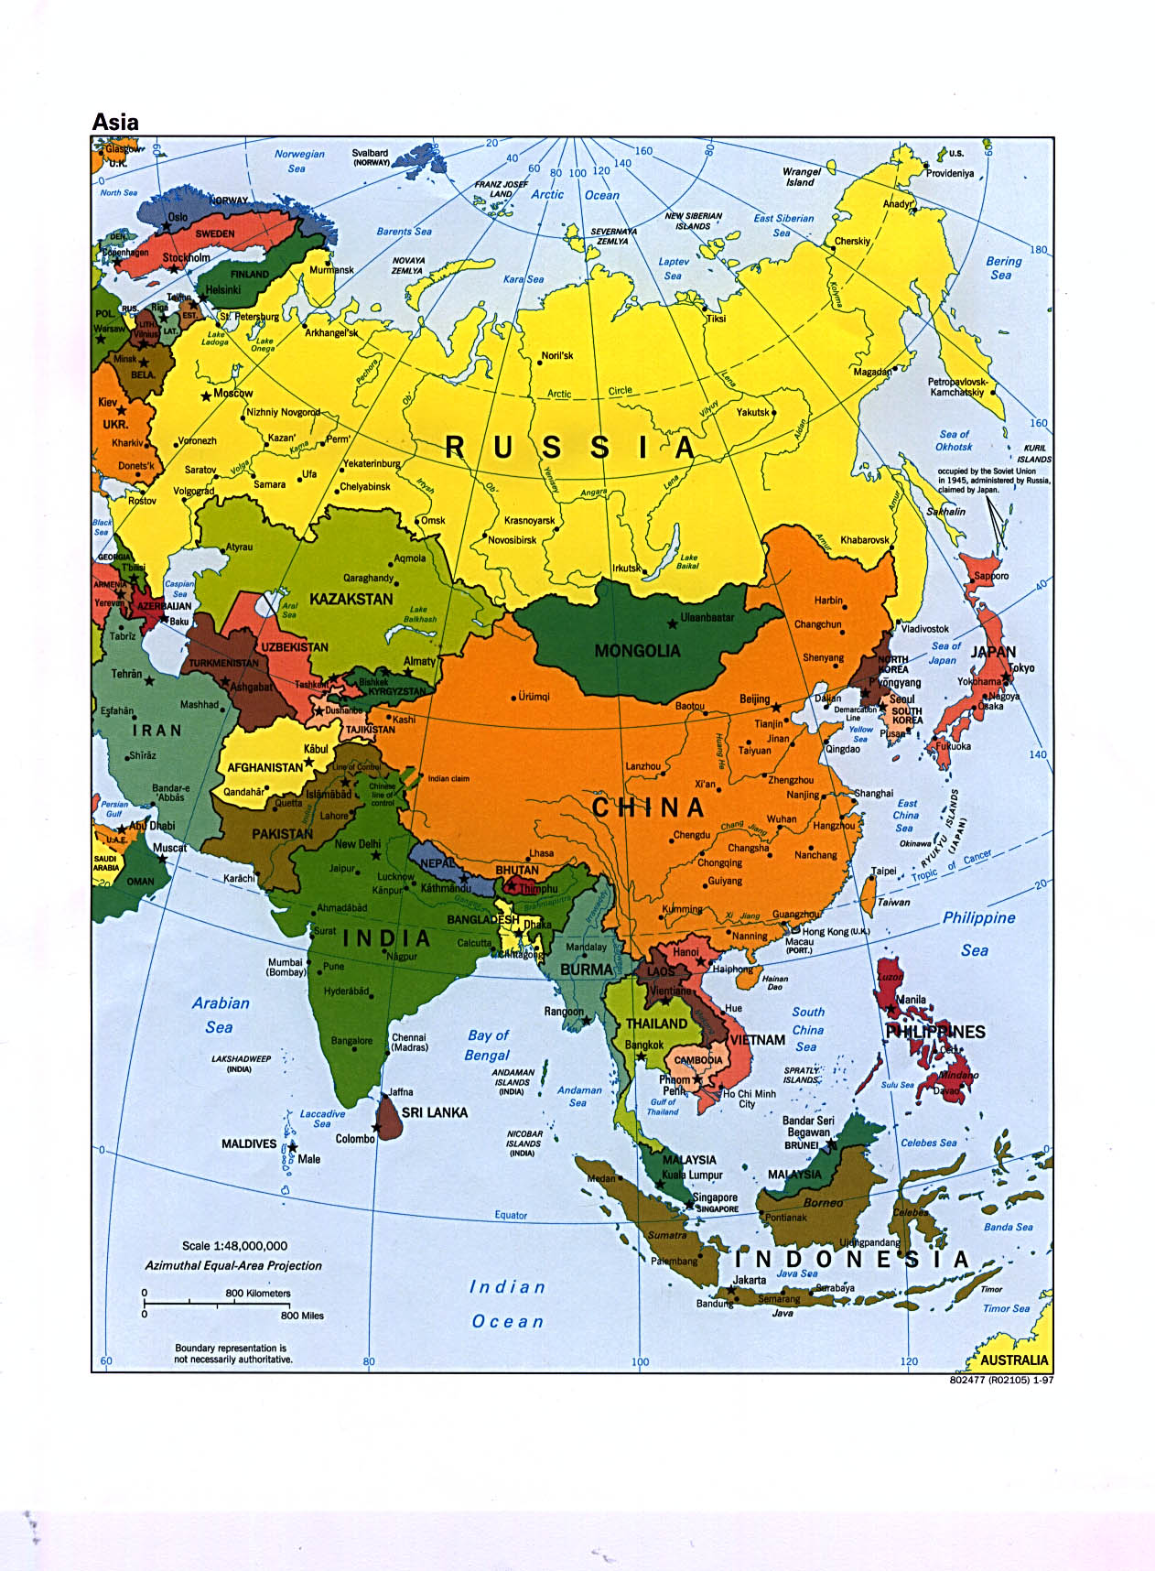

Slide 12
P.R.C. strategic context
Geography
The ‘Middle Kingdom’ and 'Mandate of Heaven’
The 'New China': CCP rule with modern tools, including nationalism through anti-colonialism
  The ‘Century of Humiliation’, 1842-1949
  ‘China is no longer on its knees’
  Great Leap Forward/Cultural Revolution
  ‘Four Modernisations’
  Xi Jinping’s national renovation increasingly a nationalist, authoritarian w/ Maoist characteristics

Slide 13
Xi's China: a CCP-driven rule
Primary goal: KEEPING THE PARTY IN POWER as focus
Balancing rising expectations versus reality
  Growing economic/social/geographic disparities
  Economic growth over, challenged, or 'getting by'?
  Environmental threats: getting a handle on it?
  Demographic realities: boys, girls, young, old
  Taiwan/Xinjiang/Tibet
  Burgeoning nationalism
  'Anti-corruption': consolidation of Xi’s and returning CCP to center of daily life
Providing remarkably adapt at addressing expectations and complaints w/o surrendering power

Slide 15
CHINA REACHES OUT:
SOVEREIGNTY AND THE MILITARY
Bernard D. Cole, Ph.D.
Captain, USN (Ret.)
Professor Emeritus, National War College
The views presented herein are the author’s alone and do not reflect those of the Center for Naval Analyses, the National War College, or any agency of the USG

Slide 17
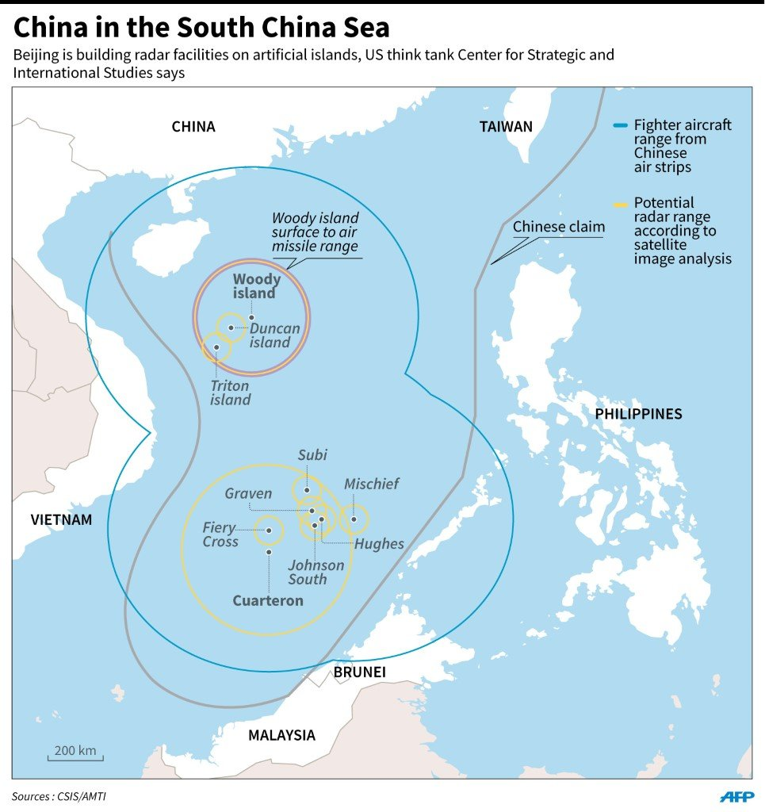

Slide 18
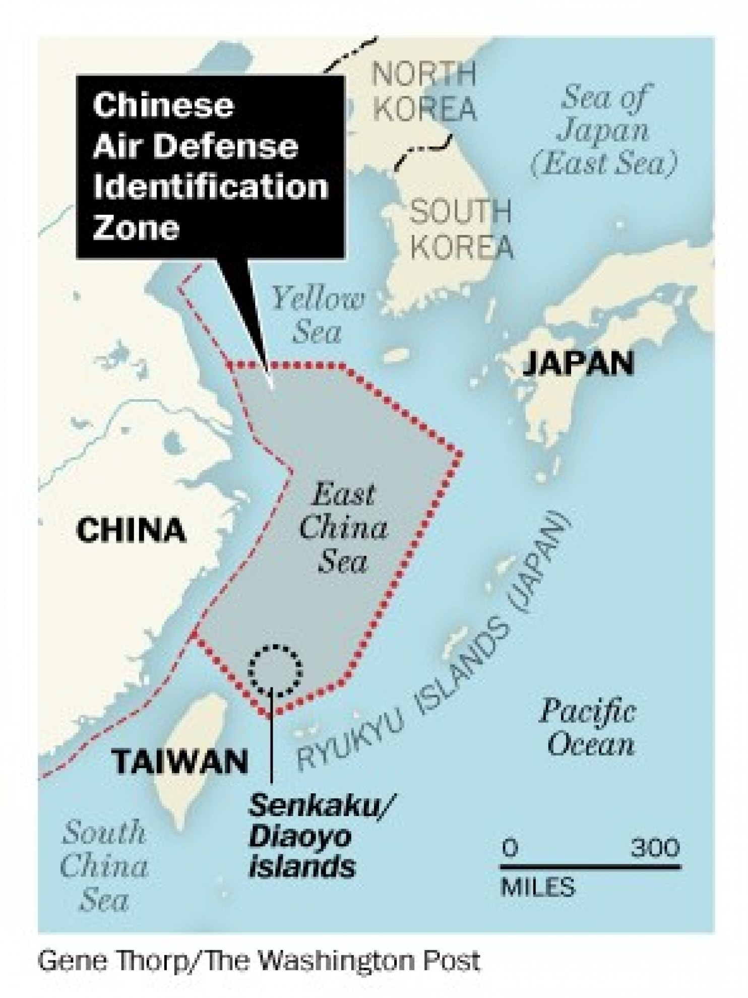

Slide 19
DIPLOMACY
ALL BORDER DISPUTES RESOLVED—EXCEPT WITH INDIA
“DIPLOMATIC PARTNERSHIPS” WITH MANY COUNTRIES
  E.G., SOUTHEAST ASIA:
  BRUNEI: STRATEGIC COOPERATIVE PARTNERSHIP, 2018
  CAMBODIA: 2018
  INDONESIA: 2013
  LAOS: 2018
  MALAYSIA: 2013
  MYANMAR: 2012
  PHILIPPINES: 2018
  SINGAPORE: 2015
  THAILAND: 2012
  VIETNAM: 2018
  ASEAN: 2003

Slide 20
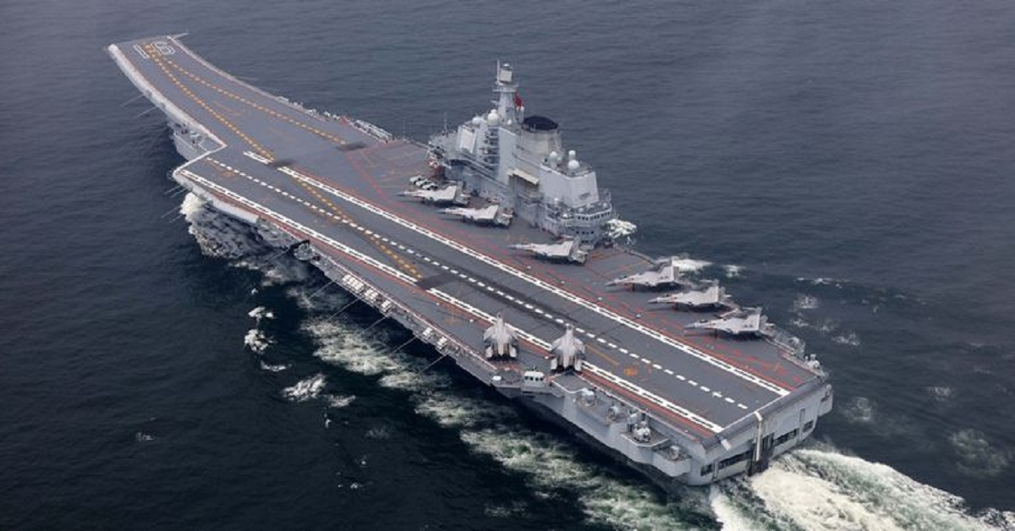

Slide 22
50/50 Drawing for BXRC Foundation
Designing for the Future by Building on Strong Foundations
50/50 Drawing

Slide 23
Conclusion
Stand for the 4-way Test
Of the things we think, say, or do
Is it the TRUTH?
Is it FAIR to all concerned?
Will it build GOODWILL and BETTER FRIENDSHIPS?
Will it be BENEFICIAL to all concerned?

Slide 24

Rotary Club of Bailey’s Crossroad

