Slide 1

BXRC Club Meeting: 03 September, 2021
Rotary Club of Bailey’s Crossroads
Community Partners Benefit CSB Clients

Slide 2
Welcome!
      Designing for the Future by Building on Strong Foundations
Welcome
    Chat before the bell rings
0730 Bell Rings
Rise for the Pledge of Allegiance
    John Thomas

Slide 3
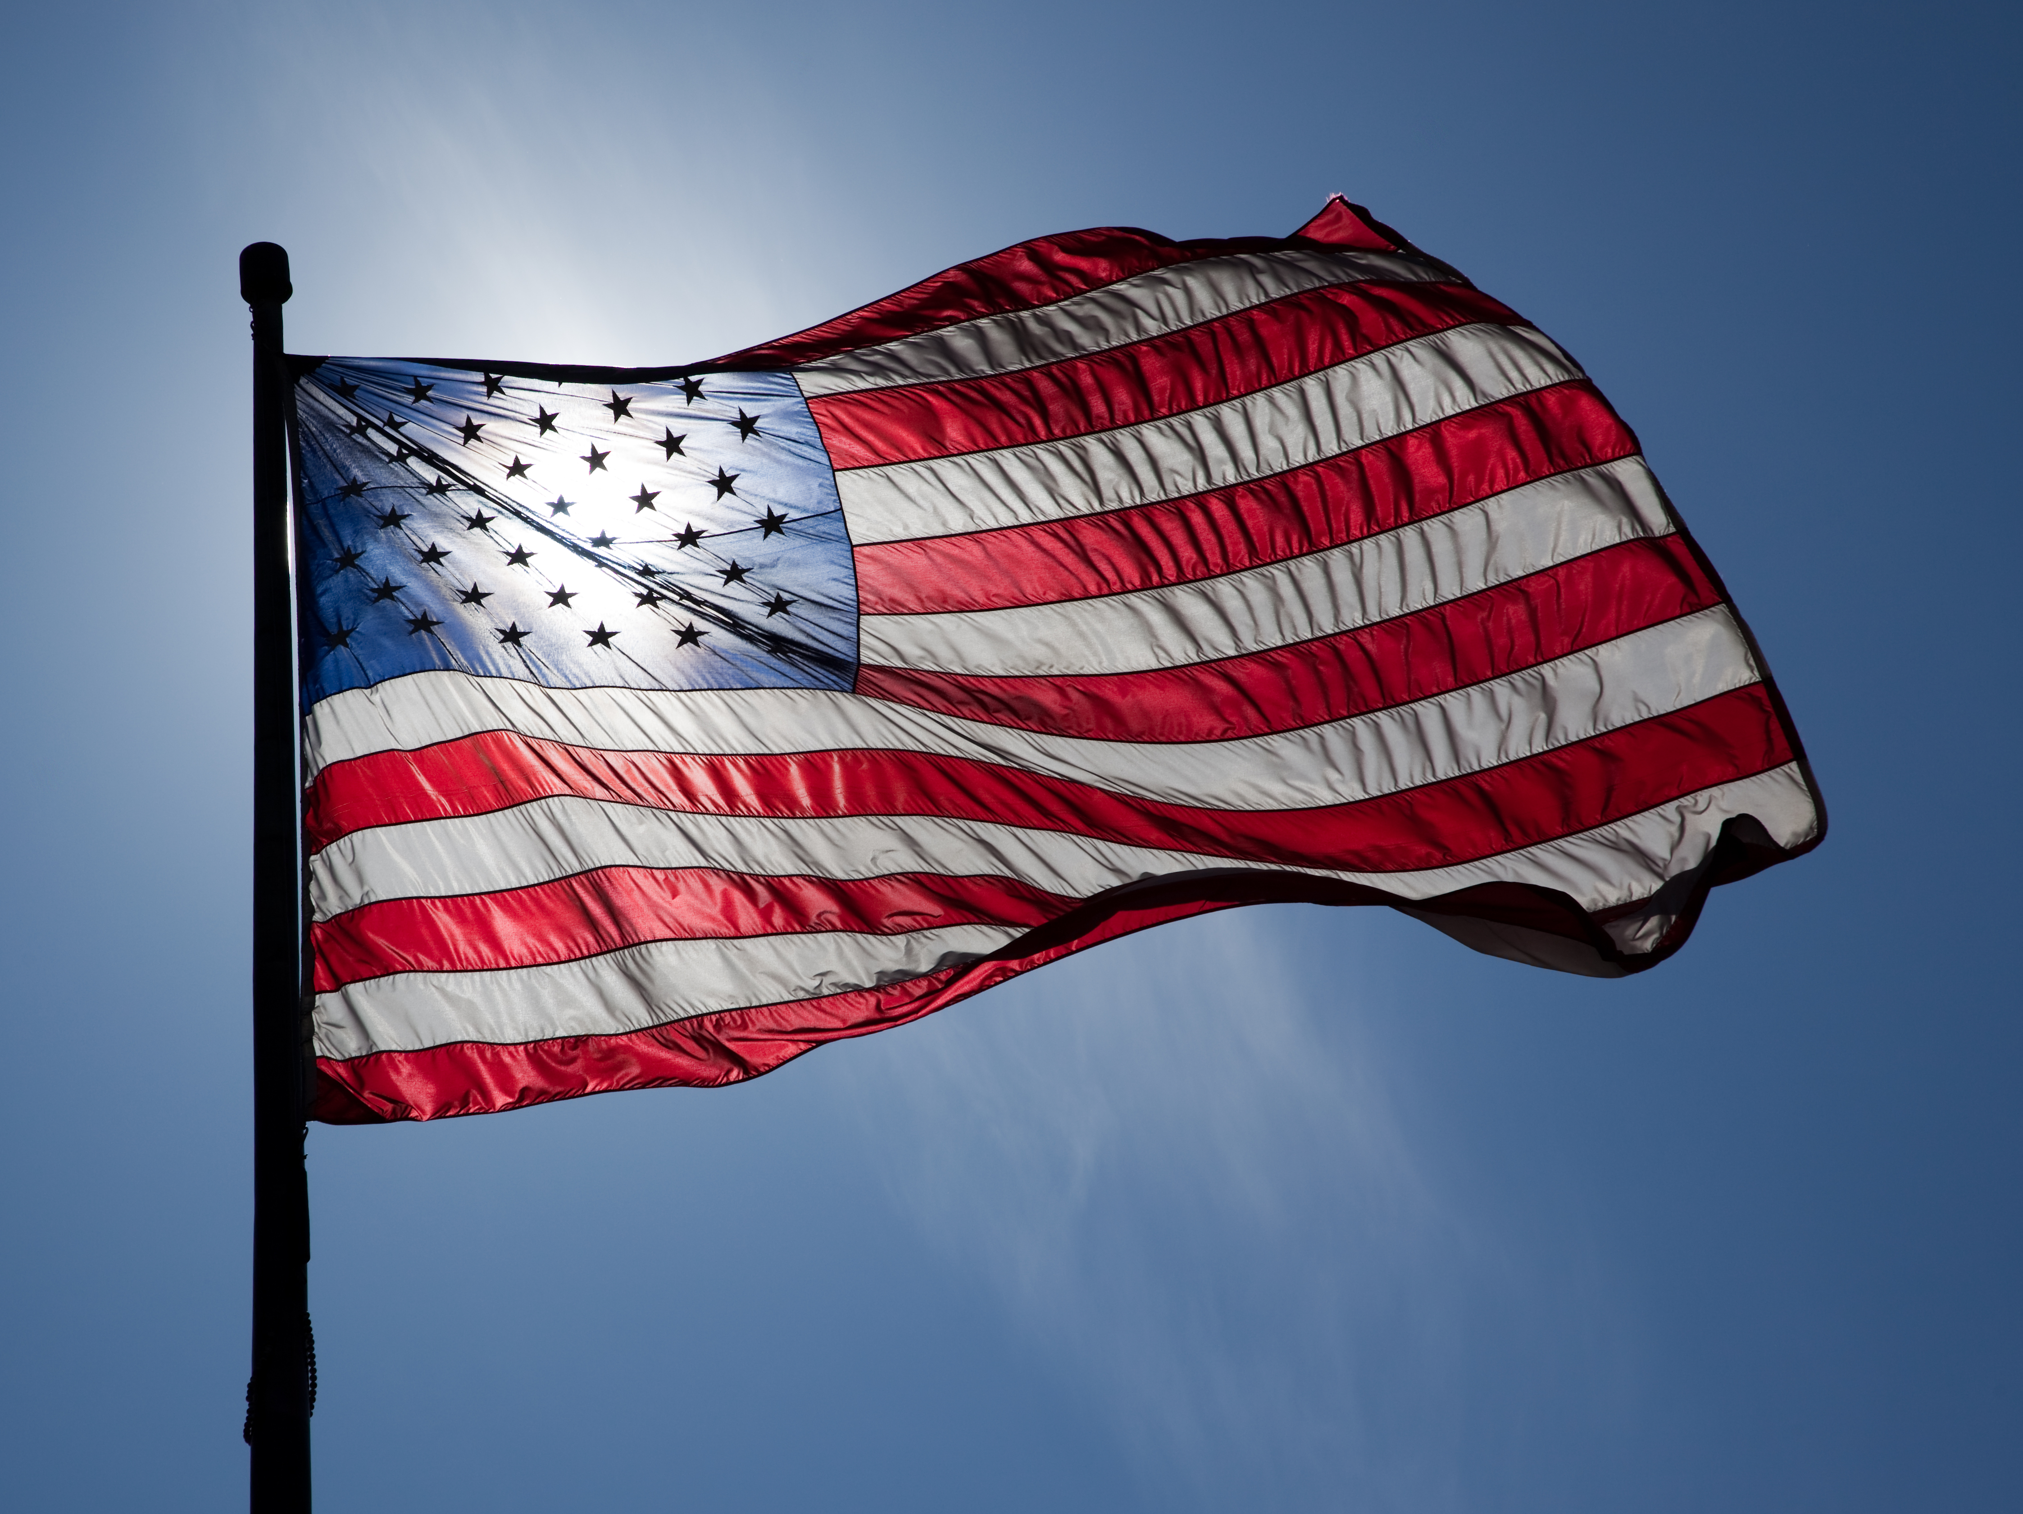
Flag
This Photo by Unknown Author is licensed under CC BY-ND

Slide 4
Welcome!
      Designing for the Future by Building on Strong Foundations
    Invocation: Kathleen Kaspar-Paty
    Birthdays: Christian Hyland – 9/7
    Anniversaries: None to report
    Song: TBD
    Guests: Welcome to our guests!
    Announcements:
      New Member: Kevin Sun
      Prospective member: Elizabeth “Georgie” Jones
      KaThandi Challenge – Mustang match up to $2,500
      Kabultec: Round up
      DISTRICT 7610 COVID REQUIREMENTS

Slide 5
Welcome!
      Designing for the Future by Building on Strong Foundations
      DISTRICT 7610 COVID REQUIREMENTS
      1. All attendees to wear masks. This places everyone, vaccinated and unvaccinated, on the same status. Post this requirement on your website, Facebook page, club newsletters, meeting announcements, and in direct communique to your members. Remind all invited guests and speakers of this requirement.
      2. Keep a respectable social distance during indoor meetings. If food is served, avoid buffet-style. Masks can be removed for eating and drinking only and put back on once eating or drinking is finished.
      3. Please provide hand sanitizers, tissues, sanitary wipes and masks at your locations. Wipe down podiums and microphones after each person’s use.
      4. As much as possible, meet in outdoor settings or rooms with adequate outside ventilation.
      5. Continue hybrid-meeting formats. We do not want to abandon our Rotarian-members who do not feel comfortable, yet, coming to in-person meetings.
      6. Please remember the COVID status requirements of neighboring municipalities and states; and that businesses, and all other organizations have the right to require mass-wearing by patrons, visitors, participates, attendees and the like.

Slide 6
MUSTANG NEWS
      Designing for the Future by Building on Strong Foundations
    Joe, Dennis and Sam
      As of September 1, 2021:
        $ 8,475 Individual
        $ 13,775 Car side
        $ 5,950 Websites
        $ 9,800 Media
        $ 34,325 Mailing
        $ 8,900 Mail Chimp
        $ 81,175 Grand Total
        $ 83, 230.95 Cash Balance

Slide 7
Mustang Raffle Car-Side Events
      Designing for the Future by Building on Strong Foundations
      Upcoming Opportunities:
        WE NEED SELLERS AND CASHIERS
        9/4 (Sat.): Old Bust Head Brewery, Vint Hill Farms
          11 am – 5 pm
          7134 Farm Station Rd., Vint Hill, VA 20187; 1 hr 20 mins/Gainesville
        9/6 (Mon.): Clifton Lion’s Club, Clifton
          8 am – 3 pm
          4081 UNIVERSITY DR, FAIRFAX, VA 22030; 25 mins/George Mason
        9/11: City of Falls Church Festival
        9/11: Stonebridge Fall Festival, Woodbridge
        9/18: Warrenton
        9/25 and 26: Occoquan Fall Festival

Slide 8
Announcements
      Designing for the Future by Building on Strong Foundations
      Upcoming Programs and Events:
        9/3 - Community Partners Benefit CSB Clients - Lee Ann Dispirito, Fairfax County Community Services Board
        9/10 - Unite2Light - Solar lighting for off grid communities and for the homeless – Megan Birney
        9/17 - MicheLo project 2021 - When governments and communities experience discourse is when humanity must shine and be the light of hope – Michelle Peters
        9/22 - Membership Mixer, Dogfish Head Alehouse (Tijani)
          https://www.eventbrite.com/e/baileys-crossroads-rotary-club-networking-event-tickets-166707914861?aff=ebdssbeac
          5:30 pm to 7:00 pm

Slide 9
Announcements
      Designing for the Future by Building on Strong Foundations
      Upcoming Programs and Events:
        9/24 – Fairfax County Animal Control – Earit Powell
        10/1 – Club Forum #2
        10/6 – BXRC Board Meeting 7 pm – DG Pat Borowski
        10/7 – DG Dinner at Wildfire at 7:00 pm (Neesa)
        10/8 – DG 7610 Pat Borowski
10/15: Victor Powell, Principal, Glasgow MS
12/3: Tiffany Narcisse, Principal, Justice HS

Slide 10
TODAY’S SPEAKER
Designing for the Future by Building on Strong Foundations
Community Partners Benefit CSB Clients
Lee Ann Dispirito, Fairfax County Community Services Board

Slide 11

Community Partners
Make a Difference
Lee Ann DiSpirito, Behavioral Health Supervisor
9/3/21

Slide 12
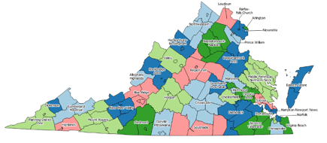
Who We Are
Established in 1969
Public agency that provides services for people in our community who have:
  Mental illness
  Substance use disorders
  Developmental disabilities
One of 40 CSBs in Virginia
Have served approximately 200,000 individuals

Slide 13




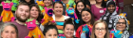
What We Do
Children, Youth and Families
Counseling, medication, crisis response, recovery supports and other services for children and youth (and their families) with mental health concerns and substance use disorders
Developmental Disabilities
Services to help people with developmental disabilities live, work and take part in our community
Substance Use Disorder
Treatment, detoxification, recovery supports for people with substance use disorders.
Mental Health
Counseling, medication, crisis response, and other services for people of all ages with mental health concerns
Prevention & Wellness
Assists the community in strengthening its emotional health and ability to handle challenges related to substance misuse and mental illness.

Slide 14
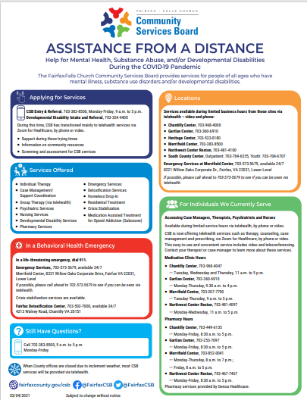
Continuing Services Through COVID-19
Assistance from a Distance
  English, Spanish, Arabic, Farsi, Korean and Vietnamese
Pivoted quickly to deliver services via Telehealth for Zoom
No interruption of services!
Clinical staff trained in PPE and vital face-to-face services have continued throughout COVID-19.
Partnered with Fairfax County Health Department (FCHD) to have our programs included as congregate living programs.
  Were able to utilize the FCHD’s mobile vaccine clinic to bring vaccinations to our most vulnerable individuals.

Slide 15
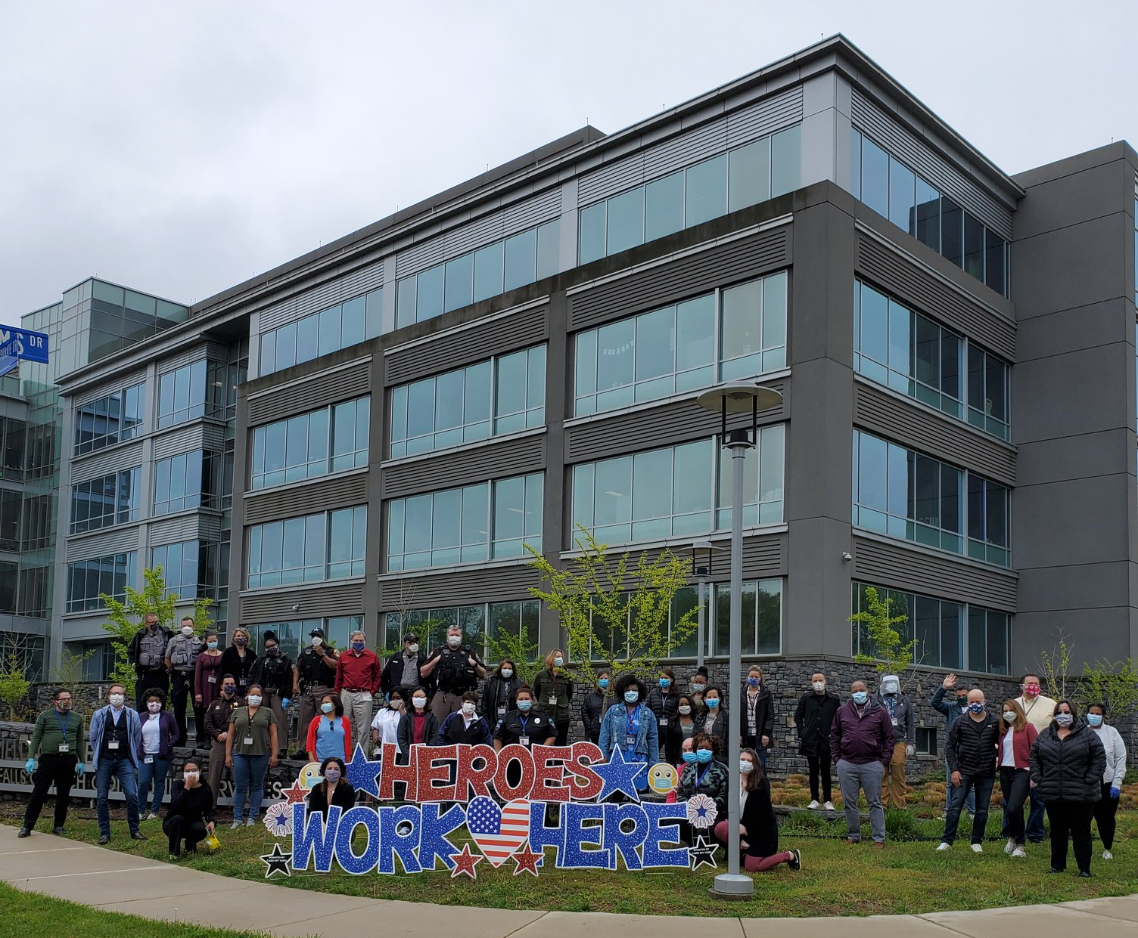
Supportive Community Residential Services (SCRS)
Teams are based in Merrifield, Reston and Alexandria.
Provide case management and mental health skill building services.
Individuals served are low-income, seriously mentally ill (SMI) adults living in Fairfax County.
Many individuals are unemployed, with chronic medical conditions, and have SMI, with limited family and/or social supports.
Individuals are served in their homes, in the community, and on-site. (M-F, 9-5. Emergency services are provided as needed.)
The Merrifield team serves approximately 40 individuals.

Slide 16
How Community Partners Help Us Help Others
Community Partners
  Individuals call Fairfax County’s Coordinated Services Program, local churches, social centers, and other community organizations to meet their basic needs, such as paying rent, making car repairs, or paying for medications or food.
Gift Cards
  Given to the individuals we serve to provide much needed personal items such as food, coats, shoes, household needs and other essentials.
    Holiday season
      Individuals are often isolated, lonely and have few resources. Gift cards from the community are often the only gift they receive.

Slide 17
Frequently Asked Questions & Success Stories
Frequently Asked Questions
How vital are community partners to the CSB?
What are the most needed items from low-income individuals in our community?
Are there unmet needs in the mental health community?
Success Stories
ACCA – Service animal fund donation
Local church – Funds to pay emergency dentist
Rotary Club – Gift cards for holidays in 2020

Slide 18
How You Can Continue to Make a Difference
Continue to give
  Everything counts! A $25 gift card can help someone stay connected to family and our services
  Donate funds for medical care, eye care, dental care, vet care, etc.
Take a screening and share the link with others
  myStrength
    https://bit.ly/csb-myStrength
  SPAN – Mental health or substance use screening
    https://screening.mentalhealthscreening.org/northern-virginia
Attend a training and invite someone to attend with you
  REVIVE! opioid overdose reversal training
  Mental Health First Aid
  Suicide prevention training
  Online behavioral health training for medical personnel
Follow us on social media and share our content
  @FairfaxCSB on Facebook and Twitter

Slide 19



Getting Started
Call 911. Ask for a CIT trained officer.
Entry & Referral Services
Call during business hours (Monday – Friday, 9 to 5)
703-383-8500, TTY 711
In Person
CSB’s Merrifield Center
(Monday – Friday, 9 to 5)
Youth screenings until 7 pm on Tuesdays
Emergency Services
Emergency Mental Health Services (24/7)
703-573-5679, TTY 711
Fairfax Detox Center (24/7)
703-502-7000 | TTY 703-322-9080
Come directly to Merrifield Center
How does someone find out if CSB services are right for them?

Slide 20



Questions?
www.fairfaxcounty.gov/csb
@FairfaxCSB
@FairfaxCSB

Slide 21
Thank you!
Lee Ann DiSpirito leeann.dispirito2@fairfaxcounty.gov
www.fairfaxcounty.gov/csb
@FairfaxCSB
@FairfaxCSB

Slide 22
50/50 Drawing for BXRC Foundation
Designing for the Future by Building on Strong Foundations
50/50 Drawing

Slide 23
Conclusion
Stand for the 4-way Test
Of the things we think, say, or do
Is it the TRUTH?
Is it FAIR to all concerned?
Will it build GOODWILL and BETTER FRIENDSHIPS?
Will it be BENEFICIAL to all concerned?

Slide 24

Rotary Club of Bailey’s Crossroad

