Slide 1
Rotary Club
of Williamsburg, VA
Survey Feedback Results
Notes:
Microsoft playlist

Slide 2
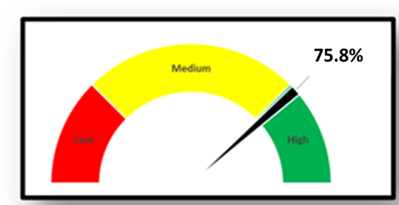
Thank you for your participation!
Overview and Participation Survey Purpose and Opportunities?
Purpose: Understand member perspectives on engagement, club activities, improvement opportunities, and assess future engagement.
Participants: 22 out of 29 active members responded.
Survey Format: 14 questions (mix of multiple choice, select all, and open-ended)
Date Range: Conducted in May 2025
Intent: Use results to inform planning, retention, and revitalization.
This response rate shows that:
Members feel invested
A culture of responsiveness and care
Survey is relevant and worth their time

Slide 3
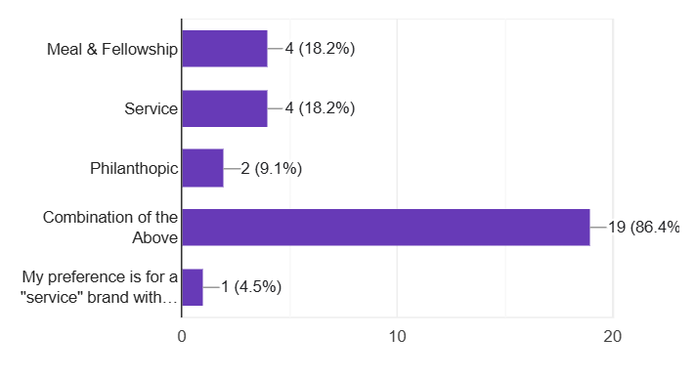
"Members are highly aware of Rotary’s mission and value both service and fellowship, but retention may be impacted by interest, venue, and scheduling challenges.
Club Identity and Engagement Who Are We? What Do We Value?
Rotary's Vision & Mission:
Majority aware – 95.5%
Room for reinforcement
Type of club do we want to be
Service: 18.2%
Fellowship: 18.2%
Combination: 86.4%
Reasons for possible resignation:
Lack of interest
Venue dissatisfaction
Scheduling conflicts (e.g., night driving)

Slide 4
Members want stronger programs, flexible meetings, and inclusive service options—satisfaction is mixed, and willingness to recruit remains uncertain.
Participation and Improvement What could we do Better?
Suggestions to Improve Participation:
Add a member relationship coordinator
Better/stronger speakers and programs
Alternative meeting times (earlier, lunch)
More flexible, inclusive service projects
Satisfied with current club activities:
👍 Satisfied: 59.1%
👎 Not satisfied or "Other": 40.9%
Willingness to recruit and invite guests:
Yes: 54.9%
No/Maybe: 54.1%

Slide 5
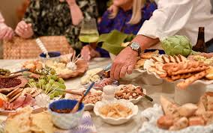
Members are split on changing meeting time or venue, but show strong interest in casual, social events like brewery nights, home gatherings, and wine tastings.
Time Venue and Social Events Meeting Preferences and Logistics
Support for Change:
Venue: 38.1% Yes
Time: 38.1% Yes
Most want to stay with current venue and time
Popular social events:
Hors d’oeuvres at a brewery 🍻
Social at a member's home 🏠
Wine tasting at a farm 🍷
Venue Time

Slide 6
Many members contribute to Rotary causes and are open to leadership roles, but comments signal concern about sustainability and a need for broader engagement.
Giving and Leadership Engagement Member Contributions and Engagement
Contributions to Foundations:
Rotary International
Local Foundation
Leadership Interest:
Committee Chair
Committee Member
Officer Roles: No 45.5%
Local International
Chair Member

Slide 7
Comments

Slide 8
“Let’s improve transparency, offer more structured service opportunities, and communicate like younger generations do.”
“Status quo is not sustainable—without change, I’ll need to step away or serve elsewhere.”
“I’m aging out—night meetings are hard; consider daytime options.”
“We need to modernize our rituals to ensure inclusivity for people of all beliefs.”
“We come from many different backgrounds, beliefs and means and Rotary has led by the desire to service others above self. ”
“Proud to be a Rotarian, but we must better engage each member’s interests to sustain commitment.”
“The pledge and singing feel outdated and may deter newer, younger members.”

Slide 9
THANK YOU
Rotary Club of Williamsburg, Virginia

