Slide 1
A Covid 19 presentation to the Rotary
Club of Summit/New Providence – Monday, June 1st 2020
By Arthur Retnakaran from the
Rotary club of North Scarborough (Toronto)

Slide 2
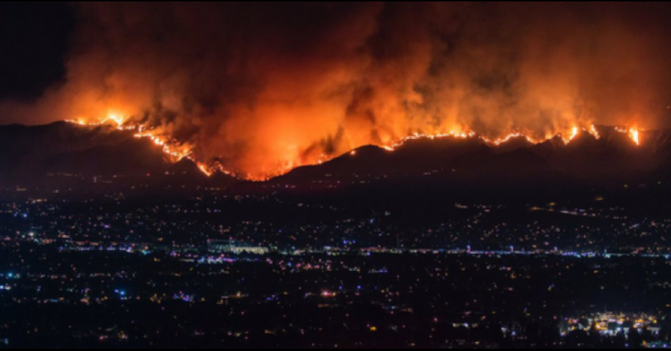
Quo vadis Covid19?
A devastating pandemic with asymptomatic transmission
Arthur Retnakaran
Rotary Club of North Scarborough
(June 1st 2020)

Slide 3
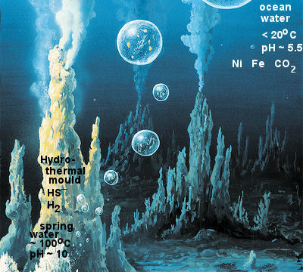
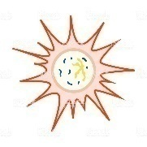
Viruses and their origin
Viruses are the simplest form of life and can live only within living cells (Obligate parasites).
They have a basic genome (DNA or RNA) wrapped in a protein vesicle. They use the host cell’s
machinery to reproduce and propagate. Viruses are supposed to have originated in vesicles
near the hydrothermal vents in the primordial ocean floor along side the hypothetical Last
Universal Common Ancestor (LUCA). Coevolution is the logical explanation.
First virus
First cell (LUCA)
Since then the viruses have coevolved
with every form of life from bacteria to
plants and all animal forms. They are so
abundant and found everywhere.
“If all the 1 × 10³¹ viruses on Earth were
laid end to end, they would stretch for
100 million light years.”

Slide 4
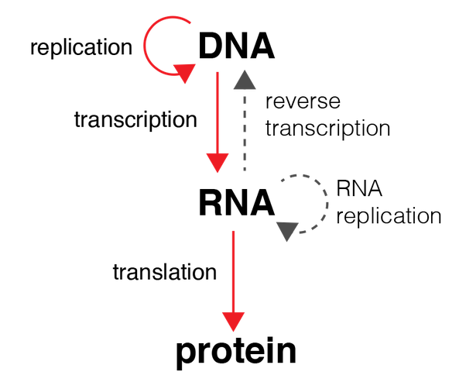
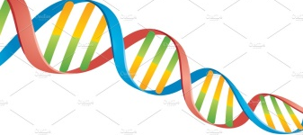
SOME BASIC TERMINOLOGY - CENTRAL DOGMA OF ALL LIFE FORMS
DNA-Double Helix
(ATGC)
Reverse transcription
- into RNA
(Sense RNA)
- Into amino acids to
form peptide
(AUGC)
(21 Amino acids)
DNA- transcription –RNA – translation – Protein
Reverse transcription – RNA to DNA
Corona virus – Single stranded RNA (Sense strand)
Triplet code
(E.g. GGU=Glycine)
SARS-CoV-2 is an RNA virus and has a single sense strand. RNA is highly unstable and can be
easily destroyed during extraction. RNA viruses are generally unstable and mutate into
different strains. Fortunately, SARS-CoV-2 is relatively stable and therefore we can expect to
make a specific vaccine. The flu virus, on the other hand, mutates so much that every year a
new vaccine has to be made.

Slide 5
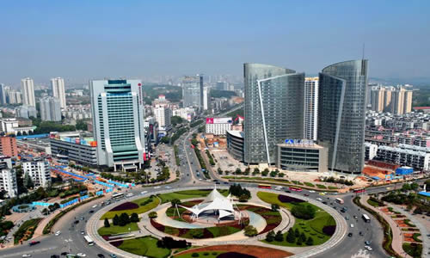
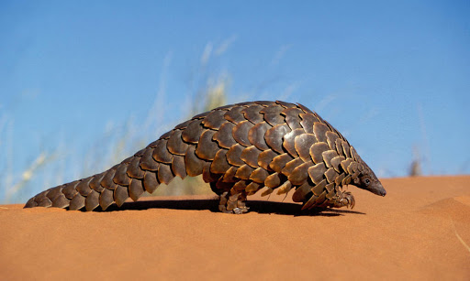
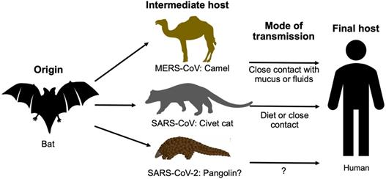
ORIGIN OF SARS-CoV-2
WUHAN
or
or
Accidental release of virus from Virus Lab(conspiracy theory?)
Virus infected bat from wet
market infected workers ?
Pangolin (Ant eater)?
Sequence similarity between bat corona virus and SARS-CoV-2
ACE2 receptor present in both bats and humans
Possible mode of entry into humans
It is a zoonotic virus that jumped from bats into humans but we do not know how exactly this happened

Slide 6
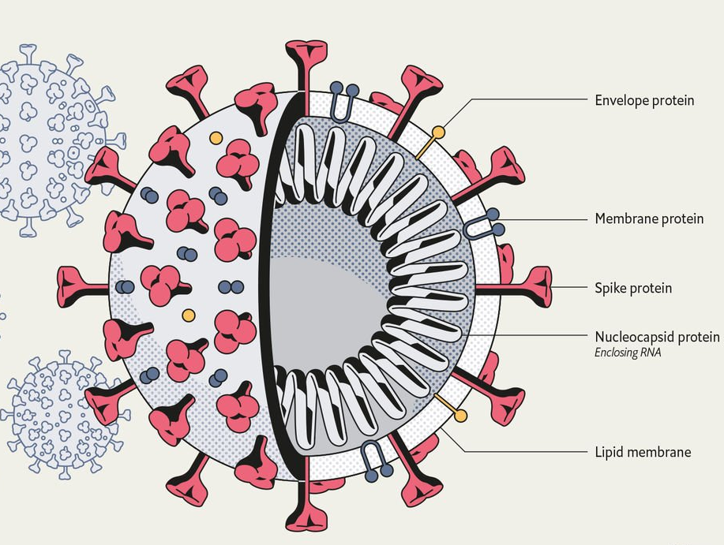
Covid19
Corona viruses are a large group of viruses that infect the
respiratory tract and range from mild cold virus (in addition to
Rhinovirus) to deadly SARS, MERS and SARS-CoV-2. They all have
a “Corona” or crown-like appearance. The official name of the virus is severe acute respiratory syndrome coronavirus 2 (SARS-CoV-2) and the disease it causes is corona virus disease of 2019 (COVID-19)
100 nm (0.0001 mm)
Hemagglutinin esterase dimer(HE)
Used as an antigen(SP)
Sense RNA enclosed in a
protein
Soap destroys the lipid

Slide 7
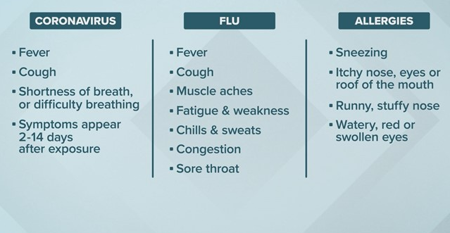
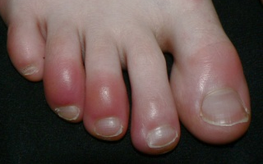
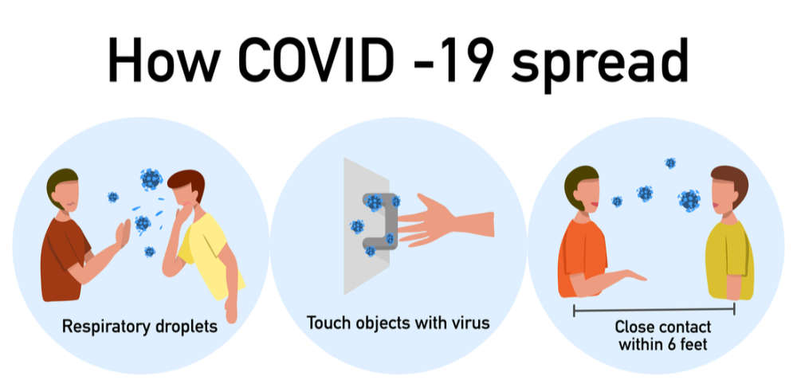
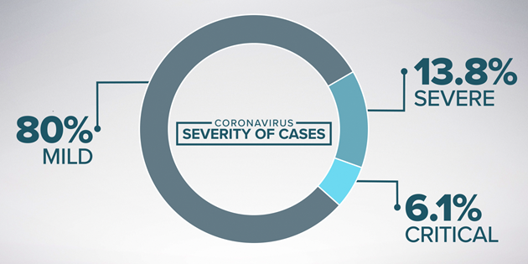
Also loss of smell and taste;
Blueish red lesions on toes
and fingers; Inflammation of
blood vessels in children
(Kawasaki syndrome)
SYMPTOMS OF CORONA VIRUS
COMPARED WITH FLU AND ALLERGIES
SARS-CoV-2, the virus that causes
COVID 19, is transmitted as micro-droplets
An infected person showing no symptoms (2-4 days, upto 2 weeks)can spread the virus (Asymptomatic Transmissiom)

Slide 8
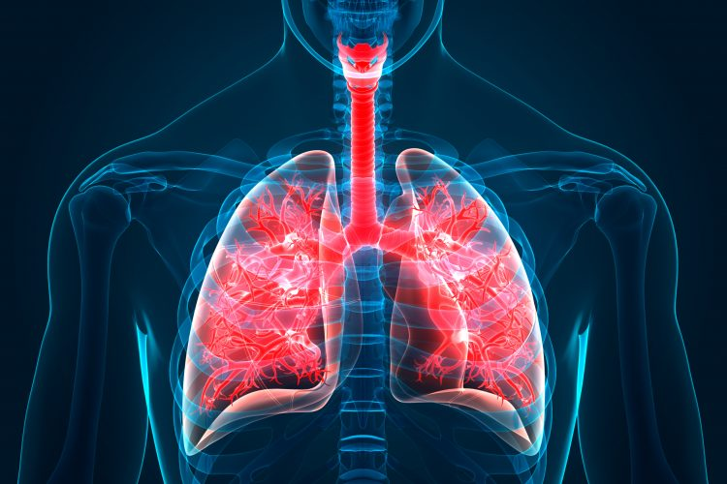
Infection by inhalation of micro-droplets containing the virus
Spike protein of the virus fuses with ACE2 receptors on
lung cells and by endocytosis enters the cell and releases
the viral RNA
Spike protein (SP)
fusing with ACE2
Spike protein of virs
Angiotensin Converting Enzyme (ACE2) Receptor

Slide 9
HOW THE CORONA VIRUS DESTROYS THE ALVEOLI
SEQUENCE OF EVENTS IN
THE AIR SACS (ALVEOLI)
INFECTION OF ALVEOLAR CELL,
INFLAMMATORY SIGNALS
RECRUIT MACROPHAGES THAT
RELEASE CYTOKINES THAT
CAUSE VASODILATION.
FEVER, COUGH
MORE IMMUNE CELLS ARRIVE,
FLUID ACCUMULATES WHICH
DILUTES SURFACTANT LEADING
TO COLLAPSE OF ALVEOLUS
DECREASING GAS EXCHANGE.
SHORTNESS OF BREATH
NEUTROPHILS RECRUITED THAT
RELEASE REACTIVE OXYGEN
THAT DESTROYS INFECTED CELL.
VENTILATOR
ACUTE RESPIRATORY DISTRESS
SYNDROME (ARDS)
Cytokines are chemical communication signals between cells and corona virus induces a “cytokine storm” of pro -inflammatory signals that result in massive destruction of infected cells

Slide 10
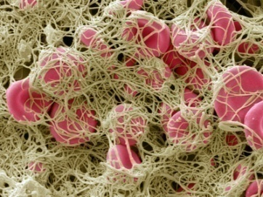
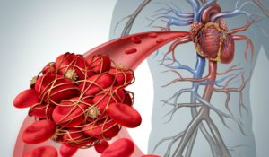
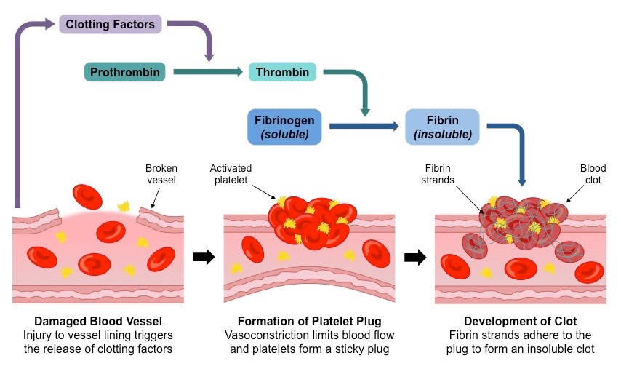
Mystery of the blood clots caused by SARS-CoV-2
The corona virus causes purple rashes, swollen legs, red toes, clogged
catheters, blood clots and sudden death all related to blood problems. Many
are caused by a storm of blood clots especially among hospitalized patients.
Strokes are caused by blood clots in the brain. The virus destroys the
endothelial lining making the smooth lining rough enabling clotting; it
stimulates the immune system to produce complement proteins that enable
clotting; there may be other mechanisms which we do not know.
The clot is degraded by blood plasmin to form D-dimers. Presence of D- dimers indicates that you have had blood clots. Corona virus causes clots which can be determined by assaying for D-dimers in the blood

Slide 11
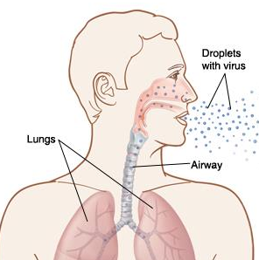
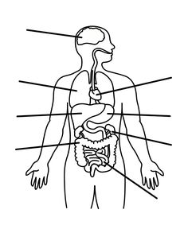
PATHOPHYSIOLOGY OF COVID19
Nose & throat rich
in ACE2.Hijacks the lining
cells machinery and
makes myriads of copies
Asymptomatic for
2-4 days(even14)
- Infectious
Fever, dry cough, sore
throat, Loss of smell &
taste, Head & body aches
Moves down wind-pipe to
lungs ,infects air sacs which
are rich in ACE2
Immune cells invade, release
chemokines, kill virus infected
cells, fluid and dead cells
accumulate, disrupt O₂ transfer,
pneumonia, rapid shallow breaths
Brain- inflammation
and confusion
Eye - conjunctivitis
Nose –source of entry,
Loss of smell
Some recover with O₂ through
nose.
Mouth – loss of taste
Lung – inflamed
Alveolus, dead cells,
Fluid,detritus
Heart-Blood clot,
Cardiac inflammation
Others deteriorate, “Acute
Respiratory Distress Syndrome”
(ARDS). X-rays and Computerized
Tomography reveal lungs with
white opacities, alveoli filled with
fluid, dead cells, mucus and detritus
Liver – depressed
enzyme levels
Kidney – Failure by
plummeting BP
Globally confirmed cases
–6,057,853 infections and
371,166 deaths (June 1st ,
2020, CNN)
Gastro-intestinal tract
- diarrhea

Slide 12
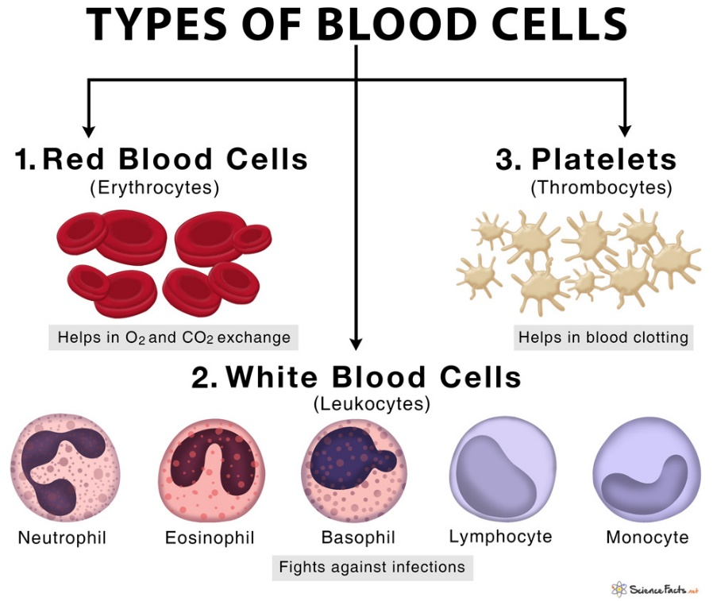
Bacteria
and Fungi
Parasitic
infections
Allergic reactions-
histamines
B-cells & T-cells
Phagocytes
Produce
antibodies
outside
Kill
pathogens
inside
Adaptive immunity (Lymphocytes), Innate immunity (The rest)

Slide 13
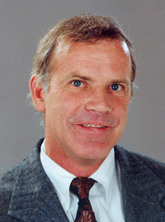
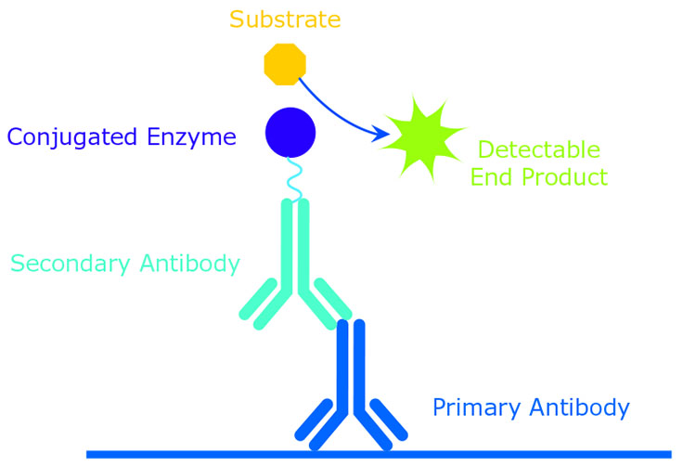
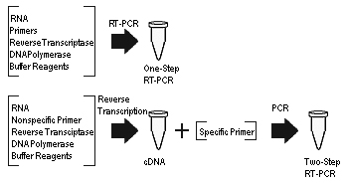
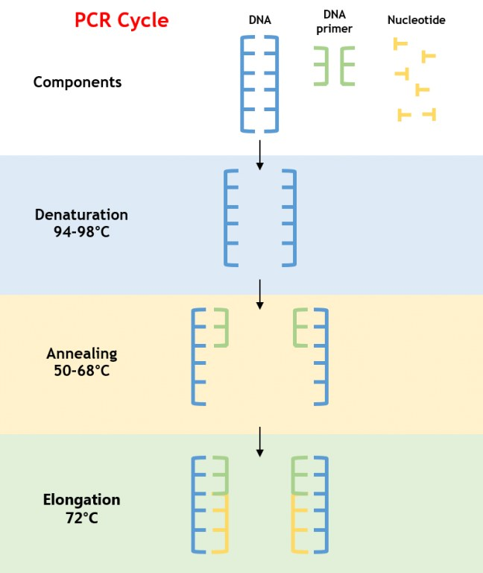
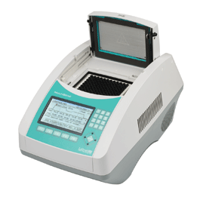
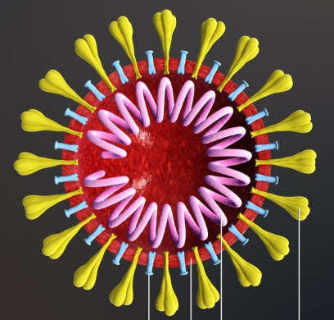
ANTIBODY ASSAY (ELISA)
RT-PCR assay of nasal swab extract of virus RNA
(Detects antibodies formed by infection of virus)
(Enzyme Linked Immunosorbent Assay or ELISA)
(Detects viral RNA)
Kary Mullis – 1944-2019 Nobel
Prize in 1993. Heat Stable DNA
polymerase from Yellow Stone
Hot springs bacterium.
Spike glycoprotein
(Antigen)
Viral RNA
Thermocycler or PCR machine (Polymerase Chain
Reaction)
Universal and rapid testing is the key to containment
and tracking.

Slide 14
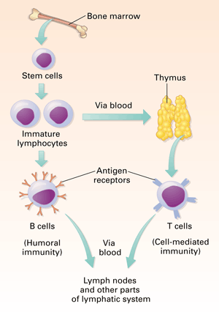
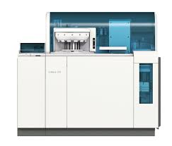
New serological test developed by Roche
The Elecsys® Anti-Sars-CoV-2 test –takes 18 minutes to conduct in a Cobas Analyzer made by Roche using 20 µl of serum + heparin and EDTA detects antibodies produced by the virus with 99.8% accuracy. Sensitivity is 65% from 0 – 6 days; 88% from 7 – 13 days; and 100% > 14 days.
Cobas ® 8000 Modular Analyzer

Slide 15
Tracking & Tracing after relaxing self isolation
Detecting new cases and identifying contacts are essential to snuffing out new outbreaks. In South Korea, one infected individual visiting several night clubs was traced using a cell phone app and the outbreak was contained.
2. A doctor who contracted the virus in Quebec and returned to New Brunswick which had no new Covid-19 cases infected 3 persons because she failed to quarantine herself.
3. Where it is not possible to conduct antibody or PCR tests, King's College (London) and Mass Gen Hospital team using artificial intelligence have created an app that can be used. It could predict with almost 80% accuracy as shown in UK and USA whether or not an individual has COVID-19. The prediction is based on their age and sex, as well as a combination of four of the most common symptoms: (i) loss of smell (anosmia) or taste (ageusia), (ii) fatigue, (iii) persistent cough and (iv) loss of appetite. An app is available.
The Corona virus is going to be with us for quite a while and unless we are vigilant it will be extremely difficult to keep the infection under control. Social distancing, wearing masks, tracking and tracing are going to be important until a vaccine becomes available.

Slide 16
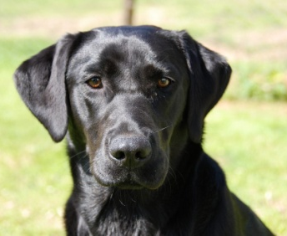
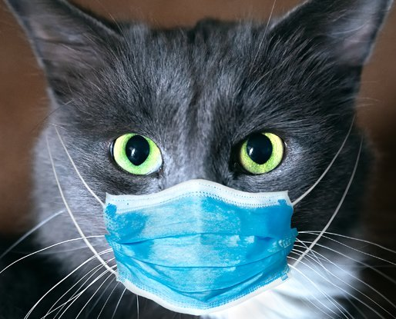
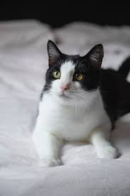
Newer Detection Systems for rapid detection and tracking are being developed
1. One of the main molecular detection methods in which the multiplication is carried out in isothermal condition and does not require thermocycler is Loop Mediated Isothermal Amplification (LAMP).This is faster less complicated than the PCR system and is being developed for corona virus detection.
2. Corona virus-glycan recognition by the ACE2 of the cell is specific and is being developed as a detection method.
Covid 19
Unlikely ?
Felines and canines have been infected by humans but the reverse has not happened yet!

Slide 17
THERAPEUTICS
There have been numerous claims of drugs that can be used for treating covid19 infection but
none of them have undergone rigorous clinical trials to establish their activity and safety.
Currently many are undergoing tests. We probably will have treatments available soon.
Remdesivir – an antiviral drug has had a lot of promise and many severely sick individuals
have recovered. The US company, Gilead, is manufacturing it in Hyderabad, India.
Favilavir – an antiviral drug being developed in China and it is in an advanced state of testing
and is showing great promise.
Hydroxychloroquine – an antimalarial drug, also used for treating lupus and rheumatoid
arthritis has been touted as a great drug but has not lived up to its expectation.
Pluristem Therapeutics (Israel) uses placentas to grow smart cells, and programs them to
secrete therapeutic proteins in the bodies of sick people. It has just treated its first American
COVID-19 patient after treating seven Israelis. Their success rate is very high with the limited
number of patients.
Miscellaneous: AT-100 (Airways Therapeutics); TZLS Monoclonal (Tiziana Life Sciences);
OYA-1 (Oya Gen); BPI-002 (Beyond Spring); Ifenprodil (Algermon); BXT-25 (Bioxytran);
MERS vaccine (Novavax); Actemra (Roche); Galidesivir (Biocryst); REGN 3048 & 3051
(Kevzara); SNG-001 (Synairgen); Amnioboost (Lattice Biologics); A1 based therapeutic
(Mateon); Synthetic antibodies (Dr.Sidhu at Toronto Recombinant Antibody Centre)
With the advanced technology available using artificial intelligence and in silico designing, we
will soon have drugs for covid19 treatment. Development of a vaccine leading to herd immunity
(80 – 90% vaccinated) is however the ultimate solution.

Slide 18
VACCINES
We really do not know how vaccines are going to pan out. The most optimistic view is that it will be like measles vaccine providing us with life-time protection. On the other hand, if it is like the Flu vaccine, it will be short lived. With the panoply of vaccines under development, we can hope for the best. SARS-CoV-2, although an RNA virus, has shown limited amount of mutation which is a good sign. Several components of the corona virus19 have been used as antigens to make antibodies using animal and plant platforms for mass production.
List of vaccines under development: DNA vaccine (Fusogenix); Chadox vaccine (Oxford); Adcovid (Altimex); TJM2 (I-Mab Pharma); VLP (Medicago); Intranasal (Altimmue); INO-4800 and INO-4700 (Inovio); HongKong Vaccine (University of HongKong); Vaccine (Generex); Vaccie
(Serum Institute of India); DNA vaccine (Zydus); Monoclonal Antibodies (Vir Biotech).
Moderna’s corona virus vaccine consisting of lipid mRNA particles of spike protein at dosages of 50 and 100 μg was safe and neutralized the virus in human volunteers and moves on to phase 2.
The Chinese company, CanSino Biologics, is already conducting human clinical trials for its vaccine and the National Research Council of Canada is working with this company.
With the advanced state of vaccine technology and the numerous trials around the world, we should be able to get a vaccine that works. Vaccine development takes time and it will at least take a year before all of the safety tests and clinical trials are completed. But it is the ultimate solution leading to herd immunity (80 – 90% are immunised).

Slide 19
Pandemic Prognostication
(or Wishful thinking from a Canadian perspective!)
Importance of a responsible, empathetic and trustworthy government will become paramount. Remember Jimmy Stewart in “Mr. Smith goes to Washington”!
2. The plight of the “have-nots” has been sharply brought into focus and social
changes to redress the situation will probably occur.
3. Self reliance for essential health care products will be addressed.
4. Quick response mechanism to any future pandemic will be in place.
There will be a trend towards democratic socialism similar to the Scandinavian
countries. Equitable taxes to eliminate homelessness, housing for everyone,
subsidized well run affordable retirement homes, adequately funded education
systems, health care that is expanded and well funded, guaranteed income and
universal pensions to all are a few to be considered.
6. Climate change will be embraced universally and addressed fully.
7. The NEW NORMAL will definitely be very different. Its never going to be like the
good old times! The challenge will be to cheerfully adapt.
“The old order changeth yielding place to new, lest one good custom should corrupt the world” - Tennyson
THANK YOU

Slide 20
The End

